Slide 1
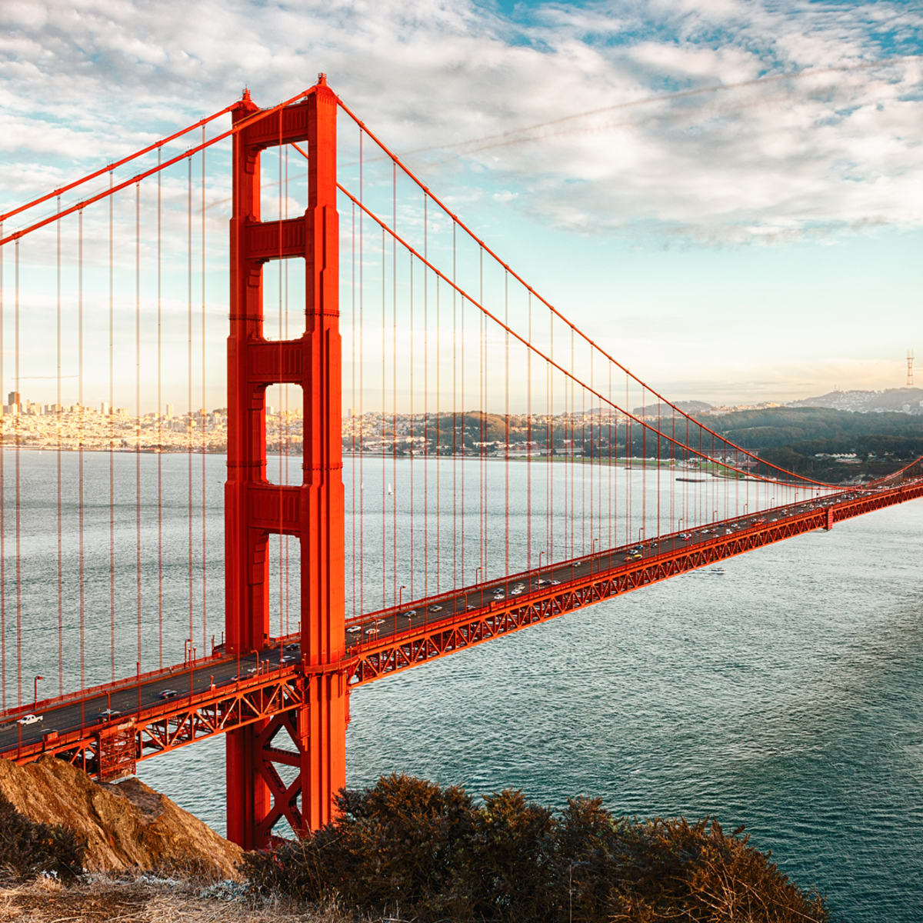
Applied Business Bridging Menu
You are about to start an exciting journey into the world of Business, good luck!
Remember
Choose what modules you do and when, but work through them consistently. Different tasks will take you varying amounts of time, but on average you should aim to do one or two per week.
All green tasks are core modules, they are compulsory and must be submitted in your first lesson in September.
The red hot chili indicates that the task is more challenging than the others
Numbers eg (1) correspond to how you should evidence the module which can be found in the slides following the menu. They can be saved within this powerpoint or as separate documents clearly labelled with the subject

Slide 2
Applied Business Bridging Menu (Green modules are core (compulsory) modules , indicates the most challenging modules )
 | Read | Watch | Listen | Visit (virtually or physically at a later date) | Do
 | Shoe Dog: A Memoir by the creator of Nike For the first time, Phil Knight, the man behind the swoosh, tells his story. He begins with his crossroads moment when at 24 he decided to start his own business. He details the many risks and daunting setbacks that stood between him and his dream - along with his early triumphs. (1) | Becoming Warren Buffett Documentary about how legendary investor Warren Buffet starts out as an ambitious, numbers-obsessed boy from Nebraska, and ends up becoming one of the richest and most respected men in the world. (1) | The Disruptive Entrepreneur: Marc Randolph - CEO of Netflix, Co-Founder & Serial Entrepreneur (1) | Westfield Shopping Centre Explore the many different retailers and spot the similarities and differences in their marketing mix – Place, Product, Promotion, Price (3) | MOOCs https://www.futurelearn.com/courses/digital-skills-retail Search through the MOOCs on Unifrog using the filter ‘Business’ and chose one that particularly interests you (6)
 | Elon Musk: How the Billionaire CEO of SpaceX and Tesla is Shaping our Future South African-born Elon Musk is the renowned entrepreneur and innovator behind PayPal, SpaceX, Tesla, and SolarCity. Musk wants to save our planet; he wants to send citizens into space, to form a colony on Mars; he wants to make money while doing these things; and he wants us all to know about it. (1) | Erin Brockovich Single mother Erin Brockovich takes on powerhouse pacific gas and electric when she discovers the company is poisoning the city’s water supply. As a result of the largest direct action lawsuit of its kind, spear-headed by Erin and Ed Masry, the utility giant was forced to pay out the largest toxic tort injury settlement in US history: $333 million in damages to more than 600 Hinkley residents. (1)
 |  |  | Mixergy: How a mom of 6 turned handmade hairbows into a $6M business (2) | The Cashless Society What does a cashless society look like? What is the technology behind the digital economy and the new forms of currency and money? 26th May 2020 at 6pm (Virtual) (1) | Generic to Brand Get creative and create your own brand name, slogan, logo, and packaging for this generic everyday household item – Milk! (7)
 |  |  |  |  | BBC News Business Explore the Business section on BBC news and summarise at least one article per week (8)
 | Steve Jobs: The Exclusive Biography An extraordinary book which gives us a unique insight into the life and thinking of the man who has single-handedly transformed the way we live today (1) | The Big Short A group of wily opportunists make a fortune off of the U.S economic crash by sniffing out the situation in advance and betting against the banks (1) | UK High Streets in Crisis (1) | The Museum of Brands Explore how brands shape – and are shaped by – people, culture and society. Fill in these worksheets as you go along. Worksheet 1 Worksheet 2 (4)
 |  |  |  |  | Top Trump Research and write about the features of 3 businesses: Purpose, Sector, Scope of Activities, Size of Business, Aims of Business/Mission Statements/Type of Ownership, Revenue and Profit figures (9)
 | Zero to One: Notes on Start Ups, or How to Build the Future A ground-breaking and thought-provoking book on innovation and what it takes for a new company to prosper (1) | The Founder All about the McDonald’s franchise. See how businessman Ray Kroc made McDonalds into a world wide multi-billion pound company (1) | The Economist: Money Talks – Peak Car? (1)
 |  |  |  |  | Write a 500 word report on an entrepreneur of your choice. Examples of Entrepreneurs Jeff Bezos Bill Gates Anita Roddick Larry Page Mark Zuckerberg Warren Buffet Elon Musk Try to incorporate as much detail as you can for each bullet point on slide 13 of this presentation (10)
 |  |  |  | Visit the Bank of England (5)
 | Building strong brands Aaker uses real brand-building cases from Saturn, General Electric, Kodak, Healthy Choice, McDonald's, and others to demonstrate how strong brands have been created and managed (1) | TED Talks (1) The single biggest reason why start-ups succeed Where’s Google going next? Why gender-based marketing is bad for business? (1) | BBC 4 Business Podcasts (1) Supply-Chains vs Covid-19 The Business of Clicks Keeping up with the burgers Ryanair – a change of direction?
 |  |  |  | Explore the Unifrog Business Guide including the ‘Geek Out’ sections (1)
 |  |  |  | Canary Wharf Explore the secondary central business district of London and the main financial centres of the UK and the world (1)
 | The Everything Store: Jeff Bezos and the Age of Amazon Find out the true story of the global giant Amazon and how it started off in a garage in Seattle simply delivering books through the mail to becoming “the everything store” (1) | Inside Aldi: Britain’s biggest budget supermarket Documentary exploring how the German supermarket has swept the UK, overcoming industry hostility and snobbery with its discount goods. Former staff reveal how Aldi used a host of clever techniques to cut costs, and how their own brand goods look and taste like their big-name counterparts but cost a fraction of the price. (1)
Notes:
https://www.bbc.co.uk/sounds/play/m000gvd3

Slide 3
(1) - Book/Journal/Podcast/Film Review
Would you/would you not recommend it? Why?
Rating:
Review by: ___________________________________________
Title: _______________________________________________________
Author: ____________________________________________________
Review of (please circle)
Book Journal Podcast Film Documentary
What was it about?
What did you find particularly interesting/inspiring/shocking? Has this changed your opinion?
What would you like to learn more about?
How does it link to this subject and why is it important?
Save your answers as part of this powerpoint & copy the template as many times as you need

Slide 4
(2) Mixergy Podcast: Bailey’s Blossom
What is Bailey’s Blossoms Revenue?
What is the name of her sister company?
How much profit is Erin making?
What was Erin's first entrepreneurial experience?
What made Erin start up in the hair clips business?
How much did she sell her hair clips for?
Where did she sell her products?
Why did she first struggle when receiving many orders?
Why did she take a break for 2-3 years from her business?
When she returned back to Texas, what was her new business idea?
Where did she source her materials from?
What other products did she diversify into?
Who was the first person she hired and why?
When asked how she would keep her business growing in a recession, what was her response?
Visit https://www.baileysblossoms.com/pages/about-us to find out more about her business and what she sells
WHAT SKILLS/CHARACTERISTICS ARE NEEDED TO BE A GOOD ENTREPRENUER LIKE ERIN HOOLEY?
You can edit your answers in this powerpoint on the next slide and print to bring along with you in the first lesson back
Notes:
https://mixergy.com/interviews/baileys-blossoms-with-erin-hooley/

Slide 5
(2) Mixergy Podcast: Bailey’s Blossom
What is Bailey’s Blossoms Revenue?
What is the name of her sister company?
How much profit is Erin making?
What was Erin's first entrepreneurial experience?
What made Erin start up in the hair clips business?
How much did she sell her hair clips for?
Where did she sell her products?
Why did she first struggle when receiving many orders?
Why did she take a break for 2-3 years from her business?
When she returned back to Texas, what was her new business idea?
Where did she source her materials from?
What other products did she diversify into?
Who was the first person she hired and why?
When asked how she would keep her business growing in a recession, what was her response?
Visit https://www.baileysblossoms.com/pages/about-us to find out more about her business and what she sells
WHAT SKILLS/CHARACTERISTICS ARE NEEDED TO BE A GOOD ENTREPRENUER LIKE ERIN HOOLEY?
Notes:
https://mixergy.com/interviews/baileys-blossoms-with-erin-hooley/

Slide 6
(3) Visit Westfield Shopping Centre
Save your answers as part of this powerpoint & copy the template as many times as you need.
You can delete the text in each box and insert your findings.
Price
Pricing Strategy
Discounts
Terms and means of payment
Criteria in granting credit
Product
Features
Quality
Branding
Packaging
Warranties/Exchanges and Support Services
Company Name/Logo
Promotion
Sales promotion
Advertising
Public Relations
Place
Physical and Online Channels
Market Coverage
Location
Distribution and transport of goods

Slide 7
(4) Visit the Museum of Brands
111 – 117 Lancaster Road
Notting Hill, W11 1QT
London
Monday to Saturday
10:00 – 18:00
Sunday and Bank Holidays
11:00 – 17:00
Adults - £9
Children - £5
Worksheet 1
Worksheet 2

Slide 8
(5) Visit the BoE
Choose whether you would like to make a
Podcast
Informative flyer
Mini film
Report
Newspaper article

Slide 9
(6) MOOCs
To evidence this you can
Save any notes you take
Take and save a screenshot of completed modules or the completed course

Slide 10
(7) Generic to Brand
Slogan:
Target Market:
Describe or draw the packaging:
Brand Name:
Extra space for ideas to create a strong brand:
Brand Logo:
You can print this slide off to draw on if you like and take a photo of it to upload

Slide 11
Summary of article here
(8) BBC News Article
SCREENSHOT OF ARTICLE HEADLINE
here
Save your answers as part of this powerpoint & copy the template as many times as you need. You may change the size and shape of the boxes above to accommodate for your screenshot

Slide 12
(9) Top Trump Example and Template
Business Logo
Overview of the Business
Apple is global technology company that designs, develops and sells consumer electronics, computer software and online services. They are one of the four biggest companies in the world.
Country of Origin: California, USA
Purpose: Profit Organisation
Sector: Secondary and Tertiary
Scope of Activities: International
Aims of the business/mission statement: To obtain stellar products and services within tight timeframes, at a cost that represents the best possible value to our customers and shareholders
Type of Ownership: Public Limited Company (Inc in USA)
Share Price (where appropriate): $279 for 1 share
Revenue/Profit 2019: $64bn in revenue for Q4 2019
Overview of the Business
Country of Origin:
Purpose:
Sector:
Scope of Activities:
Aims of the organisation/mission statement:
Size of Business: (e.g. employees, number of countries)
Type of Ownership
Share Price (where appropriate):
Revenue/Profit 2019:
Edit your findings into powerpoint & copy the template as many times as you need
Notes:
Please note – Taken from Prendergast School
These features will include:
Purpose (profit or non-profit)
Sector (primary, secondary, tertiary or quaternary)
Scope of activities (local, regional, national, international)
Size of the business (employees, number of countries they operate or sell in)
Aims of the business/mission statement
Type of ownership (sole trader, partnership, private limited company, public limited company, franchise, co-operative, charity, Government department…)
Sales (revenue) figures/profit

Slide 13
(10) 500 word report on your chosen Entrepreneur
Upload your report into your locker as a word document and save it as the name of your chosen Entrepreneur, e.g. “Report on Jeff Bezos”
Remember to include:
Background information on the entrepreneur - e.g. when were they born, where are they from, etc.
What is their business about?
How did their business start off?
How has their business grown?
What is their net worth?
What are their future business plans?
Anything else

