Slide 1
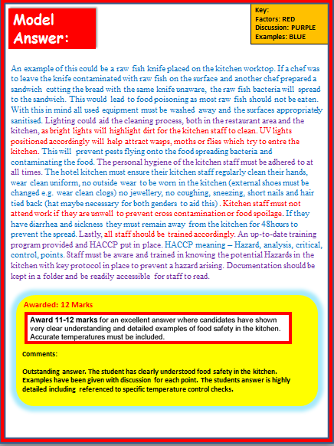
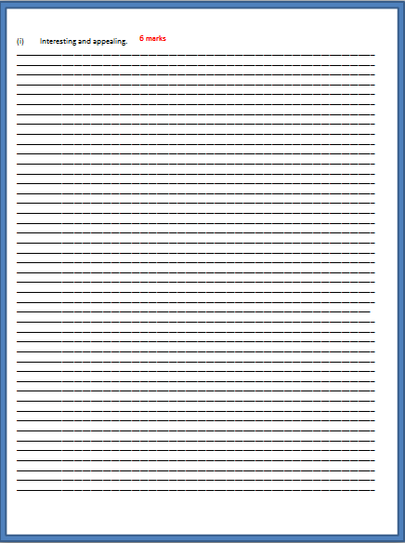
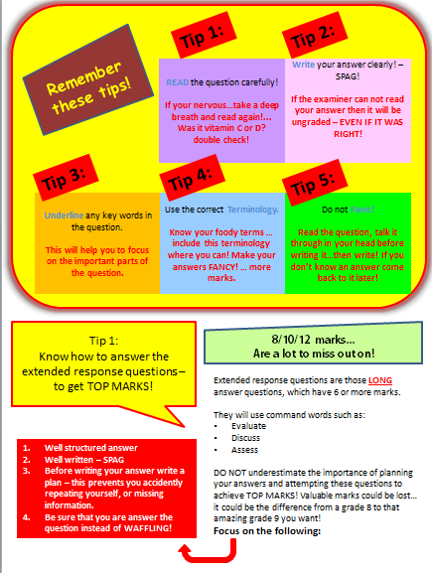
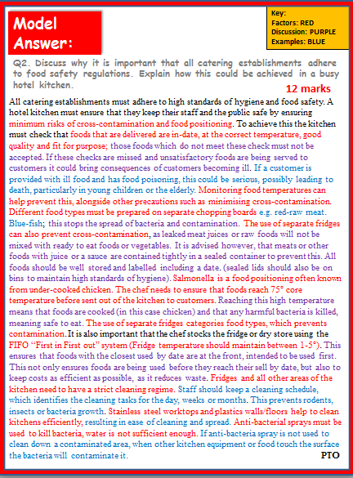
Food, Preparation and Nutrition
Exam Practice:
How to answer those
12 mark questions
Includes:
Top Tips COMMAND WORDS Model answers Marking Criteria Possible Answers
Exam Practice
KS4/GCSE

Slide 2
Tip 1:
Tip 2:
Remember these tips!
READ the question carefully!
If your nervous…take a deep breath and read again!... Was it vitamin C or D? double check!
Write your answer clearly! – SPAG!
If the examiner can not read your answer then it will be ungraded – EVEN IF IT WAS RIGHT!
Tip 3:
Tip 4:
Tip 5:
Underline any key words in the question.
This will help you to focus on the important parts of the question.
Use the correct Terminology.
Know your foody terms … include this terminology where you can! Make your answers FANCY! … more marks.
Do not Panic!
Read the question, talk it through in your head before writing it…then write! If you don’t know an answer come back to it later!
Tip 1:
Know how to answer the extended response questions – to get TOP MARKS!
8/10/12 marks...
Are a lot to miss out on!
Extended response questions are those LONG answer questions, which have 6 or more marks.
They will use command words such as:
Evaluate
Discuss
Assess
DO NOT underestimate the importance of planning your answers and attempting these questions to achieve TOP MARKS! Valuable marks could be lost… it could be the difference from a grade 8 to that amazing grade 9 you want!
Focus on the following:
Well structured answer
Well written – SPAG
Before writing your answer write a plan – this prevents you accidently repeating yourself, or missing information.
Be sure that you are answer the question instead of WAFFLING!

Slide 3
Understand them so you can use them to get TOP MARKS!
Tip 2:
Know your command words!
Command words tell you how the examiners would like you to answer the question. Knowing this is vital! Get to grips with the lingo!
State/identify
You should give a short answer or select an item from a list or table – no explaining here!.
Define
You should give a clear, precise meaning for the phrase.
Outline
You should give a brief summary of the process.
Make this your first piece of revision homework!
Describe
You should give a detailed description of something.
Explain
You should give reasons to show why.
Discuss
You should make a balanced argument covering a range of opinions.
Assess/Evaluate
You should use evidence and your own knowledge to come to a conclusion.
You will now be provided with a 12 mark question
(page 4 & 5)
Task 1: Answer the long answer question on the pages provided. You have 12 minutes to answer the question.
Task 2: Then mark your answer using the mark scheme on page 6. You will then have the opportunity to improve your answer by adding to it using the possible answers on page 6 & 7.

Slide 4
Recall knowledge -
Practice Exam style Question
You have been given a practice question to answer focusing on planning a children's’ menu.
The question is worth 12 marks, 6 marks per section.
Complete the answer now.
Q1. Discuss ways in which a caterer could make children’s menus:
Meet healthy eating guidelines;
________________________________________________________________________________________________________________________________________________________________________________________________________________________________________________________________________________________________________________________________________________________________________________________________________________________________________________________________________________________________________________________________________________________________________________________________________________________________________________________________________________________________________________________________________________________________________________________________________________________________________________________________________
____________________________________________________________________________________
____________________________________________________________________________________
____________________________________________________________________________________________________________________________________________________________________________________________________________________________________________________________________________________________________________________________________________________________________________________________________________________________________________________________________________________________________________________________________________________________________________________________________________________________________________________________________________________________________________________________________________________________________________________________________________________________________________________________________________________________________________________________________________________________________________________________________________________________________________________________________________________________________________________________________________________________________________________________________________________________________________________________________________________________________________________________________________________________________________________________________________________________________________________________________________________________________________________________________________________________________________________________________________________________________________________________
6 marks
We will revisit this later on in the lesson. You will self mark and
re-write with your extended knowledge.

Slide 5
6 marks
Interesting and appealing.
________________________________________________________________________________________________________________________________________________________________________________________________________________________________________________________________________________________________________________________________________________________________________________________________________________________________________________________________________________________________________________________________________________________________________________________________________________________________________________________________________________________________________________________________________________________________________________________________________________________
________________________________________________________________________________________________________________________________________________________________________________________________________________________________________________________________________________________________________________________________________________________________________________________________________________________________________________________________________________________________________________________________________________________________________________________________________________________________________________________________________________________________________________________________________________________________________________________________________________________
_______________________________________________________________________________________________________________________________________________________________________________________________________________________________________________________________________________________________________________________________________________________________________________________________________________________________________________________________________________________________________________________________________________________________________________________________________________________________________________________________________________________________________________________________________________________________________________________________________________________
________________________________________________________________________________________________________________________________________________________________________________________________________________________________________________________________________________________________________________________________________________________________________________________________________________________________________________________________________________________________________________________________________________________________________________________________________________________________________________________________________________________________________________________________________________________________________________________________________________________
________________________________________________________________________________________________________________________________________________________________________________________________________________________________________________________________________________________________________________________________________________________________________________________________________________________________________________________________________________________________________________________________________________________________________________________________________________________________________________________________________________________________________________________________________________________________________________________________________________________

Slide 6
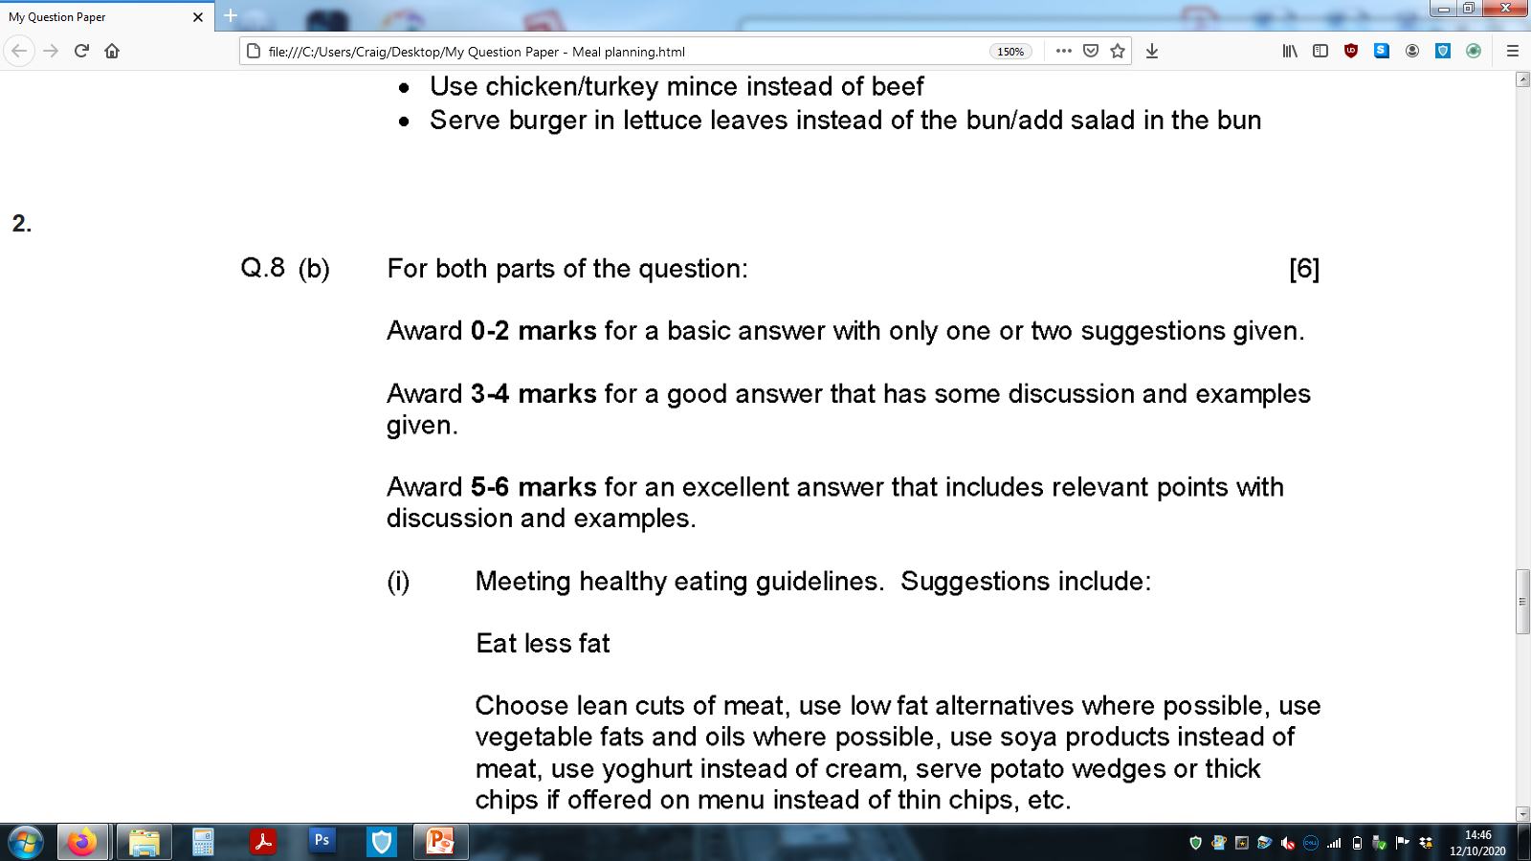
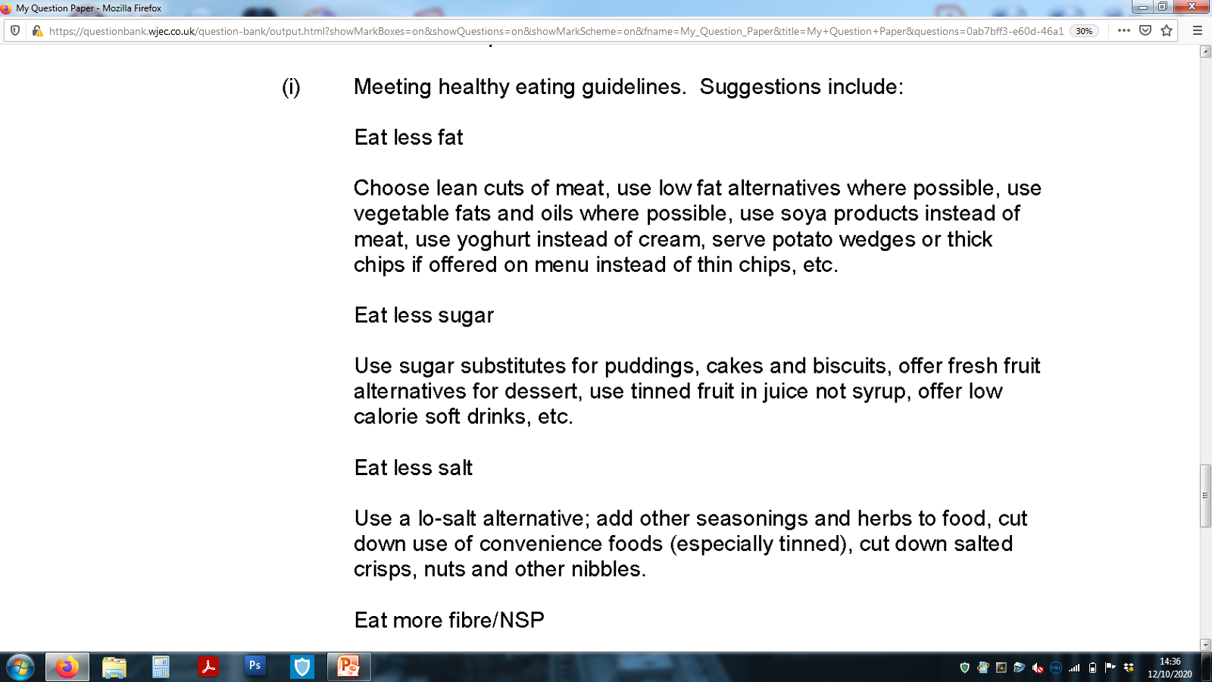
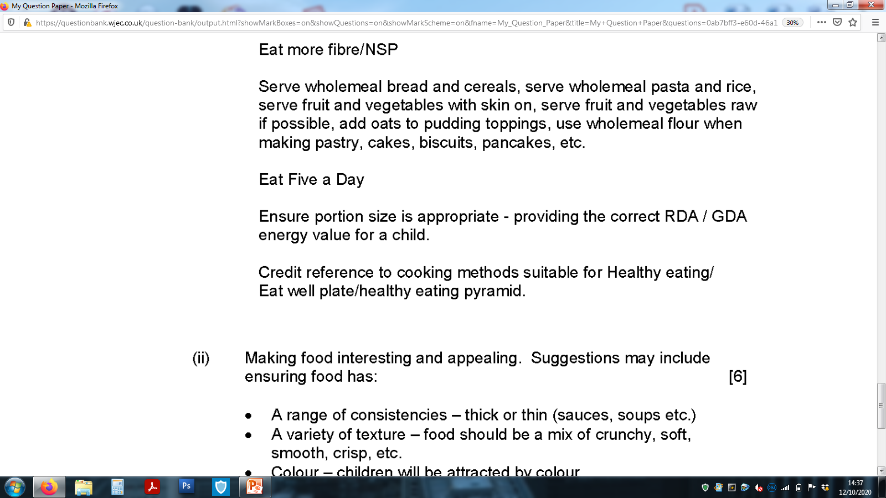
Mark Band for this long answer question
Top Tip:
Refer to the number of marks a long written question is awarded and use this as your target of points to include in the answer, along with discussion and examples.
So…. 6 marks = 6 points with discussion and examples.
Q1 PART 1 Possible answers:
Which ones did you think of from the list? Read the mark scheme carefully, then add those extra points to increase your overall mark.
Factors which help meet healthy eating
guidelines when planning a children's’ menu.

Slide 7
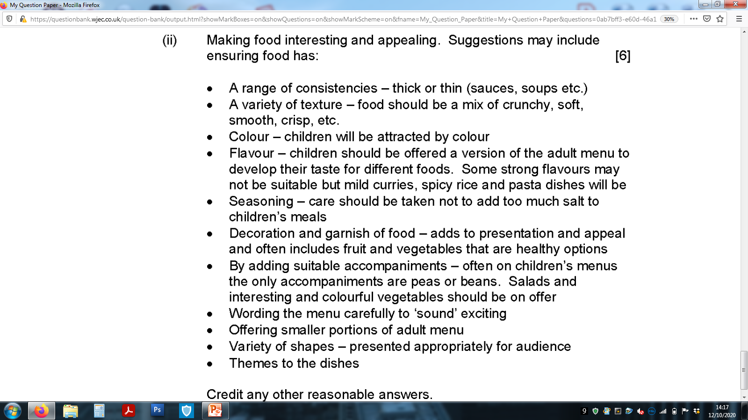
Q1 PART 2 Possible answers:
Factors which help make foods interesting
and appealing for children to eat
Self Reflection
Q1 Part 1 Self Reflection: WWW & EBI
Q1 Part 2 Self Reflection: WWW & EBI
Total Marks /6
Total Marks /6

Slide 8
You will now be provided with the model answer for this question
Task 3: Using 3 highlighters, highlight where the student has included the following in her answer.
Facts
Discussion
Examples
This will help you to identify how to structure a long answer question
and the detail required to receive top marks.
Key:
Factors: RED
Discussion: PURPLE
Examples: BLUE
Model Answer:
Discuss ways in which a caterer could make children’s menus:
Meet healthy eating guidelines;
6 marks
To make a children's’ menu meet healthy eating guidelines, a chef would need to make careful choices when selecting the dishes ingredients. First, the dishes selected would need to include low fat alternatives. For example, mash potato could be added to the children’s menu as apposed to thin fried chips or yoghurts could be paired with fruit instead of cream. Less sugar alternatives would need to be considered, substituting puddings, cakes and biscuit with fruit pots or adding soft drinks to the menu instead of fizzy pop. Less Salt added to a meal; adding other methods of flavourings such as herbs or sauces instead. The chef could reduce the portion of crisps provided to children, by including a small bowl alongside their sandwich, instead of a full sized crisp pack. When planning the menu the chef could include more fibrous foods on the menu, such as wholemeal alternatives to bread, pasta and rice. The chef could add oats to desserts by making special fruit, yoghurt pots with sprinkled oats on the top. By adding a free fruit dessert to the menu would encourage children to eat another portion of their 5 a day. Moreover, the chef could include a selection of two vegetables per meal. Children like to select their own choices so the chef could have a list of vegetables for the children to choose from. This will allow them to customise their meal, which in turn will encourage them to eat it, as they have full control of their choice.
Student’s Reflections/Comments:

Slide 9
Model Answer:
Key:
Factors: RED
Discussion: PURPLE
Examples: BLUE
Interesting and appealing.
6 marks
To make a children's’ menu interesting, the chef will need to plan a menu which makes the food sound and look exciting; this will help children want to eat it. To achieve this, the chef could pair a variety of different colourful foods together to make the plate attractive. Shapes could also be included on the plate, for example sandwiches could be shaped as stars or vegetables such as carrots as hearts. Children would then be excited to eat their vegetables as they resemble something fun. A variety of texture could be included on the plate including crunchy, soft, and smooth foods. A chef could add a garlic bread to a spaghetti bolognaise dish, this would include the smooth cheesy/tomato sauce, soft pasta and crunch from the garlic bread. Adding accompaniments and foods with texture provides a range of sensory affects on the body. This will keep children interested, especially as they are very active and distracted with the world around them. Adding alternative exciting accompaniments to the menu would be beneficial. Usually peas and beans are a side dish to a child’s menu. By adding colourful textural salads, garlic bread shaped as hedgehogs or shaped vegetables would make a dish more appealing to the child's senses. Providing meals such as spaghetti bolognaise with garlic bread as a child’s portion would mimic those foods provided to the adults. It would be beneficial for the chef to make smaller replica's of the adults menu, so the children can feel encouraged that they are eating the same foods as their parents. Adding exciting names for each food with clever wording would add interest when a child is selecting their meal, this could include “Roly-Poly meat balls and pasta” or “Out-of-this-world star Fruit Pot and yoghurt”
Student’s Reflections/Comments:

Slide 10
Model Answer:
Key:
Factors: RED
Discussion: PURPLE
Examples: BLUE
Discuss ways in which a caterer could make children’s menus:
Meet healthy eating guidelines;
6 marks
To make a children's’ menu meet healthy eating guidelines, a chef would need to make careful choices when selecting the dishes ingredients. First, the dishes selected would need to include low fat alternatives. For example, mash potato could be added to the children’s menu as apposed to thin fried chips or yoghurts could be paired with fruit instead of cream. Less sugar alternatives would need to be considered, substituting puddings, cakes and biscuit with fruit pots or adding soft drinks to the menu instead of fizzy pop. Less Salt added to a meal; adding other methods of flavourings such as herbs or sauces instead. The chef could reduce the portion of crisps provided to children, by including a small bowl alongside their sandwich, instead of a full sized crisp pack. When planning the menu the chef could include more fibrous foods on the menu, such as wholemeal alternatives to bread, pasta and rice. The chef could add oats to desserts by making special fruit, yoghurt pots with sprinkled oats on the top. By adding a free fruit dessert to the menu would encourage children to eat another portion of their 5 a day. Moreover, the chef could include a selection of two vegetables per meal. Children like to select their own choices so the chef could have a list of vegetables for the children to choose from. This will allow them to customise their meal, which in turn will encourage them to eat it, as they have full control of their choice.
Awarded: 6 Marks
Comments:
Answer is detailed and includes factual information. The student clearer understands this topic and has provided detailed examples for 6 facts. There examples are excellent.

Slide 11
Model Answer:
Key:
Factors: RED
Discussion: PURPLE
Examples: BLUE
Interesting and appealing.
6 marks
To make a children's’ menu interesting, the chef will need to plan a menu which makes the food sound and look exciting; this will help children want to eat it. To achieve this, the chef could pair a variety of different colourful foods together to make the plate attractive. Shapes could also be included on the plate, for example sandwiches could be shaped as stars or vegetables such as carrots as hearts. Children would then be excited to eat their vegetables as they resemble something fun. A variety of texture could be included on the plate including crunchy, soft, and smooth foods. A chef could add a garlic bread to a spaghetti bolognaise dish, this would include the smooth cheesy/tomato sauce, soft pasta and crunch from the garlic bread. Adding accompaniments and foods with texture provides a range of sensory affects on the body. This will keep children interested, especially as they are very active and distracted with the world around them. Adding alternative exciting accompaniments to the menu would be beneficial. Usually peas and beans are a side dish to a child’s menu. By adding colourful textural salads, garlic bread shaped as hedgehogs or shaped vegetables would make a dish more appealing to the child's senses. Providing meals such as spaghetti bolognaise with garlic bread as a child’s portion would mimic those foods provided to the adults. It would be beneficial for the chef to make smaller replica's of the adults menu, so the children can feel encouraged that they are eating the same foods as their parents. Adding exciting names for each food with clever wording would add interest when a child is selecting their meal, this could include “Roly-Poly meat balls and pasta” or “Out-of-this-world star Fruit Pot and yoghurt”
Awarded: 6 Marks
Comments:
Answer is detailed and includes factual information. The student clearer understands this topic and has discussed 6 facts. The discussion and examples provided are excellent.
Develop your answer now.
Task 4: You have now read the mark scheme and possible answers and used these to mark your own answer with self reflection comments. You then completed the task, by highlighting the key points included in the model answer. With all this knowledge, it is now your opportunity to re-write or add to your answer developing your answer so it receives top marks.

Slide 12
Recall those command words
Understand them so you can use them to get TOP MARKS!
Tip 2:
Know your command words!
Command words tell you how the examiners would like you to answer the question. Knowing this is vital! Get to grips with the lingo!
State/identify
You should give a short answer or select an item from a list or table – no explaining here!.
Define
You should give a clear, precise meaning for the phrase.
Outline
You should give a brief summary of the process.
Make this your first piece of revision homework!
Describe
You should give a detailed description of something.
Explain
You should give reasons to show why.
Discuss
You should make a balanced argument covering a range of opinions.
Assess/Evaluate
You should use evidence and your own knowledge to come to a conclusion.
You will now be provided with a 12 mark question
(page 13 & 14)
Task 1: Answer the long answer question on the pages provided. You have 12 minutes to answer the question.
Task 2: Then mark your answer using the mark scheme on page 15 You will then have the opportunity to improve your answer by adding to it using the possible answers on page 15.

Slide 13
Recall knowledge -
Practice Exam style Question
You have been given a practice question to answer focusing on food safety regulations.
The question is worth 12 marks.
Complete the answer now.
Q2. Discuss why it is important that all catering establishments adhere to food safety regulations. Explain how this could be achieved in a busy hotel kitchen.
________________________________________________________________________________________________________________________________________________________________________________________________________________________________________________________________________________________________________________________________________________________________________________________________________________________________________________________________________________________________________________________________________________________________________________________________________________________________________________________________________________________________________________________________________________________________________________________________________________________________________________________________________
____________________________________________________________________________________
____________________________________________________________________________________
________________________________________________________________________________________________________________________________________________________________________________________________________________________________________________________________________________________________________________________________________________________________________________________________________________________________________________________________________________________________________________________________________________________________________________________________________________________________________________________________________________________________________________________________________________________________________________________________________________________________________________________________________________________________________________________________________________________________________________________________________________________________________________________________________________________________________________________________________________________________________________________________________________________________________________________________________________________________________________________________________________________________________________________________________________________________________________________________________________________________________________________________________________________________________________________________________________________________________________________________________________________________________________________________________________________________________________________________________________________________________________________________________________________________________________________________________________________________________________________________________________________________________________________________________________________________
PTO
12 marks

Slide 14
________________________________________________________________________________________________________________________________________________________________________________________________________________________________________________________________________________________________________________________________________________________________________________________________________________________________________________________________________________________________________________________________________________________________________________________________________________________________________________________________________________________________________________________________________________________________________________________________________________________________________________________________________
____________________________________________________________________________________
____________________________________________________________________________________
________________________________________________________________________________________________________________________________________________________________________________________________________________________________________________________________________________________________________________________________________________________________________________________________________________________________________________________________________________________________________________________________________________________________________________________________________________________________________________________________________________________________________________________________________________________________________________________________________________________________________________________________________________________________________________________________________________________________________________________________________________________________________________________________________________________________________________________________________________________________________________________________________________________________________________________________________________________________________________________________________________________________________________________________________________________________________________________________________________________________________________________________________________________________________________________________________________________________________________________________________________________________________________________________________________________________________________________________________________________________________________________________________________________________________________________________________________________________________________________________________________________________________________________________________________________________________________________________________________________________________________________________________________________________________________________________________________________________________________________________________________________________________________________________________________________________________________________________________________________________________________________________________________________________________________________________________________________________________________________________________________________________________________________________________________________________________________________________________________________________________________________________________________________________________________________________________________________________________________________________________________________________________________________________________________________________________________________________________________________________________________________________________________________________________________________________________________________________________________________

Slide 15
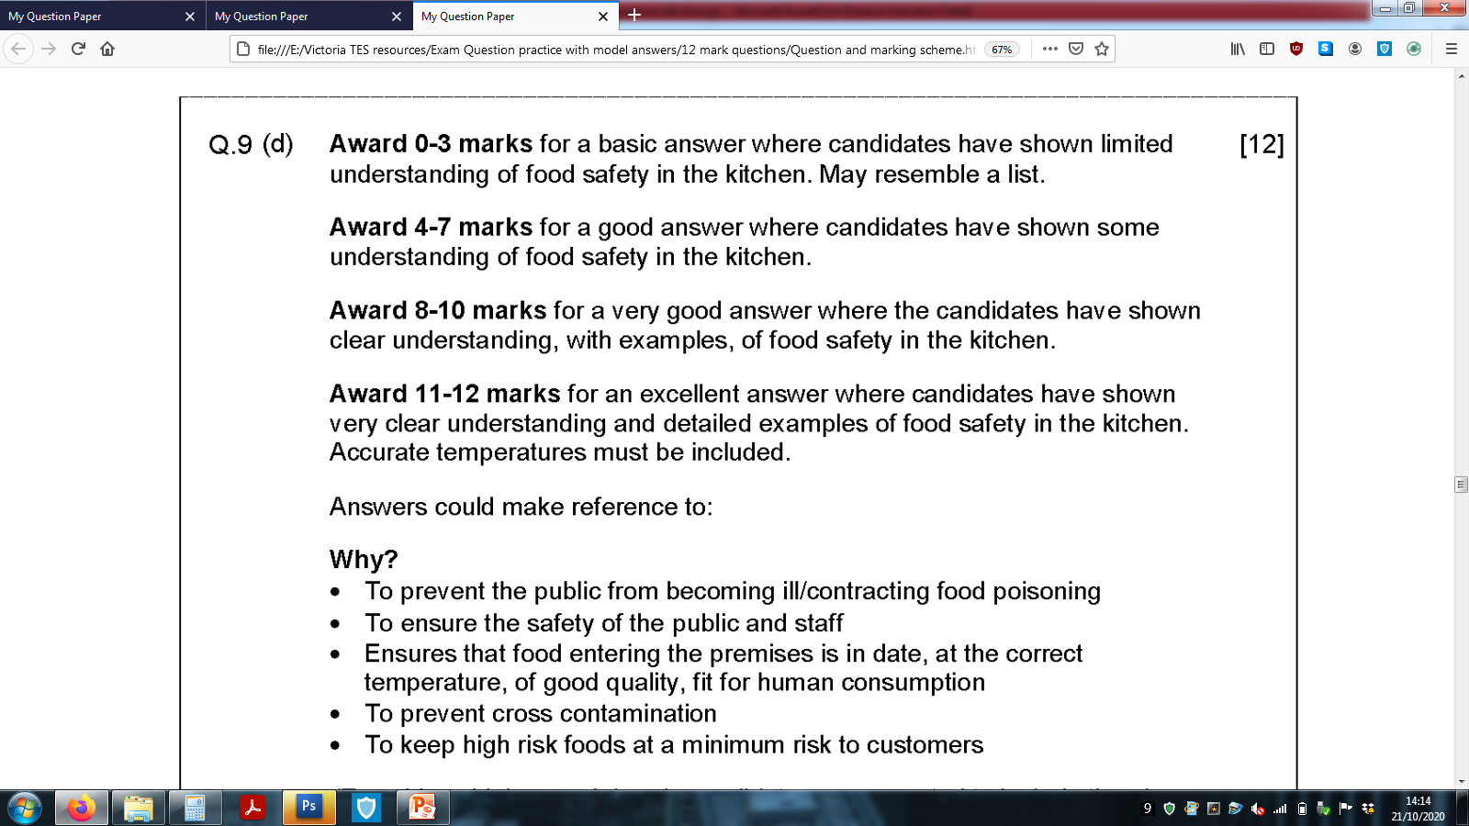
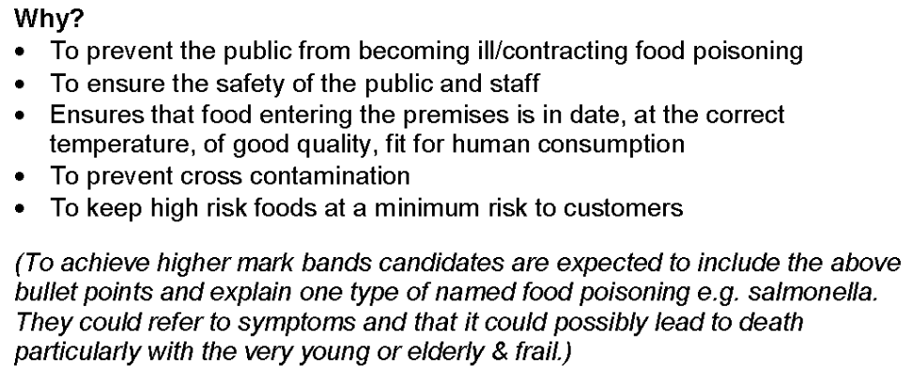
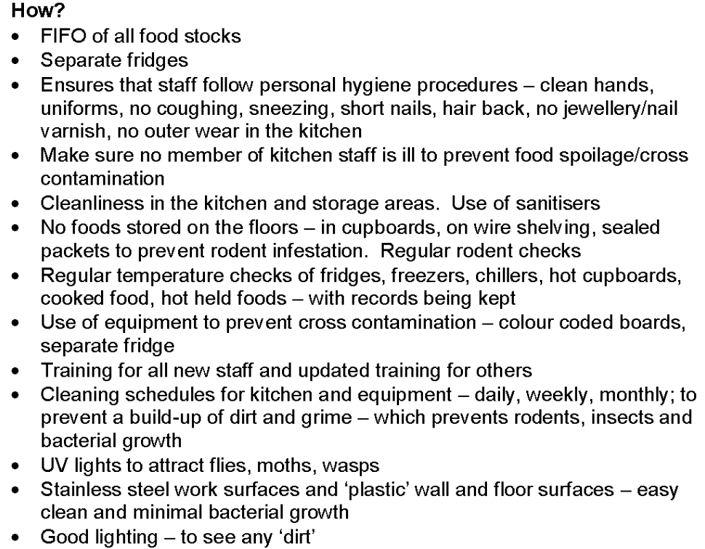
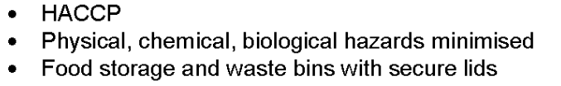
Mark Band for this long answer question
Top Tip:
Refer to the number of marks a long written question is awarded and use this as your target of points to include in the answer, along with discussion and examples.
So…. 12 marks = 12 points with discussion and examples.
Q2 Possible answers:
Which ones did you think of from the list? Read the mark scheme carefully, then add those extra points to increase your overall mark.
Food Safety Regulations – Possible Answers

Slide 16
Self Reflection
Q2 Self Reflection: WWW & EBI
Total Marks /12
You will now be provided with the model answer for this question
Task 3: Using 3 highlighters, highlight where the student has included the following in her answer.
Facts
Discussion
Examples
This will help you to identify how to structure a long answer question and the detail required to receive top marks.

Slide 17
Model Answer:
Key:
Factors: RED
Discussion: PURPLE
Examples: BLUE
Q2. Discuss why it is important that all catering establishments adhere to food safety regulations. Explain how this could be achieved in a busy hotel kitchen.
12 marks
All catering establishments must adhere to high standards of hygiene and food safety. A hotel kitchen must ensure that they keep their staff and the public safe by ensuring minimum risks of cross-contamination and food positioning. To achieve this the kitchen must check that foods that are delivered are in-date, at the correct temperature, good quality and fit for purpose; those foods which do not meet these check must not be accepted. If these checks are missed and unsatisfactory foods are being served to customers it could bring consequences of customers becoming ill. If a customer is provided with ill food and has food poisoning, this could be serious, possibly leading to death, particularly in young children or the elderly. Monitoring food temperatures can help prevent this, alongside other precautions such as minimising cross-contamination. Different food types must be prepared on separate chopping boards e.g. red-raw meat. Blue-fish; this stops the spread of bacteria and contamination. The use of separate fridges can also prevent cross-contamination, as leaked meat juices or raw foods will not be mixed with ready to eat foods or vegetables. It is advised however, that meats or other foods with juice or a sauce are contained tightly in a sealed container to prevent this. All foods should be well stored and labelled including a date. (sealed lids should also be on bins to maintain high standards of hygiene). Salmonella is a food positioning often known from under-cooked chicken. The chef needs to ensure that foods reach 75° core temperature before sent out of the kitchen to customers. Reaching this high temperature means that foods are cooked (in this case chicken) and that any harmful bacteria is killed, meaning safe to eat. The use of separate fridges categories food types, which prevents contamination. It is also important that the chef stocks the fridge or dry store using the FIFO “First in First out” system (Fridge temperature should maintain between 1-5°). This ensures that foods with the closest used by date are at the front, intended to be used first. This not only ensures foods are being used before they reach their sell by date, but also to keep costs as efficient as possible, as it reduces waste. Fridges and all other areas of the kitchen need to have a strict cleaning regime. Staff should keep a cleaning schedule, which identifies the cleaning tasks for the day, weeks or months. This prevents rodents, insects or bacteria growth. Stainless steel worktops and plastics walls/floors help to clean kitchens efficiently, resulting in ease of cleaning and spread. Anti-bacterial sprays must be used to kill bacteria, water is not sufficient enough. If anti-bacteria spray is not used to clean down a contaminated area, when other kitchen equipment or food touch the surface the bacteria will contaminate it. PTO

Slide 18
Model Answer:
Key:
Factors: RED
Discussion: PURPLE
Examples: BLUE
An example of this could be a raw fish knife placed on the kitchen worktop. If a chef was to leave the knife contaminated with raw fish on the surface and another chef prepared a sandwich cutting the bread with the same knife unaware, the raw fish bacteria will spread to the sandwich. This would lead to food poisoning as most raw fish should not be eaten. With this in mind all used equipment must be washed away and the surfaces appropriately sanitised. Lighting could aid the cleaning process, both in the restaurant area and the kitchen, as bright lights will highlight dirt for the kitchen staff to clean. UV lights positioned accordingly will help attract wasps, moths or flies which try to entre the kitchen. This will prevent pests flying onto the food spreading bacteria and contaminating the food. The personal hygiene of the kitchen staff must be adhered to at all times. The hotel kitchen must ensure their kitchen staff regularly clean their hands, wear clean uniform, no outside wear to be worn in the kitchen (external shoes must be changed e.g. wear clean clogs) no jewellery, no coughing, sneezing, short nails and hair tied back (hat maybe necessary for both genders to aid this) . Kitchen staff must not attend work if they are unwell to prevent cross contamination or food spoilage. If they have diarrhea and sickness they must remain away from the kitchen for 48hours to prevent the spread. Lastly, all staff should be trained accordingly. An up-to-date training program provided and HACCP put in place. HACCP meaning – Hazard, analysis, critical, control, points. Staff must be aware and trained in knowing the potential Hazards in the kitchen with key protocol in place to prevent a hazard arising. Documentation should be kept in a folder and be readily accessible for staff to read.
Student’s Reflections/Comments:

Slide 19
Model Answer:
Key:
Factors: RED
Discussion: PURPLE
Examples: BLUE
Q2. Discuss why it is important that all catering establishments adhere to food safety regulations. Explain how this could be achieved in a busy hotel kitchen.
12 marks
All catering establishments must adhere to high standards of hygiene and food safety. A hotel kitchen must ensure that they keep their staff and the public safe by ensuring minimum risks of cross-contamination and food positioning. To achieve this the kitchen must check that foods that are delivered are in-date, at the correct temperature, good quality and fit for purpose; those foods which do not meet these check must not be accepted. If these checks are missed and unsatisfactory foods are being served to customers it could bring consequences of customers becoming ill. If a customer is provided with ill food and has food poisoning, this could be serious, possibly leading to death, particularly in young children or the elderly. Monitoring food temperatures can help prevent this, alongside other precautions such as minimising cross-contamination. Different food types must be prepared on separate chopping boards e.g. red-raw meat. Blue-fish; this stops the spread of bacteria and contamination. The use of separate fridges can also prevent cross-contamination, as leaked meat juices or raw foods will not be mixed with ready to eat foods or vegetables. It is advised however, that meats or other foods with juice or a sauce are contained tightly in a sealed container to prevent this. All foods should be well stored and labelled including a date. (sealed lids should also be on bins to maintain high standards of hygiene). Salmonella is a food positioning often known from under-cooked chicken. The chef needs to ensure that foods reach 75° core temperature before sent out of the kitchen to customers. Reaching this high temperature means that foods are cooked (in this case chicken) and that any harmful bacteria is killed, meaning safe to eat. The use of separate fridges categories food types, which prevents contamination. It is also important that the chef stocks the fridge or dry store using the FIFO “First in First out” system (Fridge temperature should maintain between 1-5°). This ensures that foods with the closest used by date are at the front, intended to be used first. This not only ensures foods are being used before they reach their sell by date, but also to keep costs as efficient as possible, as it reduces waste. Fridges and all other areas of the kitchen need to have a strict cleaning regime. Staff should keep a cleaning schedule, which identifies the cleaning tasks for the day, weeks or months. This prevents rodents, insects or bacteria growth. Stainless steel worktops and plastics walls/floors help to clean kitchens efficiently, resulting in ease of cleaning and spread. Anti-bacterial sprays must be used to kill bacteria, water is not sufficient enough. If anti-bacteria spray is not used to clean down a contaminated area, when other kitchen equipment or food touch the surface the bacteria will contaminate it. PTO

Slide 20
Model Answer:
Key:
Factors: RED
Discussion: PURPLE
Examples: BLUE
An example of this could be a raw fish knife placed on the kitchen worktop. If a chef was to leave the knife contaminated with raw fish on the surface and another chef prepared a sandwich cutting the bread with the same knife unaware, the raw fish bacteria will spread to the sandwich. This would lead to food poisoning as most raw fish should not be eaten. With this in mind all used equipment must be washed away and the surfaces appropriately sanitised. Lighting could aid the cleaning process, both in the restaurant area and the kitchen, as bright lights will highlight dirt for the kitchen staff to clean. UV lights positioned accordingly will help attract wasps, moths or flies which try to entre the kitchen. This will prevent pests flying onto the food spreading bacteria and contaminating the food. The personal hygiene of the kitchen staff must be adhered to at all times. The hotel kitchen must ensure their kitchen staff regularly clean their hands, wear clean uniform, no outside wear to be worn in the kitchen (external shoes must be changed e.g. wear clean clogs) no jewellery, no coughing, sneezing, short nails and hair tied back (hat maybe necessary for both genders to aid this) . Kitchen staff must not attend work if they are unwell to prevent cross contamination or food spoilage. If they have diarrhea and sickness they must remain away from the kitchen for 48hours to prevent the spread. Lastly, all staff should be trained accordingly. An up-to-date training program provided and HACCP put in place. HACCP meaning – Hazard, analysis, critical, control, points. Staff must be aware and trained in knowing the potential Hazards in the kitchen with key protocol in place to prevent a hazard arising. Documentation should be kept in a folder and be readily accessible for staff to read.
Awarded: 12 Marks
Comments:
Outstanding answer. The student has clearly understood food safety in the kitchen. Examples have been given with discussion for each point. The students answer is highly detailed including referenced to specific temperature control checks.
Develop your answer now.
Task 4: You have now read the mark scheme and possible answers and used these to mark your own answer with self reflection comments. You then completed the task, by highlighting the key points included in the model answer. With all this knowledge, it is now your opportunity to re-write or add to your answer developing your answer so it receives top marks.

Slide 21
EXTRA PAPER IF NEEDED
________________________________________________________________________________________________________________________________________________________________________________________________________________________________________________________________________________________________________________________________________________________________________________________________________________________________________________________________________________________________________________________________________________________________________________________________________________________________________________________________________________________________________________________________________________________________________________________________________________________
________________________________________________________________________________________________________________________________________________________________________________________________________________________________________________________________________________________________________________________________________________________________________________________________________________________________________________________________________________________________________________________________________________________________________________________________________________________________________________________________________________________________________________________________________________________________________________________________________________________
_______________________________________________________________________________________________________________________________________________________________________________________________________________________________________________________________________________________________________________________________________________________________________________________________________________________________________________________________________________________________________________________________________________________________________________________________________________________________________________________________________________________________________________________________________________________________________________________________________________________
________________________________________________________________________________________________________________________________________________________________________________________________________________________________________________________________________________________________________________________________________________________________________________________________________________________________________________________________________________________________________________________________________________________________________________________________________________________________________________________________________________________________________________________________________________________________________________________________________________________
________________________________________________________________________________________________________________________________________________________________________________________________________________________________________________________________________________________________________________________________________________________________________________________________________________________________________________________________________________________________________________________________________________________________________________________________________________________________________________________________________________________________________________________________________________________________________________________________________________________

Slide 22
EXTRA PAPER IF NEEDED
________________________________________________________________________________________________________________________________________________________________________________________________________________________________________________________________________________________________________________________________________________________________________________________________________________________________________________________________________________________________________________________________________________________________________________________________________________________________________________________________________________________________________________________________________________________________________________________________________________________
________________________________________________________________________________________________________________________________________________________________________________________________________________________________________________________________________________________________________________________________________________________________________________________________________________________________________________________________________________________________________________________________________________________________________________________________________________________________________________________________________________________________________________________________________________________________________________________________________________________
_______________________________________________________________________________________________________________________________________________________________________________________________________________________________________________________________________________________________________________________________________________________________________________________________________________________________________________________________________________________________________________________________________________________________________________________________________________________________________________________________________________________________________________________________________________________________________________________________________________________
________________________________________________________________________________________________________________________________________________________________________________________________________________________________________________________________________________________________________________________________________________________________________________________________________________________________________________________________________________________________________________________________________________________________________________________________________________________________________________________________________________________________________________________________________________________________________________________________________________________
________________________________________________________________________________________________________________________________________________________________________________________________________________________________________________________________________________________________________________________________________________________________________________________________________________________________________________________________________________________________________________________________________________________________________________________________________________________________________________________________________________________________________________________________________________________________________________________________________________________

Slide 23
EXTRA PAPER IF NEEDED
________________________________________________________________________________________________________________________________________________________________________________________________________________________________________________________________________________________________________________________________________________________________________________________________________________________________________________________________________________________________________________________________________________________________________________________________________________________________________________________________________________________________________________________________________________________________________________________________________________________
________________________________________________________________________________________________________________________________________________________________________________________________________________________________________________________________________________________________________________________________________________________________________________________________________________________________________________________________________________________________________________________________________________________________________________________________________________________________________________________________________________________________________________________________________________________________________________________________________________________
_______________________________________________________________________________________________________________________________________________________________________________________________________________________________________________________________________________________________________________________________________________________________________________________________________________________________________________________________________________________________________________________________________________________________________________________________________________________________________________________________________________________________________________________________________________________________________________________________________________________
________________________________________________________________________________________________________________________________________________________________________________________________________________________________________________________________________________________________________________________________________________________________________________________________________________________________________________________________________________________________________________________________________________________________________________________________________________________________________________________________________________________________________________________________________________________________________________________________________________________
________________________________________________________________________________________________________________________________________________________________________________________________________________________________________________________________________________________________________________________________________________________________________________________________________________________________________________________________________________________________________________________________________________________________________________________________________________________________________________________________________________________________________________________________________________________________________________________________________________________

Slide 24
EXTRA PAPER IF NEEDED
________________________________________________________________________________________________________________________________________________________________________________________________________________________________________________________________________________________________________________________________________________________________________________________________________________________________________________________________________________________________________________________________________________________________________________________________________________________________________________________________________________________________________________________________________________________________________________________________________________________
________________________________________________________________________________________________________________________________________________________________________________________________________________________________________________________________________________________________________________________________________________________________________________________________________________________________________________________________________________________________________________________________________________________________________________________________________________________________________________________________________________________________________________________________________________________________________________________________________________________
_______________________________________________________________________________________________________________________________________________________________________________________________________________________________________________________________________________________________________________________________________________________________________________________________________________________________________________________________________________________________________________________________________________________________________________________________________________________________________________________________________________________________________________________________________________________________________________________________________________________
________________________________________________________________________________________________________________________________________________________________________________________________________________________________________________________________________________________________________________________________________________________________________________________________________________________________________________________________________________________________________________________________________________________________________________________________________________________________________________________________________________________________________________________________________________________________________________________________________________________
________________________________________________________________________________________________________________________________________________________________________________________________________________________________________________________________________________________________________________________________________________________________________________________________________________________________________________________________________________________________________________________________________________________________________________________________________________________________________________________________________________________________________________________________________________________________________________________________________________________

Slide 25
EXTRA PAPER IF NEEDED
________________________________________________________________________________________________________________________________________________________________________________________________________________________________________________________________________________________________________________________________________________________________________________________________________________________________________________________________________________________________________________________________________________________________________________________________________________________________________________________________________________________________________________________________________________________________________________________________________________________
________________________________________________________________________________________________________________________________________________________________________________________________________________________________________________________________________________________________________________________________________________________________________________________________________________________________________________________________________________________________________________________________________________________________________________________________________________________________________________________________________________________________________________________________________________________________________________________________________________________
_______________________________________________________________________________________________________________________________________________________________________________________________________________________________________________________________________________________________________________________________________________________________________________________________________________________________________________________________________________________________________________________________________________________________________________________________________________________________________________________________________________________________________________________________________________________________________________________________________________________
________________________________________________________________________________________________________________________________________________________________________________________________________________________________________________________________________________________________________________________________________________________________________________________________________________________________________________________________________________________________________________________________________________________________________________________________________________________________________________________________________________________________________________________________________________________________________________________________________________________
________________________________________________________________________________________________________________________________________________________________________________________________________________________________________________________________________________________________________________________________________________________________________________________________________________________________________________________________________________________________________________________________________________________________________________________________________________________________________________________________________________________________________________________________________________________________________________________________________________________

Slide 26
EXTRA PAPER IF NEEDED
________________________________________________________________________________________________________________________________________________________________________________________________________________________________________________________________________________________________________________________________________________________________________________________________________________________________________________________________________________________________________________________________________________________________________________________________________________________________________________________________________________________________________________________________________________________________________________________________________________________
________________________________________________________________________________________________________________________________________________________________________________________________________________________________________________________________________________________________________________________________________________________________________________________________________________________________________________________________________________________________________________________________________________________________________________________________________________________________________________________________________________________________________________________________________________________________________________________________________________________
_______________________________________________________________________________________________________________________________________________________________________________________________________________________________________________________________________________________________________________________________________________________________________________________________________________________________________________________________________________________________________________________________________________________________________________________________________________________________________________________________________________________________________________________________________________________________________________________________________________________
________________________________________________________________________________________________________________________________________________________________________________________________________________________________________________________________________________________________________________________________________________________________________________________________________________________________________________________________________________________________________________________________________________________________________________________________________________________________________________________________________________________________________________________________________________________________________________________________________________________
________________________________________________________________________________________________________________________________________________________________________________________________________________________________________________________________________________________________________________________________________________________________________________________________________________________________________________________________________________________________________________________________________________________________________________________________________________________________________________________________________________________________________________________________________________________________________________________________________________________

