Slide 1
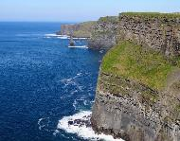
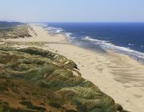
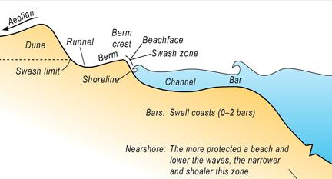
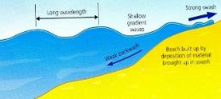
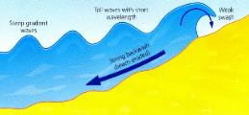
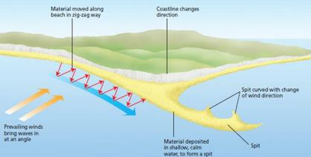
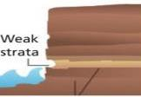
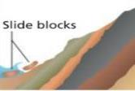
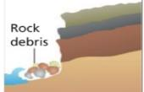
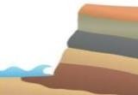
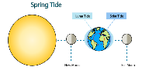
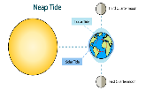
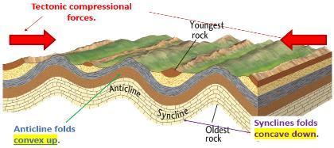
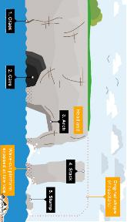
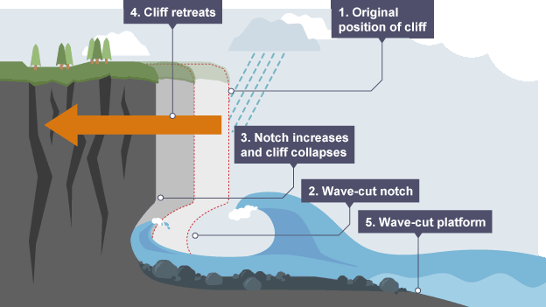
The Littoral Zone
An area of shoreline where land is subject to wave action. It's subdivided into offshore, nearshore, foreshore and backshore.
Coast | Backshore | Foreshore | Nearshore | Offshore
Land adjacent to the sea and often heavily populated and urbanised. | Above high tide level and only affected by waves during high tides & major storms. | Where wave processes occur between the high and low tide mark. | Shallow water areas close to land and used extensively for fishing, coastal trade and leisure. | Area of deeper water beyond the point at which waves begin to break. i.e. open sea.
How do waves form?
Waves are created by wind blowing over the surface of the sea. As the wind blows over the sea, friction is created - producing a swell in the water. It is the energy within the wave and not the water that moves.
Sand Dune Succession
Embryo dune | Yellow Dunes | Grey Dunes | Dune Slacks | Climax
Pioneer species colonise the bare sand, e.g. prickly saltwort have a high salt tolerance and leaves that retain moisture. The roots of these plants bind the sand together. | The pioneer species die and decompose, helping to form a thin soil. Other species move in, e.g. marram grass. The soil is still alkaline but will begin to tolerate a wide range of plants. | The soil deepens and becomes less alkaline as more organic matter forms. This is called humus. Small plants (e.g. hawkweed) and larger plants (e.g. gorse and heather) move in. | Dune slacks are very large depressions that are often deep enough to expose the water table. As fresh water is exposed at the surface, new types of vegetation such as reeds grow. | The soil can eventually support large trees. Fast-growing trees (e.g. pine), followed by slower growing ash and oak. These gradually become the dominant climax species.
Why do waves break?
1 | Waves start out at sea.
2 | As waves approach the shore, friction slows the base.
3 | This causes the orbit to become more elliptical.
4 | Eventually the top of the wave breaks over.
Types of Coastal Zones
Rocky Coastlines |  | Coastal Plains
Which have cliffs varying in height from a few metres to hundreds of metres; cliffs are formed from rock but the hardness of the rock varies. |  | The land gradually slopes towards the sea across an area of deposited sediment, with sand dunes and mud flats being the most common example.
Vegetation stabilising sediment
Roots bind sediment together. Provides a protective layer to prevent exposure. Protection from wind erosion.
Types of Coastal Zones
Concordant coasts | Discordant coasts
Sometimes referred to as ‘Pacific coasts’, these coastlines have alternating layers of hard and soft rock that run parallel to the coast. | Sometimes referred as ‘Atlantic coasts’, these coasts have alternating layers of hard and soft rock that are perpendicular to the coast.
E.g. Dalmatian coast | E.g. West Cork, Ireland
Micro-features on a Cliff Profile
Joints | Fissures | Fault
These divide rock strata up in blocks with a regular shape. | Smaller cracks in rocks. Often they are only a few cms long. | A major line of weakness within the rock. This causes large fractures.
Types of Waves
Constructive Waves | Destructive Waves
This wave has a swash that is stronger than the backwash. This therefore builds up the coast. | This wave has a backwash that is stronger than the swash. This therefore erodes the coast.
Beach Morphology
Beaches are shaped by waves and tides. This variation changes the morphology of a beach, with different landforms formed as a result of differing conditions. This impacts the beach in a range of ways.
Formation of Bays and Headlands
1. Waves attack the coastline.
2. Softer rock is eroded by the sea quicker forming a bay, calm area cases deposition.
3. More resistant rock is left jutting out into the sea. This is a headland.
Factors that affect the size of Waves:
-Fetch is how far the wave has travelled. -Strength of the wind and depth of water. -How long the wind has been blowing for.
Wave Reflection
Wave refraction is the bending of a wave due to its interaction with the seabed’s topography and/or shape of the coastline.
Dip on Cliff Profiles
Dip is the angle of rock strata in relation to the horizontal. Dip is a tectonic feature.
Horizontal dip | Seaward dip, High angle | Seaward dip, low angle | Landward dip
Steep profiles of 70 - 80° producing a very stable cliff with reduced rockfalls. | Vertical or near vertical profile with notches reflecting strata that are more easily eroded. | Sloping, low angle profile with a rock layer facing the sea; vulnerable to rock slides down the slope. | Profile may exceed 90° producing areas of overhanging rock; very vulnerable to rock falls.
The angle of the cliff dip profile can cause erosion to occur at different rates along the coastline.
Dynamic Landscapes: Coastal Landscapes and Change
What is Deposition?
When the sea loses energy, it drops the sand, rock particles and pebbles it has been carrying. Deposition can occur on coastlines that have constructive waves.
Dispositional Formation - Coastal Spits
Example: Spurn Head, Holderness Coast
The swash moves up the beach at the angle of the prevailing wind. Backwash moves down the beach at 90° due to gravity. This creates a zig-zag motion called longshore drift. This movement transports beach material along the beach. Despite a change in the coastline’s direction, deposition causes the beach to extend . This will continue until reaching a river estuary/open ocean. A change in the prevailing wind direction forms a hook. Sheltered area behind the spit encourages deposition. This can eventually form a salt marsh.
Depositional Features
Bayhead Beach Waves break at 90 degrees to the shoreline and moves sediment into a bay.
Tombolo A sand or shingle bar that links the coastline to an offshore island.
Barrier beach/Bar A sand or shingle beach connecting two areas of land with a lagoon behind.
Cuspate foreland Triangular-shaped features extending out from a shoreline.
Types of Tides
Tides are the periodic rise and fall of sea levels. They are caused by the gravitational pull of the Sun and the Moon. The moon pulls the water towards it, creating high tides One the other side of the Earth, a compensatory bulge is created causing high tides there as well. The area between the two bulges are where the tides are at their lowest.
Spring Tides |  | Neap Tides
Twice in a lunar month when the sun, moon and earth are all in a straight line, the tide force is at its strongest and highest. |  | Twice a month the Sun and Moon are positioned at 90º to each other in relation to the Earth.
Lithology
The general physical characteristics of a rock or the rocks in a particular area.
Types of Erosion
Breaking down and removal of material by the movement of wind & water.
Attrition | Rocks that bash together to become smooth/smaller.
Solution | A chemical reaction that dissolved rocks.
Abrasion | Rocks hurled at the base of a cliff to break pieces apart.
Hydraulic Action | Water enters cracks in the cliff, air compresses, causing the crack to expand.
Types of Transportation
A natural process by which eroded material is carried/transported.
Solution | Minerals dissolved in water and are carried along.
Suspension | Sediment is carried along in the flow of the water.
Saltation | Pebbles that bounce along the seabed.
Traction | Boulders that roll along a seabed by the force of the flowing water.
Mass Movement – e.g. Slumping
A large movement of soil and rock debris that moves down slopes in response to the pull of gravity in a vertical direction.
1 | Rain saturates the permeable rock above the impermeable rock making it heavy.
2 | Waves will erode the base of the slope making it unstable.
3 | The weight of the permeable rock above the impermeable rock weakens & collapses.
4 | The debris at the base of the cliff is then removed and transported by waves.
Anticline and Synclines
Tectonic forces (sometimes ancient) can deform rock layers through compressional (pushed together) and tensional (pulled apart) forces. Under high pressure and heat, rocks may bend or break apart.
Synclines | Anticline
A downward, U-shaped fold in the layers of rock in the Earth's surface | An upward, curved fold in the layers of rock in the Earth's surface
e.g. Dalmatian coast, Croatia
Cliff Retreat
1. Notch becomes deeper, the overhanging rock above is then unstable and collapses.
2. Repeated cycles of notch-cutting and collapse cause the cliffs to recede inland.
3. Former cliff position is shown by the horizontal rock platform visible at low tide. This cause a wave-cut platform.
Formation of Coastal Stack
Hydraulic action widens cracks in the cliff face over time. Abrasion forms a wave cut notch between HT and LT. Further abrasion widens the wave cut notch to form a cave. Caves from both sides of the headland break through to form an arch. Weather above/erosion below –arch collapses leaving stack. Further weathering and erosion leaves a stump.
Types of Weathering
An alternation or breakdown of rock when they are exposed to the atmosphere.
Carbonation | Breakdown of rock by changing its chemical composition.
Mechanical | A physical change caused by the movement of water or wind.
Biological | Rocks that have been broken down by living organisms.
Types of Geology
Sedimentary | Metamorphic | Igneous
Weathering and erosion of rocks exposed at the surface. e.g. Sandstone | Rocks under high temperatures & pressures change composition. e.g. Slate | Formed by the cooling and solidifying of molten rock. e.g. Granite

Slide 2
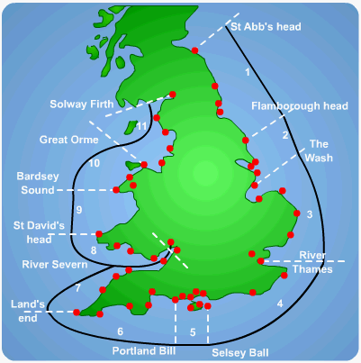
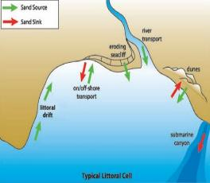
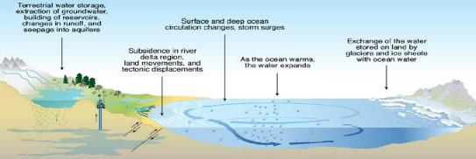
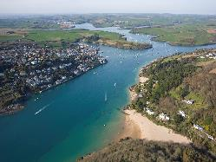
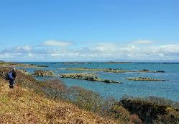
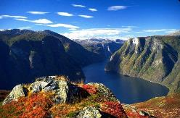
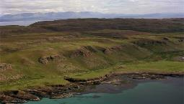
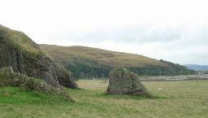
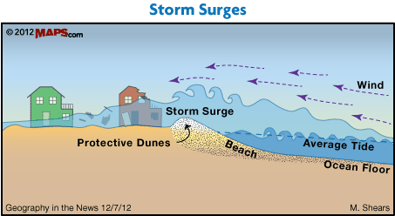
Sediment Cells of the UK
 | The movement of sand and shingle in the nearshore zone by longshore drift (littoral drift) has been found to occur in separate sediment cells. There are 11 around England and Wales. Smaller ones can be found within each cell. Interruptions to movement of sand and shingle within one cell should not affect beaches in an adjacent sediment cell.
A Sediment Cell
Sediment cells act as part of a system – with sources, transfers and sinks. The amount of sediment available within a sediment cell is called the sediment budget. The system aims for an equilibrium between inputs and outputs of sediment material.
Coastal Recession on Communities
The threat of climate change in regards to sea level rises and weather events is becoming an increasingly bigger challenge to the UK and other parts of the world. These consequences can be classified into three broad categories.
Social | Economic | Environmental
Various emotional and financial stress. | Cost to businesses, property and jobs. | Damage to ecosystems and coastal landscapes.
Coastal Defences
Hard Engineering Defences |  |  | Soft Engineering Defences
Groynes | Wood or rock barriers slow longshore drift, so the beach can build up. | Beach still accessible. No deposition further down coast = erodes faster. May be an obstacle to people moving freely. | Beach Nourishment | Beaches built up with sand, so waves have to travel further before eroding cliffs. |  | Cheap Beach for tourists. Storms = need replacing. Offshore dredging damages seabed.
Sea Walls | Concrete walls break up the energy of waves. Has a lip to stop waves going over. | Long life span Protects from flooding Curved shape encourages erosion of beach deposits. Most expensive defence. | Managed Retreat | Low value areas of the coast are left to flood and erode naturally. |  | Reduce flood risk Creates wildlife habitats. Compensation for land. Does not prevent land being lost. Medium term strategy.
Rip Rap | Boulders that are resistant to erosion with large surface to break up waves. | Long Lasting Effective at absorbing energy. Can create access difficulties. Seawater still moves through it. | Positives and Negatives of Soft Engineering
 |  |  | Relatively low cost. Less impact on the surrounding environment. A more natural appearance with limited visual intrusion. |  | Need for regular maintenance. Less likely to be effective against extreme storm events. People may have to be compensated for property loss.
Gabions | Pebbles in wire baskets. | Very flexible with placement. Need frequent repair.
Benefits of using Hard Engineering |  |  | Negatives of using Hard Engineering
It’s obvious that ‘something has been done’ to protect at risk people. Can be a quick/one-off solution that could protect a stretch of coastline. It can reassure coastal communities that properties are secure. Can reduce insurance costs of homes in high risk areas. |  |  | The cost is usually very high and requires maintenance. Can make the coastline unattractive and unappealing for tourists. Defences built in one place frequently have adverse affects downdrift. The needs of the environments are often overlooked.
Changing Sea Levels
Sea levels are rising globally at the present time, but have changed significantly over millions and millions of years. In the past (up to 13,000 years ago) Britain was actually part of Europe and the North Sea did not exist!
Global or Local Changes in Sea Levels
Isostatic Changes | Eustatic Changes
Isostatic changes refers to local changes in land and sea levels. | Eustatic changes refers to changes which affects worldwide sea levels.
Submergent Coastlines
Submergent coastlines form as a result of sea level rise.
Feature | Examples | Photograph
Rias | Kingsbridge Devon
Rias are drown river valleys. These landforms form funnel shaped branching inlets and decrease in depth and width the further it goes inland.
Fjards | Isle of Islay, Scotland
Fjards are drowned glacial lowlands. They are typically covered with scattered small islands.
Fjords | Hardanger, Norway
These are glaciated valleys near the coast which have been drowned by the rising sea levels at the end of the last ice age.
Emergent Coastlines
Emergent coastlines are formed as a result of a (relative) fall in sea level.
Feature | Examples | Photograph
Raised Beaches | Isle of Arran, Scotland
As the coastline rises (or sea levels fall) beaches which were once at sea level are left high up in the cliffs.
As the coastline rises (or sea levels falls) beaches which were once at sea level are left high up in the cliffs.
Relict Cliffs | Ayrshire, Scotland
Caves, arches and stacks formed when they were at sea level are now left high up on the cliff face today.
Managing Coastlines Sustainably
Holistic Coastal Management Coastal communities around the world face an increasing threat from the sea such as rising sea levels and frequent storms. To cope with these threats, communities need to adapt and employ sustainable coastal management. | Integrated Coastal Zone Management (ICZM)
 | National and sometimes international scale policy for a large stretch of coastline.
 | Shoreline Management Plan (SMP)
 | Regional scale management for a specific stretch of coast. Normally for a sediment cell.
 | Management Unit
 | Local scale management for a small stretch of coast within a sediment cell (sub cell).
Shoreline Management Plan (SMP) Decisions
Coastal engineers follow a strict criteria before deciding on a strategy. Each coastal strategy needs to be socially, economically and environmentally appropriate for that specific stretch of coastline.
Cost Benefit Analysis
This compares the cost of coastal defences with the value of land to be protected.
Environmental Impact Assessment (EIA)
This aims to identify the environmental positives and negatives of a development before it’s implemented.
Causes of Coastal Flooding
Severe weather events create meteorological conditions that drive up the water level, creating a storm surge such as those from hurricanes. Large waves, whether driven by local winds or swell from distant storms, raise average coastal water levels and can cause large waves that reach land. When a severe storm hits during high tide, the risk of flooding increases. Flooding from a storm surge can combine with river flooding from rain in the upland watershed.
Options for Coastal Action
Decision Making in the UK The DEFRA have four policies available for coastal management. These vary different in terms of their costs and consequences. Decision are based on: Economic value of assets. Technical feasibility of engineering solutions. Cultural and ecological value of the land. Pressure from communities. The social value of communities. | Hold the Line Maintain the existing coast by building defences.
 | Advance the Line Build new defences outwards into the sea.
 | Managed Realignment Allow the land to flood and construct a new line of defence inland.
 | No Intervention Allow natural processes to shape the coastline
CASE STUDY: Coastal Management. Odisha, India
Location and Background Odisha’s coastal zone is on India’s north-east coast. The coastline includes a range unique environments with different marine flora & fauna. The area has huge potential for offshore renewable energy. | Coastal Concerns Rapid urban industrialisation. Tourism. Coastal erosion Oil and gas production. Rising sea levels. Fishing
ICZM Project Stakeholders Central government e.g. Fisheries Department State and local government e.g. Odisha State Disaster Management Authority. Businesses e.g. Odisha Tourism Development Corporation. | Attempts at ICZM Public and organisational consultations frequently meet and discuss issues. Developments to facilitate eco-tourism. Planting/replanting more mangrove forests Building cyclone shelters.
CASE STUDY: Coastal Flooding - Typhoon Haiyan 2013
Started as a tropical depression on 2rd November 2013 and gained strength. Became a Category 5 “super typhoon”.
Effects | Management
Almost 4,000 deaths. 130,000 homes destroyed. Water and sewerage systems destroyed which caused diseases. Emotional grief for lost ones. | The UN raised £190m in aid. USA & UK sent helicopter carrier ships to deliver aid to remote areas Education on typhoon preparedness.
What are Storm Surges?
The main cause of a storm surge is high winds pushing the sea water towards the coast, causing it to pile up there. There’s also a smaller contribution from the low pressure at the centre of the storm that "pulls” the water level up.
CASE STUDY: Kiribati and Climate Change
Location & Backgrounds | Why are sea levels rising? | Effects on Kiribati | What’s next for Kiribati?
Situated in the middle of the Pacific Ocean and is composed of 33 islands. These islands are low-lying sand and mangrove atolls that are only 1 metre or less above sea level. Many of the islands could disappear under the sea in the next 50 years. Sea levels are rising by 1.2 cm per year (four times faster than the global average). | Global warming is increasing average temperatures by nearly 1°C from 1880 to 2012. Sea levels are increasing due to polar ice sheets (as well as glaciers) melting and thermal expansion (when water expands as it warms). Scientist forecast that by 2100, average sea levels will be between 30cm – 1 metre higher than what they are presently. | Rising sea levels are contaminating its ground water sources. Climate Change has caused ‘bleaching’ of the coral reefs. Homes and businesses are particularly damaged during king tides (exceptionally high tides). There has been an increase in beach erosion and flooding. Food sources are becoming increasingly insecure. | The Kiribati government has purchased land in Fiji for farming agriculture and fish-farming. Its people could become environmental refugees. Under a scheme supported by the government, known as the ‘migration with dignity’ policy, people have decided to relocate for better job opportunities in New Zealand and Fiji.
CASE STUDY: Wash East Coastal Management Strategy – Between Wolferton Creek and Hunstanton
Location and Background West coast of Norfolk. The main town is Hunstanton with several villages which include Snettisham and Heacham. The coastline has low-lying dunes, lagoons and salt marshes with rocky cliffs towards the north. The North Sea Floods of 1953, killed 65 people and significantly damaged hundreds of properties. | Coastal Concerns A storm surge and high tide combined caused excessive damage in 2013. Snettisham is home to a RSPB reserve. The economy is highly dependent on seasonal tourism. Resident and businesses are extremely vulnerable to an increase in sea levels. Coastal heritage and Sites of Special Scientific Interests are threatened. | Regional Players The SMP2 strategy has been developed through an Advisory Group. Stakeholders include: Norfolk County Council Snettisham Parish Council RSPB Hunstanton cliff top residents Caravan Park Owners Beach Bungalow Association | East Wash SMP Strategy A ‘Hold the Line’ strategy has been implemented, with hard engineering in Hunstanton. Construction of a shingle ridge using beach recycling is in place between Heacham & Snettisham. Plans for cliff netting for Hunstanton’s cliffs are under consideration.

