Slide 1
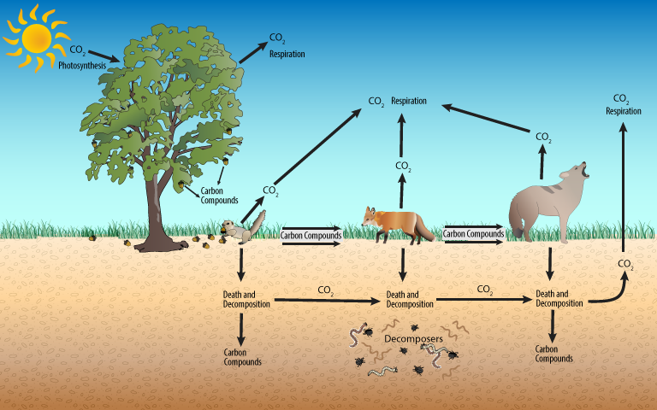
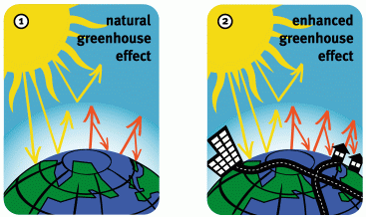
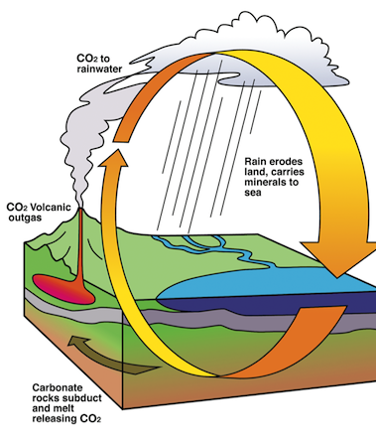


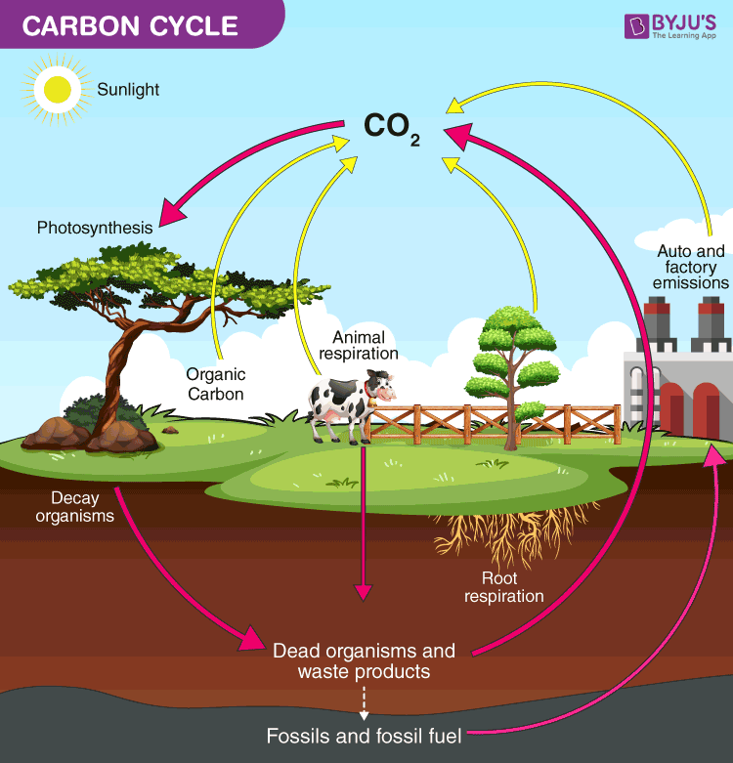
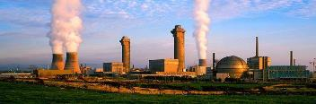
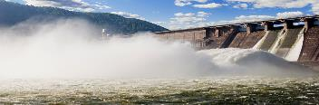
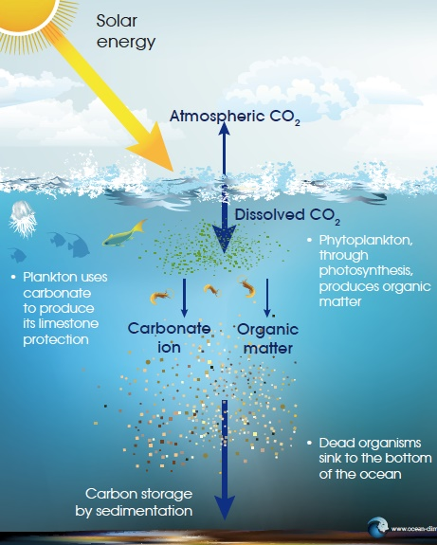
The Carbon Cycle
The exchange of carbon between the atmosphere, terrestrial biosphere, oceans and sediments.
Terrestrial Sequestering
Plants sequester carbon out of the atmosphere during photosynthesis. When animals eat plants, carbon sequestered in the plant becomes fat and protein. Respiration by animals will return some of this carbon back to the atmosphere. On land, soils are the biggest carbon stores. They are stored here as dead organic matter and can be stored for decades or longer, before being broken down by microbes and either used by plants or released into the atmosphere.
Tropical Rainforest as Carbon Stores: The Amazon Rainforest
Tropical forests are very important stores of carbon. For instance, the Amazon forest covers an estimated 5.3 million sq km and holds 17% of the global terrestrial vegetation carbon stock. If left untouched, the Amazon forest takes in more carbon dioxide than it puts back into the atmosphere. However, due to the effects of deforestation, tropical forests are becoming less efficient at trapping carbon.
Energy Consumption and Demands
This is the amount of energy or power used. However, the amount of energy consumed depends on things such as lifestyle, climate, technology, availability and demand.
The demand for energy has risen due to increasing population, economic development and rising living standards. This demand has been largely met by the burning of fossil fuels.
There is a very close relationship between GDP per capital and energy consumption. This is due to energy being necessary for countries to become economically successful.
Carbon Stores and Fluxes
Stores |  |  | Fluxes
Function as sources (adding to the atmosphere) and sinks (removing from the atmosphere). |  |  | Movements of carbon from one store to another; provide the motion in the carbon cycle.
Examples | Atmosphere Coal, Oil and Gas Sedimentary Rocks Surface and Deep Ocean Plants and soil |  | Examples | Photosynthesis Erupting volcano Decomposition Respiration Burning Fossil Fuels.
Slow Carbon Cycle |  |  | Fast Carbon Cycle
Carbon held in sediment on the floor of the oceans can be stored for an extremely long time. |  |  | The terrestrial part of the carbon cycle involves photosynthesis, respiration and decomposition of plant matter.
Measuring Carbon |  | The amount of carbon on Earth is colossal. Dealing with units such as grams and kilograms is far too complicated, so carbon is measured in a unit called Pentagrams (Pg) |  |  | = A billion tonnes (1,000,000,000t)
Energy Security
Energy security describes access to reliable and affordable sources of energy. Countries like Russia and Canada, with surplus energy, are more energy secure. Those with an energy deficit, like the USA and UK, suffer energy insecurity.
The 4 key aspects of energy security are Availability, Accessibility, Affordability and Reliability.
Affordable and competitively priced energy supply
Reliable and uninterrupted energy supply | ENERGY SECURITY | Accessible and available energy supply
Energy mix dependent on domestic rather than imported sources of energy
Having energy security is fundamental for transportation, lighting, agriculture, domestic appliances, communication and manufacturing.
The Greenhouse Effect
Natural Greenhouse Effect
The Earth is kept warm by a natural process called the Greenhouse Effect. As solar radiation hits the Earth, some is reflected back into space. However, greenhouse gases help trap the sun’s radiation. Without this process, the Earth would be too cold to support life. This is because average temperature would be -18°C instead of the current +15°C.
Enhanced Greenhouse Effect
Since the industrial revolution, there has been an increase in humans burning fossil fuels for energy. Burning these fuels emit extra greenhouse gases. This is making the Earth’s atmosphere thicker, therefore trapping more solar radiation and causing less to be reflected. As a result, our Earth is becoming warmer.
Effects on Precipitation and Temperature
Greenhouse gases naturally help to maintain the Earth’s temperature, and therefore determines the distribution of temperature and precipitation. Changing their concentration is likely to alter these patterns.
The Geological Carbon Cycle
Carbon that moves between rocks and minerals, seawater, and the atmosphere can create rock formations such as limestone and chalk.
Acid rain dissolves rocks rich in carbon, causing chemical weathering and releasing bicarbonates.
Carbon sediments are transported to the oceans via rivers. They are then deposited.
Carbon in organic matter (plants, animal shells and skeletons) sinks to the ocean floor, building up layers of chalk and limestone.
Heating along subduction boundaries alters sedimentary rocks, creating metamorphic rocks. This releases CO₂ from rocks which are carbon rich.
Rocks containing carbon get subducted at boundaries and re-emerge in volcanic eruptions.
Terrestrial carbon is released through volcanic eruptions as CO₂ – this is called out-gassing.
Energy Mix
This is a combination of the various primary energy sources (those that are consumed in their raw form) used to meet energy needs in a given geographic region.
Most energy today is consumed in the form of electricity (secondary source). The main primary energy sources in the generation of this electricity include fossil fuels (oil, natural gas and coal ), nuclear energy and the many sources of renewable energy (biofuel , hydro, wind, solar and etc).
In countries (such as the UK) where there isn’t enough energy domestically, they need to import energy from overseas sources who are energy secured (such as Russia).
Physical Systems and Suitability: Carbon Cycle and Energy Security
Case Studies: UK and Norway Energy Mix
United Kingdom | Norway
Dependent on domestic coal since the 1970s. Although this has been recently declining. An increasing use of North Sea oil and gas after 1970s. Although expensive, this was seen as a more secure alternative to the rising price of Middle Eastern Oil. ‘Clean coal’ technology exists but lacks political & public support due to climate change concerns Becoming more reliant on imported energy and privatisation of its energy supply industry. Public concerns over using fracking (earthquakes & water pollution) and nuclear energy. | Norway still has huge oil and gas potential. It currently exports oil and gas to other European countries (the UK being the prominent importer). Norway also has huge renewable energy potential. Hydroelectric power supplies 98% of its renewable electricity energy. Norway has some of the best technology in the world when it comes to Deepwater drilling. Government restricts foreign companies from owning its primary energy sources. Profits from Norway's energy sector goes towards a wealth fund to support future needs.
UK aims to broaden energy mix in the future, with a greater emphasis on renewable sources (particularly offshore wind) and nuclear energy (Hinkley Point C near Bristol). Carbon dioxide levels have decreased from 11.5 tonnes in 1980 to 7.13 tonnes per capita in 2015. | Norway intends to be carbon neutral by 2050. Carbon emissions have actually slightly increased from 11.6 tonnes in 1986 to 11.74 tonnes per capita in 2015. Norway has heavily invested in infrastructure that supports the use of electric cars.
Carbon Regulation
Oceanic and terrestrial photosynthesis plays an important role in regulating the composition of the atmosphere. On land, a key factor is soil health which in turn will create more biomass to support more carbon being sequestered from the atmosphere.
Soil Health | Atmosphere
Healthy soil will enhance ecosystem productivity. This will increase the storage of carbon within biomass and ensure more carbon is sequestered from the atmosphere. Once plant residue is added to the soil, organisms will convert it into CO_{2.}. This will gradually remove it from the atmosphere. | Greenhouse gases absorb radiation from the sun and help the Earth to maintain its temperature. Photosynthesis organisms play an essential role in helping to keep CO2 levels relatively constant, thereby regulating global average temperatures. Photosynthesis is highest where it is warm & wet.
 | The Bio-geochemical Carbon Cycle
 | This is carbon cycling through the process of photosynthesis, respiration, decomposition and combustion. Here, carbon is stored in oil, coal and natural gas. The amount of carbon released or stored is determined by these biological and chemical processes. Living organism are critical in maintaining this system because they control the balance between storage, release, transfer and absorption of carbon.
Carbon Sequestration
The removal and storage of carbon from the atmosphere. It occurs through photosynthesis and is held in oceans, forests and soils. It is crucial because it prevents too much carbon being in the atmosphere and helps to regulate the planetary temperature balance.
Fossil Fuel Implications
Fossil fuels (oil and gas) have been burnt to provide energy and power at increasing rates since the beginning of the Industrial Revolution. Fossil fuel combustion is the number one threat to the global carbon cycle. It is changing the balance of both the carbon stores and fluxes.
Ecosystems | Climate
Ecosystems will see a decline in the goods and services they provide. There will be a decline in biodiversity and a rapid change in the distributions of species. Marine organisms threatened by lower oxygen levels and ocean acidification. E.g. bleaching of corals at the Great Barrier Reef. | A rise in the mean global temperature. Sudden shifts in weather patterns and more extreme weather events, such as floods, storm surges and droughts. Climate change will vary from region to region - some areas are becoming warmer and drier and others wetter.
Hydrological cycle | Arctic
Increased temperatures and evaporation rates will cause more moisture to circulate around the hydrological cycle. Less winter snowfall and rainfall. River discharge patterns could change, with greater flooding in winter and drought in summer. As glaciers melt, water flows would result in increased sediment yield. | Melting permafrost releases carbon dioxide and methane. This will increase greenhouse concentration in the atmosphere, leading to further temperatures rises and melting. Melting Arctic (and Antarctica) ice sheets and glaciers, will cause many major coastal cities (e.g. New York) around the world to threaten from severe flooding due to sea level rises.
Oceanic Sequestering
Oceans are the Earth’s largest carbon store. They store 50 times more than that of the atmosphere. Most of the oceanic carbon is stored in marine algae, plants and coral. The rest occurs in dissolved form.
The Biological Pump
This is the ocean's biologically driven sequestration of carbon from the atmosphere to the ocean interior and seafloor sediments. It is the part of the oceanic carbon cycle responsible for the cycling of organic matter formed mainly by phytoplankton during photosynthesis, as well as the cycling of calcium carbonate formed into shells by certain organisms such as plankton.
The Thermohaline Circulation
This is a giant ocean conveyor belt that keeps the carbonate pump working. This moves carbon compounds to different parts of the ocean in downwelling and upwelling currents. Downwelling occurs in ocean areas where the cold, dense water sinks. As the cold deep ocean water begins to increase in temperature, it upwells to the ocean surface, some of the dissolved carbon dioxide is released back into the atmosphere.
Energy Players
Transnational Corporations (TNC’s) | Organization of Petroleum Exporting Countries
Often state owned or part state owned companies involved in exploring, extracting, transporting, refining and producing petrochemicals. Includes Shell and BP. | A 12 member organisation that owns two thirds of the world’s oil. It controls oil and gas prices by holding back reserves. Includes Saudi Arabia and Angola.
Consumers | Energy Companies
An all embracing term but the most influential consumers are transport, industry and domestic users. Largely passive when it comes to fixing energy prices. | Companies that convert the primary energy (oil, gas etc) into electricity and then distribute it. They set consumer tariffs. For example EDF and British Gas
National Governments
They can play a number of different roles; they are the guardians of national energy security and can influence the sourcing of energy for geopolitical reasons. For example, the UK and Norway Energy Partnership.

Slide 2
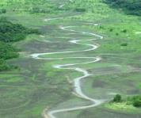
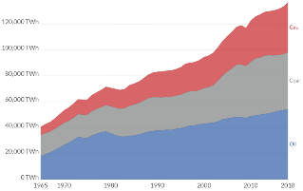
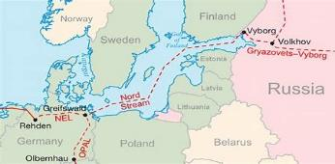
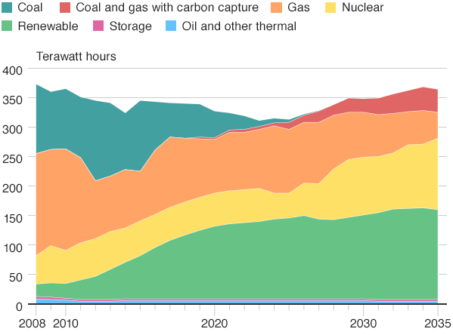
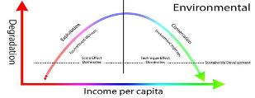


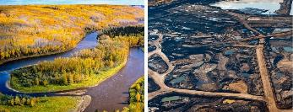
Fossil Fuel Demand & Mismatch
There is a mismatch between locations of conventional fossil fuel supply (oil, gas, coal) and regions where demand is the highest.
The growth of development around the world has meant global demand for energy is increasing. Fossil fuels (oil, gas and coal) still make up 86% of the global energy mix. The global consumption of different energy sources has nearly doubled since 1990, mainly due to the rapid growth of China. It is estimated that by 2035, China will be the world’s largest energy importer. They will have to import energy because there will be a mismatch between domestic supply & demand.
Alternatives to Fossil Fuels (continued)
Renewable Energy | Recyclable Energy
May require large areas (solar arrays, wind farms) for effective operation. NIMBY (not in my back yard) issues. Limited to no greenhouse emissions. Gas, oil and coal are less expensive options. Dependent on geographical surrounding. | Can be used repeatedly, if managed carefully. Large land area needed for biomass. Largely unresolved issues of storing high level radioactive waste. Risks with safety and security of nuclear energy. High technological knowledge is required.
Example: The UK – The Linc Wind Farm | Example: The UK - Hinkley Point C
This is a 270 MW offshore wind farm 8 kilometres from Skegness in the east of England. The total cost of the project was estimated at £1 billion. The farm was completed in 2013. An additional offshore windfarm nearby at Triton Knoll, is near completion. | Aim is to provide reliable energy at an affordable cost, powering nearly six million homes for around 60 years and creating more than 25,000 jobs. The project aim is to meet the country’s climate change commitments in a cost-effective way.
CASE STUDY: The Health of the Amazon - Droughts
The Amazon rainforest is a giant regulator. Everyday, it pumps 20 billion tonnes of water into the atmosphere. The forests' uniform humidity lowers atmospheric pressure, allowing moisture from the Atlantic to reach the rest of the continent.
Nonetheless, since 1990 there has been extreme drought and flooding. In 2005 and 2010, droughts alongside large-scale deforestation degraded most of the forest. As a result, the declining health of the rainforest has reduced it as a carbon store, its ability to sequester CO₂ and role within the hydrological cycle.
World Fossil Fuel Consumption by Fuel type
Amazon Drought in 2010
Implications for Human Wellbeing
Forest Loss | Impacts | Recovery
 | The vast amounts of carbon released into the atmosphere has resulted in rapid loss of biodiversity, habitats and indigenous communities. Forests will have lost their ability to sequester CO₂ and store carbon. | 7.6 million hectares of forest were lost but 4.3 million hectares were gained. Temperate forests have increased but tropical forests have declined. Brazil halved its rate of deforestation.
Environmental Kuznets Curve | The Kuznet Curve suggests that economic development initially leads to a deterioration in the environment, but after a certain level of economic growth, a society begins to improve its relationship with the environment and levels of environmental degradation reduces.
Energy Pathways
There are several major energy pathways which carry huge amounts of fossil fuels. These pathways depend on multilateral (between many countries) and bilateral (between two countries) agreements. Some countries/companies build energy pathways which avoid transit states (a place through which energy flows) in order to make them more secure.
Examples of major pathways include:
Nord Stream - connects Russia to Europe via pipelines on the bed of the Baltic Sea The Yamal-Europe pipeline – runs from Russia, through Belarus and Poland and into Germany Kazakhstan-China – a 2,800km long pipeline taking crude oil to Xinjiang in China .
Threats to Energy Pathways
Shipping lanes that carry gas and oil are prone to piracy attacks. For example the Strait of Malacca. Pipelines are vulnerable to physical and cyber attacks from militants, terrorist or state sponsored hackers. Pipelines can be damaged due to climatic or environmental conditions. E.g. Trans-Alaska Pipeline.
The UK’s Changing Energy Mix
The UK consumes less energy today than it did in 1970, despite an extra 6.5 million people. The major change in the make-up of UK energy consumption is the rapid decline in coal use. The void left by the fall in coal use has been filled largely by a rapid rise in natural gas. By 2030, it expects renewables to be the biggest source of energy used in electricity generation, making up 40% of the overall mix. Nuclear is also set to contribute more by the 2020s. This is because the UK's new generation of nuclear power stations comes online. Overall, the UK may still be using the same amount of energy in 2030 as it was in 1970, but it will be generating it in very different ways.
Map of Nord Stream
Rising Temperatures
Rising temperatures from greenhouse gases are increasing rates of both evaporation and water vapour. As a result, this will change precipitation patterns, river regimes, the cryosphere and drainage basin stores.
Declining Ocean Health
Acidification and bleaching have resulted in changes to marine food webs. This will effect people/countries who; depend on fishing for jobs and/or a source of food, the tourism industry based around coral reefs. Rising sea levels will increase costs for countries having to strengthen their coastal defences.
CASE STUDY: Ocean Health - The Arctic
The Arctic plays a key role in regulating evaporation and precipitation. Recently, temperatures there have risen twice as fast as the global average. This has led to a rapid loss of sea ice and therefore a decline in the albedo effect – which will increases temperatures even further. However, due to longer growing season, carbon uptake has increased and navigation through the North-West passage during summer is now possible.
Alternative Energy Source: Biofuels
Biofuels are fuels produced from organic matter (biomass). Biofuel includes bio-ethanol (from sugar beet, cane, maize and wheat), bio-diesel (from animal fat and vegetable oil) and bio-methane (from domestic and animal waster, sewage and organic waste).
CASE STUDY: Biofuels in Brazil
Brazil took the lead when it diversified its energy sources in order to combat concerns about power supply security, investing in alternative energy sources such as hydroelectricity & biofuels. Today, 45% of its energy comes from renewable sources and approximately 90% of new passenger vehicles sold in Brazil contain flex-fuel engines, which work using any combination of gasoline and sugarcane ethanol. This has led to a significant reduction in the country's C0₂ emissions, with 600 million tons of CO2 being avoided since the 1970s. However, the large-scale production of biofuels has led to large clearances of the Amazon Rainforest.
Unconventional Fossil Fuels
Coal, petroleum, and natural gas that have historically been economically or technically infeasible to produce. This may have been due to the geologic location of the fuel source, host rock composition, and the technology/methods necessary to actually acquire or refine it.
Tar Sands | Shale Gas | Oil Shale | Deep Water Oil
Also known as oil sands. This is a mixtures of sand, clay, water and bitumen (heavy oil). | Methane or natural gas which is held in underground sandstone and shale. | Deposits of kerogen within sedimentary rocks that haven’t yet become oil. | Companies are looking into deeper ocean waters. This is more risky and expensive.
Uncertainty of Global projection
Due to the ever increasing global consumption of energy, greenhouse gas emissions are expected to rise. Some climate models project that surface temperatures will continue to rise 2-6°C by the end of this century. Some regions such as the Arctic will exceed global average temperatures. Nonetheless, these projected future scenarios have a range of physical and human uncertainties.
Physical Factors | Human Factors
Oceans and forests function as carbon sinks and store heat energy. As a result, oceans take longer to respond to atmospheric changes and so they will continue to affect the global climate for a long time if/when human emissions slow. Forest cover increasing will make it a more efficient carbon sink; in HIC countries there is evidence that more trees are being planted. | Economic growth isn’t always steady. i.e. the 2008 financial crash affected rates of emission. Energy consumption is still growing, however renewable energy is becoming more available. Countries could embrace or reject the use of green technology, affecting emissions of GHGs. There could be technologies in the future which would better help to combat CO₂ emissions.
Case Study: Canadian Tar Sands
Location and Background
Canada holds the world’s largest reserves of tar sands, with three major deposits in Alberta. The area is larger than England. The tar sands increase Canada’s energy security. Regional and national governments promote for economic purposes.
Benefits | Players
Tar sands is a relatively secure source of energy in comparison to other sources. It provides a localized economic benefit such as jobs with huge wages. Some land preservation and repair efforts can occur simultaneously with tar sands operations. Earns revenues for provisional and national governments in the form of taxation. | Nation and Regional Governments: Strongly in favour of exploiting tar sands reserves. Oil companies: Against any rigorous environmental regulations that might reduce profits. Indigenous Communities: Concerned about traditional lands and incidences of cancer among community. Often not receiving economic benefits. Greenpeace: Refers to it as ‘environmental disaster’.
Negatives
Tar sands oil creates three times the greenhouse gas of conventional oil production. Their emissions have been linked to respiratory sickness, asthma, and even cancer. Environmentally, the tar sand extract and dump four tonnes of soil for every one barrel of oil. This means destroying massive plots of land for small oil yield.
Alternative Energy Source: Radical Technologies
Carbon Capture and Storage | Hydrogen Fuel Cells
Involves 'capturing' the carbon dioxide released by the burning of fossil fuel, and burying it deep underground (i.e. disused gas reservoirs). Carbon capture is a very expensive process due to the complex technology involved. Uncertainty over whether the stored carbon will stay trapped underground or if it will slowly leak to the surface and into the atmosphere. Has the potential to cut global carbon emissions by 19% if financially viable. | Combines hydrogen and oxygen to produce electricity, heat and water. A promising technology for powering buildings and electric vehicles. Sourcing hydrogen isn’t cheap or easy. Is the most abundant chemical element, but does not occur naturally as a gas. e.g. Water. Once hydrogen can be separated easily, these cells will be able to offer a real prospect of successfully reducing carbon emissions.
Adaption strategies for a Changed Climate
Adaptation strategies are ways to live with the impacts of climate change.
 | Positives | Negatives
Water conservation | Less ground abstraction and an increase use of grey water. | May not meet water demands and therefore will need enforcement.
Land-use planning | Restrictions on building on floodplains and low-lying coastlines. | Needs strong governance and not realistic for large urban areas at risk. e.g. Dhaka.
Flood-risk management | Reduced deforestation and changes to urban designs to reduce flood risk. | Requires an increased investment, maintenance and possibly compensation.
Global Demand for Resources
Global demand for food, fuel and other resources globally has led to contrasting regional trends in land-use cover. This is affecting the terrestrial carbon stores with wider implications for the water cycle & soil health.
Deforestation | Grassland Conversion
Clearance of forest has occurred for the timber and land they occupy. Land is often used for grazing or for cash crops, such as palm oil. | Temperate and tropical grasslands have been heavily exploited by agriculture. Ploughing leads to a loss of carbon dioxide and moisture levels.
Urbanisation
Many ecosystems have been destroyed by rapidly growing urban population and economic activities. This particular demand is the most disruptive impact due to their greenhouse emissions and thirst for water.
Alternatives to Fossil Fuels
Renewable Energy | Recyclable Energy
Renewable energy is energy that is collected from renewable resources, which are naturally replenished on a human timescale. | Recyclable resource can be used over and over, but must first go through a process to prepare it for re-use. Can be human-driven or naturally occurring.
Biomass, Solar Power, Wind Energy, Wave and Tidal Energy, Hydroelectric Power (HEP) | Nuclear Power, Biomass, Heat Recovery Systems, or ground source heat pump.
Adaption strategies for a Changed Climate
Mitigation aims to rebalance the carbon cycle and reduce the impact of climate change.
Carbon taxation | Unpopular with industry and environmental groups, it was ‘frozen’ in 2015 by the UK government. It aimed to set a minimum price for the CO² emitted by companies.
Renewable switching | These provide intermittent electricity and not the continuous power that fossil fuels provide. National governments (e.g. Sweden) are now investing and supporting their use.
Energy efficiency | Aims at reducing energy consumption by constructing products/places with energy-saving improvements. Evident with energy efficient boilers, LED lighting, insulation & batteries.
Ocean Acidification
Ocean acidification is a change in the chemistry (pH levels) of the world's seas, primarily due to the burning of fossil fuels. This is having severe consequences for marine wildlife and ecosystems. For instance, coral reefs will have reduced calcification rates of up to 60%. A reduction could affect the corals' ability to build faster than the skeleton is eroded. Weaker structures are likely to be prone to greater degrees of erosion from storms and heavy wave action. A rise in ocean surface temperatures is also causing widespread bleaching.

