Slide 1
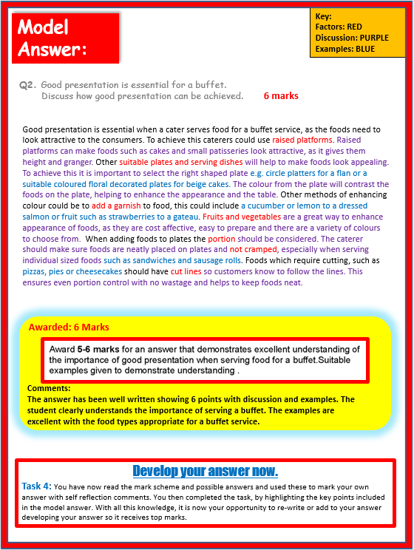
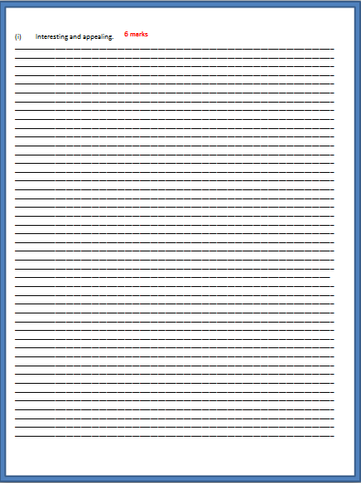
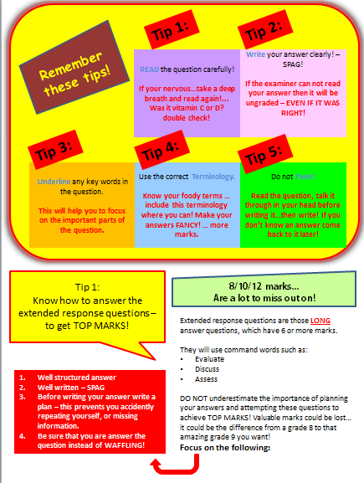
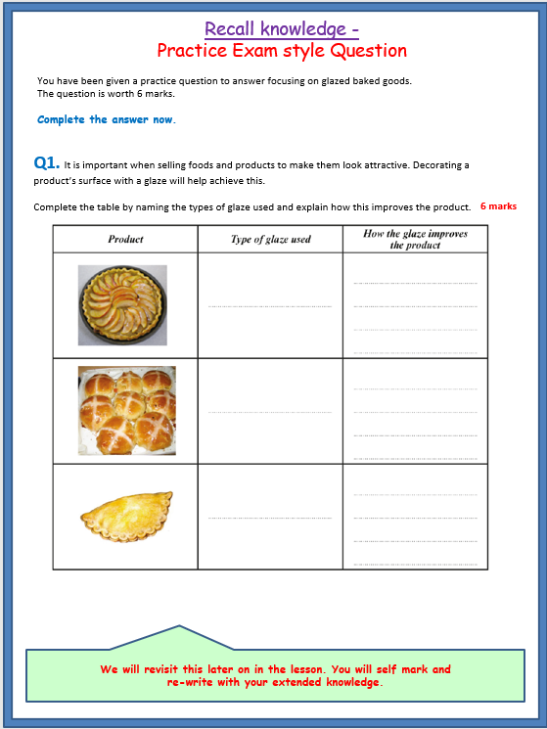
Food, Preparation and Nutrition
Exam Practice:
How to answer those
6 mark questions
Includes:
Top Tips COMMAND WORDS Model answers Marking Criteria Possible Answers
Exam Practice
KS4/GCSE

Slide 2
Tip 1:
Tip 2:
Remember these tips!
READ the question carefully!
If your nervous…take a deep breath and read again!... Was it vitamin C or D? double check!
Write your answer clearly! – SPAG!
If the examiner can not read your answer then it will be ungraded – EVEN IF IT WAS RIGHT!
Tip 3:
Tip 4:
Tip 5:
Underline any key words in the question.
This will help you to focus on the important parts of the question.
Use the correct Terminology.
Know your foody terms … include this terminology where you can! Make your answers FANCY! … more marks.
Do not Panic!
Read the question, talk it through in your head before writing it…then write! If you don’t know an answer come back to it later!
Tip 1:
Know how to answer the extended response questions – to get TOP MARKS!
8/10/12 marks...
Are a lot to miss out on!
Extended response questions are those LONG answer questions, which have 6 or more marks.
They will use command words such as:
Evaluate
Discuss
Assess
DO NOT underestimate the importance of planning your answers and attempting these questions to achieve TOP MARKS! Valuable marks could be lost… it could be the difference from a grade 8 to that amazing grade 9 you want!
Focus on the following:
Well structured answer
Well written – SPAG
Before writing your answer write a plan – this prevents you accidently repeating yourself, or missing information.
Be sure that you are answer the question instead of WAFFLING!

Slide 3
Understand them so you can use them to get TOP MARKS!
Tip 2:
Know your command words!
Command words tell you how the examiners would like you to answer the question. Knowing this is vital! Get to grips with the lingo!
State/identify
You should give a short answer or select an item from a list or table – no explaining here!.
Define
You should give a clear, precise meaning for the phrase.
Outline
You should give a brief summary of the process.
Make this your first piece of revision homework!
Describe
You should give a detailed description of something.
Explain
You should give reasons to show why.
Discuss
You should make a balanced argument covering a range of opinions.
Assess/Evaluate
You should use evidence and your own knowledge to come to a conclusion.
You will now be provided with a 6 mark question
(page 4)
Task 1: Answer the long answer question on the pages provided. You have 6 minutes to answer the question.
Task 2: Then mark your answer using the mark scheme on page 5. You will then have the opportunity to improve your answer by adding to it using the possible answers on page 5.

Slide 4
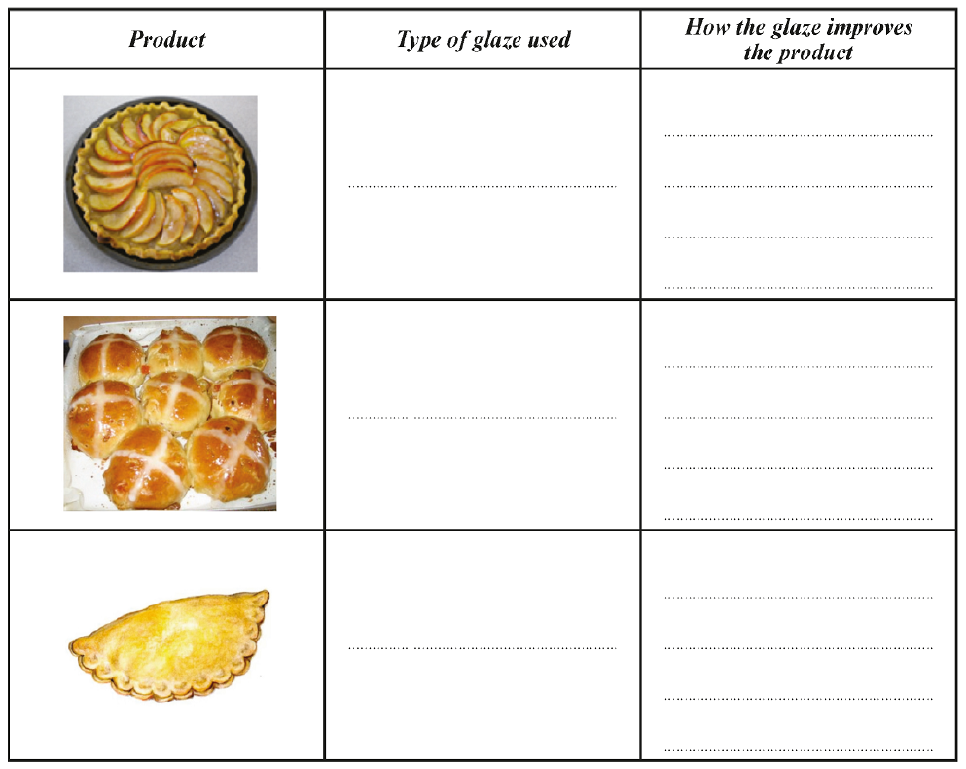
Recall knowledge -
Practice Exam style Question
You have been given a practice question to answer focusing on glazed baked goods.
The question is worth 6 marks.
Complete the answer now.
Q1. It is important when selling foods and products to make them look attractive. Decorating a product’s surface with a glaze will help achieve this.
Complete the table by naming the types of glaze used and explain how this improves the product.
6 marks
We will revisit this later on in the lesson. You will self mark and
re-write with your extended knowledge.

Slide 5
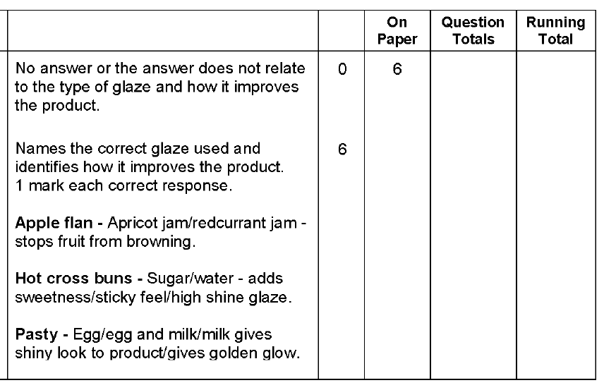
Mark Band for this question
Which ones did you think of from the list? Read the mark scheme carefully, then add those extra points to increase your overall mark.
1 possible answer for each is required.
Q1 Possible answers:
Top Tip:
Refer to the number of marks a question is awarded and use this as your target of points to include in the answer. So…. 6 marks = 6 points.
You may answer the question quicker than 6 minutes, but use this as your guide. Extra time can be used on those long answer questions later in the paper.
Self Reflection
Q1 Self Reflection: WWW & EBI
Total Marks /12

Slide 6
You will now be provided with the model answer for this question
Task 3: Use a highlighter to highlight any points that you missed from your answer. Underneath write down notes to help you remember these answers. Develop your original answer now if necessary,
Q1. It is important when selling foods and products to make them look attractive. Decorating a product’s surface with a glaze will help achieve this.
Complete the table by naming the types of glaze used and explain how this improves the product.
Model Answer:
6 marks
Stops fruit from browning.
Apricot Jam
1 marks
1 marks
Add a sticky high shine glaze.
Sugar & Water
1 marks
1 marks
Gives a golden glow.
Egg
1 marks
1 marks
Student’s Reflections/Comments:
Awarded: 6 Marks
Comments: The student has clearly read the table headings, as the answers are in the right column.
All answers have been given and correct. Full marks awarded.

Slide 7
Recall those command words
Understand them so you can use them to get TOP MARKS!
Tip 2:
Know your command words!
Command words tell you how the examiners would like you to answer the question. Knowing this is vital! Get to grips with the lingo!
State/identify
You should give a short answer or select an item from a list or table – no explaining here!.
Define
You should give a clear, precise meaning for the phrase.
Outline
You should give a brief summary of the process.
Make this your first piece of revision homework!
Describe
You should give a detailed description of something.
Explain
You should give reasons to show why.
Discuss
You should make a balanced argument covering a range of opinions.
Assess/Evaluate
You should use evidence and your own knowledge to come to a conclusion.
You will now be provided with a 6 mark question
(page 8)
Task 1: Answer the long answer question on the pages provided. You have 6 minutes to answer the question.
Task 2: Then mark your answer using the mark scheme on page 9 You will then have the opportunity to improve your answer by adding to it using the possible answers on page 9.

Slide 8
Recall knowledge -
Practice Exam style Question
You have been given a practice question to answer focusing on presenting a buffet.
The question is worth 6 marks.
Complete the answer now.
Q2. Good presentation is essential for a buffet.
Discuss how good presentation can be achieved.
________________________________________________________________________________________________________________________________________________________________________________________________________________________________________________________________________________________________________________________________________________________________________________________________________________________________________________________________________________________________________________________________________________________________________________________________________________________________________________________________________________________________________________________________________________________________________________________________________________________________________________________________________
____________________________________________________________________________________
____________________________________________________________________________________
________________________________________________________________________________________________________________________________________________________________________________________________________________________________________________________________________________________________________________________________________________________________________________________________________________________________________________________________________________________________________________________________________________________________________________________________________________________________________________________________________________________________________________________________________________________________________________________________________________________________________________________________________________________________________________________________________________________________________________________________________________________________________________________________________________________________________________________________________________________________________________________________________________________
6 marks

Slide 9
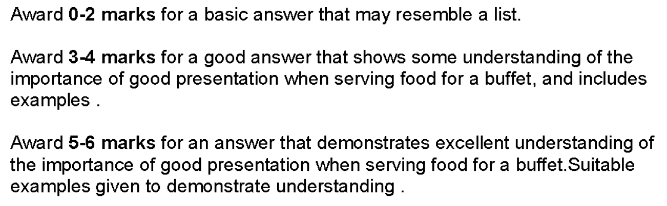
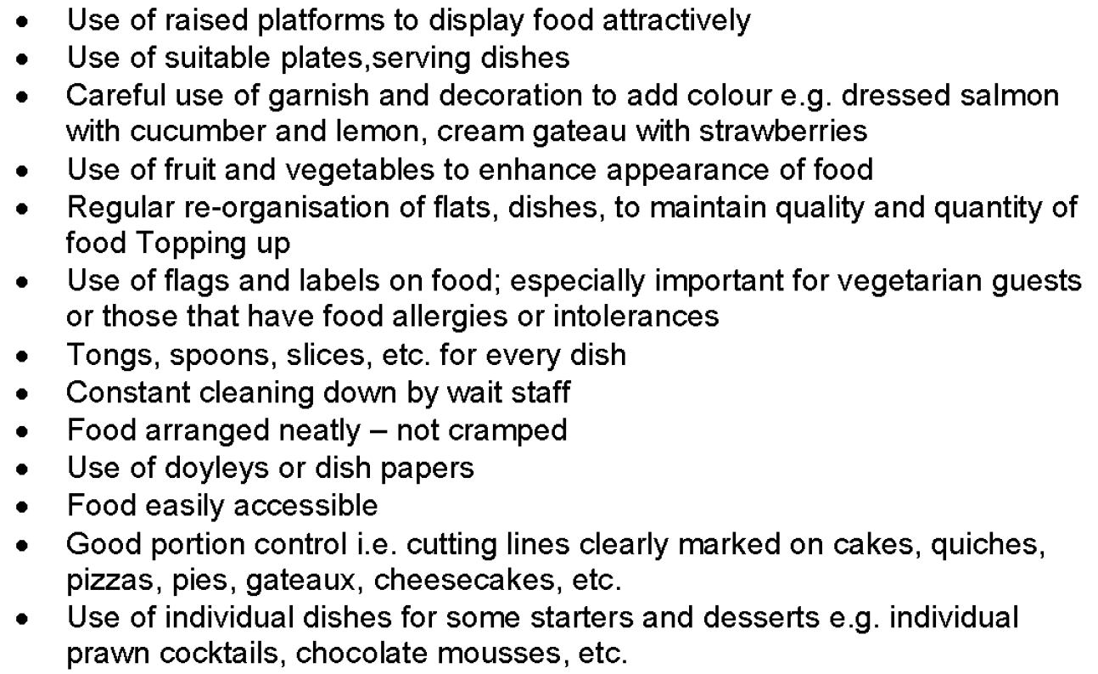
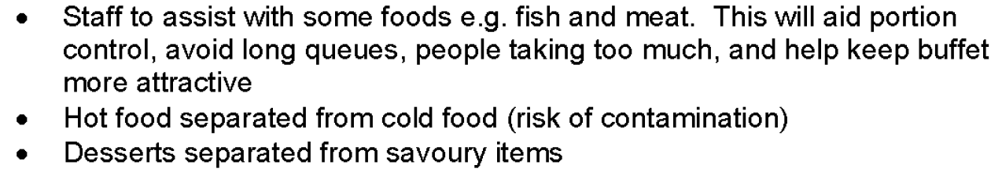
Mark Band for this question
Top Tip:
Refer to the number of marks a question is awarded and use this as your target of points to include in the answer, along with discussion and examples.
So…. 12 marks = 12 points with discussion and examples.
Q2 Possible answers:
Presenting Buffet food– Possible answers
Which ones did you think of from the list? Read the mark scheme carefully, then add those extra points to increase your overall mark.

Slide 10
Self Reflection
Q2 Self Reflection: WWW & EBI
Total Marks /12
You will now be provided with the model answer for this question
Task 3: Using 3 highlighters, highlight where the student has included the following in her answer.
Facts
Discussion
Examples
This will help you to identify how to structure a long answer question and the detail required to receive top marks.

Slide 11
Model Answer:
Key:
Factors: RED
Discussion: PURPLE
Examples: BLUE
Q2. Good presentation is essential for a buffet.
Discuss how good presentation can be achieved.
6 marks
Good presentation is essential when a cater serves food for a buffet service, as the foods need to look attractive to the consumers. To achieve this caterers could use raised platforms. Raised platforms can make foods such as cakes and small patisseries look attractive, as it gives them height and granger. Other suitable plates and serving dishes will help to make foods look appealing. To achieve this it is important to select the right shaped plate e.g. circle platters for a flan or a suitable coloured floral decorated plates for beige cakes. The colour from the plate will contrast the foods on the plate, helping to enhance the appearance and the table. Other methods of enhancing colour could be to add a garnish to food, this could include a cucumber or lemon to a dressed salmon or fruit such as strawberries to a gateau. Fruits and vegetables are a great way to enhance appearance of foods, as they are cost affective, easy to prepare and there are a variety of colours to choose from. When adding foods to plates the portion should be considered. The caterer should make sure foods are neatly placed on plates and not cramped, especially when serving individual sized foods such as sandwiches and sausage rolls. Foods which require cutting, such as pizzas, pies or cheesecakes should have cut lines so customers know to follow the lines. This ensures even portion control with no wastage and helps to keep foods neat.
Student’s Reflections/Comments:

Slide 12
Model Answer:
Key:
Factors: RED
Discussion: PURPLE
Examples: BLUE
Q2. Good presentation is essential for a buffet.
Discuss how good presentation can be achieved.
6 marks
Good presentation is essential when a cater serves food for a buffet service, as the foods need to look attractive to the consumers. To achieve this caterers could use raised platforms. Raised platforms can make foods such as cakes and small patisseries look attractive, as it gives them height and granger. Other suitable plates and serving dishes will help to make foods look appealing. To achieve this it is important to select the right shaped plate e.g. circle platters for a flan or a suitable coloured floral decorated plates for beige cakes. The colour from the plate will contrast the foods on the plate, helping to enhance the appearance and the table. Other methods of enhancing colour could be to add a garnish to food, this could include a cucumber or lemon to a dressed salmon or fruit such as strawberries to a gateau. Fruits and vegetables are a great way to enhance appearance of foods, as they are cost affective, easy to prepare and there are a variety of colours to choose from. When adding foods to plates the portion should be considered. The caterer should make sure foods are neatly placed on plates and not cramped, especially when serving individual sized foods such as sandwiches and sausage rolls. Foods which require cutting, such as pizzas, pies or cheesecakes should have cut lines so customers know to follow the lines. This ensures even portion control with no wastage and helps to keep foods neat.
Awarded: 6 Marks
Comments:
The answer has been well written showing 6 points with discussion and examples. The student clearly understands the importance of serving a buffet. The examples are excellent with the food types appropriate for a buffet service.
Develop your answer now.
Task 4: You have now read the mark scheme and possible answers and used these to mark your own answer with self reflection comments. You then completed the task, by highlighting the key points included in the model answer. With all this knowledge, it is now your opportunity to re-write or add to your answer developing your answer so it receives top marks.

Slide 13
Recall those command words
Understand them so you can use them to get TOP MARKS!
Tip 2:
Know your command words!
Command words tell you how the examiners would like you to answer the question. Knowing this is vital! Get to grips with the lingo!
State/identify
You should give a short answer or select an item from a list or table – no explaining here!.
Define
You should give a clear, precise meaning for the phrase.
Outline
You should give a brief summary of the process.
Make this your first piece of revision homework!
Describe
You should give a detailed description of something.
Explain
You should give reasons to show why.
Discuss
You should make a balanced argument covering a range of opinions.
Assess/Evaluate
You should use evidence and your own knowledge to come to a conclusion.
You will now be provided with a 6 mark question
(page 14)
Task 1: Answer the long answer question on the pages provided. You have 6 minutes to answer the question.
Task 2: Then mark your answer using the mark scheme on page 15 You will then have the opportunity to improve your answer by adding to it using the possible answers on page 15.

Slide 14
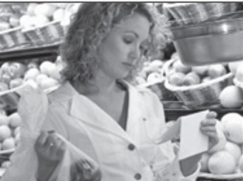
Recall knowledge -
Practice Exam style Question
You have been given a practice question to answer focusing on food safety and condition.
The question is worth 6 marks.
Complete the answer now.
Q3. Joanna’s mum often shops for food during her lunch break.
Describe how she can ensure her food shopping remains at a safe temperature and in good condition until home time.
6 marks
________________________________________________________________________________________________________________________________________________________________________________________________________________________________________________________________________________________________________________________________________________________________________________________________________________________________________________________________________________________________________________________________________________________________________________________________________________________________________________________________________________________________________________________________________________________________________________________________________________________________________________________________________
____________________________________________________________________________________
____________________________________________________________________________________
________________________________________________________________________________________________________________________________________________________________________________________________________________________________________________________________________________________________________________________________________________________________________________________________________________________________________________________________________________________________________________________________________________________________________________________________________________________________________________________________________________________________________________________________________________________________________________________________________________________________________________________________________________________________________________________________________________________________________________________________________________________________________________________________________________________________________________________________________________________________________________________________________________________
Notes:
Please note I do not own the photo nor do I claim to, it has been added as a visual aid for the purpose of this question. It can be found on the Eduqas word bank.

Slide 15
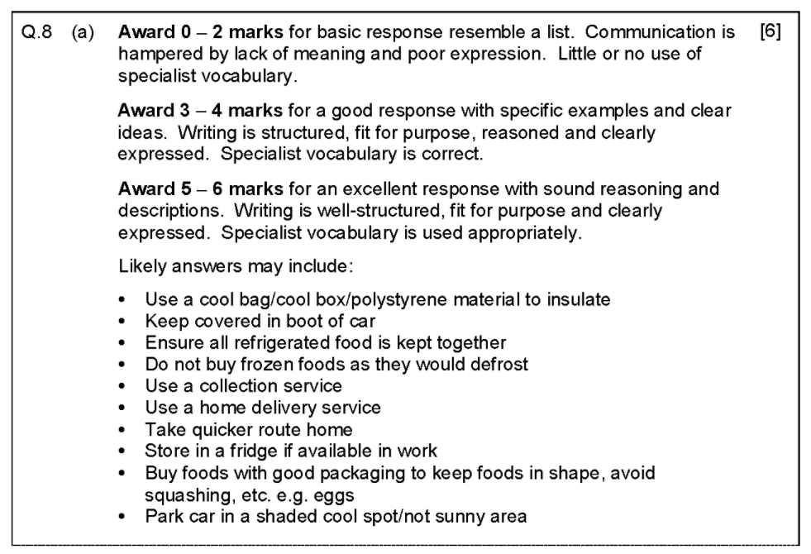
Mark Band for this question
Top Tip:
Refer to the number of marks a question is awarded and use this as your target of points to include in the answer, along with discussion and examples.
So…. 12 marks = 12 points with discussion and examples.
Q3 Possible answers:
Food Safety– Possible answers
Which ones did you think of from the list? Read the mark scheme carefully, then add those extra points to increase your overall mark.

Slide 16
Self Reflection
Q2 Self Reflection: WWW & EBI
Total Marks /12
You will now be provided with the model answer for this question
Task 3: Using 3 highlighters, highlight where the student has included the following in her answer.
Facts
Discussion
Examples
This will help you to identify how to structure a long answer question and the detail required to receive top marks.

Slide 17
Model Answer:
Key:
Factors: RED
Discussion: PURPLE
Examples: BLUE
Q3. Joanna’s mum often shops for food during her lunch break.
Describe how she can ensure her food shopping remains at a safe temperature and in good condition until home time.
6 marks
To ensure the food maintains a safe temperature and good condition until home time, Joanne’s mum could use cooler bags or cooler boxes. Cooler bags especially are easy to transport as they are light weight and foldable. If Joanne’s mother drives then the cooler boxes/bags can stay in the boot of her car until needed, the food can then remain in them in her car until driving home. Cooler boxes/bags help to keep foods cool due to insulative lining, this should help chilled items (e.g. butter, milk, meats) to remain as cool as possible. However, it would be advised for no frozen items to be brought as they will defrost. Alternatively, food could be covered and kept in the boot of the car with material or blankets to keep sunlight off of the food. If Joanne’s mother is planning on storing the foods for a considerable time in her car, then she could think about parking her car in a shaded area when returning back to work. Regardless of if she has a car or not, a click and collect service would be of use, as the foods could be collected on the way home, meaning that they would be kept at the right storage temperature (in store) until collected. If a click and collect service adds on time to the end of her working day, then she could arrange a food delivery to her home for an evening or weekend time slot. Both click and collect and delivery slots are available to book simply on an app. She can still complete her shopping on her lunch break, but instead of travelling to a store her shopping can be completed on a chosen shopping app or on a computer e.g. Asda or Tesco.
Student’s Reflections/Comments:
Notes:
Please note I do not own the photo nor do I claim to, it has been added as a visual aid for the purpose of this question. It can be found on the Eduqas word bank.

Slide 18
Model Answer:
Key:
Factors: RED
Discussion: PURPLE
Examples: BLUE
Q3. Joanna’s mum often shops for food during her lunch break.
Describe how she can ensure her food shopping remains at a safe temperature and in good condition until home time.
6 marks
To ensure the food maintains a safe temperature and good condition until home time, Joanne’s mum could use cooler bags or cooler boxes. Cooler bags especially are easy to transport as they are light weight and foldable. If Joanne’s mother drives then the cooler boxes/bags can stay in the boot of her car until needed, the food can then remain in them in her car until driving home. Cooler boxes/bags help to keep foods cool due to insulative lining, this should help chilled items (e.g. butter, milk, meats) to remain as cool as possible. However, it would be advised for no frozen items to be brought as they will defrost. Alternatively, food could be covered and kept in the boot of the car with material or blankets to keep sunlight off of the food. If Joanne’s mother is planning on storing the foods for a considerable time in her car, then she could think about parking her car in a shaded area when returning back to work. Regardless of if she has a car or not, a click and collect service would be of use, as the foods could be collected on the way home, meaning that they would be kept at the right storage temperature (in store) until collected. If a click and collect service adds on time to the end of her working day, then she could arrange a food delivery to her home for an evening or weekend time slot. Both click and collect and delivery slots are available to book simply on an app. She can still complete her shopping on her lunch break, but instead of travelling to a store her shopping can be completed on a chosen shopping app or on a computer e.g. Asda or Tesco.
Awarded: 6 Marks
Comments:
This answer is excellent. The student has provided a range of options with discussion and examples. The answer is well written with no errors.
Develop your answer now.
Task 4: You have now read the mark scheme and possible answers and used these to mark your own answer with self reflection comments. You then completed the task, by highlighting the key points included in the model answer. With all this knowledge, it is now your opportunity to re-write or add to your answer developing your answer so it receives top marks.
Notes:
Please note I do not own the photo nor do I claim to, it has been added as a visual aid for the purpose of this question. It can be found on the Eduqas word bank.

Slide 19
EXTRA PAPER IF NEEDED
________________________________________________________________________________________________________________________________________________________________________________________________________________________________________________________________________________________________________________________________________________________________________________________________________________________________________________________________________________________________________________________________________________________________________________________________________________________________________________________________________________________________________________________________________________________________________________________________________________________
________________________________________________________________________________________________________________________________________________________________________________________________________________________________________________________________________________________________________________________________________________________________________________________________________________________________________________________________________________________________________________________________________________________________________________________________________________________________________________________________________________________________________________________________________________________________________________________________________________________
_______________________________________________________________________________________________________________________________________________________________________________________________________________________________________________________________________________________________________________________________________________________________________________________________________________________________________________________________________________________________________________________________________________________________________________________________________________________________________________________________________________________________________________________________________________________________________________________________________________________
________________________________________________________________________________________________________________________________________________________________________________________________________________________________________________________________________________________________________________________________________________________________________________________________________________________________________________________________________________________________________________________________________________________________________________________________________________________________________________________________________________________________________________________________________________________________________________________________________________________
________________________________________________________________________________________________________________________________________________________________________________________________________________________________________________________________________________________________________________________________________________________________________________________________________________________________________________________________________________________________________________________________________________________________________________________________________________________________________________________________________________________________________________________________________________________________________________________________________________________

Slide 20
EXTRA PAPER IF NEEDED
________________________________________________________________________________________________________________________________________________________________________________________________________________________________________________________________________________________________________________________________________________________________________________________________________________________________________________________________________________________________________________________________________________________________________________________________________________________________________________________________________________________________________________________________________________________________________________________________________________________
________________________________________________________________________________________________________________________________________________________________________________________________________________________________________________________________________________________________________________________________________________________________________________________________________________________________________________________________________________________________________________________________________________________________________________________________________________________________________________________________________________________________________________________________________________________________________________________________________________________
_______________________________________________________________________________________________________________________________________________________________________________________________________________________________________________________________________________________________________________________________________________________________________________________________________________________________________________________________________________________________________________________________________________________________________________________________________________________________________________________________________________________________________________________________________________________________________________________________________________________
________________________________________________________________________________________________________________________________________________________________________________________________________________________________________________________________________________________________________________________________________________________________________________________________________________________________________________________________________________________________________________________________________________________________________________________________________________________________________________________________________________________________________________________________________________________________________________________________________________________
________________________________________________________________________________________________________________________________________________________________________________________________________________________________________________________________________________________________________________________________________________________________________________________________________________________________________________________________________________________________________________________________________________________________________________________________________________________________________________________________________________________________________________________________________________________________________________________________________________________

