Slide 1
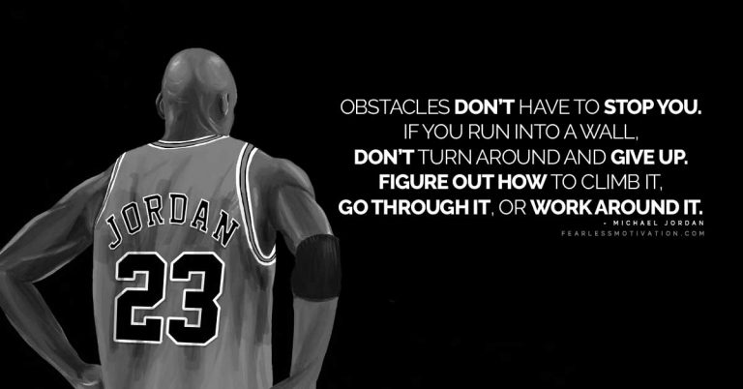
PE Bridging Menu
You are about to continue your exciting journey into the world of Physical Education, good luck!
Remember
Choose which modules you do and when, but work through them consistently. Different tasks will take you varying amounts of time, but on average you should aim to do one or two per week.
All shaded tasks are compulsory and must be completed and brought with you to your first lesson in September.
The red hot chilli indicates that the task is more challenging than the others.
Numbers in brackets correspond to how you should evidence the module which can be found in the slides following the menu. They can be saved within this powerpoint or as separate documents clearly labelled with the subject

Slide 2





PE Bridging the gap GCSE to A level (Next steps)
Prepare an A level folder ready for when you start | Read | Watch | Visit | Do
 | AQA PE specification https://filestore.aqa.org.uk/resources/pe/specifications/AQA-7582-SP-2016.PDF (1) | Moneyball Oakland A's general manager Billy Beane's successful attempt to assemble a baseball team on a lean budget by employing computer-generated analysis to acquire new players. Learn about types of data (Quantitative and qualitative).(3) https://www.youtube.com/watch?v=kR7b3dk0toY | Visit a sports stadium: Eg https://bookings.wembleytours.com/stadiumtours/booking/default.htm A Level PE looks at advertisement, sponsorship and how it impacts sport. What evidence of this can you identify on your visit? (6) | MOOCs & FutureLearn https://www.mooc.org/ Search through the MOOCs online learning portal; choose from a range of courses (many of them free) that interest you. Also check out https://www.futurelearn.com/ for more free webinars and online courses (7)
 |  | Lance Armstrong Learn about drug cheating and types of drugs leading to Lance Armstong’s overall ban from cycling (3) https://www.youtube.com/watch?v=JmZDO64LqCE
 | AQA A level book: https://www.aqabookshop.co.uk/product/aqa-a-level-pe-year-1-and-year-2/ (1) | A Level Paper 1 revision podcast 2024 The Everlearner https://www.youtube.com/watch?v=kBbfUAD8BzE A Level Paper 2 revision podcast 2023 The Everlearner https://www.youtube.com/watch?v=YGYUUCjAWQM | Attend or watch a sports match eg netball or football match / women’s sporting event vs a men's event. What do you notice? At A level you will learn about –factors affecting participation (6) | Complete The Everlearner Videos and Checkpoints (2)
 |  |  |  | Complete a Powerpoint or ‘Ted talk’ Presentation on an area of you choice from the AQA Spec (3)
 | Revision world: https://revisionworld.com/a2-level-level-revision/physical-education-level-revision (1) | The commericialisation of sport https://www.youtube.com/watch?v=ps1sWA9Aoes The history of 100m Medalists http://archive.nytimes.com/www.nytimes.com/interactive/2012/08/05/sports/olympics/the-100-meter-dash-one-race-every-medalist-ever.html (4) | Science Museum – Do you understand the laws of physics. At A level you will learn about Biomechanics https://www.sciencemuseum.org.uk/home (6) The Olympic Stadium is located inside the Queen Elizabeth Olympic Park in the east of the city. Has the2012 Olympics left the legacy intended for sport in this country? (6) | Design your own paper aeroplane OR make this Diamondback one https://www.youtube.com/watch?v=9ws5QUqT2QU vary the height; angle and speed of the release of your plane, record your PB– video your results. (5) Perhaps try one or more of these practical ‘Impulse’ Experiments (write up/video your result/conclusions/findings or maybe create a Podcast!) https://www.youtube.com/watch?v=oXW6RqEwVWA (5)
 | Subscribe to : https://www.hoddereducation.co.uk/pereview (1)
 | Newspaper/journals and magazines– sports. Keep up to date with sports news (1) | At A level you will learn about the History of sport. Watch the film Tom Brown school day to gain a little understanding: https://www.youtube.com/watch?v=s3QQRNWUCEU (3)

Slide 3
(1)Reference Materials
This section is populated with some important reference materials
Download the A level specification and put a copy into your folder
The textbooks are a requirement for the course – please purchase either Book 1 or the Book 1&2 combined for September (if you are unsure about your A level choices you may wish to wait until August to buy the book)

Slide 4
(2)The Everlearner
Students from Drayton Manor are set up on The Everlearner – either with your email address from last year, or, if you didn’t take GCSE PE you can be set up with your school email address. If you let me know I can add you (jbl@draytonmanorhighschool.co.uk)
Please refer to the following slide to see the lessons required. Study the lessons and use the practice tests as much as you want to – there is no limit on time or attempts.
To study, go to courses at the top of your dashboard then click on the relevant section
You can access the whole course by clicking the relevant lessons if there are areas you might want to look into

Slide 5
(2) Everlearner Tasks to be completed
Physiological Aspects (1) | Physiological Aspects (2) | Physiological Aspects (3) | Psychological Aspects | Sociological Aspects
Cardiovascular and Respiratory System | Joints and Movement | Preparation and Training | Skill Acquisition | Commercialisation
Impact of activity Lesson 1 Lesson 2 The Heart Lesson 1 Lesson 2 Lesson 3 | Joint Actions Lesson 1 Lesson 2 Lesson 3 Lesson 4 Lesson 5 Joints and Movement Lesson 1 Lesson 2 Lesson 3 Lesson 4 | Preparation Lesson 1 Lesson 2 Lesson 3 Lesson 4 Lesson 5 Lesson 6 Training Lesson 1 Lesson 2 Lesson 3 | Skill Acquisition and Transfer Lesson 1 Lesson 2 Lesson 3 Lesson 4 Lesson 5 Lesson 6 Lesson 7 Lesson 8 | Commercialisation Lesson 1 Lesson 2 Lesson 3
 |  |  |  | Complete tasks on following slides (4)

Slide 6
(3) - Book/Journal/Podcast/Film Review
Would you/would you not recommend it? Why?
Rating:
Review by: ___________________________________________
Title: _______________________________________________________
Author: ____________________________________________________
Review of (please circle)
Book Journal Podcast Film Documentary
What was it about?
What did you find particularly interesting/inspiring/shocking? Has this changed your opinion?
What would you like to learn more about?
How does it link to this subject and why is it important?
Save your answers as part of this powerpoint and upload to your application.

Slide 7
(4)Literacy Challenge:
How many of the key words and concepts below can you use to EXPLAIN what is happening in the videos? Choose a method to do this :-
1 Write your ideas down in full sentences.
2 Give the list of words to someone else then explain your ideas verbally (teach them).
3 Create a voice recording using an electronic device.
Commercialisation / Profit / Individual / Sport / Product / Contracts / Commodity
Sponsorship / Success / Media / Money / Business/ Merchandising / Private / Elite / Wealth /
TV Rights

Slide 8
(5) Design / Practical Experiments
Video your results and upload to your application

Slide 9
(6) Visits
Visits may be difficult but will make your studying ‘come to life’.
Choose how you report on your visits and how you relate them to your future courses and your future careers
Choose whether you would like to make a
Podcast
Informative flyer
Mini film
Report
Newspaper article
Save your work on this on your application and call it ‘Visits’

Slide 10
MOOCs (7)
To evidence this you can
Save any notes you take
Take and save a screenshot of completed modules or the completed course
Save it on your application as part of this powerpoint or if there is a downloadable certificate save as ‘PE MOOC’

