Slide 1
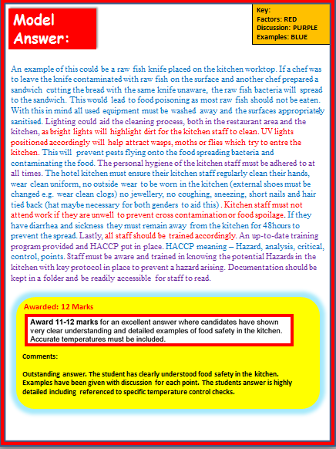
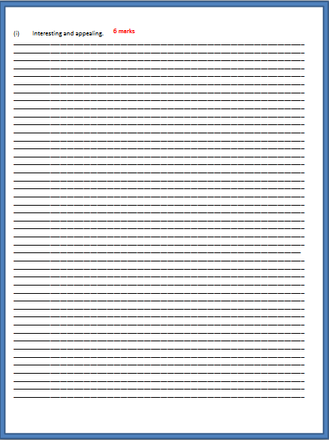
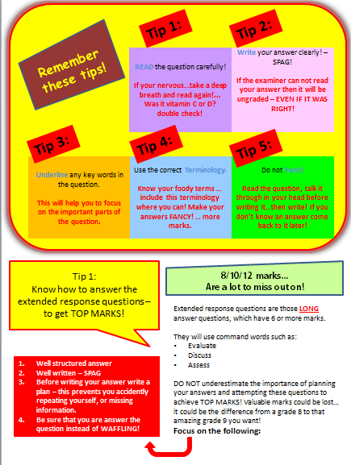
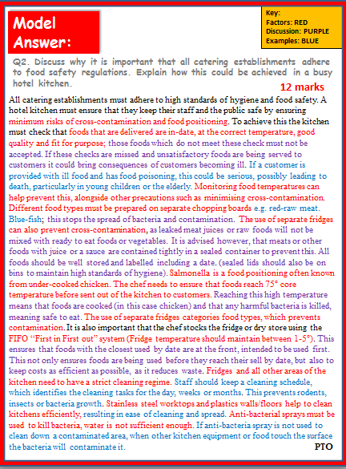
Food, Preparation and Nutrition
Exam Practice:
How to answer those
8 mark questions
Includes:
Top Tips COMMAND WORDS Model answers Marking Criteria Possible Answers
Exam Practice
KS4/GCSE

Slide 2
Tip 1:
Tip 2:
Remember these tips!
READ the question carefully!
If your nervous…take a deep breath and read again!... Was it vitamin C or D? double check!
Write your answer clearly! – SPAG!
If the examiner can not read your answer then it will be ungraded – EVEN IF IT WAS RIGHT!
Tip 3:
Tip 4:
Tip 5:
Underline any key words in the question.
This will help you to focus on the important parts of the question.
Use the correct Terminology.
Know your foody terms … include this terminology where you can! Make your answers FANCY! … more marks.
Do not Panic!
Read the question, talk it through in your head before writing it…then write! If you don’t know an answer come back to it later!
Tip 1:
Know how to answer the extended response questions – to get TOP MARKS!
8/10/12 marks...
Are a lot to miss out on!
Extended response questions are those LONG answer questions, which have 6 or more marks.
They will use command words such as:
Evaluate
Discuss
Assess
DO NOT underestimate the importance of planning your answers and attempting these questions to achieve TOP MARKS! Valuable marks could be lost… it could be the difference from a grade 8 to that amazing grade 9 you want!
Focus on the following:
Well structured answer
Well written – SPAG
Before writing your answer write a plan – this prevents you accidently repeating yourself, or missing information.
Be sure that you are answer the question instead of WAFFLING!

Slide 3
Understand them so you can use them to get TOP MARKS!
Tip 2:
Know your command words!
Command words tell you how the examiners would like you to answer the question. Knowing this is vital! Get to grips with the lingo!
State/identify
You should give a short answer or select an item from a list or table – no explaining here!.
Define
You should give a clear, precise meaning for the phrase.
Outline
You should give a brief summary of the process.
Make this your first piece of revision homework!
Describe
You should give a detailed description of something.
Explain
You should give reasons to show why.
Discuss
You should make a balanced argument covering a range of opinions.
Assess/Evaluate
You should use evidence and your own knowledge to come to a conclusion.
You will now be provided with a 8 mark question
(page 4)
Task 1: Answer the long answer question on the pages provided. You have 8 minutes to answer the question.
Task 2: Then mark your answer using the mark scheme on page 5. You will then have the opportunity to improve your answer by adding to it using the possible answers on page 6.

Slide 4
Recall knowledge -
Practice Exam style Question
You have been given a practice question to answer focusing on preserving foods in the home.
The question is worth 8 marks.
Complete the answer now.
Q1. Preservation in the home is becoming more popular.
Discuss how a family can preserve foods in the home to save money and minimise waste.
________________________________________________________________________________________________________________________________________________________________________________________________________________________________________________________________________________________________________________________________________________________________________________________________________________________________________________________________________________________________________________________________________________________________________________________________________________________________________________________________________________________________________________________________________________________________________________________________________________________________________________________________________
____________________________________________________________________________________
____________________________________________________________________________________
____________________________________________________________________________________________________________________________________________________________________________________________________________________________________________________________________________________________________________________________________________________________________________________________________________________________________________________________________________________________________________________________________________________________________________________________________________________________________________________________________________________________________________________________________________________________________________________________________________________________________________________________________________________________________________________________________________________________________________________________________________________________________________________________________________________________________________________________________________________________________________________________________________________________________________________________________________________________________________________________________________________________________________________________________________________________________________________________________________________________________________________________________________________________________________________________________________________________________________________________
8 marks
We will revisit this later on in the lesson. You will self mark and
re-write with your extended knowledge.

Slide 5
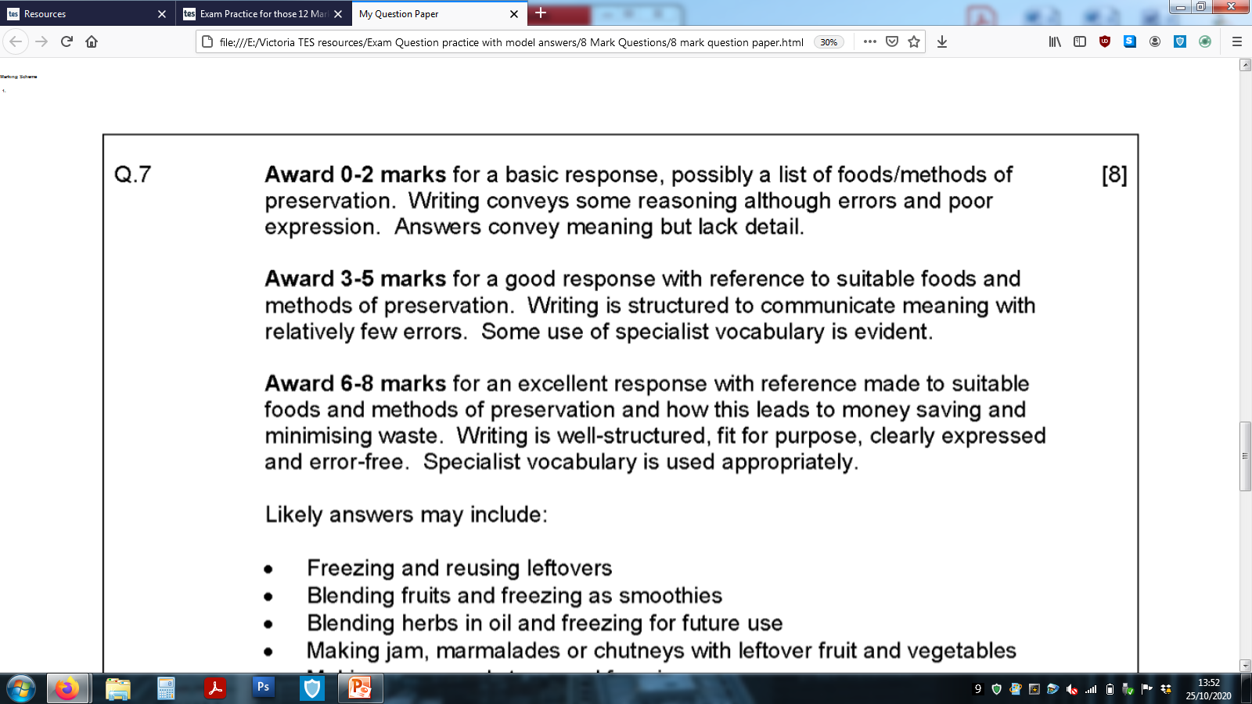
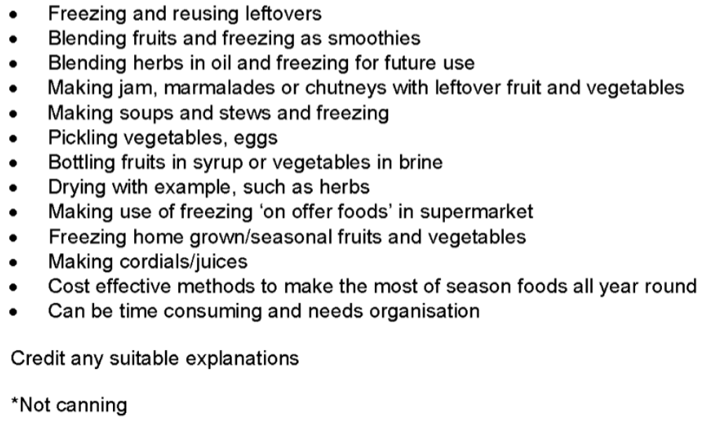
Mark Band for this long answer question
Top Tip:
Refer to the number of marks a long written question is awarded and use this as your target of points to include in the answer, along with discussion and examples.
So…. 6 marks = 6 points with discussion and examples.
Q1 Possible answers:
Factors which help preserve food in the home
- Possible answers.
Which ones did you think of from the list? Read the mark scheme carefully, then add those extra points to increase your overall mark.

Slide 6
Self Reflection
Q1 Self Reflection: WWW & EBI
Total Marks /12
You will now be provided with the model answer for this question
Task 3: Using 3 highlighters, highlight where the student has included the following in her answer.
Facts
Discussion
Examples
This will help you to identify how to structure a long answer question and the detail required to receive top marks.

Slide 7
Model Answer:
Q1. Preservation in the home is becoming more popular.
Discuss how a family can preserve foods in the home to save money and minimise waste.
8 marks
Families can preserve foods at home by considering home freezing, reusing foods, pickling or drying foods. These methods will help families save food waste and money. Freezing leftover foods means they can be eaten at another meal time, this saves waste and in turn creates another meal e.g. left over lasagne could be stored in an air tight container and defrosted when required by heating in a microwave for a dinner later in the week/month. Soups could be made using un-used vegetables then frozen. This preserves the vegetables and all foods can be stored safely in the freezer as long as they are used within 3 months. If freezing is a favoured cost saving method, families could also purchase foods in a super market which are on offer stored in the fridge or freezer isles. These foods would need to state suitable for freezing on the packaging. Ready made meals such as curries, Spaghetti Bolognaise or Pies could be brought at a reduced cost and then stored in the fridge until required. If the family has left over fruits which are before their best before dates, but will not be eaten, they could turn them into jams. Blackcurrants and Strawberries could be reduced on the hob with sugar and turned into jams. The sugars added to the fruit preserve the fruit meaning they have a longer life and more time to be consumed. Turning fruits and vegetables into smoothies gives them a new lease of life and can encourage those family members to consume leftover/unwanted foods. Lastly, drying freshly grown herbs can prolong their shelf-life e.g. home grown basil, coriander or sage.
Student’s Reflections/Comments:

Slide 8
Model Answer:
Q1. Preservation in the home is becoming more popular.
Discuss how a family can preserve foods in the home to save money and minimise waste.
8 marks
Families can preserve foods at home by considering home freezing, reusing foods, pickling or drying foods. These methods will help families save food waste and money. Freezing leftover foods means they can be eaten at another meal time, this saves waste and in turn creates another meal e.g. left over lasagne could be stored in an air tight container and defrosted when required by heating in a microwave for a dinner later in the week/month. Soups could be made using un-used vegetables then frozen. This preserves the vegetables and all foods can be stored safely in the freezer as long as they are used within 3 months. If freezing is a favoured cost saving method, families could also purchase foods in a super market which are on offer stored in the fridge or freezer isles. These foods would need to state suitable for freezing on the packaging. Ready made meals such as curries, Spaghetti Bolognaise or Pies could be brought at a reduced cost and then stored in the fridge until required. If the family has left over fruits which are before their best before dates, but will not be eaten, they could turn them into jams. Blackcurrants and Strawberries could be reduced on the hob with sugar and turned into jams. The sugars added to the fruit preserve the fruit meaning they have a longer life and more time to be consumed. Turning fruits and vegetables into smoothies gives them a new lease of life and can encourage those family members to consume leftover/unwanted foods. Lastly, drying freshly grown herbs can prolong their shelf-life e.g. home grown basil, coriander or sage.
Awarded: 8 Marks
Comments:
An excellent answer provided. The student has referenced suitable foods and methods of preservation. The answer is well-structured and error-free.
Develop your answer now.
Task 4: You have now read the mark scheme and possible answers and used these to mark your own answer with self reflection comments. You then completed the task, by highlighting the key points included in the model answer. With all this knowledge, it is now your opportunity to re-write or add to your answer developing your answer so it receives top marks.

Slide 9
Recall those command words
Understand them so you can use them to get TOP MARKS!
Tip 2:
Know your command words!
Command words tell you how the examiners would like you to answer the question. Knowing this is vital! Get to grips with the lingo!
State/identify
You should give a short answer or select an item from a list or table – no explaining here!.
Define
You should give a clear, precise meaning for the phrase.
Outline
You should give a brief summary of the process.
Make this your first piece of revision homework!
Describe
You should give a detailed description of something.
Explain
You should give reasons to show why.
Discuss
You should make a balanced argument covering a range of opinions.
Assess/Evaluate
You should use evidence and your own knowledge to come to a conclusion.
You will now be provided with a 8 mark question
(page 10)
Task 1: Answer the long answer question on the pages provided. You have 8 minutes to answer the question.
Task 2: Then mark your answer using the mark scheme on page 11 You will then have the opportunity to improve your answer by adding to it using the possible answers on page 11.

Slide 10
Recall knowledge -
Practice Exam style Question
You have been given a practice question to answer focusing on Healthy snacks.
The question is worth 8 marks.
Complete the answer now.
Q2. Recent trends suggest that the consumption of ‘healthy snacks’ is increasing.
Identify the range of healthy snacks available and discuss how they contribute to dietary needs.
________________________________________________________________________________________________________________________________________________________________________________________________________________________________________________________________________________________________________________________________________________________________________________________________________________________________________________________________________________________________________________________________________________________________________________________________________________________________________________________________________________________________________________________________________________________________________________________________________________________________________________________________________
____________________________________________________________________________________
____________________________________________________________________________________
________________________________________________________________________________________________________________________________________________________________________________________________________________________________________________________________________________________________________________________________________________________________________________________________________________________________________________________________________________________________________________________________________________________________________________________________________________________________________________________________________________________________________________________________________________________________________________________________________________________________________________________________________________________________________________________________________________________________________________________________________________________________________________________________________________________________________________________________________________________________________________________________________________________________________________________________________________________________________________________________________________________________________________________________________________________________________________________________________________________________________________________________________________________________________________________________________________________________________________________________________________________________________________________________________________________________________________________________________________________________________________________________________________________________________________________________________________________________________________________________________________________________________________________________________________________________
PTO
8 marks

Slide 11
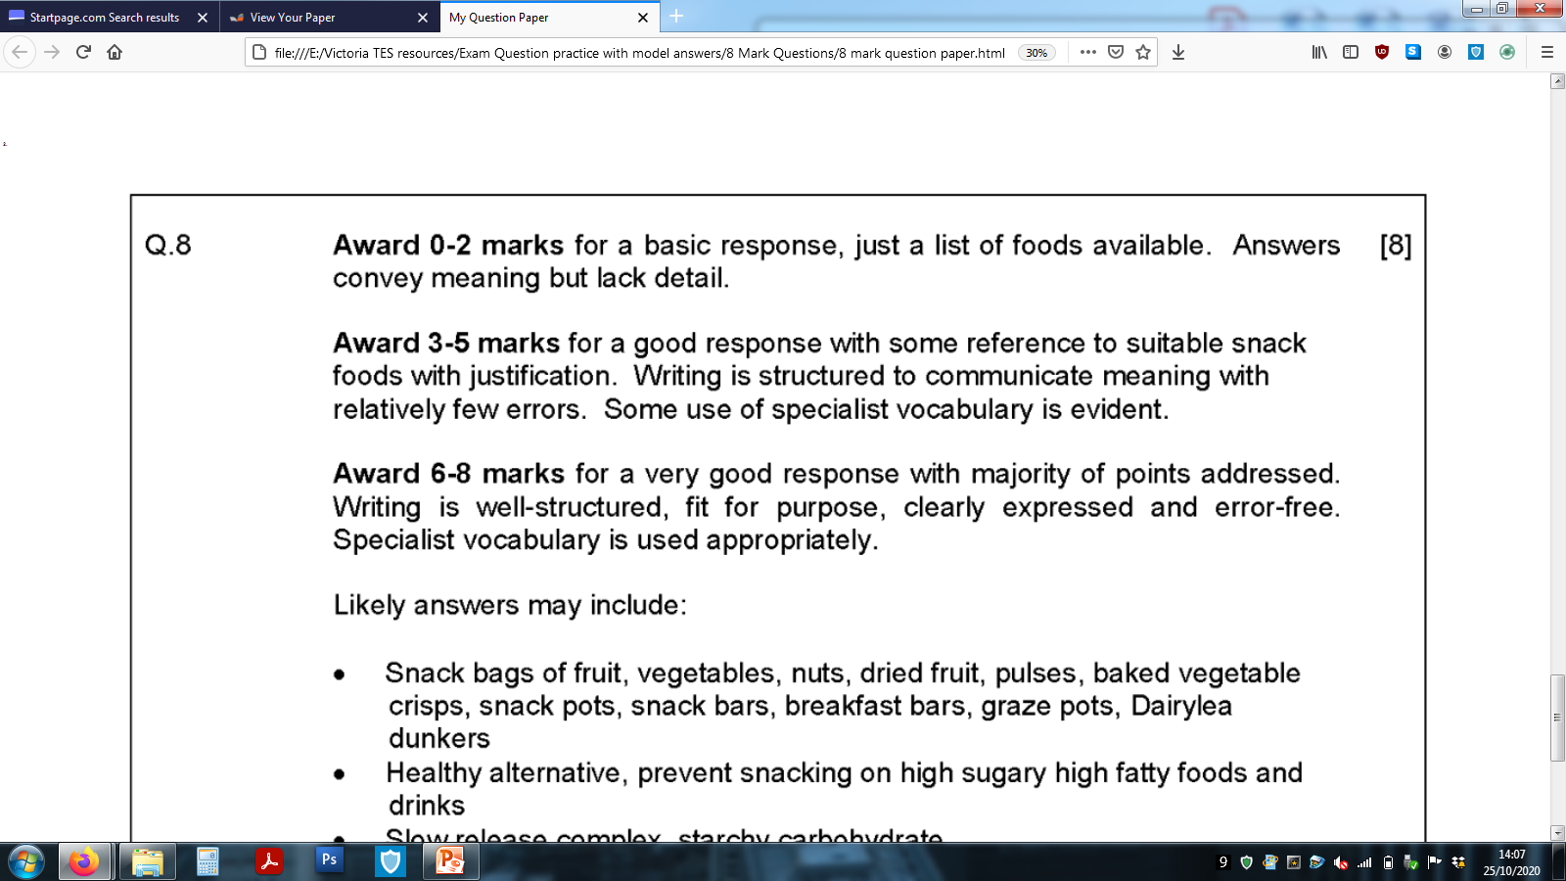
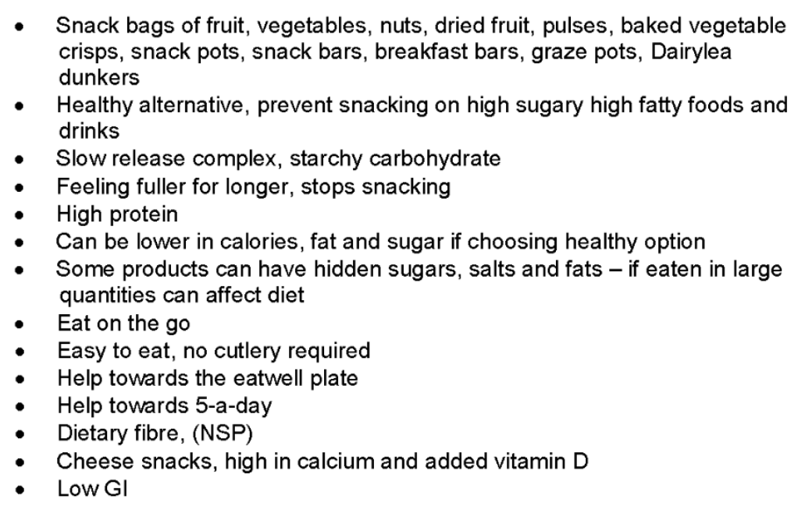
Mark Band for this long answer question
Top Tip:
Refer to the number of marks a long written question is awarded and use this as your target of points to include in the answer, along with discussion and examples.
So…. 12 marks = 12 points with discussion and examples.
Q2 Possible answers:
Healthy Snacking – Possible answers
Which ones did you think of from the list? Read the mark scheme carefully, then add those extra points to increase your overall mark.

Slide 12
Self Reflection
Q2 Self Reflection: WWW & EBI
Total Marks /12
You will now be provided with the model answer for this question
Task 3: Using 3 highlighters, highlight where the student has included the following in her answer.
Facts
Discussion
Examples
This will help you to identify how to structure a long answer question and the detail required to receive top marks.

Slide 13
Model Answer:
Key:
Factors: RED
Discussion: PURPLE
Examples: BLUE
Q2. Recent trends suggest that the consumption of ‘healthy snacks’ is increasing.
Identify the range of healthy snacks available and discuss how they contribute to dietary needs.
8 marks
Healthy snacking has been increasingly popular with a whole range of snacks provided by consumers. Fruit bags, nuts, dried fruit, pulses, baked vegetable crisps are just some healthy snacks available. Healthy snacking allows consumers to eat on the go; this encourages them to swop hand held chocolate bars for a healthy alternative. Healthy alternatives, prevent consumers snacking on high fat or sugary foods. Alternatives, such as snack bars are shaped into convenient hand held bars resembling chocolate bars. This helps prevent unhealthy snacking on high sugary/fatty food or drinks. Protein filled snacks such as mixed nuts provide the body with it’s protein requirements to build its daily needs. Consumers in later adulthood require more protein in their diet, halved boiled eggs with a herb mayonnaise will give them the protein boost needed. Fruit and vegetable bags are a great way to help towards eating 5 a day and the Eatwell plate. Following the Eat well plate promotes a healthy balanced diet. Consuming snacks such as yoghurt pots and nuts target the dairy and protein sections of the Eatwell Plate. Although the body does not require these in large quantities, small snacks can help towards a persons daily allowance. Other diary snacks such as cheese and crackers are high in calcium and adds Vitamin D to a person’s diet, which helps protect teeth and bones, and prevent disease.
Student’s Reflections/Comments:

Slide 14
Model Answer:
Key:
Factors: RED
Discussion: PURPLE
Examples: BLUE
Q2. Recent trends suggest that the consumption of ‘healthy snacks’ is increasing.
Identify the range of healthy snacks available and discuss how they contribute to dietary needs.
8 marks
Healthy snacking has been increasingly popular with a whole range of snacks provided by consumers. Fruit bags, nuts, dried fruit, pulses, baked vegetable crisps are just some healthy snacks available. Healthy snacking allows consumers to eat on the go; this encourages them to swop hand held chocolate bars for a healthy alternative. Healthy alternatives, prevent consumers snacking on high fat or sugary foods. Alternatives, such as snack bars are shaped into convenient hand held bars resembling chocolate bars. This helps prevent unhealthy snacking on high sugary/fatty food or drinks. Protein filled snacks such as mixed nuts provide the body with it’s protein requirements to build its daily needs. Consumers in later adulthood require more protein in their diet, halved boiled eggs with a herb mayonnaise will give them the protein boost needed. Fruit and vegetable bags are a great way to help towards eating 5 a day and the Eatwell plate. Following the Eat well plate promotes a healthy balanced diet. Consuming snacks such as yoghurt pots and nuts target the dairy and protein sections of the Eatwell Plate. Although the body does not require these in large quantities, small snacks can help towards a persons daily allowance. Other diary snacks such as cheese and crackers are high in calcium and adds Vitamin D to a person’s diet, which helps protect teeth and bones, and prevent disease.
Awarded: 8 Marks
Comments:
The student’s answer is well written and clearly shows they have considered dietary needs. Examples have been given for healthy snacks discussing how the nutritional content of the snacks can help the body. Error free and well structured.
Develop your answer now.
Task 4: You have now read the mark scheme and possible answers and used these to mark your own answer with self reflection comments. You then completed the task, by highlighting the key points included in the model answer. With all this knowledge, it is now your opportunity to re-write or add to your answer developing your answer so it receives top marks.

Slide 15
EXTRA PAPER IF NEEDED
________________________________________________________________________________________________________________________________________________________________________________________________________________________________________________________________________________________________________________________________________________________________________________________________________________________________________________________________________________________________________________________________________________________________________________________________________________________________________________________________________________________________________________________________________________________________________________________________________________________
________________________________________________________________________________________________________________________________________________________________________________________________________________________________________________________________________________________________________________________________________________________________________________________________________________________________________________________________________________________________________________________________________________________________________________________________________________________________________________________________________________________________________________________________________________________________________________________________________________________
_______________________________________________________________________________________________________________________________________________________________________________________________________________________________________________________________________________________________________________________________________________________________________________________________________________________________________________________________________________________________________________________________________________________________________________________________________________________________________________________________________________________________________________________________________________________________________________________________________________________
________________________________________________________________________________________________________________________________________________________________________________________________________________________________________________________________________________________________________________________________________________________________________________________________________________________________________________________________________________________________________________________________________________________________________________________________________________________________________________________________________________________________________________________________________________________________________________________________________________________
________________________________________________________________________________________________________________________________________________________________________________________________________________________________________________________________________________________________________________________________________________________________________________________________________________________________________________________________________________________________________________________________________________________________________________________________________________________________________________________________________________________________________________________________________________________________________________________________________________________

Slide 16
EXTRA PAPER IF NEEDED
________________________________________________________________________________________________________________________________________________________________________________________________________________________________________________________________________________________________________________________________________________________________________________________________________________________________________________________________________________________________________________________________________________________________________________________________________________________________________________________________________________________________________________________________________________________________________________________________________________________
________________________________________________________________________________________________________________________________________________________________________________________________________________________________________________________________________________________________________________________________________________________________________________________________________________________________________________________________________________________________________________________________________________________________________________________________________________________________________________________________________________________________________________________________________________________________________________________________________________________
_______________________________________________________________________________________________________________________________________________________________________________________________________________________________________________________________________________________________________________________________________________________________________________________________________________________________________________________________________________________________________________________________________________________________________________________________________________________________________________________________________________________________________________________________________________________________________________________________________________________
________________________________________________________________________________________________________________________________________________________________________________________________________________________________________________________________________________________________________________________________________________________________________________________________________________________________________________________________________________________________________________________________________________________________________________________________________________________________________________________________________________________________________________________________________________________________________________________________________________________
________________________________________________________________________________________________________________________________________________________________________________________________________________________________________________________________________________________________________________________________________________________________________________________________________________________________________________________________________________________________________________________________________________________________________________________________________________________________________________________________________________________________________________________________________________________________________________________________________________________

Slide 17
EXTRA PAPER IF NEEDED
________________________________________________________________________________________________________________________________________________________________________________________________________________________________________________________________________________________________________________________________________________________________________________________________________________________________________________________________________________________________________________________________________________________________________________________________________________________________________________________________________________________________________________________________________________________________________________________________________________________
________________________________________________________________________________________________________________________________________________________________________________________________________________________________________________________________________________________________________________________________________________________________________________________________________________________________________________________________________________________________________________________________________________________________________________________________________________________________________________________________________________________________________________________________________________________________________________________________________________________
_______________________________________________________________________________________________________________________________________________________________________________________________________________________________________________________________________________________________________________________________________________________________________________________________________________________________________________________________________________________________________________________________________________________________________________________________________________________________________________________________________________________________________________________________________________________________________________________________________________________
________________________________________________________________________________________________________________________________________________________________________________________________________________________________________________________________________________________________________________________________________________________________________________________________________________________________________________________________________________________________________________________________________________________________________________________________________________________________________________________________________________________________________________________________________________________________________________________________________________________
________________________________________________________________________________________________________________________________________________________________________________________________________________________________________________________________________________________________________________________________________________________________________________________________________________________________________________________________________________________________________________________________________________________________________________________________________________________________________________________________________________________________________________________________________________________________________________________________________________________

Slide 18
EXTRA PAPER IF NEEDED
________________________________________________________________________________________________________________________________________________________________________________________________________________________________________________________________________________________________________________________________________________________________________________________________________________________________________________________________________________________________________________________________________________________________________________________________________________________________________________________________________________________________________________________________________________________________________________________________________________________
________________________________________________________________________________________________________________________________________________________________________________________________________________________________________________________________________________________________________________________________________________________________________________________________________________________________________________________________________________________________________________________________________________________________________________________________________________________________________________________________________________________________________________________________________________________________________________________________________________________
_______________________________________________________________________________________________________________________________________________________________________________________________________________________________________________________________________________________________________________________________________________________________________________________________________________________________________________________________________________________________________________________________________________________________________________________________________________________________________________________________________________________________________________________________________________________________________________________________________________________
________________________________________________________________________________________________________________________________________________________________________________________________________________________________________________________________________________________________________________________________________________________________________________________________________________________________________________________________________________________________________________________________________________________________________________________________________________________________________________________________________________________________________________________________________________________________________________________________________________________
________________________________________________________________________________________________________________________________________________________________________________________________________________________________________________________________________________________________________________________________________________________________________________________________________________________________________________________________________________________________________________________________________________________________________________________________________________________________________________________________________________________________________________________________________________________________________________________________________________________

Slide 19
EXTRA PAPER IF NEEDED
________________________________________________________________________________________________________________________________________________________________________________________________________________________________________________________________________________________________________________________________________________________________________________________________________________________________________________________________________________________________________________________________________________________________________________________________________________________________________________________________________________________________________________________________________________________________________________________________________________________
________________________________________________________________________________________________________________________________________________________________________________________________________________________________________________________________________________________________________________________________________________________________________________________________________________________________________________________________________________________________________________________________________________________________________________________________________________________________________________________________________________________________________________________________________________________________________________________________________________________
_______________________________________________________________________________________________________________________________________________________________________________________________________________________________________________________________________________________________________________________________________________________________________________________________________________________________________________________________________________________________________________________________________________________________________________________________________________________________________________________________________________________________________________________________________________________________________________________________________________________
________________________________________________________________________________________________________________________________________________________________________________________________________________________________________________________________________________________________________________________________________________________________________________________________________________________________________________________________________________________________________________________________________________________________________________________________________________________________________________________________________________________________________________________________________________________________________________________________________________________
________________________________________________________________________________________________________________________________________________________________________________________________________________________________________________________________________________________________________________________________________________________________________________________________________________________________________________________________________________________________________________________________________________________________________________________________________________________________________________________________________________________________________________________________________________________________________________________________________________________

Slide 20
EXTRA PAPER IF NEEDED
________________________________________________________________________________________________________________________________________________________________________________________________________________________________________________________________________________________________________________________________________________________________________________________________________________________________________________________________________________________________________________________________________________________________________________________________________________________________________________________________________________________________________________________________________________________________________________________________________________________
________________________________________________________________________________________________________________________________________________________________________________________________________________________________________________________________________________________________________________________________________________________________________________________________________________________________________________________________________________________________________________________________________________________________________________________________________________________________________________________________________________________________________________________________________________________________________________________________________________________
_______________________________________________________________________________________________________________________________________________________________________________________________________________________________________________________________________________________________________________________________________________________________________________________________________________________________________________________________________________________________________________________________________________________________________________________________________________________________________________________________________________________________________________________________________________________________________________________________________________________
________________________________________________________________________________________________________________________________________________________________________________________________________________________________________________________________________________________________________________________________________________________________________________________________________________________________________________________________________________________________________________________________________________________________________________________________________________________________________________________________________________________________________________________________________________________________________________________________________________________
________________________________________________________________________________________________________________________________________________________________________________________________________________________________________________________________________________________________________________________________________________________________________________________________________________________________________________________________________________________________________________________________________________________________________________________________________________________________________________________________________________________________________________________________________________________________________________________________________________________

