Slide 1
9 Mark Question Preparation 15-May-23
Do Now
1 | State what happens to the heart during ventricular systole and atrial diastole
2 | How is more than one protein made from one gene?
3 | State the function of the cerebrum
4 | How does fMRI work ?
5 | When there is high blood oxygen or low CO2 or high pH levels what is the neurone and transmitter that's involved and how ?
6 | State the respiratory minute ventilation equation
7 | What factors affect rate of breathing ?
8 | How is the mechanism of releasing hormones involved in thermoregulation?

Slide 2
Review
1 | State what happens to the heart during ventricular systole and atrial diastole | Atria relax/ventricles contract/increase pressure in ventricle/AV valves shut/SL valves open/blood forced into arteries (pressure currently lower in arteries)
2 | How is more than one protein made from one gene? | mRNA splicing
3 | State the function of the cerebrum | Involved in vision, learning, thinking, emotions and movement
4 | How does fMRI work ? | They show changes in brain activity as they happen. More oxygenated blood flows to active areas of the brain, to supply the neurones with oxygen and glucose. Molecules in oxygenated blood respond differently to a magnetic field than those in deoxygenated blood, the signal that is returned to the scanner is stronger from the oxygenated blood, which allows more active areas of the brain to be identified.

Slide 3
Review
5 | When there is high blood oxygen or low CO2 or high pH levels what is the neurone and transmitter that's involved and how ? | Impulses are sent to the cardiovascular control centre, which sends impulses along parasympathetic neurons. These secrete acetylcholine which binds to receptors on SAN
6 | State the respiratory minute ventilation equation | Volume of gas breathed in or out in a minute
7 | What factors affect rate of breathing ? | temperature, exercise, hormones, CO2 and O2 conc, pH
8 | How is the mechanism of releasing hormones involved in thermoregulation? | the body releases adrenaline and thyroxine. these increase metabolism so more heat is produced

Slide 4
Lesson Objectives
To establish an approach on how to answer 9 mark questions.
The Bigger Picture
Students found these types of questions most difficult in your mock exams.
These usually require sound subject knowledge from a range of topics that need to be linked and applied to the context of the question.
They usually involve A03 skills where data or information has to be interpreted and a judgement or suggestion made.
They could have ANY command word so you will need to apply what we have done in previous lessons!

Slide 5
Discuss
Consider all aspects and opinions on an issue or argument.

Slide 6
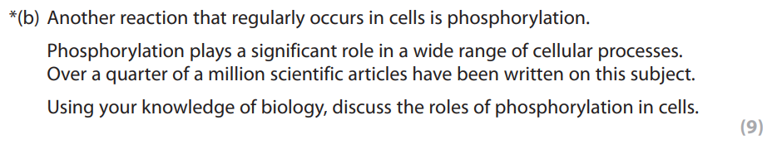
Think Ink Pair Share
What:
Read the question below. Then on mini whiteboards bullet point a list of examples where phosphorylation occurs in cells.
How:
Try from memory initially for the think and ink
Then in pairs you can use the revision guides to fill in knowledge gaps
How long:
2 min think and ink, 2 min in pairs, then share with the class
Specimen

Slide 7
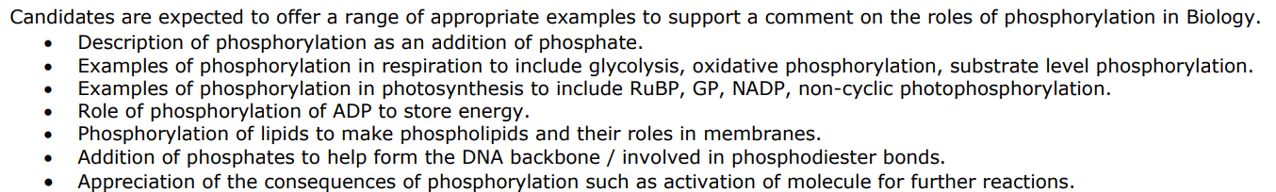

Slide 8
Task
What:
Now draft your answer
How:
On lined paper
How long:
7 mins

Slide 9
Review
Project student answer on visualiser and mark as a class

Slide 11
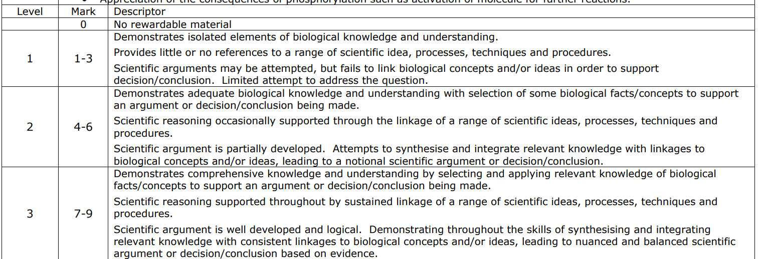

Slide 12
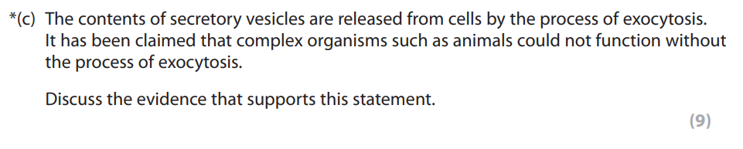
Think Ink Pair Share
What:
Read the question below. Then on mini whiteboards bullet point a list of examples where exocytosis occurs in animal cells.
How:
Try from memory initially for the think and ink
Then in pairs you can use the revision guides to fill in knowledge gaps
How long:
2 min think and ink, 2 min in pairs, then share with the class
Specimen

Slide 13
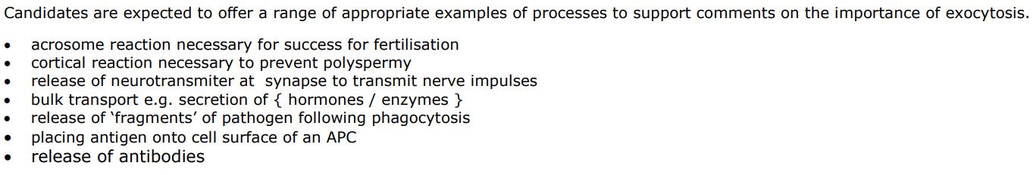

Slide 14
Task
What:
Now draft your answer
How:
On lined paper
How long:
7 mins

Slide 15
Review
Project student answer on visualiser and mark as a class

Slide 16
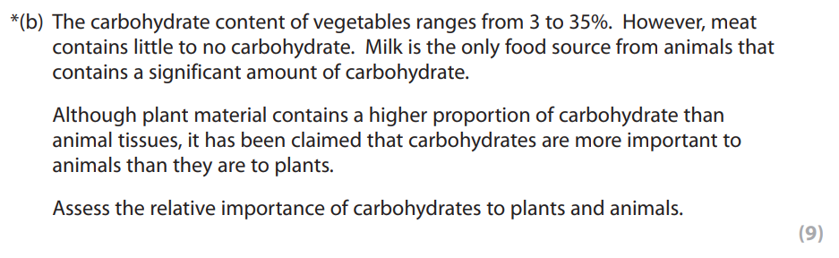
Think Pair Share
What:
Read the question below. What does the command word assess mean that you have to do?
How long:
30s think, 1 min in pairs, then share with the class
2018

Slide 17
Task
What: Answer the question below.
How:
Do a mindmap of all of the uses of carbohydrates that you can think of from memory at first on your mini whiteboard.
Fill in knowledge gaps using the revision guides.
Answer the question on lined paper
How long:
3 min think and ink
2 min with revision guide
6 mins to write on lined paper

Slide 18
Review
Project student answer on visualiser and mark as a class

Slide 19
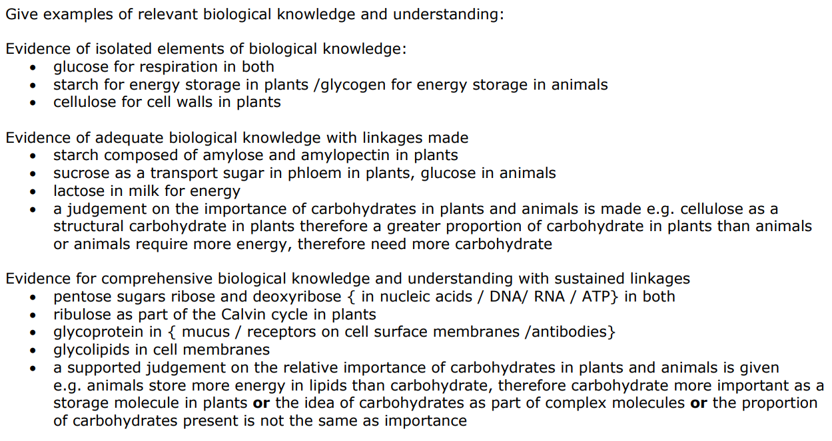

Slide 20
Exit Ticket
What rules would you give yourself when answering a 9 mark question?
Suggestions:
Underline and define the command word
Check if there is any information given in or above the question that you need to include
Do a mindmap/plan of all of the biological concepts that you need to include before starting to answer
Practice and prepare for 9 mark questions by making flash cards or mind maps on suggested topics (next lesson)

Slide 21
Lesson Objectives
To establish an approach on how to answer 9 mark questions.
The Bigger Picture
Students found these types of questions most difficult in your mock exams.
These usually require sound subject knowledge from a range of topics that need to be linked and applied to the context of the question.
They usually involve A03 skills where data or information has to be interpreted and a judgement or suggestion made.
They could have ANY command word so you will need to apply what we have done in previous lessons!

