Slide 1
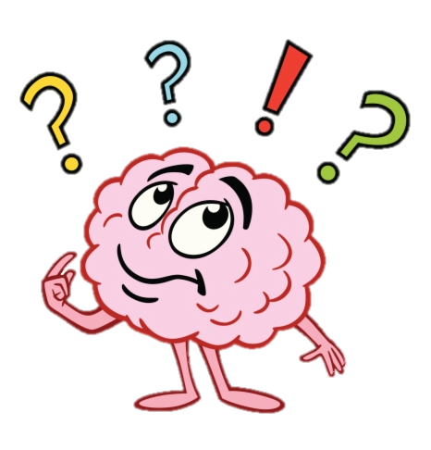
Title: An introduction to Psychology
Do Now:
Write the following questions down before attempting to answer them. Leave enough space between each question to add additional answers when we feedback.
What is Psychology?
What might we study in Psychology?
Why is studying Psychology useful?

Slide 2
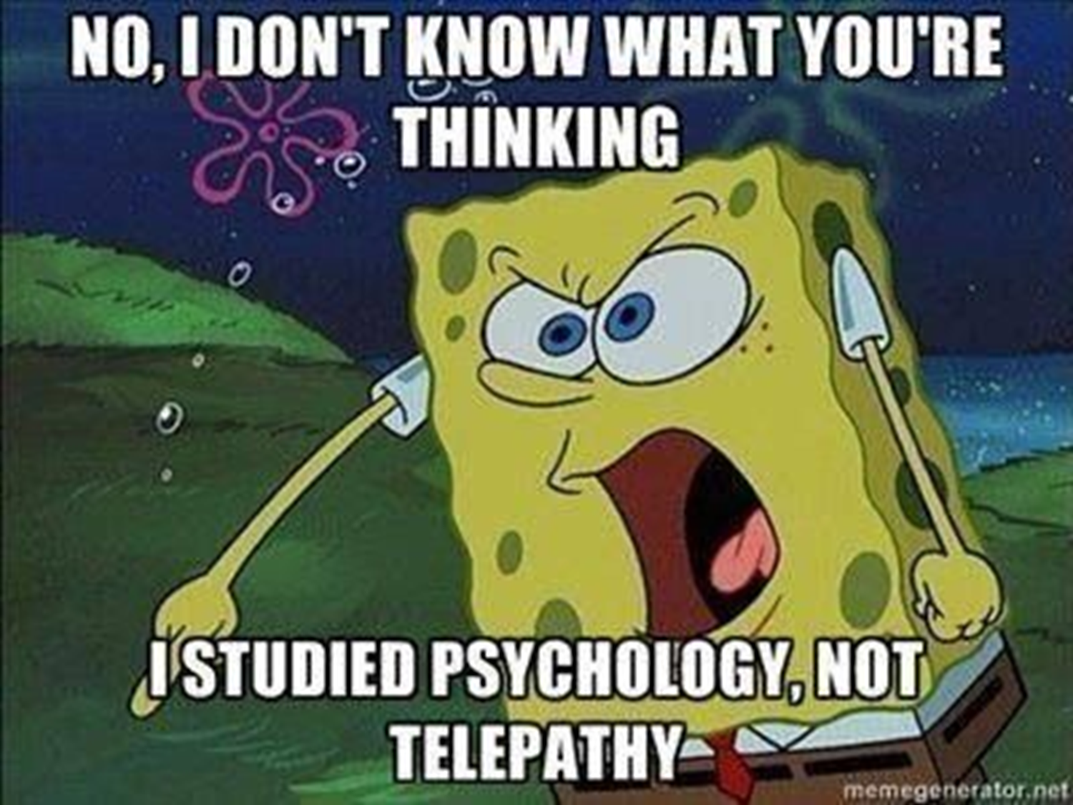
What is Psychology?
The scientific study of the mental processes and behaviour.

Slide 3
What will we study in Psychology?
Schizophrenia
What is schizophrenia? What causes it and how can we treat it?
Issues and debates
Do we have free will over our behaviour? Is our behaviour innate or learned?
Forensic Psychology
How can we explain and modify offending behaviour?
Exam preparation:
Revision of course content.
Year 13 Spring Term
Year 13 Summer Term
Gender
How do schools, the media and parents reinforce gender roles?
Research methods 2
What makes research scientific?
Year 13 Autumn Term
Year 12 Summer Term
Social influence
Why do people obey harmful orders? How can we bring about social change?
Memory
Why are eyewitness testimonies often inaccurate and how can we improve their accuracy?
Year 12 Autumn Term
Year 12 Spring Term
Research methods
How do Psychologists research human behaviour and analyse their data?
Approaches in Psychology
What factors influence our behaviour?
Biopsychology
How does our brain and bodily systems affect our behaviour?
Psychopathology
What are phobias, depression and OCD? How do Psychologists attempt to explain and treat them?
Attachment
How do our early attachments influence our later relationships? What happens if a child loses their attachment?

Slide 4
Brain gym!
Stand behind you chair on one leg
Clap 5 times
Pat your head and rub your stomach at the same time
Do a 360 degree turn
Stretch your arms above your head
Say “Psychology is the best”
Make an animal noise

Slide 5
Title: Obedience
Think-pair-share:
What is obedience?
Can you think of why/when obedience might be good?
Can you think of why/when obedience might be bad?

Slide 6
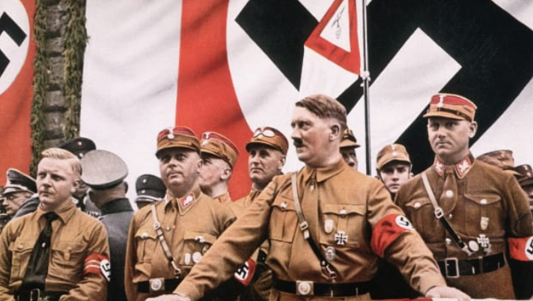
"When you think of the long and gloomy history of man, you will find more hideous crimes have been committed in the name of obedience than have ever been committed in the name of rebellion."

Slide 7
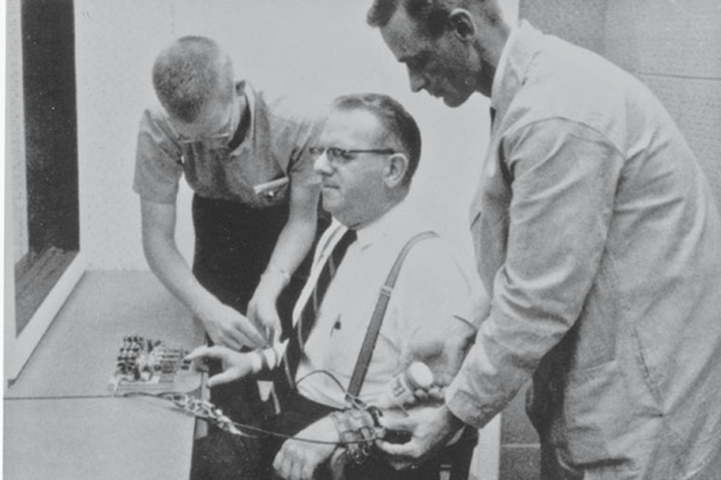

Slide 8
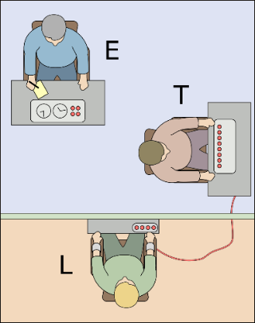
Milgram’s (1963) original obedience research
Aim: To investigate whether people will obey an order from an authority figure to inflict pain on another person.
Procedure: 40 American men aged 20-50 volunteered to take part in a paid laboratory study falsely advertised to be investigating ‘punishment on learning’ at Yale University. Participants were met by an experimenter dressed in a lab coat who entered them into a fake draw with a confederate (fake participant who worked with the researcher) to decide who would become the teacher (which was always assigned to the naive participant) and who would become the learner (which was always assigned to the confederate). The teacher was instructed to administer an electric shock to the learner, who was sat in another room, each time they gave a wrong response in a word-pair test. The shock generator had switches, each clearly marked with a voltage that ranged from 15 to 450 volts. The teacher (participant) was told to increase the shock level by one switch (15v) each time. Unbeknown to the participant, no shocks were actually administered. During the test, pre-recorded tape recordings played the learner shouting and crying in pain. If the naive participant expressed an unwillingness to continue, the experimenter gave a series of standardised prods such as ‘you have no choice, you must go on’.
Findings: 100% of participants obeyed the experimenter’s instructions up until 300 volts. 65% of participants obeyed to the maximum 450 volts. Most participants found the experience stressful and showed signs of distress (e.g. digging their nails into their flesh and sweating).
Conclusions: Most people will obey orders from an authority figure, even if those orders go against their conscience.
Task:
Read through the description of Milgram’s study. Using the highlighted text to guide you, note down any strengths and limitations of the research as you can think of.
Discuss your notes with the person next to you. Add any differences to your notes.

Slide 9
Milgram’s (1963) original obedience research
Aim: To investigate whether people will obey an order from an authority figure to inflict pain on another person.
Procedure: 40 American men aged 20-50 volunteered to take part in a paid laboratory study falsely advertised to be investigating ‘punishment on learning’ at Yale University. Participants were met by an experimenter dressed in a lab coat who entered them into a fake draw with a confederate (fake participant who worked with the researcher) to decide who would become the teacher (which was always assigned to the naive participant) and who would become the learner (which was always assigned to the confederate). The teacher was instructed to administer an electric shock to the learner, who was sat in another room, each time they gave a wrong response in a word-pair test. The shock generator had switches, each clearly marked with a voltage that ranged from 15 to 450 volts. The teacher (participant) was told to increase the shock level by one switch (15v) each time. Unbeknown to the participant, no shocks were actually administered. During the test, pre-recorded tape recordings played the learner shouting and crying in pain. If the naive participant expressed an unwillingness to continue, the experimenter gave a series of standardised prods such as ‘you have no choice, you must go on’.
Findings: 100% of participants obeyed the experimenter’s instructions up until 300 volts. 65% of participants obeyed to the maximum 450 volts. Most participants found the experience stressful and showed signs of distress (e.g. digging their nails into their flesh and sweating).
Conclusions: Most people will obey orders from an authority figure, even if those orders go against their conscience.
Methodological critiques | Ethical critiques
Population validity: Is the sample of participants representative of the population? Can we generalise the findings to the wider population? Demand characteristics: When participants guess the aims of the research and change their behaviour to suit the aims. Replicability: would it be easy to carry out the research again in the exact same way? Ecological validity: is the research conducted in a natural, everyday setting for participants? | Deception: Researchers should not lie to participants. Protection of participants from harm: Researchers should not mentally or physically harm participants. Right to withdraw: Researchers should always allow participants to withdraw from the study at any point.

Slide 10
What equipment will you need?
1 x small folder (class folder)
3 x large folders (for each paper)
File dividers
A notepad
Black pens
Pencil
Rubber
Ruler
Green pen
Highlighters
Calculator

Slide 11
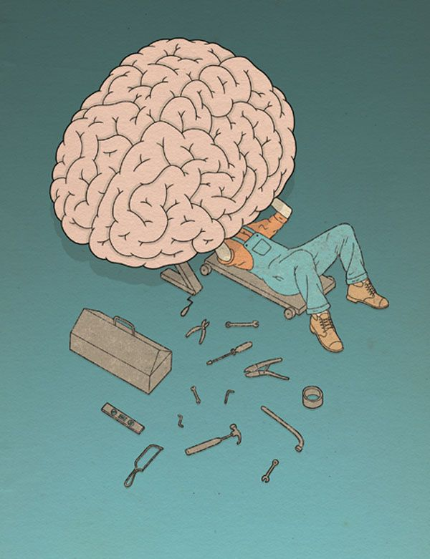
Psychology Bridging Menu
You are about to start an exciting journey into the world of Psychology where you will learn about the scientific study of the mind and behaviour!
Remember:
Choose what modules you do and when, but work through them consistently. Different tasks will take you varying amounts of time, but on average you should aim to do one or two per week.
All green tasks are core modules, they are compulsory and must be completed.
The red hot chili indicates that the task is more challenging than the others.
Numbers e.g. (1) correspond to how you should evidence the module which can be found in the slides following the menu.

Slide 12
Psychology Bridging Menu (Green modules are core (compulsory) modules , indicates the most challenging modules)
Read | Watch | Listen | Visit (virtually or physically at a later date) | Do
The man who mistook his wife for a hat – Oliver Sacks (1) A collection of studies detailing the most bizarre neurological disorders resulting from damage to the brain. | A beautiful mind (Movie) (1) A brilliant mathematician becomes entangled in a conspiracy – a winner of 4 Oscars. | Harlow's Monkeys (1) Claudia Hammond revisits Harry Harlow's surrogate mothers experiment with monkeys, that revolutionised parenting. | The Virtual Koshland Science Museum (4) Explore the interactive brain to learn about its structures and functions. | Starting with psychology The greatest puzzle we face is ourselves. Psychologists put forward a range of explanations about why people feel, think and behave the way they do. It is not easy to pin down all the many influences but this free course makes a start. (5)
Opening Skinner's Box: Great Psychological Experiments of the Twentieth Century (1) Slater takes us from deep empathy with Stanley Milgram's obedience subjects to a disturbing re-creation of an experiment questioning the validity of psychiatric diagnosis. | The Stanford Prison Experiment (Movie) (1) The controversial psychology experiment in which college students pretend to be prisoners and guards, but the proceedings soon get out of hand. | Joseph Wolpe and Systematic Desensitization (1) Joseph Wolpe's treatment for phobias can be seen as the foundation for today's cognitive behaviour therapy used to treat many mental health conditions. | The open university (5) – complete one of the following free online Psychology courses: Forensic Psychology An introduction to cognitive psychology Young people and their mental health Understanding Anxiety, Depression and CBT Attachment Obedience and ethics
 |  |  |  | Are criminals born or made? (7) Research and produce an essay on the above question.
 |  |  |  | Research one of the Psychological approaches listed below and produce a presentation which covers: The main assumptions of the approach The key concepts of the approach The research methods used by the approach The contributions of the approach The strength and limitations of the approach Psychological approaches: The Psychodynamic approach The behaviourist approach The humanistic approach The cognitive approach Social learning theory The biological approach (8)
The Lucifer Effect: How Good People Turn Evil (1) Psychologist Philip Zimbardo challenges our conceptions of who we think we are and what we believe we will never do. | TED Talks (1) 9 myths about psychology, debunked How reliable is your memory? The Psychology of evil | The Bobo Doll (1) Bandura's ground-breaking Bobo Doll experiment exposed the dangers of imitation. |  | Research one of the Psychological approaches listed below and produce a presentation which covers: The main assumptions of the approach The key concepts of the approach The research methods used by the approach The contributions of the approach The strength and limitations of the approach Psychological approaches: The Psychodynamic approach The behaviourist approach The humanistic approach The cognitive approach Social learning theory The biological approach (4)
 |  | Case Study: HM - The Man Who Couldn't Remember (1) Having lost his own memory, HM revealed how new memories are formed.
Elephants on Acid (1) The craziest psychological experiments. | Crash Course Psychology (2) A playlist of informative videos.
The Little Book of Psychology: An Introduction to the Key Psychologists and Theories You Need to Know (1) An introduction to the key thinkers, themes and theories in Psychology. | Three identical strangers (3) Identical triplets separated at birth reunite and unearth an unimaginable secret that has radical repercussions. | The Boy Raised as a Girl (1) For decades the John/Joan case ‘proved’ that nurture dictates gender identity. In fact, the case was not a success and hid a personal tragedy. | Bethlehem Museum of the Mind (6) (Virtual work available) Explore the history of mental healthcare and create your own art work inspired by past patients of Bethlehem Hospital – the UK’s oldest residential psychiatric hospital.
The Psychology Book (1) The Psychology Book is your visual guide to the complex and fascinating world of human behaviour. | The Brain with David Eagleman - What Is Reality (1) Dr David Eagleman explores how the brain, locked in silence and darkness, conjures up the world we all take for granted.
 |  | Case Study: The Man with a Hole in His Head (1) Phineas Gage survived a bizarre accident that changed him - and the study of neuroscience.
 |  |  | Freud Museum London (1) The home of Freud, the founder of psychoanalysis.

Slide 13
(1) - Book/Journal/Podcast/Film/Visit Review
Would you/would you not recommend it? Why?
Rating:
Review by: ___________________________________________
Title: _______________________________________________________
Author: ____________________________________________________
Review of (please circle)
Book Journal Podcast Film Documentary
What was it about?
What did you find particularly interesting/inspiring/shocking? Has this changed your opinion?
What would you like to learn more about?
How does it link to this subject and why is it important?

Slide 14
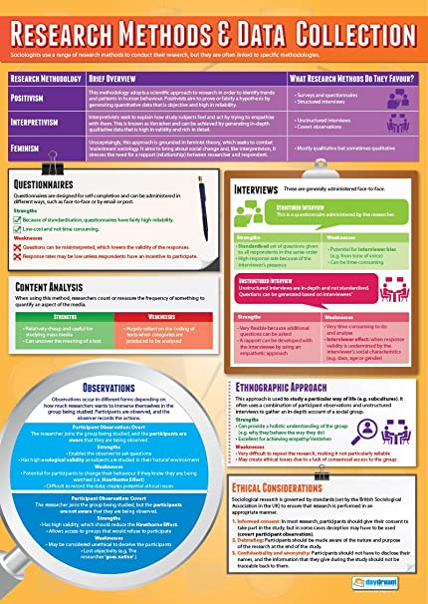
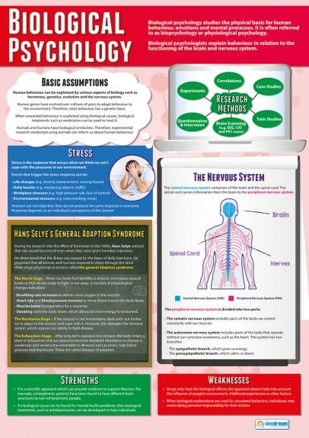
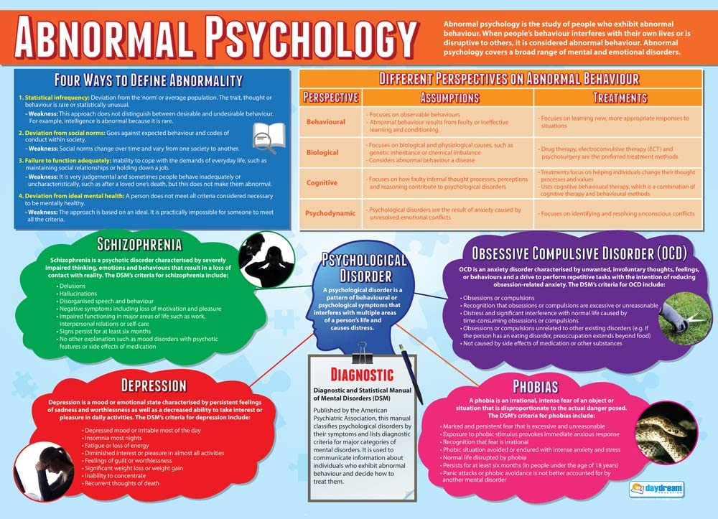
(2) Crash Course Psychology
Select at least three of the videos in the playlist that most interest you (you are always encouraged to watch more!)
Produce a creative and informative poster on each of the videos you selected. This must include:
An overview of the topic i.e. what you learned.
Key terminology for the topic
Pictures should be used to make your poster engaging and easy to understand.

Slide 15
(3) Three identical strangers documentary
Answer the following questions regarding the documentary:
Describe what happened to the triplets and how their upbringing differed.
Define the nature vs nurture debate and explain how can it be applied to the story of the triplets.
Twins are often used in psychological research to determine whether we are born a particular way (due to our genes) or whether our behaviour is caused by our environmental experiences. Identify any of the triplets’ behaviour that was due to their genetics (nature) and any of their behaviour that was due to their environments (nurture).
All three were adopted through the Louise Wise Services Adoption Agency. Describe the circumstances of their adoption and what ethical implications there are from this.
Nature | Nurture

Slide 16
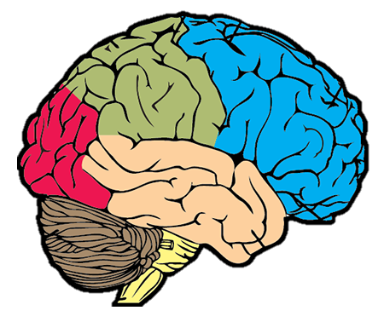
(4) The Virtual Koshland Science Museum
Use the interactive brain model on the Virtual Koshland science Museum’s website to fill in the diagram below:
Name of lobe:
Function:
Consequence if damaged:
Name of lobe:
Function:
Consequence if damaged:
Name of lobe:
Function:
Consequence if damaged:
Name of lobe:
Function:
Consequence if damaged:
Name of structure:
Function:
Consequence if damaged:

Slide 17
(5) Starting with Psychology / The Open University
To evidence your completion of the course(s) you must:
Write down notes
Take a picture of your statement of participation certificate that you gain on completion.

Slide 18
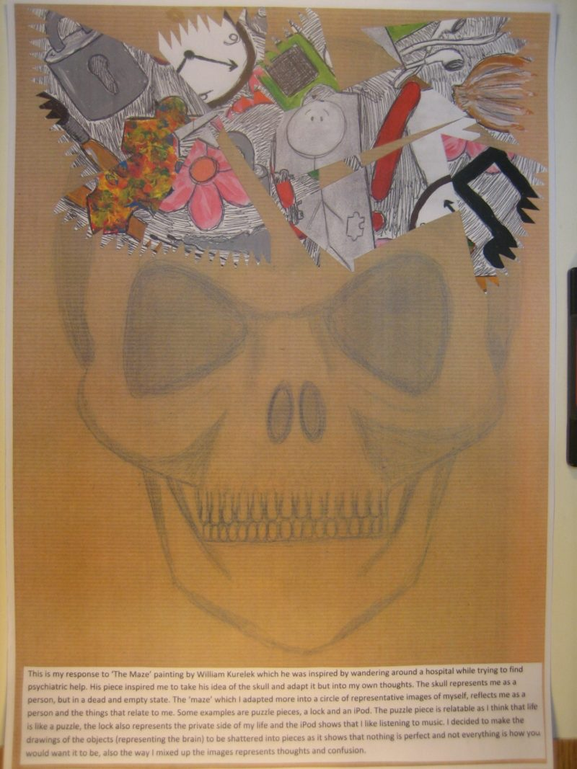
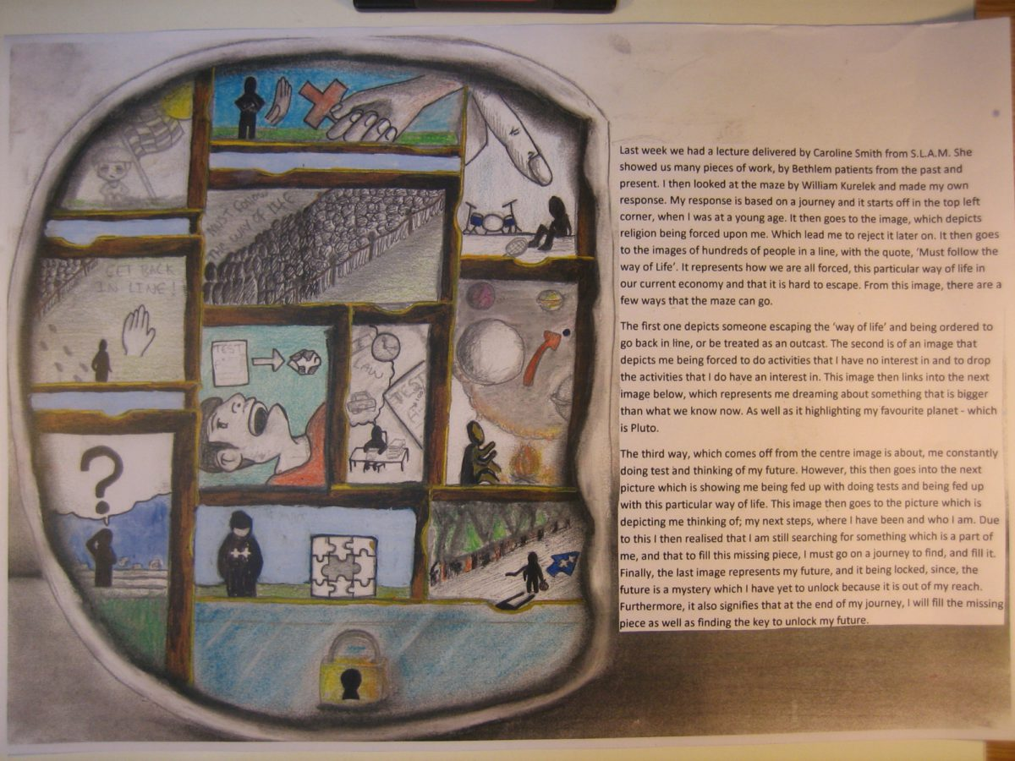
(6) Bethlehem Museum of the mind
It may be difficult to visit the Bethlehem Museum of the mind in person. However, you can look at some of the art work online. Follow the link below to read about William Kurelek’s autobiographical painting ‘The Maze’ which was painted when he was 26 and a patient at Bethlem’s sister hospital The Maudsley:
https://museumofthemind.org.uk/learning/the-maze
Once you had analysed the meaning behind the art, use it as inspiration to create your own piece of art representing your life. You must also write a summary of the meaning behind your art. Below are some examples of students’ work inspired by The Maze. You can read about the meaning behind them by clicking the images.

Slide 19
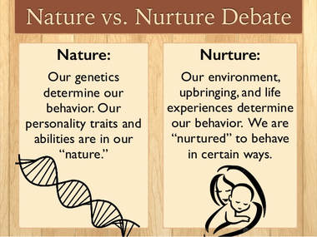
(7) Are criminals born or made?
Research and produce an essay on the following question: ‘Are criminals born or made?’
You must weigh up the arguments from the nature perspective (that argues criminality is caused by genetics, brain abnormalities etc) as well as the nurture perspective (that argues criminality is caused by environmental experiences e.g. a history of abuse) and come to a conclusion.
You should use examples of famous criminals (e.g. Ted Bundy) to support your discussion.
You could use research evidence to support either side of the debate.
Some links to help your research on this topic:
https://www.youtube.com/watch?v=u2V0vOFexY4
https://www.bbc.co.uk/news/magazine-31714853
https://www.independent.co.uk/news/uk/do-your-genes-make-you-a-criminal-1572714.html
http://www.laurahamlett.com/blog/ted-bundy-nature-vs-nurture/
https://www.youtube.com/watch?v=MJ7Zl4j911Q

Slide 20
(8) Presentation on a psychological approach
An approach is a perspective (i.e., view) that involves certain assumptions (i.e., beliefs) about human behavior: how it should be explained, which aspects of behaviour are important to study, and what research methods are appropriate for undertaking this study.
1) Research one of the following approaches in Psychology:
The Psychodynamic approach
The behaviourist approach
The humanistic approach
The cognitive approach
Social learning theory
The biological approach
2) Create an information sheet/powerpoint presentation on your approach. You must have a separate slide dedicated to each of the following points:
The main assumptions of the approach
The key concepts of the approach
The research methods used by the approach
The contributions of the approach
The strength and limitations of the approach

