Slide 1


Exam Preparation Theory Workbook
Name: ……………………………………………..
> Please keep this as a revision resource for the exam <
A LEVEL
Materials, Comparing Material Properties and their Suitability

Slide 2
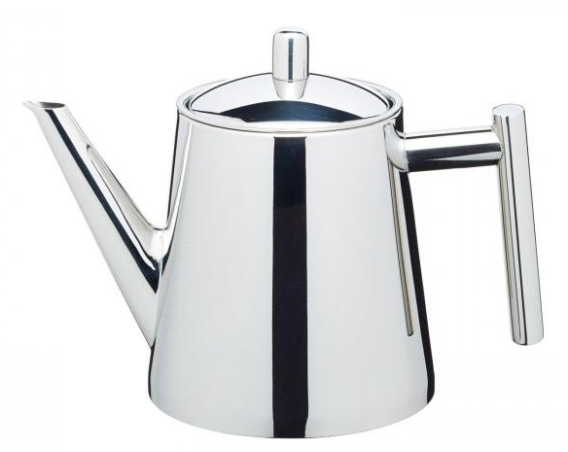
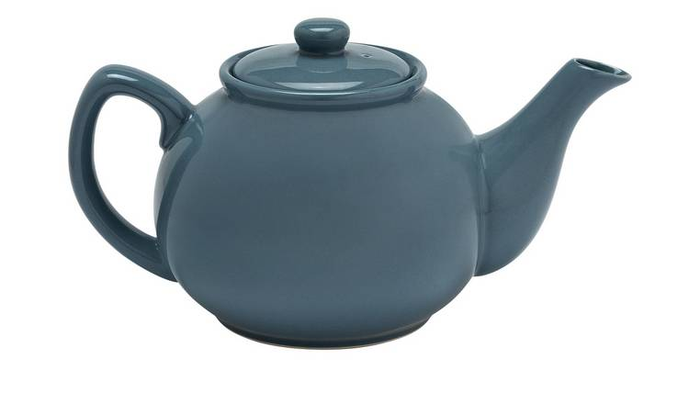
Exam Style Practice Question on Materials, Comparing Material Properties and their Suitability
Question 1
Figure 1 and Figure 2 show two teapots.
1 For each teapot, compare the materials used and their suitability.
Figure 1: Metal Teapot (Stainless Steel)
Figure 2: Ceramic Teapot
( 8 marks)

Slide 3
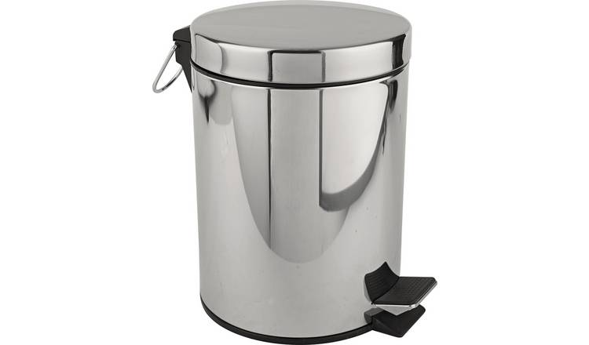
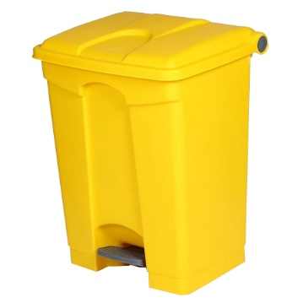
Exam Style Practice Question on Materials, Comparing Material Properties and their Suitability
Question 2
Figure 1 and Figure 2 show two pedal bins.
1 For each bin, compare the materials used and their suitability.
Figure 1: Metal Pedal Bin (Stainless Steel)
Figure 2: Plastic Pedal Bin (Polypropylene)
( 8 marks)

Slide 4
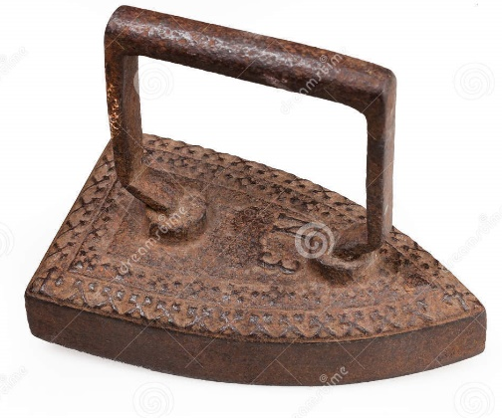
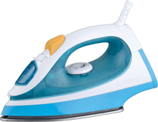
Exam Style Practice Question on Materials, Comparing Material Properties and their Suitability
Question 2
Two irons are shown below:
2 Two irons are shown in Figures 1 and 2. Discuss the technological; developments that have allowed the evolution of the product.
Figure 1:
Figure 2:
( 9 marks)

Slide 5
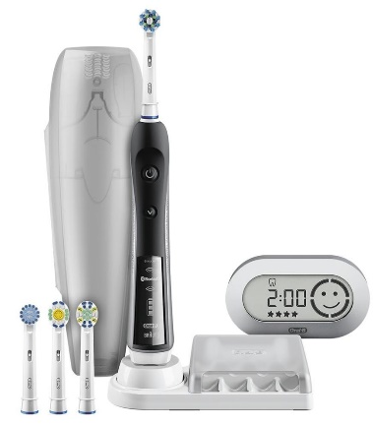
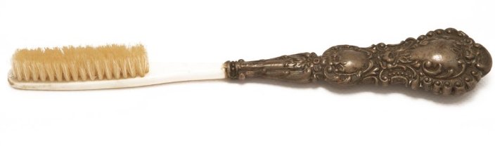
Exam Style Practice Question on Materials, Comparing Material Properties and their Suitability
Question 2
Figure 2:
Two toothbrushes are shown below:
2 Two toothbrushes are shown in Figures 1 and 2. Discuss the technological; developments that have allowed the evolution of the product.
Figure 1:
( 9 marks)

