Slide 1


Exam Preparation Theory Workbook
Name: ……………………………………………..
> Please keep this as a revision resource for the exam <
A LEVEL
Materials, Material Properties and Manufacturing Techniques

Slide 2

Exam Style Practice Question on Product Analysis, Materials, Processes and Finishes
Question 6
Study the photograph of the product right:
6 (a) (i) Name a specific material for this product.
……………………………………………………………………………………………………
6 (a) (ii) Explain in detail why this materials is suitable for the product in Figure 1.
6 (a) (iii) Use notes and diagrams to describe the process used to manufacture this product.
Exam Tip:
Be specific with your material. Justify the suitability of a material by referring to its specific properties. Make sure the process diagrams are drawn clearly, labelled fully and accurately, you have explained what is happening at each stage. Also for top marks make sure any moulds or formers look like the shape of the product.
Figure 1: Plastic Drinks Bottle
(1 mark)
(6 marks)
Page 1 of 2

Slide 3
Exam Style Practice Question on Product Analysis, Materials, Processes and Finishes
(10 marks)
6 (a) (iv) Identify a suitable finishing process for this product (if required).
……………………………………………………………………………………………………………………………………..
(1 mark)
Page 2 of 2

Slide 4
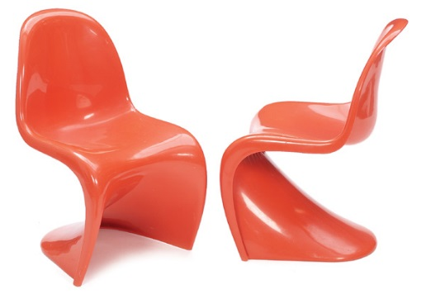
Exam Style Practice Question on Product Analysis, Materials, Processes and Finishes
Question 6
Study the photograph of the product right:
6 (a) (i) Name a specific material for this product.
……………………………………………………………………………………………………
6 (a) (ii) Explain in detail why this materials is suitable for the product in Figure 1.
6 (a) (iii) Use notes and diagrams to describe the process used to manufacture this product.
Exam Tip:
Be specific with your material. Justify the suitability of a material by referring to its specific properties. Make sure the process diagrams are drawn clearly, labelled fully and accurately, you have explained what is happening at each stage. Also for top marks make sure any moulds or formers look like the shape of the product.
  Figure 1: Plastic Chair
(1 mark)
(6 marks)
Page 1 of 2

Slide 5
Exam Style Practice Question on Product Analysis, Materials, Processes and Finishes
(10 marks)
6 (a) (iv) Identify a suitable finishing process for this product (if required).
……………………………………………………………………………………………………………………………………..
(1 mark)
Page 2 of 2

Slide 6
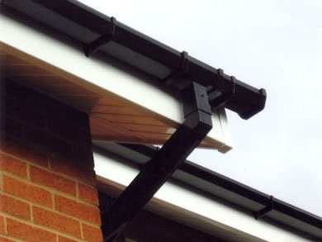
Exam Style Practice Question on Product Analysis, Materials, Processes and Finishes
Question 6
Study the photograph of the product right:
6 (a) (i) Name a specific material for this product.
……………………………………………………………………………………………………
6 (a) (ii) Explain in detail why this materials is suitable for the product in Figure 1.
6 (a) (iii) Use notes and diagrams to describe the process used to manufacture this product.
Exam Tip:
Be specific with your material. Justify the suitability of a material by referring to its specific properties. Make sure the process diagrams are drawn clearly, labelled fully and accurately, you have explained what is happening at each stage. Also for top marks make sure any moulds or formers look like the shape of the product.
Figure 1: Plastic Guttering
(1 mark)
(6 marks)
Page 1 of 2

Slide 7
Exam Style Practice Question on Product Analysis, Materials, Processes and Finishes
(10 marks)
6 (a) (iv) Identify a suitable finishing process for this product (if required).
……………………………………………………………………………………………………………………………………..
(1 mark)
Page 2 of 2

Slide 8
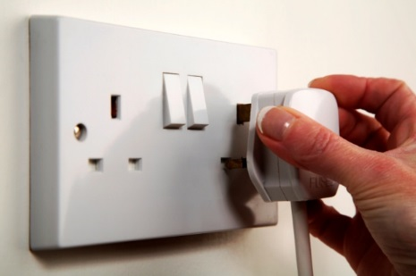
Exam Style Practice Question on Product Analysis, Materials, Processes and Finishes
Question 6
Study the photograph of the product right:
6 (a) (i) Name a specific material for this product.
……………………………………………………………………………………………………
6 (a) (ii) Explain in detail why this materials is suitable for the product in Figure 1.
6 (a) (iii) Use notes and diagrams to describe the process used to manufacture this product.
Exam Tip:
Be specific with your material. Justify the suitability of a material by referring to its specific properties. Make sure the process diagrams are drawn clearly, labelled fully and accurately, you have explained what is happening at each stage. Also for top marks make sure any moulds or formers look like the shape of the product.
  Figure 1: Plastic Plug Socket
(1 mark)
(6 marks)
Page 1 of 2

Slide 9
Exam Style Practice Question on Product Analysis, Materials, Processes and Finishes
(10 marks)
6 (a) (iv) Identify a suitable finishing process for this product (if required).
……………………………………………………………………………………………………………………………………..
(1 mark)
Page 2 of 2

Slide 10

Exam Style Practice Question on Product Analysis, Materials, Processes and Finishes
Question 6
Study the photograph of the product right:
6 (a) (i) Name a specific material for this product.
……………………………………………………………………………………………………
6 (a) (ii) Explain in detail why this materials is suitable for the product in Figure 1.
6 (a) (iii) Use notes and diagrams to describe the process used to manufacture this product.
Exam Tip:
Be specific with your material. Justify the suitability of a material by referring to its specific properties. Make sure the process diagrams are drawn clearly, labelled fully and accurately, you have explained what is happening at each stage. Also for top marks make sure any moulds or formers look like the shape of the product.
Figure 1: Plastic Bag
(1 mark)
(6 marks)
Page 1 of 2

Slide 11
Exam Style Practice Question on Product Analysis, Materials, Processes and Finishes
(10 marks)
6 (a) (iv) Identify a suitable finishing process for this product (if required).
……………………………………………………………………………………………………………………………………..
(1 mark)
Page 2 of 2

Slide 12
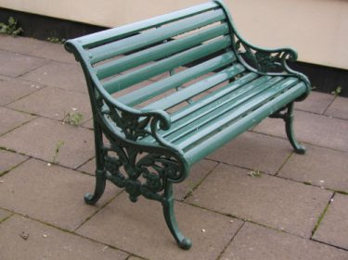
Exam Style Practice Question on Product Analysis, Materials, Processes and Finishes
Question 6
Study the photograph of the product right:
6 (a) (i) Name a specific material for this product.
……………………………………………………………………………………………………
6 (a) (ii) Explain in detail why this materials is suitable for the product in Figure 1.
6 (a) (iii) Use notes and diagrams to describe the process used to manufacture this product.
Exam Tip:
Be specific with your material. Justify the suitability of a material by referring to its specific properties. Make sure the process diagrams are drawn clearly, labelled fully and accurately, you have explained what is happening at each stage. Also for top marks make sure any moulds or formers look like the shape of the product.
Figure 1: Metal park bench
(1 mark)
(6 marks)
Page 1 of 2

Slide 13
Exam Style Practice Question on Product Analysis, Materials, Processes and Finishes
(10 marks)
6 (a) (iv) Identify a suitable finishing process for this product (if required).
……………………………………………………………………………………………………………………………………..
(1 mark)
Page 2 of 2

Slide 14

Exam Style Practice Question on Product Analysis, Materials, Processes and Finishes
Question 6
Study the photograph of the product right:
6 (a) (i) Name a specific material for this product.
……………………………………………………………………………………………………
6 (a) (ii) Explain in detail why this materials is suitable for the product in Figure 1.
6 (a) (iii) Use notes and diagrams to describe the process used to manufacture this product.
Exam Tip:
Be specific with your material. Justify the suitability of a material by referring to its specific properties. Make sure the process diagrams are drawn clearly, labelled fully and accurately, you have explained what is happening at each stage. Also for top marks make sure any moulds or formers look like the shape of the product.
Figure 1: Metal Coffee Maker
(1 mark)
(6 marks)
Page 1 of 2

Slide 15
Exam Style Practice Question on Product Analysis, Materials, Processes and Finishes
(10 marks)
6 (a) (iv) Identify a suitable finishing process for this product (if required).
……………………………………………………………………………………………………………………………………..
(1 mark)
Page 2 of 2

Slide 16
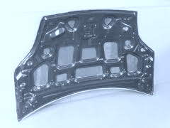
Exam Style Practice Question on Product Analysis, Materials, Processes and Finishes
Question 6
Study the photograph of the product right:
6 (a) (i) Name a specific material for this product.
……………………………………………………………………………………………………
6 (a) (ii) Explain in detail why this materials is suitable for the product in Figure 1.
6 (a) (iii) Use notes and diagrams to describe the process used to manufacture this product.
Exam Tip:
Be specific with your material. Justify the suitability of a material by referring to its specific properties. Make sure the process diagrams are drawn clearly, labelled fully and accurately, you have explained what is happening at each stage. Also for top marks make sure any moulds or formers look like the shape of the product.
Figure 1: Metal Car Bonnet
(1 mark)
(6 marks)
Page 1 of 2

Slide 17
Exam Style Practice Question on Product Analysis, Materials, Processes and Finishes
(10 marks)
6 (a) (iv) Identify a suitable finishing process for this product (if required).
……………………………………………………………………………………………………………………………………..
(1 mark)
Page 2 of 2

Slide 18
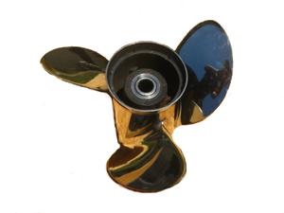
Exam Style Practice Question on Product Analysis, Materials, Processes and Finishes
Question 6
Study the photograph of the product right:
6 (a) (i) Name a specific material for this product.
……………………………………………………………………………………………………
6 (a) (ii) Explain in detail why this materials is suitable for the product in Figure 1.
6 (a) (iii) Use notes and diagrams to describe the process used to manufacture this product.
Exam Tip:
Be specific with your material. Justify the suitability of a material by referring to its specific properties. Make sure the process diagrams are drawn clearly, labelled fully and accurately, you have explained what is happening at each stage. Also for top marks make sure any moulds or formers look like the shape of the product.
  Figure 1: Metal Boat Propeller
(1 mark)
(6 marks)
Page 1 of 2

Slide 19
Exam Style Practice Question on Product Analysis, Materials, Processes and Finishes
(10 marks)
6 (a) (iv) Identify a suitable finishing process for this product (if required).
……………………………………………………………………………………………………………………………………..
(1 mark)
Page 2 of 2

Slide 20
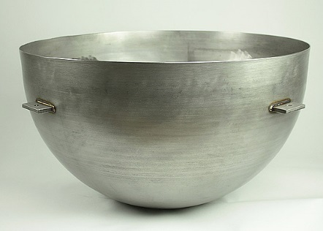
Exam Style Practice Question on Product Analysis, Materials, Processes and Finishes
Question 6
Study the photograph of the product right:
6 (a) (i) Name a specific material for this product.
……………………………………………………………………………………………………
6 (a) (ii) Explain in detail why this materials is suitable for the product in Figure 1.
6 (a) (iii) Use notes and diagrams to describe the process used to manufacture this product.
Exam Tip:
Be specific with your material. Justify the suitability of a material by referring to its specific properties. Make sure the process diagrams are drawn clearly, labelled fully and accurately, you have explained what is happening at each stage. Also for top marks make sure any moulds or formers look like the shape of the product.
Figure 1: Metal Bowl
(1 mark)
(6 marks)
Page 1 of 2

Slide 21
Exam Style Practice Question on Product Analysis, Materials, Processes and Finishes
(10 marks)
6 (a) (iv) Identify a suitable finishing process for this product (if required).
……………………………………………………………………………………………………………………………………..
(1 mark)
Page 2 of 2

Slide 22
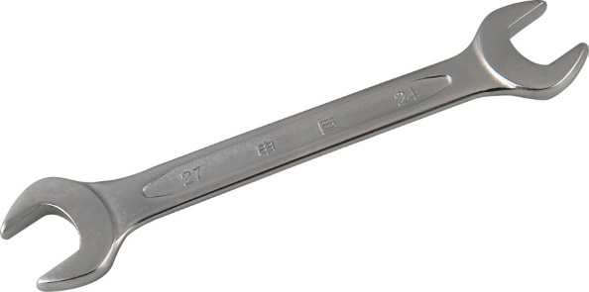
Exam Style Practice Question on Product Analysis, Materials, Processes and Finishes
Question 6
Study the photograph of the product right:
6 (a) (i) Name a specific material for this product.
……………………………………………………………………………………………………
6 (a) (ii) Explain in detail why this materials is suitable for the product in Figure 1.
6 (a) (iii) Use notes and diagrams to describe the process used to manufacture this product.
Exam Tip:
Be specific with your material. Justify the suitability of a material by referring to its specific properties. Make sure the process diagrams are drawn clearly, labelled fully and accurately, you have explained what is happening at each stage. Also for top marks make sure any moulds or formers look like the shape of the product.
  Figure 1: Metal Spanner
(1 mark)
(6 marks)
Page 1 of 2

Slide 23
Exam Style Practice Question on Product Analysis, Materials, Processes and Finishes
(10 marks)
6 (a) (iv) Identify a suitable finishing process for this product (if required).
……………………………………………………………………………………………………………………………………..
(1 mark)
Page 2 of 2

Slide 24
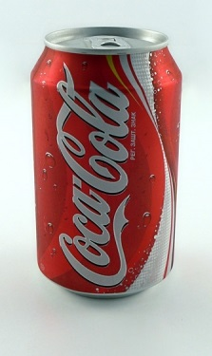
Exam Style Practice Question on Product Analysis, Materials, Processes and Finishes
Question 6
Study the photograph of the product right:
6 (a) (i) Name a specific material for this product.
……………………………………………………………………………………………………
6 (a) (ii) Explain in detail why this materials is suitable for the product in Figure 1.
6 (a) (iii) Use notes and diagrams to describe the process used to manufacture this product.
Exam Tip:
Be specific with your material. Justify the suitability of a material by referring to its specific properties. Make sure the process diagrams are drawn clearly, labelled fully and accurately, you have explained what is happening at each stage. Also for top marks make sure any moulds or formers look like the shape of the product.
  Figure 1: Metal Drinks Can
(1 mark)
(6 marks)
Page 1 of 2

Slide 25
Exam Style Practice Question on Product Analysis, Materials, Processes and Finishes
(10 marks)
6 (a) (iv) Identify a suitable finishing process for this product (if required).
……………………………………………………………………………………………………………………………………..
(1 mark)
Page 2 of 2

Slide 26
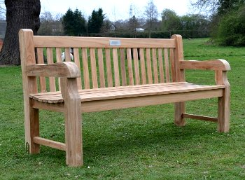
Exam Style Practice Question on Product Analysis, Materials, Processes and Finishes
Question 6
Study the photograph of the product right:
6 (a) (i) Name a specific material for this product.
……………………………………………………………………………………………………
6 (a) (ii) Explain in detail why this materials is suitable for the product in Figure 1.
6 (a) (iii) Use notes and diagrams to describe the process used to manufacture this product.
Exam Tip:
Be specific with your material. Justify the suitability of a material by referring to its specific properties. Make sure the process diagrams are drawn clearly, labelled fully and accurately, you have explained what is happening at each stage. Also for top marks make sure any moulds or formers look like the shape of the product.
  Figure 1: Wooden park bench
(1 mark)
(6 marks)
Page 1 of 2

Slide 27
Exam Style Practice Question on Product Analysis, Materials, Processes and Finishes
(10 marks)
6 (a) (iv) Identify a suitable finishing process for this product (if required).
……………………………………………………………………………………………………………………………………..
(1 mark)
Page 2 of 2

Slide 28
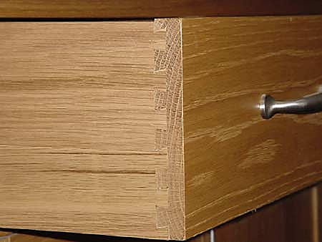
Exam Style Practice Question on Product Analysis, Materials, Processes and Finishes
Question 6
Study the photograph of the product right:
6 (a) (i) Name a specific material for this product.
……………………………………………………………………………………………………
6 (a) (ii) Explain in detail why this materials is suitable for the product in Figure 1.
6 (a) (iii) Use notes and diagrams to describe the process used to manufacture this product.
Exam Tip:
Be specific with your material. Justify the suitability of a material by referring to its specific properties. Make sure the process diagrams are drawn clearly, labelled fully and accurately, you have explained what is happening at each stage. Also for top marks make sure any moulds or formers look like the shape of the product.
Figure 1: Wooden Chest of Drawers (Draw)
(1 mark)
(6 marks)
Page 1 of 2

Slide 29
Exam Style Practice Question on Product Analysis, Materials, Processes and Finishes
(10 marks)
6 (a) (iv) Identify a suitable finishing process for this product (if required).
……………………………………………………………………………………………………………………………………..
(1 mark)
Page 2 of 2

Slide 30
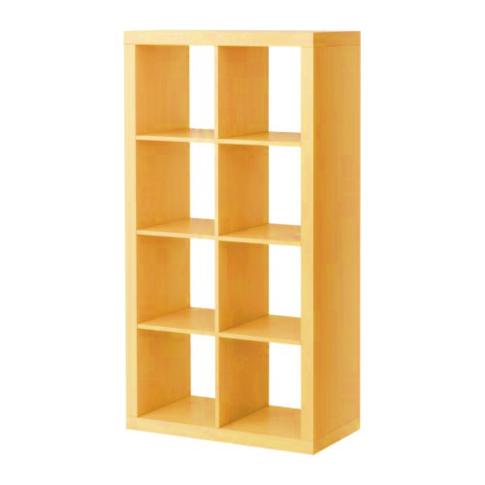
Exam Style Practice Question on Product Analysis, Materials, Processes and Finishes
Question 6
Study the photograph of the product right:
6 (a) (i) Name a specific material for this product.
……………………………………………………………………………………………………
6 (a) (ii) Explain in detail why this materials is suitable for the product in Figure 1.
6 (a) (iii) Use notes and diagrams to describe the process used to manufacture this product.
Exam Tip:
Be specific with your material. Justify the suitability of a material by referring to its specific properties. Make sure the process diagrams are drawn clearly, labelled fully and accurately, you have explained what is happening at each stage. Also for top marks make sure any moulds or formers look like the shape of the product.
Figure 1: Self Assembly Bookcase
(1 mark)
(6 marks)
Page 1 of 2

Slide 31
Exam Style Practice Question on Product Analysis, Materials, Processes and Finishes
(10 marks)
6 (a) (iv) Identify a suitable finishing process for this product (if required).
……………………………………………………………………………………………………………………………………..
(1 mark)
Page 2 of 2

Slide 32

Exam Style Practice Question on Product Analysis, Materials, Processes and Finishes
Question 6
Study the photograph of the product right:
6 (a) (i) Name a specific material for this product.
……………………………………………………………………………………………………
6 (a) (ii) Explain in detail why this materials is suitable for the product in Figure 1.
6 (a) (iii) Use notes and diagrams to describe the process used to manufacture this product.
Exam Tip:
Be specific with your material. Justify the suitability of a material by referring to its specific properties. Make sure the process diagrams are drawn clearly, labelled fully and accurately, you have explained what is happening at each stage. Also for top marks make sure any moulds or formers look like the shape of the product.
  Figure 1: Composite Canoe Hull
(1 mark)
(6 marks)
Page 1 of 2

Slide 33
Exam Style Practice Question on Product Analysis, Materials, Processes and Finishes
(10 marks)
6 (a) (iv) Identify a suitable finishing process for this product (if required).
……………………………………………………………………………………………………………………………………..
(1 mark)
Page 2 of 2

Slide 34
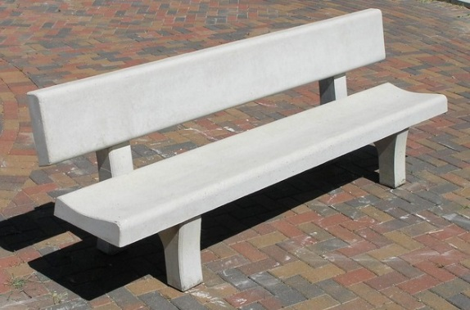
Exam Style Practice Question on Product Analysis, Materials, Processes and Finishes
Question 6
Study the photograph of the product right:
6 (a) (i) Name a specific material for this product.
……………………………………………………………………………………………………
6 (a) (ii) Explain in detail why this materials is suitable for the product in Figure 1.
6 (a) (iii) Use notes and diagrams to describe the process used to manufacture this product.
Exam Tip:
Be specific with your material. Justify the suitability of a material by referring to its specific properties. Make sure the process diagrams are drawn clearly, labelled fully and accurately, you have explained what is happening at each stage. Also for top marks make sure any moulds or formers look like the shape of the product.
Figure 1: Ceramic Bench
(1 mark)
(6 marks)
Page 1 of 2

Slide 35
Exam Style Practice Question on Product Analysis, Materials, Processes and Finishes
(10 marks)
6 (a) (iv) Identify a suitable finishing process for this product (if required).
……………………………………………………………………………………………………………………………………..
(1 mark)
Page 2 of 2

Slide 36
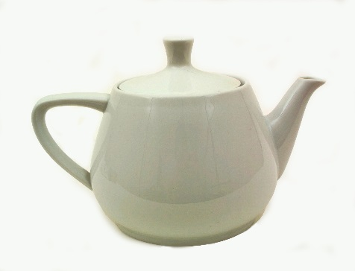
Exam Style Practice Question on Product Analysis, Materials, Processes and Finishes
Question 6
Study the photograph of the product right:
6 (a) (i) Name a specific material for this product.
……………………………………………………………………………………………………
6 (a) (ii) Explain in detail why this materials is suitable for the product in Figure 1.
6 (a) (iii) Use notes and diagrams to describe the process used to manufacture this product.
Exam Tip:
Be specific with your material. Justify the suitability of a material by referring to its specific properties. Make sure the process diagrams are drawn clearly, labelled fully and accurately, you have explained what is happening at each stage. Also for top marks make sure any moulds or formers look like the shape of the product.
  Figure 1: Ceramic Tea Pot
(1 mark)
(6 marks)
Page 1 of 2

Slide 37
Exam Style Practice Question on Product Analysis, Materials, Processes and Finishes
(10 marks)
6 (a) (iv) Identify a suitable finishing process for this product (if required).
……………………………………………………………………………………………………………………………………..
(1 mark)
Page 2 of 2

Slide 38
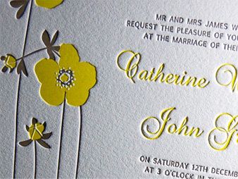
Exam Style Practice Question on Product Analysis, Materials, Processes and Finishes
Question 6
Study the photograph of the product right:
6 (a) (i) Name a specific material for this product.
……………………………………………………………………………………………………
6 (a) (ii) Explain in detail why this materials is suitable for the product in Figure 1.
6 (a) (iii) Use notes and diagrams to describe the process used to manufacture this product.
Exam Tip:
Be specific with your material. Justify the suitability of a material by referring to its specific properties. Make sure the process diagrams are drawn clearly, labelled fully and accurately, you have explained what is happening at each stage. Also for top marks make sure any moulds or formers look like the shape of the product.
Figure 1: Printed Invitation
(1 mark)
(6 marks)
Page 1 of 2

Slide 39
Exam Style Practice Question on Product Analysis, Materials, Processes and Finishes
(10 marks)
6 (a) (iv) Identify a suitable finishing process for this product (if required).
……………………………………………………………………………………………………………………………………..
(1 mark)
Page 2 of 2

Slide 40

Exam Style Practice Question on Product Analysis, Materials, Processes and Finishes
Question 6
Study the photograph of the product right:
6 (a) (i) Name a specific material for this product.
……………………………………………………………………………………………………
6 (a) (ii) Explain in detail why this materials is suitable for the product in Figure 1.
6 (a) (iii) Use notes and diagrams to describe the process used to manufacture this product.
Exam Tip:
Be specific with your material. Justify the suitability of a material by referring to its specific properties. Make sure the process diagrams are drawn clearly, labelled fully and accurately, you have explained what is happening at each stage. Also for top marks make sure any moulds or formers look like the shape of the product.
Figure 1: High Gloss Printed Magazine
(1 mark)
(6 marks)
Page 1 of 2

Slide 41
Exam Style Practice Question on Product Analysis, Materials, Processes and Finishes
(10 marks)
6 (a) (iv) Identify a suitable finishing process for this product (if required).
……………………………………………………………………………………………………………………………………..
(1 mark)
Page 2 of 2

