Slide 1
Applied Business Taster Session
Contents
Breakdown of the course
Skills you will develop
Insight into the content which will be studied on this course
Transition tasks and expectations
DO NOW:
What do you hope to learn from studying Applied Business this year? How do you think this will help you in future?
Notes:
Hello everyone and welcome to today’s session on Retrieval Practise. The aims of this session is to understand how we should structure retrieval practise to maximise long term memory and when we should use retrieval practise.

Slide 2
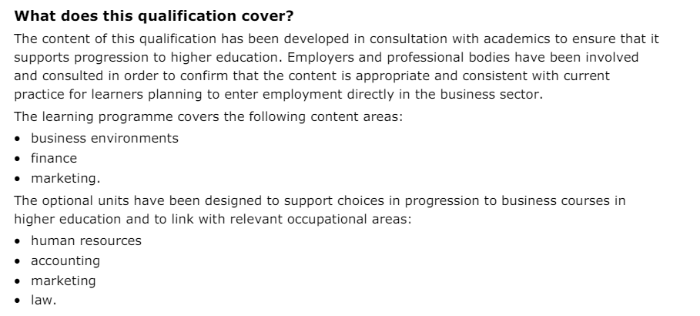
Pearson BTEC Level 3 National Extended Certificate in Business Content

Slide 3
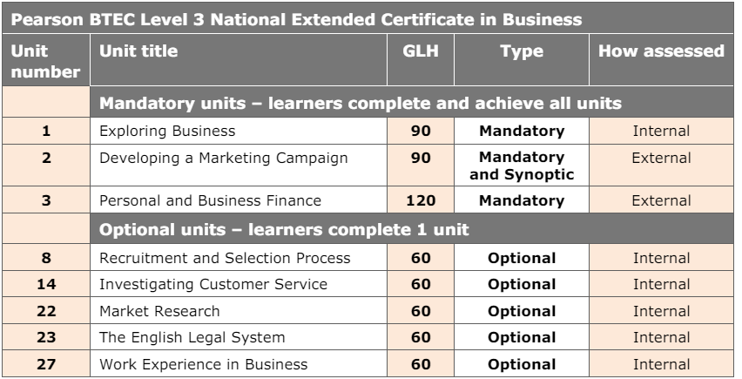
What units will you be studying?

Slide 4
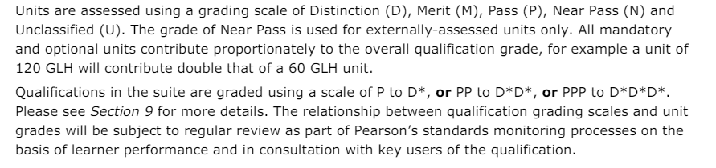
How will you be graded in Applied Business?

Slide 5

Key Skills
Literacy
Mathematics
Knowledge and Understanding
Application
Analysis
Evaluation
Problem-solving
Interpersonal
Intrapersonal

Slide 6
Examples of examination
Unit 3 Personal and Business finance
https://qualifications.pearson.com/content/dam/pdf/BTEC-Nationals/Business/2016/External-assessments/31463H_Unit_3_Jan_2021.pdf

Slide 7
Task 1- The biscuit challenge
Design and market a brand-new premium biscuit for Lord Sugar.
Decide on what type of biscuit you will be producing and prepare a range of promotional materials that you can use to market your biscuit to potential customers or investors. You may want to include...
Name / Logo
Prototype packaging
Posters
TV / Radio / Social Media advertising
Be creative with this task, if you want to be the Apprentice you need to stand out from the crowd!

Slide 8
Task 2
Business Idea 1:​
Why do you think this product will sell?​
What makes it unique?​
Who will you be selling it to (Be Specific)?
What: Brainstorm 3 business ideas
How: Independently
How long: 6 minutes
Business Idea 2:​
Why do you think this product will sell?​
What makes it unique?​
Who will you be selling it to (Be Specific)?
Business Idea 3:​
Why do you think this product will sell?​
What makes it unique?​
Who will you be selling it to (Be Specific)?

Slide 9
What: Pitch your ideas to your group members, then as a group decide on which of the ideas has the most potential, why did you reject the other ideas?
How: In groups
How long: 5 minutes
Now…
Pick a leader, who will be overlooking the marketing activities of the business.
Decide how you will promote your business online/in person.
You must create marketing materials to represent and promote your chosen business.
Each group should have at least 2 different promotion materials.

Slide 10
Activity 1
Research Amazon and answer the following questions with your partner:
Does Amazon perform better than its competition and what measure do you use to determine this?
How does Amazon do things that makes it more successful than its competitors?
Will Amazon continue to be as successful over the next 10 years? Why/why not?

Slide 11
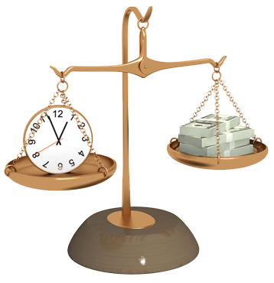


What have we learnt from this activity?

Slide 12

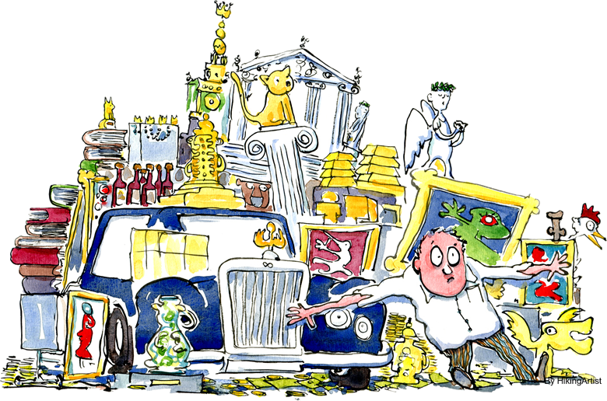
Competition
Businesses all have competitors
All trying to serve a finite population
So…
They must compete with each other
and so…
They make business decisions
They try to outperform their competition by some measure
In Business we study this as Competition

Slide 13
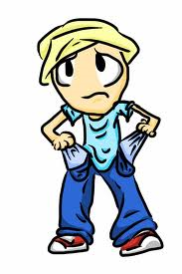
Making Choices
Every time you make a purchase, a business has convinced you to use their product over a competitors.
We will study how businesses can do this.

Slide 14

Competition
How did Applied Business out compete other subjects to persuade you to study it?

Slide 15
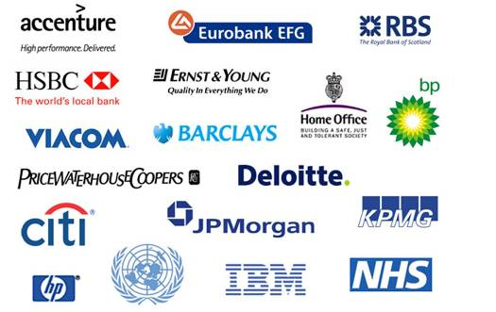
Applied Business
Is about understanding how businesses operate and why the operate the way they do, from established businesses due to small businesses and start ups.

Slide 16
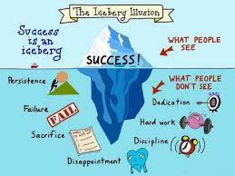
Expectations
Alongside the other 6th form expectations, in Applied Business we expect you to
Be prepared to be assessed regularly
Meet regular coursework deadlines
Have a folder with dividers to maintain organisation of notes, homework, and assessments

Slide 17
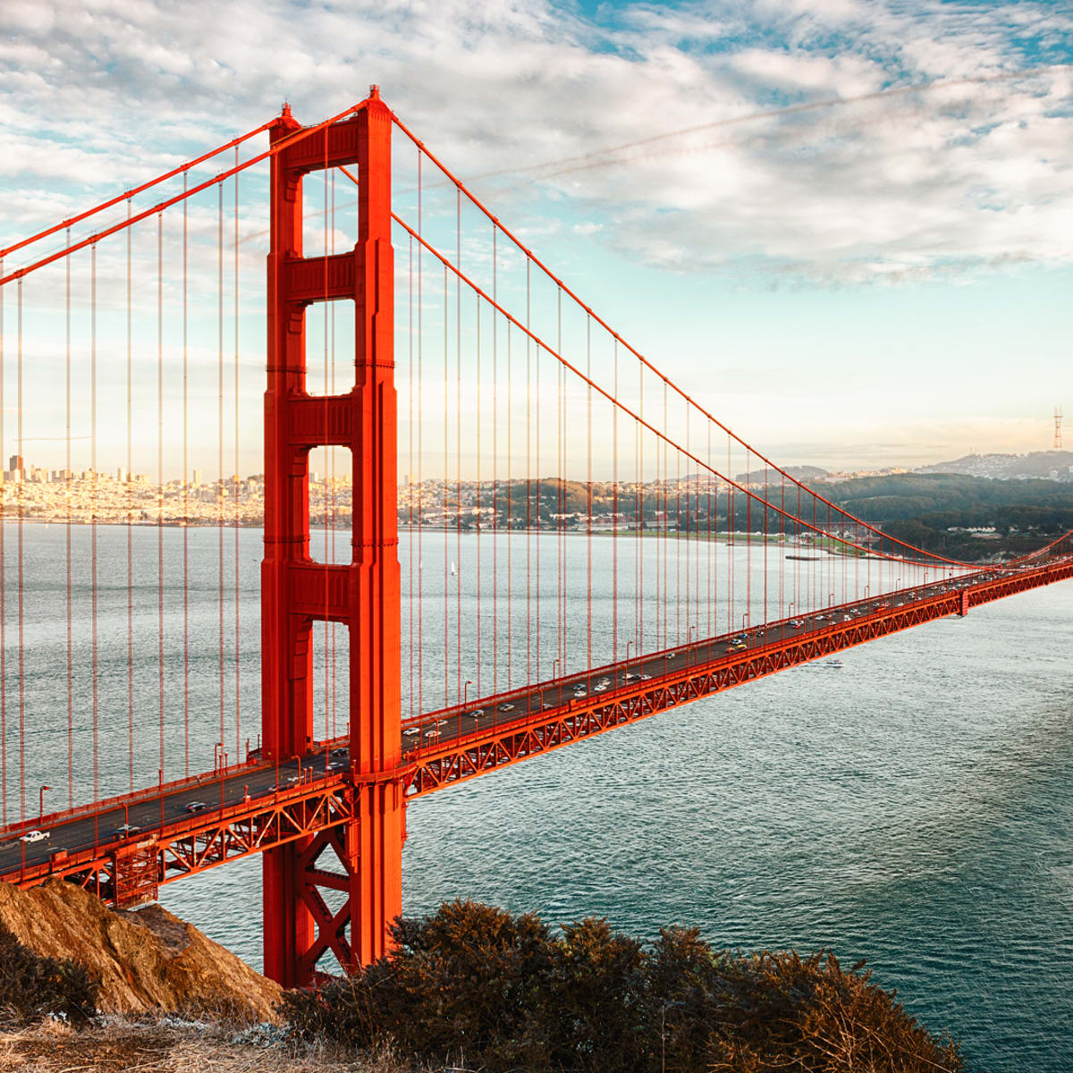


Applied Business Bridging Menu
You are about to start an exciting journey into the world of Business, good luck!
Remember
Choose what modules you do and when, but work through them consistently. Different tasks will take you varying amounts of time, but on average you should aim to do one or two per week.
All green tasks are core modules, they are compulsory and must be completed and uploaded onto your application by 19 August.
The red hot chili indicates that the task is more challenging than the others
Numbers eg (1) correspond to how you should evidence the module which can be found in the slides following the menu. They can be saved within this powerpoint or as separate documents clearly labelled with the subject

Slide 18





Applied Business Bridging Menu (Green modules are core (compulsory) modules , indicates the most challenging modules )
 | Read | Watch | Listen | Visit (virtually or physically at a later date) | Do
 | Shoe Dog: A Memoir by the creator of Nike For the first time, Phil Knight, the man behind the swoosh, tells his story. He begins with his crossroads moment when at 24 he decided to start his own business. He details the many risks and daunting setbacks that stood between him and his dream - along with his early triumphs. (1) | Becoming Warren Buffett Documentary about how legendary investor Warren Buffet starts out as an ambitious, numbers-obsessed boy from Nebraska, and ends up becoming one of the richest and most respected men in the world. (1) | The Disruptive Entrepreneur: Marc Randolph - CEO of Netflix, Co-Founder & Serial Entrepreneur (1) | Westfield Shopping Centre Explore the many different retailers and spot the similarities and differences in their marketing mix – Place, Product, Promotion, Price (3) | MOOCs https://www.futurelearn.com/courses/digital-skills-retail Search through the MOOCs on Unifrog using the filter ‘Business’ and chose one that particularly interests you (6)
 | Elon Musk: How the Billionaire CEO of SpaceX and Tesla is Shaping our Future South African-born Elon Musk is the renowned entrepreneur and innovator behind PayPal, SpaceX, Tesla, and SolarCity. Musk wants to save our planet; he wants to send citizens into space, to form a colony on Mars; he wants to make money while doing these things; and he wants us all to know about it. (1) | Erin Brockovich Single mother Erin Brockovich takes on powerhouse pacific gas and electric when she discovers the company is poisoning the city’s water supply. As a result of the largest direct action lawsuit of its kind, spear-headed by Erin and Ed Masry, the utility giant was forced to pay out the largest toxic tort injury settlement in US history: $333 million in damages to more than 600 Hinkley residents. (1)
 |  |  | Mixergy: How a mom of 6 turned handmade hairbows into a $6M business (2) | The Museum of Brands Explore how brands shape – and are shaped by – people, culture and society. Fill in these worksheets as you go along. Worksheet 1 Worksheet 2 (4) | Generic to Brand Get creative and create your own brand name, slogan, logo, and packaging for this generic everyday household item – Milk! (7)
 |  |  |  |  | BBC News Business Explore the Business section on BBC news and summarise at least one article per week (8)
 | Steve Jobs: The Exclusive Biography An extraordinary book which gives us a unique insight into the life and thinking of the man who has single-handedly transformed the way we live today (1) | The Big Short A group of wily opportunists make a fortune off of the U.S economic crash by sniffing out the situation in advance and betting against the banks (1) | UK High Streets in Crisis (1)
 |  |  |  |  | Top Trump Research and write about the features of 3 businesses: Purpose, Sector, Scope of Activities, Size of Business, Aims of Business/Mission Statements/Type of Ownership, Revenue and Profit figures (9)
 |  |  |  | Visit the Bank of England (5)
 | Zero to One: Notes on Start Ups, or How to Build the Future A ground-breaking and thought-provoking book on innovation and what it takes for a new company to prosper (1) | The Founder All about the McDonald’s franchise. See how businessman Ray Kroc made McDonalds into a world wide multi-billion pound company (1) | The Economist: Money Talks – Peak Car? (1)
 |  |  |  | Explore the Unifrog Business Guide including the ‘Geek Out’ sections (1)
 |  |  |  |  | Write a 500 word report on an entrepreneur of your choice. Examples of Entrepreneurs Jeff Bezos Bill Gates Anita Roddick Larry Page Mark Zuckerberg Warren Buffet Elon Musk Try to incorporate as much detail as you can for each bullet point on slide 13 of this presentation (10)
 | Building strong brands Aaker uses real brand-building cases from Saturn, General Electric, Kodak, Healthy Choice, McDonald's, and others to demonstrate how strong brands have been created and managed (1) | TED Talks (1) The single biggest reason why start-ups succeed Where’s Google going next? Why gender-based marketing is bad for business? (1) | BBC 4 Business Podcasts (1) Supply-Chains vs Covid-19 The Business of Clicks Keeping up with the burgers Ryanair – a change of direction?
 |  |  |  | Canary Wharf Explore the secondary central business district of London and the main financial centres of the UK and the world (1)
 | The Everything Store: Jeff Bezos and the Age of Amazon Find out the true story of the global giant Amazon and how it started off in a garage in Seattle simply delivering books through the mail to becoming “the everything store” (1) | Inside Aldi: Britain’s biggest budget supermarket Documentary exploring how the German supermarket has swept the UK, overcoming industry hostility and snobbery with its discount goods. Former staff reveal how Aldi used a host of clever techniques to cut costs, and how their own brand goods look and taste like their big-name counterparts but cost a fraction of the price. (1)
Notes:
https://www.bbc.co.uk/sounds/play/m000gvd3

Slide 19
(1) - Book/Journal/Podcast/Film Review
Would you/would you not recommend it? Why?
Rating:
Review by: ___________________________________________
Title: _______________________________________________________
Author: ____________________________________________________
Review of (please circle)
Book Journal Podcast Film Documentary
What was it about?
What did you find particularly interesting/inspiring/shocking? Has this changed your opinion?
What would you like to learn more about?
How does it link to this subject and why is it important?
Save your answers as part of this powerpoint & copy the template as many times as you need

Slide 20
(2) Mixergy Podcast: Bailey’s Blossom
What is Bailey’s Blossoms Revenue?
What is the name of her sister company?
How much profit is Erin making?
What was Erin's first entrepreneurial experience?
What made Erin start up in the hair clips business?
How much did she sell her hair clips for?
Where did she sell her products?
Why did she first struggle when receiving many orders?
Why did she take a break for 2-3 years from her business?
When she returned back to Texas, what was her new business idea?
Where did she source her materials from?
What other products did she diversify into?
Who was the first person she hired and why?
When asked how she would keep her business growing in a recession, what was her response?
Visit https://www.baileysblossoms.com/pages/about-us to find out more about her business and what she sells
WHAT SKILLS/CHARACTERISTICS ARE NEEDED TO BE A GOOD ENTREPRENUER LIKE ERIN HOOLEY?
You can edit your answers in this powerpoint on the next slide and save on your application clearly labelled with the subject ‘Business’
Notes:
https://mixergy.com/interviews/baileys-blossoms-with-erin-hooley/

Slide 21
(2) Mixergy Podcast: Bailey’s Blossom
What is Bailey’s Blossoms Revenue?
What is the name of her sister company?
How much profit is Erin making?
What was Erin's first entrepreneurial experience?
What made Erin start up in the hair clips business?
How much did she sell her hair clips for?
Where did she sell her products?
Why did she first struggle when receiving many orders?
Why did she take a break for 2-3 years from her business?
When she returned back to Texas, what was her new business idea?
Where did she source her materials from?
What other products did she diversify into?
Who was the first person she hired and why?
When asked how she would keep her business growing in a recession, what was her response?
Visit https://www.baileysblossoms.com/pages/about-us to find out more about her business and what she sells
WHAT SKILLS/CHARACTERISTICS ARE NEEDED TO BE A GOOD ENTREPRENUER LIKE ERIN HOOLEY?
Notes:
https://mixergy.com/interviews/baileys-blossoms-with-erin-hooley/

Slide 22
(3) Visit Westfield Shopping Centre
Save your answers as part of this powerpoint & copy the template as many times as you need.
You can delete the text in each box and insert your findings.
Price
Pricing Strategy
Discounts
Terms and means of payment
Criteria in granting credit
Product
Features
Quality
Branding
Packaging
Warranties/Exchanges and Support Services
Company Name/Logo
Promotion
Sales promotion
Advertising
Public Relations
Place
Physical and Online Channels
Market Coverage
Location
Distribution and transport of goods

Slide 23
(4) Visit the Museum of Brands
111 – 117 Lancaster Road
Notting Hill, W11 1QT
London
Monday to Saturday
10:00 – 18:00
Sunday and Bank Holidays
11:00 – 17:00
Adults - £9
Children - £5
Worksheet 1
Worksheet 2
Take a photo/scan a copy of your completed worksheets and call it “Business studies visit to the Museum of Brands”

Slide 24
(5) Visit the BoE
Choose whether you would like to make a
Podcast
Informative flyer
Mini film
Report
Newspaper article
Save your work on this and call it ‘Business studies visit to the Bank of England’

Slide 25
(6) MOOCs
To evidence this you can
Save any notes you take
Take and save a screenshot of completed modules or the completed course
Save it as part of this powerpoint or if there is a downloadable certificate save as ‘Business Studies MOOC’ on your application

Slide 26

(7) Generic to Brand
Slogan:
Target Market:
Describe or draw the packaging:
Brand Name:
Extra space for ideas to create a strong brand:
Brand Logo:
You can print this slide off to draw on if you like and take a photo of it to upload

Slide 27
Summary of article here
(8) BBC News Article
SCREENSHOT OF ARTICLE HEADLINE
here
Save your answers as part of this powerpoint & copy the template as many times as you need. You may change the size and shape of the boxes above to accommodate for your screenshot

Slide 28

(9) Top Trump Example and Template
Business Logo
Overview of the Business
Apple is global technology company that designs, develops and sells consumer electronics, computer software and online services. They are one of the four biggest companies in the world.
Country of Origin: California, USA
Purpose: Profit Organisation
Sector: Secondary and Tertiary
Scope of Activities: International
Aims of the business/mission statement: To obtain stellar products and services within tight timeframes, at a cost that represents the best possible value to our customers and shareholders
Type of Ownership: Public Limited Company (Inc in USA)
Share Price (where appropriate): $279 for 1 share
Revenue/Profit 2019: $64bn in revenue for Q4 2019
Overview of the Business
Country of Origin:
Purpose:
Sector:
Scope of Activities:
Aims of the organisation/mission statement:
Size of Business: (e.g. employees, number of countries)
Type of Ownership
Share Price (where appropriate):
Revenue/Profit 2019:
Edit your findings into powerpoint & copy the template as many times as you need
Notes:
Please note – Taken from Prendergast School
These features will include:
Purpose (profit or non-profit)
Sector (primary, secondary, tertiary or quaternary)
Scope of activities (local, regional, national, international)
Size of the business (employees, number of countries they operate or sell in)
Aims of the business/mission statement
Type of ownership (sole trader, partnership, private limited company, public limited company, franchise, co-operative, charity, Government department…)
Sales (revenue) figures/profit

Slide 29
(10) 500 word report on your chosen Entrepreneur
Upload your report into your locker as a word document and save it as the name of your chosen Entrepreneur, e.g. “Report on Jeff Bezos”
Remember to include:
Background information on the entrepreneur - e.g. when were they born, where are they from, etc.
What is their business about?
How did their business start off?
How has their business grown?
What is their net worth?
What are their future business plans?
Anything else

