Slide 1
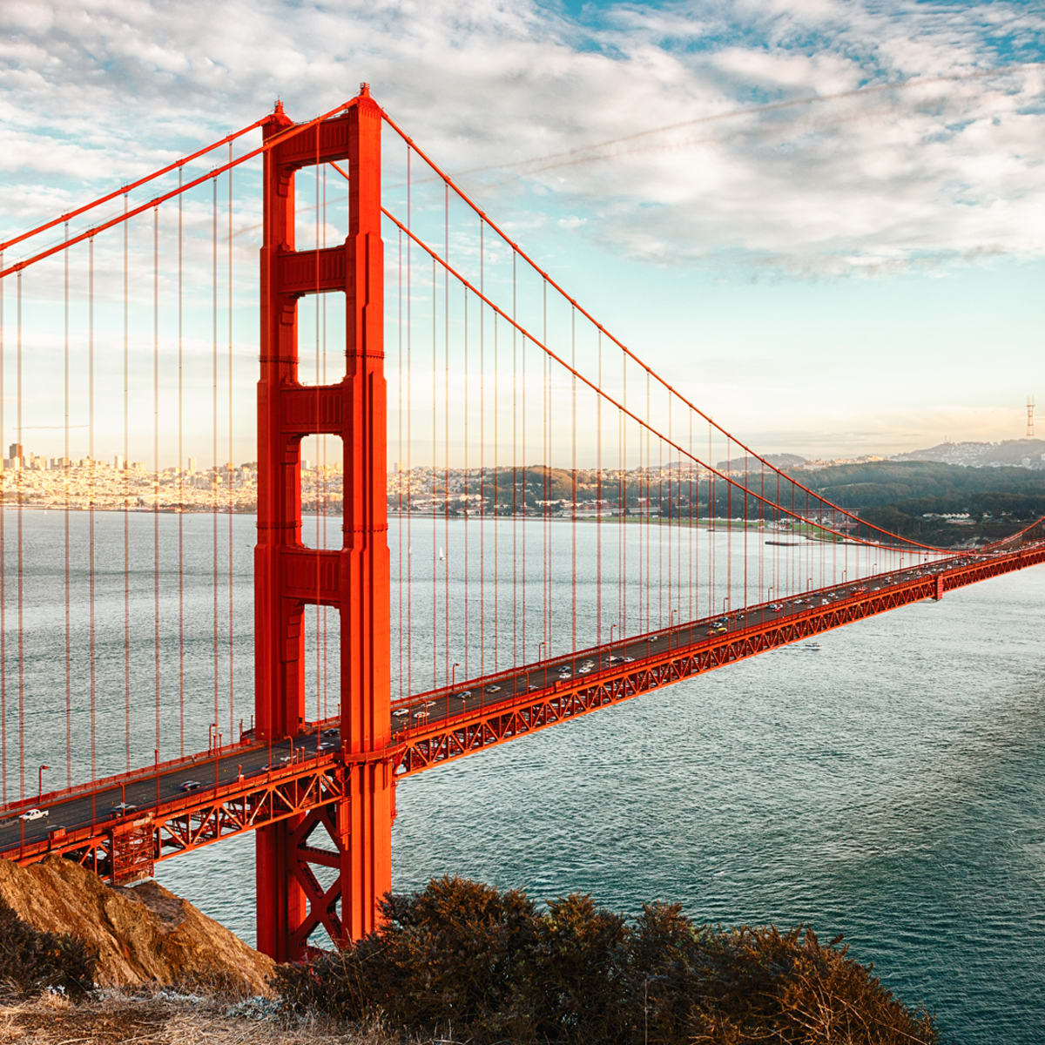
Applied IT Bridging Menu
You are about to start an exciting journey into the world of IT, good luck!
Remember
Choose what modules you do and when, but work through them consistently. Different tasks will take you varying amounts of time, but on average you should aim to do one or two per week
All green tasks are core modules, they are compulsory and must be completed
The red hot chili indicates that the task is more challenging than the others
Numbers eg (1) correspond to how you should evidence the module which can be found in the slides following the menu. They can be saved within this powerpoint or as separate documents clearly labelled with the subject

Slide 2
Applied IT Bridging Menu (Green modules are core (compulsory) modules , indicates the most challenging modules )
 | Read | Watch | Listen | Visit (virtually or physically at a later date) | Do
 | Cisco Digital Transformation fueled by the Internet of Everything Digital Transformation with the Internet of Everything (cisco.com) (1) | Craig & Dave https://www.youtube.com/channel/UC0HzEBLlJxlrwBAHJ5S9JQg/pla ylists?shelf_id=10&sort=dd&view=50 (1) | The Digital Human BBC Radio 4 Digital Human Podcast (1) | The National Museum of Computing - http://www.tnmoc.org/ (3) | MOOCs https://www.futurelearn.com/courses/learn-to-code-for-the-web Search through the MOOCs using the filter ‘IT’ and choose one that particularly interests you (6)
 | IBM Watson Internet of Things: IoT in the cognitive era https://www.ibm.com/uk-en/cloud/internet-of-things (1) | BBC Click - http://www.bbc.co.uk/programmes/n13xtmd5 (1) | BBC Tech tent https://www.bbc.co.uk/programmes/p01plr2p (1) | Bletchley Park - https://bletchleypark.org.uk/ (3) | Independent research task Emerging computer technology (4)
 | Chips with Everything from the Guardian https://www.theguardian.com/technology/series/chips-with-everything (1) | Cyber Security Facts https://www.youtube.com/watch?v=sdpxddDzXfE (1) | Wired http://www.wired.co.uk/series/wired-podcast (1) | The UK Computer Museum, Cambridge http://www.computinghistory.org.uk/ (3)
 | MIT News http://news.mit.edu/topic/computers (1) | TED Talks https://www.youtube.com/watch?v=EF692dBzWAs&list=PLF7032F8EB1A4F9E2 (2) | BBC – Computing Britain http://www.bbc.co.uk/programmes/b06bq6j1/episodes/downloads (1)

Slide 3
(1) - Book/Journal/Podcast/Film Review
Would you/would you not recommend it? Why?
Rating:
Review by: ___________________________________________
Title: _______________________________________________________
Author: ____________________________________________________
Review of (please circle)
Book Journal Podcast Film Documentary
What was it about?
What did you find particularly interesting/inspiring/shocking? Has this changed your opinion?
What would you like to learn more about?
How does it link to this subject and why is it important?
Save your answers as part of this powerpoint & copy the template as many times as you need

Slide 4
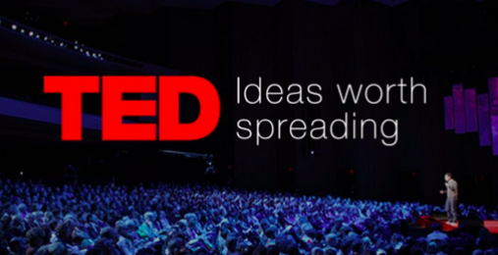
(2) – Review of TED Talk
George Dyson: The birth of the computer

Slide 5
(3) – Review of Visit
Would you/would you not recommend visiting? Why?
Rating:
Review by: ___________________________________________
Location: _______________________________________________________
What does the location specialise in? Why is it well known?
Did you find out anything new that you had previously not known?
What would you like to learn more about?
What was the most fascinating section of the museum/laboratory?
Save your answers as part of this PowerPoint & copy the template as many times as you need

Slide 6
Independent research task
(4)
Emerging computer technology
In this task you get to investigate any area of emerging computer technology which interests you.
You can pick any area which interests you, but examples could be:
Artificial intelligence
Robotics
Automated self driving cards
Quantum computing
In no more than ONE side of A4 summarise the area you have chosen under the following four headings:
What is it?
What are the possible Social, Moral, Cultural and Ethical benefits of this technology on society
What are the possible Social, Moral, Cultural and Ethical risks of this technology on society
My conclusion on this technology and what it will mean for our world 10 years from now
Additional help:
For additional help and support in structuring your answer you might like to watch some of the videos from the following Craig ‘n’ Dave playlists:
OCR:
SLR 17 – Ethical, morale and cultural issues
https://student.craigndave.org/videos/slr-17-ethical-moral-and-cultural-issues

Slide 7
(5) the Internet of Everything (IoE)
Produce a leaflet which explains the concept of the Internet of Everything (IoE). In your leaflet explain:
Explain what the internet is
What is the www
How does information get sent?
What is the internet of everything?
Explain the four pillars of the IoE
Some example technology
Where you can get more information from
You can edit your answers in the powerpoint

Slide 8
(6) MOOCs
How Computers Work: Demystifying Computation
https://www.futurelearn.com/courses/how-computers-work
To evidence this you can
Save any notes you take
Take and save a screenshot of completed modules or the completed course

