Slide 1
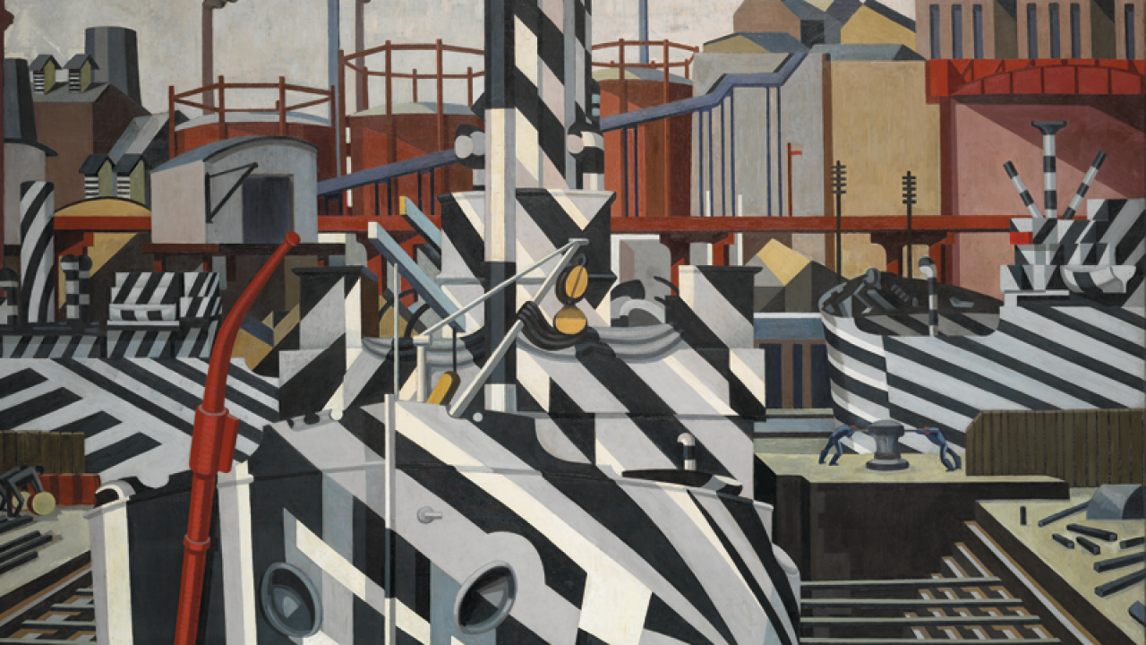

Art and Photography Bridging Menu
You are about to start an exciting journey into the world of Art and Photography, good luck!
Remember
Choose what modules you do and when, but work through them consistently. Different tasks will take you varying amounts of time, but on average you should aim to do one or two per week
All green tasks are core modules, they are compulsory and must be completed ready to hand in on your first lesson in September
The red hot chilli indicates that the task is more challenging than the others
Numbers eg (1) correspond to how you should evidence the module which can be found in the slides following the menu

Slide 2


Art and Photography Bridging Menu (Green modules are core (compulsory) modules , indicates the most challenging modules )
 | Read | Watch |  | Visit | Do
 | Ways of Seeing - John Berger (1) Chapter One (both) and Chapter Five (Art) and Chapter 7 (Photography) https://monoskop.org/images/9/9e/Berger_John_Ways_of_Seeing.pdf | MAKE YOUR OWN DAMN ART https://www.youtube.com/watch?v=ZmJaRGEFkqM |  | The Tate Modern – FREE! (3) Contemporary art and Photography https://www.tate.org.uk/ (3) | See Next Slide – Note one is for Fine Art, the other is Photography. (4)
 |  |  |  | Tate Britain – FREE! British art of the last 200 years https://www.tate.org.uk/ | Buy a robust Memory stick for use over the next two years. Link below is a recommended size and brand. https://www.amazon.co.uk/SanDisk-Ultra-Luxe-Flash-Drive/dp/B07SYB38Q8/ref=sr_1_1?crid=1RZG05MSO04B2&keywords=128+gig+sandisk+metal+sb&qid=1656410752&sprefix=128+gig+sandisk+metal+sb%2Caps%2C57&sr=8-1
 | https://www.radicalartreview.org/ The Radical Art Review is a digital and biannual print magazine that tackles popular culture and promotes emerging, marginalised, and outsider artists. | 10 BLACK BRITISH ARTISTS YOU SHOULD KNOW | ART SKL https://www.youtube.com/watch?v=IP9mP5nPXjs (5) |  | Tate Britain – FREE! British art of the last 200 years https://www.tate.org.uk/ | Buy a robust Memory stick for use over the next two years. Link below is a recommended size and brand. https://www.amazon.co.uk/SanDisk-Ultra-Luxe-Flash-Drive/dp/B07SYB38Q8/ref=sr_1_1?crid=1RZG05MSO04B2&keywords=128+gig+sandisk+metal+sb&qid=1656410752&sprefix=128+gig+sandisk+metal+sb%2Caps%2C57&sr=8-1
 | The New Manifestos: 6 Artist Texts That Are Defining Today's Avant-Garde www.artspace.com/magazine/news_events/trend_report/the_new_manifestos-52304 | The Great Pottery Throwdown 2022 https://www.channel4.com/programmes/the-great-pottery-throw-down |  | Saatchi Gallery – FREE! Contemporary collection of Charles Saatchi https://www.saatchigallery.com/
 | Robert Rauschenberg, Canyon https://www.khanacademy.org/humanities/art-1010/post-war-american-art/new-york-school/a/robert-rauschenberg-canyon | Grayson Perry’s Art Club https://www.channel4.com/programmes/graysons-art-club |  | Photographers gallery – FREE! (under 18, take ID) https://thephotographersgallery.org.uk/visit/visitor-information (3)
 |  |  |  | The British Museum – FREE! Collections of 1000s of years of human history from all over the world. https://www.britishmuseum.org/
 | What is Art? and/or What is Beauty? (2) https://philosophynow.org/issues/108/What_is_Art_and_or_What_is_Beauty |  |  | National portrait Gallery – FREE! Gallery dedicated to the art of portraiture https://www.npg.org.uk/

Slide 3
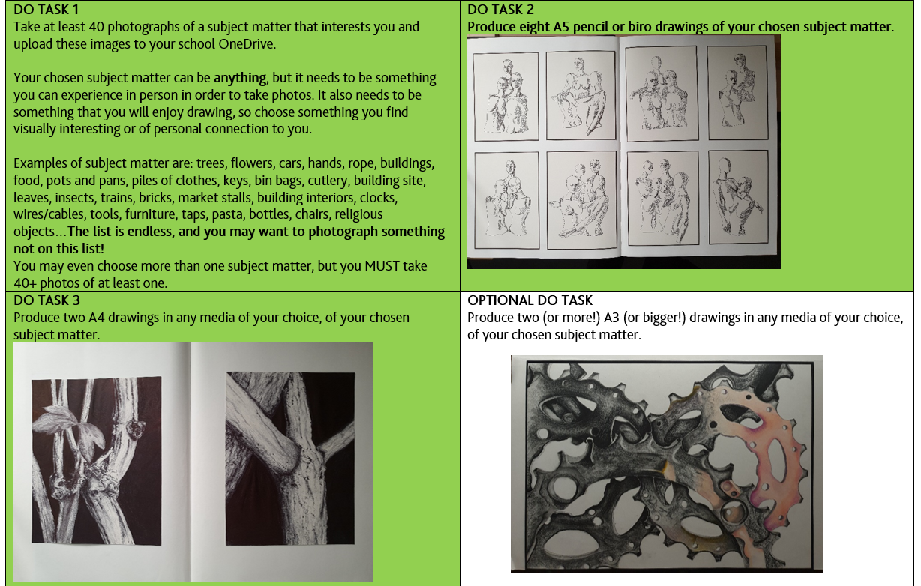
(4)

Slide 4
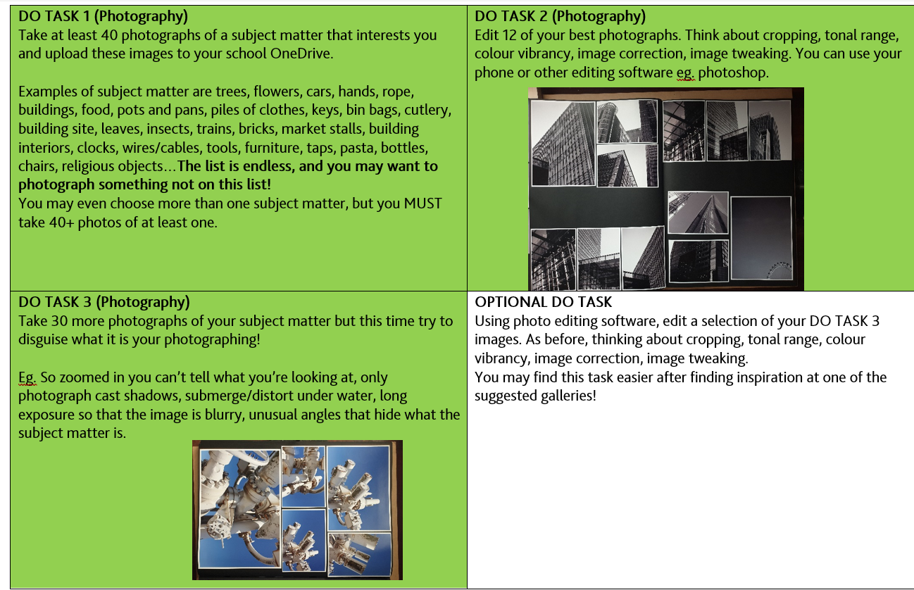
(4)

Slide 5
WTP? What’s the point?
A-level Fine Art and Photography involves learning a creative process and developing a visual language with which you can express ideas, concepts and emotions. To do this, you need a starting point of visual ingredients, and this is why the summer work is important. The four ‘Do Tasks’ are designed to make you generate visual knowledge about your chosen subject matter. With this knowledge, we can begin your personal investigations in September at an exciting pace.

Slide 6
Book/Journal/Film/Gallery/Exhibition/Artwork Review (1)
Has it had an affect on your opinion of what art can be?
Review by: ___________________________________________
Title: _______________________________________________________
Author: ____________________________________________________
Review of (please circle)
Book Journal Podcast Film Documentary
What is it about?
What did you find particularly interesting/inspiring/shocking? Has this changed your opinion?
What would you like to learn more about?
How does it link to this subject and why is it important?
Save your answers as part of this powerpoint & copy the template as many times as you need

Slide 7
List of Artists or Photographers that you experienced over the summer. (3)
In the tables that follow, list the artists and photographers that you experienced in galleries and that had an effect on you over the summer.
Artist/photographer name | Name of piece and gallery seen at | Description and analysis (What dies the piece/photo look like and what is it about? | How has it effected you?

Slide 8
Artist/photographer name | Name of piece and gallery seen at | Description and analysis (What dies the piece/photo look like and what is it about? | How has it effected you?

Slide 9
Artist/photographer name | Name of piece and gallery seen at | Description and analysis (What dies the piece/photo look like and what is it about? | How has it effected you?

Slide 10
Written task in response to ‘What is art and/or what is beauty?’(2)
https://philosophynow.org/issues/108/What_is_Art_and_or_What_is_Beauty
For use in discussions in the first few weeks, please write your own response to this question. Minimum 200 words, but no more than 500.

