Slide 1
Attendance Hub Module 6: Quality Assurance 20 March 2025
'NEC ASPERA TERRENT'
'hardships do not deter us'
Rob Johnston AHT
Ross Boniface AAHT
Notes:
RBN

Slide 2
Housekeeping and Expectations
Expectations for hub partner schools and lead school
The sessions will be recorded and available after the session
Questions posted into the chat. There will be a chance to answer at pause points
attendancehub@draytonmanorhighschool.co.uk
Resources page: https://www.draytonmanorhighschool.co.uk/school-resources.php
Notes:
RBN

Slide 3
Objectives
To detail systematic quality assurance protocols that have worked in our context
To provide an opportunity for you to consider your own protocols
Notes:
RJH

Slide 4
Pause Point 1
"Sharpening the right tools for the right job"
What should we QA in relation to attendance systems and procedures?
What might we look for?
What is the role of modelling best practice?
How should feedback be delivered, especially considering some staff may be non-teaching?
What is the role of the calendar?
How might data inform/support your QA?
How might you use your stakeholders?
Notes:
RJH

Slide 5
What should we Quality Assure and Why?
What?
The work of key staff in your team e.g. Attendance Officer – what are their key duties each day? Are they completed effectively?
Contacting home e.g Absence calls/texts – timing, script usage/tone
Coding – are the right codes being input for the right reasons and at the right time (10.30am?)?
‘Threshold system’ implementation - letters/pastoral meetings/attendance contracts/fines/EWO involvement
Why?
Outcome = Attendance figure
Integrity and excellence
Identifying areas of strength to celebrate
Identifying growth areas before they become concern areas
Culture of improvement
Notes:
RJH
Pose the question: what should we QA and why? Give colleagues a minute and then to post their views on the chat function.
Read a few valid ones before revealing our what and why. What is self explanatory, but the why will need clarification.
Integrity and excellence: we have an attendance policy and a clearly defined system. The objective of the QA procedure is to ensure there is integrity in the system – are we doing what we say we will do? In addition, we are aiming for excellent levels of attendance – 96% and above – if we aren't achieving this it is incumbent on us know why.

Slide 6
Making it Work (The QA Cycle)
Train and model best practice
Quality Assure implementation
Feedback – be brave in your conversations
Notes:
RJH
Key questions to ask yourself here are
Does every person that holds a responsibility for attendance in your organisation have clarity about what they must do, the best way to do it, and what to do if they don't?
Do you have a clear picture of what you want to Quality Assure and have you planned that out in a timeline?
What happens if things are done with efficacy and efficiency?
What happens if this are not done effectively? What actions are taken and by whom?

Slide 7
Training and Modelling Best Practice
Job descriptions and descriptions of role and responsibility at every level
Checklists and guides
Scripts for parent interactions (phone conversations and meetings)
Modelling these and supporting colleagues during implementation
Support following feedback (deliberate practice)
Line Management support – weekly focus for Pastoral Leaders
Notes:
RBN – case study for each
- introduction of Attendance Welfare officer – what we had to do to make sure the role was successful?

Slide 8
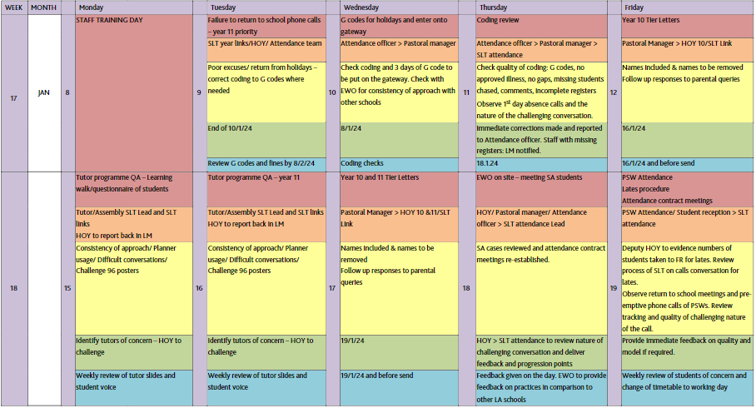
How do we Quality Assure our systems?
"Clarity and Certainty"
Notes:
The key to quality assurance protocols is not 'just do more'. For us, it is about
Ensuring everyone knows their role and how to do it (training)
Ensuring there is clarity about what we are checking for
Ensure there is certainty about when we will check and who will do it
In addition to this, the overall figures are reviewed in depth at weekly SLT meetings, feedback provided from the week's events and key actions taken forward by the member responsible for attendance.
With this is in place, we have found we are more likely to
See Key tasks being completed promptly/to time
Full implementation of the system
Happier staff – no surprises
Identify opportunities to praise
Identify more areas for growth/development/efficiency within the system. This is really important because you are able to fully identify problems affecting the output and consider improvements, rather than being 'blinded' by personnel concerns/inadequacies

Slide 9
Getting Viewpoints and Input
Regular student panels and hotspot mapping (where do students feel unsafe)
Impact: Early identification of barriers to school attendance and pre-emptive actions
Regular Student Council and Student Voice
Impact: Early identification of trends/Social Media influence/Local context/issues that can influence attendance
Regular Staff Panels
Impact: Provide useful data/information about implementation of staff led initiatives/on the ground information about student cohorts
Safeguarding and Attendance External Audits
Notes:
What could come up as future issues?
Future barriers – what can the stakeholders tell us about future trends.

Slide 10
Feedback Conversations
We have integrity and are aiming for excellence
We aim to ensure staff have clarity of what is expected, provide training on best practice and are consistent in our QA methods and approach
This provides us with the basis to intervene early and have honest feedback conversations that support improvements

Slide 11
Feedback Conversations
Honest feedback conversations
Identify the exact problem/s at a granular level and its impact (clarity)
Check the problem is persistent/not a one off (certainty)
Agree time and place to meet in advance in person explaining that the topic of the conversation to be had
Script the feedback conversation
Detail of the concern
Detail how the problem has impacted the school/individuals
Detail of why it is important the problem is resolved
Detail of possible solutions but script for them to provide input on the next steps required to resolve
Agree what and when action will be taken as well as any training that is required
Agree follow up QA and meeting/s to check on progress
Follow up in writing
Question: Despite support and training, what should happen if the desired result isn't achieved and the issue persists?
Notes:
No system or individual is perfect. As you have seen, we are on a journey and are aiming for excellence. If there is a part of the system that is not functioning/working to the expected level, we intervene to make changes. For us, we feel a duty to our values as a school and to being honest with our staff if they are not meeting expectations. So how do we approach this?
Pose the question and give one minute to think. Colleagues post ideas in the chat function.

Slide 12
'Break Out' Rooms
Questions to focus the conversation
Is everyone clear about their role and how to do it well?
How do you QA this currently, what do you not?
How systematic is your protocol? Does everyone know what, who and when processes occur?
What role have your team had in developing the QA processes? Should they be involved?
What action do you take when concerns/problems arise?
What processes do you have to identify and intervene early?

Slide 13
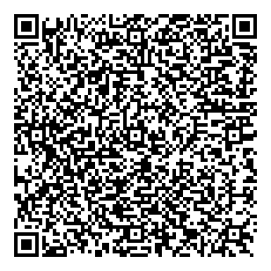
WHY WE FOCUS ON TRANSITION?
We start to build a relationship with each family before they arrive, and they start to build a relationship with us
Collection of data, trends and experiences of students and their families
Plan the use of school resources to meet the needs of our incoming cohort
Continue to build momentum throughout the year
Notes:
Focusing on the transition from primary to secondary school is essential because it marks a critical period of change that can significantly impact a student's educational journey, wellbeing, and overall success.
A well-structured transition plan does more than just support the students—it helps us collect key data early, establish relationships with families, and ensure that the right school resources are in place.
It’s important to remember that although we are focusing on attendance today, all the data we collect during transition feeds into broader pastoral systems. A student’s attendance patterns, emotional wellbeing, and academic progress are interconnected, so by taking a holistic approach, we can create interventions that address multiple needs simultaneously.
We also need to be flexible. Transition isn’t a one-off event in September—it’s an ongoing process that requires regular review and adaptation as new trends emerge.
We have included here a link to the recently published DfE Attendance Toolkit which we contributed a several resources as part of our case study on school transition.
Notes
Though we are focusing on attendance today – all of this collected data will feed into the other pastoral systems
Focusing on the transition between primary and secondary school is essential because it marks a critical period of change that can significantly impact a student's educational journey, wellbeing, and overall success.
Establish systems to continuously track the progress of the cohort and evaluate the impact of interventions. Adjust strategies as new trends or needs arise.

Slide 14
TIMELINE
Visits
Meetings
Early Offer
Primary Schools
Parents and students
Passport
Induction meeting
Medical
SEND
Safeguarding
Pastoral
LA EWO
Summer School
SEN workshops
Parent Events
In School Foci
Keeping Momentum
Induction Day
Challenge 96
Assembly and Tutor Programme
Parent Events
Return to school meetings
Student experience
Primary schools
Notes:
Transition is not a single event—it is a carefully structured, phased process that ensures students, parents, and staff are fully prepared. Let’s break this down into distinct stages, with clear actions for each phase:
1. Primary School Visits & Early Engagement
Every feeder primary school is visited by a dedicated transition team, including pastoral leads, SEND specialists, and student ambassadors.
Student Ambassadors return to their own primary schools to act as role models and build a connection between new students and their future peers.
Engagement with Year 6 teachers to collect key information, including academic progress, behaviour patterns, and attendance data.
2. Building Relationships with Families
Multiple Parent and Student Visits: At least three touchpoints before September, including Open Evenings, Transition Days, and a Welcome Event.
Personalised Meetings: Formal enrolment meetings with each family to discuss pastoral needs, SEND support, and safeguarding concerns.
Follow-ups for non-attendees to ensure no student or family falls through the cracks.
Key documents translated into top five languages to make communication inclusive.
3. Early Support & Preparation
Summer School: A targeted programme offering academic support, wellbeing activities, and a chance to build friendships before September.
SEND Transition Workshops: Bespoke sessions for students requiring additional support, ensuring familiarity with the school environment.
The Passport Initiative: Structured activities that allow students to explore school expectations and routines before they start.
4. First Weeks of Term – Immediate Support
Induction Day: A dedicated day for Year 7s, separate from older students, allowing them to familiarise themselves with the building and routines.
Challenge 96: A tutor-based competition focused on securing 96%+ attendance in the first half-term.
Tutor Check-Ins: Structured daily engagement to ensure early attendance patterns are positive.
Early intervention for at-risk students flagged from primary data.
5. Keeping the Momentum Going
Return-to-School Meetings: Personalised check-ins for students whose attendance dips early in the year.
Parent Curriculum Events: Sessions tailored to family requests and year group trends, ensuring ongoing parental engagement.
Stacking Strategies: Continuous review and refinement of transition processes based on live data and staff feedback.
Transition is not just about getting students through the door—it is about creating a structured, supportive environment that makes strong attendance the expectation from day one.
Notes:
ASSESS – PLAN – DO – REVIEW
Visits
All primary schools visited by the transition team (student ambassadors and staff)
Parents and students visit repeatedly to build their understanding of the school culture and network with staff
Passport – students undertake activities to get to know the school using the school website, transition team and visits
Meetings
Formal meetings with each parent and child in July to go through enrolment details – SEND/Welfare/Safeguarding/Pastoral
Robust follow up with non-attendees
Key texts translated into top 5 languages
Bespoke meetings for families identified as high risk
Early Support
Summer School – early involvement of external agencies if required
Update Vulnerability Index using obtained information
Primary school data (attendance, welfare, SEND, progress, safeguarding)
Early Support
Parent drop-in clinics
Week 2: Parent Event – building networks
Drop-in clinics for quick fixes
In school foci
Challenge 96 – inter tutor attendance competition
Assembly Programme – early celebrations for improving attendance/ monthly streaks
Tutor engagement and calls
Keeping Momentum
Parent Curriculum Events – adapted for requests and year group trends
Stacking – adding small iterations on to your pre-existing offer

Slide 15
TRANSITION TASKS
September Actions
Day 1 absence calls
Extra-curricular sign up and advertisement to parents
Explicit target setting – challenge 96
Baseline testing and screening
Tutor attendance calls
Return to school meetings
Data
Early Transfer File (ETF) – local authority data
Attendance & punctuality Percentage
Local authority EWO handover
Academic progress
Pastoral information (friendships, hobbies)
Safeguarding
Vulnerability Index (VI)
Beyond the School Gates report
Medical and Welfare
Special Educational Needs (SEND)
English as an Additional Language
Parent engagement with primary school
Parent engagement with transition process
Mobility – previous primary schools
Induction paperwork included within the Information Handbook
Pupil Passport
Summer School feedback
All data combined into the ‘super spreadsheet’
NEETs
Extra-curricular interests
Curriculum audits
Events
Pre-September
Open Evening
Parent Open Morning
Transition team primary welcome events
Primary visits for every feeder school
Audience for drama/musical rehearsal
Subject HOD primary curriculum visits
Passport launch
Primary liaison meetings
Year 6 teacher
DSL – safeguarding and welfare
SEND and EAL lead
1:1 Induction meetings with all parents and students
Year 6 Induction Day
SEN workshop days
July Parent Welcome Evening
Summer School
Pre-start visit: collect timetable & meet tutor
Post first day
Daily debrief (1st week) – SLT & Year Team
After-school troubleshooting Parent clinics
Parent success evening in first two weeks
Year 7 music concert in first term
PTA invite/ second hand uniform sell
Parent curriculum evenings
SEN/Parent Coffee Mornings
Key Professionals
Head of Year
Tutor team
Year group link SLT
Transition Coordinator
Student Transition Team
DSL
SENDco
Graduate Inclusion Support Assistants
Admission officer
LA EWO/ data team
Primary staff
In year admissions
Pupil information form
Contact previous schools
Admission pre-meeting
Baseline testing and screening
Post testing meeting
Head Teacher meeting
Assigned buddy
Keeping Momentum
Assess, Plan, Do, Review
Leadership – professional curiosity of the trends of the year
Uncovering what the data tells you
Developing the culture of the year group
Extracurricular sign up
Early parent meetings and attendance contracting
Staying connected with primaries
Strategic Discussion Points
How do we assess the needs of the cohort?
How do we plan effectively for the incoming cohort and adapt the curriculum where required?
What resources do we have available to use?
How do we build and establish relationships with schools, students and families?
How do we know our transition offer is fit for purpose?
Notes:
Notes:
Task checklist
Use this to audit your current offer and review possible adaptations (stacking) on your current provision.
What systems will you adapt to be able to collate more data on your incoming cohort?

