Slide 1
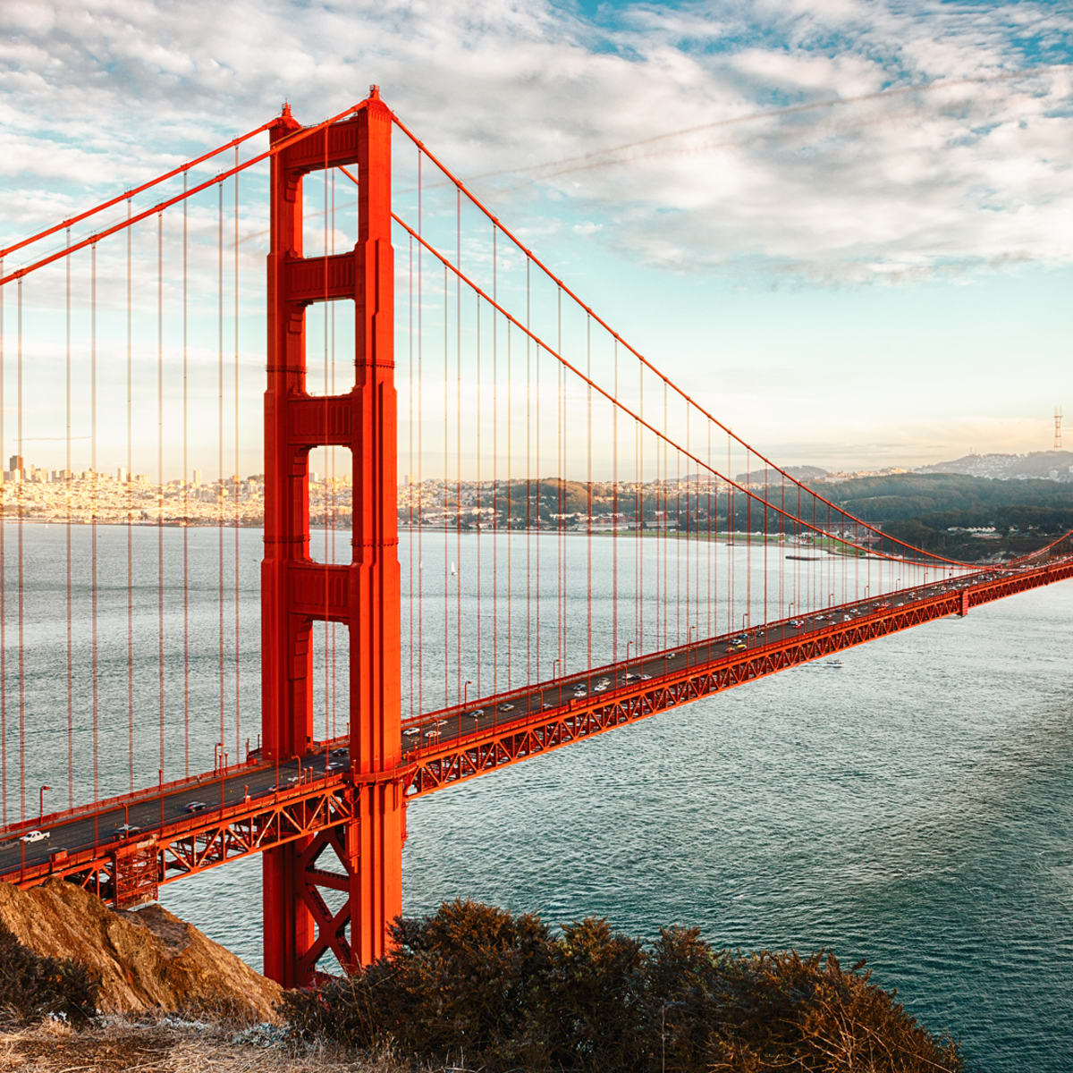
Biology Bridging Menu
You are about to start an exciting journey into the world of Biology, good luck!
Remember
Choose what modules you do and when, but work through them consistently – we will be checking in on your progress regularly. Different tasks will take you varying amounts of time, but on average you should aim to do one or two per week
All green tasks are core modules, they are compulsory and must be completed by 10 July
The red hot chili indicates that the task is more challenging than the others
Numbers eg (1) correspond to how you should evidence the module which can be found in the slides following the menu. These must be saved in your Unifrog locker as you work. They can be saved within this powerpoint or as separate documents clearly labelled with the subject

Slide 2
Biology Bridging Portfolio (Green modules are core (compulsory) modules , indicates the most challenging modules )
Reviews of your work should be saved in your Subject Lockers on Unifrog | Read | Watch | Listen | Visit (virtually or physically at a later date) | Do
 | Buy the CGP revision guide ‘Head Start to A-level Biology’ to help you to build on your GCSE Biolgy knowledge. You can buy the revision guide book from cgpbooks.co.uk (5) | Watch a TED talk A_global_pandemic_calls_for_global_solutions When is a pandemic really over? How does the immune system work? Sex determination: more complicated than you think What if there were 1 trillion more trees? (2) | Thisweekinviroogy How are the tests for vaccines for CV-19 done? (1) | The Natural History Museum http://www.nhm.ac.uk (4) | Active Review of Biological concepts Which were your weakest GCSE Biology areas? Review these topics areas using: Cognito Revisely Further develop your understanding of some concepts to prepare you for A-level Biology. Snaprevise CrashCourseBiology (5)
 | Want to read a Biology classic book that has influenced worldwide understanding of Biology? Here is a list of suggested books to read: Richard Dawkins: The Selfish Gene James Watson: The Double Helix: Personal Account of the Discovery of the Structure of DNA Charles Darwin: The origin of species Bill Bryson: A Short History of Nearly Everything (1)
 |  | Our Planet (2019) The series addresses issues of conservation while featuring these disparate animals in their respective home regions, and has been noted for its greater focus on humans' impact on the environment than traditional nature documentaries. (1) | Level Up Human Series 10 episode 2 (1) | The Royal Society Lectures on You and the Planet (4) | 10% of your A-level Biology exam uses higher tier GCSE Maths skills. Try the ‘Maths For A Level Biology Questions and Tips’ from Maths made easy (6)
 | Visit the Edexcel site below and download a copy of the specification for A level Biology A Specification (9) | The C word (2016) The C Word is a 2015 documentary film about the effort to prevent cancer, particularly the research of Dr. David Servan-Schreiber, and addresses the failure of Western medicine's approach to cancer. (1) | Radiolab podcast relative genius (1) | A university open day (or virtual tour) of a university you are interested in. Here is the Oxford Biology Department. Oxford Biology (3) | MOOCs Shortonlinecourses Search through the MOOCs on using the filter ‘Biology’ and chose one that particularly interests you. (7)
 | Look at the BBC News page for Science and the Environment BBCnews (1) | The Game Changers (2018) This documentary looks at viewpoints and evidence to promote a vegan diet but how reliable is it? (1) | Thisweekinevolution (1)
 |  |  |  |  | BiologyOlympiadPastpapers An annual competition seeking out the best Biologists across the country. Attempt a past paper and mark it. (8)
 |  |  |  | Science Museum (4) (virtual tour here)
 | Take a look at the Biological Science Review periodical via the website: BiologicalSciencesReview Pick one of the articles to read from one of the issues of the Biological Sciences Review periodical. (1) | Why are we getting so fat? BBC Horizon (2016) Dr Giles Yeo investigates obesity in the UK. Many people believe that if people could just eat less, the obesity problem would be solved, but this may be harder than it sounds. (1) | Thenaturalselectionpodcast (1) | Visit London Zoo ZSL-virtual-tour (4) | Sign yourself up to Seneca Learning if you don’t have an account already and find the Biology Edexcel A A-level course. Have a look through the types of topics that we will be studying. (5)

Slide 3
(1) – Book/Article/Journal/Podcast/Film Review
Would you/would you not recommend it? Why?
Rating:
Review by: ___________________________________________
Title: _______________________________________________________
Author: ____________________________________________________
Review of (please circle)
Book Article Journal Podcast Film Documentary
What was it about?
What did you find particularly interesting/inspiring/shocking? Has this changed your opinion?
What would you like to learn more about?
How does it link to this subject and why is it important?
Save your answers as part of this PowerPoint in your locker & copy the template as many times as you need

Slide 4
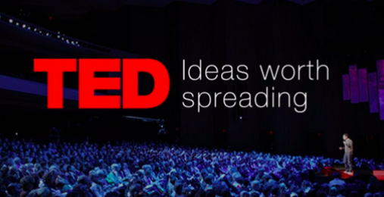
(2) – Questions on TED talks
What is GCSE Biology content does this relate to?
What are the key Biological concepts discussed?
What can we learn from it?
Are you going to change anything as a result of watching the talk?
Save your answers in the PowerPoint and save in your locker clearly labelled with the subject ‘Biology”

Slide 5
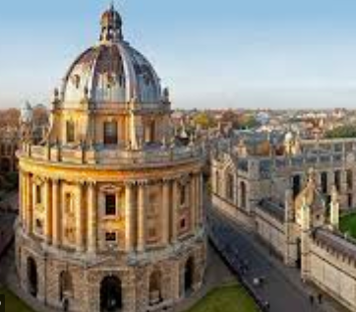
(3) – Questions on visit to a university open day (or the Oxford Biology Department)
What is the first year like on the BSc Biology Programme?
What can I expect over the three/four years?
How important is maths for a Biology Degree?
What job opportunities does a degree in Biology offer?
What percentage of the course is practical?
What is unique about Oxford (or the university you visit)?
What do Oxford (or the university you visit) look for in applicants?
What are the alternative courses you can do with a Biology A-level?
Save your answers in the PowerPoint and save in your locker clearly labelled with the subject ‘Biology”

Slide 6
(4) – Review of Visit
Would you/would you not recommend visiting? Why?
Rating:
Review by: ___________________________________________
Location: _______________________________________________________
What does the location specialise in? Why is it well known?
Did you find out anything new that you had previously not known?
What would you like to learn more about?
What was the most fascinating section of the museum/laboratory?
Save your answers as part of this PowerPoint in your locker & copy the template as many times as you need

Slide 7
(5) – Review of GCSE content
Use your GCSE Biology Personal Learning Checklists to review GCSE content. This is content you must be familiar with when you start as it will not be recapped.
Create flash cards for these topics to help you remember.
Make mind maps to show how your knowledge across each module of the GCSE links together
Use revisely or cognito
*Use the following YouTube accounts to further develop your understanding to A-level standard:
Snaprevise
CrashCourseBiology
Use the Specification to help you to establish what you need to understand. Suggested topics to focus on for the first term back include:
Carbohydrates
Proteins an enzymes
The cardiac cycle
Non-communicable diseases such as obesity
Cell membrane and transport
DNA, RNA and protein synthesis
Your notes should be completed and saved in your locker for marking.
Take a photo of your resources and answers to worksheets and save in your locker clearly labelled with the subject ‘Biology”

Slide 8
(6) – Review GCSE Maths Content
Try the ‘Maths For A Level Biology Questions and Tips’ from Maths made easy
The booklet here should be completed and saved in your locker and marked.
If you found this difficult you could buy CGP's A-level-biology-essential-maths-skills to help you before and during your A-level Biology course.
Save the booklet in your locker clearly labelled with the subject ‘Biology”

Slide 9
(7) – MOOCs
These are massive open online courses that you can take whilst you are at home. Most are completely free to complete with a small fee for the certificate (but you do not need to print this- you can screen shot the completed stage).
To evidence this you can
Save any notes you take
Take and save a screenshot of completed modules or the completed course
Save it in your locker as part of this PowerPoint or if there is a downloadable certificate save as ‘Biology MOOC’ in your locker

Slide 10
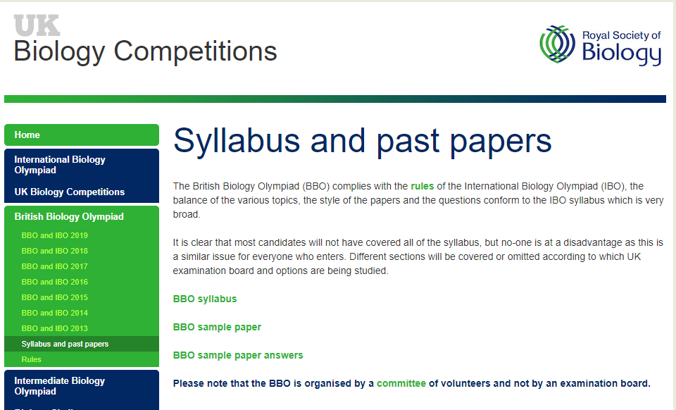
(8) – Biology Olympiad Challenges
These challenges will stretch your Biology knowledge and make you think outside the box.
Try some of the past paper questions here.
BiologyOlympiadPastpapers
An annual competition seeking out the best biologists across the country.
Save your work/take a photo of your work and upload to your locker.
Save or take photos of your work and save as ‘Biology’ in your locker

Slide 11
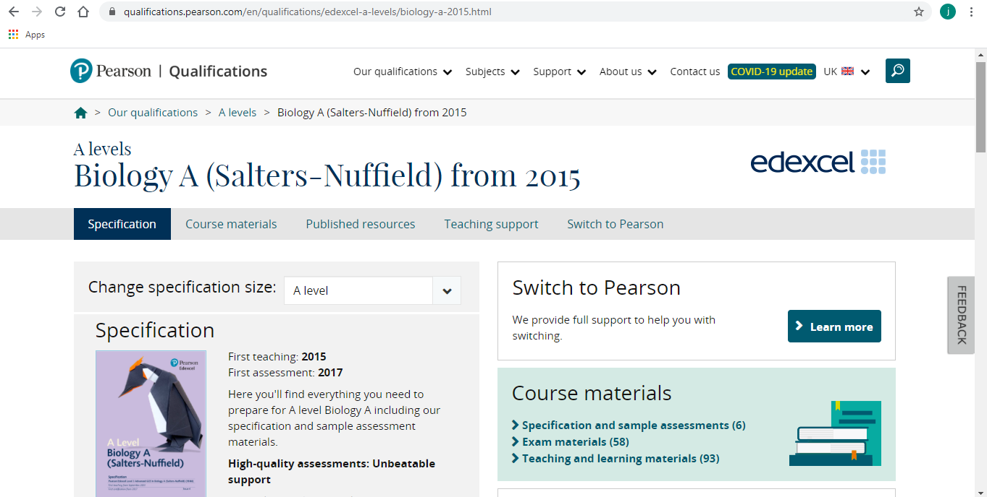
(9) –Specification for A level Biology
Download and save the specification
Traffic light your understanding of the objectives for year 1 A-level Biology (topics 1, 2, 3 and 4).
Red = you’ve never heard of it
Amber = you know some things about it
Green = you are confident on this
This should help you with your active review of your biological knowledge.
Save the specification in your locker clearly labelled with the subject ‘Biology”

