Slide 1

A-Level Core Concepts
6. Photosynthesis
© Copyright The PiXL Club Ltd, 2019
This resource is strictly for the use of member schools for as long as they remain members of The PiXL Club. It may not be copied, sold nor transferred to a third party or used by the school after membership ceases. Until such time it may be freely used within the member school.
All opinions and contributions are those of the authors. The contents of this resource are not connected with nor endorsed by any other company, organisation or institution.
www.pixl.org.uk The PiXL Club Ltd, Company number 07321607

Slide 2
A-Level Core Concepts
6. Photosynthesis
  Complete me
    Light dependent stage
    Calvin cycle
  Chloroplast ID
  Card sort Pairs
  Photosynthesis sequencing
  Student mis-answers
  Photosynthesis MCQ
  Apply and Link
© Copyright The PiXL Club Ltd, 2019
This resource is strictly for the use of member schools for as long as they remain members of The PiXL Club. It may not be copied, sold nor transferred to a third party or used by the school after membership ceases. Until such time it may be freely used within the member school.
All opinions and contributions are those of the authors. The contents of this resource are not connected with nor endorsed by any other company, organisation or institution.
www.pixl.org.uk The PiXL Club Ltd, Company number 07321607

Slide 3
6.1 Complete me
Complete the tasks on the Calvin cycle
3. Complete the light-dependent reaction:
1. Circle the co-enzymes involved in photosynthesis:
ATP synthase NADP FAD
NAD Amylase Pyruvate
ADP ATP P_{i}
NADP →
2. Put the following molecules in order of their involvement in the light-dependent reaction:
Reduced NADP
Photosystem 1
Photosystem 2
NADP⁺
Electron transport chain
Electron
Water
PS
PS

Slide 4
6.1 Complete me
Complete the tasks on the light-dependent stage
3. Complete the light-dependent reaction:
1. Circle the co-enzymes involved in photosynthesis:
ATP synthase NADP FAD
NAD Amylase Pyruvate
ADP ATP P_{i}
NADP → NADPH
ADP + P_{i} → ATP
Electron acceptor
Electron acceptor
Electron transport chain
2. Put the following molecules in order of their involvement in the light-dependent reaction:
Water
Electron
Photosystem 2
Electron transport chain
Photosystem 1
NADP⁺
Reduced NADP
Light
Light
H⁺ ion
PS1
PS2

Slide 5
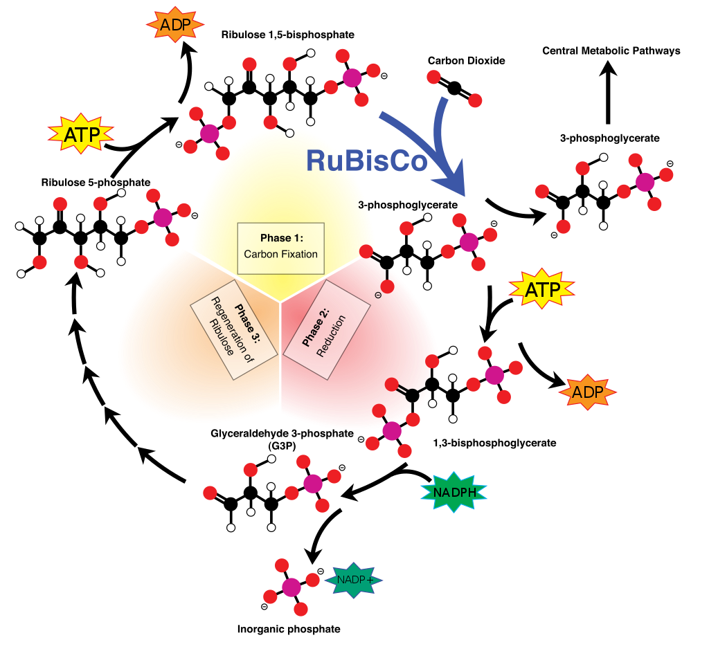
6.1 Complete me
Complete the tasks on the light-independent stage
3. Complete the light-independent reaction:
1. State whether a molecule is Oxidised (O) or Reduced (R) during the Calvin cycle.
NADP CO₂
GP
2. Put the following molecules in order of their involvement in the light-independent reaction:
GP
TP (Triose phosphate)
RuBP
Reduced NADPH
ATP
Notes:
By Mike Jones - Own work, CC BY-SA 3.0, https://commons.wikimedia.org/w/index.php?curid=9504547

Slide 6
6.1 Complete me
Complete the tasks on the light-independent stage
3. Complete the light-independent reaction:
1. State whether a molecule is Oxidised (O) or Reduced (R) during the Calvin cycle.
NADP R CO₂ R
GP R
Fatty acids & some amino acids
ADP
RuBP
CO₂
ATP
GP
GP
2. Put the following molecules in order of their involvement in the light-independent reaction:
RuBP
GP
ATP
Reduced NADPH
TP (Triose phosphate)
ATP
ATP
ADP
TP
Reduced NADP
NADP⁺
Notes:
By Mike Jones - Own work, CC BY-SA 3.0, https://commons.wikimedia.org/w/index.php?curid=9504547

Slide 7
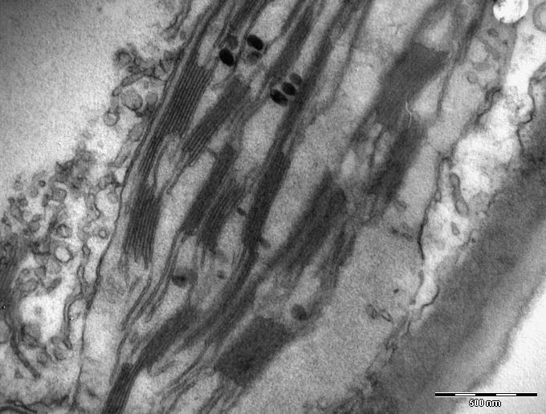
6.2 Chloroplast
1. Label the chloroplast.
2. State the tissue that would have the highest density of chloroplasts.
3. Match the molecules to the stages where they are used:
Light-dependent reaction
 |  |  | Calvin cycle
ATP
Reduced NADP
Rubisco
Water
CO₂
4. Calculate the magnification of the image as shown by the scale bar.
Calculate the height of the stack as shown by the yellow line.
Notes:
By Bela Hausmann from Vienna, Austria - Chloroplast 30000x, CC BY-SA 2.0, https://commons.wikimedia.org/w/index.php?curid=40047064
Height of grana – 4.5mm
Length of scale bar 33.8mm

Slide 8
6.2 Chloroplast
2. State the tissue that would have the highest density of chloroplasts – Palisade mesophyll
3. Match the molecules to the stages where they are used:
Light dependent reaction
 |  |  | Calvin cycle
ATP
Reduced NADP
Rubisco
Water
CO₂
Notes:
By Bela Hausmann from Vienna, Austria - Chloroplast 30000x, CC BY-SA 2.0, https://commons.wikimedia.org/w/index.php?curid=40047064
Height of grana – 4.5mm
Length of scale bar 33.8mm

Slide 9
6.2 Chloroplast
1. Label the chloroplast.
Thylakoid stack / Grana
Inter-granal lamellae
Stroma
Thylakoid membrane (any single membrane)
1. Magnification = Image / Actual
Length of scale bar = 33.8mm
=33,800,000nm
Actual = 500nm
33,800,000/500 =67,600
2. Stack = 4.5mm or 4,500,000
Image / Magnification = 450,000 / 67,600
= 66.6 nm
4. Calculate the magnification of the image as shown by the scale bar.
Calculate the height of the stack as shown by the yellow line.
Notes:
By Bela Hausmann from Vienna, Austria - Chloroplast 30000x, CC BY-SA 2.0, https://commons.wikimedia.org/w/index.php?curid=40047064
Height of grana – 4.5mm
Length of scale bar 33.8mm

Slide 10
6.3 Photosynthesis pairs
Pair the cards – watch out for some common misconceptions.
The use of light energy to split water into 2H+, 2e- and ½ O_{2 .} | The electrochemical gradient created by a concentration gradient of H⁺ ions. | The process of creating ATP due to the transfer of electrons by releasing energy from the oxidation of sugars. | The process of creating ATP using light energy.
The loss of an electron from chlorophyll due to light energy. | A soluble molecule that releases energy in small quantities. | Wavelength of light absorbed by Chlorophyll A in Photosystem 2. | The movement of an electron which results in the production of ATP and reduced NADP.
The movement of an electron which results in the production of ATP only. | A co-enzyme from the respiration pathway that is commonly used when discussing photosynthesis. | A co-enzyme responsible for reducing GP. | The gain of Hydrogen or electrons.
Wavelength of light absorbed by Chlorophyll A in Photosystem 1. | A process that plants carry out all the time. | Often referred to as stalked particles and combined ADP + P_{i} into ATP. | A key enzyme involved in the addition of CO₂ to RuBP.

Slide 11
6.3 Photosynthesis pairs
Pair the cards – watch out for some common misconceptions.
ATP | Reduced NADP | Reduced NAD | Photolysis
Photoionisation | Rubisco | ATP synthase | P680nm
Proton motive force | Non-cyclic phosphorylation | Respiration | P700nm
Reduction | Photo-phosphorylation | Oxidative phosphorylation | Cyclic phosphorylation

Slide 12
Photophosphorylation | The process of creating ATP using light energy
Non-cyclic phosphorylation | The movement of an electron which results in the production of ATP and reduced NADP.
Reduction | The gain of Hydrogen or electrons.
Rubisco | A key enzyme involved in the addition of CO₂ to RuBP.
Oxidative phosphorylation | The process of creating ATP due to the transfer of electrons by releasing energy from the oxidation of sugars.
P680nm | Wavelength of light absorbed by Chlorophyll A in Photosystem 2.
Reduced NADP | A co-enzyme responsible for reducing GP.
ATP synthase | Often referred to as stalked particles and combined ADP + P_{i} into ATP.
Proton motive force | The electrochemical gradient created by a concentration gradient of H⁺ ions.
ATP | A soluble molecule that releases energy in small quantities.
Reduced NAD | A co-enzyme from the respiration pathway that is commonly used when discussing photosynthesis.
Respiration | A process that plants carry out all the time.
Photolysis | The use of light energy to split water into 2H+, 2e- and ½ O_{2.}
Photoionization | The loss of an electron from chlorophyll due to light energy.
Cyclic phosphorylation | The movement of an electron which results in the production of ATP only.
P700nm | Wavelength of light absorbed by Chlorophyll A in Photosystem 1.

Slide 13
6.4 Photosynthesis sequence
Sequence each of the two processes.
Light-dependent stage |  | Calvin cycle
H+ ion is moved from Stroma to lumen of grana |  | ATP is used to phosphorylate GP
Electrons are transferred to an electron acceptor and then to NADP⁺ |  | Triose phosphate converted to amino acids, glycerol and carbohydrates
Electrons move along electron transport chain to Photosystem I |  | Some TP is recycled back to RuBP using ATP
Energy level of electrons raised and they are transferred an electron acceptor |  | 6C product splits into 2 x GP
Reduced NADP is formed |  | RuBP binds to CO₂
4 more photons of light excite electrons |  | Unstable 6 carbon product formed
Movement of protons through ATP synthase generates ATP |  | Reduced NADP donates H+ & electrons to form TP
4 photons of light excite a pair of electrons from Photosystem II |  | Reaction is catalysed by Rubisco

Slide 14
6.4 Photosynthesis sequence
Solution
Light-dependent stage |  | Calvin cycle
4 photons of light excite a pair of electrons from Photosystem II |  | RuBP binds to CO₂
Energy level of electrons raised and they are transferred an electron acceptor |  | Reaction is catalysed by Rubisco
Electrons move along electron transport chain to Photosystem I |  | Unstable 6 carbon product formed
H+ ion is moved from Stroma to lumen of grana |  | 6C product splits into 2 x GP
Movement of protons through ATP synthase generates ATP |  | ATP is used to phosphorylate GP
4 more photons of light excite electrons |  | Reduced NADP donates H+ & electrons to form TP
Electrons are transferred to an electron acceptor & then to NADP⁺ |  | Triose phosphate converted to amino acids, glycerol and carbohydrates
Reduced NADP is formed |  | Some TP is recycled back to RuBP using ATP

Slide 15
6.5 Mis-answers
Identify weaknesses in the student answer and give a correction.
1. Describe 1 function of ATP and NADP in the light dependent reaction.
ATP is used to convert GP into TP.
Reduced NADP adds Hydrogen.
3. The concentration of CO₂ above a jungle changes over a period of 24 hours. Suggest why these changes occur.
During the day plants are photosynthesising which uses up CO2, therefore levels fall.
At night time, they are respiring which gives out Carbon dioxide and so levels change.
2. State the precise location of the Calvin cycle.
In the cytoplasm of the chloroplast.

Slide 16
6.5 Mis-answers
Identify weaknesses in the student answer and give a correction.
1. Describe 1 function of ATP and NADP in the light dependent reaction.
ATP is used to convert GP into TP.
Reduced NADP adds Hydrogen.
Both phrases are relatively weak and lacking in A-level detail.
State the precise role of each – ATP - e.g. it phosphorylates GP, it provides energy for the conversion of GP→ TP
Reduced NADP REDUCES GP and provides electrons
2. Precise location refers to the structures within the chloroplast (mitochondria)
Stroma
2. State the precise location of the Calvin cycle.
In the cytoplasm of the chloroplast.

Slide 17
6.5 Mis-answers
Identify weaknesses in the student answer and give a correction.
This answer would benefit from a clear structure and writing clear sentences.
The student is confused about when plants respire.
They have failed to talk about net CO₂ uptake.
During the day the rate of uptake by photosynthesis is greater than release by respiration so levels fall.
At night, there is no photosynthesis, but respiration continues so the levels rise.
3. The concentration of CO₂ above a jungle changes over a period of 24 hours. Suggest why these changes occur
During the day plants are photosynthesising which uses up CO2, therefore levels fall.
At night time, they are respiring which gives out Carbon dioxide and so levels change.

Slide 18
6.6 Photosynthesis MCQ
D1
Which enzyme combines CO₂ with RuBP?
A : ATP synthase
B : NADP reductase
C : Rubisco
D : Amylase
E : Decarboxylase
F : Dehydrogenase

Slide 19
6.6 Photosynthesis MCQ
D1
Which enzyme combines CO₂ with RuBP?
A : ATP synthase
B : NADP reductase
C : Rubisco
D : Amylase
E : Decarboxylase
F : Dehydrogenase

Slide 20
6.6 Photosynthesis MCQ
D2
Which enzyme is involved in the light-dependent stage?
A : ATP synthase
B : NADP reductase
C : Rubisco
D : Amylase
E : Decarboxylase
F : Dehydrogenase

Slide 21
6.6 Photosynthesis MCQ
D2
Which enzyme is involved in the light-dependent stage?
A : ATP synthase
B : NADP reductase
C : Rubisco
D : Amylase
E : Decarboxylase
F : Dehydrogenase

Slide 22
6.6 Photosynthesis MCQ
D3
Which molecule is a type of nucleotide?
A : Acetyl co-enzyme A
B : NADP reductase
C : Rubisco
D : Cl⁻
E : NADP
F : ATP

Slide 23
6.6 Photosynthesis MCQ
D3
Which molecule is a type of nucleotide?
A : Acetyl co-enzyme A
B : NADP reductase
A : Acetyl co-enzyme A
B : NADP reductase
C : Rubisco
D : Cl⁻
C : Rubisco
D : Cl⁻
E : NADP
F : ATP
F : ATP

Slide 24
6.6 Photosynthesis MCQ
D4
Which process produces ATP but not reduced NADP?
A : Light-dependent stage
B : Calvin cycle
C : Cyclic phosphorylation
D : Non -Cyclic phosphorylation

Slide 25
6.6 Photosynthesis MCQ
D4
Which process produces ATP but not reduced NADP?
A : Light-dependent stage
B : Calvin cycle
C : Cyclic phosphorylation
D : Non -Cyclic phosphorylation

Slide 26
6.6 Photosynthesis MCQ
D5
Which molecule is used to produce fatty acids?
A :Reduced NADP
B : GP
C : TP
D : RuBP

Slide 27
6.6 Photosynthesis MCQ
D5
Which molecule is used to produce fatty acids?
A :Reduced NADP
B : GP
C : TP
D : RuBP

Slide 28
6.6 Photosynthesis MCQ
D6
Which molecule is phosphorylated by ATP in photosynthesis?
A :Reduced NADP
B : GP
C : TP
D : RuBP

Slide 29
6.6 Photosynthesis MCQ
D6
Which molecule is phosphorylated by ATP in photosynthesis?
A :Reduced NADP
B : GP
C : TP
D : RuBP

Slide 30
6.6 Photosynthesis MCQ
D7
What is the precise location of photosystem 2?
A :Thylakoid membrane
B : Stroma
C : Cristae
D : lumen of granum

Slide 31
6.6 Photosynthesis MCQ
D7
What is the precise location of photosystem 2?
A :Thylakoid membrane
B : Stroma
C : Cristae
D : lumen of granum

Slide 32
6.6 Photosynthesis MCQ
D8
Which molecule is used to produce amino acids and glycerol?
A :Reduced NADP
B : GP
C : TP
D : RuBP

Slide 33
6.6 Photosynthesis MCQ
D8
Which molecule is used to produce amino acids and glycerol?
A :Reduced NADP
B : GP
C : TP
D : RuBP

Slide 34
6.6 Photosynthesis MCQ
D9
Which wavelength of light is absorbed by Photosystem I?
A :680nm
B : 690nm
C : 700nm
D : 710nm

Slide 35
6.6 Photosynthesis MCQ
D9
Which wavelength of light is absorbed by Photosystem I?
A :680nm
B : 690nm
C : 700nm
D : 710nm

Slide 36
6.6 Photosynthesis MCQ
D10
Which of these is not an accessory pigment?
A :Chlorophyll A
B : Chlorophyll B
C : Carotenoid
D : Xanthophyll

Slide 37
6.6 Photosynthesis MCQ
D10
Which of these is not an accessory pigment?
A :Chlorophyll A
B : Chlorophyll B
C : Carotenoid
D : Xanthophyll

Slide 38
6.7 Apply and Link
To answer this question you need to recall:
Light-dependent stage
Enzyme modes of action
How organisms grow
Many weeds are dicotyledonous plants. Wheat is a type of grass which is a monocot.
Herbicides effect plant growth. A class of herbicides called triazine herbicides work by binding to the electron transfer chain of certain species of weed. It reduces the transfer of electrons along the chain.
Suggest why Triazines reduce plant growth.
Explain why Triazines do not effect crops.
When faced with a “suggest” style question you should:
Go back to the very start of the question and carefully review all the information, there are often clues at the start.
Be prepared that you have not been taught this exact idea, but have been taught the core knowledge you need to apply.
Notes:
This activity should focus more on the recall of the areas that the question discusses rather than offering an answer to the question.
It is an example of how examiners will expect students to make links.
Display this slide and give out the students the template on the next slide.

Slide 39
6.7 Apply and Link
Growth of organisms
Herbicides
Light-dependent stage
Enzymes
Notes:
Students to use mindmap to revise core ideas BEFORE trying the question
https://commons.wikimedia.org/wiki/File:Thylakoid_membrane_4.svg
By Kevin Olson - Original Creation, Public Domain, https://commons.wikimedia.org/w/index.php?curid=19352433

Slide 40
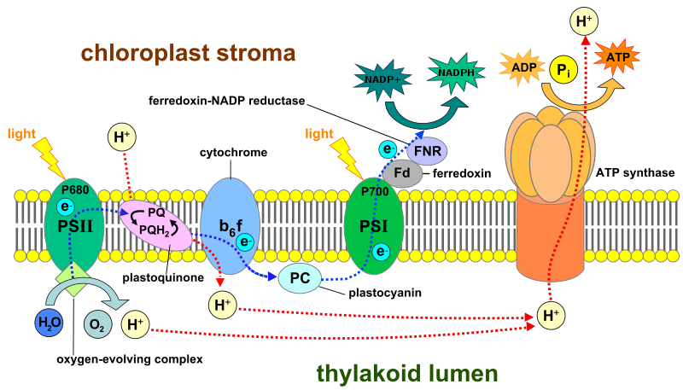
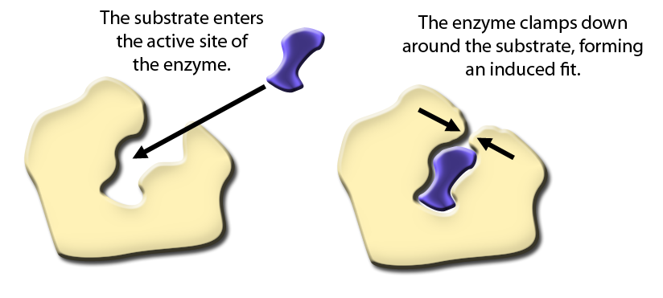
6.7 Apply and Link
Photosynthesis produces TP which is converted to Glucose
and amino acids.
Glucose is respired to produce ATP.
ATP is used to turn amino acids into proteins.
Growth of organisms
Herbicides
Light-dependent stage
Enzymes
Notes:
Some but not exclusive list of ideas
https://commons.wikimedia.org/wiki/File:Thylakoid_membrane_4.svg
By Kevin Olson - Original Creation, Public Domain, https://commons.wikimedia.org/w/index.php?curid=19352433

Slide 41
6.7 Apply and Link

Slide 42
6.7 Apply and Link
Now build your answer
Many weeds are dicotyledonous plants. Wheat is a type of grass which is a monocot.
Herbicides effect plant growth. A class of herbicides called triazine herbicides work by binding to the electron transfer chain of certain species of weed. It reduces the transfer of electrons along the chain.
Suggest why Triazines reduce plant growth.
Explain why Triazines do not effect crops.
Triazines bind to electron acceptors which prevents the movement of electrons along the electron transport chain (partially given in question).
Therefore, no H+ ions can be moved across the thylakoid membrane into the grana lumen.
No reduced NADP is produced.
The Calvin cycle is unable to reduce carbon dioxide or combine it with RuBP.
No GP or TP can be produced.
TP can not be converted into amino acids or glucose.
No new proteins can be produced for growth.
Notes:
This activity should focus more on the recall of the areas that the question discusses rather than offering an answer to the question.
It is an example of how examiners will expect students to make links.
Display this slide and give out the students the template on the next slide.

Slide 43
6.7 Apply and Link
Now build your answer
Many weeds are dicotyledonous plants. Wheat is a type of grass which is a monocot.
Herbicides effect plant growth. A class of herbicides called triazine herbicides work by binding to the electron transfer chain of certain species of weed. It reduces the transfer of electrons along the chain.
Suggest why Triazines reduce plant growth.
Explain why Triazines do not effect crops.
Triazines bind to a specific electron acceptor.
Electron acceptors in the electron transport chain are a series of co-enzyme or enzymes.
Different species will have small differences in the structure of their electron acceptors (due to random mutation).
Triazines will be unable to bind to electron acceptors of different species and will have no effect.
Notes:
This activity should focus more on the recall of the areas that the question discusses rather than offering an answer to the question.
It is an example of how examiners will expect students to make links.
Display this slide and give out the students the template on the next slide.

