Slide 1
Brain Structure and Imaging Revision 9 May, 2023
Do Now
1 | Describe the structure of the Cerebrum
2 | State the function of the cerebrum
3 | Structure and function of the hypothalamu
4 | Describe the structure of the cerebellum
5 | Describe the medulla oblongata
6 | How are CT scans used to investigate brain structure and function ?
7 | What does long term memory storage involve ?
8 | What are the cons of CT scans?
8 | How are MRI scans used to investigate brain structure and function ?
10 | How are fMRI scans used to investigate brain structure and function ?
11 | How are PET scans used to investigate brain structure and function ?

Slide 2
Answers
1 | Describe the structure of the Cerebrum | Largest part of the brain, divided into two halves called cerebral hemispheres. Has a thin outer layer called the cerebral cortex. The cortex has a large SA so it is highly folded to fit into the skull
2 | State the function of the cerebrum | Involved in vision, learning, thinking, emotions and movement
3 | Structure and function of the hypothalamu | Found beneath the middle part of the brain. Automatically maintains body temperature at the normal level (thermoregulation). Produces hormones that control the pituitary gland, which is below the hypothalamus
4 | Describe the structure of the cerebellum | Is underneath the cerebrum and also has a folded cortex. Co-ordinates smooth movement, posture and balance
5 | Describe the medulla oblongata | At base of brain near top of the spinal cord. Automatically controls breathing rate, heart rate and blood pressure

Slide 3
Answers
6 | How are CT scans used to investigate brain structure and function ? | Use X ray radiation to produce cross section images of the brain. Dense structures in the brain absorb more radiation than less dense structures so show up as a lighter colour on the scan. The scan shows the major structures but does not show functions.
7 | What does long term memory storage involve ? | an increase in the number of synaptic connections. repeated use of a synapse leads to creation of additional synapses between the neurones
8 | What are the cons of CT scans? | X rays can cause mutations of DNA which may lead to cancer. The risk is very low however. only give frozen moment pictures, look at structures not functions and have limited resolution
9 | How are MRI scans used to investigate brain structure and function ? | Uses a really strong magnetic field and radio waves to produce cross section images of the brain. MRI gives higher quality images for soft tissue types and better resolution between tissue types for an overall better resolution final picture. Allows you to clearly see the difference between normal and abnormal

Slide 4
Answers
10 | How are fMRI scans used to investigate brain structure and function ? | Give a detailed high resolution picture of the brains structure but they can also be used to research the function. If the function is carried out whilst in the scanner, the part of the brain thats involved with that function will be more active
11 | How are PET scans used to investigate brain structure and function ? | They show how active different areas of the brain are. A radioactive tracer is introduced into the body and is absorbed into the tissues. The scanner detects the radioactivity of the tracer- building a map of radioactivity in the body. DIfferent tracers can be used. It is very detailed and can show structure and function in real time

Slide 5
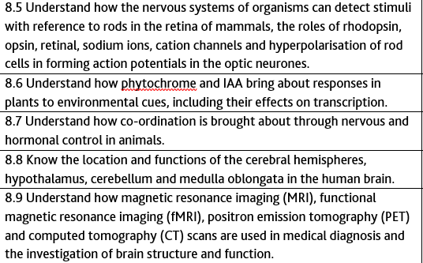
Learning Objectives
We are looking at this part of the PLC today

Slide 6
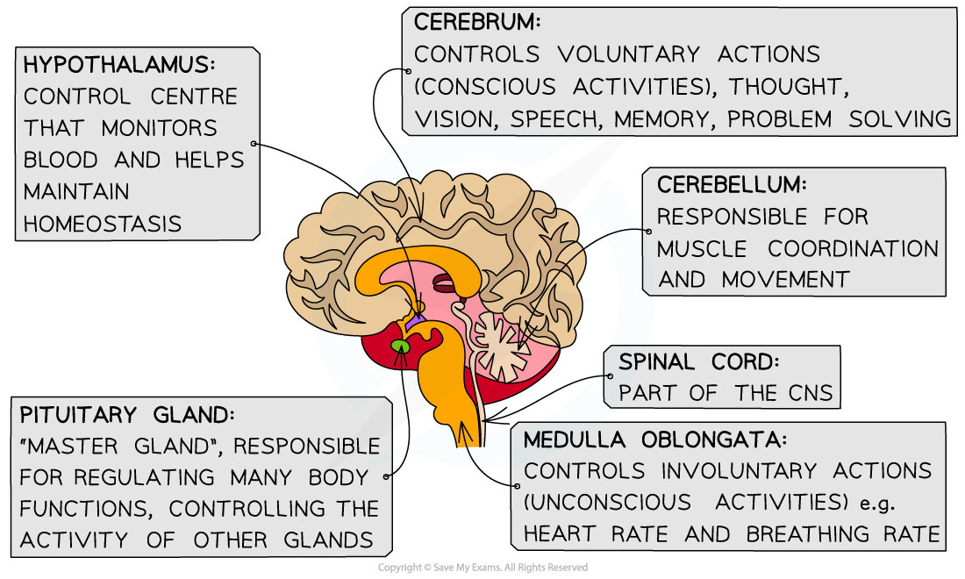

Slide 7
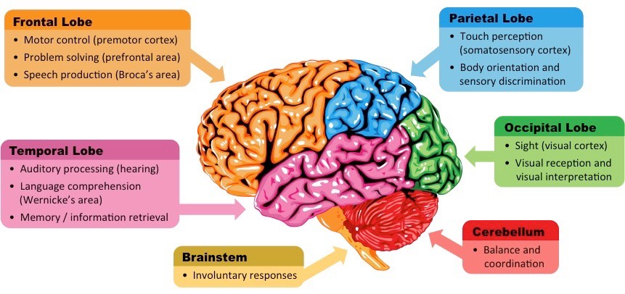

Slide 8

Now quiz each other using your flash cards in your groups.
You have 3 minutes

Slide 9
Which part of the brain has been damaged?
A patient has great difficulty moving down stairs.
Cerebral cortex
Hypothalamus
Pituitary
Cerebellum
Medulla

Slide 10
Which part of the brain has been damaged?
A patient is slurring and has broken speech.
Cerebral cortex
Hypothalamus
Pituitary
Cerebellum
Medulla
Can you give the name of the lobe?
Frontal

Slide 11
Which part of the brain has been damaged?
A patient struggles with their short term memory.
Cerebral cortex
Hypothalamus
Pituitary
Cerebellum
Medulla
Can you give the name of the lobe?
Frontal

Slide 12
Which part of the brain has been damaged?
A patient falls frequently.
Cerebral cortex
Hypothalamus
Pituitary
Cerebellum
Medulla

Slide 13
Which part of the brain has been damaged?
A patient has developed arrhythmia (irregular heart beat)
Cerebral cortex
Hypothalamus
Pituitary
Cerebellum
Medulla

Slide 14
Which part of the brain has been damaged?
A patient has struggles to breathe at a steady rate.
Cerebral cortex
Hypothalamus
Pituitary
Cerebellum
Medulla

Slide 15
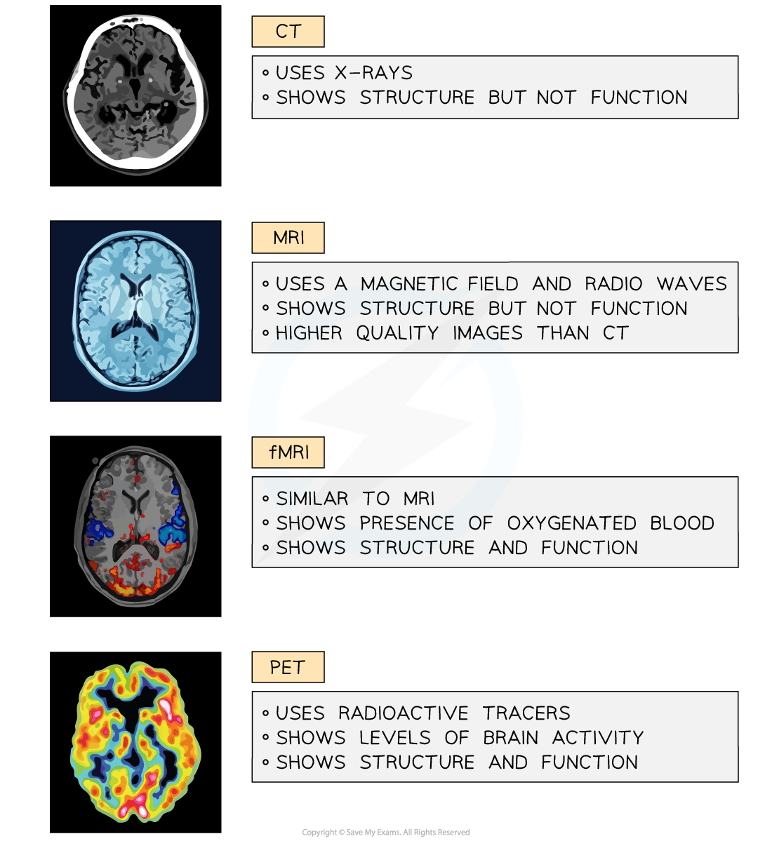

Slide 17
Think Pair Share
What: How do CT, MRI, fMRI an PET scans work? What is each used for?
How long: 1 min think, 2 min discuss in pairs, then share with the class

Slide 18
Task
What:
Answer the exam questions on the brain in the booklet provided
How:
In pairs or independently
Teacher will use the visualiser to help with some of the harder questions
How long:
20 mins

Slide 19
Review
What:
Mark your answers in green pen
How:
As we go through some students answers on the visualiser
With the mark scheme
How long:
10 mins

Slide 20
Extra Exam Qu Practise
https://www.physicsandmathstutor.com/pdf-pages/?pdf=https%3A%2F%2Fpmt.physicsandmathstutor.com%2Fdownload%2FBiology%2FA-level%2FTopic-Qs%2FEdexcel-A%2F8-Grey-Matter%2FSet-C%2FInvestigating%2520Brain%2520Function.pdf

