Slide 1
Cardiac Cycle
26/04/2023
Do Now
1 | What is the cluster of cells in the right atrium that form the heart’s natural pacemaker called?
2 | Describe the flow of blood in the left side of the heart when the ventricle contract.
3 | What are the valves separating the ventricles and the pulmonary artery and aorta called?
4 | What attaches the heart valve tissue to the walls of the heart?
5 | What do coronary arteries do?

Slide 2
Cardiac Cycle
26/04/2023
Do Now
1 | What is the cluster of cells in the right atrium that form the heart’s natural pacemaker called? | Sinoatrial node (SAN)
2 | Describe the flow of blood in the left side of the heart when the ventricle contract. | Blood is forced upwards, opening the semilunar (aortic) valve and passing through the aorta which branches off to supply oxygenated to the body
3 | What are the valves separating the ventricles and the pulmonary artery and aorta called? | Semilunar Aortic and pulmonary
4 | What attaches the heart valve tissue to the walls of the heart? | Tendons
5 | What do coronary arteries do? | Supply the heart muscle with oxygenated blood

Slide 3
Cardiac Cycle
26/04/2023
1.1 Understand why many animals have a heart and circulation (mass transport to overcome limitations of diffusion in meeting the requirements of organisms).
1.2 Understand the importance of water as a solvent in transport, including its dipole nature.
1.3 Understand how the structures of blood vessels (capillaries, arteries and veins) relate to their functions.
1.4 i) Know the cardiac cycle (atrial systole, ventricular systole and cardiac diastole) and relate the structure and operation of the mammalian heart, including the major blood vessels, to its function. ii) Know how the relationship between heart structure and function can be investigated practically.
We will be looking at this part of the PLC today

Slide 4
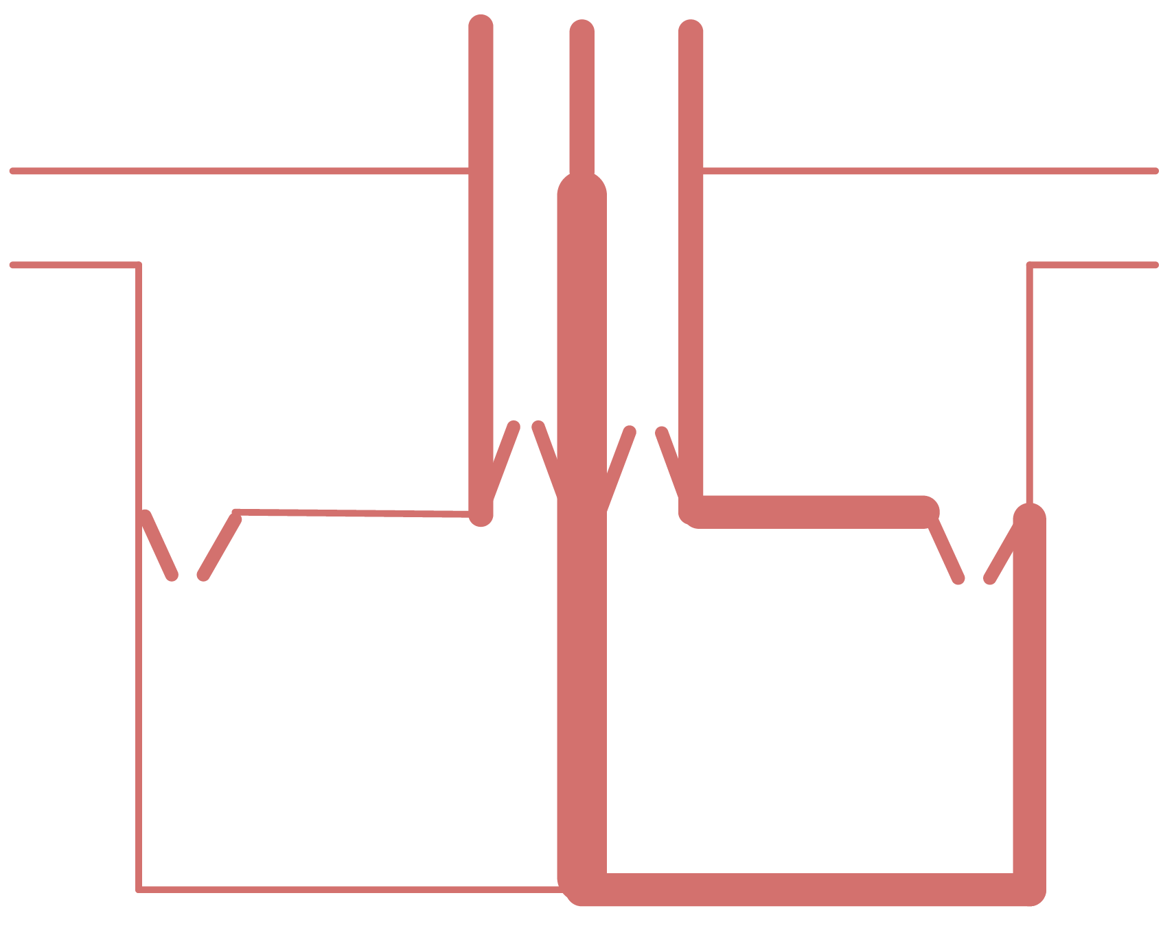
Pulmonary artery
Aorta
Vena cava
Pulmonary vein
Right atrium
Left atrium
Atrioventricular valve
Atrioventricular valve
Pulmonary valve
aortic valve
Right ventricle
Left ventricle
Septum

Slide 5
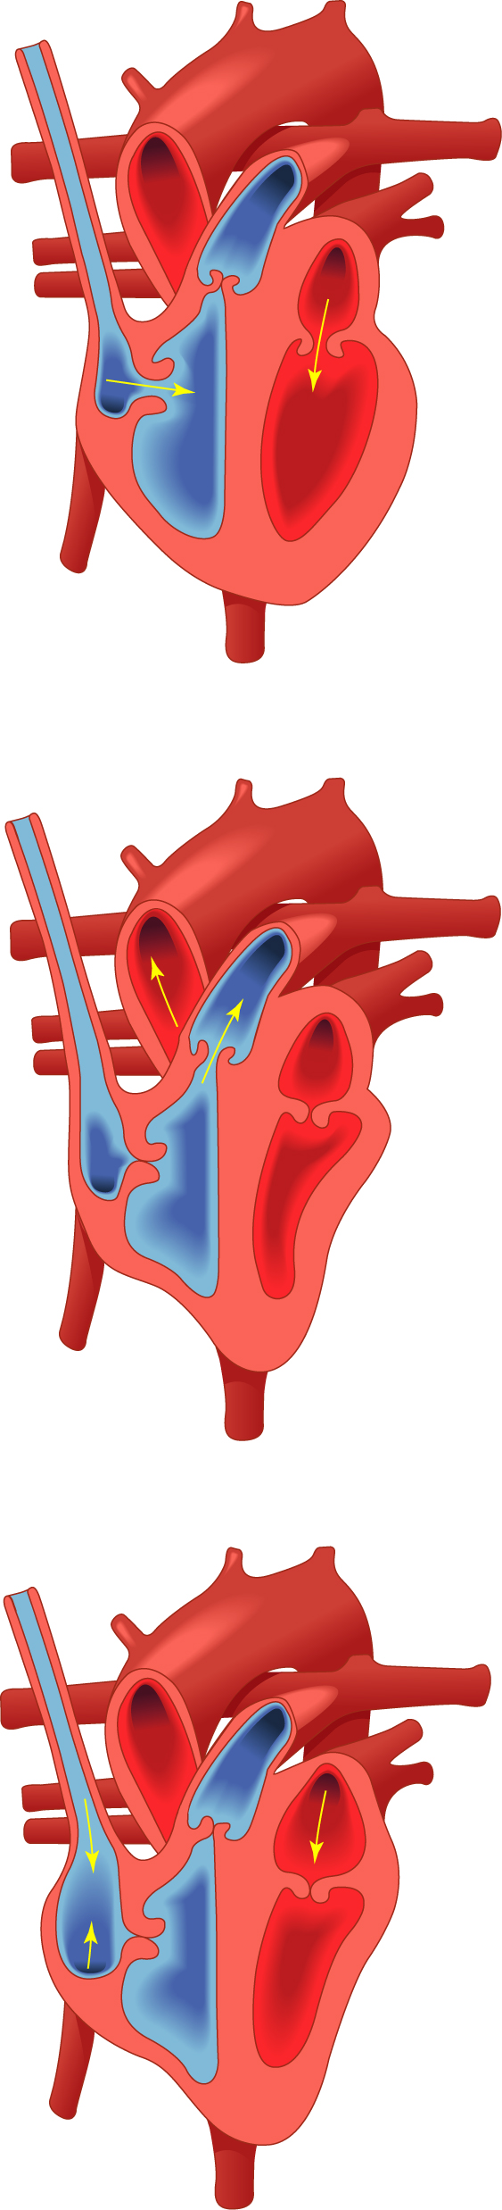
Phase 1 – Atrial systole:
Blood returns to the heart from the body via the superior and inferior vena cavae which transport deoxygenated blood from the upper and lower regions of the body respectively and via the pulmonary veins which transport oxygenated blood to the heart from the lungs.
The blood, which is flowing under low pressure flows into the left and right atria, filling them and increasing the pressure of blood against the atrioventricular valves, this causes the flaps of the valves to open slightly with blood leaking into the ventricles.
An action potential produced by the cells of the sinoatrial node triggers an electrical impulse which causes contraction of the atrial muscles, forcing the blood from the atria into the ventricles through the atrioventricular valves which will now be fully open. The cardiac muscle surrounding the ventricles is in diastole.
What: Describe what happens during phase 1 - atrial systole
How: Partner talk
How long: 2 minutes

Slide 6
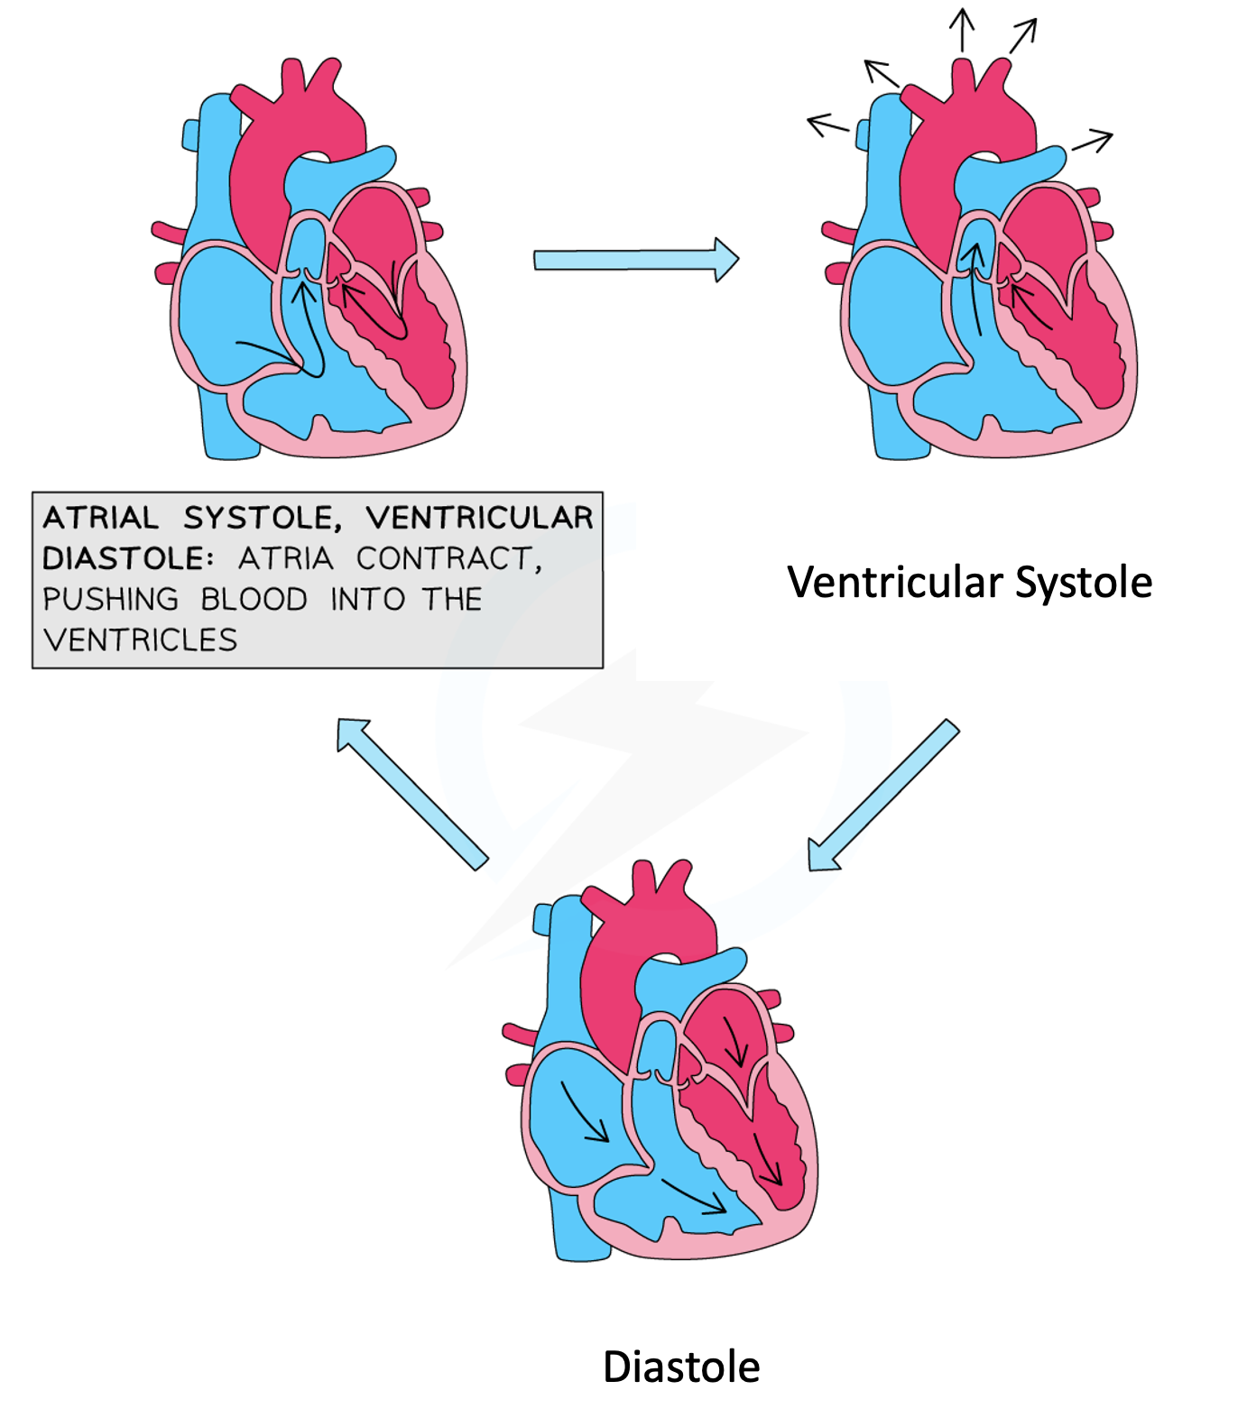

Slide 7
Mini-Whiteboards
Which chambers of the heart contract during phase one of the cardiac cycle?
Both ventricles
Left atrium
Both atria

Slide 8
Mini-Whiteboards
What causes the contraction of the atria?
A latent potential produced by the atrioventricular node
An action potential produced by the sinoatrial node
An action potential produced by the sinoatrial valve

Slide 9
Phase 2 – Ventricular systole:
After a slight delay, atrial systole is followed by ventricular systole. The left and right ventricles contract from the base of the heart and upwards. This increases the pressure in each ventricle as their volume decreases.
The increase in pressure forces the semilunar valves open and blood moves up and out of the heart through the pulmonary artery on the right, which transports deoxygenated blood to the lungs and the aorta on the left which transports oxygenated blood to the body.
The pressure of the blood in the ventricles, pushes against the atrioventricular valves (between the atria and ventricles) keeping them tightly closed and preventing the backflow of blood and maintaining its unidirectional flow. The atria are now in diastole.
What: Describe what happens during phase 2 - ventricular systole
How: Partner talk
How long: 2 minutes, then 2 minutes

Slide 10
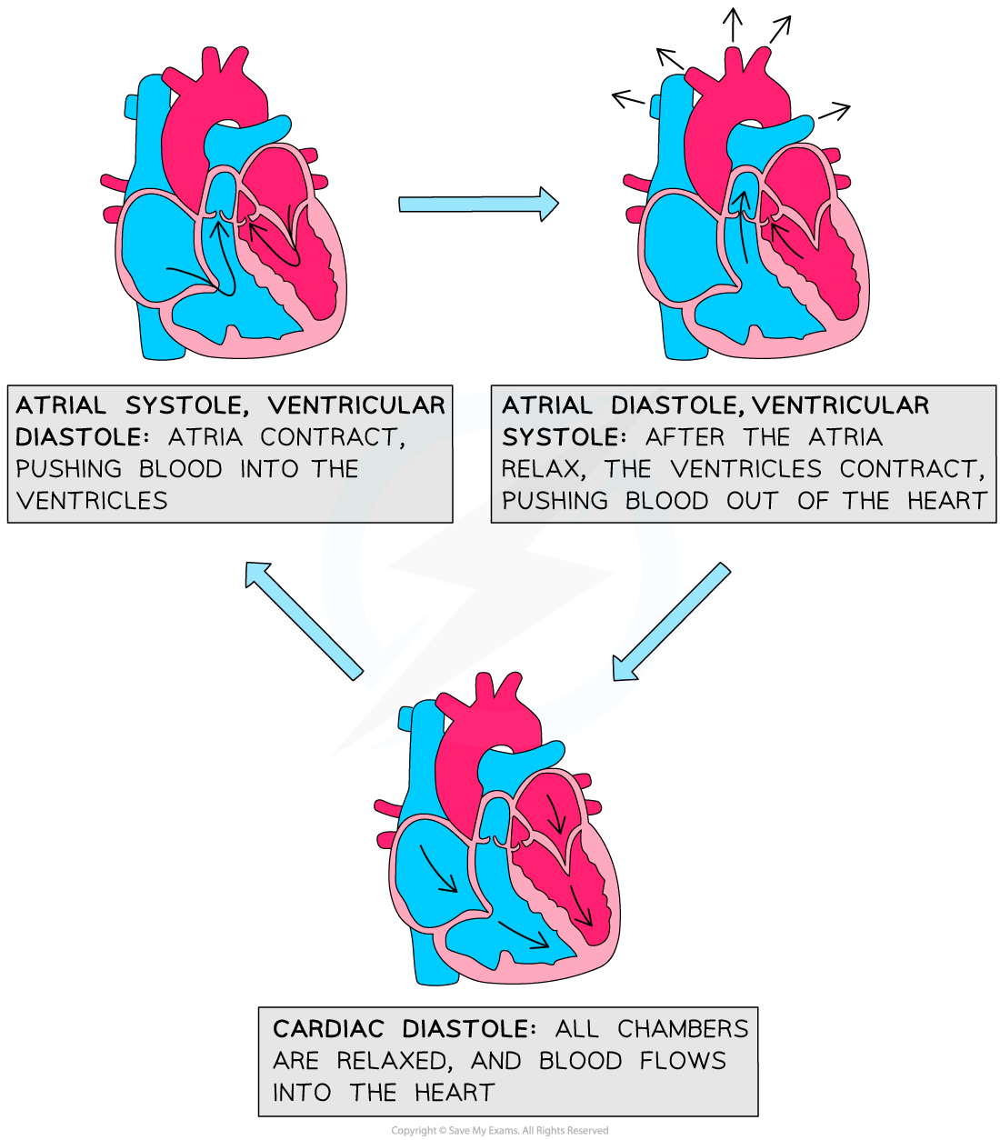
Diastole

Slide 11
Mini-Whiteboards
Which chambers of the heart relax during phase two of the cardiac cycle?
Both ventricles
Left atrium
Both atria

Slide 12
Mini-Whiteboards
Pressure from the blood in the ventricles, force open which valves and close which valves?
Open the semilunar valves, close the atrioventricular valves
Open the atrioventricular valves, close the semilunar valves
Open the tricuspid valves, close the mitral valves

Slide 13
Phase 3 – Cardiac diastole:
All heart chambers then enter a relaxation period, called cardiac diastole. Elastic recoil of the relaxing heart muscle walls causes the pressure in the atria and ventricles to decrease.
Blood being transported at higher pressure in the pulmonary artery and aorta is drawn back towards the ventricles and the semilunar valves close due to this downward pressure, preventing the backflow of blood.
During cardiac diastole the coronary arteries are supplied with oxygenated blood. Whilst the lower pressure in the atria allows blood to be drawn into the heart from the vena cava and pulmonary veins.
What: Describe what happens during phase 3 – Cardiac diastole
How: Listen, then explain to your partner
How long: 2 minutes, then 2 minutes

Slide 15
Mini-Whiteboards
When all chambers of the heart are in a relaxed state, this is called…
Atrial diastole
Cardiac systole
Cardiac diastole

Slide 16
Mini-Whiteboards
During cardiac diastole, which valves close?
Atrioventricular valves
Semilunar valves
Mitral valves

Slide 17
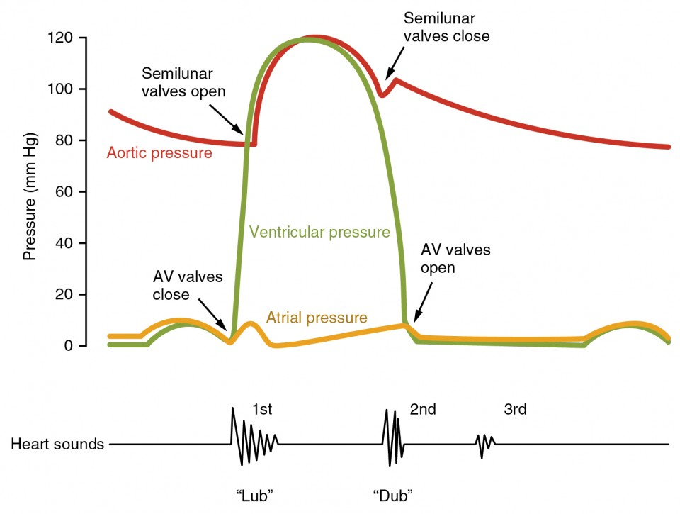
The diagram shows the pressure changes in the left side of the heart during the cardiac cycle.
The shape of the diagram would be similar for the right side of the heart but the maximum pressure in the right ventricle would be 30 mm hg.

Slide 18
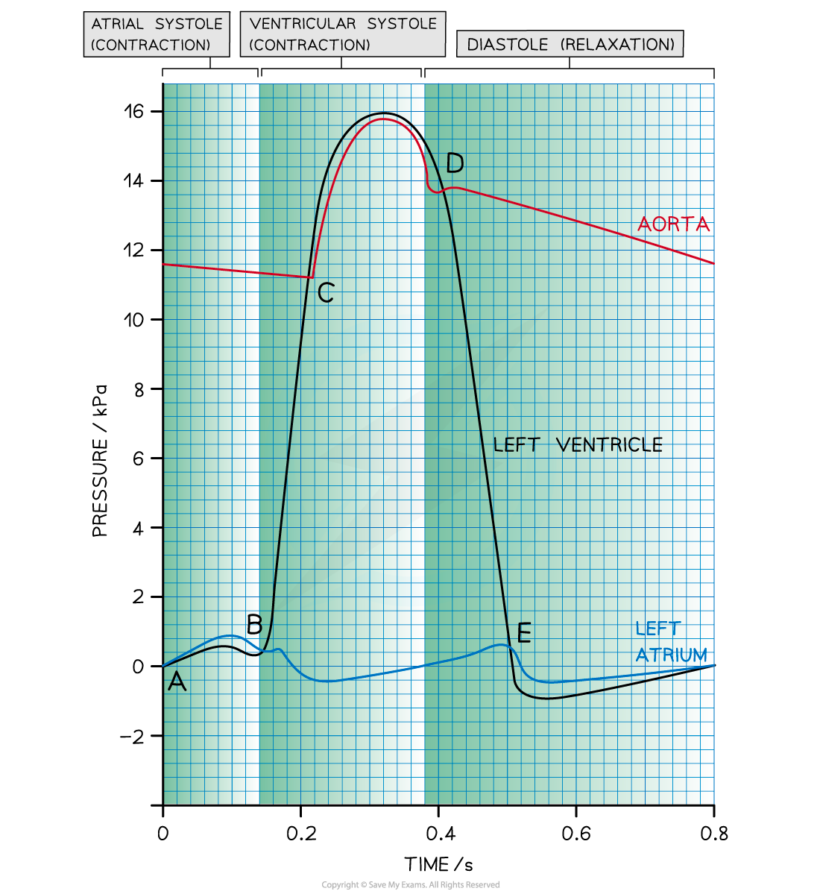
Point A - the end of diastole
The atrium has filled with blood during the preceding diastole.
Pressure is higher in the atrium than in the ventricle, so the AV valve is open
Between points A and B - atrial systole
Left atrium contracts, causing an increase in atrial pressure and forcing blood into the left ventricle.
Ventricular pressure increases slightly as it fills with blood
Pressure is higher in the atrium than in the ventricle, so the AV valve is open

Slide 19
Point B - beginning of ventricular systole
Left ventricle contracts causing the ventricular pressure to increase.
Pressure in the left atrium drops as the muscle relaxes.
Pressure in the ventricle exceeds pressure in the atrium, so the AV valve shuts

Slide 20
Point C - ventricular systole
The ventricle continues to contract.
Pressure in the left ventricle exceeds that in the aorta.
Aortic valve opens and blood is forced into the aorta.

Slide 21
Point D - beginning of diastole
Left ventricle has been emptied of blood
Muscles in the walls of the left ventricle relax and pressure falls below that in the newly filled aorta
Aortic valve closes
Between points D and E - early diastole
The ventricle remains relaxed and ventricular pressure continues to decrease.
In the meantime, blood is flowing into the relaxed atrium from the pulmonary vein, causing an increase in pressure.

Slide 22
Point E - diastole
The relaxed left atrium fills with blood, causing the pressure in the atrium to exceed that in the newly emptied ventricle
AV valve opens
After point E - late diastole
There is a short period of time during which the left ventricle expands due to relaxing muscles
This increases the internal volume of the left ventricle and decreases the ventricular pressure
At the same time, blood is flowing slowly through the newly opened AV valve into the left ventricle, causing a brief decrease in pressure in the left atrium
The pressure in both the atrium and ventricle then increases slowly as they continue to fill with blood

Slide 23
Partner Talk
What:
Explain what is happening at points A-E
How:
In pairs, taking turns
Refer to the pressure and where the blood flows
How long:
2 minutes

Slide 24
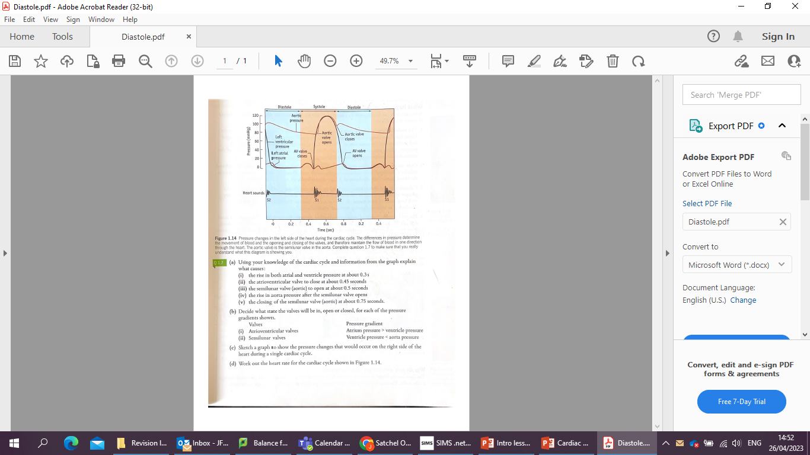

Slide 25
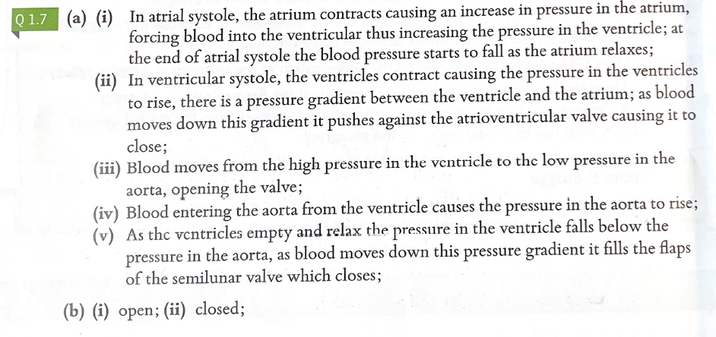

Slide 26
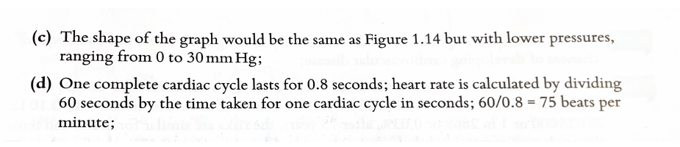

Slide 27
Exam Questions
What:
Answer the questions on the sheets provide
How:
Independently
The teacher will demo how to lay your answer out for some of these questions using the visualiser
How long:
15 mins

Slide 28
Review
What:
Correct your answers using green pen
How:
Use the mark scheme and any students answers on the visualiser
How long:
5 mins

