Slide 1
CP12,CP13, 5.20-5.21 temp impact on organisms, carbon cycle, biofuels 3 May 2022
Do Now
For CP 12 what were your a) independent, b) dependent (including how to measure) and c) control variables?
For CP 13 what were your a) independent, b) dependent and c) control variables?
What is the effect of increasing temperature on the rate of enzyme activity?
Why is climate change controversial ?
State an ethical argument when considering the impact of global warming
How do scientists discuss and review their work?

Slide 2
Review
For CP 12 what were your independent, dependent (including how to measure) and control variables?
Independent = temperature, dependent variable = The rate of oxygen production. This is measured by an inverted measuring cylinder full of water. The water level drops, indicating the volume of oxygen that has been produced. We then calculate the Q10 from our plotted results. Control = Volume of hydrogen peroxide. Mass of potato. Duration of collection.
For CP 13 what were your independent, dependent and control variables?
Independent = the temperature of the solution (e.g. 10, 20, 30, 40, 50 ͦC), the dependent variable = The number of brine shrimp hatched, the controlled variables = volume of water, concentration of salt, number of brine shrimp
What is the effect of increasing temperature on the rate of enzyme activity?
The molecules gain kinetic energy and move faster, enzyme and substrate are more likely to collide , the frequency and energy of collisions increases, more enzyme substrate complexes are made

Slide 3
Review
Why is climate change controversial ?
science cannot prove theories. there is incomplete knowledge of how the climate systems work and the data sets used in making predictions have limitations
State an ethical argument when considering the impact of global warming
we all have the right to choose for ourselves whether or not we use fossil fuels to achieve a good standard of living. we have a duty to allow others to improve their standard of living. we have a duty to preserve the environment for the next generation.
How do scientists discuss and review their work?
scientific journals, peer review, scientific conferences

Slide 4

Thumbs Up/Down. How much do you think you know about:
CORE PRACTICAL 12: Investigate the effect of temperature on the initial rate of an enzyme-catalysed reaction, to include Q10. CORE PRACTICAL 13: Investigate the effects of temperature on the development of organisms (such as seedling growth rate, brine shrimp hatch rates). 5.20 Understand the way in which scientific conclusions about controversial issues, such as what actions should be taken to reduce climate change or the degree to which humans are affecting climate change, can sometimes depend on who is reaching the conclusions. 5.21 Understand how knowledge of the carbon cycle can be applied to methods to reduce atmospheric levels of carbon dioxide.

Slide 5
Focus Area 1 from Do Now:
CORE PRACTICAL 12:
Investigate the effect of temperature on the initial rate of an enzyme-catalysed reaction, to include Q10.

Slide 6
Q10…
Q10 is known as the temperature coefficient, and is calculated by:
Q10 = rate at higher temp
rate at lower temp
It indicates how much the rate of reaction increases with a 10 °C increase in temperature.
https://www.youtube.com/watch?v=UQWWSmGM0yQ

Slide 7
The Enzyme: Catalase…
You will be focusing on the enzyme catalase, which is found in almost all living tissues.
Catalase breaks down hydrogen peroxide (H₂O₂), a toxic metabolic by-product, into water and oxygen.
Collecting and measuring the volume of oxygen gas produced is relatively easy and can be used to work out the rate of reaction.
https://www.youtube.com/watch?v=rABpkD42Ap4
Notes:
Start 2 min 50sec into the video since not doing potatoes

Slide 8
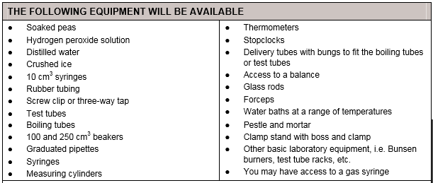
Equipment…
Your Task:
Identify the independent, dependent and controlled variables and how you will monitor/observe them.
Write a method which considers the above and how you will make your results repeatable.
Write up a prediction using research to inform it and reference your sources using the havard referencing system (homework).
Notes:
Results table: oxygen produced every 10 seconds at temperatures 20, 30, 40, 50, 60

Slide 9
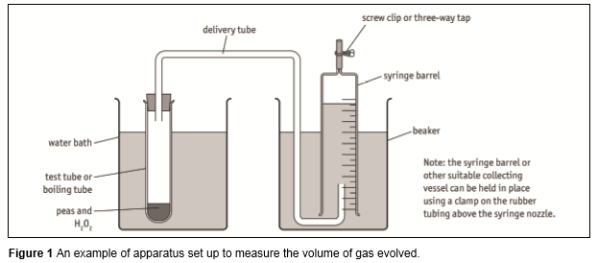
Possible Set up…

Slide 10
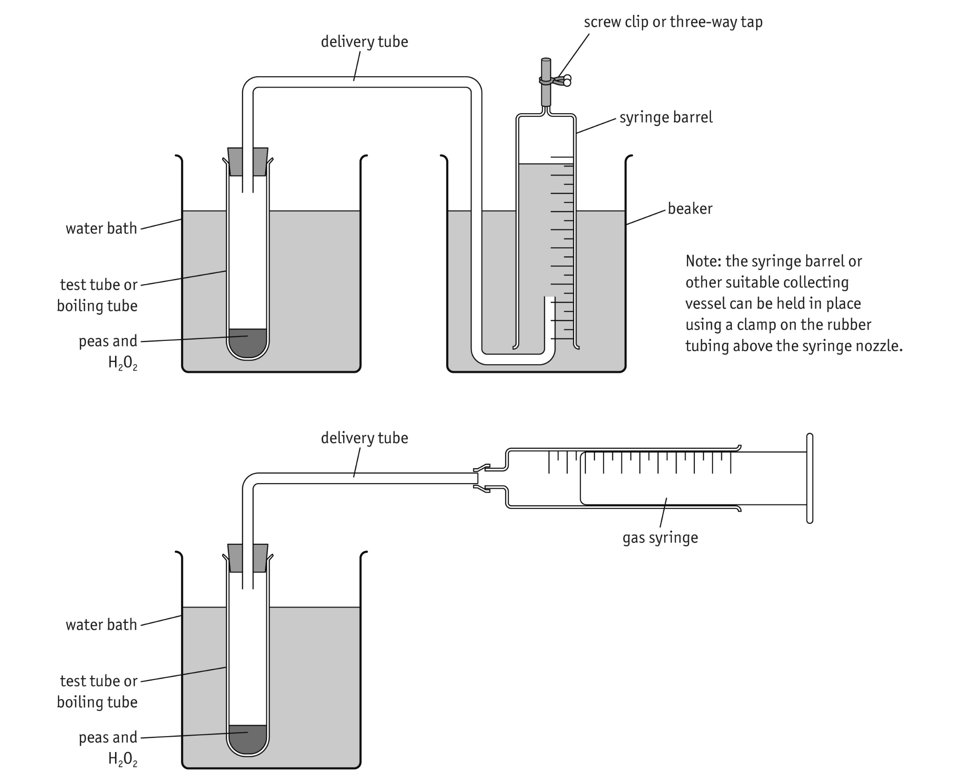

Slide 11
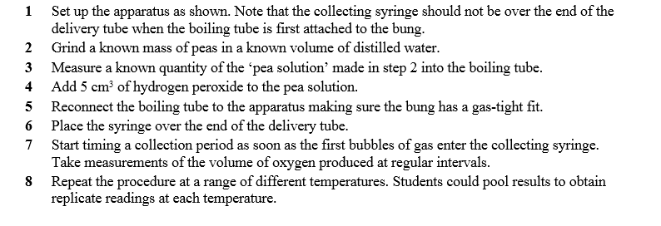
Method

Slide 12
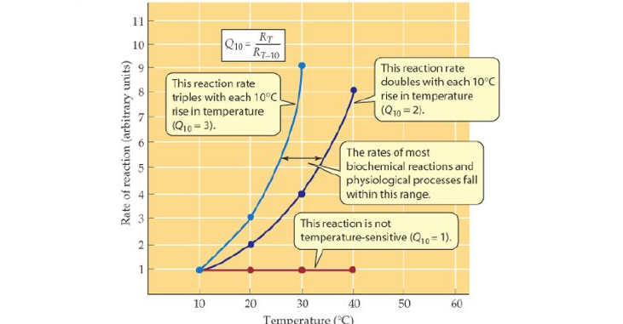

Slide 13
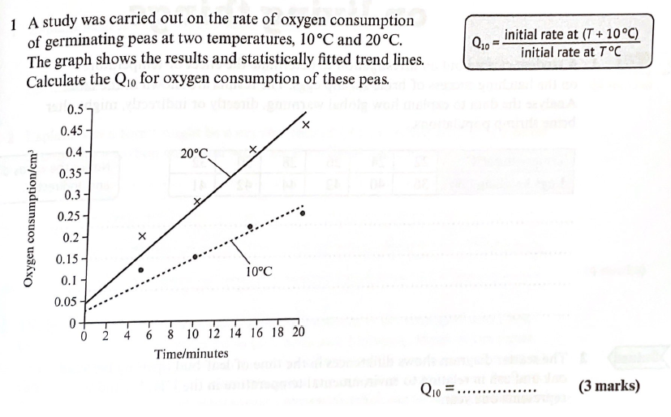
Exam Question

Slide 14
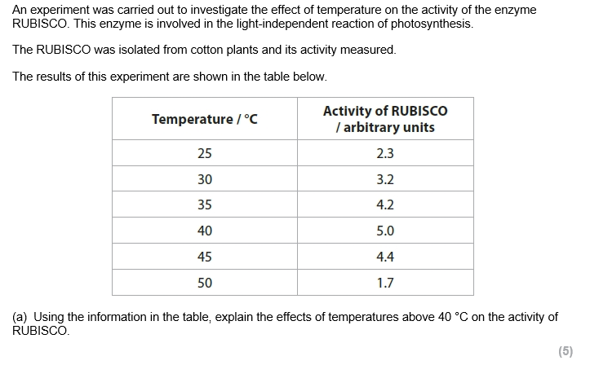
Exam Question

Slide 15
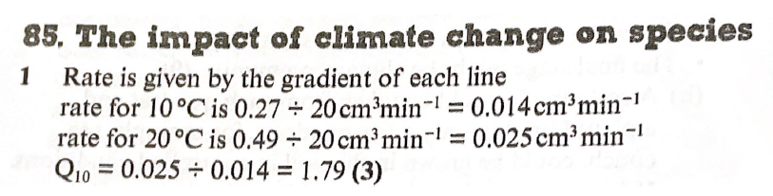

Slide 16
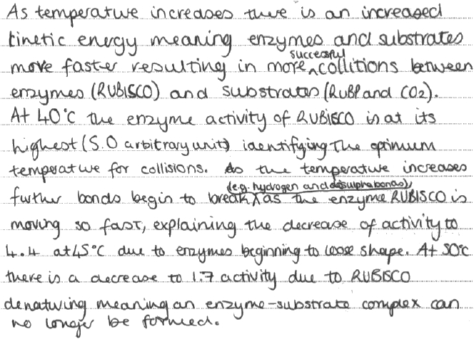
Model Answer

Slide 17
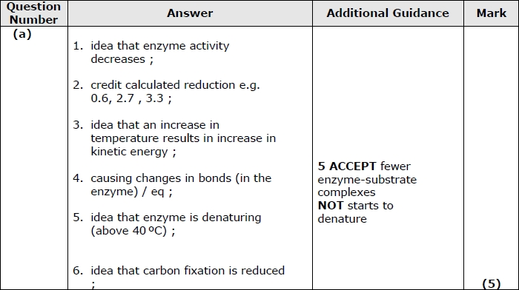

Slide 18
Focus Area 2 from Do Now:
CORE PRACTICAL 13:
Investigate the effects of temperature on the development of organisms (such as seedling growth rate, brine shrimp hatch rates).

Slide 19

Task: while watching the video note:
The independent variable
The dependent variable
The controlled variables
How you will make it repeatable
What is your control disc for?

Slide 20
Review
The independent variable
The temperature of the solution (e.g. 10, 20, 30, 40, 50 ͦC)
The dependent variable
The number of brine shrimp hatched
The controlled variables
Volume of water, concentration of salt, number of brine shrimp
How you will make it repeatable
Repeat the experiment for each temperature 3 times, check for outliers and calculate a mean.

Slide 21
Equipment
YOU NEED
Brine shrimp egg cysts 2 g sea salt for each treatment 100 cm³ de-chlorinated water for each treatment 40 cm³ beaker of salt water 100 cm³ beakers (one for each temperature to be tested) Water baths or incubators (one for each temperature to be investigated) | Stirring rod Magnifying glass Pair of forceps Fine glass pipette Bright light Access to refrigerator Sheet of graph paper 3 cm × 4 cm

Slide 22
Method
Decide on a range of temperatures from 5 °C to 35 °C to be tested.
Place 2 g of sea salt into a 100 cm3 beaker.
Add 100 cm3 of de-chlorinated water and stir until the salt completely dissolves.
Label the beaker with the temperature at which it will be incubated.
Place a tiny pinch of egg cysts onto a large sheet of white paper.
Wet the piece of graph paper using a few drops of salt water. Dab the paper onto the white sheet to pick up approximately 40 eggs. This will look like a tiny shake of pepper. Use a magnifying glass to count the eggs. Cut the graph paper so that there are exactly 40 eggs.
Put the paper with the 40 eggs into the beaker (eggs-side down). After 3 minutes, use a pair of forceps to gently remove the paper, making sure that all the egg cysts have washed off into the water.

Slide 23
Method
Repeat steps 2 to 7 for all the temperatures that are to be investigated.
If possible, replicate the treatments.
Incubate the beakers at the appropriate temperatures. In the ICT Support there is a datalogging sheet on monitoring temperature in a long-term investigation. Set an alarm to remind you to check your brine shrimps at the same time on three or four successive days.
The next day count the number of hatched larvae in each of the beakers. To do this, place a bright light next to the beaker. Any larvae will swim towards the light. Using a fine glass pipette, reversed with the tip inserted into the teat, catch the hatched brine shrimps and place them in a small beaker of salt water. Repeat the counting daily. Brine shrimps are very delicate and care must be taken when handling them. Finally, release the young brine shrimps into a salt water aquarium.
Record the number of larvae that have successfully hatched at each temperature.

Slide 24
Example Results Table
Temperature ( ͦC) | Number of eggs hatched
 | Day 1 |  |  |  | Day 2 |  |  |  | Day 3 |  |  |  | Day 4
 | 1 | 2 | 3 | Av | 1 | 2 | 3 | Av | 1 | 2 | 3 | Av | 1 | 2 | 3 | Av
5 (fridge)
20 (room)
35 (water bath)
50 (water bath)

Slide 25
Show me!
For core practical 13 investigating the effect of temperature on the development of organisms……..

Slide 26
What is the independent variable?
1. The number of brine shrimp hatched
2. Temperature
Option 3
3. Volume of salt water
Option 4
4. Light intensity

Slide 27
What is the dependent variable?
1. The number of brine shrimp hatched
2. Temperature
Option 3
3. Volume of salt water
Option 4
4. Light intensity

Slide 28
What a control variable?
1. The number of brine shrimp hatched
2. Temperature
Option 3
3. Volume of salt water
Option 4
4. Light intensity

Slide 29
Doing three repeats and calculating an average makes the investigation …..
1. Reliable
2. Accurate
Option 3
3. Valid
Option 4
4. Repeatable

Slide 30
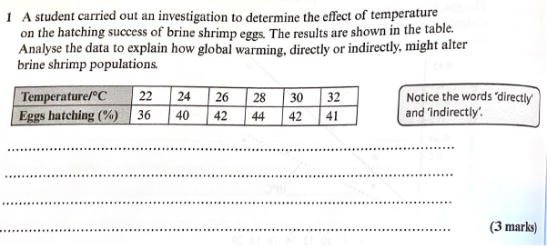
Exam Question

Slide 31
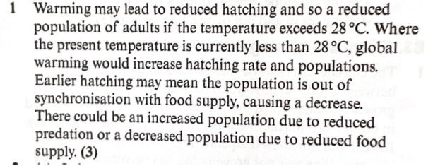
Answers

Slide 32
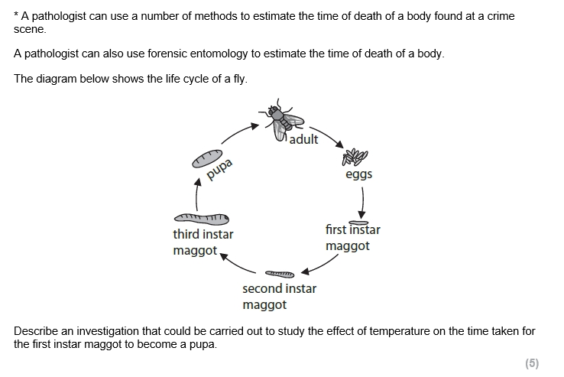
Exam Question

Slide 33
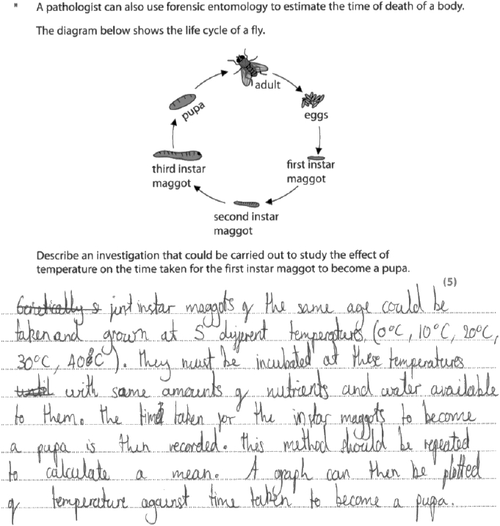
Model Answer
The examiners did not like the use of the word nutrients though

Slide 34
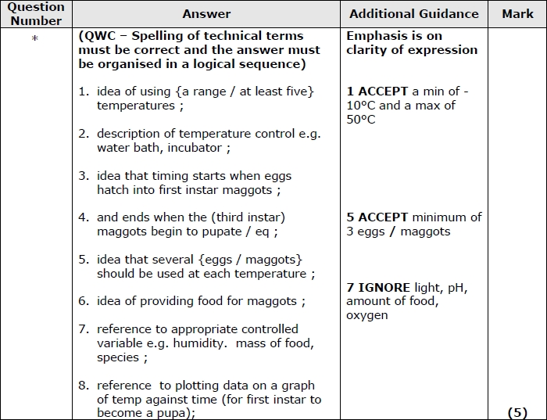

Slide 35
Focus Area 3 from Do Now:
5.20 Understand the way in which scientific conclusions about controversial issues, such as what actions should be taken to reduce climate change or the degree to which humans are affecting climate change, can sometimes depend on who is reaching the conclusions.
5.21 Understand how knowledge of the carbon cycle can be applied to methods to reduce atmospheric levels of carbon dioxide.

Slide 36
Can’t be proven- we try to disprove them time and time again
With increasing failed attempts, the theory becomes more widely accepted
Scientific Theory
Temperatures are rising, as are greenhouse emissions
Incomplete knowledge about how climate systems work
Emission levels are estimates based on defensible procedures
e.g. no way to determine exactly how much carbon added to atmosphere by combustion
Instead, current temperature changes are part of natural cycle, or due to changes in Sun’s activity
In fact, rising carbon dioxide levels in atmosphere will mean greater GPP!
What are your personal priorities? Now pick a side!

Slide 37
We all have the right to chose for ourselves whether we use fossil fuels
We have a duty to preserve the environment for future generations
We have a duty to others to allow improved standard of living (industrialisation)
Ethical Arguments are often quoted

Slide 38
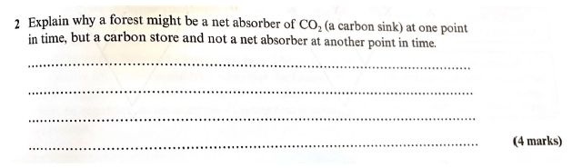
Exam Question

Slide 39

Answer

Slide 40
Exam Skill Focus:
Complete the exam questions in the booklet provided by your teacher.
The teacher will project some of the questions on the visualiser to help you to answer them.
Then mark using the mark scheme and add in improvements in green pen.
Teacher note: At least 25 minutes of the lesson should be spent doing this

Slide 41
Exit Ticket
Traffic light your PLC for:
CORE PRACTICAL 12:
Investigate the effect of temperature on the initial rate of an enzyme-catalysed reaction, to include Q10.
CORE PRACTICAL 13:
Investigate the effects of temperature on the development of organisms (such as seedling growth rate, brine shrimp hatch rates).
5.20 Understand the way in which scientific conclusions about controversial issues, such as what actions should be taken to reduce climate change or the degree to which humans are affecting climate change, can sometimes depend on who is reaching the conclusions.
5.21 Understand how knowledge of the carbon cycle can be applied to methods to reduce atmospheric levels of carbon dioxide.

