Slide 1
Data Analysis Skills 15-Mar-23
Do Now
Can you remember the definitions of these command words?
Write a definition for each on your mini whiteboard.
Assess
Calculate
Choose
Comment
Compare and contrast
Criticise
Deduce
Describe

Slide 2
Answers
Assess | Consider all the factors that apply to the situation and identify which are the most important or relevant. Make a judgement on the importance of these factors, and come to a conclusion.
Calculate | Use the numbers in the question to workout the answer.
Choose | Carefully pick from a range of options.
Comment | Requires the use of trends in data to form a judgement.
Compare and contrast | Describe the similarities and differences between things. You must not just write what you know about each thing. You might need to use data to back up your statements.
Criticise | Look at the merits (+) and faults(-) of the information presented and support your judgements by giving evidence.
Deduce | Draw conclusions using the information provided.
Describe | Say what you can see or say what happens in a process step by step.

Slide 3
Lesson objectives
To review A03 skills required for your A-level Biology exams.
The Bigger Picture
A03 questions are roughly 25-27% of your marks
They are usually based on experiment skills
They require you to analyse, interpret and evaluate scientific information, ideas and evidence, including in relation to issues, to:
make judgements and reach conclusions
develop and refine practical design and procedures

Slide 4
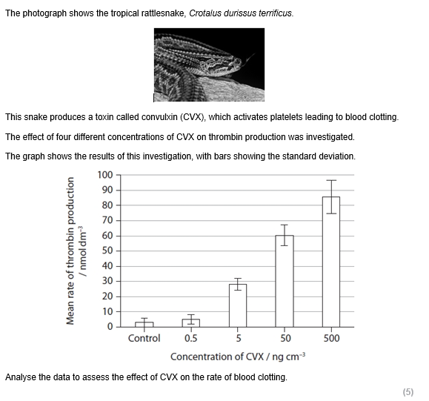
Mini whiteboards
What would you write if ? was describe?
Answers
Thrombin production increases as the concentration of CVX increases.
Therefore, the higher concentration of CVX, the higher the rate of blood clotting.
The relationship between concentration of CVX and rate of thrombin production is not proportional.
There is little difference between the control and 0.5.
The largest difference is between 5ngcm-3 and 50ngcm-3.
?

Slide 5
Mini whiteboards
What would you write if ? was explain?
Answers
Greater thrombin production leads to a faster rate of conversion of fibrinogen to fibrin.
Therefore, greater thrombin production leads to a faster rate of blood clotting.
?

Slide 6
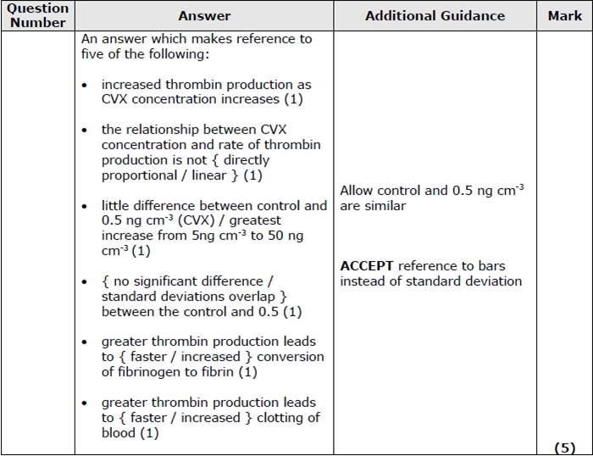
Mini whiteboards
Now answer the actual exam question!

Slide 7
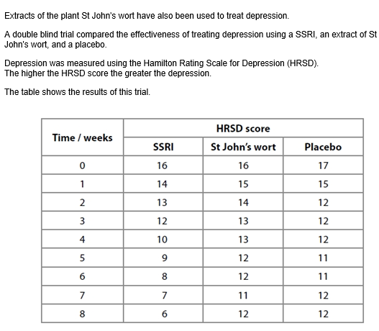
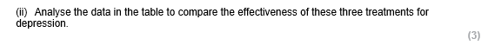
Independent task
What:
Answer the exam question
How:
On lined paper, independently
How long:
3 mins

Slide 8
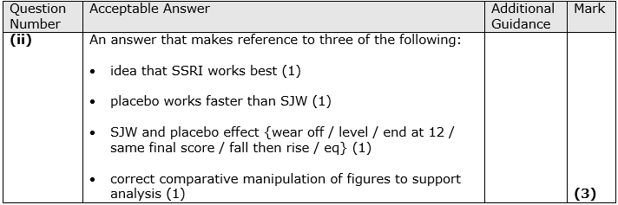
Review

Slide 9
Exam questions
What:
Answer the exam questions
How:
On the printed sheets, independently or in pairs
How long:
10 mins
*Teacher to break down how to lay your answers out on visualiser

Slide 10
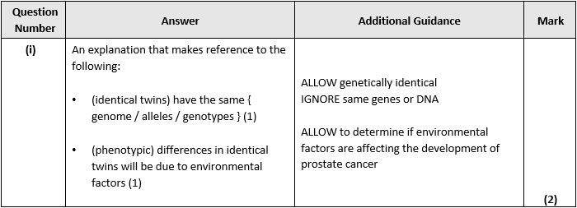
Review
Review

Slide 11
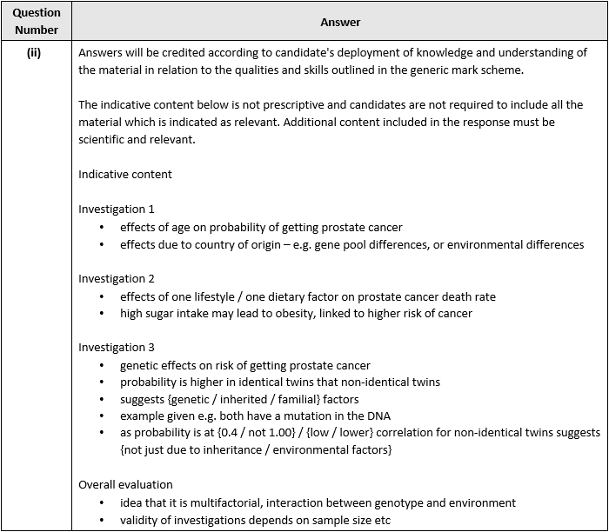
*Teacher live mark

Slide 12
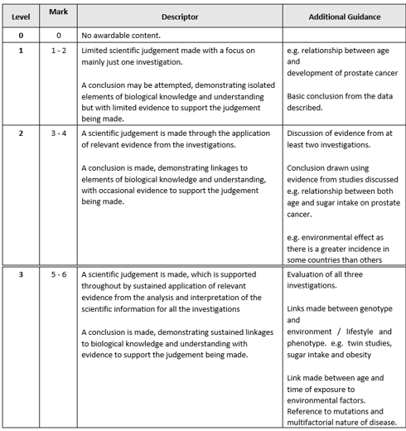

Slide 13
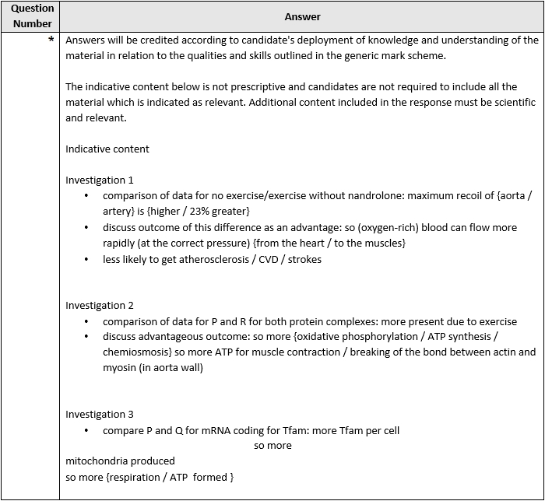
Q2

Slide 14
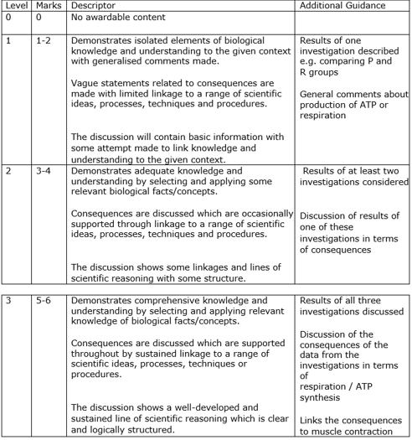

Slide 15
Exit Ticket
What rules would you give yourself when answering an ‘analyse’ question?
Suggestions:
Check what the command word is after this.
Describe trends in the data that show what is being asked for.
Look out for any SD overlaps
Add in data manipulation to demonstrate the trend being described/asked for.
Identify any biological knowledge that you might need to apply.

Slide 16
Lesson objectives
To review A03 skills required for your A-level Biology exams.
The Bigger Picture
A03 questions are roughly 25-27% of your marks
They are usually based on experiment skills
They require you to analyse, interpret and evaluate scientific information, ideas and evidence, including in relation to issues, to:
make judgements and reach conclusions
develop and refine practical design and procedures

