Slide 1
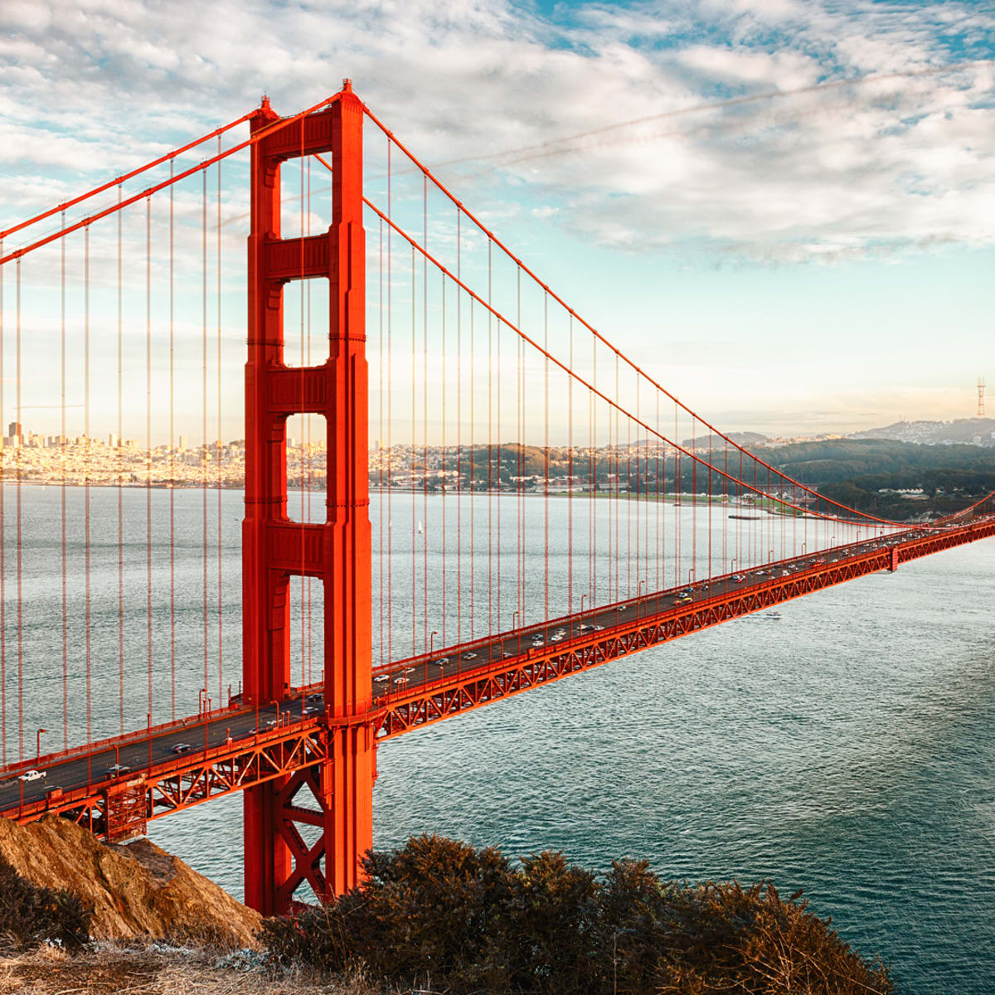


Economics Bridging Menu
You are about to start an exciting journey into the world of Economics, good luck!
Remember
Choose what modules you do and when, but work through them consistently. Different tasks will take you varying amounts of time, but on average you should aim to do one or two per week
All green tasks are core modules, they are compulsory and must be brought to your first lesson back in September
The red hot chili indicates that the task is more challenging than the others
Numbers eg (1) correspond to how you should evidence the module which can be found in the slides following the menu. They can be saved within this powerpoint or as separate documents clearly labelled with the subject

Slide 2





Economics Bridging Menu (Green modules are core (compulsory) modules , indicates the most challenging modules )
 | Read | Watch | Listen | Visit (virtually or physically at a later date) | Do
 | Undercover Economist The book provides an introduction to principles of economics, including demand-supply interactions, market failures, externalities, globalisation, international trade and comparative advantage. (1) | Moneyball Oakland A's general manager Billy Beane's successful attempt to assemble a baseball team on a lean budget by employing computer-generated analysis to acquire new players. (1) | Demand and Supply – What are you waiting for? Income inequality A true story of the gender pay gap (1) | Visit the Bank of England (7) | MOOCs https://www.futurelearn.com/courses/global-prosperity Search through the MOOCs on Unifrog using the filter ‘Economics’ and chose one that particularly interests you (5)
 | Poor Economics Why do the poor borrow to save? Why do they miss out on free life-saving immunizations, but pay for unnecessary drugs? In Poor Economics, Abhijit V. Banerjee and Esther Duflo, answer these questions from the ground. (1) | Inside Job An analysis of the global financial crisis of 2008, which at a cost over $20 trillion, caused millions of people to lose their jobs and homes in the worst recession since the Great Depression, and nearly resulted in a global financial collapse. (1) |  | LSE Economics Department Open Day (6) | Young Economist of the Year Essay writing Competition (3)
 |  |  | Economics in Ten (1)
 |  |  | Planet Money Podcast: The Tale of the Onion King (2)
 |  |  |  |  | Choose a developed and a developing country – Research and produce a presentation on the Economic Growth Level of Unemployment Inflation Rate House Prices Average Wage National Debt Main industries Explain what each of these indicators show and how they impact the different groups of people in society e.g. Government, businesses and consumers. How has each country’s economy been affected by Covid 19? What are the main points of comparison for the economies overall? (4)
 | The truth about Markets Why market economies performed better than socialist or centrally directed ones. The book looks at markets in a number of different settings around the world. (1) | Capitalism – A love story An examination of the social costs of corporate interests pursuing profits at the expense of the public good. (1) | How Trickle-Down Economics Works? (1) | Gresham College Lecture: Executive Pay – What’s right, what’s wrong and what could be fixed? (1)
 | Nudge Nudge is about choices - how we make them and how we can make better ones. (1) | Sicko A film comparing international health care systems. (1) | Are the Rich Really Less Generous Than the Poor? (1)
 |  |  |  | LSE Public Lectures (1)
 | Talking to My Daughter About the Economy: A Brief History of Capitalism by Yanis Varoufakis (1) | TED Talks (1) Donut Economics The Economics of Enough Why renewables can’t save the planet | Should we really behave like economist say we do? (1)
 |  |  |  | Explore the Unifrog Economics Guide including the ‘Geek Out’ sections (1)
 | Freakonomics The hidden side of everything! (1) | Margin Call: A boardroom crisis ensues at an investment bank when one young analyst begins to raise questions about the company's financial stability (Thriller) (1)

Slide 3
(1) - Book/Journal/Podcast/Film Review
Would you/would you not recommend it? Why?
Rating:
Review by: ___________________________________________
Title: _______________________________________________________
Author: ____________________________________________________
Review of (please circle)
Book Journal Podcast Film Documentary
What was it about?
What did you find particularly interesting/inspiring/shocking? Has this changed your opinion?
What would you like to learn more about?
How does it link to this subject and why is it important?
copy the template as many times as you need

Slide 4

(2) Planet Money Podcast: The Tale of the Onion King
1. How are onion prices set?
2. What are futures? Apply to an agriculatural market e.g. wheat
3. What does Cornering the market mean? Apply to Vincent W. Kosuga, the onion king, and what he did.
4. How did he corner the market?
5. Why did he do this in secret?
6. How did he create an onion shortage?
7. How did he make a million?
8. How did he make his second million?
9. Affect on other onion farmers?
10. Overall results on onion market (include new laws)
11. Why would this never happen now?
You can type up your answers and bring along to the first lesson

Slide 5
Young Economist of the Year Essay writing Competition (3)
Upload your essay onto your application as a word document and save it as ‘Young Economist of the Year Essay’

Slide 6
(4) Research presentation comparing and contrasting two developing countries
Do this as a powerpoint presentation
Include a slide on each bullet point for each country
Add the notes you would say in the notes section beneath each slide so that each slide just shows the key concise points
(if you don’t have powerpoint you can write a report)

Slide 7
MOOCs (5)
To evidence this you can
Save any notes you take
Take and save a screenshot of completed modules or the completed course
If there is a downloadable certificate save as ‘Economics MOOC’ and print and bring along to the first lesson back

Slide 8
LSE Economics Department Open Day (6)
What is the first year like on the BSc Economics Programme?
What can I expect over the three years?
How important is Maths for an Economics Degree?
Why study Economics and what does LSE have to offer?
What do LSE look for in applicants?
Save your answers and bring along with you to your first lesson

Slide 9
(7) Visit the BoE
Choose whether you would like to make a
Podcast
Informative flyer
Mini film
Report
Newspaper article

