Slide 1
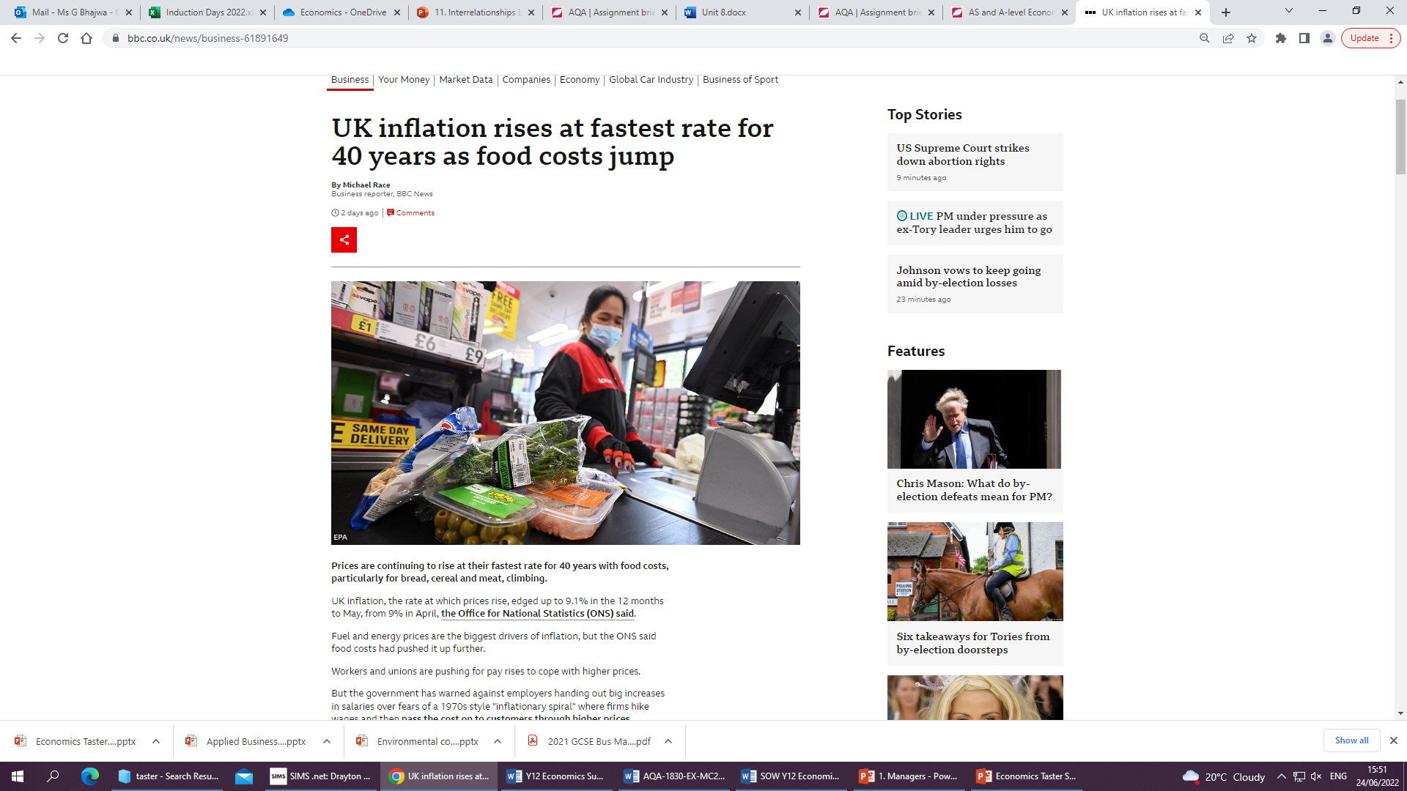
Economics Taster Session
Contents
Breakdown of the course
Skills you will develop
Insight into the content which will be studied on this course
Transition tasks and expectations
Do Now:
Use your high level analytical skills to explain the economic implications of this headline from BBC News
Challenge: How can you link this article to the recent rail strikes that took place?
Notes:
Hello everyone and welcome to today’s session on Retrieval Practise. The aims of this session is to understand how we should structure retrieval practise to maximise long term memory and when we should use retrieval practise.

Slide 2
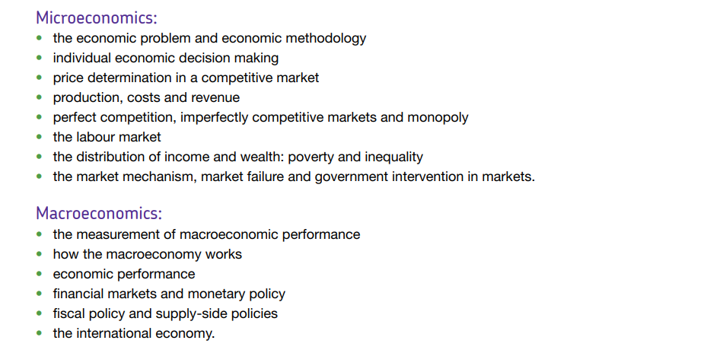
A Level Economics Content

Slide 3
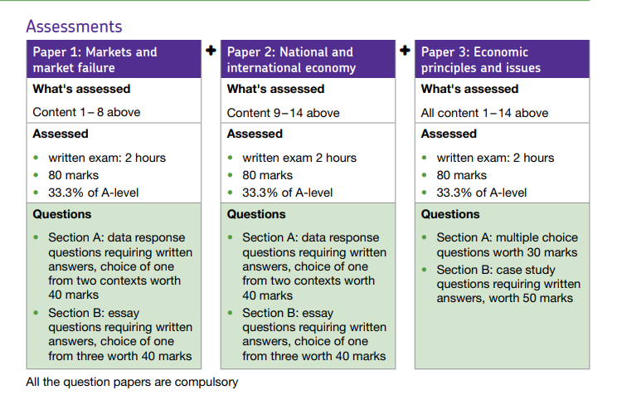

Slide 4

Key Skills
Knowledge and Understanding
Application
Analysis
Evaluation
Quantitative
Data Interpretation
Constructing diagrams
Critical Thinking
Problem Solving

Slide 5

Activity 1
What is a dialysis machine?

Slide 6
Scenario
These machines are used for patients who have kidneys that do not work properly – without dialysis the patients would quickly die.
Dialysis machines are very expensive to purchase.
Some kidneys can get a kidney transplant which means they wont need dialysis any longer.

Slide 7

Activity: In pairs, decide how you will allocate the 30 hours, in order of preference. Justify in the blank box next to it why you have made this choice
A hospital in town has one dialysis machine that can run for 30 hours per week. As the lead doctor of the hospital, you must decide who gets the treatment.
There are a number of patients who require treatment and their needs are given on the sheets on your table.
Notes:
Have discussion and feedback from each pair or group

Slide 8
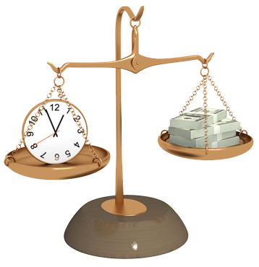


What have we learnt from this activity?

Slide 9

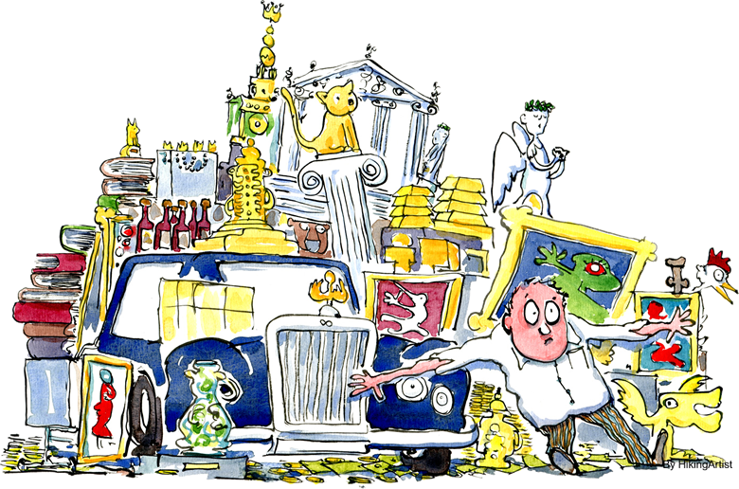
Scarce Resources
The Earth has finite resources
Humans have infinite wants
So…
We can’t have everything we want
and so…
We must make choices
We must give up one opportunity to take another
In Economics we call this the Opportunity Cost

Slide 10

Making Choices
In life, decisions always have to be made as you cannot do everything
This is especially true when you only have a certain amount of time and money.
Every choice involves an opportunity costs, when you choose one thing, you're giving up others.

Slide 11
Opportunity Cost
The choices people make have both present and future consequences. Any opportunity you take up means you are losing out on something else.
For example if you decide to stay in full-time education until 21 you are losing out on earning money straight away.
This would be your opportunity cost.

Slide 12

Opportunity Cost
What would be your opportunity cost of picking Economics as an A Level subject?

Slide 13

Activity 2 - Experiment
Two participants
You have two options – SPLIT or STEAL (you cannot show your opponent your choice)
If both parties SPLIT – you both get to share the KitKat
If both participants STEAL – both of you will leave with nothing
If one party steals and the other split – the person who steals gets to keep the whole chocolate and the person who splits leaves with nothing

Slide 14
Rational economic decision making
Occurs when individuals compare the benefits and costs of alternative decisions and select the one that maximises their personal net benefit
What are the characteristics of a rational consumer?

Slide 15

Economic Man (Homo Economicus)
Behaves Rationally
Has Complete Knowledge
Behavioural economists question this concept and argue that these assumptions are not realistic in modern society
Acts solely in self-interest
Aims to maximise personal utility/satisfaction/happiness

Slide 16
Behavioural Economics
Behavioural Economics tries to mix insights from Psychology with Economics, and looks at problems through the eye of a “Human”, rather than an “Econ”.
Behavioural economics uses insights from psychology to explain why people make apparently irrational decisions such as why people eat too much, take too little exercise, or do not save enough for retirement.

Slide 17
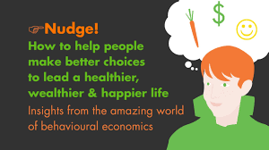
Richard Thaler - Nudge
https://www.youtube.com/watch?v=xoA8N6nJMRs

Slide 18
Nudge
Nudge: Improving Decisions about Health, Wealth and Happiness is a famous 2008 book by economist Richard Thaler and legal scholar Cass Sunstein.
Impressed with the ideas in Nudge the coalition government under prime minister David Cameron on coming into power in 2010 set up the Behavioural Insights Team (BIT) to advise the government on how nudging could be used in policy-making.

Slide 19
Activity 2 - Experiment
Two participants
You have two options – SPLIT or STEAL (you cannot show your opponent your choice)
If both parties SPLIT – you both get to share the KitKat
If both participants STEAL – both of you will leave with nothing
If one party steals and the other split – the person who steals gets to keep the whole chocolate and the person who splits leaves with nothing

Slide 20
Inequity Aversion
Altruism is often linked to the concept of inequity aversion i.e. humans do not like unequal outcomes.
Whilst this is usually seen as positive, it can also result in a negative outcome e.g. a person being willing to forego a gain / reward if it means that someone else won’t gain an even better reward.

Slide 21
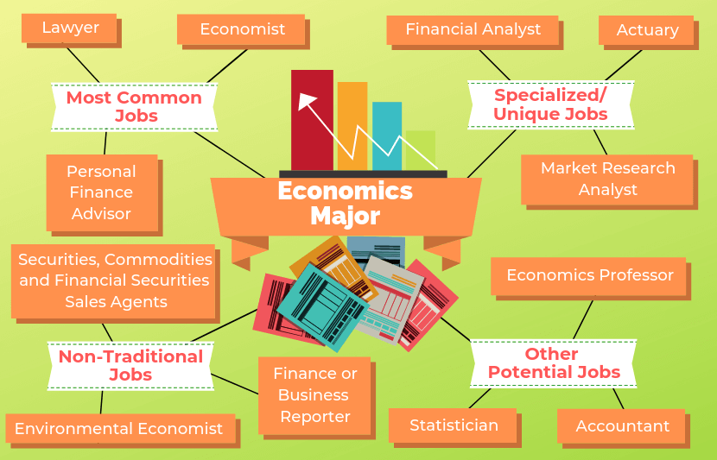
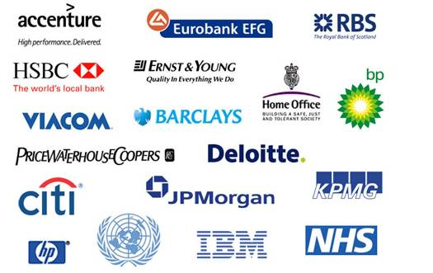
Economics
Economics is the science which studies human behaviour as a relationship between unlimited wants and scarce resources which have alternative uses.

Slide 22
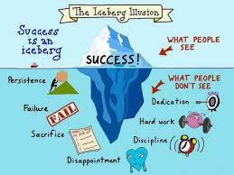
Expectations
Alongside the other 6th form expectations, in Economics we expect you to
Be prepared to be assessed regularly
Meet weekly homework deadlines
Have a folder with dividers to maintain organisation of notes, homework, and assessments
Keep a journal of the wider reading you are encouraged to do on this course

Slide 23



Economics Bridging Menu
You are about to start an exciting journey into the world of Economics, good luck!
Remember
Choose what modules you do and when, but work through them consistently. Different tasks will take you varying amounts of time, but on average you should aim to do one or two per week
All green tasks are core modules, they are compulsory and must be completed and uploaded to your application by 19 August
The red hot chili indicates that the task is more challenging than the others
Numbers eg (1) correspond to how you should evidence the module which can be found in the slides following the menu. They can be saved within this powerpoint or as separate documents clearly labelled with the subject

Slide 24





Economics Bridging Menu (Green modules are core (compulsory) modules , indicates the most challenging modules )
 | Read | Watch | Listen | Visit (virtually or physically at a later date) | Do
 | Undercover Economist The book provides an introduction to principles of economics, including demand-supply interactions, market failures, externalities, globalisation, international trade and comparative advantage. (1) | Moneyball Oakland A's general manager Billy Beane's successful attempt to assemble a baseball team on a lean budget by employing computer-generated analysis to acquire new players. (1) | Demand and Supply – What are you waiting for? Income inequality A true story of the gender pay gap (1) | Visit the Bank of England (if reopened to the public) (7) | MOOCs https://www.futurelearn.com/courses/global-prosperity Search through the MOOCs on Unifrog using the filter ‘Economics’ and chose one that particularly interests you (5)
 | Poor Economics Why do the poor borrow to save? Why do they miss out on free life-saving immunizations, but pay for unnecessary drugs? In Poor Economics, Abhijit V. Banerjee and Esther Duflo, answer these questions from the ground. (1) | Inside Job An analysis of the global financial crisis of 2008, which at a cost over $20 trillion, caused millions of people to lose their jobs and homes in the worst recession since the Great Depression, and nearly resulted in a global financial collapse. (1) |  | LSE Economics Department Open Day (6) Navigate to find the academic department sessions and watch the recorded sessions for Department of Economics | Young Economist of the Year Essay writing Competition (3)
 |  |  | Economics in Ten (1)
 |  |  | Planet Money Podcast: The Tale of the Onion King (2)
 |  |  |  |  | Choose a developed and a developing country – Research and produce a presentation on the Economic Growth Level of Unemployment Inflation Rate House Prices Average Wage National Debt Main industries Explain what each of these indicators show and how they impact the different groups of people in society e.g. Government, businesses and consumers. How has each country’s economy been affected by Covid 19? What are the main points of comparison for the economies overall? (4)
 | The truth about Markets Why market economies performed better than socialist or centrally directed ones. The book looks at markets in a number of different settings around the world. (1) | Capitalism – A love story An examination of the social costs of corporate interests pursuing profits at the expense of the public good. (1) | Are the Rich Really Less Generous Than the Poor? (1) | Gresham College Lecture: Nudging society to better decisions (1)
 | Nudge Nudge is about choices - how we make them and how we can make better ones. (1) | Sicko A film comparing international health care systems. (1)
 |  |  |  | LSE Public Lectures (1)
 | Talking to My Daughter About the Economy: A Brief History of Capitalism by Yanis Varoufakis (1) | TED Talks (1) Donut Economics The Economics of Enough Why renewables can’t save the planet | Should we really behave like economist say we do? (1)
 |  |  |  | Explore the Unifrog Economics Guide including the ‘Geek Out’ sections (1)
 | Freakonomics The hidden side of everything! (1) | Margin Call: A boardroom crisis ensues at an investment bank when one young analyst begins to raise questions about the company's financial stability (Thriller) (1)

Slide 25
(1) - Book/Journal/Podcast/Film Review
Would you/would you not recommend it? Why?
Rating:
Review by: ___________________________________________
Title: _______________________________________________________
Author: ____________________________________________________
Review of (please circle)
Book Journal Podcast Film Documentary
What was it about?
What did you find particularly interesting/inspiring/shocking? Has this changed your opinion?
What would you like to learn more about?
How does it link to this subject and why is it important?
Save your answers as part of this powerpoint & copy the template as many times as you need

Slide 26

(2) Planet Money Podcast: The Tale of the Onion King
1. How are onion prices set?
2. What are futures? Apply to an agriculatural market e.g. wheat
3. What does Cornering the market mean? Apply to Vincent W. Kosuga, the onion king, and what he did.
4. How did he corner the market?
5. Why did he do this in secret?
6. How did he create an onion shortage?
7. How did he make a million?
8. How did he make his second million?
9. Affect on other onion farmers?
10. Overall results on onion market (include new laws)
11. Why would this never happen now?
’

Slide 27
Young Economist of the Year Essay writing Competition (3)
Upload your essay onto your application as a word document and save it as ‘Young Economist of the Year Essay’

Slide 28
(4) Research presentation comparing and contrasting two developing countries
Do this as a powerpoint presentation
Include a slide on each bullet point for each country
Add the notes you would say in the notes section beneath each slide so that each slide just shows the key concise points

Slide 29
MOOCs (5)
To evidence this you can
Save any notes you take
Take and save a screenshot of completed modules or the completed course
Save it as part of this powerpoint or if there is a downloadable certificate save as ‘Economics MOOC’ on your application

Slide 30
LSE Economics Department Open Day (6)
What is the first year like on the BSc Economics Programme?
What can I expect over the three years?
How important is Maths for an Economics Degree?
Why study Economics and what does LSE have to offer?
What do LSE look for in applicants?
Save your answers on your application as part of this powerpoint

Slide 31
(7) Visit the BoE
Choose whether you would like to make a
Podcast
Informative flyer
Mini film
Report
Newspaper article

