Slide 1
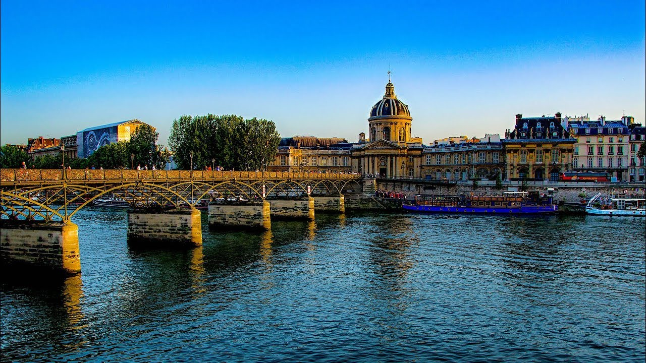

French Bridging Menu
You are about to start an exciting journey into the world of French A level
– well done!
Remember:
Choose what modules you do and when, but work through them consistently. Different tasks will take you varying amounts of time
- on average you should aim to do one or two per week
All green tasks are core modules - they are compulsory and
they must be completed and brought to your first lesson in September
The red chilli indicates that the task is more challenging than the others
Numbers eg (1) correspond to how you should evidence the module
which can be found in the slides following the menu.
You can download a copy of this PowerPoint and add in your answers.
Bon travail et bon courage!

Slide 2





French Bridging Portfolio (All green tasks are those which are compulsory elements of your portfolio)
 | Read | Watch | Listen | Visit (virtually or physically at a later date) | Do
 | News | Film/TV review (3) Watch and review a French film, short film, or TV episode. | Podcasts | Museums (4) Go on a virtual museum tour of one of the museums and complete the task. Musée du Louvre Musée d'Orsay Musée de l'orangerie Musée du quai Branly | Grammar Practise the following: Present tense Perfect tense with avoir Perfect tense with être Imperfect – states of being, habitual actions Perfect vs. imperfect Upload a photo of your work to the your locker on Unifrog.
 | News log (2) Explore a topic/topics from the news in different French media and keep a log of what you find. |  | Le festival de Cannes (6) Listen to the podcast episode and complete the tasks.
 |  | Les bandes dessinées
 |  | Watch this video about the history of comics in French and answer the questions (6). | La famille en confinement (5) Episode: ‘parents et confinés ensemble’ (middle of webpage).
 | Le confinement en France (5) Article about lockdown in France during the coronavirus pandemic. |  | La famille en confinement (5)
 | Literature in French or in translation | Interview with Emma (comics writer and illustrator) about emotional labour on the Radio Télévision Suisse (9). | La revue de la semaine (2) Weekly look at French politics by politician Jean-Luc Mélenchon. | French at university (1) Explore the section for French and other associated degrees in the 'Geek Out' section on Unifrog.
 | Short stories: Le petit prince (Antoine de Saint-Exupéry) Famous French story, also available as audiobook. (1) La parure (Guy de Maupsassant) Famous short story. (1)
 |  |  |  |  | French regional stereotypes Watch the video for 'Chez moi’ (Big Flo & Oli). Click CC in the bottom right for French subtitles. Research and explain the regional stereotypes : Bordeaux Normandie Lyon Marseille Saint-Etienne la Bretagne (Brest/Rennes) Paris Montpellier Nantes Toulouse Upload your answers to your locker on UniFrog and use title ’Regional stereotypes’.
 |  |  | News in slow French (2) Updated several times a week with news stories and reflections on lockdown. |  | French regional stereotypes Watch the video for 'Chez moi’ (Big Flo & Oli). Click CC in the bottom right for French subtitles. Research and explain he regional stereotypes : Bordeaux Normandie Lyon Marseille Saint-Etienne la Bretagne (Brest/Rennes) Paris Montpellier Nantes Toulouse
 | Novel: La peste (Albert Camus) Novel about a plague outbreak in Algeria. (1) |  | Music (3) Explore one or more artists on LyricsTraining. Watch their videos, read the lyrics closely and practise with the gap fill tasks. Write a response in French. Suggestions: Angèle Stromae Zaz Indila Cœur de pirate MC Solaar Kyo | French monuments (4) Go on a virtual tour of one or more of these and complete the task: Palais Garnier Eiffel Tower Cathédrale de Strasbourg Châteaux de la Loire: Angers Chambord Grotte de Lascaux Le Mont St Michel (here and here) Bastille fort in Grenoble
 | Poems: Demain dès l’aube (Victor Hugo) A classic 19th-century poem frequently taught in French schools. Text and English translation. (1) Les Hiboux (Robert Densnos) Often taught in French schools. Reading and video. (1) | Languages and linguistics
 | News: le confinement en France (10) Article about lockdown in France during the coronavirus pandemic. | The linguistic genius of babies (1) Lecture on how babies collect ‘data’ from the world around them to learn how to talk.
 | Les bandes dessinées (7) Choose one of the comics and respond to the question prompts. | What our language habits reveal (1) Lecture by famous linguist Steven Pinker.

Slide 3
(1) – Literature/Podcast/Lecture review
Would you/would you not recommend it? Why?
Rating:
Review by: ___________________________________________
Title: _______________________________________________________
Author: ____________________________________________________
Review of (please circle)
Book Journal Podcast Film Documentary
What was it about?
What did you find particularly interesting/inspiring/shocking? Has this changed your opinion?
What would you like to learn more about?
How does it link to this subject and why is it important?
Save your answers as part of this PowerPoint in your locker and copy the template as many times as you need.

Slide 4
(2) News log
Use these French websites to explore the news (in increasing order of difficulty):
1 jour 1 actu, L'Actu, 20 minutes, Le Parisien
You can explore how a topic is discussed on different websites, or you can explore different topics on the same website.
Log your findings in the table below.
Topic | Website/link | Summary in English | Vocab learned (English and French)

Slide 5
(3) Review of French film/short film/TV series/song/musician
Films |  | Short films
L'Auberge espagnole Intouchables La Vie est un long fleuve tranquille Les Demoiselles de Rochefort OSS 177 Le Caire nid d'espions OSS 117 Rio ne répond plus La Grande vadrouille Les Vacances de Monsieur Hulot La Haine (you will study this film next year) On Netflix: La famille Bélier Albert Camus Madame Bovary | On Amazon Prime: Back to Burgundy Once in a Lifetime Franz What's in a Name Amélie Dinner Game 120 BPM Little White Lies Divines Faces Places School of life Délicatessen | Majorité opprimée, Elénore Pourriat (Youtube) L'Homme qui plantait des arbres, Frédéric Back (YouTube) (winner of the oscar for best short in 1988) La Jetée, Chris Marker (Vimeo) (winner of the Palme d'Or 1962) Le sang d'un poète, Jean Cocteau
 |  | TV Series
 |  | Call My Agent (Netflix) A very Secret Service (Netflix) Fais pas ci, Fais pas ça (YouTube, S01E01 here) Marseille (Amazon Prime)
Give your opinion, in French, of the film/épisode you watched, answering these questions:
Quels sont les thèmes principaux du film/de l’épisode/de la chanson?
Quelle impression t'a-t-il laissé?
As-tu aimé la fin?
Est-ce que tu recommenderais ce film/cet episode/cette chanson à un(e) ami(e) ? Pourquoi ?
(If you install the Language Learning with Netflix extension on your browser you can have French and English subtitles simultaneously!)

Slide 6
(4) Virtual museum tour
Choose whether you would like to write:
an informative flyer the museum/monument
a blog post about visiting the museum/monument
a description of a work of art/monument, why you chose it and your opinion.
Guidelines:
Write in French.
Include information and opinions.
Try to include a range of GCSE Grade 8/9 structures (conditional, subjunctive, imperfect etc.)

Slide 7
(5) Le confinement en France
1. Read this document and answer the questions:
Find the following words and expressions: the entire world – contagious – a cold – diseases – flu - (it) worries – a bat – a human being – to spread out – coughs (v) - sneezes (v) - to forbid.
How did the coronavirus appear?
When was the first patient oustide China discovered?
What are we doing around the world to avoid contamination?
2. Now read this second document and answer the questions:
Translate the expressions in bold in the top section titled "L'Etat prend des décisions importantes" (in orange): "environ 140 hôpitaux" - "des chambres spéciales" - "prendre en charge très vite les personnes malades" - "plusieurs million de masques" - "l’obligation de fermer" - "plusieurs événements".
Summarise in English the four steps taken by the French government when dealing with the spread of coronavirus.
After reading the section "Et toi, tu peux faire quoi ?" (in yellow), complete the sentences in English:
  1. If you touch an infected ______ and you bring your ____ to your ____, you risk contamination.
  2. In order to protect them, you must ____________ to your personal hygiene.
  3. Wash your hands every _________ with soap or use hydroalcoholic gel (hand sanitiser)
  4. Use throw away ______.
  5. Cough or sneeze inside your _____ in order to avoid to sputter.
3. Listen to this podcast about parents and teenagers being confined together and answer the questions:
Qu'est-ce qui a changé pour l'organisation de la famille ?
Quelle est la nouveauté par rapport aux repas ?
Comment se passe la cohabitation pour cette famille ? Quels sont les côtés positifs et les côtés négatifs du confinement ?
Quelles importantes discussions le père a-t-il eues avec ses filles ?
Qu'est-ce qui manque le plus à la famille ?
Comment imaginent-ils et elles l'après-confinement ?

Slide 8
(6) Le festival de Cannes
1. Listen to this episode of the Coffee Break French podcast on the Cannes Film Festival, a world-renowned event which happens every year in the South of France.
Listen to the first 3:46 minutes and then pause the podcast. While listening, take notes of what you understand. Listen to it once more if you need to. Once you have paused the podcast, summarise what you have understood from the text Susie read.
These questions should help you know what to listen for (you don't have to answer all of them, work with what you understand):
When does the festival happen?
How long does it last?
Who goes to the festival?
Where does it take place?
What do they celebrate?
When was the festival created?
What happens in this festival?
What is the most prestigious prize called?
When was the first edition supposed to happen and who was supposed to preside over it?
Why was it cancelled?
Where do the projections happen?
Why do tourists, spectators and journalists come to the festival?
Then listen to the rest of the podcast, and make notes of the vocabulary or grammar points they explain and you didn't know.
2. Research the following :
Le septième art (what it means)
La Palme d'or
Louis Lumière
La montée des marches
If you are interested in other episodes, the podcast is available on Spotify.

Slide 9
(7) Watch – la bande dessinée
1. First, read these facts about comics:
La "BD" veut dire "bande dessinée" - une série d'images avec de courts textes.
Il y a une grande tradition de la BD en France et en Belgique.
Environ 5000 bandes dessinées sont publiées chaque année en France.
Il y a beaucoup de festivals de la BD en France et en Belgique. Le plus célèbre est le Festival de bande dessinée d'Angoulême, qui a lieu tous les ans dans le Sud Ouest de la France. C'est l'un des plus importants au monde : chaque année, il reçoit 6000 professionnels de la BD et 220 000 visiteurs.
2. Now watch this video about the history of "la bande dessinée".
(The text is transcribed below which you can use to help you understand, but try as much as possible to not use it in order to work on your listening.)
3. Answer the following questions on comics – do some research if you need to.
Où sont apparues les premières BD en France ? Est-ce le seul public pour cette forme ?
Qui est Tintin, et que racontent ses aventures ?
Qu'est-ce la BD est nommée "le neuvième art" ? Pourquoi a-t-on donné ce nom à la BD ?
Qu'est-il arrivé en 2016 au festival d'Angoulême ? Pourquoi penses-tu que ça a créé une controverse ? Qu'en penses-tu ?

Slide 10
(8) Read – les bandes dessinées
Choose at least one comic from the list, and answer the corresponding questions:
Boule et Bill, Jean Roba
Qu'est-ce qui se passe dans cette BD ?
Pourquoi la maman est-elle agacée ? Penses-tu que sa colère est justifiée ?
Que dit cette courte BD de l'organisation dans les familles ?
Cette planche date de 2008. Penses-tu qu'elle est toujours d'actualité ?
Fallait demander, Emma
Quel est le concept clé expliqué par la BD d'Emma ?
Explique avec tes propres mots ce qu'est 'la charge mentale'.
Pourquoi est-ce plus encore difficile à changer que le partage des tâches ménagères ?
D'après ce que tu sais, la situation a-t-elle évolué ces dernières années ? Pourquoi ?
Propose quelques solutions dont tu penses qu'elles pourraient aider à compenser cette inégalité.
La queue du Marsupilami, Batem, Greg et André Franquin
Pense aux dynamiques raciales/coloniales de cette bande dessinée : d'où vient chaque personnage (Bring M. Backalive, le "capitano", Sacristano Tezhébété, Tapamilastiko) ? Quelle est son statut, et sa relation aux autres personnages ? Observes-tu une hiérarchie ?
Page 19, le chasseur dit "Aah, je vois jeune homme que nous sommes éblouis par les merveilles de la civilisation...", et appelle les natifs des "sauvages". Qu'est-ce qu'il insinue à propos des populations indigènes ? La BD semble-elle montrer son attitude supérieure et paternaliste comme justifiée ?
La fin, page 48, nous offre une morale : "Alors que le Marsupilami est parfaitement adapté au terrible climat humide de la forêt palombienne, rares sont les prédateurs venus d'ailleurs qui y résistent longtemps sans dommage... Et voilà pourquoi cette région fascinante restera longtemps inaccessible aux méfaits de la civilisation !"
  Quel est le point de vue de la BD sur "la civilisation" cherchant à s'imposer dans cette forêt primaire riche ?
  Cette BD date de 1987. Sa prédiction est-elle toujours valable aujourd'hui ?

Slide 11
(9) Interview with Emma, comics artist
Interview with Emma (comics writer and illustrator) about mental labour on the RTS. (French subtitles available: click on the little gear on the bottom right of the video and turn the "sous-titres" on). Watch up to 4:49, taking notes of the important ideas she conveys. Watch it again if you need to, and answer the following questions:
Pourquoi le mot "aider" pour décrire le rôle de l'homme à la maison pose-t-il problème ?
Quel concept a-t-elle aidé à populariser ? Donne une définition avec tes mots.
D'après Emma, quelles raisons font que c'est la femme, dans un couple hétérosexuel, qui porte généralement la charge mentale ?
Quelles solutions propose-t-elle pour changer les choses concernant l'égalité homme-femme, le climat, etc. ?
Que dit-elle sur la différence entre la politesse et la galanterie ?

