Slide 1

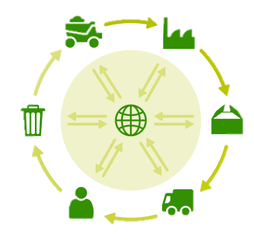
Environment
The 6Rs | Meaning
Reuse | To use a product again either for the same purpose or a different one
Reduce | To have less of material/packaging/pollution when making products by making them more efficient
Recycle | Breaking down and forming the material into another product
Refuse | Customers not buying or supporting products that make an environmental impact
Rethink | Designers and customer rethinking their decisions when making and buying products.
Repair | Fixing a product rather than throwing it away. Extending its life rather than using more resources to make another Often products are Designed for Maintenance so can easily be repaired. E.g. Using screws so even non-specialists can take a product apart, or using components that can easily be replaced like fuses or batteries
Repairing products rather than throwing them away
Reducing Product Miles buy making the product in the country it is sold in
Planting more trees to reduce deforestation
What can we do to reduce environmental impact or products and manufacture?
Reducing Pollution by using less plastics, efficient manufacture, less waste and using renewable energy (like solar and wind)
Recycling products and materials
Using less finite resources
Sustainability is maintaining our planet and its resources and making a minimal negative impact
Finite Resources Will run out of eventually | Infinite Resources Can be re-grown and re-bread. Will not run out of
Plastics | Paper
Metals | Boards
Polymers (Textiles) | Natural Timbers
 | Cotton
 | Leather
Life Cycle Assessment
This is when a designer looks at the environmental impact a product makes over its life time and how it could be reduced. Including:
Impact of materials
Impact of processes
Product Miles (how far a product has to travel to get from factory to consumer)
Impact while in use
Impact when disposed of (6Rs)
Planned Obsolescence | This is where products “die” after a certain amount of time. E.g. Disposable cups, Phones, Lightbulbs, Printer Ink, etc This can have a big environmental impact as customers are throwing away lots of products, and resources are being used to create new ones.

