Slide 1
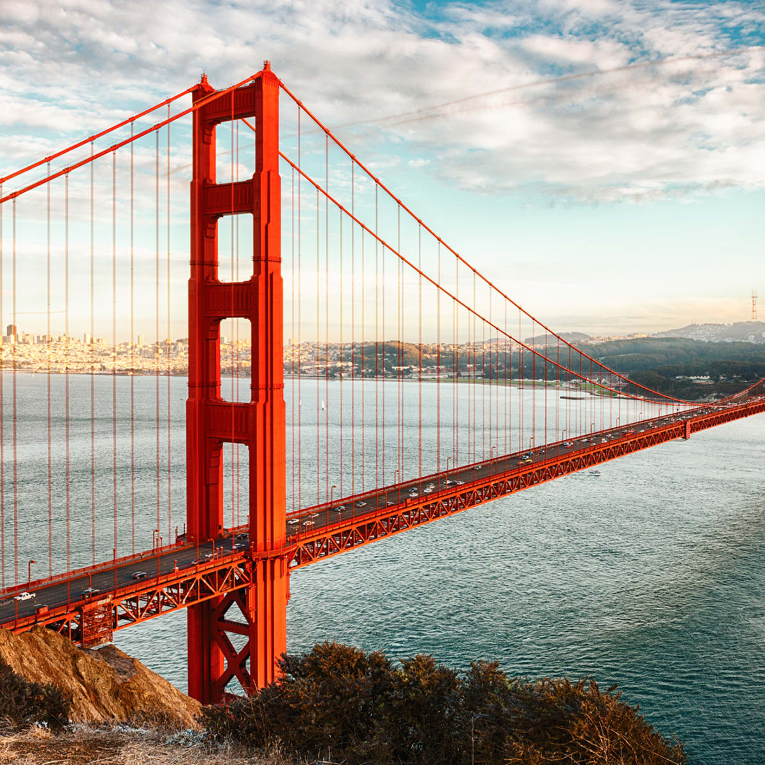


Government and Politics Bridging Menu
You are about to start an exciting journey into the world of Politics, good luck!
Remember
Choose what modules you do and when, but work through them consistently. Different tasks will take you varying amounts of time, but on average you should aim to do one or two per week
All green tasks are core modules, they are compulsory and must be completed
The red hot chili indicates that the task is more challenging than the others
Numbers eg (1) correspond to how you should evidence the module which can be found in the slides

Slide 2





Government and Politics Bridging Menu (Green modules are core (compulsory) modules , indicates the most challenging modules )
 | Read | Watch | Listen | Visit (virtually or physically at a later date) | Do
 | Francis Fukuyama Liberalism and its discontents?. (1) Fukuyama analyses the challenges to Liberalism from both the left and right and offers solutions to the erosion of liberal democracy | This England(1) It depicts the first wave of the COVID-19 pandemic in the United Kingdom based on testimonies of people in the Johnson administration, on the various advisory groups (including the Scientific Advisory Group for Emergencies, and in other affected British institutions such as care homes and hospitals. | The Rest is Politics (1) Rory Stewart and Alistair Campbell revies politics. Write a review of 2 episodes | Visit the UK Supreme Court (7) Opposite the Houses of Parliament, find out about Magna Carta, how the judicial system has developed and the changes since the Constitutional Reform Act 2005. | MOOCs https://www.futurelearn.com/courses/global-prosperity Search through the MOOCs using the filter ‘Politics’ and chose one that particularly interests you (5)
 | Code of Conduct Why we need to fix parliament and how to do it’ by Chris Bryant(1) | Inside Job (2010) (1) This documentary narrated by Matt Damon tells the shocking story of the global financial crisis of 2007/8. Jaw dropping. | News Agents USA 1) https://www.bestpodcasts.co.uk/podcast/the-news-agents-usa/ Review 2 episodes of this podcast presented by Emily Maitliss and Jon Sopel | The Houses of Parliament (1) You will need to contact your local MP to get a pass but it is free. | Collect newspaper articles each week and relate and evidence the topics from component 1 Conservative and Labour Party policies and ideas Activity of Pressure Groups including trade unions (4)
 | Against White Feminism : Rafia Zakaria Against White Feminism traces the connections between feminism and white supremacy from the earliest stirrings of the women's suffrage movement to the 'fourth wave' we see today. 1) | Sunday Morning with Laura Kuenssberg(1) Every Sunday morning, BBC journalist interviews the political decision makers. Watch two episodes and write a brief review as evidence | https://podcasts.apple.com/gb/podcast/the-a-level-politics-show/id1473697674 1) | University Politics Open Day (6) Visit a University either in person or on a virtual tour | Collect newspaper articles each week and relate and evidence the topics from Component 2 Constitution including the Human Rights Act Prime Minister The Judiciary (4)
 |  |  |  |  | Write your own opinion of each issue
 | https://www.politics.co.uk/ Write 3 articles tracking the key political developments. Each entry should be one side of A4. | Blair and Brown: The New labour Revolution (2021):The story of two powerful personalities at the heart of a political phenomenon. (1)Available on I Player Write a review of episodes 1 and 5 | https://www.nytimes.com/column/the-daily Daily podcast on all things US politics 1)

Slide 3
(1) - Book/Journal/Podcast/Film/TV Review
Would you/would you not recommend it? Why?
Rating:
Review by: ___________________________________________
Title: _______________________________________________________
Author: ____________________________________________________
Review of (please circle)
Book Journal Podcast Film Documentary
What was it about?
What did you find particularly interesting/inspiring/shocking? Has this changed your opinion?
What would you like to learn more about?
How does it link to this subject and why is it important?

Slide 4
Collect newspaper articles each week and relate and evidence the topics from: (4)
Component 1
Democracy and Participation
Party policies and ideas
Elections
Pressure Groups
And from Component 2
Constitution
Prime Minister
Parliament
The Judiciary
(4)
Write your own opinion of each issue and upload to your application called ‘Weekly news in Politics’ with each week clearly labelled.

Slide 5
MOOCs (5)
To evidence this you can
Save any notes you take
Take and save a screenshot of completed modules or the completed course

Slide 6
University Politics or International Relations Open Day (6)
What is the first year like on the BA Politics or International Relations Programme?
What can I expect over the three years?
How important are different subject combinations for a Politics Degree?
Why study Politics and what do Universities have to offer?
What does your University look for in applicants?

Slide 7
(7) Visit the UK Supreme Court (opposite the Houses of Parliament)
Choose whether you would like to make a
Podcast
Informative flyer
Mini film
Report
Newspaper article

