Slide 1
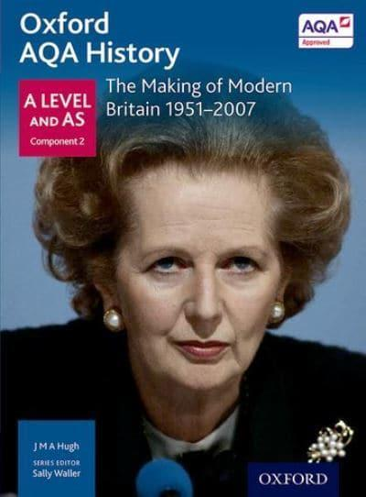
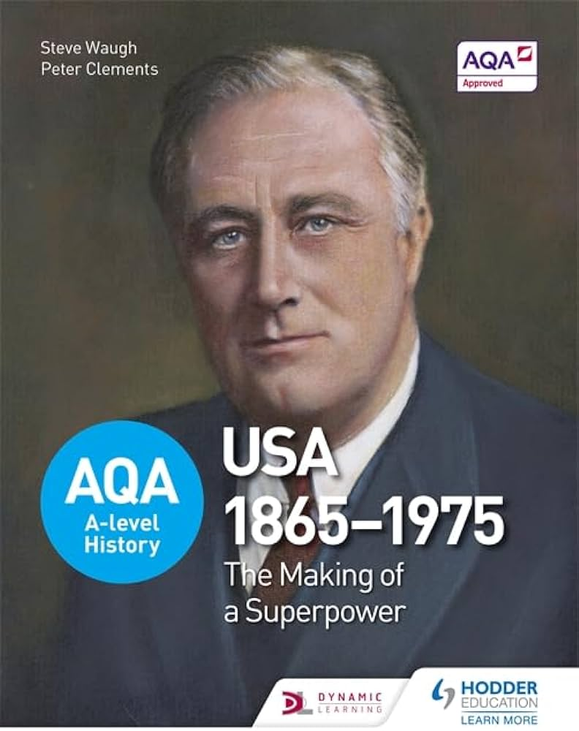
Welcome to A level History at Drayton Manor!
Summer Transitional Work
Course Overview:
Paper 1 - The making of a Superpower: USA, 1865–1975
Paper 2 – Making of Modern Britain, 1951-2007
"Success is not final; failure is not fatal: it is the courage to continue that counts.” Winston Churchill
Notes:
Change name before the lesson :)

Slide 2
Overview
Suggested Activities
Comparative Essay: Post-War Britain and Post-War USA
Source Analysis Activity
Documentaries and Films Review
Research Project: Key Figures
Timeline Creation
Book Review
Debate Preparation
Interactive Map Creation

Slide 3





Suggested Activities
Reviews of your work should be saved in your Subject Lockers on Unifrog | Read | Watch | Listen | Visit | Do
 | A people's History of the USA by Howard Zinn Portrays a side of American history that can largely be seen as the exploitation and manipulation of the majority by rigged systems that hugely favour a small aggregate of elite rulers. | The Iron lady (2011) The Iron Lady is a 2011 biographical drama film based on the life and career of Margaret Thatcher (1925–2013), a British stateswoman and politician who was the first ever female and longest-serving Prime Minister of the United Kingdom since 1827. | Revolutions American, English, French, Haitian, Mexican, Russian, and more: If it's a revolt, rebellion, or overthrow. | Visit the British Museum Artefacts from across British history right up to the present day. Virtual tour available. | MOOCs Search through the MOOCs using the filter ‘History’ and chose one that particularly interests you https://www.mooc.org/
 | A Journey by Tony Blair In 1997, Tony Blair won the biggest Labour victory in history to sweep the party to power and end eighteen years of Conservative government. | The Crown Netflix takes us through the whole period covered in Year 12 from the point of view of the Monarchy. Brilliant TV as much as really quite useful for the course. | 15minutehistory.org has an episode on Reconstruction (episode 20). | www.Milicenter.org - has all the presidents profiles including their policies. - easy to follow. | Create a table of all the American presidents from 1865-1975.
 |  |  |  |  | Research 4 UK General Elections (4) 1951, 1964, 1979, 1997 Present your work by answering the following questions What were the appealing party policies? Did voting turnout play a part? Who did the policies of the winning party appeal to What was going on at the time to affect the result? How important were the media? Who were the leaders and what impact did they have? Whish of these elections changed Britain the most?
 | A History of Modern Britain – Andrew Marr Read this before watching the TV series | Selma (2014). Based on the 1965 Selma to Montgomery voting rights marches led by James Bevel, Hosea Williams, Martin Luther King Jr., | Explaining History The Counterculture and the 1960s How the hippy movement developed https://courses.lumenlearning.com/boundless-ushistory/chapter/counterculture/ | University History Open Day Visit a University Open Day a list of virtual days are on the link.
 | Give me Liberty! By Eric Foner Threaded through the chronological narrative is the theme of freedom in American history | Empire How Britain Made the Modern World. YouTube. Niall Ferguson showing how a gang of buccaneers and gold-diggers planted the seed of the biggest empire in all history. | BBC Witness History The birth of Britain’s National Health Service - the NHS https://www.bbc.co.uk/programmes/p0053d39 | Places where the Crown was filmed. www.visitengland.com
 | Margaret Thatcher – The Downing Street Years Margaret Thatcher was the towering figure of late-twentieth-century. | A History of Modern Britain Andrew Marr Once you have read the book check out the TV series. confronts head-on the victory of shopping over politics. It tells the story of how the great political visions of New Jerusalem or a second Elizabethan Age, rival idealisms, came to be defeated by a culture of consumerism. | The Rest is History Podcast on Spotify, The world’s most popular history podcast, with Tom Holland and Dominic Sandbrook.
 | Dominic Sandbrook – Never had it so good: The story of Britain from Suez to the Beatles takes a fresh look at the dramatic story of affluence and decline between 1956 and 1963

Slide 4
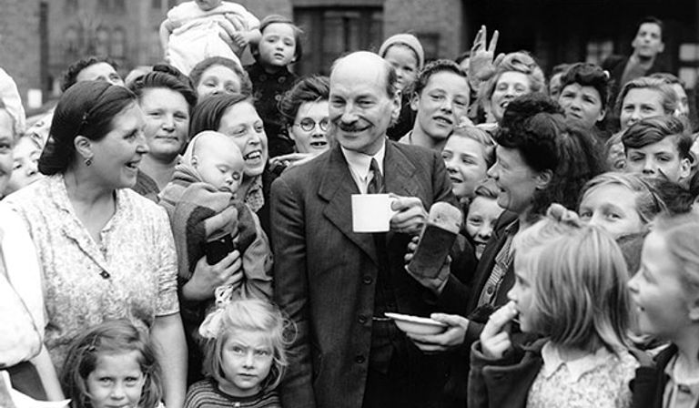
Task 1: Comparative Essay: Post-War Britain and Post-War USA
What – Write a comparative essay (1500-2000 words) discussing the key social, economic, and political changes in Britain and the USA in the aftermath of World War II up to the 1960s.
Focus Areas:
Economic recovery plans (Marshall Plan, Keynesian economics in Britain).Social changes (civil rights movements in the USA, welfare state in Britain).Political shifts (rise of the Cold War, domestic policies).

Slide 5
Task 2: Source Analysis
What – Source Analysis Activity Task:
Analyse a primary source identifying the author, context, and purpose of the source. Discuss its significance in relation to the historical event it describes. Evaluate the reliability and usefulness of the source.
Assess the value of these three sources to an historian studying the success of the British Economy Between 1951 and 1964
Source 1
Harold Macmillan, addressing a large audience of Conservative supports at Bedford football ground, July 1957. This was at a rally to celebrate 25 years of service by the local Conservative MP.
Let’s be frank about it; most of our people have never had it so good. Go around the country, go to individual towns, go to the farms, and you will see a state of prosperity such as we have never had in my lifetime – nor indeed ever in the history of this country. What is beginning to worry some of us, “Is it too good to be true?”, or perhaps I should say, “Is it too good to last?” For amidst all this prosperity there is one problem that has troubled us ever since the war. It is the problem of rising prices. Our concern today is, “Can be prices be steadied while at the same time we maintain full employment in an expanding economy?” For if inflation prices us out of world markets, we shall be back in the hold nightmare of unemployment. The older ones among you will know what this meant. I hope the younger ones never have to learn it

Slide 6


Task 3: Documentaries and Films Review
What – Watch a selection of documentaries and films related to the course content and write reviews (500-700 words each).
For Britain: "The Crown" (specific episodes focusing on the 1950s-70s), "This Is England" (2006, for cultural context), "The Long Walk to Finchley" (about Margaret Thatcher).
For the USA: "Eyes on the Prize" (civil rights movement), "All the President’s Men" (Watergate scandal), "Selma" (civil rights movement).

Slide 7
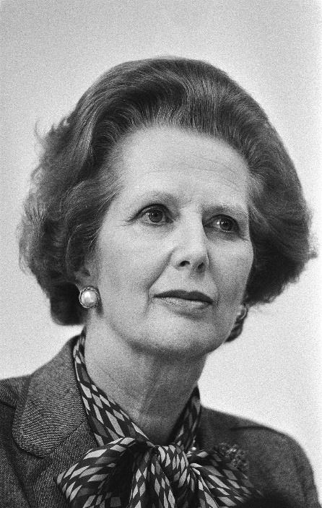
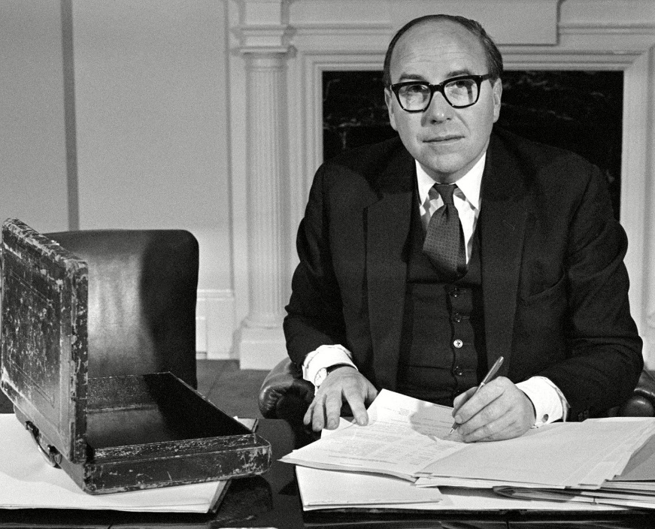
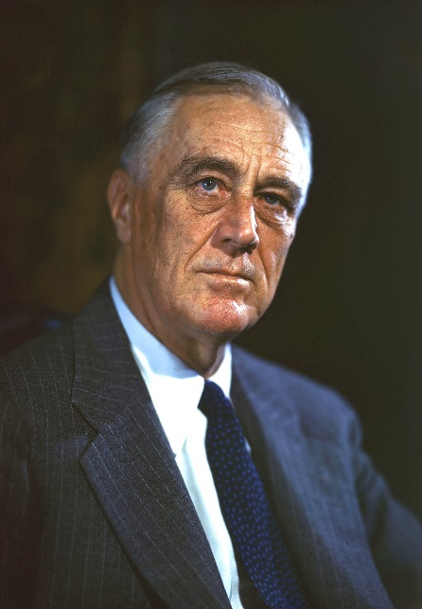
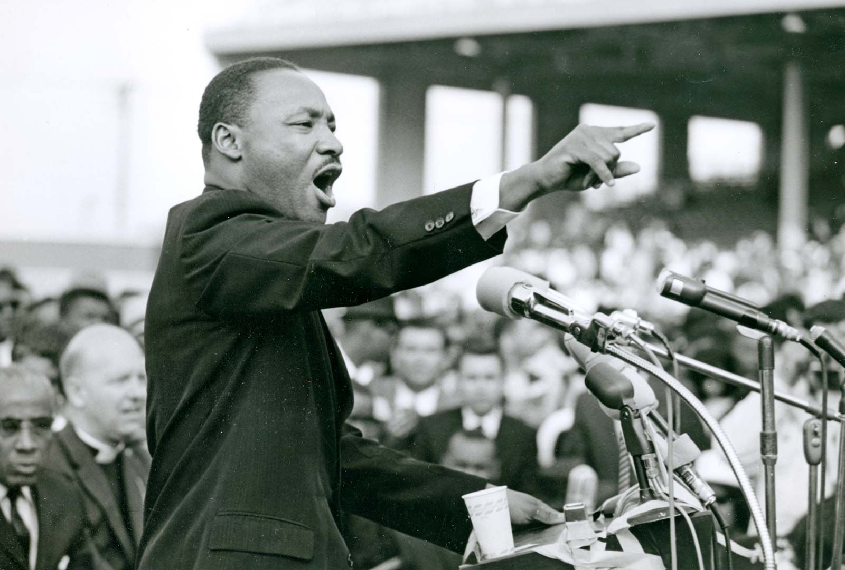
Task 4: Research Project: Key Figures
What – Research and write a detailed profile (1000-1500 words) on key figures from each unit.
Suggestions:
For Britain: Winston Churchill, Margaret Thatcher, Harold Wilson.
For the USA: Abraham Lincoln, Martin Luther King Jr., Richard Nixon.

Slide 8
Task 4: Research Project: Key Figures
What – Research and write a detailed profile (1000-1500 words) on key figures from each unit.
Suggestions:
For Britain: Winston Churchill, Margaret Thatcher, Harold Wilson.
For the USA: Abraham Lincoln, Martin Luther King Jr., Richard Nixon.
Suggested Content:
Early Life, career, key contributions, impact

Slide 9
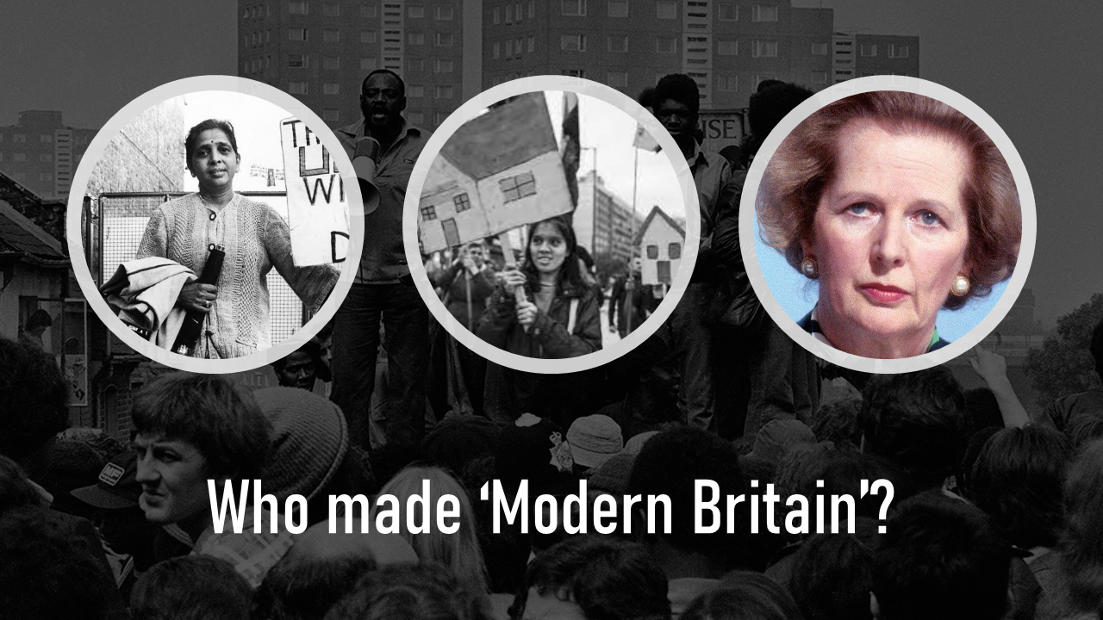
Task 4: Timeline Creation
What – Create detailed timelines for both units, highlighting major events, policies, and shifts in society.
Instructions: Use a combination of text and images.
Ensure timelines are comprehensive and cover political, economic, and social aspects.

Slide 10

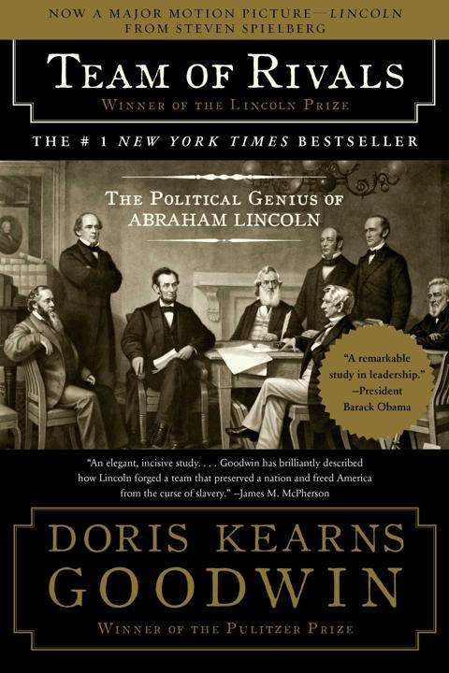
Task 5: Book Review
What – Read a book relevant to either unit and write a critical review (1000-1500 words).
Suggestions:
For Britain: "Never Had It So Good: A History of Britain from Suez to the Beatles" by Dominic Sandbrook, "Margaret Thatcher: The Authorized Biography" by Charles Moore.
For the USA: "Team of Rivals: The Political Genius of Abraham Lincoln" by Doris Kearns Goodwin, "The Fire Next Time" by James Baldwin.

Slide 11
Task 6: Preparing for a debate
What - Prepare arguments for and against significant historical debates relevant to the units.
Topics:
Britain: The impact of Thatcherism, the importance of the welfare state.
USA: The effectiveness of Reconstruction, the justification of the Vietnam War.
How:
Research both sides of the argument, Prepare evidence-based points, Write a summary of your findings and personal stance (800-1000 words).

