Slide 1
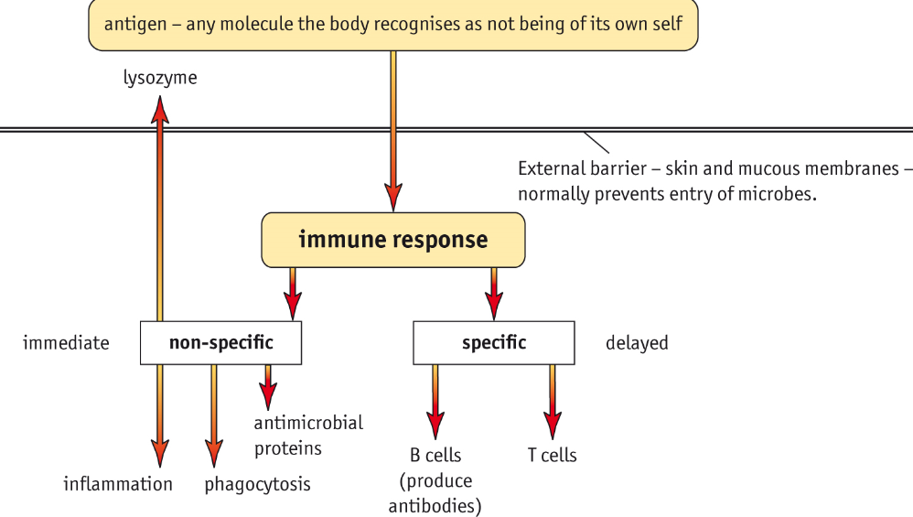

Slide 2

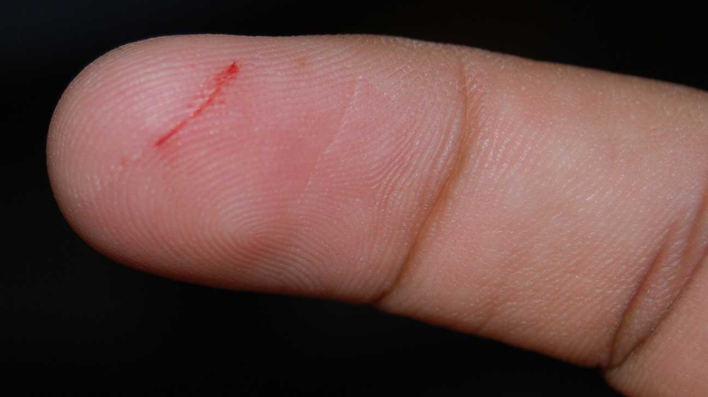
Non Specific Responses – inflammation
Inflammation occurs when damaged white blood cells and mast cells (found in connective tissue beneath skin and blood vessels) release histamines.
Histamines cause arterioles to dilate, thus increasing the blood flow to capillaries.
Capillaries also become more permeable in response to histamines, causing plasma fluid, containing white blood cells and antibodies to leak from blood into the tissue causing a oedema (sweeling).
Pronounced edeema.

Slide 3
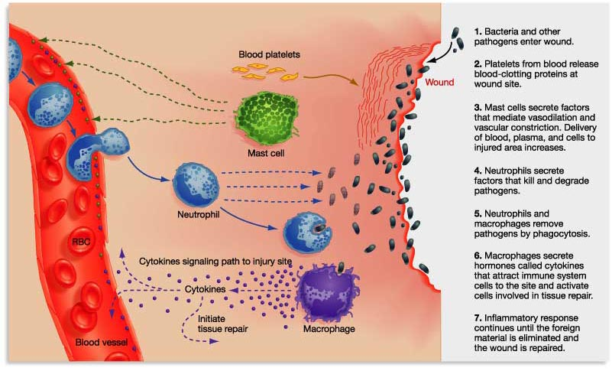
Inflammation

Slide 4
Task 1: Put the following statements into the correct order:
Plasma fluid, white blood cells and antibodies leak out of capillaries.
This causes an oedema to form.
Damaged cells such as white blood cells and mast cells release the chemical histamine.
This causes arterioles to dilate, increasing blood flow to the area.
The causes the permeability of capillaries increases.

Slide 5
Answers Task 1: Put the following statements into the correct order:
Damaged cells such as white blood cells and mast cells release the chemical histamine.
This causes arterioles to dilate, increasing blood flow to the area.
The causes the permeability of capillaries increases.
Plasma fluid, white blood cells and antibodies leak out of capillaries.
This causes an oedema to form.

Slide 6
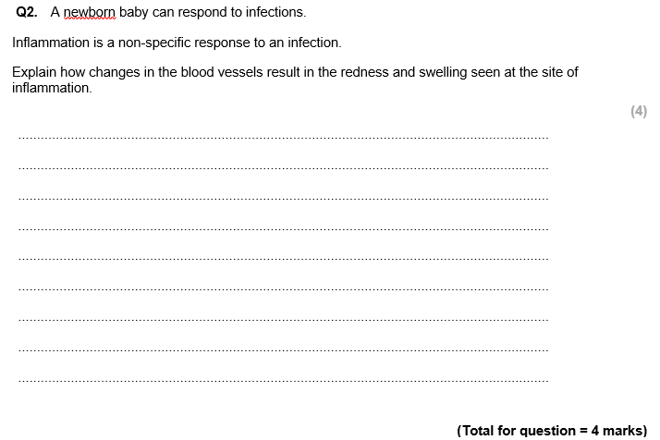
Task 3: Complete the exam question

Slide 7
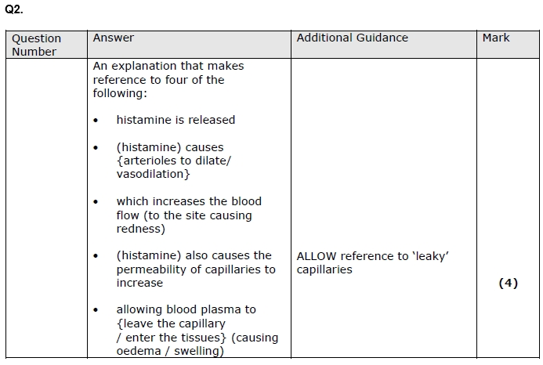
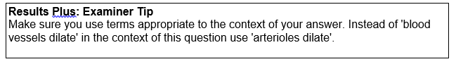
Mark Scheme

Slide 8
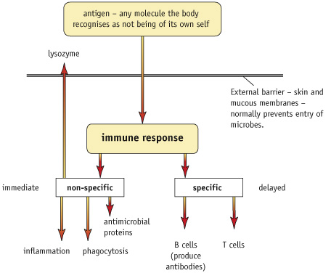

Slide 9
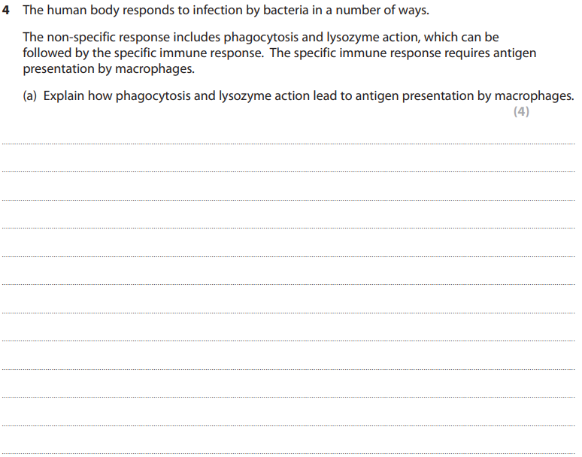
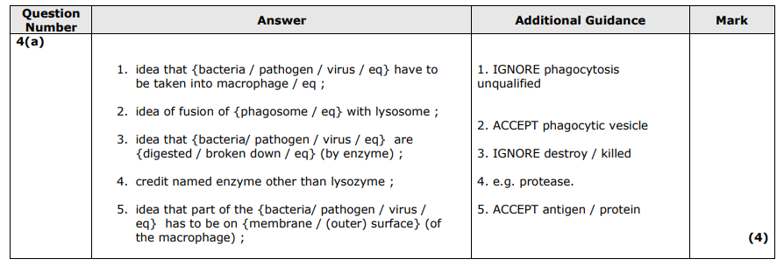

Slide 10
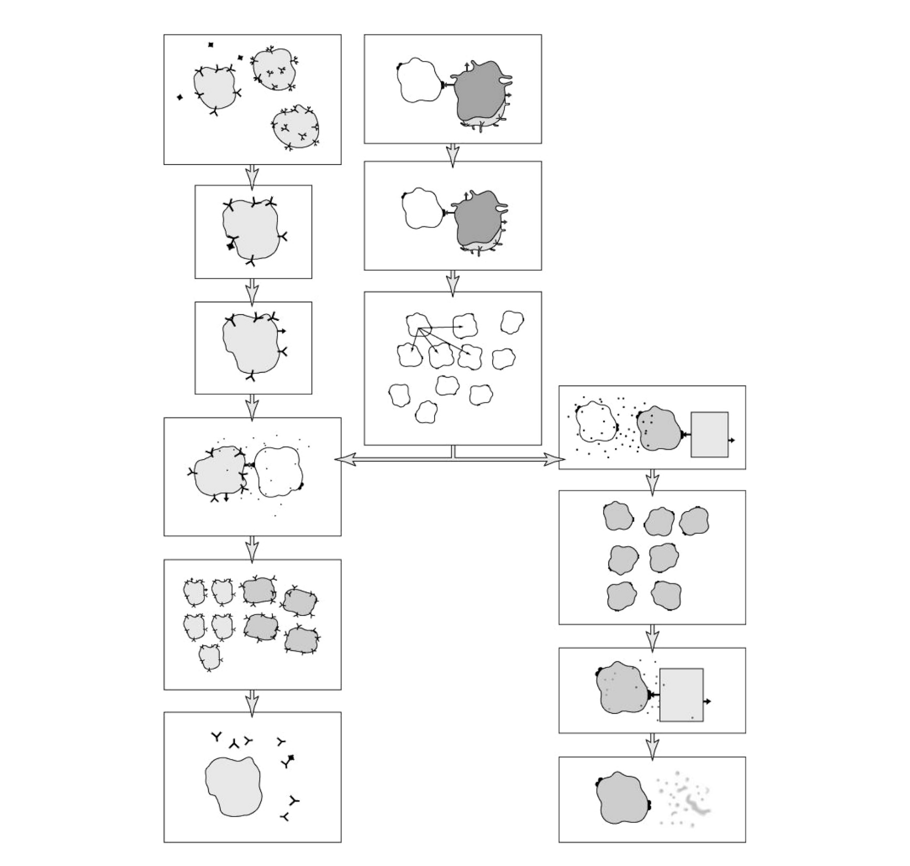
Task: Identify A-I
C
D
E
G
A
H
B
I

Slide 11
Answers
C – T helper cell (inactive)
D – Antigen presenting macrophage
E - Cytokines
G – T killer cell
A - Antigen
B – B Cell
H – Infected cell
I – Plasma cell

Slide 12
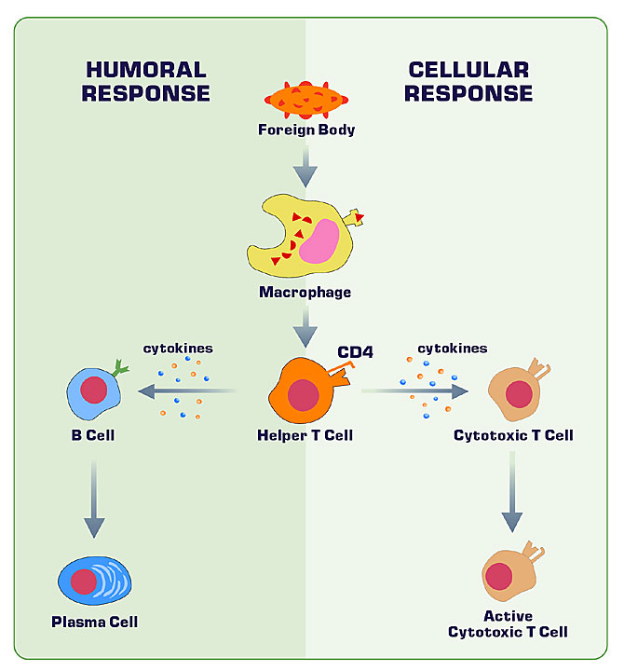
a.k.a. Cell mediated response
The T helper cell has in important role in both the humoral response (involving antibodies) and cellular response (not involving antibodies).
What similarities and differences do you notice between the two responses?
a.k.a T-killer cell
a.k.a T-killer cell

Slide 13
HUMORAL AND CELL MEDIATED RESPONSE
Both involve specificity to antigens.
Both involve antigen presenting cells.
Both involve activation of T helper cells to produce activated cells.
Both involve clonal selection – since activated T helper cells only activate those cells with antigens it has complementary receptors for.
Both involve clonal expansion – since cells are made in large numbers.

Slide 14
Whiteboards: Where are B cells made?
Bone Marrow

Slide 15
Whiteboards: Where are T cells made?
Bone Marrow

Slide 16
Whiteboards: Where do T cells mature?
Thymus.

Slide 17
Whiteboards: What is found on the surface of B and T cells?
Antigen receptors

Slide 18
Whiteboards: What is special about antigen receptors?
They are unique and will only bind an antigen with a complementary shape.
(think lock and key model of enzymes ☺)

Slide 19

Whiteboards: What do B cells secrete?
Antibodies

Slide 20
Whiteboards:
Which type of protein are antibodies classed as?
Immunoglobulins

Slide 21
Whiteboards:
What do antibodies bind to?
Antigens

Slide 22
Whiteboards:
Which cell recognises a pathogen marked with antibodies?
Macrophage.

Slide 23
Whiteboards:
What is the response of a macrophage after recognising a pathogen marked with antibodies?
It engulfs the pathogen and forms a vacuole around it. Lysosomes release digestive enzymes into the vacuole which digest the pathogen.

Slide 24
Task: Answer these in your books.
Where are B cells made?
Where are T cells made?
Where do T cells mature?
What type of cell are B cells and T cells? (answer is 11 letters long)
Which of the two cells is capable of making antibodies?
What do antibodies do?
Which type of cell responds to pathogens labelled with antibodies?
What does the cell you named in Q7 do when it comes into contact with the antibodies?

Slide 25
Answers
Where are B cells made? Bone marrow
Where are T cells made? Bone marrow
Where do T cells mature? Thymus
What type of cell are B cells and T cells? Lymphocytes
Which type of cell is capable of making antibodies? B cells
What do antibodies do? Bind to antigens
Which type of cell responds to the antibodies? Macrophage
What does the cell in Q6 do when it comes into contact with the antibodies? Engulfs the pathogen and forms a vacuole around it. Lysosomes release digestive enzymes into the vacuole, which digest the pathogen.

Slide 26
Two types of T cell – Helper + Killer
T helper cell – when activated (process coming up) these cells will activate B cells to divide and become cells capable of producing antibodies. They also enhance phagocyte activity.
T killer cell – destroy cells with antigens on their surface that are recognised as non-self, cells infected with pathogens and transplanted tissue. → More of this cell later
Lymphocytes
B cell
T cell
T helper cell
T killer cell

Slide 27
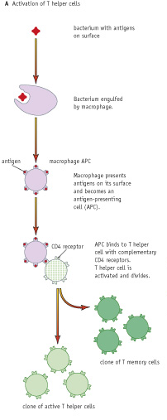
T helper cell needs to be activated as part of the immune response.
Can anyone volunteer to summarise what they think is happening?

Slide 28
Lymphocytes
B cell
T cell
T helper cell
T killer cell
T helper cell
T memory cell

Slide 29
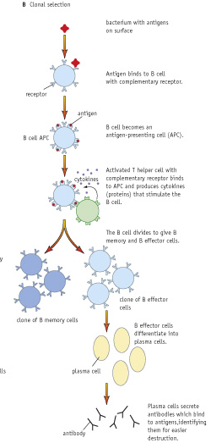
B cell needs to be activated as part of the immune response.
Can anyone volunteer to summarise what they think is happening?

Slide 30
Lymphocytes
B cell
T cell
B effector cell
B memory cell
T helper cell
T killer cell
T helper cell
T memory cell
Plasma cell

Slide 31
Whiteboards:
What happens to a macrophage after it has engulfed and digested the pathogen? Mention a few points here.
Peptide fragments (from the digested pathogen) are attached to proteins in the macrophage.
These are then added to the macrophage’s cell surface membrane.
They can then be displayed by the macrophage as non-self antigens.
We say the macrophages is now an ‘antigen presenting cell’ (APC).

Slide 32
Whiteboards:
Which cell does the antigen presenting macrophage bind to? What does it use to bind?
T helper cell.
The T-helper cell has CD4 receptors which bind to the antigens on the APC.

Slide 33
Whiteboards:
What happens to the T helper cell once it binds to the APC.
It is activated and it clones into a clone T helper cell and a memory T helper cell.

Slide 34
Whiteboards:
What happens to the T helper cell once it binds to the APC.
It is activated and it clones into a clone T helper cell and a memory T helper cell.

Slide 35
Whiteboards:
What happens to the B cell when it comes across a ‘non self’ antigen?
It binds them using its receptors and becomes an antigen presenting cell.

Slide 36
Whiteboards:
What binds an antigen presenting B cell?
What does it do in response to binding?
T helper cell – it releases cytokines.

Slide 37
Whiteboards:
What do cytokines released by the T helper cell do?
The help stimulate division and differentiation of the B cell.
They form B effector cells and B memory cells.
This is known as clonal selection.

Slide 38
Whiteboards:
What do B effector differentiate into and what do they do?
Plasma cells – secrete antibodies specific to the antigen.

Slide 39
Task: Answer these in your books.
What are the two types of T cell called?
Where did they mature?
Describe how the macrophage became antigen presenting.
Which type of cell binds to the antigen presenting macrophage?
How does the binding of the T helper cell to the APC affect it?
What do T helper cells have on their surface which allows it to bind?
What cell does the T helper cell bind to in order to cause clonal selection?
What does the T helper cell release which assists in clonal selection?
What do the B cells clone into?
What do B effector cells differentiate into and what do these cells do?

Slide 40
Answers
What are the two types of T cell called? T helper and T killer
Where did they mature? Thymus
Describe how the macrophage became antigen presenting. After engulfing and ingesting the pathogen, it presents a peptide fragment of the pathogen on its surface as a ‘non’ self antigen.
Which type of cell binds to the antigen presenting macrophage? T helper
How does the binding of the T helper cell to the APC affect it? It activates the T helper, causing it to clone into a clone T helper cell and memory T helper.
What do T helper cells have on their surface which allows it to bind? CD4 receptors
What cell does the T helper cell bind to in order to cause clonal selection? An antigen presenting B cell.
What does the T helper cell release which assists in clonal selection? Cytokines
What do the B cells clone into? B effector cells and B memory cells
What do B effector cells differentiate into and what do these cells do? Plasma cells
Notes:
The repeat question is deliberate
40

Slide 41
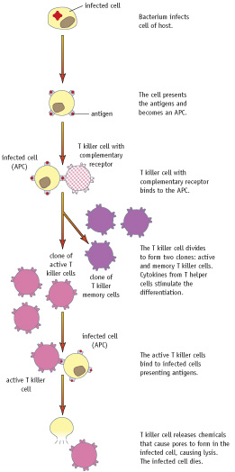
How is the T killer cell activated and what is its role?
Can anyone volunteer to summarise what they think is happening?

Slide 42
T killer cell
If a bacterium or virus infects a body cell.
Body cells will present a fragment of it as an antigen, becoming an antigen presenting cell.
T killer cells with receptors complementary to the antigen bind.
The T killer cell divides to form an active clone and a memory cell.
Cytokines from T helper cell aid in division and are needed for enough T killer cells to be made.
T killer cells release enzymes which create pores in the membrane of the infected cell.
Water and ions flow into the infected cell, causing it undergo lysis and releasing the pathogens.
The debris formed from lysis is engulfed and broken down by macrophages.

Slide 43
Task: Answer these in your books.
What happens to a body cell do when it becomes infected by a pathogen?
Which cell binds to the infected body cell?
What happens to the cell when its binds?
What helps the cell clone? Where do they come from?
How does the T killer cell destroy the infected cell?

Slide 44
Answers
What happens to a body cell do when it becomes infected by a pathogen? Body cells will present a fragment of it as an antigen, becoming an antigen presenting cell.
Which cell binds to the infected body cell? T killer cell using it complementary receptors.
What happens to the cell when its binds? It clones and forms an active and memory T killer cell.
What helps the cell clone? Where do they come from? Cytokines from T helper cells.
How does the T killer cell destroy the infected cell? T killer cells release enzymes which create pores in the membrane of the infected cell. Water and ions flow into the infected cell, causing it undergo lysis and releasing the pathogens.

Slide 45
Task: Identify A-I
C
D
E
G
A
H
B
I

Slide 46
Answers
C – T helper cell (inactive)
D – Antigen presenting macrophage
E - Cytokines
G – T killer cell
A - Antigen
B – B Cell
H – Infected cell
I – Plasma cell

Slide 47
Exam Question
As part of the immune response, a B cell has to be activated. It then divides to form a clone of cells. These cells then differentiate into plasma cells, which produce antibodies.
Describe how a B cell is activated.
(3 marks)

Slide 48
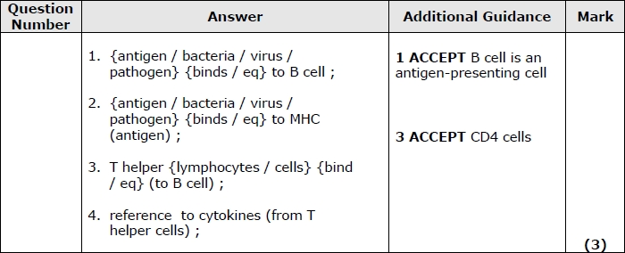
Answers

Slide 49
Exam Question
The human body responds to infection by bacteria in a number of ways. The non-specific response includes phagocytosis and lysozyme action, which can be followed by the specific immune response. The specific immune response requires antigen presentation by macrophages.
(a) Explain how phagocytosis and lysozyme action lead to antigen presentation by macrophages. (4)
(b) Explain how macrophages present antigens to T helper cells.

Slide 50
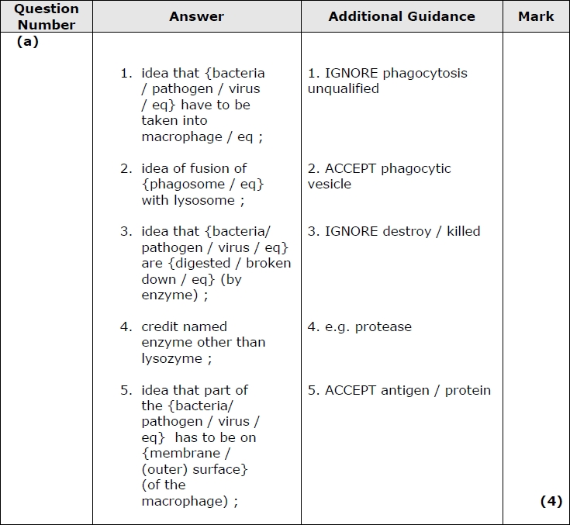
Exam Question
Answers

Slide 51
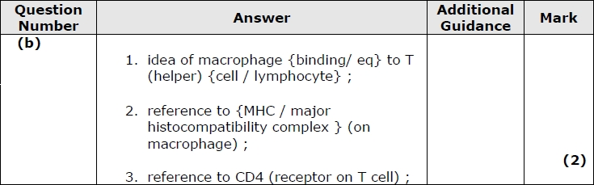
Answers

