Slide 1


Slide 2
Attendance Hub
Welcome and Introduction
18 April 2024
'NEC ASPERA TERRENT'
'hardships do not deter us'
Notes:
Welcome to Drayton Manor High School Attendance Hub
Schools from across the country
DfE trial for a smaller hub
All aiming to tackle the issue of lower attendance since the pandemic
I can see from the participants that we have:
6 schools from the North West
7 from the North East
1 from West Midlands
11 from East England and London

Slide 3
Hub Purpose
Attendance is one of the biggest challenges facing school systems today. The aim of school attendance hubs is to enable schools with strong attendance practices to share their approaches with senior leaders in other similar schools to help them to improve. They also aim to facilitate an ongoing professional dialogue about attendance amongst school leaders on a peer support basis (School attendance hubs, DfE 2023)
Notes:
As the DfE state, attendance is one of the biggest challenges we now face as schools and together we will share best practice so that we can all improve.
The sessions will be half termly and allow us all to feedback on how we are tackling the common issues round school avoidance and poor attendance.

Slide 4
Housekeeping and Expectations
Expectations for hub partner schools and lead school – attached document
The sessions will not be recorded to allow for full participation
Questions please in the chat. There will be a chance to answer at pause points
attendancehub@draytonmanorhighschool.co.uk
Resources can be found here including the expectations document: https://www.draytonmanorhighschool.co.uk/school-resources.php
Please ensure your webcams are on to allow for full participation but your microphones muted
Date of next meeting: Thursday 13 June
Notes:
The resources page is the go to place to find programmes and initiatives that we mention. We will keep this regularly updated so that it is a useful place for you. The user name and password have already been emailed out but please drop us an email if you need this reshared. There is a document which shares the expectations for being part of an attendance hub. Please do give this a read
Expectations during our meetings are to keep your camera on, engage with the chat area when prompted and email us if you have follow up questions
Our next meeting is 13 June for module 2
Today we will be covering this introduction and module 1: the value of attendance
We will email out the resources and PowerPoint slides at the end of the session – they will be also placed on the resources webpage. We will also send out a feedback form so that we can continue to work with you on providing effective sessions to support you

Slide 5
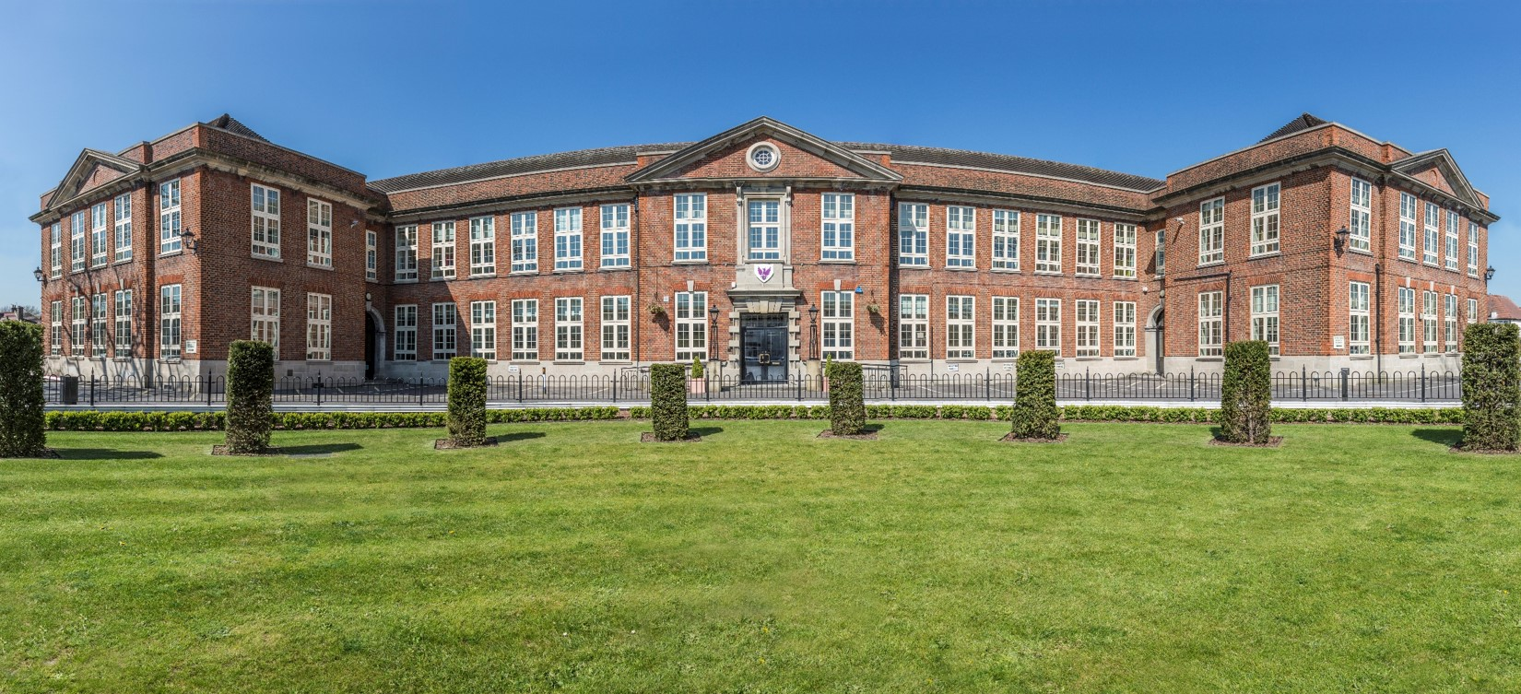
Welcome to Drayton Manor High School
Ambition . Character . Civic Virtue
Drayton Manor High School is situated in Hanwell - Ealing, West London. The non-selective, mixed comprehensive academy, has over 1430 Year 7 – 13 students on roll with 36% classified as Pupil Premium.
Our school community is diverse and harmonious – 52% of students are EAL and 23% SEND. The school has a current attendance rate of 95% and has introduced a range of measures to support with increasing school attendance
Notes:
Firstly a warm virtual welcome to Drayton Manor High School. We are a large comprehensive West London school with a real mix of students. Based in Ealing, we serve over 1400 students and include a sixth form. Many of our students come from challenging backgrounds as will yours.
Some of our key statistics are:
36% PP
52% EAL
23% SEND
And we have an improved figure of 95% - which has improved year on year since the pandemic.

Slide 6

‘The Drayton Manor Way’
We are committed to producing personally rounded and highly knowledgeable students who strive to be exemplary citizens, contributing in all ways, and especially as role models within their communities and on the world stage.
Ambition
Ambitious learning; instilling in every student the fundamental importance of academic rigour and hard work in all they do, combined with the value of breadth in their studies and the commitment to doing their very best and being the best possible version of themselves.
Character
The character of students; stimulating relish for fresh challenges and personal responsibility alongside the development of the necessary resilience, courage and determination to overcome challenges in a fast-moving world; inspired by the school’s motto Nec Aspera Terrent
Civic Virtue
Acquisition of civic virtue; including integrity, care for others, service and sharing non-academic life experiences. Civic virtues are character traits that are necessary for engaged responsible citizenship, contributing to the common good.
Notes:
Our starting point for everything we do in the school.
Our values trilogy was launch in 2019 to ensure that our leadership, strategy and operations was centered around these key values of ambition, character and civic virtue. We ensure that these values are lived and not laminated and support each staff member in having difficult conversations with students about issues like poor attendance to school. Our values for staff and students mean that we consistently talk about doing the right thing and not the easy. And we ensure that we are centered in the community and reacting to the needs of the community through our work in civic virtue.

Slide 7
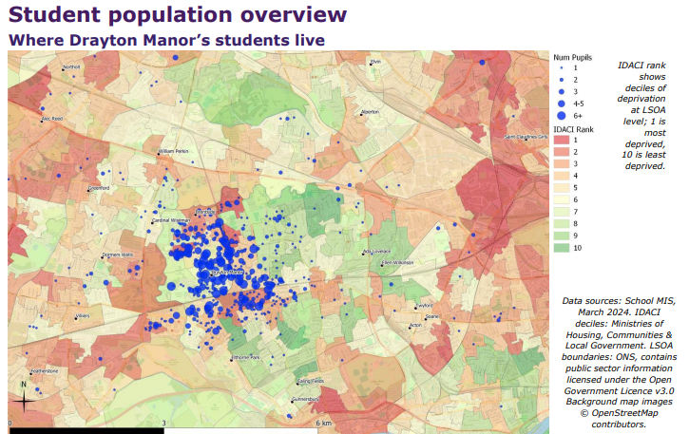

Understanding Drayton Manor High School
Beyond the school gates
Notes:
A starting point to get to know our context is this report.
Welcome to Ealing borough.
We annually commission a report into Beyond the school gates. This is the real starting area for connecting with our community and ensuring that our strategy for attendance is reflective of the needs of our students.
Many of our students are local to the school and live in multi-generational 2 or 3 bed-room apartments and often social housing.
There are a growing number of students (small blue dots away from school) living in emergency accommodation or social housing/hotels which takes them further away from school increasing their commute
Other schools will have different challenges but being certain in these challenges is vital to know how to put further support in place.

Slide 8
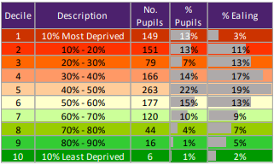
Understanding Drayton Manor High School
Beyond the school gates
Notes:
The report provides detailed analysis using census, local authority data and independent research so that we can truly understand the challenges that our families in each year group face.
Deprivation scales (like ours included here), reports into housing type and quality, access to medical services and use of local authority services all help to get us to know our students, the local community and the external challenges that a student might face.
I really recommended commissioning a report like this if you do not already.

Slide 9
Our Attendance Journey
Pre-Pandemic
95.6%
8.5% PA
21/22: 93.9%
22/23: 93.4%
18.2% PA
23/24: 95%
12.5% PA
National
Year | 2018/19 | 2021/22 | 2022/23 | 2023/24
Attendance % | 94.5 | 91 | 91 | 91.3
PA | 13.7 | 27.7 | 26.5 | 25.4
Notes:
But our work with attendance has been a journey and importantly, is always evolving – we do not stand still when it comes to attendance and the school improvement attitude that we have with our attendance strategy is always fine tuning our approach and initiatives.
Hard questions were asked and answered to keep us reviewing and adapting
We are almost there in recovering to pre-covid but we have not been able to stand still in getting to that point.
And we know that the national picture is extremely challenging – hence why we are all here today. Attendance has not recovered nationally since the pandemic and persistent absence remains extremely high across many schools.
We were slightly above average in our attendance figure before the pandemic but suffered similar issues during the recovering years with increasing numbers of PA students.

Slide 10
Our challenges
Pastoral staffing – consistency of approach and delegated leadership
Engagement from families and understanding the importance of attendance and the clear link to attainment
Post pandemic recovery – reengaging a generation into education
One day absences and ‘work from home’ environment
Notes:
Our challenges have been identified through our quality assurance schedule and using resources like beyond the school gates mentioned earlier.
Our focus this year has been on:
Ensuring the right people are highly skilled in pastoral positions so that they are empowered to spot issues with attendance early and have difficult conversations in order to support and tackle low attendance
Re-engaging our parents into the life of the school but also ensuring they understand that clear link between attendance and attainment in school
Our post pandemic recovery is still ongoing – ensuring students understand the importance of education and being in school but also ensuring that each child feels valued in school
Our ongoing work with ensuring that one day absences reduce and building resilance around attending each day. Medical appointments being booked outside of school hours and in the holidays

Slide 11
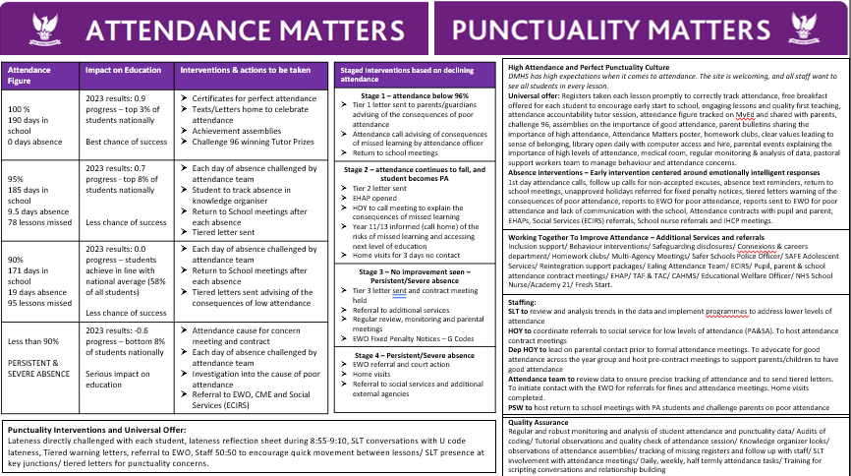
Putting Attendance onto a Page
Mission statement
Simple
Everyone has it and everyone uses it
Notes:
An activity I would encourage you to start with and you can find our copy on the attendance hub webpage after this session
Our mentality when it comes to attendance strategy is that If you can’t summarise in a few sentences or into a single page, we don’t know it well enough
Clarity and consistency for all of SLT
Starting the year right and keeping us consistent with our values and policy
On this single page, we include:
Our attendance data and the link it has to our most recent GCSE progress 8 data
The interventions and the staggered response to falling attendance
How we build our culture
What our universal offer is when it comes to attendance
Additional services we rely on to support lower attenders
Staffing roles and responsibilities
Punctuality response
How we quality assure

Slide 12
Putting attendance together
A strong culture of attending school
1. Value of attendance
2. Partnerships
3. Structure
4. Data and Systems
5. Effective Interventions
6. Quality Assurance
Importance of strong Leadership
Applying school improvement approaches to attendance
Consistent and timely cycle of review
Notes:
Here I would like to introduce our programme and modules. We will be starting with the value of attendance in just a moment. We will be covering each module per half term over the next year and an opportunity to feedback on progress that we have all made and sharing of best practice.
However, it is key to mention with each of these modules that:
The thread that is apparent throughout is bold and consistent leadership that develops a rigorous culture of review
School improvement approach of review
Lots of schools will be doing this but we are here to share what is successful in our setting and school

Slide 13
Attendance Hub
Module 1 – The Value of Attendance
'NEC ASPERA TERRENT'
'hardships do not deter us'
Notes:
Welcome to module 1 with our focus turning to the value of attendance
Agenda for each session is on the hub page drop down for module 1

Slide 14

Welcome to Module 1: The Value of Attendance
Task: For 1 minute, consider what the influences are on students attending your school. Put the top three in the chat
Local circumstances
Parents/home life
Physical or mental health
Finances
Parents holding students to account (one day absences)
Habits and routines
Peer relations
Travel
Social media and overuse of technology
Engagement with education and school
Student and parental resilience
Notes:
We all face different attendance challenges – we have already shared ours.
Please put your top three challenges that you face into the chat.

Slide 15
Key Outcomes
Provide you with core strategies for how we engage parents, students and staff in improving attendance – communication strategy. Keep attendance on the agenda
Detail how the value of attendance is promoted to students – putting competition at the heart of staff and students value of attendance
Notes:
So our outcomes from today are:
How to effectively communicate the value of attendance and to keep it on the agenda – effective communications strategy
How we place a sense of belonging and competition to help to promote attendance for students

Slide 16
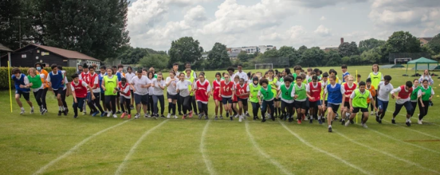
Why Attendance Matters
Notes:
Why – the work we do makes a difference to our students
Attendance builds resilience, enjoyment of school, routines, confidence and much more
Attendance is a central focus here at Drayton Manor from the Governors, Head, SLT, teaching staff, pastoral staff and students and families as we know that having students in school for the full 190 days means that they are better prepared for examinations and their own futures.

Slide 17
Why Attendance Matters
Progress 8 2023
Attendance %
Notes:
Correlative – but a significant correlation
2023 data – Sisra analytics provides this useful data set and we use extensively to advertise to students
But our data as well as national data shows that students do not do as well if they are not in school. It is a moral imperative to ensure they are in so they can achieve in their exams. The correlation is immensely important to share with all pupils and parents to reinforce the link between good attendance and attainment.

Slide 18
How we work as a leadership team
CRAVE Leadership: Whatever we turn our attention to, it gets better
Clarity – be clear on who is leading
Reflection – autopsy without blame
Accountability – define what needs improving and how it will be measured
Values – do what is right for our students, not easy
Expertise – go seek out advice, adapt current practice and act
Notes:
I would like to now introduce our senior leadership style – CRAVE. As I said earlier – this is the thread that pulls together the attendance strategy.
We are always clear on who is leading – I am the attendance lead for the school but each year group has an SLT link which is responsible for driving attendance
We reflect on what is working and what needs to change.
We hold students, parents and staff members including ourselves accountable for improvement and work out how we will measure if it has improved or not
We hold firmly are values and use these values in every conversation that we have with parents, students and staff.
And when needed, we seek out advice from the local authority, other schools and school improvement partners on how to address certain issues.
This is our CRAVE leadership and it is involved in every single aspect of our attendance strategy.

Slide 19
The Value of Attendance – what?
 | Student | Staff | Parents
Pre-DMHS | Y6 Summer school to set the high attending culture Year 6 students invited to summer show Each student spoken to during primary school visits | Safeguarding training includes responsibility for safeguarding Knowing the law and guidance Training for staff in attendance roles Analysis of Year 6 EWO data | Year 6 parent meetings Year 7 welcome event in first week
Daily | All late students reflect on why they are late on arrival with a member of SLT Detentions for one of lates Next day Tutor/HOY conversation with returning absent students Free breakfast available each day Nurture breakfast for selected EBSA students Return to school meetings Pre-emptive 8am phone calls | Dedicated SLT Attendance lead – strategy, leadership and data sharing Attendance systems work schedule and daily, termly checklists Everyone responsible for attendance Extended opening hours: library, music practice rooms, basketball courts SLT walk the local community each morning and afternoon | First day absence call and expectation to name return time/date Parents phoned for each late Access attendance percentage on school app
Notes:
Here I would like to show you our communications strategy for before students join and the daily, weekly and half termly interactions that we have for parents, students and staff.
Everything we do/when to communicate the importance of good attendance and areas where we challenge poor attendance.
Pre DMHS: Secondary school places allocated – start to contact!
We will visit all 41 feeder schools to get to know our incoming students and the possible issues that there might be. Each student will be invited into school with their parent for an enrolement discussion where attendance and our high expectations is a key moment of the meeting. Through our induction day, induction programme and finally a parent success evening for year 7 parents in the first week, our new parents and students in September know how attendance is key at Drayton Manor.
Next we have our daily programme for communicating good attendance. Phone calls and holding the line with punctuality and poor excuses is key here. We have ensured in the last two years that we have grown the capacity of our attendance team so that pre-emptive phone calls can be made at 7:30 for students of concern who are struggling with routines but also to phone students who are expected to return after absence. Furthermore, we have ensured that all students who do not report into form time are phoned on the first day of absence and those who do not report the absence are also written to through a app alert and text. Parents know through this daily system that there has to be a legitimate reason for a lack of attendance and that the school will challenge each day of absence and expect a date of return and evidence of the absence sent into school.
The other bullet points will be discussed further in todays session and others across the hub programme

Slide 20
The Value of Attendance – what?
 | Student | Staff | Parents
Weekly | Escalating sanctions for persistent lates Weekly attendance tracking in student planner and form group Attendance mentoring Challenge 96 tutor programme | Attendance support interventions and referrals for each PA/SA | Tiered warning letters for poor attenders Each PA/SA attendance contract meeting Weekly parent bulletin with advice on attendance
Termly/ Annually | End of term celebration for high attenders Celebration breakfast Celebration texts and merits Attendance standards assembly | Attendance matters/safeguarding training Attendance data linked to progress data Reward letters home Extensive budgeting for yearly repairs/painting of entire site | Six curriculum/pastoral parent events each academic year All students written to below 96% warned about low levels of attendance Year group parent success evenings Parents evening
Notes:
Our comms strategy continues with weekly and termly or annually communications with parents. A key half termly event is our parent curriculum/pastoral evenings. Here we plan based off of parental feedback, issues that are occurring in school or the local community and we deliver a event which aims to support and educate parents. School attendance is always discussed at these events. This is in addition to parents evening and parent success evenings for each year group which also have a theme of the importance of attendance.
Another key weekly communications programme to create competition between school houses and form groups is our challenge 96 programme. We will discuss this in todays session and a prime example to keep attendance as part of the tutorial/pastoral programme

Slide 21
Having an attendance culture – Attendance matters
Key question: 1.What is the most important mode of communication in your school relating to attendance?
2. How do you ensure that attendance is on the agenda for all stake holders?
Write into the chat your suggestions – 1 minute
Promote
Clear and consistent communications
Celebrate
High attenders are publicly praised
Challenge
Poor excuses for attendance is not accepted
Parent, child and staff stakeholders
Forms and Houses compete over their attendance scores
Students know their attendance score
Evidencing the link between progress and school attendance
Clear systems of escalation for students of concern
Notes:
So we have our first key question
What is your attendance and communication strategy? How do you ensure that attendance is on the agenda? Please take a moment to write into the chat and share any suggestions or some of your own brilliant practice.
Thank you for sharing – I can see…
Our strategy at DMHS when it comes to communications about attendance includes:
Active promotion: assemblies, parent events, staff training, weekly form time
Celebration of high attendances: celebration breakfasts, challenge 96, lunch queue skip card, texts/post cards home to congratualate
Challenge: 1st day absence calls, escalated scale of intervention for poor attendance, pre-empitive phone calls and return to school meetings to discuss reasons for absence – challenge is for both parents and students – and includes staff training (pastoral/admin staff and form tutors) on how to hold these conversations

Slide 22
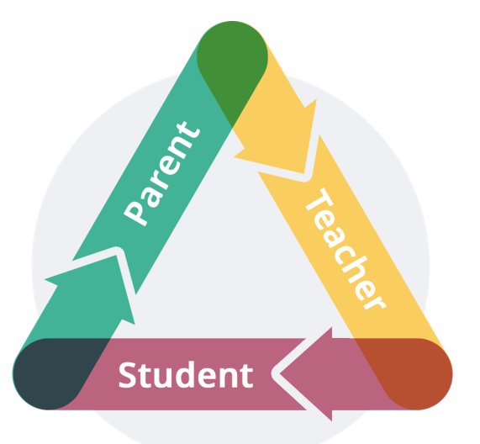
Keeping stakeholders engaged with attendance
Attendance is a school priority for staff, parents and students.
We ensure that our messaging around attendance is communicated using
Staff, parent and student bulletins
Assembly and Tutor Programme – Challenge 96
Staff training
Parent events – Getting parents across the threshold to see the values of the school in action and educate on the importance of attendance
Notes:
We ensure that all stakeholders are trained or educated on the importance of attendance.
Staff are reminded of key attendance notices in the weekly bulletin but also through attendance focused weeks led by the head of year who will direct tutors to support with attendance phone calls and having difficult conversations with tutees.
Parents are consistently reminded of the importance of good attendance during parent events and also through the absence reporting procedure. No poor excuses for attendance are acceptable
And students discuss attendance during one weekly form time where they track their attendance figure and days off. Form tutors are trained to ensure they challenge students on the reason for the absence and if there were any ways to avoid it in the future

Slide 23
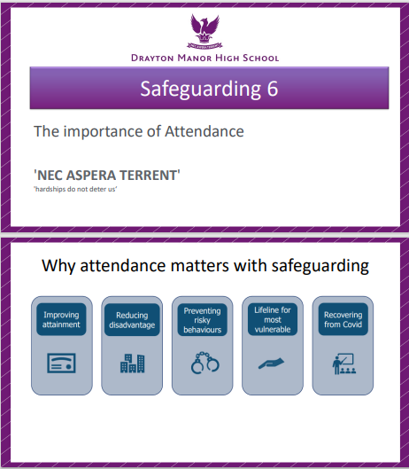
In Focus: Keeping engaged with attendance
Regular communication about:
  The minimum expectation of attendance – challenge 96
  Challenging students on absence and explaining the impact that missing school has
  Ensuring that parents report absence and parents explaining the exact return date and actions taken to remedy the absence
Notes:
We have discussed already a variety of ways in which we keep attendance on the agenda. The urgency around keeping attendance on the agenda is carried by the CRAVE leadership style. Where we reflect on the systems of how we are communicating attendance, especially this year, we realized a gap in tutors knowledge around the impact of missed learning and how to speak to students about this.
This influenced our safeguarding training. We use a half termly faculty/department meeting to spend 6 minutes on a safeguarding issue and share expertise and up to date research with collagues. Our most recent safeguarding 6 focused on school attendance – what is persistent absence – what does the research tell us about school attendance – what can all staff members do to support impoving attendance. You will find the powerpoint for this 6 minute training on the hub page. This training is pre recorded meaning that it is quick and easy for faculty or department leads to play and helps to support tutors with holding those tough conversations with returning absent students. We have found that staff now talk more about the importance of attendance and mention during parents evenings meaning that attendance continues to remain on the school agenda for both staff, parents and students.

Slide 24
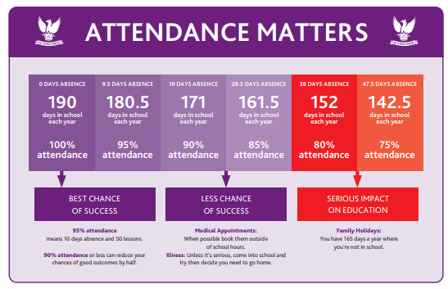
Strong communications and getting parents across the threshold
Bulletins
Staffing – communication officer
Educational attendance letters and posters
Six parent curriculum/pastoral events a year and aiding the development of the PTA
Create purpose
Notes:
We continue to advertise attendance using our attendance matters and punctuality matters school posters. Walking around the school site, you will see these posters in each form room and on display boards in key places like main reception and student reception. These posters keep staff consistent with their conversations with students about the impact of not being in school and turn a percentage into real life data (days missed). We consistently send these posters out to students in the weekly parent bulletin and the daily student bulletin which is sent daily for tutors to read out. This is supported by a communications officer which leads on clear parent messaging. You can find this resource in the library on the hub page – please use and adapt for your setting.

Slide 25
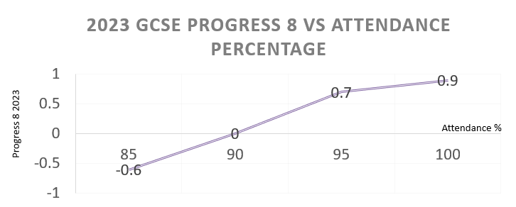
Linking Progress Data and Attendance
Drayton Manor High School looks closely at the link between progress and attending school. We use real GCSE data and internal assessments to prove this link
Attendance Figure | Impact on Education | Interventions & actions to be taken
100 % 190 days in school 0 days absence | 2023 results: 0.9 progress – top 3% of students nationally Best chance of success | Certificates for perfect attendance Texts/Letters home to celebrate attendance Achievement assemblies Challenge 96 winning Tutor Prizes
95% 185 days in school 9.5 days absence 78 lessons missed | 2023 results: 0.7 progress - top 8% of students nationally Less chance of success | Each day of absence challenged by attendance team Student to track absence in knowledge organiser Return to School meetings after each absence Tiered letter sent
90% 171 days in school 19 days absence 95 lessons missed | 2023 results: 0.0 progress – students achieve in line with national average (58% of all students) Less chance of success | Each day of absence challenged by attendance team Return to School meetings after each absence Tiered letters sent advising of the consequences of low attendance
Less than 90% PERSISTENT & SEVERE ABSENCE | 2023 results: -0.6 progress – bottom 8% of students nationally Serious impact on education | Attendance cause for concern meeting and contract Each day of absence challenged by attendance team Investigation into the cause of poor attendance Referral to EWO, CME and Social Services (ECIRS)
Notes:
Going back to this key data, we wanted to demonstrate to all students that attendance does not just make a difference to all school children, but specifically makes a difference to students who attend our school. We find this data supports conversation with KS4/5 students. We provide this data set for each set of mocks meaning that during results assemblies, the HOY can draw out trends in the data and re-educate students that those who attend more, do better.
We have found that parents find this data clear and support their own conversations in the home. It is a clear message: attend more, do better.

Slide 26
Pause Point
Notes:
I am just going to pause for 2 minutes so that you can digest our first objective. If you have any questions relating to this objective please do post into chat and we can discuss in just a moment.

Slide 27
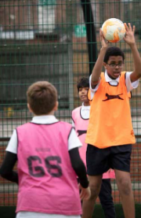
In focus: A strong start to the day
Welcome on the gate and a warm hello
Free breakfast, basketball hoops open, library warm and welcoming, music practice rooms for hire, revision and exam boosters
Tutors/assembly programme – having attendance on the agenda
Pre-emptive attendance phone calls
SLT on duty each lesson. Challenging conversations on lates and poor excuses – not allowing attendance to slip
First day absence calls – which date will you return? Can you come in later?
Notes:
I wanted to take a moment on focusing in on our start to each day. This is a key moment in making sure the day is a success but also to ensure that students have a sense of belonging and excitement around being on school site.
As seen in our At the school gate report – we have researched that many of our students have to travel to reach the school site and many students live in housing too small for their family. Our CRAVE leadership style adapted the school day to ensure that the school site is open early allowing students to have access to the library from 8am for a quiet and warm study area but we also encourage students to use the school site for their basketball or football games or music practice. We have also budgeted to provide free breakfast of toast or porridge for all students – this has been popular with parents especially during the recent rise in the cost of living.
Punctuality is also important for school attendance and upholding a warm but strict environment when it comes to attending school. All students who are late to school do not go to form/tutor time but instead are supervised in completing a lateness reflection sheet. This gives senior leaders and heads of year an opportunity to speak with late students who often have lower levels of attendance. The late reflection sheet can be found in the hub library and often uncovers attendance or safeguarding issues which can then be acted upon during the school day.
Our new initiative of pre-emptive phone calls have helped to support emotionally based school avoidance students with a consistent friendly call to get students into school. These calls are made by the same staff member from 7:30 each day and help to build routine into the home. The same member of staff will then phone students who were absent during the day before and encourage home to attend school that day. Often the member of staff will go to the school gate to then support a good start to the school day from the students they have just phoned.

Slide 28

Sense of Belonging
Question: 1. How do you currently create and maintain an environment that you want students want to come in for? 1 Minute – in the chat
House system – a sense of identity and creation of competition
Hard reset post pandemic
Student leadership
Merits for attendance and House percentage score aid House competition
Notes:
Draytonians – all part of the community
We had to reboot our house system to create the strong culture of belonging and competition. The previous house system was out dated and did not match to our values triology. With our CRAVE leadership in mind, we spoke with the student leadership to see what the house system should look like.
Attendance feeds directly into this house system. Students compete to win the highest attending houses. They compete against each other to win merits for attendance 20 day streaks. They can see the points total on the main page of the website and this is shared during tutor time, parent and student bulletins and in assemblies. The house system puts competition at the heart of a high attending culture.

Slide 29
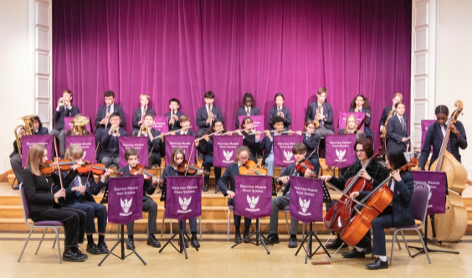
Sense of Belonging
Fear of missing out (on school)
At Drayton Manor High School, we ensure that big school events are well advertised to students and hosted in line of sight of students. This builds a desire to become involved
Student, staff and parent bulletins are used to advertise the extracurricular programs running each day
Site opening times: allowing for longer days to provide for our families and create a safe reliable space for students
Notes:
Our sense of belonging continues with the events schedule that we put on. Each music, sporting, drama event is scheduled to both practice and perform so that students have enjoyment from these cultural events but also create a buzz of a fear of missing out. From looking at our website, our announcement section will regularly contain short videos or pictures of winning performances. While practicing for these events, we will allow students to sit in during lunch time rehearsals so that a buzz gets created around the school. This creates our high attending culture of belonging.

Slide 30
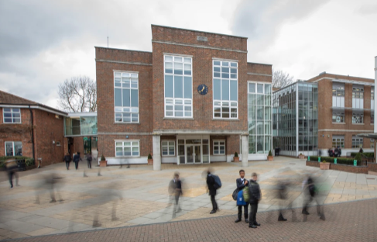
Competition
A positive reward system in your school can celebrate good and improving attendance
Assembly programme used to regularly celebrate high attending students
Students who have improved on their attendance can be rewarded with a spirit of endeavor award
Question: How could you develop a competition/reward system in your school to be the focus for both staff and students in improving attendance? Share into the chat any suggestions
Notes:
On to our next outcome from today: creating competition. As previously mentioned with our 4 house system – it is key in driving attendance but it really aids in creating interstaff competition.
Our rewards are big in the school. We hold a half termly ethic of excellence and spirit of endevour morning breakfast where each student can be nominated by staff – this includes making great strides in improving attendance. Children come out of lesson and meet the head and provided a photo opportunity and certificate. They are then provided a with a breakfast, cookie or pizza.
Please share into the chat any attendance rewards that you use to create competition and urgency around attendance.
House system
Competition that leads to rewards
Staff reward
Competition and sanction

Slide 31
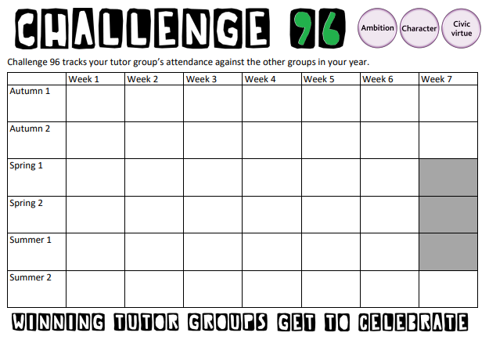
In Focus: Competition and sense of belonging
Challenge 96 programme
Competitive weekly spirit
Team collaboration
Prizes for the winning form
Student success stories shared in assembly and praised with token amazon vouchers
Notes:
I have already mentioned this programme – the tutor competition challenge 96. You can find the template for this in the resources library.
Each week, the head of year shares with tutors the weekly attendance of the form. The A3 sheet is displayed on the tutor board and during the attendance tutor session, students track their own personal attendance in their planner but also their form attendance. The challenge 96 creates urgency around attendance and allows for forms groups to be celebrated in a public way for the highest attending form and the most improved. All year groups track their forms weekly attendance on this grid – and the displays make attendance public in each classroom.

Slide 32
Pause Point
Notes:
I am just going to pause for 2 minutes so that you can digest our second objective. If you have any questions relating to this objective please do post into chat and we can discuss in just a moment.

Slide 33
Further discussion questions
Who needs the greatest buy in at your setting to promote good attendance: Children, Parents, Staff?
Whose responsibility is it to promote good school attendance? How will you quality assure this?
Who is responsible for having difficult conversations with parents/children regarding their attendance? How will this be quality assured and be a supportive intervention?
What needs to happen to ensure that attendance is on the school agenda for each stakeholder?
Notes:
Please take two or three minutes to type some further responses into the chat in response to these takeaway questions.

Slide 34
Key Outcomes
Provide you with core strategies for how we engage parents, students and staff in improving attendance – communication strategy. Keep attendance on the agenda
Detail how the value of attendance is promoted to students – putting competition at the heart of staff and students value of attendance
Notes:
Thank you so much for joining us today and for your activate participation. Our outcomes were to provide you with an overview of our communications strategy which keeps attendance on the agenda. We have also discussed how we place competition at the heart of staff and students value around attendance.

Slide 35
How we work as a leadership team
CRAVE Leadership: Whatever we turn our attention to, it gets better
Clarity – be clear on who is leading
Reflection – autopsy without blame
Accountability – define what needs improving and how it will be measured
Values – do what is right for our students, not easy
Expertise – go seek out advice, adapt current practice and act
Notes:
But importantly, we discussed that the thread that will go through all the sessions is our CRAVE leadership style which keeps us focused on the importance of attendance and reviewing it like any aspect of school improvement work.

Slide 36
DMHS Attendance Hub
A strong culture of attending school
1. Value of attendance
2. Partnerships
3. Structure
4. Data and Systems
5. Effective Interventions
6. Quality Assurance
Module 2 is now open to access on the Hub webpage
We look forward to seeing you on Thursday 13 June for module 2: Effective Partnership working
Notes:
I hope you have enjoyed the session today. We will be emailing out further information about the next session on 13 June and a feedback form from today. Please bring with you on 13 June any feedback on any of the programmes and initiatives that you have used from today.

