Slide 1
Paper 3 Preparation 13-Nov-20 Key terminology from the article From Organoids to Gastruloids 2019
Do Now. Using the article supplied:
In one colour highlight any key words or phrases that you do not know the definition of or are new to you (tricky words/phrases).
In another colour highlight any key words or phrases that may be related to aspects of Biology that we have studied (e.g. inheritance, gene expression etc) .
3. Add in any extra words that your partner found!

Slide 2
Paper 3 Article Preparation Monday, 16 November 2020
Lesson objectives
To become familiar with the key words and concepts that appear in the 2019 article
To become familiar with the types of questions asked on the scientific article
To practise how to answer questions that could come up on the scientific article

Slide 3
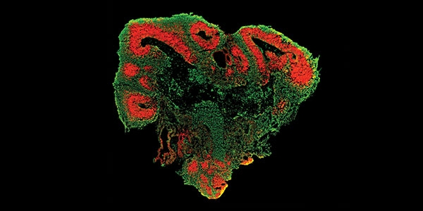
From Organoids to Gastruloids Scientific article 2019
What does organoid look like?
An organoid is a 3D multicellular in vitro tissue construct that mimics its corresponding in vivo organ, such that it can be used to study aspects of that organ in the tissue culture dish.
https://www.youtube.com/watch?v=gij88paaFB4

Slide 4
Gastruloids
Mouse embryonic stem cells (mESCs) are by definition cells that can self-renew (make identical copies of themselves) and specialise into any cell type of the body.
When injected into a mouse early embryo, mESCs can become any cell type of the body but can also be passed on to the next generation.
Using this technique, scientists have been able to generate hundreds of transgenic mouse models, invaluable for the progress of biology and medicine.
Why might scientists want to study transgenic mouse models?

Slide 5
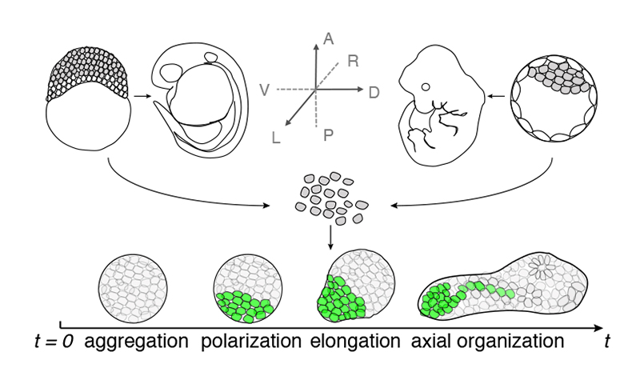
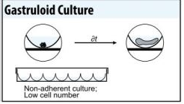
Gastruloids
However, mESCs cultured in a dish do not organize themselves into structures that are similar to embryos. If aggregated into balls, called embryoid bodies, they can develop into a disorganized mass that does not resemble an embryo.
Van der Brink and colleagues have published a culture protocol with which they obtain mESCs structures that exhibit collective behaviors similar to those of the cells in the early mouse embryo: axis elongation, axial organization and early cell specialization.
They thus call these structures gastruloids, in reference to gastrulation, one of the key and central process of early embryo development.
https://www.youtube.com/watch?v=Si9pWVWyGjU&t=122s

Slide 6
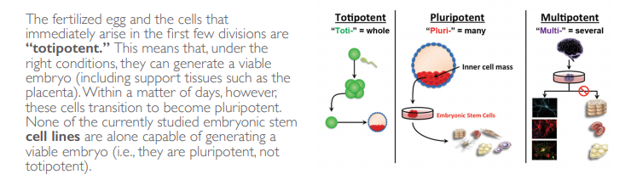
Stem cells Recap
On mini whiteboards describe what multipotent, pluripotent and totipotent mean.

Slide 7
Getting to know the meanings of the words in the article
Use the glossary to have a quick look at the definitions of the key words from the article.
In pairs, take it in turn to read out one of the definitions and the other to guess the key word. The person guessing should not have the glossary in front of them.
Highlight any key words that you find tricky to remember.

Slide 8
Guess the word
3D aggregates of embryonic stem cells; has 3 germ layers
Gastruloid

Slide 9
Guess the word
In glass, in lab conditions
In vitro

Slide 10
Guess the word
Any chemical which regulates gene expression
Gene signals

Slide 11
Guess the word
Pluripotent stem cells from blastocyst of mouse, human or primate
Embryoid body

Slide 12
Guess the word
The same results are obtained by a different person or by using a different method
Reproducible

Slide 13
Guess the word
In vitro, miniature simplified organ
Organoid

Slide 14
Guess the word
How the genes control the development of the body axis
Axial patterning

Slide 15
Guess the word
Spread information widely
disseminated

Slide 16
Guess the word
Spherical structure, inner cell mass which forms embryo and outer layer trophoblast, formed day 5-9 of embryo development
blastocyst

Slide 17
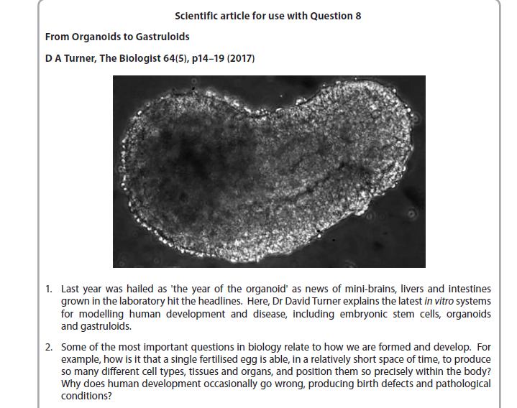
Now assign each of the paragraphs to an area of biology that you have studied and the topic
e.g. stem cells, topic 3

Slide 18
Use the revision guides and textbooks to fill in the boxes from the broadsheet given to you
Add definitions and examples for all headings
Start now and finish for your home learning

Slide 19
Stages of fertilisation
June 2019 Scientific article
From Organoids to Gastruloids
YR 1 CONTENT
Genetics
Genotype:
Phenotype:
Gene:
Allele:
Epigenome:
Gene switches – lac operon:
What happens when gene expression goes wrong:
Master genes:
Cardio Vascular Disease
CVD risk factors:
CVD prevention:
Cardiac Cycle
List the stages in the cardiac cycle:

Slide 20
Drug testing
Stages of drug testing:
List the features of a good clinical study:
How is information between scientists shared and checked for its validity?
June 2019 Scientific article
From Organoids to Gastruloids
YR 1 CONTENT
Stem cells. Define the following:
Blastocyst:
Pluripotent:
Multipotent:
Totipotent:
Ethics of using stem cells:
Gene and environment interactions
Examples:
Environmental influences on the epigenome:
Causes of cancer:

Slide 21
Cell signalling
Gene switches
How do transcription factors work?
Diseases
Virus structure
Bacteria structure
Transmission of TB bacterium:
Transmission of HIV:
Treatment of AIDs:
Treatment of TB:
June 2019 Scientific article
From Organoids to Gastruloids
YR 2 CONTENT
Ethics (yr 1 and 2):
Ethical frameworks arguments:
Ethical arguments for and against using animal models:
Ethical arguments for and against using embryos for medical research:

Slide 22
Paper 3 Article Preparation. Lesson 2
Do Now
Give 2 risk factors of CVD.
Describe what happens during ventricular systole.
Give one feature of a good clinical study.
Define pluripotent.
Give one ethical argument for and against the use of animals as models for organ systems.
Draw a labelled diagram of a virus.
Describe how HIV hijacks the cells protein synthesis.

Slide 23
Answers
Age/genetics/lifestyle e.g. diet, smoking, alcohol and exercise.
During ventricular systole the ventricles contract from the base upwards, pressure forces the semilunar valves to open and pushes blood through the aorta/pulmonary artery.
Features of a good study include: clear aim, representative sample e.g. size, gender, ages, controls included to make results valid, procedures reproducible.
Pluripotent = embryonic stem cells from blastocyst that can give rise to most cells but not all.

Slide 24
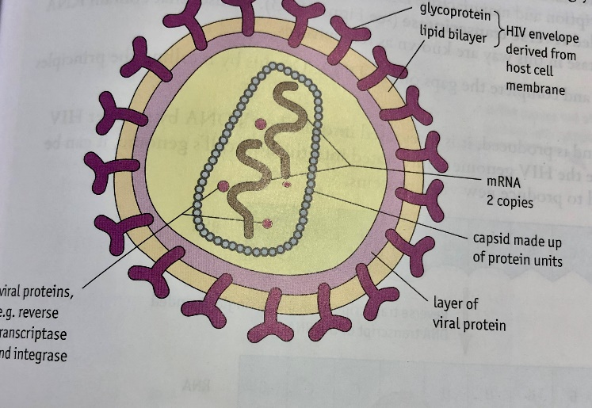
Answers
Ethics include: Animals feel pain; animals have rights, animals can not give consent; some animals’ systems are not similar enough to our own to truly show the full scale of the effectiveness of any drugs or side effects; tissue cultures are not enough to see the full scale of the effects of drugs and so a full system such as an animals is needed; some animal systems are close to ours to mimic the side effects of drugs and it depends on how many others will benefit from the research being done on the animals.
Virus structure
The HIV virus invades T helper cells allwoing its viral RNA and enzymes into the cell. Reverse transcriptase makes viral DNA which is integrated into the hosts DNA using the enzyme integrase. This is then transcribed and translated into virus proteins.

Slide 25
Paper 3 Article Preparation Monday, 16 November 2020
Lesson objectives
To become familiar with the key words and concepts that appear in the 2019 article
To become familiar with the types of questions asked on the scientific article
To practise how to answer questions that could come up on the scientific article

Slide 26
Stages of fertilisation
June 2019 Scientific article
From Organoids to Gastruloids
YR 1 CONTENT
Genetics
Genotype:
Phenotype:
Gene:
Allele:
Epigenome:
Gene switches – lac operon:
What happens when gene expression goes wrong:
Master genes:
Cardio Vascular Disease
CVD risk factors:
CVD prevention:
Reviewing your homework
What can you add in?
Cardiac Cycle
List the stages in the cardiac cycle:

Slide 27
Drug testing
Stages of drug testing:
List the features of a good clinical study:
How is information between scientists shared and checked for its validity?
June 2019 Scientific article
From Organoids to Gastruloids
YR 1 CONTENT
Stem cells. Define the following:
Blastocyst:
Pluripotent:
Multipotent:
Totipotent:
Ethics of using stem cells:
Gene and environment interactions
Examples:
Environmental influences on the epigenome:
Causes of cancer:

Slide 28
Cell signalling
Gene switches
How do transcription factors work?
Diseases
Virus structure
Bacteria structure
Transmission of TB bacterium:
Transmission of HIV:
Treatment of AIDs:
Treatment of TB:
June 2019 Scientific article
From Organoids to Gastruloids
YR 2 CONTENT
Ethics (yr 1 and 2):
Ethical frameworks arguments:
Ethical arguments for and against using animal models:
Ethical arguments for and against using embryos for medical research:

Slide 29
Ethics In This Article
Read the article again and note quotes from the article (with reference to paragraph numbers) where you see something that could be considered an ethical issue.
Summarise what most of these ethical issues are about.
E.g. using animal models and stem cells
Why might some people be against using embryos for medical use?
When is it appropriate to stop work on embryos?

Slide 30
What type of questions have come up in past article questions?
Look at the past article questions and:
Note the command words that are coming up.
Note the number of marks each question is.
Note the types of topics coming up (how many year 1, how many year 2 etc).

Slide 31
Make your own article questions on your article
You have been assigned a few pages to make 10 questions and 10 answers (separately) to make as HL
We will have a go at these next lesson to help us before you sit the mock paper

Slide 32
Exit Ticket
What topics have come up in the 2019 article?
What types of questions are asked on the scientific article?

