Slide 1
Article Preparation: Darwin’s Cancer Fix 9-May-22
Do Now
Using your annotated article completed for homework compare the keywords and phrases highlighted with others on your table and annotate your article further so that you have:
Key words/phrases that you don’t understand highlighted and definitions added
Colour coded links have been made to topics 1 – 8 for each paragraph

Slide 2
Review
Compare your annotations to mine and add to your own article

Slide 3
Paragraph | Term / Word | Definition
1 | oncologists | A doctor who treats cancer and provides medical care for a person diagnosed with cancer
2 | metastatic | The spread of cancer cells from the place where they first formed to another part of the body
5 | oncogenesis | The process through which healthy cells become transformed into cancer cells
5 | ailment | An illness, typically a minor one
10 | perturbations | An alteration of the function of of a biological system by internal or external means
12 | confer | To grant
13 | paleontologists | A scientist who studies the history of life on Earth through the fossil record
Notes:
*print as handout

Slide 4
Paragraph | Term / Word | Definition
14 | Proliferation | The increase in the number of cells as a result of cell growth and division.
17 | Malignancies | The presence of cancerous cells that have the ability to spread to other sites of the body or to invade and destroy tissues
17 | Sterile | Free from bacteria or microorganisms
18 | Drug resistance | Reduction in effectiveness of a medication used to treat a disease or condition
19 | Competitive release | When one of the 2 species competing for the same resource disappears
19 | Chemotherapy | Treatment of cancer using chemical substances

Slide 5
Paragraph | Term | Definition
24 | Evolution-based strategy | A mathematical programming technique based on ideas of evolution
 | Anti-cancer drug | A drug that is effective in the treatment of cancer
 | Chemotherapy | A type of cancer treatment that uses anti-cancer drugs
 | Hormone therapy | A type of cancer treatment that slows or stops the growth of cancer that uses hormones to grow
 | Immune system boosters | A type of cancer treatment that boosts the body's natural defences to fight cancer
 | Metastasizing | The spread of cancer
 | Treatment sensitive cancer cells | Cells that respond less effectively to treatment
25 | Mathematical models | Used to study the interactions of many factors
 | Experimental methods | Procedures carried out to support or refute a hypothesis
26 | Oncologist | A doctor who treats patients with cancer
27 | Aggressive (in relation to cancer) | Describes a tumour that spreads quickly
28 | Evolutionary model | They describe the rates at which one nucleotide replaces another during evolution
 | Proclivity | A predisposition to a disease
 | Evolutionary dynamics | The study of the mathematical principles according to which biological organisms as well as cultural ideas

Slide 6
Lesson objectives
To become familiar with the key words and concepts that appear in the 2022 article
To become familiar with the types of questions asked on the scientific article
To practise how to answer questions that could come up on the scientific article

Slide 7
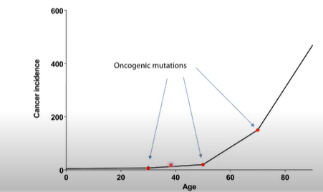
Darwin’s Cancer Fix: what is the article about?
Why do we get cancer in old age?
We know that mutations in DNA cause cancer but why so much more in old age?

Slide 8
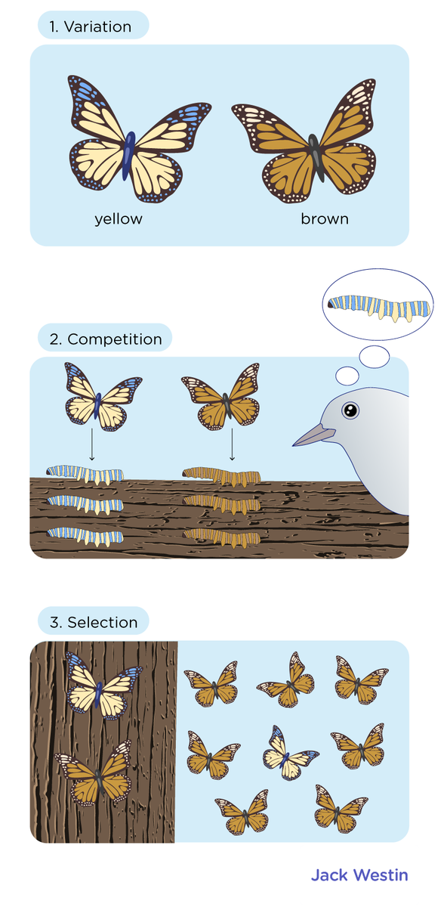
Why do we get cancer in old age?
A molecular biologist DeGregori and physician Gatenby have applied the theory of evolution to explain how this happens.
They believe it is the environmental changes that the cells are subject that drive the cell changes like in natural selection …..

Slide 9
Natural selection recap

Slide 10
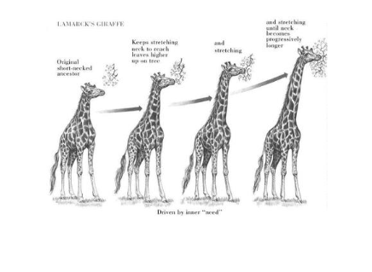
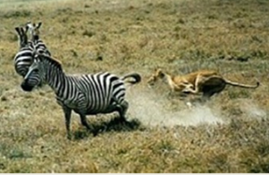
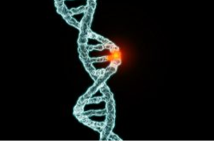
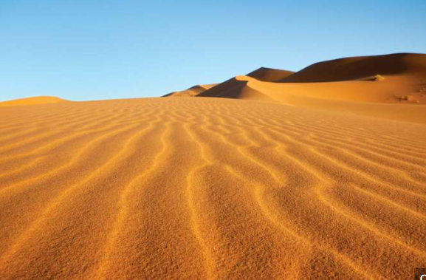
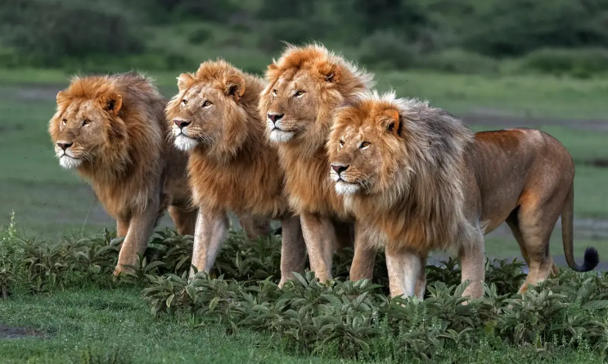
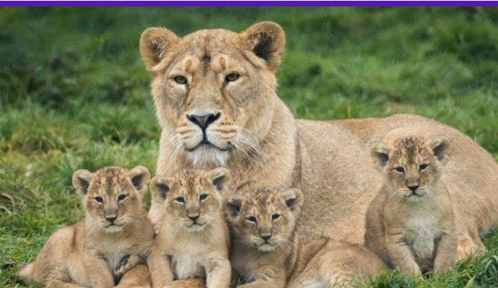
Think Pair Share. What key words are the pictures showing?
survival of the fittest/competition
C
B
mutation
D
selection pressure
A
Evolution, the change in a species over time.
F
allele frequency
E
reproduce

Slide 11
Natural Selection and Evolution
Sorghum is a plant that lives in very dry regions, and has extensive root systems, to get as much water as possible. How did it become so well adapted?
- selection pressure
- variation
- Competition
advantageous adaptation
survive and reproduce.
pass on
allele frequency

Slide 12
Natural Selection and Evolution
Sorghum is a plant that lives in very dry regions, and has extensive root systems, to get as much water as possible. How did it become so well adapted?
- selection pressure
- variation
- Competition
advantageous adaptation
survive and reproduce.
pass on
allele frequency
Partner Talk:
What would you need to say for the highlighted words in this context?

Slide 13
Natural Selection and Evolution
Sorghum is a plant that lives in very dry regions, and has extensive root systems, to get as much water as possible. How did it become so well adapted?
Major selection pressure – lack of water
Variation (in alleles) in population
Due to mutation
Competition between plants for water
Some will have larger root systems
These are more likely to survive and reproduce
Pass on alleles (for larger root systems)
Allele increases in frequency within the population

Slide 14
Natural Selection and Evolution
Task: now do the same for the following scenarios:
The cheetah is very fast, to catch prey.
The male peacock has a large, colourful tail, which attracts females.
The veined octopus uses the suckers on its legs to carry coconut shells, and hides under them for shelter from predators.

Slide 15
Why do we get cancer in old age?
A mutation in a cancer causing gene should not provide an advantage to the cell, in fact it can be disadvantageous if it makes the cell less able to use resources (paragraph 12).
Studies on mice have shown that the same mutation can have very different effects on the cells depending on the age of the mice.
Therefore, the determining factor doesn’t seem to be the mutated gene but actually the metabolism and gene activity of the cells around them (paragraph 14).
When the environment has changed so much that the mutated cells can take advantage over other cells, then they will multiply (survival of the fittest).

Slide 16
How can we use this information?
If we know that the environment that the cells are in is the driving selection pressure that enables cancer then perhaps we can introduce ways to limit them!
For example, life style changes but also looking at ways that cancer is treated.

Slide 17
From prevention to therapy
Common drug resistance examples are given in the article such as pesticide resistance and antibiotic resistance.
DeGregori claims that cancer is no different and that eventually drug resistant cancer cells occur.
A new approach to cancer treatment therapy is where the drugs are used to keep the tumour size and growth limited without completely killing all cells.
This should mean that the cells left behind are still sensitive to the drugs and that no resistant cells have occurred.
Trials are still on going but have shown that some patients can live longer with this therapy.

Slide 18
Partner Talk
From the article give an example of how cancer and age behave like natural selection:
What does the process start with?
What is the selection pressure?
What are the cells competing over?
Which cells survive and why?

Slide 19
Mini whiteboards
From the article give an example of how cancer and age behave like natural selection:
What does the process start with?
What is the selection pressure?
What are the cells competing over?
Which cells survive and why?
Mutation
The change in the environment of the cells
Resources
Those that can obtain more resources?

Slide 20
Mini whiteboards
Explain how cancer cell resistance to drug treatment happens?
Key words: selection pressure, competition, mutation, survival of fittest
The drug is the selection pressure.
The cancer cells are competing for resources for survival.
Some cancer cells mutate allowing them to not be killed by the drug.
The mutated cells have the survival advantage and are not killed by the drug.
These cells then multiply.

Slide 21
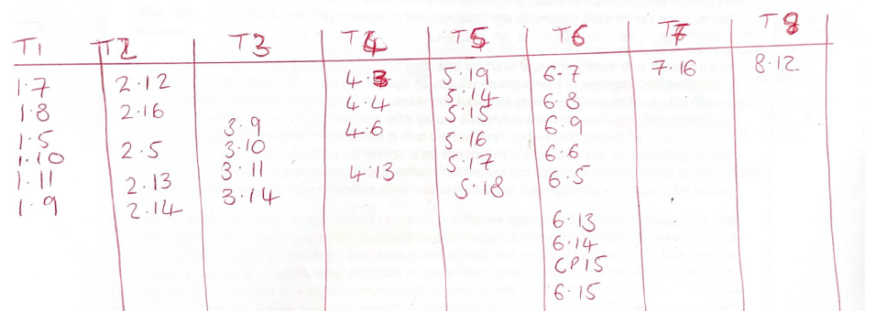
Task
What: make a list of all of the topics that occur in the article, this could be a table or mindmap
How: in pairs
How long: 3 minutes

Slide 22
Task: start now and finish for homework
Use textbooks and revision guides to fill in the revision sheets on the topics from the article
Watch this lecture by James De Gregori https://www.youtube.com/watch?v=0IVDFdUrCNA
Summarise what he said in the lecture as Cornell notes

Slide 23
MUTATIONS
Define a mutation
How do errors in DNA replication cause mutations?
CELL DIVISION
Define meiosis
Briefly describe the 4 phases of mitosis
STEM CELLS AND CELL DIFFERENTIATION
Define:
Stem cell
Pluripotency
Totipotency
List three ethical issues with the use of stem cells as treatments
ALLELES, GENETIC VARIATION AND FREQUENCY
State the Hardy-Weinberg equations
Explain how a new species can be formed through genetic variation

Slide 24
NATURAL SELECTION
Explain how evolution occurs through gene mutation
DRUG TRIALS AND RESISTANCE
Outline the history of the development of drug testing.
In what conditions do bacteria grow?
How would you investigate antimicrobial properties of plants (mint vs garlic)
ADAPTATIONS
Explain how a monkey is adapted to its environment including and define physiological, anatomical and behavioural adaptations
DEFENCE AGAINST INFECTION AND THE IMMUNE SYSTEM
Outline the steps of inflammatory response
How does phagocytosis destroy pathogens?
Give an example of passive and active immunity
COMPETITION FOR RESOURCES
Define: Ecosystem
Community
Population
Habitat
How does competition lead to natural selection?

Slide 25
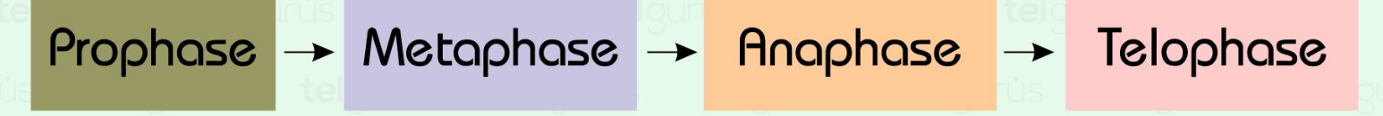
Outline the stages of inflammatory response:
What is the role of the lymphatic system?
Contemporary drug testing
PHASE 1:
PHASE 2:
PHASE 3:
How can errors in DNA replication give rise to mutations?
How can natural selection lead to adaptation and evolution?
What are the three types of mutation?

Slide 26
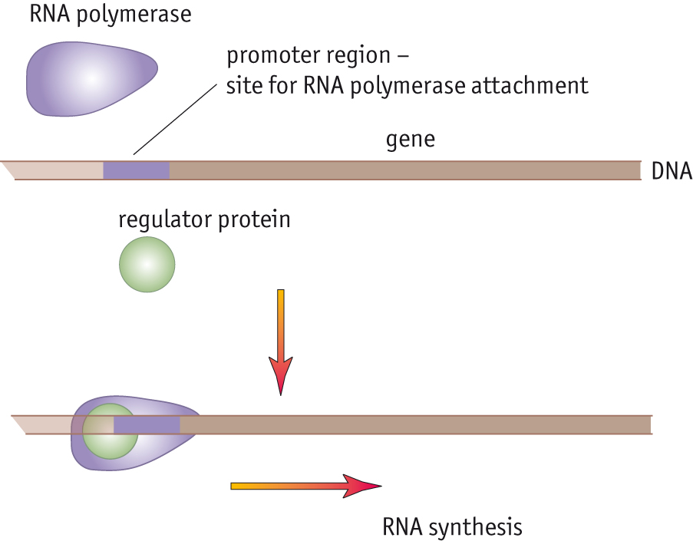
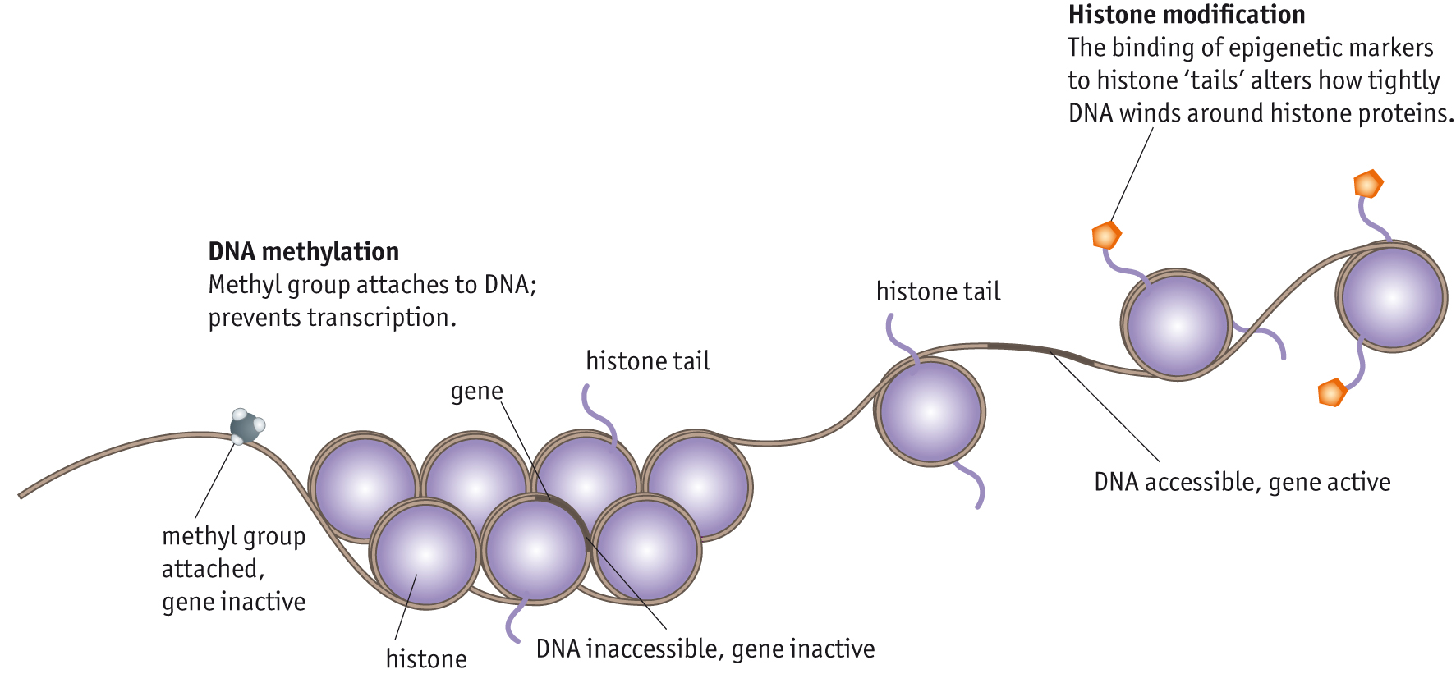
Explain what is meant by the term ‘gene’
Explain how transcription factors work and why they are so important in controlling gene expression:
Explain how a mutation in a gene can lead to the production of a defective protein (this can cause cancer).
Epigenome | Explain how these chemical markers influence gene expression
DNA methylation
Histone acetylation

Slide 27
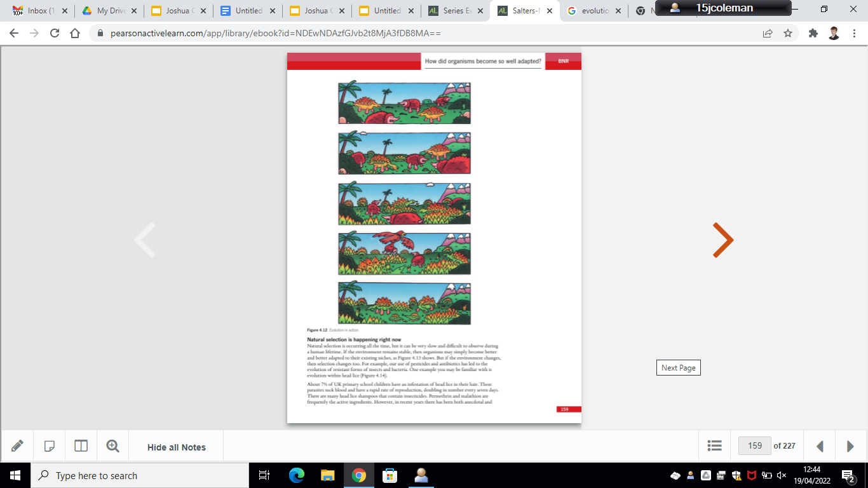
Describe the stages of natural selection:
Define the following:
Evolution:
Natural Selection:
Describe Darwin’s ‘Theory of Evolution’

Slide 28
Describe the 5 stages of modern drug testing:
Explain how modern drug trials are similar/different from Withering’s drug trial:
Explain what a double blind trial is:
What are new drugs tested for?

Slide 29
Article Preparation L2: Darwin’s Cancer Fix 9-May-22
Do Now
How does genetics affect cardiovascular disease risk?
How does an atheroma form?
How can a gene mutation result in a protein not being synthesised?
What is a frame shift mutation?
How does epigenetic control work?
What do selection pressures do?
How do scientists discuss and review their work?
What is inflammation?

Slide 30
Answers
Do Now
How does genetics affect cardiovascular disease risk?
Some people inherit particular alleles that make high blood pressure more likely.
How does an atheroma form?
White blood cells accumulate chemicals especially cholesterol and this deposit builds up
How can a gene mutation result in a protein not being synthesised?
Mutation changes sequence of bases, A premature stop codon or frame shift is changed by the mutation. Transcription/translation does not occur
What is a frame shift mutation?
Frame shift mutation - the reading frame changes and this results in a different protein structure

Slide 31
Answers
How does epigenetic control work?
by attaching or removing chemical groups to or from the DNA, this affects how easy it is for enzymes needed for transcription to interact with and transcribe genes
What do selection pressures do?
create a struggle for survival
How do scientists discuss and review their work?
scientific journals, peer review, scientific conferences
What is inflammation?
Pathogens enter body , damaged WBC and mast cells recognise foreign antigen and release histamine which causes the arterioles in the area to dilate so vasodilation around the site, increasing the blood flow to it. They also increase permeability of the capillaries so plasma fluid, WBC and and antibodies leak from the blood into the tissue causing oedema. The infecting microbes can now be attacked by these intact white blood cells

Slide 32
Lesson objectives
To become familiar with the key words and concepts that appear in the 2022 article
To become familiar with the types of questions asked on the scientific article
To practise how to answer questions that could come up on the scientific article

Slide 33
Homework due in
Completed sheets on topics
Watch this lecture by James De Gregori https://www.youtube.com/watch?v=0IVDFdUrCNA
Summarise what he said in the lecture as Cornell notes

Slide 34
Task
What: Look at the 2019 qu 8 ‘style’ of questions and summarise:
How many marks each question is
The command words
How: In pairs
How long: 5 minutes

Slide 35
Task
What: You will be assigned a page of the article to make 5-6 questions on. Questions on front, answers on the back.
How: Independently
How long: 10 minutes

Slide 36
Task: circus of questions on the article
What: on a separate piece of paper answer the questions that are in front of you
How: Independently, move to the next sheet when the time is up
How long: 5 minutes per set of questions to answer, 1 minute to mark

Slide 37
EXAM QUESTIONS:
1a) How does inflammation destroy invading microbes?
1b) What is the chemical released by damaged white blood cells and mast cells?
2a) The genetic variation in a gene pool is increased as a result of several factors. Identify two of these factors.
2b) Mutations are continually occurring in DNA, though most errors are corrected before the DNA is replicated. However there are many factors that can increase the mutation rate; one of these factors is genetics.
i) Identify two examples of mutagenic agents
ii) What is the difference between acquired mutations and hereditary mutations?

Slide 38
Exam Qu answers
Damaged white blood cells and mast cells release a chemical called histamines.
Histamines trigger an inflammatory response through:
Vasodilation to increase blood flow in arteries and capillaries.
Leaky capillaries allow more fluid and plasma to leak out of capillaries, causing swelling of the damaged area.
Prophase: Chromosomes duplicate, thicken and coil up, and the nuclear envelope is digested
Metaphase: Chromosomes line up in the centre of the cell in homologous pairs and the centrioles attach swindle fibres onto each chromatin of the chromosome from opposite ends of the cell.
Anaphase: The chromosomes are pulled apart to opposite sides of the cell.
Telophase: a new nuclear envelope is formed around each of the new bundles of chromosomes and the cytoplasm splits, a new membrane is formed and 2 daughter cells are produced.
Lymphatic system: The lymphatic system drains excess tissue fluid from the capillaries around the body, and houses the lymph nodes which contain immune cells such as B and T cells, that help us fight against disease and germs. The lymphatic system also works by cleansing and filtering the blood.
DNA mutations can occur via radiation or chemicals or random mutations, and causes bases or sections of DNA to disappear or be substituted. It can result in the production of erroneous proteins including enzymes with the wrong active site.
Addition, Deletion, Substitution.
Natural selection can lead to evolution through the advantageous gene. A change in environment or climate can cause an advantageous gene, which was originally uncommon or dormant, to appear, allowing animals or plants with them to survive and produce offspring, increasing the allele frequencies of that gene in the gene pool, and thus evolution has just happened. These can include anatomical changes or physiological changes such as beak size etc.

Slide 39
By increasing plasma and bloody fluids to move in larger volumes to the area of damage, via the leaky capillaries, more B and T cells are able to access the area and prevent microbes from accessing that specific area. It also means more fluid is to be drained into the lymphatic system, cleaning the blood and allowing more exposure to immune cells.
Histamines
Gene mutations, Meiosis, Recombination, Independent assortment, crossing over, random fertilisation
Radiation, Chemicals
Acquired mutation: A genetic change that occurs in a single cell after the conception of an individual.
Hereditary mutation: A gene change that occurs in a germ cell (an egg or a sperm) and is then incorporated into every cell in the developing body of the new organism.

Slide 40
Exit Ticket
What topics have come up in the 2022 article?
What types of questions are asked on the scientific article?

Slide 41
Lesson objectives
To become familiar with the key words and concepts that appear in the 2022 article
To become familiar with the types of questions asked on the scientific article
To practise how to answer questions that could come up on the scientific article

