Slide 1
Article Preparation 28-Mar-24 Life In The Sloth Lane
Do Now
What:
Add to your annotated article done for homework with:
Key words/phrases that you don’t understand and definitions
Colour coded links made to spec points from topics 1 – 8 for each paragraph
How:
Compare your annotated article with others and my annotated example
How long:
10 mins

Slide 2
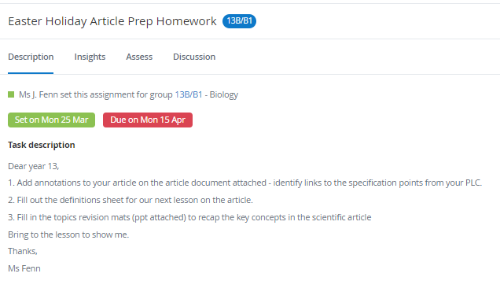
Task: homework

Slide 3
Lesson objectives
To become familiar with the key words and concepts that appear in the 2024 article
To become familiar with the types of questions asked on the scientific article
To practise how to answer questions that could come up on the scientific article

Slide 4
Task
What:
Mark your definitions of the key words from the article
How:
Use the mark scheme
In green pen
How long:
5 mins

Slide 5
Articulate
What:
Check your key words and definitions with the mark scheme
How:
In pairs
Person A describes a word from the sheet, Person B guesses without looking at the sheet, then swap roles and alternate who describes and who guesses
How long:
5 mins

Slide 6
Mini whiteboards
What:
Write the word(s)/phrases for the definitions on the following slides.
How:
On your mini whiteboard.
How long:
15 sec each time

Slide 7
The digestive tract, including the esophagus, stomach, and intestines.
Alimentary canal

Slide 8
The principal taxonomic category into which organisms are divided.
Phyla

Slide 9
The family that now includes only the three-toed sloths after the new classification.
Bradypodidae

Slide 10
A relationship between species where one benefits while the other is unaffected.
Commensalism

Slide 11
Biological catalysts that accelerate chemical reactions.
Enzymes

Slide 12
The rate of energy expenditure for an animal in its natural environment.
Field metabolic rate

Slide 13
One of the mammalian subclasses, comprising placental mammals.
Eutherian

Slide 14
A virus transmitted by arthropod vectors like mosquitoes.
Arbovirus

Slide 15
Classification Recap

Slide 16
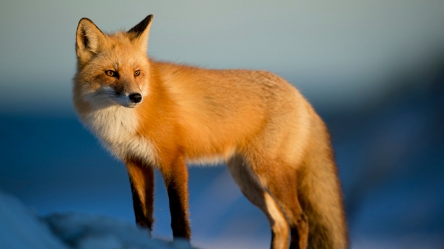
Kingdom
Animalia
Phylum
Chordata
Class
Mammalia
Order
Carnivora
Family
Canidae
Genus
Vulpes
Species
Vulpes vulpes
Public domain pictures - Jean Beaufort- Red Fox

Slide 17
Kids Prefer Candy Over Fried Green Spinach
The Linnaean system of classification – A mnemonic
Kingdom Phylum Class Order Family Genus Species
Notes:
Feel free to adapt if you use a different mnemonic

Slide 18
Kingdom
Animalia
Phylum
Chordata
Class
Mammalia
Order
Primates
Family
Hominidae
Genus
Homo
Species
Homo sapiens

Slide 19
Kingdom
?
Phylum
Class
Order
Family
Genus
Species

Slide 20
Kingdom
Phylum
Class
?
Order
Family
Genus
Species

Slide 21
Kingdom
Phylum
Class
Order
Family
Genus
?
Species

Slide 22
Kingdom
?
Phylum
Class
Order
Family
Genus
Species

Slide 23
Naming species
Binomial name
Genus and species
Humans = Homo sapiens

Slide 24
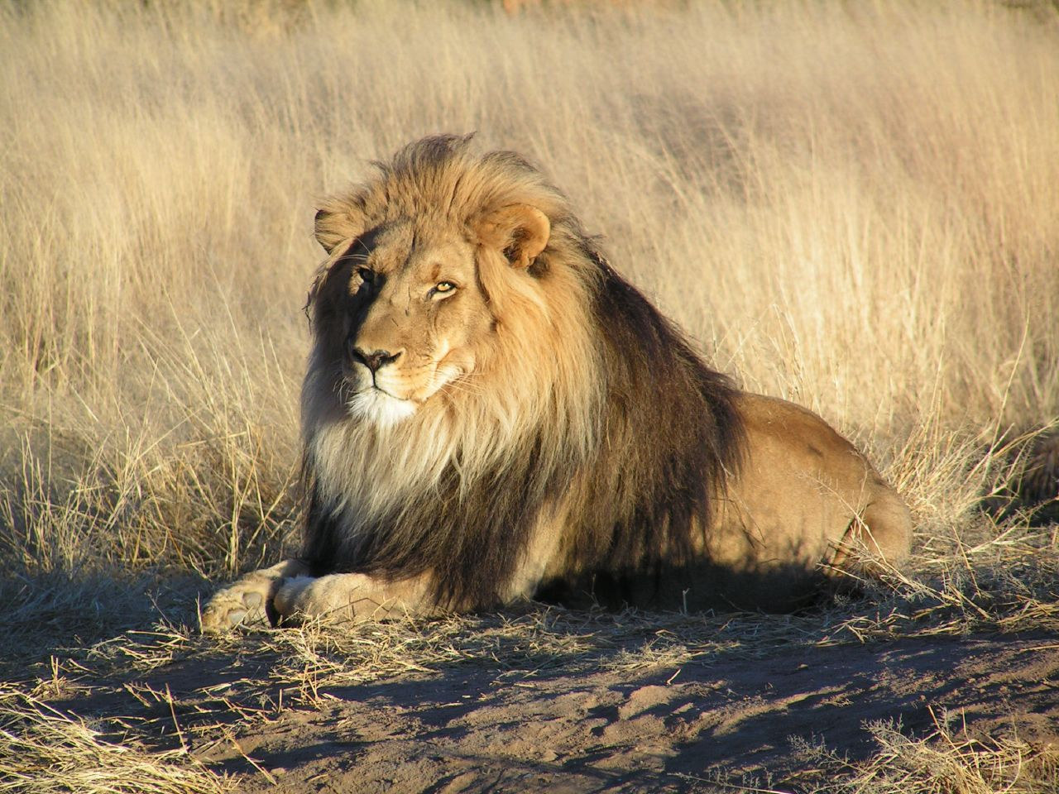
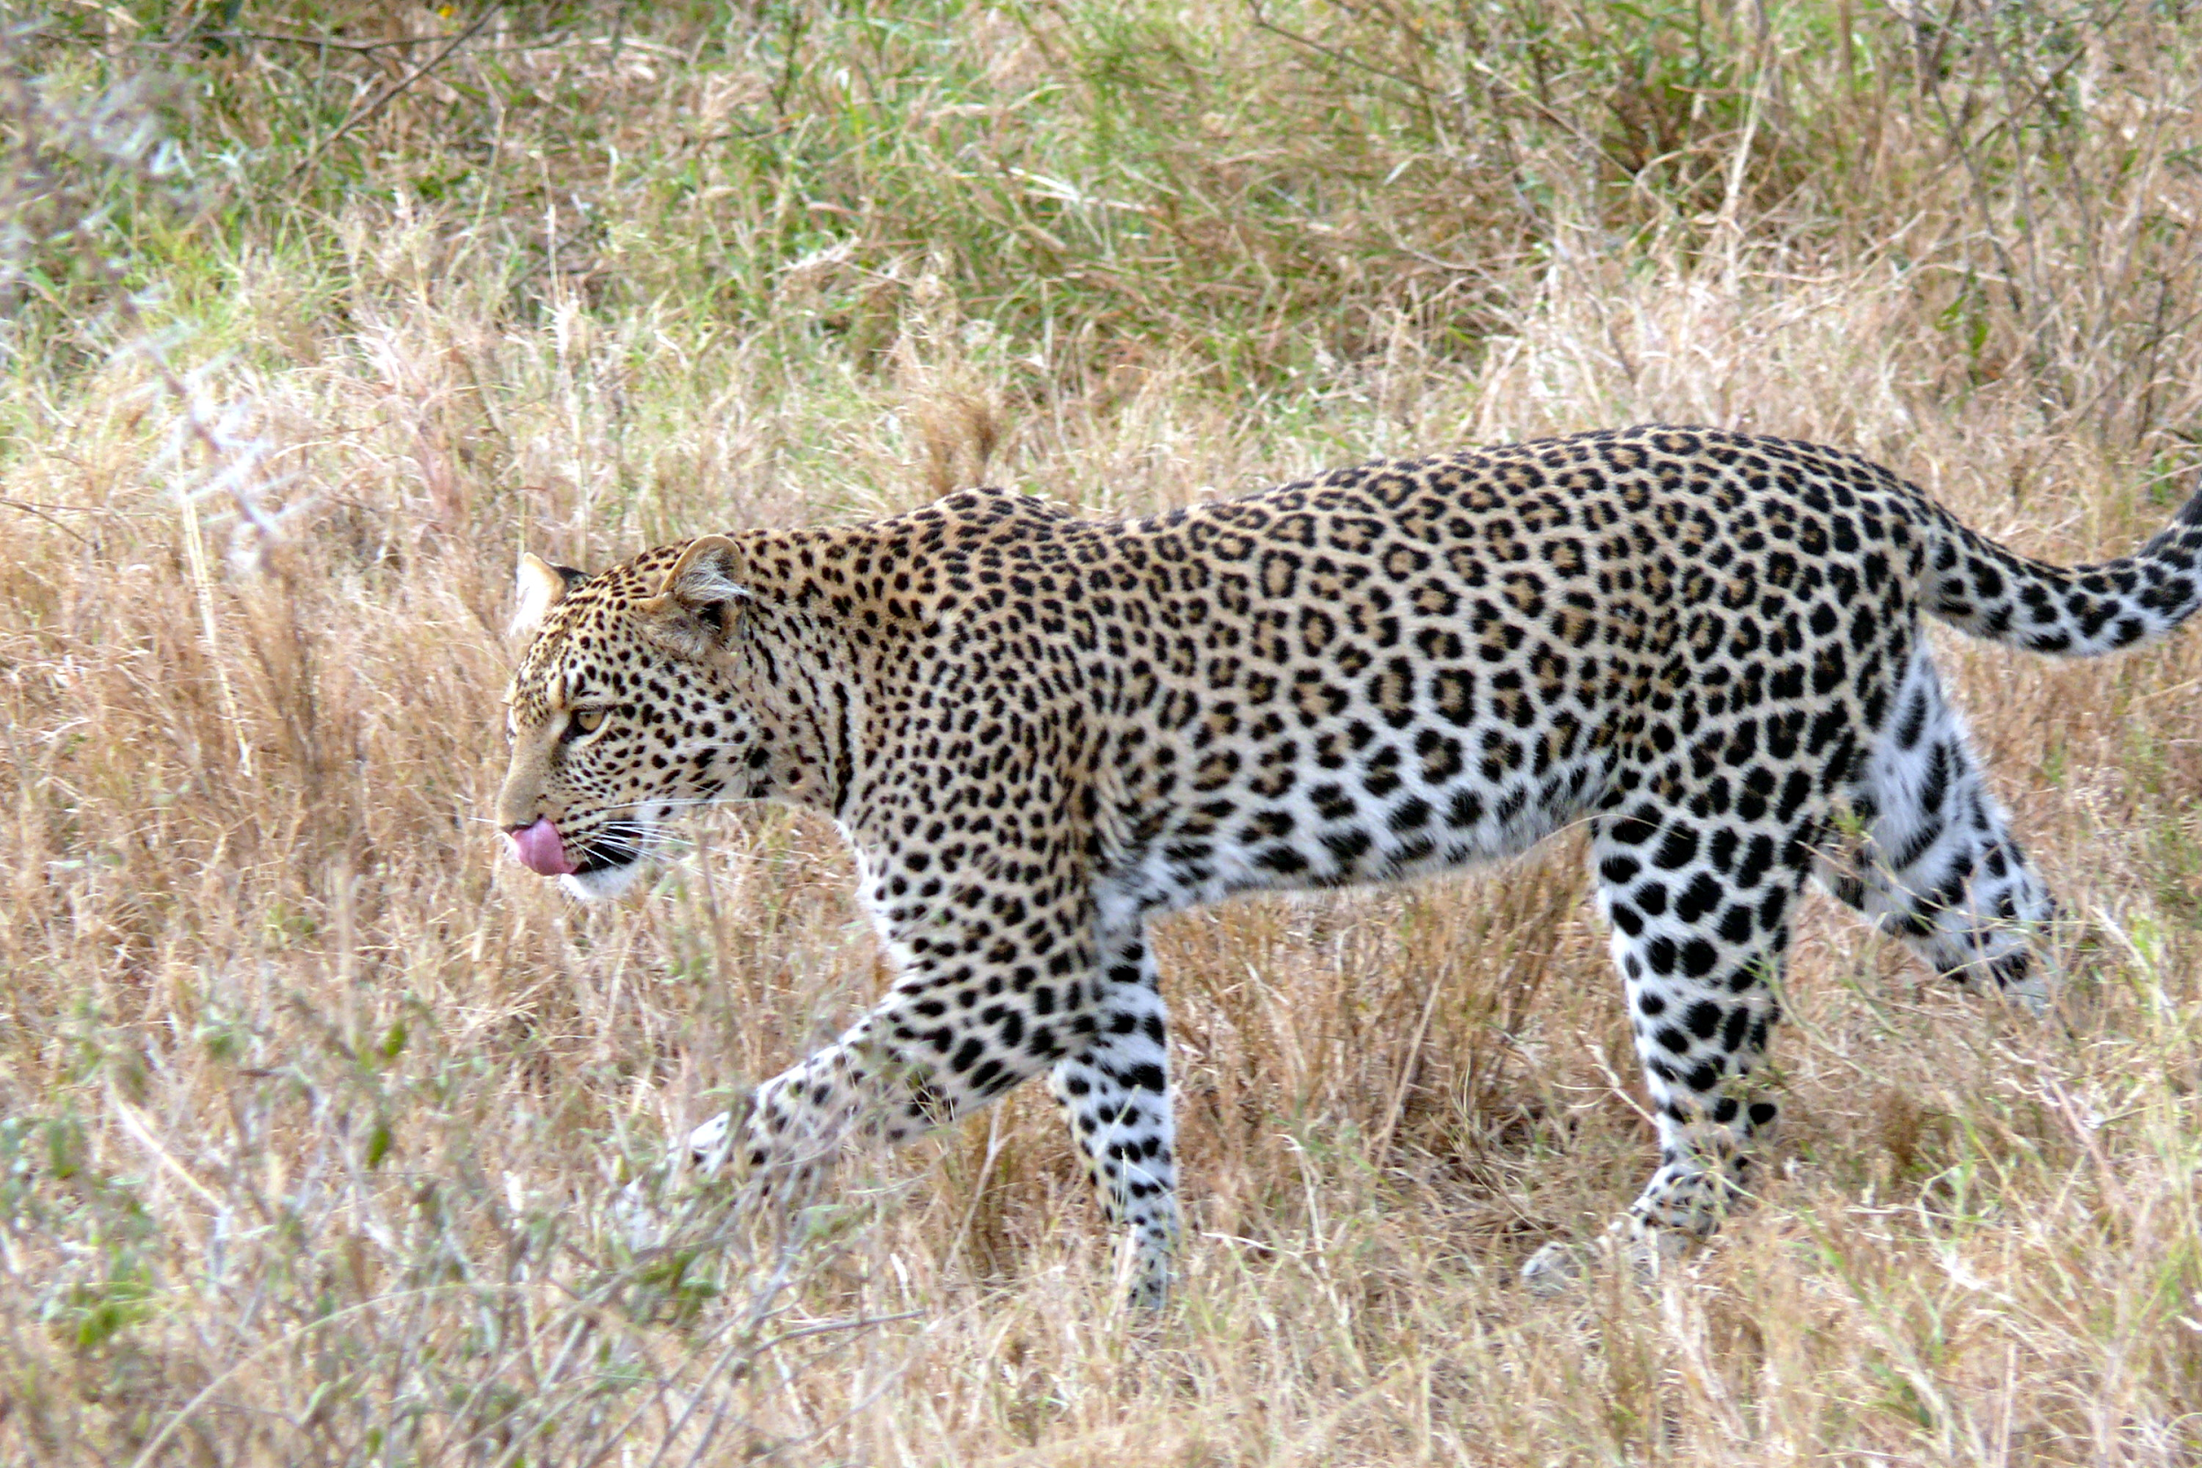
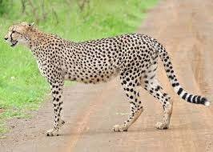
Naming species
Think Pair Share
What: which are the most closely related here? How do you know?
How: 30s to think in silence, 30s to discuss in pairs
Panthera leo
Panthera pardus
Flickr- Kevin Pluck - Lion Waiting in Namibia
Acinonyx jubatus
Wikimedia- Haplochromis- Leopard
Wikimedia- Bernard Dupont- Cheetah

Slide 25

Who Are Sloths And Where Did They Come From?
What: While watching the video answer the questions on the sheet of paper.
How: In silence, on lined paper
How long: 12 mins

Slide 26
Questions To Answer While Watching The Video
What order do sloths belong to?
What adaptations do sloths have for digging burrows?
If 11 different genera of sloths lived in the same area, what abiotic and biotic factors would they likely have competed over? What stopped them from competing one another into extinction?
Give a definition of a niche
List adaptations that allowed sloths to survive in some unusual places.
What type of competition would it be if sloths of different genera competed over the resources?
What would you see on a DNA profile to suggest that the sloths of the genera Bradypus and Choelopus to suggest that they are not closely related?
What is convergent evolution?
Why would a large body make an organism more adapted to cold weather?
Why did many sloths goes extinct?

Slide 27
Answers
What order do sloths belong to?
Xenarthra
What adaptations do sloths have for digging burrows?
Long, curved claws and extra contact points between vertebra
If 11 different genera of sloths lived in the same area, what abiotic and biotic factors would they likely have competed over? What stopped them from competing one another into extinction?
Food, water, space
Occupying separate niches
Give a definition of a niche
The role of an organism/species within its environment/ecosystem.
List adaptations that allowed sloths to survive in some unusual places.
Low metabolic rate to reduce energy loss, able to digest lots of food with 4 chambers in their stomach, teeth that won’t get worn away.

Slide 28
Answers
What type of competition would it be if sloths of different genera competed over the resources?
Interspecific competition
What would you see on a DNA profile to suggest that the sloths of the genera Bradypus and Choelopus to suggest that they are not closely related?
DNA bands sizes and locations would be different
What is convergent evolution?
Convergent evolution occurs when organisms that aren’t closely related evolve similar features or behaviours, often as solutions to the same problems/selection pressures.
Why would a large body make an organism more adapted to cold weather?
Smaller surface area to volume ratio so less heat loss.
Why did many sloths goes extinct?
Due to their low metabolic rates and body temperatures they were slow moving in warmer climates to prevent overheating and therefore like a target for predators when the climate warmed.

Slide 29
The Key Themes For Article 2024
Evolution, molecular evidence and natural selection
Abiotic, biotic factors, niche and adaptations
Classification
Homeostasis and thermoregulation
Muscles
Pathogens and the immune response
Proteins and enzymes
Photosynthesis and respiration

Slide 30
Task
What:
Answer the exam questions
How:
On the sheet provided
Break down using CUBE first
How long:
25 mins
C = Circle the command work
U = Underline the subject specific words
B = Box the tricky words
E = Eliminate the irrelevant words

Slide 31
Answers
What:
I will live mark some of your answers
Add in improvements to your own using a green pen
How:
Then continue using the mark scheme
How long:
10 mins

Slide 32
Exit Ticket – Mini Whiteboards/On PLC
How does today's learning connect to what you know already?​
What connections can you make between today's learning and what we have studied previously?​
*Annotate the above on your Personal Learning Checklist!

Slide 33
Lesson objectives
To become familiar with the key words and concepts that appear in the 2024 article
To become familiar with the types of questions asked on the scientific article
To practise how to answer questions that could come up on the scientific article

Slide 34
Article Preparation L2 28-Mar-24 Radiation and the Evolution of Photosynthesis
Do Now
1 a. Give the genus name of the photosynthetic bacteria Rhodobacter sphaeroides mentioned in p9 (1)
b. Explain which domain this bacterium would be classified into p9 (2)
2. Compare and contrast the structure of a prokaryotic cell such as Rhodobacter sphaeroides and an oxygenic photosynthetic plant cell (3)
3. In paragraph 4 it is said that we have an ‘anthropocentric interest in oxygen’. Explain why humans have evolved mass transport systems to absorb this oxygen. (3)
4. Paragraph 8 mentions that oxygen is ‘jettisoned into the air’. Describe how oxygen leaves plants after being formed in photosynthesis (2).
5. List the products and reactants of the light independent reaction (4).

Slide 35
Answers
1a) Rhodobacter
1b) Bacteria, because it is a prokaryote.
2. DNA is circular and not in a nucleus; plasmids; both have a cell wall; difference in size; vacuole.
3.Large surface area to volume ratio; diffusion insufficient for needs; oxygen required for aerobic respiration; release of energy in the form of ATP; lungs have large SA due to alveoli.
4. Diffusion; concentration gradient; stomata.
5. Water, ADP, NADP+; Oxygen, ATP, NADPH

Slide 36
Lesson objectives
To become familiar with the key words and concepts that appear in the 2023 article
To become familiar with the types of questions asked on the scientific article
To practise how to answer questions that could come up on the scientific article

Slide 37

Homework due in

Slide 38
Task
What: You will be assigned a page of the article to make 5-6 questions on. Questions on front, answers on the back.
How: Independently
How long: 10 minutes

Slide 39
Task: circus of questions on the article
What: on a separate piece of paper answer the questions that are in front of you
How: Independently, move to the next sheet when the time is up
How long: 5 minutes per set of questions to answer, 1 minute to mark

Slide 40
Exit Ticket
What topics have come up in the 2022 article?
What types of questions are asked on the scientific article?

Slide 41
Lesson objectives
To become familiar with the key words and concepts that appear in the 2023 article
To become familiar with the types of questions asked on the scientific article
To practise how to answer questions that could come up on the scientific article

Slide 42
Article Preparation L3 28-Mar-24 Radiation and the Evolution of Photosynthesis
Do Now
What:
Fill out the definitions of the key words on the sheet provided
How:
In silence
How long:
6 mins

Slide 43
Answers
Do Now
What:
Check and adapt your definitions using my glossary answers
How:
In green pen
How long:
3 mins

Slide 44
Lesson objectives
To become familiar with the key words and concepts that appear in the 2023 article
To become familiar with the types of questions asked on the scientific article
To practise how to answer questions that could come up on the scientific article

Slide 45
Task
What: Answer the suggested questions on the sheet
How: In pairs, from memory first, then use revision guides and textbooks to fill in anything you can’t answer
How long: 20 - 25 minutes
Notes:
If get time print out questions and write in model answers

Slide 46
Exam Questions On Article
What: Answer the exam questions
How: In exam conditions, use your annotated article if needed
How long: 30 minutes
Notes:
If get time print out questions and write in model answers

Slide 47
Lesson objectives
To become familiar with the key words and concepts that appear in the 2023 article
To become familiar with the types of questions asked on the scientific article
To practise how to answer questions that could come up on the scientific article

