Slide 1
Article Preparation 8-May-25 The Big Sleep
Do Now
What:
Add to your annotated article done for homework with:
Key words/phrases that you don’t understand and definitions
Colour coded links made to spec points from topics 1 – 8 for each paragraph
How:
Compare your annotated article with others and my annotated example
How long:
10 mins

Slide 2
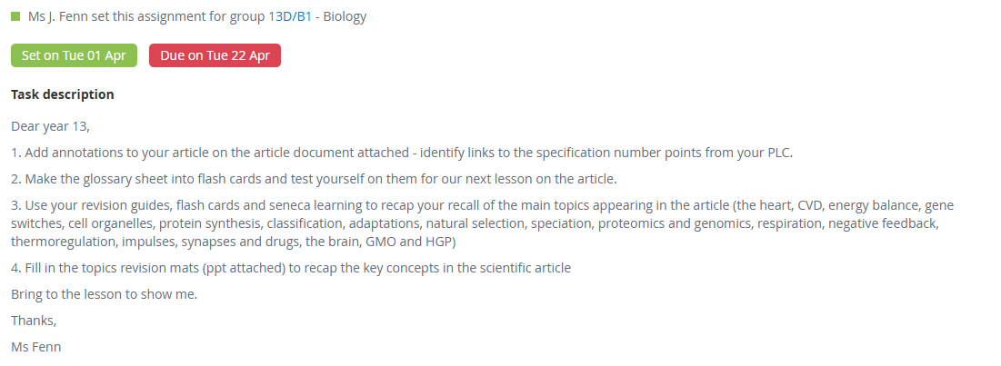
Task: homework

Slide 3
Lesson objectives
To become familiar with the key words and concepts that appear in the 2025 article
To become familiar with the types of questions asked on the scientific article
To practise how to answer questions that could come up on the scientific article

Slide 4
Mini whiteboards
What:
Write the word(s)/phrases for the definitions on the following slides.
How:
On your mini whiteboard.
How long:
15 sec each time

Slide 5
The set of life-sustaining chemical reactions within organisms that convert energy for cellular processes.
Metabolism

Slide 6
A neurotransmitter involved in regulating sleep and metabolism, playing a role in inducing torpor.
Adenosine

Slide 7
The study of the similarities and differences in the genetic sequences of different species to understand evolutionary relationships and functional genes.
Comparative genomics

Slide 8
The complete set of RNA molecules transcribed from the genome of an organism, providing insight into gene expression
Transcriptome

Slide 9
The process by which genetic information is used to synthesise proteins, regulating cellular function and adaptation.
Gene expression

Slide 10
A process where neural activity is reduced or suppressed, often to conserve energy or regulate bodily functions.
Neural suppression

Slide 11
Specific molecules in cells that can be manipulated by drugs to achieve a desired physiological effect, such as mimicking hibernation.
Molecular Targets

Slide 12
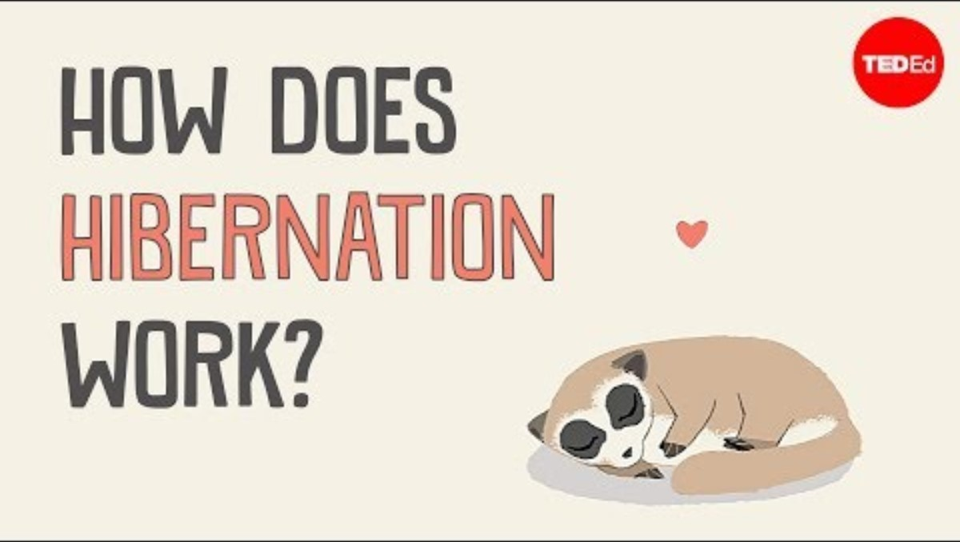
What is hibernation?
What: While watching the video answer the questions on the sheet of paper.
How: In silence, on lined paper
How long: 5 mins

Slide 13
Questions To Answer While Watching The Video
What temperature does the arctic ground squirrel’s body temperature go down by?
Give examples of behavioural adaptations that occur during hibernation for some animals.
Give an example of a anatomical adaptation that allows an animal to hibernate.
Why do animals hibernate?
How slow do he heart beats go to?
Which key processes do not happen during hibernation
What is torpor?
What is interbout arousal?
What controls hibernation?
How might studying hibernating animals help humans?

Slide 14
Answers
What temperature does the arctic ground squirrel’s body temperature go down by? -2.9C
Give examples of behavioural adaptations that occur during hibernation for some animals. Giving birth and lactating.
Give an example of a anatomical adaptation that allows an animal to hibernate. Dwarf lemur stores fat in tail
Why do animals hibernate? To survive harsh winters with lack of food and water
How slow do he heart beats go to? 1 to 3% of original rate
Which key processes do not happen during hibernation? Defecation and urination
What is torpor? Bouts of reduced metabolic activity and body temperature
What is interbout arousal? Periods of reduced metabolic activity and body temperature interspersed with periods of time such as 24hours where body temperature and metabolic activity returns to normal
What controls hibernation? Genes switching on and off throughout the year
How might studying hibernating animals help humans? Use to help control blood flow for stroke victims and reducing muscle deterioration, look at control of metabolism and weight gain

Slide 15
The Key Themes For Article 2025
T1 the heart, CVD, energy balance
T2 and T6 protein synthesis
T3 gene switches, cell organelles
T4 classification, adaptations, natural selection
T5 speciation, proteomics and genomics
T7 respiration, negative feedback, thermoregulation
T8 impulses, synapses and drugs, the brain, GMO and HGP

Slide 16
Task
What:
Answer the exam questions
How:
On the sheet provided
Break down using CUBE first
How long:
25 mins
C = Circle the command work
U = Underline the subject specific words
B = Box the tricky words
E = Eliminate the irrelevant words

Slide 17
Task: homework
What:
Finish the exam questions and mark in green pen using the mark scheme
Due in:

Slide 18
Answers
What:
I will live mark some of your answers
Add in improvements to your own using a green pen
How:
Then continue using the mark scheme
How long:
10 mins

Slide 19
Exit Ticket – Mini Whiteboards/On PLC
How does today's learning connect to what you know already?​
What connections can you make between today's learning and what we have studied previously?​
*Annotate the above on your Personal Learning Checklist!

Slide 20
Lesson objectives
To become familiar with the key words and concepts that appear in the 2025 article
To become familiar with the types of questions asked on the scientific article
To practise how to answer questions that could come up on the scientific article

Slide 21
A quick reminder of what the article questions look like
June 2024?

Slide 22
Task
What: You will be assigned a page of the article to make 3 questions on. Questions on front, answers on the back.
How: Independently, using textbooks and revision guides to help you
How long: 8 minutes

Slide 23
Task: circus of questions on the article
What: on a separate piece of paper answer the questions that are in front of you
How: Independently, move to the next sheet when the time is up
How long: 4 minutes per set of questions to answer, 1 minute to mark (3 rounds)

Slide 24
Task
What: Answer the following questions for each paragraph
How: In pairs, from memory
How long: 4 -5 minutes per paragraph
Notes:
If get time print out questions and write in model answers

Slide 25
Exit Ticket
What topics have come up in the 2025 article?
What types of questions are asked on the scientific article?

Slide 26
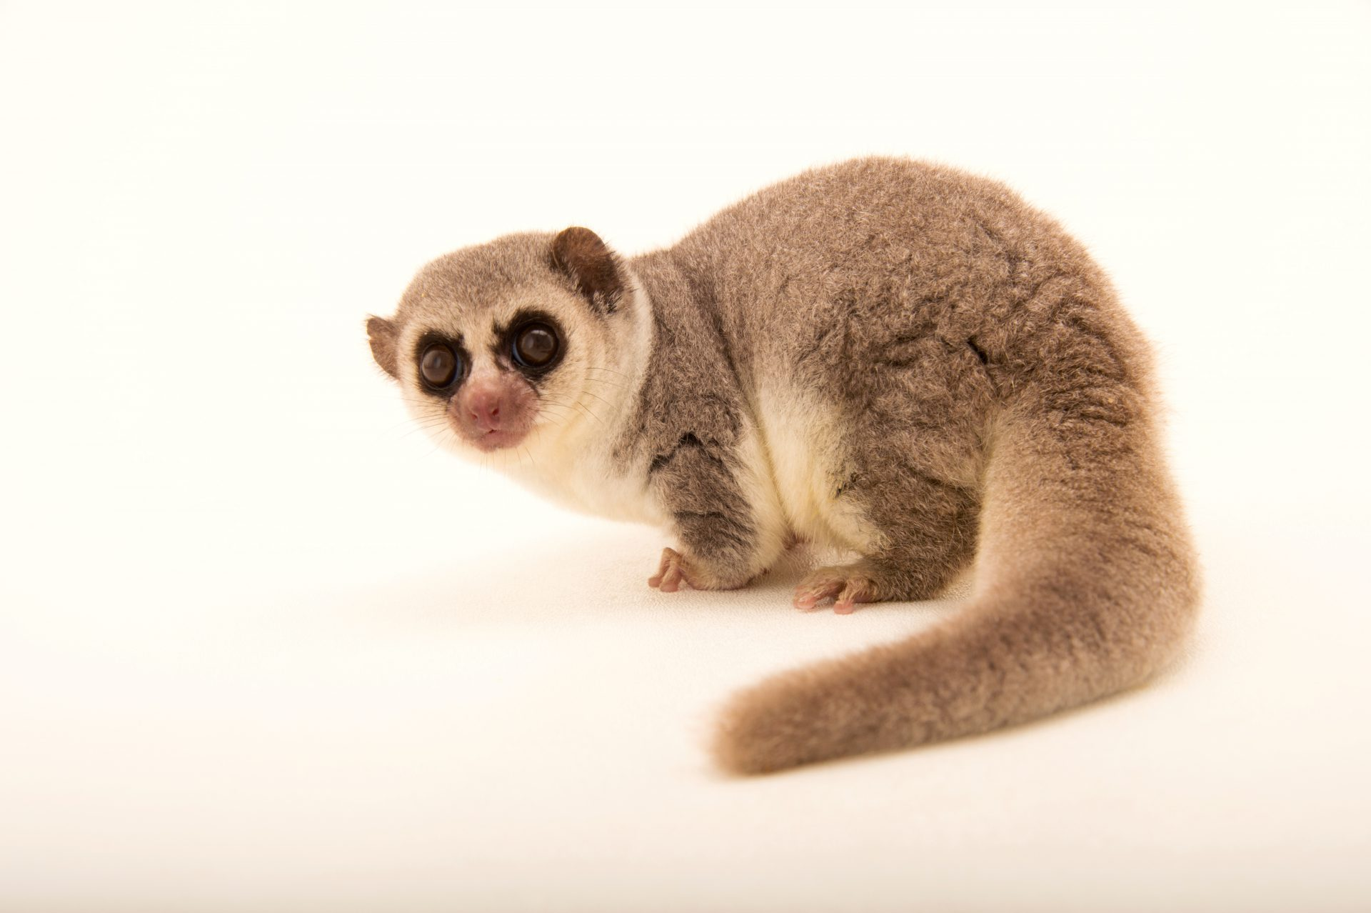
PAPER 3: General and Practical Applications in Biology
DO NOW: The fat tail lemur gorges on food before hibernation nd doubles it body weight by storing fat reserves in its tail. During hibernation it can metabolise and use lipids for energy.
What type of adaptation is the lemur's ability to conserve glycogen by using lipids? (1)
(ii) Triglycerides are a type of lipids used for energy storage. What bond needs to be hydrolysed to break down a triglyceride? (1)
(iii) Triglycerides are hydrolysed to form ________ and __________ (1)
(iv) This adaption first evolved in early ancestors of the lemur. With reference to natural selection, suggest how this adaptation could have evolved? (4)

Slide 27
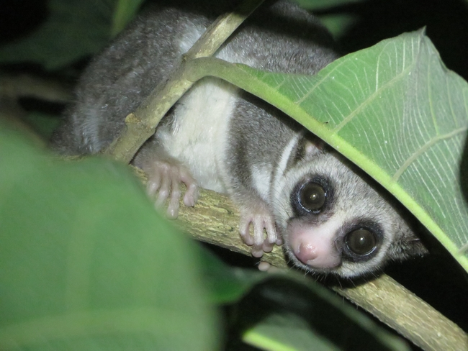
Self Assess: The fat tail lemur gorges on food before hibernation nd doubles it body weight by storing fat reserves in its tail. During hibernation it can metabolise and use lipids for energy.
What type of adaptation is the lemur's ability to conserve glycogen by using lipids? (1)
Physiological Adaptation
(ii) Triglycerides are a type of lipids used for energy storage. What bond needs to be hydrolysed to break down a triglyceride? (1) Ester
(iii) Triglycerides are hydrolysed to form Gylcerol and (3) Fatty (1)
With reference to natural selection, suggest how this adaptation could have evolved? (4)
Variation/Mutation → Selection pressure → Survival → allele frequency

Slide 28
Self Assess: The fat tail lemur gorges on food before hibernation nd doubles it body weight by storing fat reserves in its tail. During hibernation it can metabolise and use lipids for energy.
What type of adaptation is the lemur's ability to conserve glycogen by using lipids? (1)
Physiological Adaptation
(ii) Triglycerides are a type of lipids used for energy storage. What bond needs to be hydrolysed to break down a triglyceride? (1) Ester
(iii) Triglycerides are hydrolysed to form Gylcerol and (3) Fatty (1)
With reference to natural selection, suggest how this adaptation could have evolved? (4)
Variation/Mutation → Selection pressure → Survival → allele frequency

Slide 29
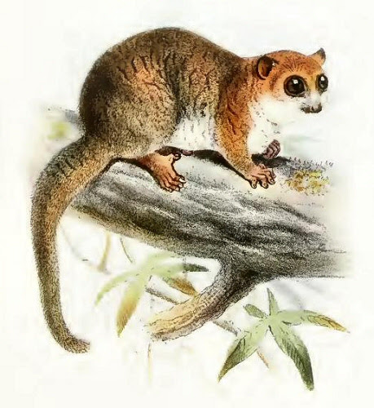
With reference to natural selection, suggest how this adaptation could have evolved? (4)
There was variation within a population of lemurs those with alleles for genes that allowed for more efficient metabolism of lipids could hibernate longer when food is scarce / require less food before / immediately after hibernation. These lemurs were more likely to survive and pass on these favourable alleles. Over many generations the allele frequency changed so that all members of the modern lemur population have acquired this adaptation
Additional Questions
How could the epigenome of the lemurs influence the genes that for lipid metabolism?
Suggest how similar changes might be useful to a marathon runner.

Slide 30
Lesson objectives
To become familiar with the key words and concepts that appear in the 2025 article
To become familiar with the types of questions asked on the scientific article
To practise how to answer questions that could come up on the scientific article

Slide 31
Task: circus of questions on the article
What: on a separate piece of paper answer the questions that are in front of you
How: Independently, move to the next sheet when the time is up
How long: 4 minutes per set of questions to answer, 1 minute to mark (3 rounds)

Slide 32
Exam Questions On Article
What: Answer the exam questions
How: In pairs, use your annotated article if needed
How long: 20 minutes
Notes:
If get time print out questions and write in model answers

Slide 33
Article Preparation L3 8-May-25 Life In The Sloth Lane
Do Now
What unique anatomical adaptation allows sloths to maintain a constant grip while hanging?
How do sloth muscles defy the conventional understanding of muscle specialization?
Describe the unique features of sloth muscles that contribute to their resistance to fatigue.
Why do sloths have less overall muscle tissue compared to other arboreal mammals?
Identify the arthropods mentioned in the article that are associated with sloths.
Discuss the possible role of sloth moths in the sloth ecosystem, according to the article.
Explain why it is considered unusual that sloths descend to the forest floor to defecate.
What drives the remarkable evolutionary adaptations observed in sloths, as discussed in the article?
Approximately when did the separate evolution of the two living sloth families begin, according to the article?
How does the study of sloths contribute to our understanding of evolutionary adaptation in response to diet and metabolism?

Slide 34
Answers
They have lots of tendons in the hands and feet that allow them to draw their digits closed while at rest.
Sloths muscles can resist fatigue, while also maintaining strength which muscles don't usually do both.
Sloths have enzymes tolerate high levels of lactic acid to resist fatigue.
Sloths have less muscles than other arboreal mammals because they spend most time hanging upside down motionless?
Sloths are associated with the arthropods mosquitoes, sandflies, triatome bugs, lice, ticks and mites .
Sloth moths receive protection from predators and nutrients from secretions of the sloths skin.

Slide 35
Answers
Sloths descend to the floor to defecate which seems unusual because it expends energy.
The sloths diet and metabolism has driven their evolutionary adaptations of being slow, muscles/tendons and digestion.
The separate evolution of the two living sloth families began 35 million years ago.
The study of sloths contribute to our understanding of evolutionary adaptation in response to diet and metabolism since we can see how two different families of sloth have come up with similar adaptations to the same selection pressures?

Slide 36
Homework due in
Paper 3 review

Slide 37
Lesson objectives
To become familiar with the key words and concepts that appear in the 2024 article
To become familiar with the types of questions asked on the scientific article
To practise how to answer questions that could come up on the scientific article

Slide 38
Lesson objectives
To become familiar with the key words and concepts that appear in the 2024 article
To become familiar with the types of questions asked on the scientific article
To practise how to answer questions that could come up on the scientific article

Slide 39
Article Preparation L4 8-May-25 Life In The Sloth Lane
Do Now
What are the key themes/topics that you need to revise in preparation for your article in paper 3?
How will you revise these key themes/topics?

Slide 40
Answers: The Key Themes For Article 2024
Evolution, molecular evidence and natural selection
Abiotic, biotic factors, niche and adaptations
Classification
Homeostasis and thermoregulation
Muscles
Pathogens and the immune response
Proteins and enzymes
Photosynthesis and respiration

Slide 41
Lesson objectives
To become familiar with the key words and concepts that appear in the 2024 article
To become familiar with the types of questions asked on the scientific article
To practise how to answer questions that could come up on the scientific article

Slide 42
Task
What:
Break down the exam questions using CUBE first
How:
On the sheet provided in red/green pen
How long:
3 mins
C = Circle the command work
U = Underline the subject specific words
B = Box the tricky words
E = Eliminate the irrelevant words

Slide 43
Exam Questions On Article
What: Answer the exam questions
How: In exam conditions, use your annotated article if needed
How long: 30 minutes
Notes:
If get time print out questions and write in model answers

Slide 44
Mark
What:
Mark the answers in front of you
How:
Swap with the person next you
In green pen
Use the mark scheme
How long:
12 mins

Slide 45
Exit Ticket
What topics have come up in the 2024 article?
What types of questions are asked on the scientific article?
How are you going to prepare for the article questions?

