Slide 1
Making judgements and reaching conclusions 26-Apr-23
Do Now: Can you remember the definitions of these command words? Write a definition for each.
Determine
Devise
Discuss
Draw
Evaluate
Explain
Give
Identify

Slide 2
Answers
Determine | Use the data or information given to come up with an answer.
Devise | Use your scientific knowledge and imagination to come up with a way of doing something that will come out with a certain outcome.
Discuss | Consider all aspects and opinions on an issue or argument.
Draw | To illustrate what something looks like or how it happens using diagrams.
Evaluate | Use the information supplied, with your own knowledge and understanding to come up with evidence for or against an argument. Your answer should end with a concluding judgement that you have made based on the evidence.
Explain | To give reasons why something happens.
Give | Similar to 'state'. You need only name something.
Identify | Name or select something from the information given to you.

Slide 3
Lesson objectives
To review A03 skills required for your A-level Biology exams.
The Bigger Picture
A03 questions are roughly 25-27% of your marks
They are usually based on experiment skills
They require you to analyse, interpret and evaluate scientific information, ideas and evidence, including in relation to issues, to:
make judgements and reach conclusions
develop and refine practical design and procedures

Slide 4
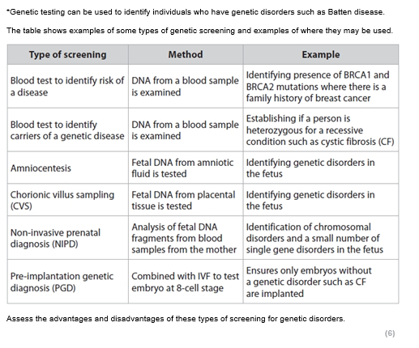
Making judgements and reaching conclusions
Mini whiteboards
What does the command word assess mean?
To answer this question what are the types of screening that you need to have covered?
Answers
Consider all the factors that apply to the situation and identify which are the most important or relevant. Make a judgement on the importance of these factors, and come to a conclusion.
Blood tests, amniocentesis, CVS, NIPD, PGD.

Slide 5
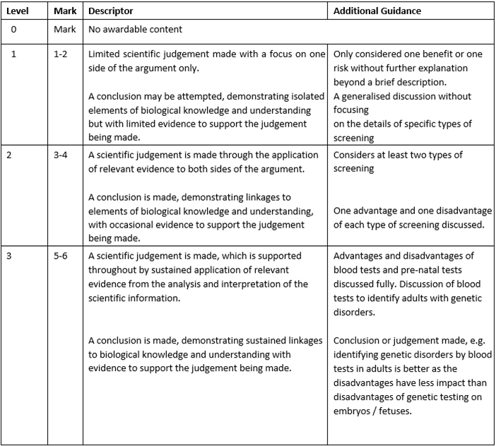
Task: use the level criteria to mark the student’s work. What level would you give it and why?

Slide 6
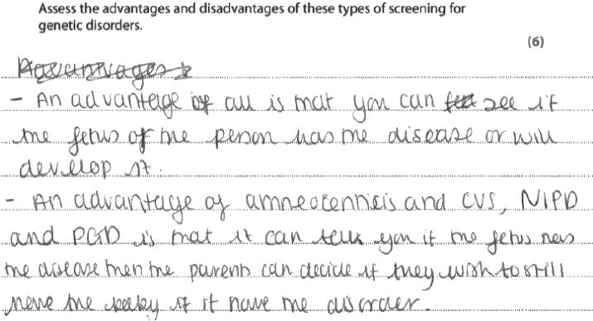
Notes:
Print?

Slide 7
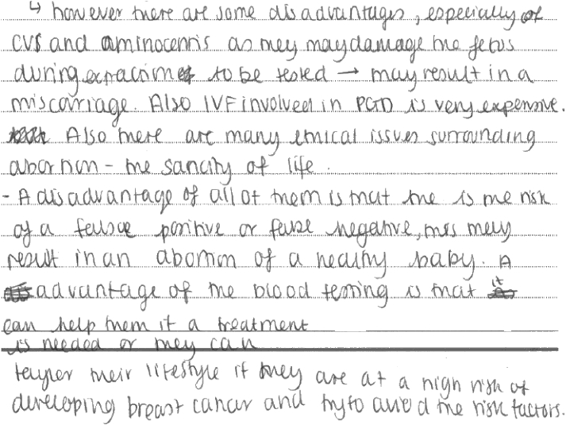

Slide 8
Results Plus: Examiner Comments
This response gives a number of advantages and disadvantages of different types of screening, referencing in particular to amniocentesis and CVS. No conclusions are made, therefore, it gains level 2, 4/6

Slide 9
Task: draft your own answer

Slide 10
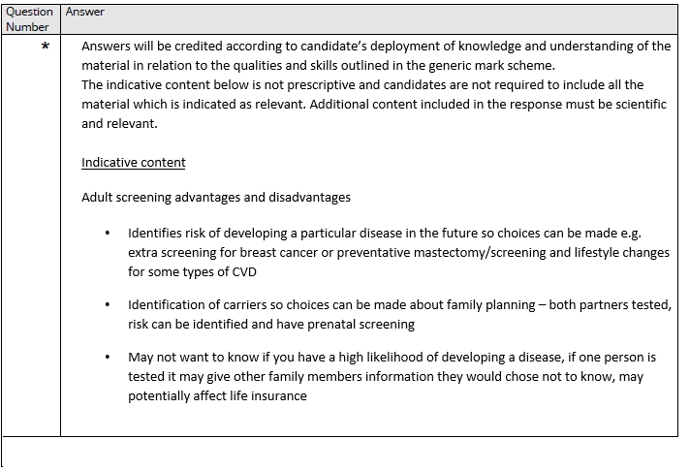
Review

Slide 11
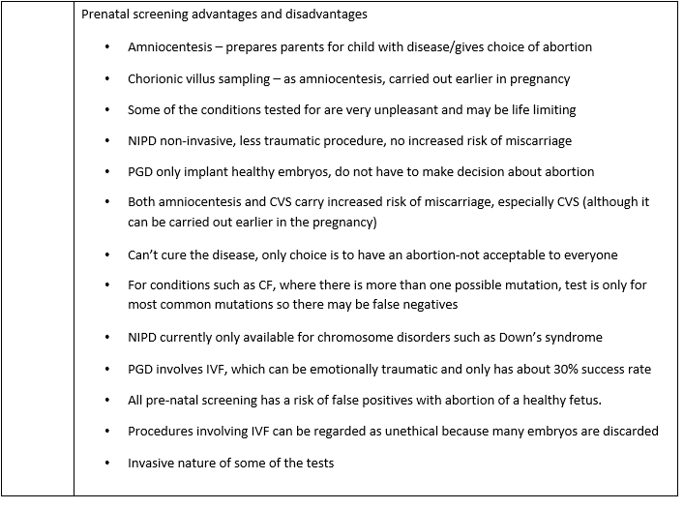

Slide 12
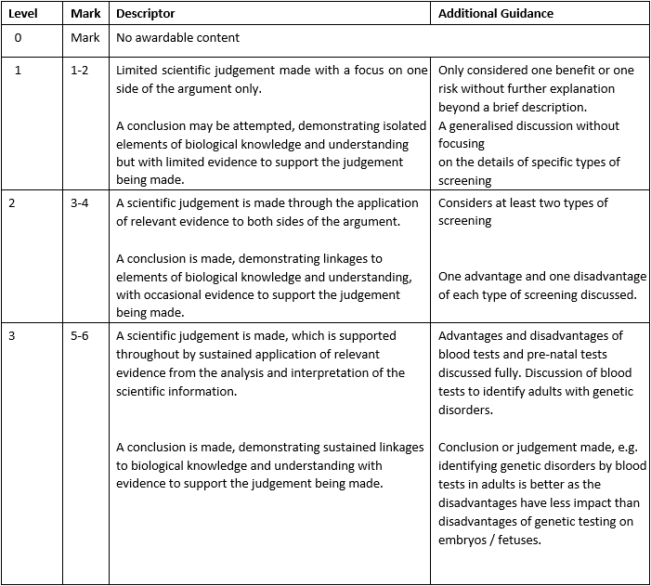

Slide 13
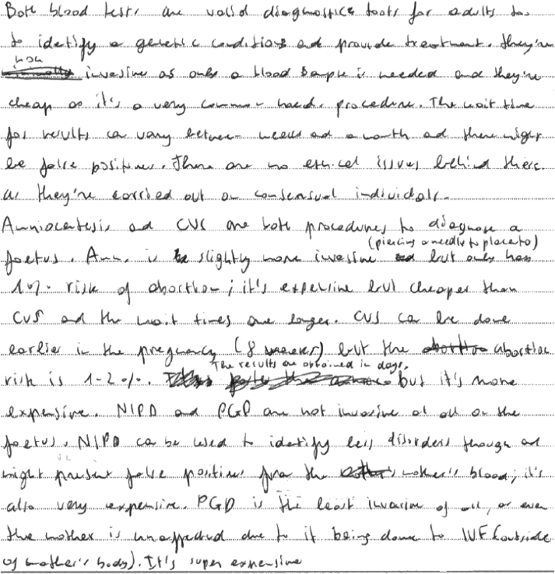
Example of 5/6 marks

Slide 14
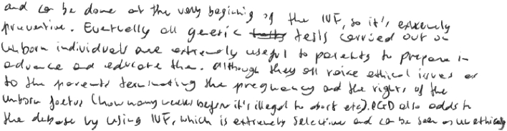

Slide 15
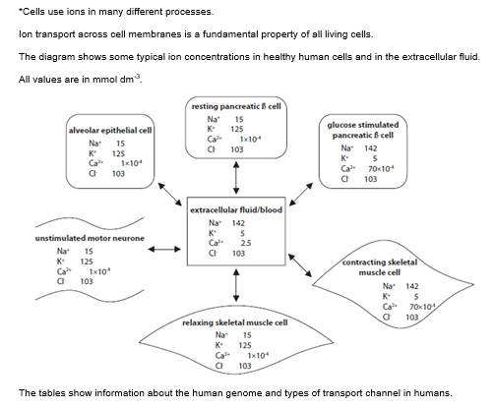
Exam question practice

Slide 16
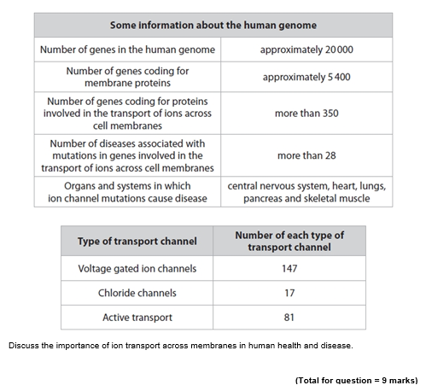
What: Plan what you will write about on your mini whiteboards first – what topics do you need to draw knowledge from? How: in pairs How long: 2 mins

Slide 17
What: Now answer the question How: on lined paper How long: 7 mins

Slide 18
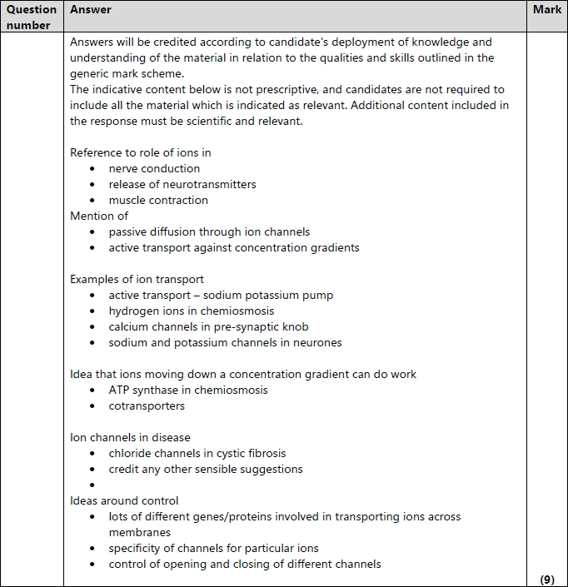
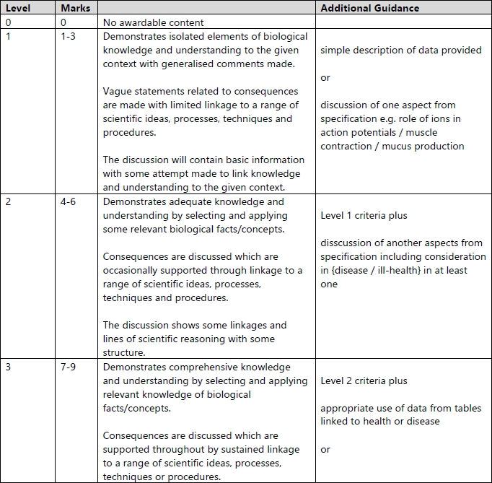

Slide 19
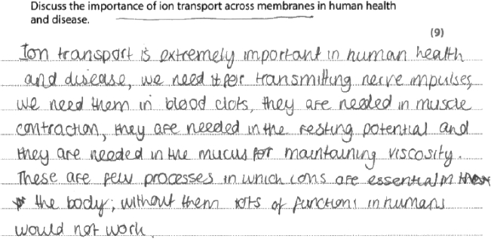
This response met all the criteria for a level 2 response and some of those for a level three response it was awarded 7 marks.

Slide 20
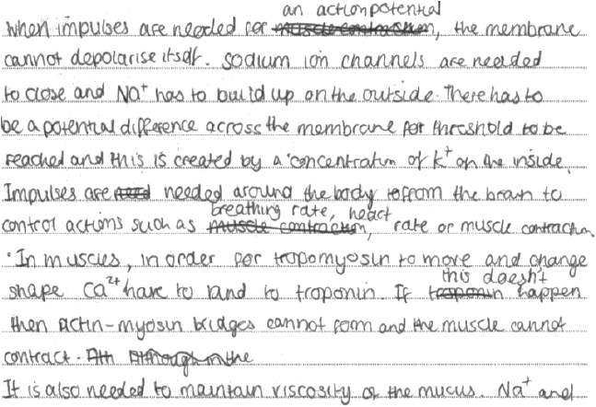

Slide 21
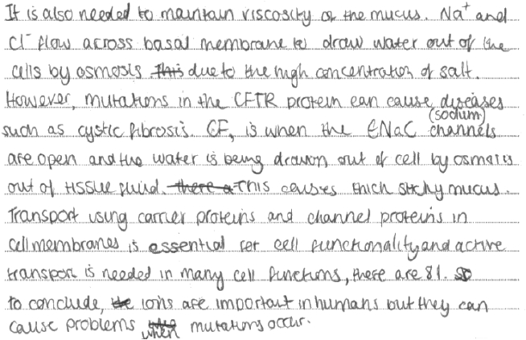

Slide 22
Exit Ticket
What rules would you give yourself when answering an ‘discuss, assess or evaluate’ question?
Suggestions:
Assess - consider all the factors that apply to the situation
Assess - identify which are the most important or relevant
Discuss - consider all aspects and opinions on an issue or argument.
Evaluate - use your own knowledge and understanding to come up with evidence for or against an argument
Both – make a concluding judgement

Slide 23
Lesson objectives
To review A03 skills required for your A-level Biology exams.
The Bigger Picture
A03 questions are roughly 25-27% of your marks
They are usually based on experiment skills
They require you to analyse, interpret and evaluate scientific information, ideas and evidence, including in relation to issues, to:
make judgements and reach conclusions
develop and refine practical design and procedures

