Slide 1
Scales of Production
Revised
Exam Question
Revised again
Research and Investigation
Revised
Exam Question
Revised again
Developing and Communicating Ideas
Revised
Exam Question
Revised again
Paper and Boards
Revised
Exam Question
Revised again
Finishes
Revised
Exam Question
Revised again
Standard Components and Stock Forms
Revised
Exam Question
Revised again
Production Methods
Revised
Exam Question
Revised again
Plastics
Revised
Exam Question
Revised again
Prototyping and Development
Revised
Exam Question
Revised again
Briefs and Specs
Revised
Exam Question
Revised again
Textiles
Revised
Exam Question
Revised again
Woods and Boards
Revised
Exam Question
Revised again
Tolerances
Revised
Exam Question
Revised again
Process and Manufacture
Designing Products
Properties of materials
Revised
Exam Question
Revised again
New and Smart Materials
Revised
Exam Question
Revised again
GCSE DT
Revision
Topics
Materials
Approaches to Design
People, Society and Culture
Revised
Exam Question
Revised again
Work of Others
Revised
Exam Question
Revised again
Maths and Science
Energy
Revised
Exam Question
Revised again
Angles
Revised
Exam Question
Revised again
Energy and Mechanisms
Design Strategies
Revised
Exam Question
Revised again
Industry and Enterprise
Revised
Exam Question
Revised again
Mechanical Systems
Revised
Exam Question
Revised again
Forces
Revised
Exam Question
Revised again
Environment
Revised
Exam Question
Revised again
Decimals
Revised
Exam Question
Revised again
Environment
Revised
Exam Question
Revised again
Energy Generation and Storage
Revised
Exam Question
Revised again
Process Orders
Revised
Exam Question
Revised again
Ratios, Fractions and Percentages
Revised
Exam Question
Revised again
Area and Volume
Revised
Exam Question
Revised again
Charts and Graphs
Revised
Exam Question
Revised again

Slide 2
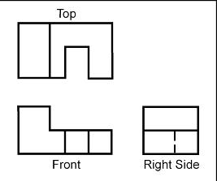
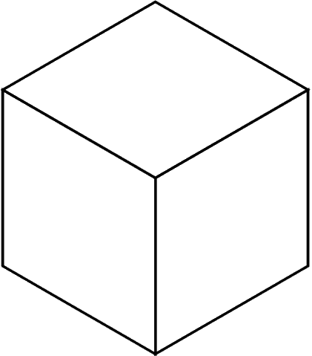
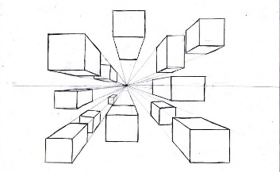
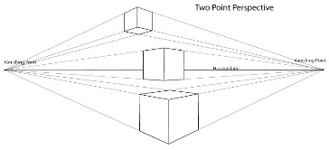
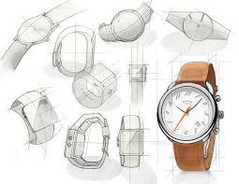
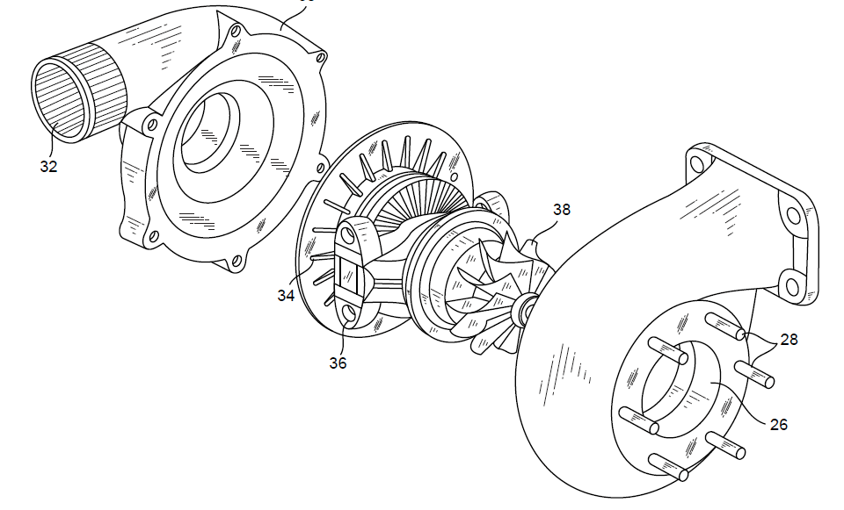
Technique | Description/ notes | Diagram
Orthographic Projection/ Working Drawings | Includes “Front”, “Plan” and “End” 2D Views, and often an Isometric 3D View Standardised method for scale, dimensions and line types Great for manufacturing
Isometric | Common 3D sketching method Can be drawn free-hand or using isometric paper and ruler Angles are at 30 degrees Great for seeing most of the products
1-Point Perspective | A 3D drawing method Often used by interior designers and architects Gives drawings depth Only uses 1 vanishing point
2-Point Perspective | Used for 3D designs Exaggerates the 3D effect Objects can be drawn above of below the horizon line but must go to the 2 vanishing points
Annotated Drawings/ Free and Sketches | Quick and easy way of getting ideas down Range of ideas can be seen Annotation helps explain designs further
Exploded View | Helps see a final design of a product and all it’s parts Can see where all the parts fit Great for manufacturers
Briefs, Specifications, ideas and development
Design Briefs
A Design Brief is the statement of how you will solve the Design Problem It will often include:
Constraints/ limitations
What the product is
Materials/processes
Any key information you know
Design Specifications
A Design Specification is a list of requirements your product has to meet in order to be successful
It is also useful for evaluation. If your product hasn’t met the Spec then it gives you a starting point for improvements.
Aesthetics | What the product looks like? Style? Colour Scheme? Design Movement?
Customer | Who would buy it? (Age, gender, socio-economic, personality) How does the design appeal to them?
Cost | How much will it cost? (min-max) Why?
Environment | Where will it be used? Why? How will you make it suitable?
Safety | How is it safe? How will it be checked? Why must it be safe?
Size | What is the maximum or minimum size? Why?
Function | What does the product do? What features make it do that function well? How is it unique from similar products?
Materials | What is it made from? Why?
Manufacture | How might it be made? Why? What scale of production? Why?
Modelling and Development
Modelling and development are key to testing and improving products
This can be done physically using materials like; card, foam, clay, man-made boards or virtually in CAD
Modelling helps the designer get feedback from the customer, check aesthetics, function, sizes and even materials and production methods and change them if needed

Slide 3
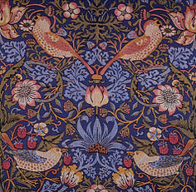
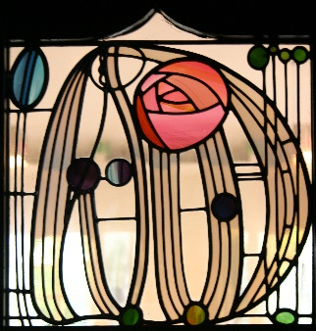
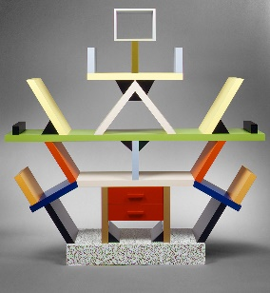
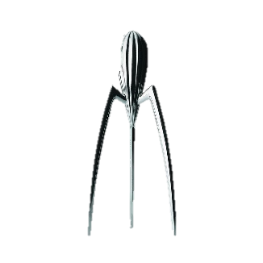
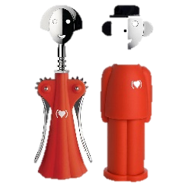

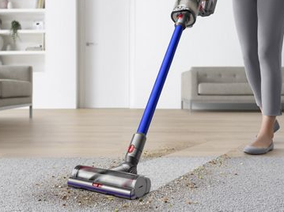
Work of Others
Image/ Example | Designer | Design Movement | Key info
 | William Morris | Arts and Crafts | British designer in 1880s Simple natural crafts Useful and beautiful products (wallpapers, cushions, etc)
 | Charles Rennie Mackintosh | Art Nouveau | Scottish designer in 1860s – 1920s Known for light and shadow Created stained glass and furniture Inspired by nature and geometric lines
 | Ettore Stottas | Memphis | Italian designer in the 1950s/60s Enjoyed making everyday objects wacky and bold Used lots of bold colours and black lines
Research
Product Analysis
Case studies
Interviews
What methods of research can be used to find information?
Questionnaires and surveys
Materials testing
Social media and email
Research can be divided into 2 categories; Primary Research and Secondary Research.
Primary is research you complete yourself.
Secondary is research from resources others can gathered e.g. books, magazines and internet
Primary research is generally more reliable as it is done by the person using it and can double-check the data
Image/ Example | Brand | Key info
 | Alessi | Italian Design Company Homeware and kitchen utensils “Post-modern” style Phillipe Starke is a major designer
 | Apple | USA-based tech company Famous for iconic designs of iPod and iPhone Steve Jobs and Johnathon Ive are major designers Known for innovative and modern design
 | Dyson | British engineering company Famous for vacuum cleaners and innovative technology James Dyson is a major designer
Another key piece of research, is Anthropometrics and Ergonomics. This helps develop the sizes of products, etc to make sure it fits the User
Anthropometrics | The study of measurements of the human body. E.g. Knowing the grip width of a palm, if designing a new travel coffee cup
Ergonomics | The application of anthropometrics to ensure products are safe and comfortable to use. This can also include; size, material, appearance, brightness, sound and texture. E.g. making sure the travel cup is the correct size, and an insulating smooth material to make it comfortable to hold for long periods

Slide 4
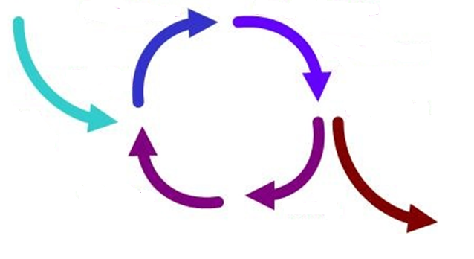
Design Strategies
Design Strategies are used to solve Design Fixation, and help develop creative design ideas.
Iterative Design
A Proposal is made
It is then planned and developed to meet the brief
It is analysed and refined
It is then tested and modelled
Systems Approach
Usually used for electronic products
Often uses diagrams to show systems in a visual way
Planning the layout for the correct sequences e.g. inputs, outputs, timings, etc
Electronics and mechanical systems need an ordered and logical approach
Then evaluated against the brief – many versions fail but that then informs development to make the idea better
The cycle then repeats and if the product is successful it is then made and sold on the market
Systems Approach
Advantages | Disadvantages
Does not need specialist knowledge Easy to communicate stages Easy to find errors | Sometimes over-simplifies stages Can lead to unnecessary stages
Iterative Design
Advantages | Disadvantages
Consistent testing helps solve problems earlier Constant feedback Easy evidence of progress | Designers can loose sight of “the big picture” Time consuming
Collaborative Approach
Working with others to share data and solving problems and coming up with design proposals can help with creativity
User-Centred Design
This is when designs are based on fulfilling the needs and wants of the Users/ Clients at every stage of the design process
Numerous companies work in teams, and has been shown to improve the range and quality of ideas produced
Questioning and testing is ongoing and is often found through interviews, questionnaires, surveys, etc
Collaborative Approach
Advantages | Disadvantages
Gets multiple opinions and a range of views Working in groups can produce more ideas | Can be difficult to design ideas with opposing views Can be difficult to find time to communicate with multiple people
User-Centred
Advantages | Disadvantages
User feels listened to Makes sure the product meets their needs | Requires extra time to get customer feedback If focused on just one person it can limit appeal to others

Slide 5
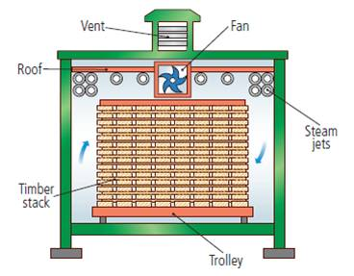
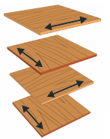
Natural Timbers
Woods and Boards
Softwoods are generally cheaper than hardwoods as they are more available, since they grow quicker.
But because man-made boards are manufactured they are cheaper than timbers. Man-made boards also come in a better variety of sizes since they don’t depend on tree growth.
Stock forms for both include; sheets, dowel, planks, etc
Man-Made Boards
Manufactured boards are made from wood chips/dust/ layers and glue.
Material | Key info | Examples
Chipboard | Prone to chipping but good compressive strength. Not-water resistant | Flooring, low-end furniture, flat-pack
MDF | Rigid and stable. Easy to finish. Absorbs liquid easily | Flat-pack furniture and kitchen unites
Plywood | Very stable. Exterior veneer can be used from more expensive woods | Shelving, furniture, toys
Hardwoods come from Deciduous Trees. These trees loose leaves in winter and grow fruit and flowers in spring
Material | Key info | Examples
Ash | Flexible, tough and shock resistant | Sports equipment Tool Handles
Beech | Fine finish, tough and durable | Toys, furniture and veneers
Mahogany | Easily worked, durable, high quality finish | High-end furniture
Balsa | Very soft and spongy. Light | Modelling
Oak | Tough, durable and hard | Flooring, furniture and veneers
Primary Processing of Papers and Boards
Trees are cut then converted into planks by cut using saws
It is then seasoned to reduce the moisture in the wood. This is done by either:
Air-drying – Planks are stacked and air allowed to circulate; causing evaporation
Kiln-drying – Where planks are put into a kiln and dried rapidly. This process is more costly than air-drying
Softwoods come from Coniferous Trees. These have thin, needle-like leaves and grow all year round. Often have pine cones and sometimes nuts and seeds
Material | Key info | Examples
Larch | Durable, tough, good water resistance and finishes well | Furniture, flooring and used outdoors
Pine | Light, easy to work with but can split | Cheap furniture, construction and decking
Spruce | Easy to work with, high stiffness but can decay quickly | Furniture, musical instruments and construction
Manufactured boards can be either be made by lamination or compression
Lamination – Layers of woods and adhesive are layered and compressed together. Usually with a more expensive wooden veneer on the top
Compression – Wood is shredded, heated and compressed with adhesive under extreme pressure

Slide 6
Metals, Alloys and Plastics
Metals
Plastics
Metals come from ores in the ground. Stock forms are sheets, bars and rods
Plastics come from crude oil. Stock forms are sheets, powders, granules and rods
Ferrous Metals contain iron and are magnetic and rust
Material | Key info | Examples
Low Carbon Steel | Tough and ductile and easily machined and welded | Construction, screws, cars
High Carbon Steel | Hard and wears well | Tools, blades and knives
Cast Iron | Hard but brittle. Easily cast but hard to machine | Pots, pans, vices
Thermoplastics can be reheated and reshaped and infinite amount of times
Material | Key info | Examples
PET | Easily blow moulded, food safe and easily recycled | Bottles, packaging, etc
PVC | Flexible, tough, easily extruded | Pipes, tape, hard hats
HIPS | Flexible, lightweight, food safe and easily vacuum formed | Containers and yoghurt pots
Acrylic | Tough, brittle, easily scratched | Car lights, baths, displays/ signs
Non-Ferrous Metals do not contain iron, aren’t magnetic and don’t rust
Material | Key info | Examples
Aluminium | Light, high strength to weight ratio and ductile | Pots, pans, cars, cans
Copper | Ductile, malleable and good conductor | Plumbing supplies and cables
Tin | Soft, malleable and good conductor | Used as a protective coating
Thermosets once heated and set cannot be reshaped
Material | Key info | Examples
Melamine Formaldehyde | Food safe, hygienic, hard and brittle | Kitchenware and work surfaces
Urea Formalehyde | Good insulator, hard and brittle | Electrical casings, buttons and handles
Polyester Resin | Strong, heat resistant, can be transparent | Coatings, casings
Alloys
Alloys are mixtures of 2 or more metals to get the best of their properties
Material | Key info | Examples
Brass | Malleable and easy to cast | Musical instruments, plumbing
Stainless Steel | Doesn’t rust, hard and smooth | Cutlery, medical tools, etc
Primary Processing of Metals and Alloys
Primary Processing of Plastics
Crude oil is extracted from the earth and then processes into different types of fuels, etc. This is called Fractional Distillation
A process called Cracking then converts the large hydrocarbon molecules into plastics
Metals are mined from the earth and then go through an extraction process
Extraction happens by putting the ore in a blast furnace
The metal is then separated from the waste material

Slide 7
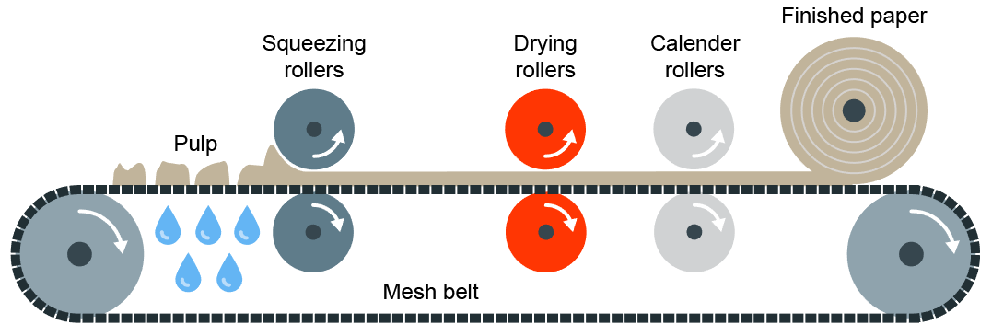
Modern and Smart Materials
Papers and Boards
Modern Materials are materials that have been developed recently
Material | Key info | Examples
Corn-starch Polymers | These are plant-based polymers that are a replacement for plastics that are biodegradable but cannot be recycled. | Plastic bottles, tubs, food containers, etc
Flexible MDF | Made in the same way as normal MDF but with grooves cut into the surface so it is flexible. Flexiply is the same but for Plywood. These can easily be shaped into curves | Modern furniture, interior walls and room dividers
Titanium | High strength to weight ratio. Doesn’t corrode or rust. Suitable for medical use as its hypo-allergneic | Prosthetics, medical applications, sports cars, etc
Kevlar | A woven polymer with a high strength to weight ratio. | Bullet-proof vests, tyres, helmets, etc
Papers and Boards come from trees. The Stock forms for papers are: rolls, sheets, A4, A3, etc
Material | Key info | Uses/ Examples
Cartridge Paper | Thick white paper, completely opaque and more expensive than photocopy paper | Sketching, ink drawings
Layout Paper | Light, semi-translucent, good for blending inks and artist markers | Sketching, drawing and some tracing
Corrugated Cardboard | Strong but light. Rigid triangles of card sandwiched between a top and bottom layer. | Outer packaging, food packaging
Duplex Board | Light card with white outside layers. Waxy coating can be added | Cheap packaging. If waxy coating is applied, can be used for food
Foil-lined Board | White card coated with a thin aluminium layer. Foil is great for insulation and water resistance | Takeaway containers
Solid White Board | High-quality white card with a smooth finish. Stiff and holds colours well | Greetings cards, packaging and advertising
Smart Materials are materials that change and react to the stimuli
Material | Key info | Examples
Thermochromic Pigments | Change colour in reaction to heat | Kettles, baby bottles, etc
Photochromic Pigments | Change colour in reaction to light | Colour changing glasses, windows, etc
Shape Memory Alloy | Returns to its original shape, in reaction to heat | Braces and glasses
Polymorph | Granules that once exposed to hot water, become a modelling material (like a dough or clay) | Modelling and repairs
Primary Processing of Papers and Boards
Paper is made by first making pulp. Pulp is a mix of tree fibres and water. This is cooked and bleached white, and adding any other additives.
The pulp is then drained and goes through Calendering where the pulp is drained and goes through rollers to convert it to its stock forms

Slide 8

Industry and Enterprise
Textiles
Automation
This is when machines and robotics help make products or make them for you.
Often this is done by CAD (Computer Aided Design) and CAM (Computer Aided Manufacture)
This helps products be made quicker, with more accuracy. Reducing errors humans make to products.
However, these machines are expensive to buy, need specialist training to use and need constant maintenance to keep them working properly
Natural or synthetic. Natural are from renewable resources. Synthetic are man-made from non-renewable sources. Fibres are spun into yarn, knitted or woven into fabric.
Material | Key info | Examples
Cotton | Smooth, absorbent, comfortable, hard-wearing. Creases, dries slowly, high flammability. | Denim, calico. Jeans, t-shirts, soft furnishings.
Wool | Can be soft or coarse. Warm, absorbent, good elasticity. Can shrink when washed, can feel itchy, expensive. | Knitted fabrics, tweed. Suits, jumpers, carpet
Elastane | Extremely elastic, strong, lightweight, hard-wearing. Not absorbent, not biodegradable. | Lycra. Sportwear, underwear. Combined with other fibres to give stretch.
Polyester | Smooth, strong, hard-wearing, cheap, resists creasing, not biodegradable. | Bed sheets, curtains, cushions, clothing
Virtual Marketing
This is when websites, social media and email are used to promote and sell products. This has become very popular in recent years, with big social media apps being funded by advertisers
Companies can also pay search engines to push their company further to the top of the results page, so customers are more likely to click it.
Cooperatives
A Cooperative is an Enterprise that is run by members that are part of the workforce or customers.
This means the organisation is democratic and often supports the local community. They are set-up to protect the rights of their members and ensure the same rules apply to everyone
Enterprise
This is when an idea is developed into a business and produces a viable product.
Often, one of the biggest enterprises in in apps for smartphones
To make sure ideas are protected from being copied, a Patent can be applied for. This legally protects your idea on invention from being stolen.
Fair Trade
This is an organisation that promotes fair pay, working conditions and better trade with farmers in developing countries
You can tell when something is Fairtrade as it will often have the symbol on the product or packaging. Common Fairtrade items include; bananas, cotton and chocolate.
Crowdfunding
This is where ideas are funded by large groups of ordinary people.
www.Kickstarter.com is a good example of this.

Slide 9




Finishes, Standard Components,
Tolerances
The total amount a specific dimension or property is permitted to vary. This can apply to hole depth, length, angle, thickness, weight and elasticity. A gauge can be inserted into a gap or hole to check if the sizes fall within tolerance If parts do not fit within the specified tolerances they are discarded or recycled
Finishes
Finishes are used to improve the aesthetics and durability of products
Material Type | Finishes Used
Papers and Boards | Paints Varnishes Laminating
Timbers and Boards | Paints Varnishes Wax and Polish
Metals and Alloys | Painting Lacquering Electroplating Galvanzing
Plastics | Polishing Painting Decals (stickers)
Plastic coating
Wax coating
Staining
Oil
Quality Control and Quality Assurance
QC is product oriented Quality control is where products are regularly tested (during and after manufacture) to ensure they meet the defined set of quality criteria
QA is process oriented Quality assurance is ensuring that the processes used to test the product have been done correctly and consistently You can test a product all you like, but if the tests are wrong/ inconsistent with each other than the results are invalid
Below are examples of Quality Assurance symbols:
Polishing
Plastic Coating
Powder Coating
Standard Components
Standard components are parts or components manufactured in the 1000s+
They are readily available, don’t require specialist knowledge or tools to replace them and are universally recognised
European Conformity
BSI Kitemark
Lion Mark
Registration Mark
Material Type | Components used
Papers and Boards | Staples Clips Split pins
Timbers and Boards | Nails Screws
Metals and Alloys | Nuts and bolts Screw
Plastics | Plastic hinges
Process Orders
An Input is information/ stimuli that enters a PC
An example would be keyboard, sensor, mouse, etc
A Process is process of transforming information into an Output
An example would be a PC
An Output is a response to the stimuli
An example would be speakers, text on a screen, alarm, lights, etc
Panel Pins
Hinges
Rivet
Washer

Slide 10
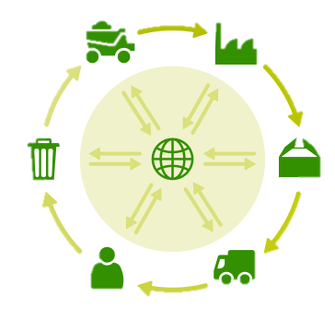
Environment
Repairing products rather than throwing them away
The 6Rs | Meaning
Reuse | To use a product again either for the same purpose or a different one
Reduce | To have less of material/packaging/pollution when making products by making them more efficient
Recycle | Breaking down and forming the material into another product
Refuse | Customers not buying or supporting products that make an environmental impact
Rethink | Designers and customer rethinking their decisions when making and buying products.
Repair | Fixing a product rather than throwing it away. Extending its life rather than using more resources to make another Often products are Designed for Maintenance so can easily be repaired. E.g. Using screws so even non-specialists can take a product apart, or using components that can easily be replaced like fuses or batteries
Reducing Product Miles buy making the product in the country it is sold in
Planting more trees to reduce deforestation
What can we do to reduce environmental impact or products and manufacture?
Reducing Pollution by using less plastics, efficient manufacture, less waste and using renewable energy (like solar and wind)
Recycling products and materials
Using less finite resources
Sustainability is maintaining our planet and its resources and making a minimal negative impact
Finite Resources Will run out of eventually | Infinite Resources Can be re-grown and re-bread. Will not run out of
Plastics | Paper
Metals | Boards
Polymers (Textiles) | Natural Timbers
 | Cotton
 | Leather
Life Cycle Assessment
This is when a designer looks at the environmental impact a product makes over its life time and how it could be reduced. Including:
Impact of materials
Impact of processes
Product Miles (how far a product has to travel to get from factory to consumer)
Impact while in use
Impact when disposed of (6Rs)
Planned Obsolescence | This is where products “die” after a certain amount of time. E.g. Disposable cups, Phones, Lightbulbs, Printer Ink, etc This can have a big environmental impact as customers are throwing away lots of products, and resources are being used to create new ones.

Slide 11
Energy Generation and Storage
Non-Renewable Energy Sources | This is when certain sources of energy will run out eventually
Fossil Fuels | Coal, Oil and Gas Burned to create steam, turned in turbines to create electricity. Burning creates C02 which adds to Global Warming
Nuclear Power | Nuclear Fission controls the reactor (that creates the electricity). This requires Uranium which is non-renewable Accidents and waste can severely damage the environment and cause radiation poisoning Radiation poisoning can be fatal and cause physical deformations Nuclear waste has to be disposed of properly and is hazardous for thousands of years.
Renewable Energy Sources | This is when certain sources of energy will not run out.
Solar | Solar panels are used to collect light and convert it into electricity There is no waste and a consistent supply However, the panels are not effective at night or in countries where there isn’t a lot of sunlight
Wind | Turbines harness wind energy Not effective on non-windy days Some people don’t like turbines as they are noisy, and not attractive to look at
Hydro-Electrical | This harnesses energy from water held behind a dam Has to be created by flooding land – damaging wildlife habitats Tidal energy comes from using energy from waves
Biomass | This is fuel from natural sources e.g. crops, scrap woods and animal waste Growing biomass crops produces oxygen and uses up C02 However, is a very expensive method
Storing Energy
Pneumatics: This is the production of energy using compressed gas or air. E.g. Pistons in an engine
Hydraulics: Like a Pneumatic system, but uses water or oil under pressure. E.g. Wheelchair lifts
Kinetic: Energy that is generated by movement. This is stored by items like springs in a “clickable” pen or balloons,
Batteries: Electrical power can be stored in batteries. Rechargeable batteries are becoming increasingly popular.

Slide 12
Production Techniques and Systems
CAD Computer Aided Design
Examples; 2D Design, Autodesk Inventor, Fusion 360, Photoshop, etc
Advantages | Disadvantages
Easy to change designs Designs are easily saved and sent Can be worked on by multiple people simultaneously Can be used for virtual testing Can produce high-quality designs | Complex and time-consuming to learn Expensive to buy PCs can crash or be hacked – causing work to be lost Takes up PC memory
CAM Computer Aided Manufacture
Examples; 3D Printing, Laser Cutting, CNC Router, Automated Machines and Robotics, etc
Advantages | Disadvantages
Faster and more accurate than traditional tools Repetitive accuracy/ consistent outcomes Machines can run 24/7 | Expensive to buy the equipment, etc Training takes cost and time Need specialists to maintain and repair the machines Dependence on CAM can cause unemployment
Flexible Manufacturing Systems
This is where automated machines are adaptable and can produce different products if needed. If a manufacture is making a product with machines that are just dedicated to specific tasks they have to be reprogrammed and re-tooled before changing to a new task. This is time consuming and expensive. Examples include; CNC Machines, 3D Printers, Laser Cutters, Robotic arms, etc
Just-in-Time (JIT) Manufacture
This is where manufacturers only order materials, parts, etc when needed. The customer’s order triggers the production process and the resources needed for that order are the only ones bought. This can be used in any scale of production but is particularly useful for one-off production.
Advantages | Disadvantages
Saves on warehouse and storage costs Money is not tied-up in stock Little/minimal waste Customer often pays in advance so money is secure before production | All production stops if a part/ material is missing Needs to have a fast, reliable and good quality supply chain to work properly Can be time-consuming
Lean Manufacturing
This is where waste and energy is kept to a minimum. This helps manufacturers save money and resources in production, as well as helping minimise the environmental impact of producing products.

Slide 13
Scales of Production
Name/ Type | How many it makes | Key Info | Examples of Products
One-off Production | 1 | Also known as Bespoke or Prototype manufacture Custom-made products Specialist workers/ skills Specialist machines and materials High Quality but expensive | Towers / Bridges One-off Houses Custom made clothes
Batch | 10s-1000s | Uses a mix of workers and machinery Uses jigs, moulds and templates to help make identical products Stations of workers e.g. cutting station, painting station, etc Can have some variation e.g. colour, finish, flavour | Baked foods Limited edition car Socks Chairs
Mass | 10,000s - 100,000s | Big assembly lines (and sub-assembly lines) Heavily automated Standard and identical products Little worker input | Cars Bottles Microchips Plain shirts
Continuous | 100,00s + | 24/7 production Heavily automated Standard and identical products Little worker input | Energy Water Paper Plastic
One-off Production
Advantages | Disadvantages
Custom made High Quality Materials High Quality Craftsmanship | Time consuming Specialist training for workers Expensive to buy
Batch Production
Advantages | Disadvantages
Lower cost than one-off Jigs, moulds and templates help products look identical Can have some variety | High storage costs Jugs, moulds and templates have to be checked Workers can become bored on their station
Mass Production
Advantages | Disadvantages
Large amounts made at once All products are identical and to same standard Using automation reduced human error | Initial starting costs are high If production line stops, the product can’t be made Workers become bored monitoring machines and repetitive tasks
Continuous Production
Advantages | Disadvantages
Large amounts made at once All products are identical and to same standard Using automation reduced human error | Initial starting costs are high If production line stops, the product can’t be made Workers become bored monitoring machines and repetitive tasks

Slide 14
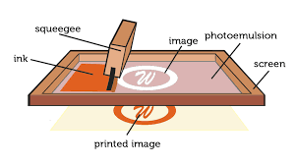
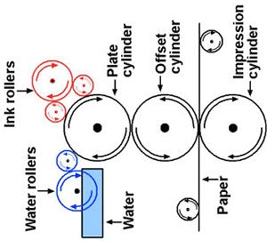
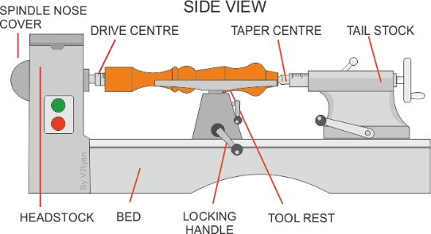
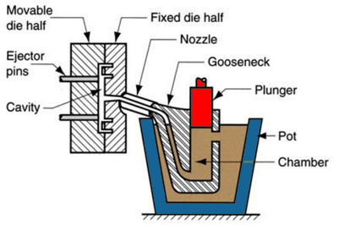
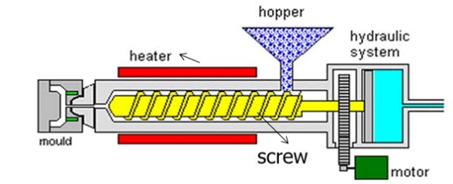
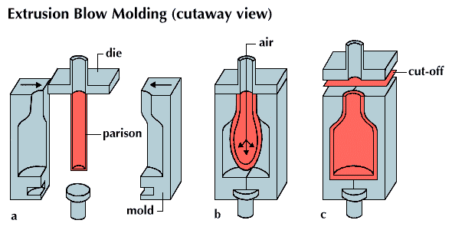
Production Processes
Name of Process | Diagram | Material | Products Made | Key info
Screen-printing |  | Papers and Textiles | Posters, signs and t-shirts | Screen printing places paint on top of a screen. The screen has a stencil embedded in it, so when the paint is passed across it the desired shape is printed underneath. Good process in one-off and batch production as often done by hand
Offset Lithography |  | Papers and card (thin, flexible plastics) | Posters, newspapers, plastics bags | Rollers containing the colours and water go onto the plate cylinder. The water stops the colours sticking to certain places, creating the shape. The shape is transferred between rollers and onto the material. Can be used at batch and mass production
Lathe Turning |  | Wood and metal | Chair legs, baseball bats )(cylindrical items) | Material is placed between the tail stock and the headstock and spun at high speed. The material is then cut using specialist tools (either by hand or my automated machinery) to the desired shape. Can be used in one-off and batch production
Die Casting |  | Metal | Car parts, engine components, etc | Molten metal is poured into a chamber and a plunger forces the metal through the nozzle into the mould. Unlike sand casting, the mould is reusable. Good process for both one-of and batch production
Injection Moulding |  | Plastics | Chairs, toys, etc | Plastic granules are poured into the hopper and onto the screw. The screw moves the material towards the heater where it turns into a liquid. The liquid is then forced into the mould, cooled and released. Great process for mass production as it makes 100s+ of products at once, to a identical standard.
Blow Moulding |  | Plastics | Plastic bottles | A Plastic parison is heated and put into the mould. The parison is then filled with air (like blowing up a balloon) and is forced to fit the mould shape. It is then cooled and then released. This is a great process for mass producing bottles.

