Slide 1
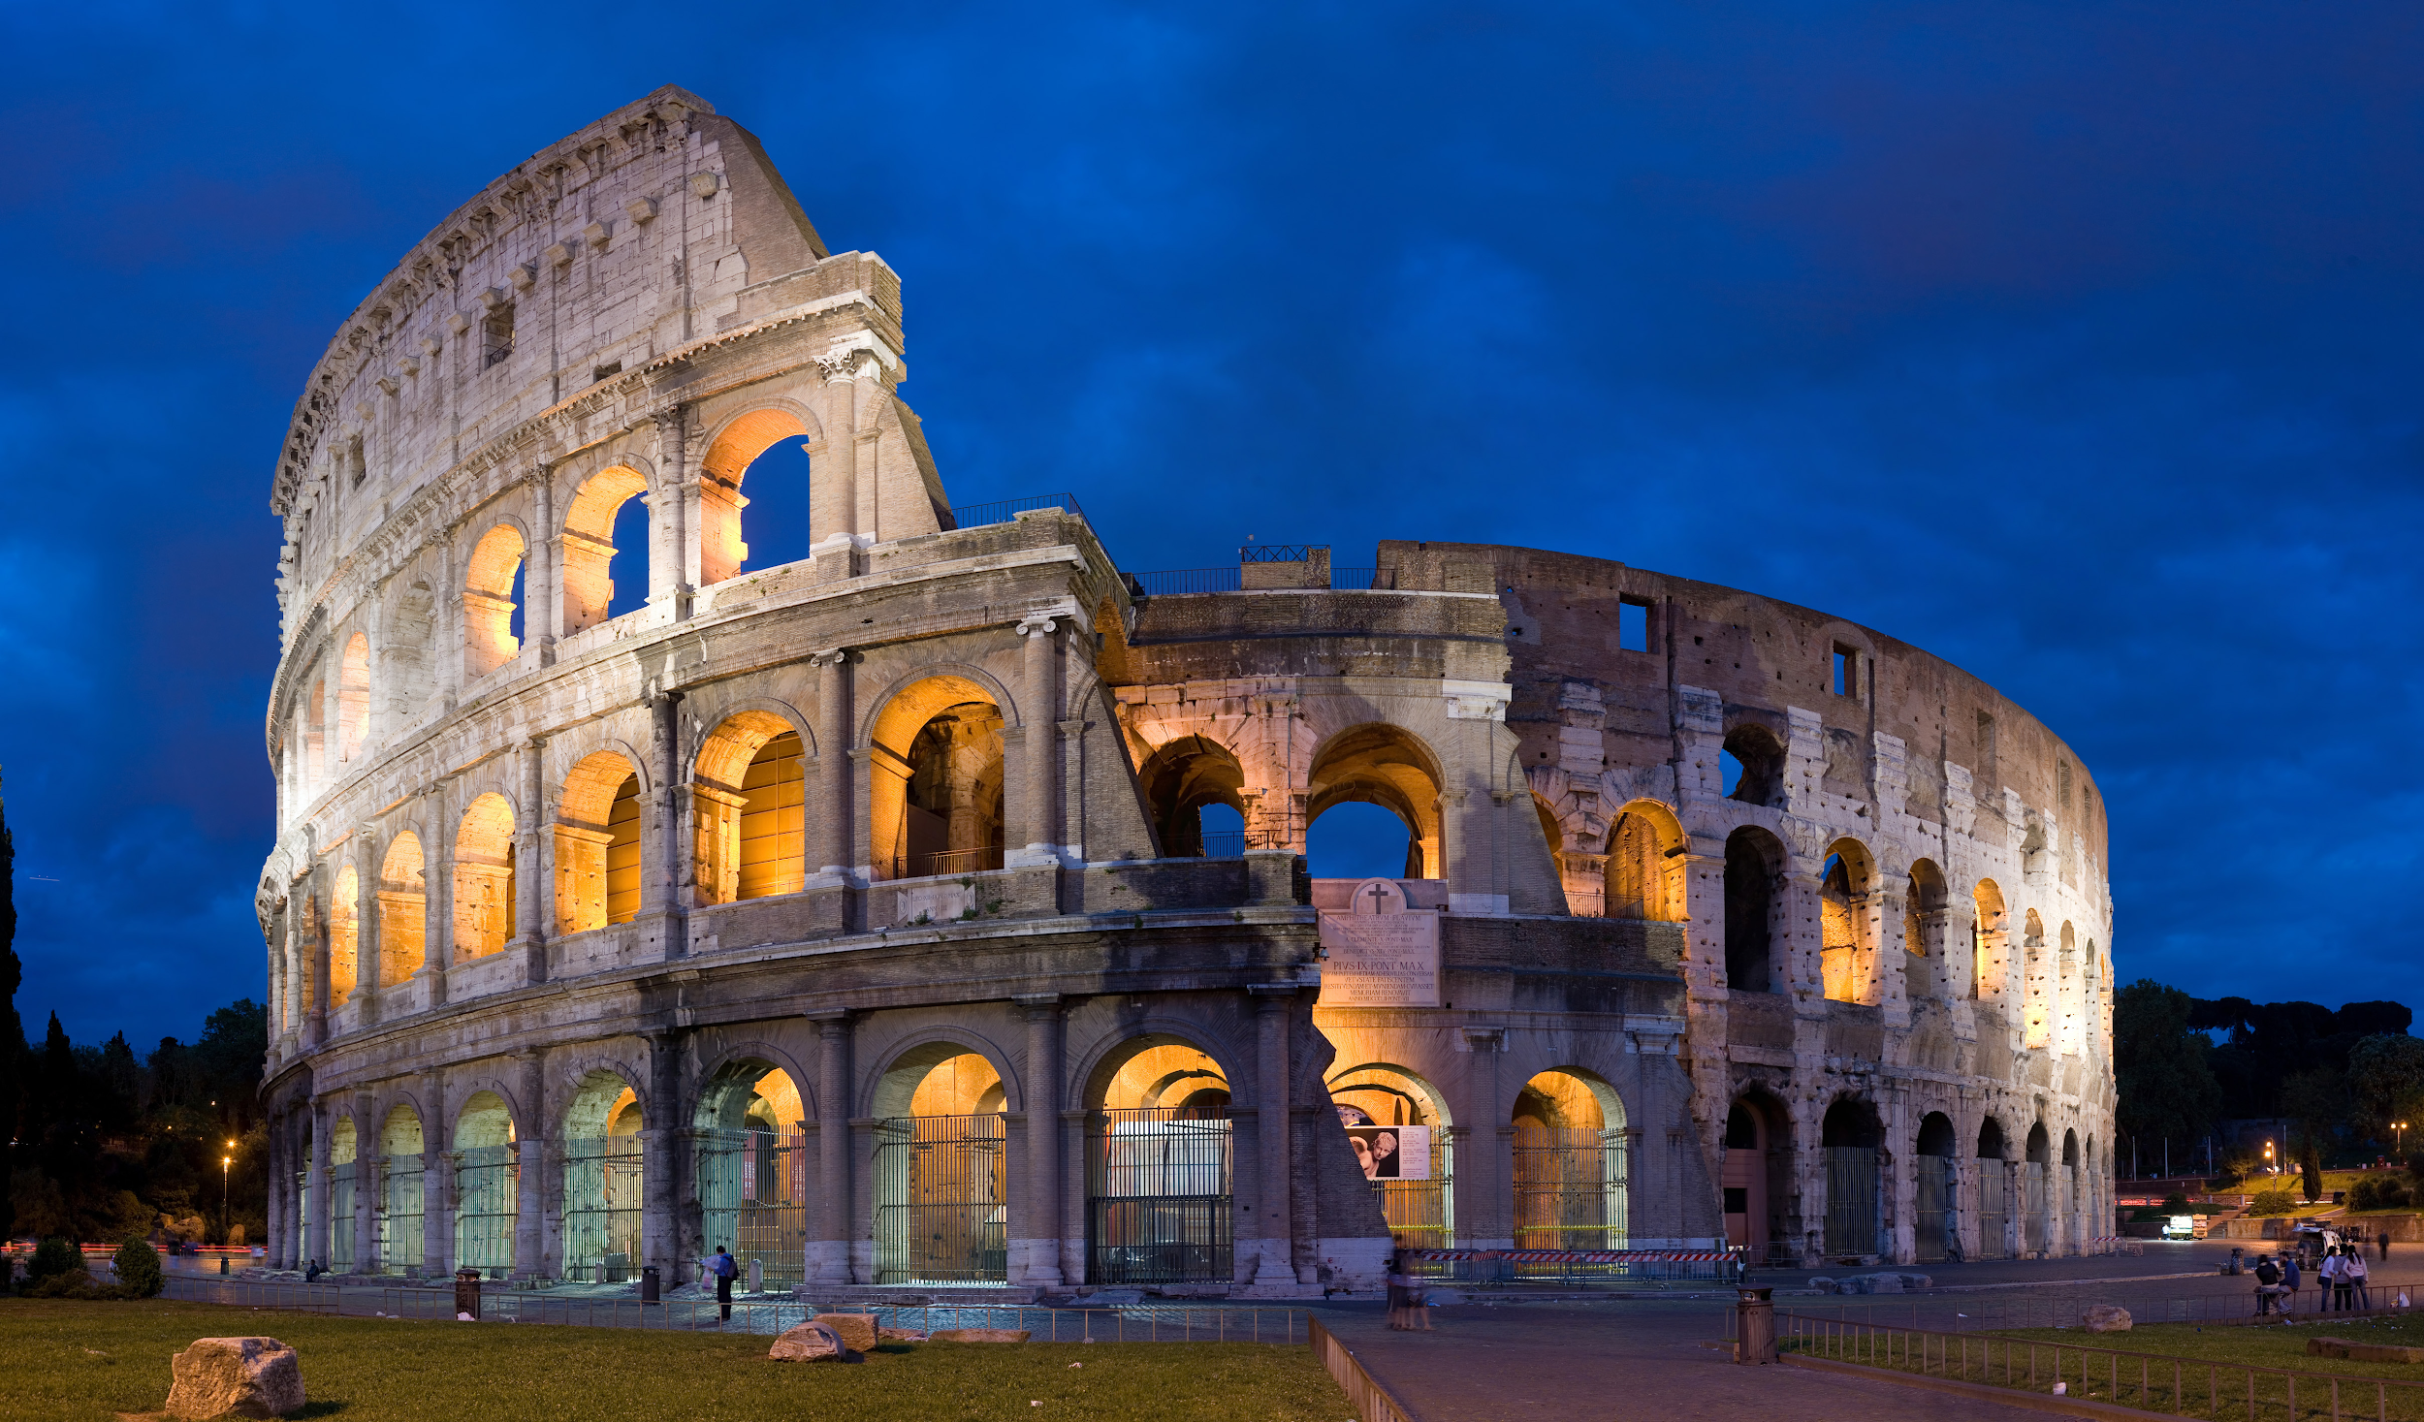

salvete, amici amicaeque!
Welcome (back) to Latin!
The menu attached contains a number of tasks that will prepare you for A Level
Tasks in green are compulsory and must be brought to your first lesson (further information about these is found on the 'Compulsory tasks' slide).
Tasks in yellow are optional, and will provide good preparation for the course.
Tasks marked with a chilli ( ) are particularly challenging.
fortuna audentes iuvat!

Slide 2

Latin Bridging Portfolio (All green tasks are those which are compulsory elements of your portfolio)
Read | Watch | Listen | Visit
Revision materials You’ll be needing to do some revision! The best resource for that is probably your old textbook - Essential GCSE Latin; these are available cheap on Amazon second hand (for as little as a penny!) Latin Stories is another good textbook available, containing short, GCSE-style passages to read. (1, 2) | Ancient Rome in 20 Minutes Brian Cox (the actor, not the scientist) narrates an incredible history of Rome in just 20 minutes. The Latin pronunciation’s a bit iffy, but I can forgive him for that. If you ever wanted to find out more about the overall history of Rome, this is the video to watch. | In Our Time The brilliant BBC podcast featuring loads of discussions on topics both classical and non-classical. Start with this one about one of our key authors, Ovid, and explore the collection from there. | British Museum So many classical objects to explore! Go on a virtual tour here, or explore the catalogue here, and go to it in the holidays! The current Greece and Persia exhibit is particularly good.
Virgil - Aeneid The bit of the Aeneid we read at GCSE is from book 2. This year, we're going to read more of the earlier half of that poem. Read through all of Book 2! (3) | Cambridge Greek Play Not Latin, but certainly classical! Every three years Cambridge puts on an ancient Greek play in the original language. Make sure to click the subtitles! You’ll be astonished by how modern even these ancient plays can appear... | Emily Wilson on translation At A Level, you do more than just tell me what the Latin means; you get to make choices about how you translate. In fact you will be required to do so! In this lecture, Emily Wilson, who produced a recent version of the Odyssey, talks about what translation really is. | A tour of the Cambridge Cast Gallery Professor Carrie Vout guides you round the cast gallery of the University of Cambridge Classics department, and tells you a little bit about the artworks you can see there.
Very Short Introductions I love these books - written by academics to give you an accessible introduction to a topic, with guidance for further reading. Cheap (under £10 new) too! Particularly relevant ones might be: Classics Classical Mythology Classical Literature The Roman Republic The Roman Empire | I, Claudius For my money the best historical drama you’ll find anywhere. Emperor Claudius tells the story of his family from Augustus all the way through to himself. Clips on YouTube; I think the whole thing’s on Amazon Prime if you have it. Look out for Brian Blessed as a very shouty Augustus and Sian Phillips as the poisonous Livia. | quomodo dicitur? (How do you say?) For when you’ve done a bit of practice! A couple of Latin teachers get together and talk - in Latin! - about all sorts of things, from ancient authors to what they watched on TV this week. | Eidolon Provocative dispatches from the world of classical studies. My favourite article is this one, about the problems of teaching Latin (particularly problems with the Cambridge Latin Course)
Catullus - poems You all loved the outrageous titles on the Wikipedia page; we’re going to be reading some of them in Y12. For now, read poems 5, 7 and 8. (4) | Meet the Romans with Mary Beard The pre-eminent British classicist gives you a look at the day-to-day lives of ordinary Romans, not just the famous ones. A great documentary. | Hadestown Hadestown, originally a concept album based on the myth of Orpheus and Eurydice, was turned into a musical and swept the board at the Tony Awards. A really engaging soundtrack! | Hexameter This needs a sign-up, but it’s a fun game! Latin poetry follows a rhythmical scheme called metre. If you learn the rules, you can work out how a line of poetry sounded when read aloud in Latin. This site teaches you the rules, and then gets you to ‘scan’ likes of poetry from its database to work out its rhythm. We’ll be doing this a lot next year.

Slide 3
Compulsory tasks
Language
1) Complete the 2021 GCSE language paper attached here.
2) Print off and RAG rate the GCSE vocabulary list attached here.
R: I do not remember this word at all
A: I remember this word but I can't fully recall its meaning
G: I know this word
Bring these with you to your first language lesson.

Slide 4
Compulsory tasks
Literature
3) Once you’ve read Aeneid 2, summarise its events in no more than a page. What happens? Who are the main characters? What are the major themes?
4) The Catullus poems attached here show the author’s relationship with his girlfriend Lesbia. What story do these poems tell us about what the relationship is like, and what each party feels at each time?
Bring these with you to your first literature lesson.

Slide 5
You can, of course, tell me what you think about any of the other material I’ve suggested here! Please write me a personal response with questions, observations or things you found interesting about any of the other areas to explore I’ve given you.
Do also tell me about anything you find independently!

