Slide 1
Microscopy and Magnification

Slide 2
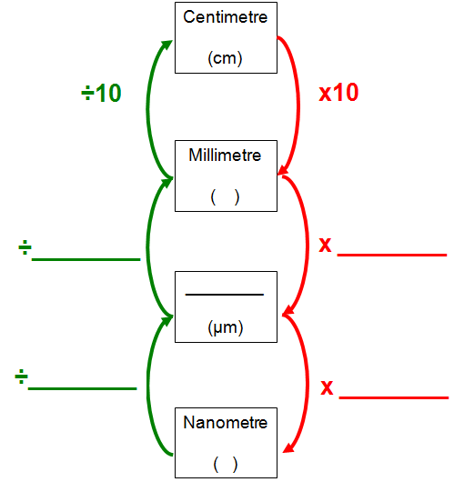
mm
1000
1000
Micrometre
1000
1000
nm

Slide 3
Nanometre | Micrometre | Millimetre
5 | 0.005 | 0.000005
1
 | 1
 |  | 1
 | 3
7
 |  | 0.5
0.001
0.000001
1000
0.001
1 000 000
1000
3000
0.003
0.007
0.000007
500 000
500

Slide 4
The difference between magnification and resolution.
Magnification is the degree to which the size of an image is larger than the image itself.
Resolution is the degree to which it is possible to distinguish between two objects that are very close together.

Slide 5
How do we find the overall magnification of a light microscope?
Eyepiece
Objective lens
Eyepiece Magnification | Objective Magnification | Overall Magnification
X10 | X4
X10 | X10
X10 | X40
X10 | X100
40
100
400
1000

Slide 6

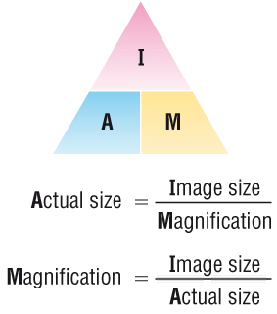
The diagram below is a drawing of an organelle from a ciliated cell as seen with an electron microscope.
Calculate the actual length of the organelle as shown by the line AB in the diagram. Express your answer to the nearest micrometer (mm).
Show your working.
Answer = ........................................... μm
I
M
102mm
20000
102000μm
20000
A =
=
=
5.1
Notes:
Ask students to summarise the steps that they need to take when calculating a) actual size and b) image c) magnification

Slide 7
The diagram below is a drawing of an alveolus together with an associated blood capillary.
The line AB in the diagram represents an actual distance of 1.5 µm.
Calculate the magnification of the drawing. Show your working.
Answer = × .................................................
I
A
M =
21mm
1.5μm
=
21000μm
1.5μm
=
14000

Slide 8
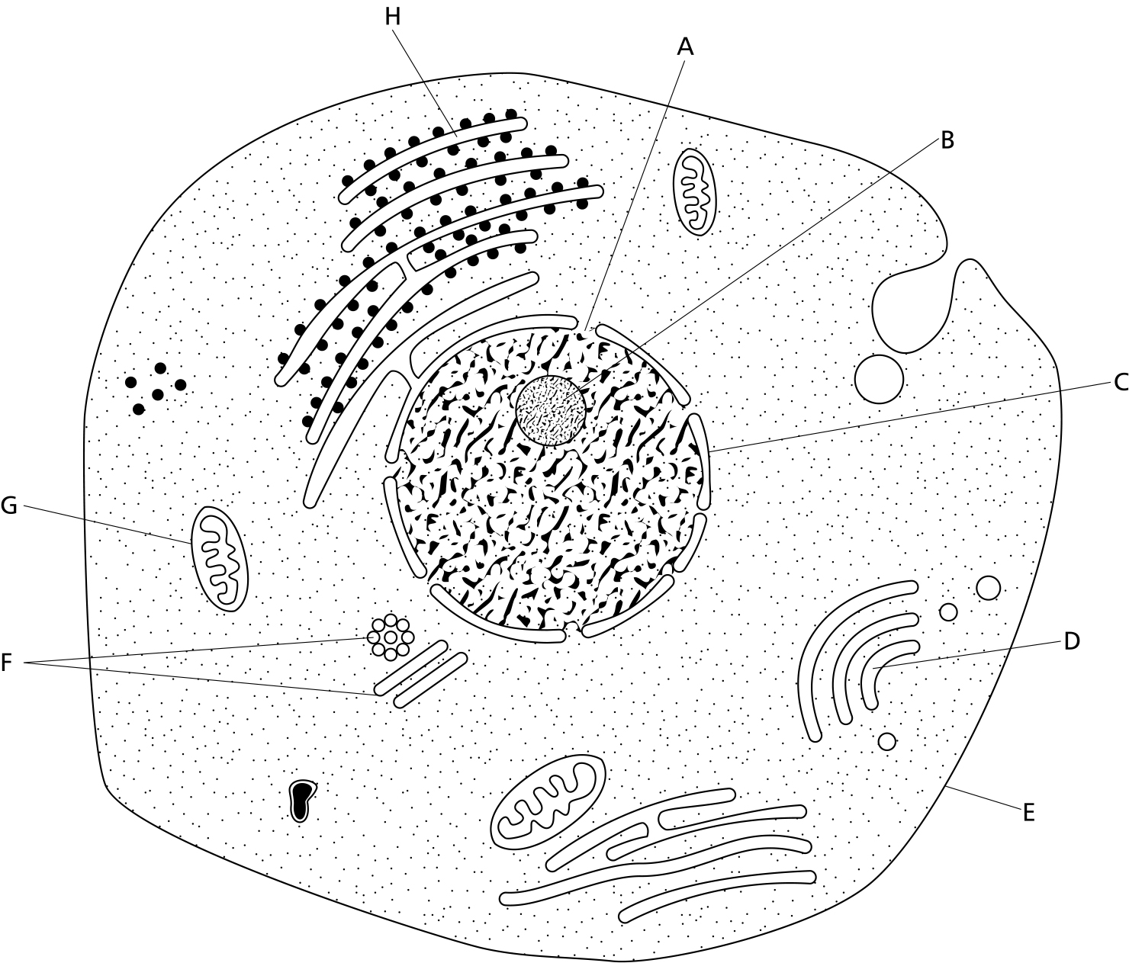
The diagram below shows the general structure of an animal cell as seen under an electron microscope.
_________
5μm
I
A
M =
24mm
5μm
=
24000μm
5μm
=
= 4800
1) Calculate the magnification factor of the diagram

Slide 9
The diagram below shows the general structure of an animal cell as seen under an electron microscope.
_________
5μm
I
M
A =
12mm
4800
=
12000μm
4800
=
= 2.5μm
2) Calculate the actual length of structure G

Slide 10
The diagram below shows the general structure of an animal cell as seen under an electron microscope.
_________
5μm
I
M
A =
8mm
4800
=
8000μm
4800
=
= 1.666μm
= 1.7μm
3) Calculate the diameter of the nucleolus (structure B)

Slide 11
The diagram below shows the general structure of an animal cell as seen under an electron microscope.
_________
5μm
I
M
A =
36mm
4800
=
36000μm
4800
=
= 7.5μm
4) Calculate the diameter of the nucleus

Slide 12
The diagram below shows the general structure of an animal cell as seen under an electron microscope.
_________
5μm
I
M
A =
116mm
4800
=
116000μm
4800
=
= 24.16666μm
= 24.2μm
5) Calculate the diameter of the cell at its widest point

Slide 13
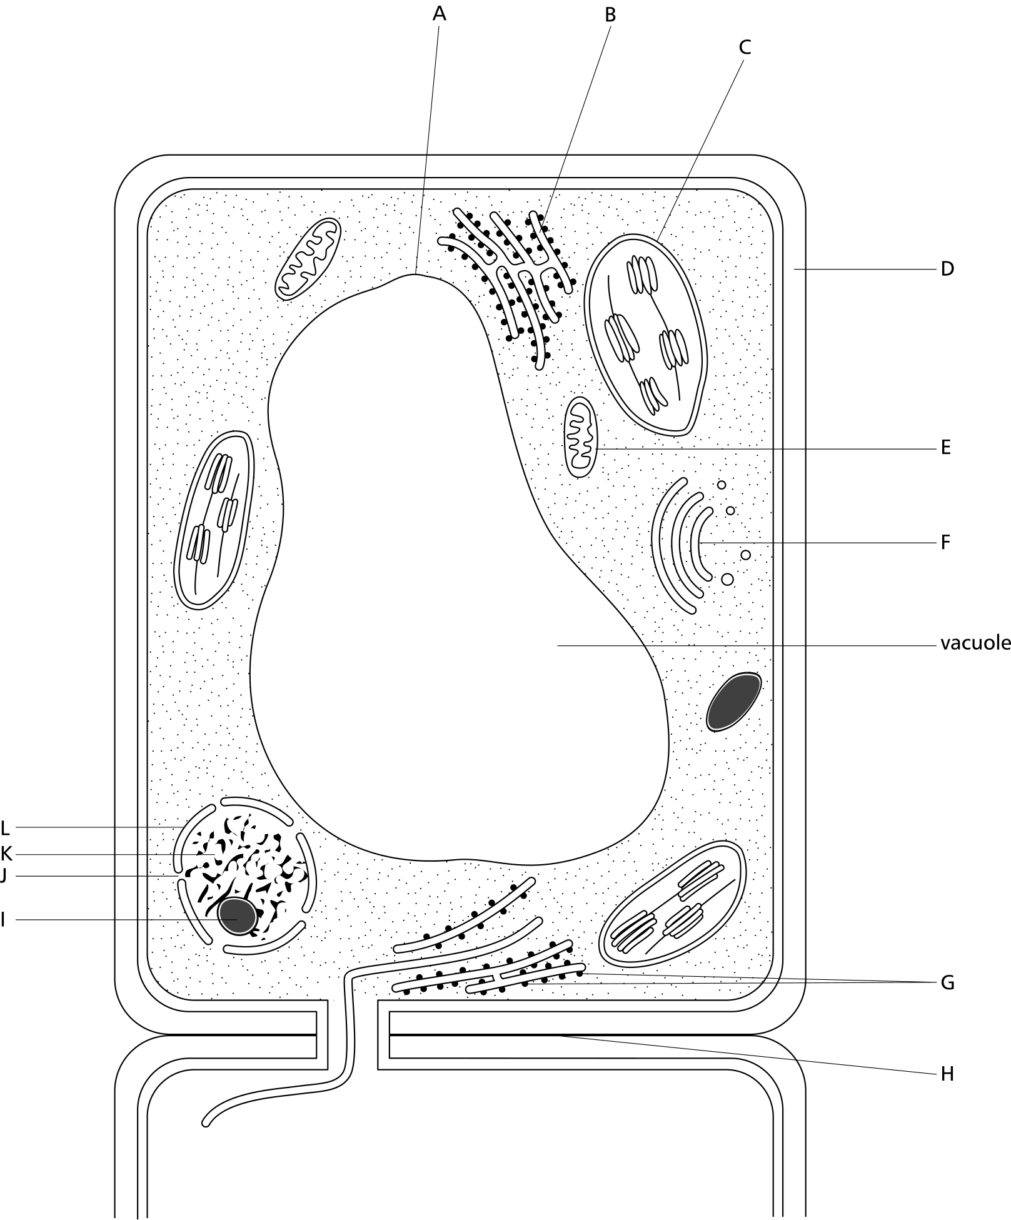
The diagram below shows the general structure of a plant cell when viewed under and electron microscope.
___________
40μm
I
A
M =
23mm
40μm
=
23000μm
40μm
=
= 575
1) Calculate the magnification factor of the diagram

Slide 14
The diagram below shows the general structure of a plant cell when viewed under and electron microscope.
___________
40μm
I
M
A =
3mm
575
=
3000μm
575
=
= 5.2μm
2) Calculate the thickness of the cellulose cell wall.

Slide 15
The diagram below shows the general structure of a plant cell when viewed under and electron microscope.
___________
40μm
I
M
A =
98mm
575
=
98000μm
575
=
= 107.4μm
3) Calculate the length of the cell.

Slide 16
The diagram below shows the general structure of a plant cell when viewed under and electron microscope.
___________
40μm
I
M
A =
24mm
575
=
24000μm
575
=
= 41.7μm
4) Calculate the length of structure C.

Slide 17
The diagram below shows the general structure of a plant cell when viewed under and electron microscope.
___________
40μm
I
M
A =
71mm
575
=
71000μm
575
=
= 123.5μm
5) Calculate the length of the vacuole.

Slide 18
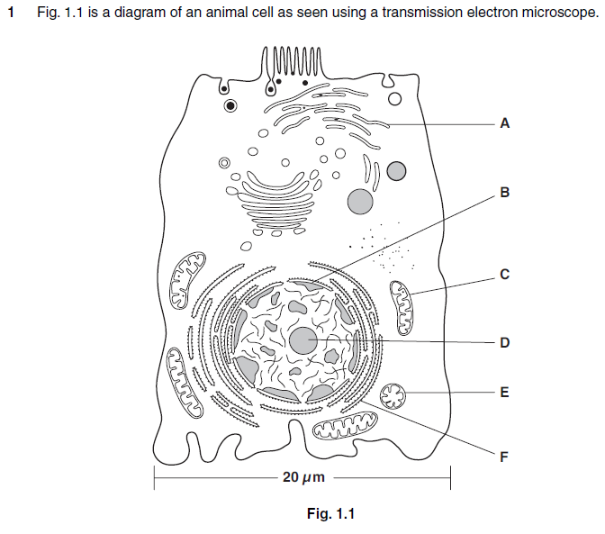
I
A
M =
82mm
20μm
=
82000μm
20μm
=
= 4100
Calculate the actual length of structure C.
Show your working and give your answer in micrometres (μm).

Slide 19
I
A
I
M
M =
A =
82mm
20μm
15mm
4100
=
=
82000μm
20μm
15000μm
4100
=
=
= 4100
= 3.6μm
Calculate the actual length of structure C.
Show your working and give your answer in micrometres (μm).

Slide 20

Take a calculator and a clear ruler into Biology exams
Always show the working out
Make sure correct units are added

