Slide 1
GCSE Design Technology
NEA Guidance Booklet
2024-2025
Name
Tutor Group
Target Grade
Aspirational Grade
IMPORTANT INFORMATION
The most up-to-date version of your non-examined assessment MUST always be saved in more than one place. You should ALWAYS have the latest version saved on your school drive AND a memory stick/Dropbox. It is also highly recommended that you have a version saved at home. This is so that if you lose one version of your work, you will always have a backup.
***Remember this is a guide that will inform you of how it could be done, this is not a set list of items that must be on each page. This is just one approach***

Slide 2
Important Deadlines and Progress Tracker
Use the following table to record important deadlines that you must meet during the course of your NEA. Be aware that failing to meet deadlines will result in contact with home and sanctions. You will also limit the level of feedback you are able to receive to help you make improvements to your work.
Work Due | Deadline | Met?
SECTION A: Identifying & Investigating Design Possibilities (10 Marks)
SECTION B: Producing A Design Brief & Specification (10 Marks)
SECTION C: Generating Design Ideas (20 MARKS)
SECTION D: Developing Design Ideas (20 MARKS)
SECTION E: Realising Design Ideas (20 MARKS)
SECTION F: Analysing & Evaluating (20 MARKS)
Introduction to your NEA
Over the coming months, you are going to be working on your NEA. This is worth 50% of your final GCSE grade for Design Technology. The remaining 50% will be achieved in your exam in summer 2020.
Your NEA requires you to work through the product development process as you complete a project focused on a set task, which is outlined below:
Context: A high-profile activity or occasion
Time: 30–35 hours (recommended)
Evidence: Written or electronic design portfolio with photographic evidence of final prototype(s). Approximately 20 pages of A3, digital or A4 equivalent.
The project is broken down into different sections. We will work through the sections together as a class, although all of your work must be completed individually. Work completed will involve both written and practical tasks. Main sections for the project include:
SECTION A: Identifying & Investigating Design Possibilities (10 Marks)
SECTION B: Producing A Design Brief & Specification (10 Marks)
SECTION C: Generating Design Ideas (20 MARKS)
SECTION D: Developing Design Ideas (20 MARKS)
SECTION E: Realising Design Ideas (20 MARKS)
SECTION F: Analysing & Evaluating (20 MARKS)

Slide 3
Things to Remember
All pages must have a consistent appearance
All pages must include your name, candidate number, centre name, centre number and page number.
All pages must have a detailed introduction to explain what the page is for.
All pages must have a detailed page summary to present the key findings from the page and explain how they will influence the project moving forward.
All sources of information (websites, books, etc.) must be clearly referenced on each page the information is used on.
All research must be re-written into your own words.
Assessment
It is important to realise that AQA assesses your D&T work on a “best fit” model. What this means is that the assessment criteria are applied loosely. It begins by your teacher finding criteria which best describes the work you submit. It is likely that the criteria fits into different bands and your teacher will need to choose a score which best fits what you have done. You do not have to meet every statement in a particular band to achieve a score within that band.

Slide 4
MARK SCHEME
SECTION A: IDENTIFYING & INVESTIGATING DESIGN POSSIBILITIES (10 MARKS)
Mark | Description
9 – 10 | Design possibilities identified and thoroughly explored, directly linked to a contextual challenge demonstrating excellent understanding of the problems/opportunities.
 | A user/client has been clearly identified and is entirely relevant in all aspects to the contextual challenge and student has undertaken a comprehensive investigation of their needs and wants, with a clear explanation and justification of all aspects of these.
 | Comprehensive investigation into the work of others that clearly informs ideas.
 | Excellent design focus and full understanding of the impact on society including; economic and social effects.
 | Extensive evidence that investigation of design possibilities has taken place throughout the project with excellent justification and understanding of possibilities identified.
6 – 8 | Design possibilities identified and explored, linked to a contextual challenge demonstrating a good understanding of the problems/opportunities.
 | A user/client has been identified that is mostly relevant to the contextual challenge and student has undertaken an investigation of their needs and wants, with a good explanation and justification of most aspects of these.
 | Detailed investigation into the work of others that has influenced ideas.
 | Good design focus and understanding of the impact on society including; economic and social effects.
 | Evidence of investigation of design possibilities at various stages in the project with good justification and understanding of possibilities identified.
3 – 5 | Design possibilities identified and explored with some link to a contextual challenge demonstrating adequate understanding of the problems/ opportunities.
 | A user/client has been identified that is partially relevant to the contextual challenge. Student has undertaken an investigation of their needs and wants, with some explanation and justification of some aspects of these.
 | Some investigation into the work of others that has had some influence on their ideas.
 | Some design focus and understanding of the impact on society including; economic and social effects.
 | Investigation of design possibilities goes beyond the initial stages of the project but only some justification and understanding of possibilities identified.
1 – 2 | Basic design possibilities identified. Link to a contextual challenge is unclear and student demonstrates only a limited understanding of the problems/ opportunities.
 | An attempt has been made to identify a user/client but is not be relevant to the contextual challenge. Student has undertaken a basic investigation of their needs and wants, but given little explanation and justification of these.
 | Basic investigation into the work of others that has not been used to inform their ideas.
 | Limited design focus and understanding of the impact on society including; economic and social effects.
 | Investigation of design possibilities only takes place in the initial stages of the project and there is very little justification and understanding of possibilities identified.
0 | Nothing worthy of credit.
The aim of this section is to identify the problem. You will need to analyse the contextual challenge set by AQA and identify design possibilities, investigate client needs and wants and factors including economic and social challenges. You will need to look at the work of others (past and/or present with primary and secondary analysis) to help you to generate ideas. Research should be concise and relate to the contextual challenge. You need to have range of research materials (primary/secondary) in order to draw accurate conclusions. You are encouraged to investigate throughout the project to help inform decisions.
Possible Content
Design Context Analysis
Initial Design Brief
Task Analysis
Market Research
Client/User Profile
Primary Analysis
Secondary Analysis

Slide 5
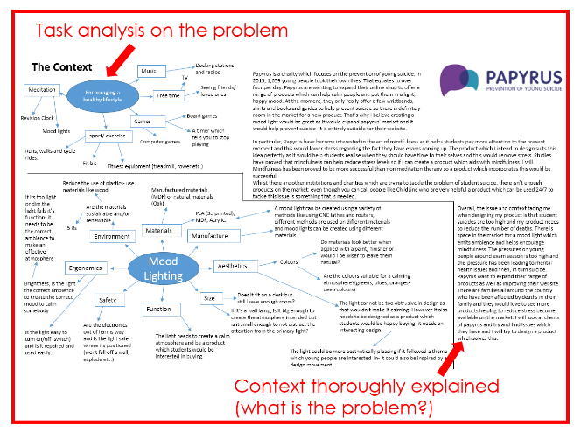

SECTION A: IDENTIFYING & INVESTIGATING DESIGN POSSIBILITIES (10 MARKS)
Exploring the context
Explain in detail what the specific design problem is and how you have arrived at it.
You will need to do some research and find out some facts to support your explanation.
You will need to conduct a task analysis to show understanding of the problem and possible ways to tackle it.
Consider the user and their needs, suitable materials, ways to manufacture the product and where will it be sold.
You may also need to consider packaging, transporting the product, ergonomics etc.
What do you need to know?
The design context will raise a series of questions
Where might you gather the following information?
  What are the client’s requirements?
  Who will use the product?
  Suitable materials for manufacture and the cost?
  What size should it be?
  Primary sources of data can also include: physical material testing, measurements and user observations

Slide 6
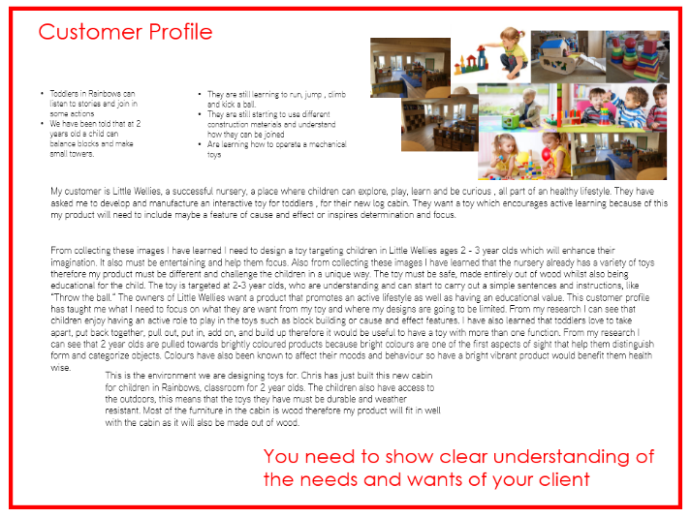

SECTION A: IDENTIFYING & INVESTIGATING DESIGN POSSIBILITIES (10 MARKS)
Research helps designers analyse and identify the market need for a product, the competition and the customer base
  Information can be gathered using
  interviews and questionnaires
  Non-specific, open-ended questions
  can help to gather general information
  Detailed questions help collect answers to very specific points
  What variety of methods could you use to collect this type of market research?
  How would you prepare to gather this data effectively?
Identify client/user profile
Your customer profile should be a combination of primary and secondary research. You should have a clear a customer/user that links to the context.
You may need to do the following:
Questionnaire to gather information from your customer (primary research)
Client interview (primary research)
Collect images and information that explains the needs and wants of your chosen target user (secondary research).

Slide 7
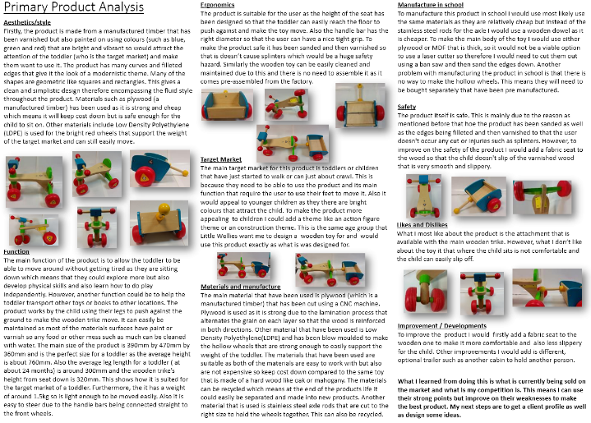


SECTION A: IDENTIFYING & INVESTIGATING DESIGN POSSIBILITIES (10 MARKS)
Product analysis can help your awareness of:
  Production methods
  Which materials have been used and types of finishes
  How materials perform, both functionally and aesthetically
  What areas should you consider when carrying out product analysis?
Consider the following areas and their options:
Form – shape, size, weight, colour, texture
Materials –what properties are needed
Scale of production – this will influence production methods
Cost – target price to sell the product for
Function – what it needs to do
Ergonomics – easy of use, safety etc.
Environmental factors – use of sustainable materials and end of life issues
WHO?
WHAT?
WHEN?
WHERE?
WHY?
You will need to explain how these factors might influence your thinking.

Slide 8
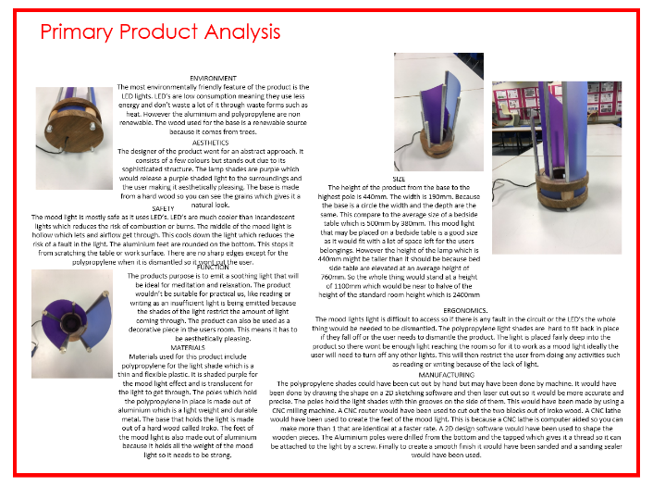

SECTION A: IDENTIFYING & INVESTIGATING DESIGN POSSIBILITIES (10 MARKS)
As part of your research, it’s essential to know what else is on the market and how it’s made
Consider the functionality of
the product
Observe the aesthetics and
customer appeal
Note the use of materials and the finish
Analyse both the successful and weak areas
of a design
Qualitative feedback from focus groups is informative
How does this analysis help a designer improve their design?
 | Questions to think about
AESTHETICS | What colours/shapes/materials have been used? How do these target the customer? What materials have been used and why?
FUNCTION | What is the function of the product? Does the product have more than one function?
ERGONOMICS | How has the designer made the product to suit the user? How is it designed to be easy to use? What features have been added to improve the ease of use? What anthropometric data has been used to design this product? How has the anthropometric data been applied?
TARGET MARKET | Who do you think the product is aimed too? Explain why you think this. How could you improve its appeal to the customer? Would you change the shape, colour etc?
MATERIALS AND MANUFACTURE | What materials have been used to make the product? Do you think these materials are suitable? Why? How do you think the product has been manufactured?
MANUFACTURE IN SCHOOL | What materials would you use to make the product in school? Why are these materials appropriate? What processes would you use to make the product? For example laser cutting, vacuum forming, drilling etc.
SAFETY: | Is the product safe? Explain why it is or isn’t. How could you make sure it is safe? How would you manufacture it safely?
LIKES AND DISLIKES | What do you like about the product and why? What do you not like about the product and why?
IMPROVEMENTS/ DEVELOPMENTS YOU COULD MAKE | How could it be improved? Why would these changes make it better?

Slide 9
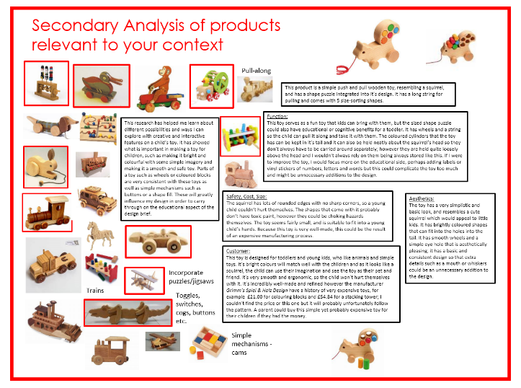
SECTION A: IDENTIFYING & INVESTIGATING DESIGN POSSIBILITIES (10 MARKS)
You will need to undertake both Primary and Secondary research.
Primary research means you’re completing research yourself rather than taking someone else's research. Possible examples of this could be:
Your own photos
Sketches and drawings. (Possible drawing cross sections of existing products to show hidden details)
Visiting museums, design shops that are relevant to your context.
Finding products and disassembling them for analysis
Secondary research is when research is taken from other people. Examples of this are:
Using the internet for images.
Completing product analysis from images from the internet.
Creating image boards.
Using other peoples photos.
You will need to explain what have you learnt by undertaking this research and how is it going to influence your ideas?

Slide 10
MARK SCHEME
Section B: Producing A Design Brief & Specification (10 Marks)
Mark | Description
9–10 | Comprehensive design brief which clearly justifies how they have considered their user/client’s needs and wants and links directly to the context selected.
 | Comprehensive design specification with very high level of justification linking to the needs and wants of the client/user. Fully informs subsequent design stages.
6–8 | Good design brief with an attempt to justify how they have considered most of their client’s needs and wants and has clear links to the context selected.
 | Detailed design specification with good justification linking to the needs and wants of the client/user. Largely informs subsequent design stages.
3–5 | Adequate design brief with some consideration of their client’s needs and wants is evident, as is the relevance to the context selected.
 | Adequate design specification lacking some detail. Some justification linking to the needs and wants of the client/user. Informs subsequent design stages to some extent.
1–2 | Basic design brief that contains only limited consideration of their client's needs and wants and has little or no relevance to the context selected.
 | Basic design specification has minimal detail. Limited justification linking to the needs and wants of the client/user. Very little influence on subsequent design stages.
0 | Nothing worthy of credit.
Based on conclusions from investigations, you need to explain what have you learnt during your research and explain how it will influence your design brief and your design specification. You will outline design possibilities by producing a design brief and design specification. You will need to refer back to this throughout the project.
DESIGN BRIEF
This is the conclusion of all your research and data
  A statement of intent will summarise your design plan:
  What are you going to design?
  Who is the target audience?
  Where are they going to use the product?
  What is the budget?
  When does it need to be completed?
  What size does it need to be?
  Some of these are known as immovable constraints
  Which do you think are immovable and why?

Slide 11
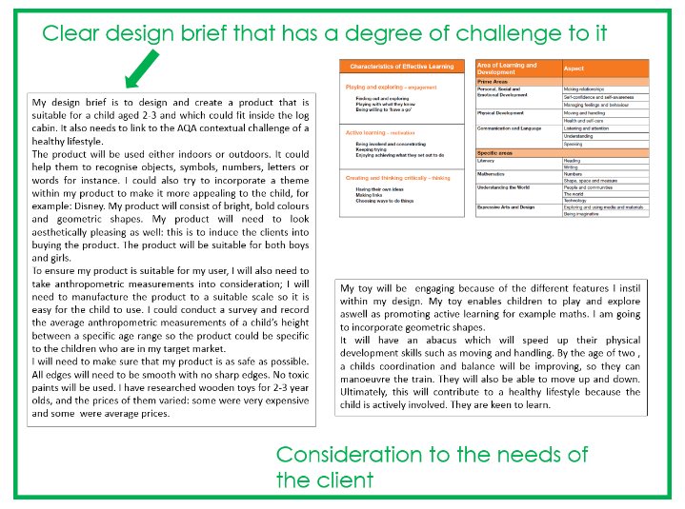
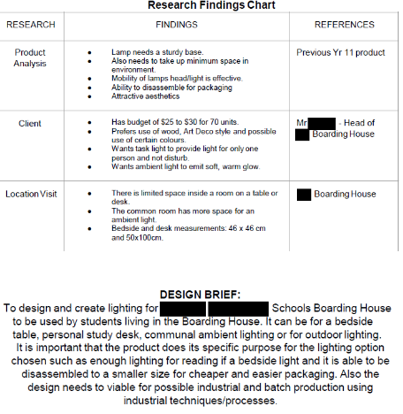
SECTION B: PRODUCING A DESIGN BRIEF & SPECIFICATION (10 MARKS)
DESIGN BRIEF:
The brief needs to clearly outline what your project is and what you are aiming to achieve. Make sure you discuss the following:
How does your brief fit the design context?
Discuss the needs and wants of your customer, how will your brief meet these?
Potential further investigations or research you may need to carry out.
Potential ideas that you may develop further after your initial ideas.

Slide 12
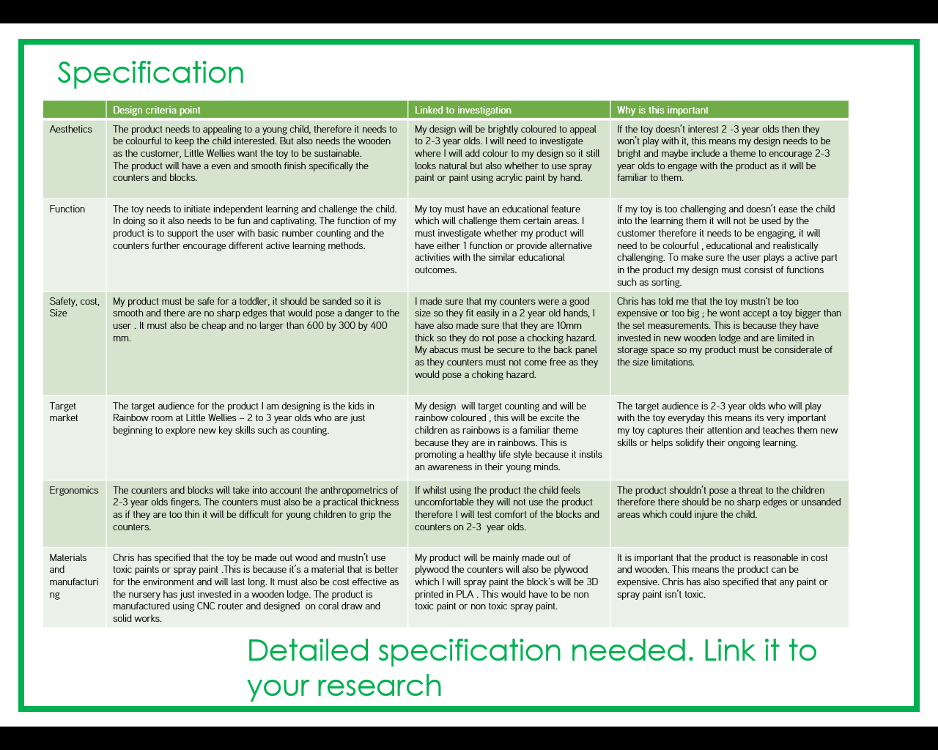
SECTION B: PRODUCING A DESIGN BRIEF & SPECIFICATION (10 MARKS)
SPECIFICATION
A design specification is used to describe all of the client and technical requirements gathered throughout the research process
It is a series of statements that outline:
  The function and type of materials to be used in the product
  The client requirements including anthropometric data
Before manufacture, the design specification is used to help create the final designs for the product
The final designs are then used to develop a detailed manufacturing specification

Slide 13
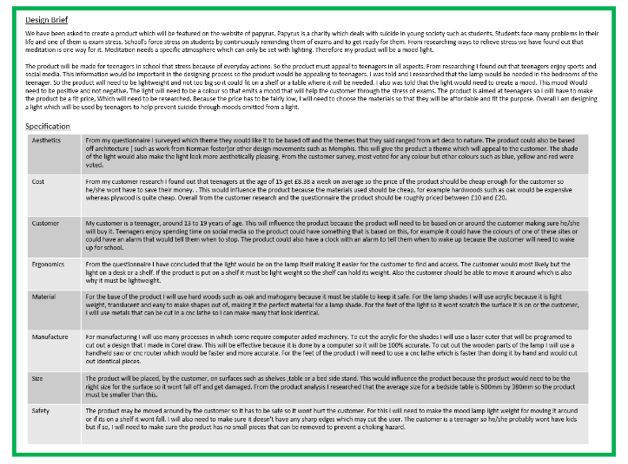
SECTION B: PRODUCING A DESIGN BRIEF & SPECIFICATION (10 MARKS)
SPECIFICATION
You need to produce a detailed specification. You will need to think of all the important things that your product will need to meet. This will need discussing in detail. Remember to refer to your research, particularly your customer’s wants. Use the following suggestions:
Aesthetics How will your product look? Will it link to a particular designer or movement? What aesthetics does your customer like?
Function What will you product need to do? Why is this product needed?
Cost This will link to the materials you plan on using. Is it cost effective. Will your customer be able to afford the product?
Customer Who is the customer? What do you already know about their wants and needs?
Ergonomics How will the customer use your product? How will your product be built to be comfortable and safe. What anthropometric data might you require?
Materials What materials will you use and more importantly, why? Why are those materials suitable? What are the properties of those materials?
Manufacture How will you manufacture your product? Is it important that the product is permanently joined or temporary methods used? Will you use knockdown fittings or traditional methods?
Size How big will the product be? This will link to customer and ergonomics. Is it important that the product can be easily transported? Does it need to fit in the boot of a car?
Safety How will the customer interact with the product? How will you ensure they are safe? This can be particularly important for children. For example choking hazards.

Slide 14
MARK SCHEME
SECTION C: GENERATING DESIGN IDEAS (20 MARKS)
Mark | Description
16 – 20 | Imaginative, creative and innovative ideas have been generated, fully avoiding design fixation and with full consideration of functionality, aesthetics and innovation.
 | Ideas have been generated, that take full account of on-going investigation that is both fully relevant and focused.
 | Extensive experimentation and excellent communication is evident, using a wide range of techniques.
 | Imaginative use of different design strategies for different purposes and as part of a fully integrated approach to designing.
11 – 15 | Imaginative and creative ideas have been generated which mainly avoid design fixation and have adequate consideration of functionality, aesthetics and innovation.
 | Ideas have been generated, taking into account on-going investigation that is relevant and focused.
 | Good experimentation and communication is evident, using a wide range of techniques.
 | Effective use of different design strategies for different purposes as an approach to designing.
6 – 10 | Imaginative ideas have been generated with a degree of design fixation and having some consideration of functionality, aesthetics and innovation.
 | Ideas have been generated that take some account of investigations carried out but may lack relevance and/or focus.
 | Experimentation is sufficient to generate a range of ideas. Communication is evident, using a range of techniques.
 | Different design strategies explored but only at a superficial level with the approach tending to be fairly narrow.
1 – 5 | Basic ideas have been generated with clear design fixation and limited consideration of functionality, aesthetics and innovation.
 | Ideas generated taking little or no account of investigations carried out.
 | Basic experimentation and communication is evident, using a limited number of techniques.
 | Basic use of a single design strategy.
0 | Nothing worthy of credit.
You need to explore a range of possible ideas linking to the contextual challenge selected. These design ideas should demonstrate flair and originality and you are encouraged to take risks with your designs. You need to use a variety of techniques to communicate them. Within this section you are encouraged to be imaginative in your approach by experimenting with different ideas and possibilities that avoid design fixation. In the highest band you are expected to show some innovation by generating ideas that are different to the work of the others in your class and demonstrate new ways of improving existing solutions.
You need to use an iterative design process and use clear design strategies.
Design Strategies
There are a variety of strategies that companies and individuals can employ to complete a design project:
Collaborative design
User-centered design
Systems approach
Iterative design
Each method has its own merits, and can also be used in conjunction with each other.

Slide 15


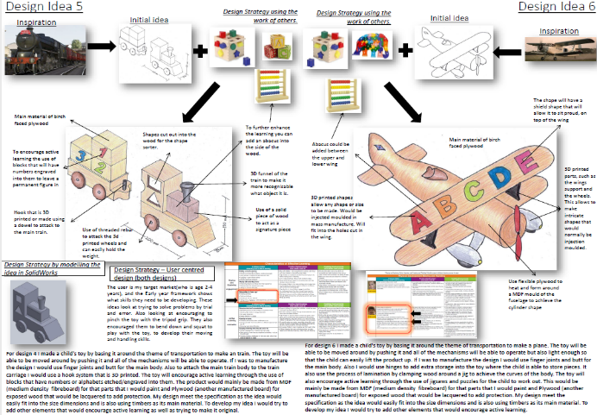
SECTION C: GENERATING DESIGN IDEAS (20 MARKS)
Methods of communication
Working on the presentation
of a design is a useful skill
A portfolio is a good format for
communicating designs
It should be accompanied by
any working notes, sketches and
mood boards that led to the final design
Losing any stages of work can be frustrating
and time consuming
What would be a good method
of safely collating all the elements that
make up a portfolio of work?
The focus of user-centred design
is the client or user group
Their requirements and limitations guide the design process
A clear understanding
of how the item will be used is the basis of any design
Continuous consultation
and testing ensures a
project fulfils the brief
What information would you gather to understand
the user experience?
User-centred design
User-centred design bases the design of a product around the needs of the target market. The user is questioned and consulted throughout development, and evidence is gathered through questionnaires, interviews, testing and observations, and the results are used to improve the product.

Slide 16
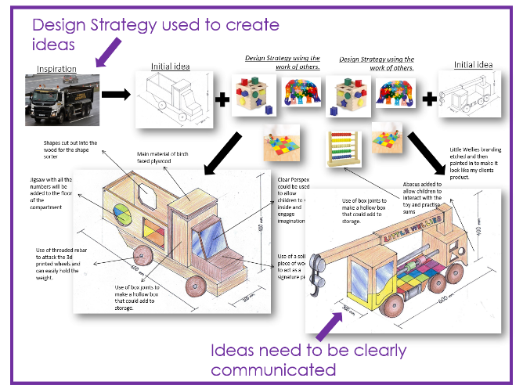
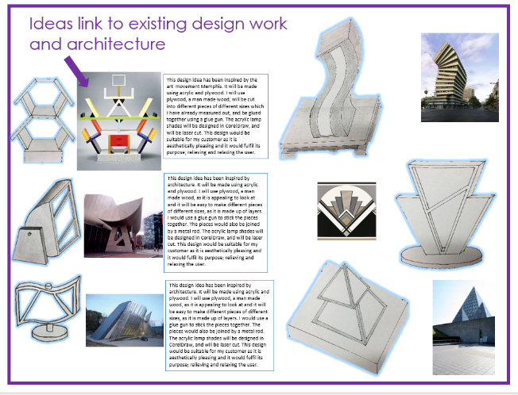
SECTION C: GENERATING DESIGN IDEAS (20 MARKS)
ANNOTATION NOTES
Aesthetics
Function
Ergonomics
Target market
Materials and manufacture
Manufacture in school
Safety
Linked to Research.
Likes and dislikes
Improvements/ developments you could make

Slide 17
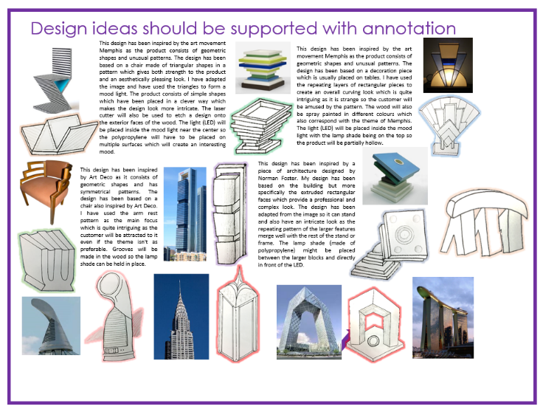
SECTION C: GENERATING DESIGN IDEAS (20 MARKS)
WHO?
WHAT?
WHEN?
WHERE?
WHY?
Annotation checklist:
Added labels to say what each parts are
Explained why you have chosen the colour/style/features you have?
Have you thought about materials and how it would be manufactured?
Have you linked it to your user/client and added notes to explain it?
Have you linked it to your research/investigation and added notes to explain it?
Have you linked it to your specification and added notes to explain it?
Have you linked it to your contextual challenge and added notes to explain it?
Have you added main measurements?
Whilst designing you will need to consider the following:
• Does the design target your audience?
• What materials will you use to make the idea?
• What and who has been your inspiration?

Slide 18
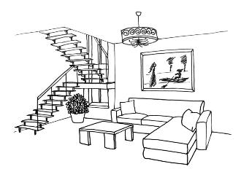

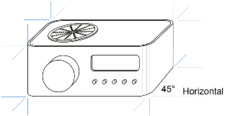
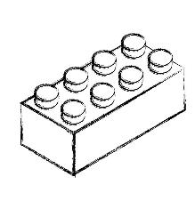
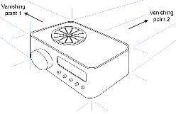
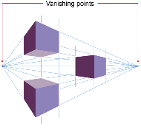
SECTION C: GENERATING DESIGN IDEAS (20 MARKS)
Drawing techniques
Graphical projection and perspective are useful drawing skills for presenting designs
There are three key types of 3D drawing styles:
  Oblique projection
  Isometric projection
  Two point perspective
2D and 3D sketching
2D drawings are good for expressing ideas, dimensions, mechanical and electrical concepts
3D drawings are better
at representing the
look and feel of an object
A 3D room plan
allows the viewer to
imagine they are
present in the room
Oblique projection
Oblique projection is a simpler technique and useful in the early stages of design
What are the problems with oblique projection?
Isometric projection
Isometric drawings shows three faces of an object
Lines leading away are all
parallel instead of narrowing
towards a vanishing point
which can create
slight distortion
Isometric grid paper can be
a helpful guide when drawing
in isometric projection
Two point perspective
Two point uses two vanishing points, so shapes that project towards them appear smaller
This vanishing effect
simulates the natural way
we observe objects
The following drawing used
a rule for working out the
structure, combined with
freehand sketching for
curved shapes
All lines are drawn at a 30° angle away from the nearest corner of the object and accurate measurements can be added

Slide 19
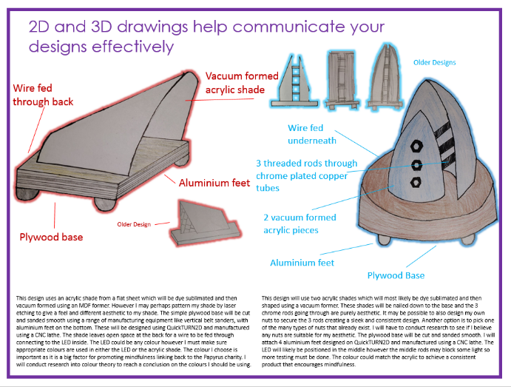
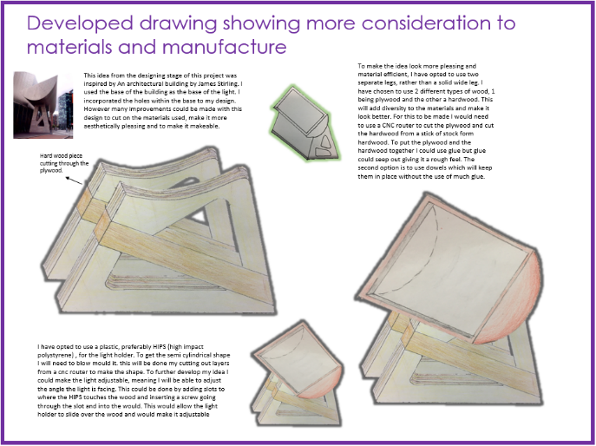
SECTION C: GENERATING DESIGN IDEAS (20 MARKS)

Slide 20
MARK SCHEME
SECTION D: DEVELOPING DESIGN IDEAS (20 MARKS)
Mark | Description
16 – 20 | Very detailed development work is evident, using a wide range of 2D/3D techniques (including CAD where appropriate) in order to develop a prototype
 | Excellent modelling, using a wide variety of methods to test their design ideas, fully meeting all requirements.
 | Fully appropriate materials/components selected with extensive research into their working properties and availability.
 | Fully detailed manufacturing specification is produced with comprehensive justification to inform manufacture.
11 – 15 | Good development work is evident, using a range of 2D/3D techniques (including CAD where appropriate) in order to develop a prototype.
 | Good modelling which uses a variety of methods to test their design ideas, largely meeting requirements.
 | Materials/components selected are mostly appropriate with good research into their working properties and availability.
 | Largely detailed manufacturing specification is produced with good justification to inform manufacture.
6 – 10 | Development work is sufficient, using some 2D/3D techniques (including CAD where appropriate) in order to develop a prototype.
 | Modelling is sufficient, using a variety of methods to test their design ideas, meeting some requirements.
 | Materials/components selected with some research into their working properties and availability. Some of these may not be fully appropriate for purpose.
 | Adequate manufacturing specification contains sufficient detail with some justification to inform manufacture.
1 – 5 | Basic development work is evident, using a limited range of 2D/3D techniques (including CAD where appropriate) in order to develop a prototype.
 | Modelling is basic, using a limited number of methods to test their design ideas meeting requirements only superficially
 | Materials/components selected with minimal research into their working properties or availability and may not be fully fit for purpose.
 | Basic manufacturing specification that lacks detail and has minimal justification to inform manufacture.
0 | Nothing worthy of credit.
You will need to develop and refine your design ideas. This may include formal and informal 2D/3D drawing including CAD, systems and schematic diagrams, models and schedules. You will need to develop at least one model, however marks will be awarded for the suitability of the model(s) and not the quantity produced.
You will also be asked to select suitable materials and components, communicating your decisions throughout the development process. You are encouraged to reflect on the developed ideas by looking at the requirements; including how your designs meet the design specification. Part of this work will then feed into the development of a manufacturing specification providing sufficient accurate information for third party manufacture, using a range of appropriate methods, such as measured drawings, control programs, circuit diagrams, patterns, cutting or parts lists.

Slide 21

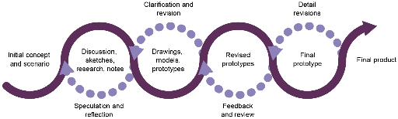
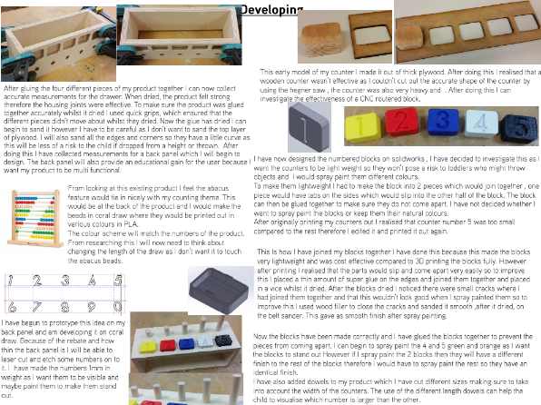
SECTION D: DEVELOPING DESIGN IDEAS (20 MARKS)
Iterative process of designing
Using drawings, notes and models enables designers to work through a series of ideas
These ideas are constantly revisited and reviewed at each stage of the design process to culminate in a finished product
What happens at the end of this process?
The iterative cycle enables
the designer to refine their
work in progress
By actually making the item,
designers begin to fully
understand it and how
successfully it works
Many versions will fail to work as
well as intended
The outcomes, good or bad,
dictate the next step
With every iteration, the results improve
Testing Development
Making
Ongoing Research
Development

Slide 22
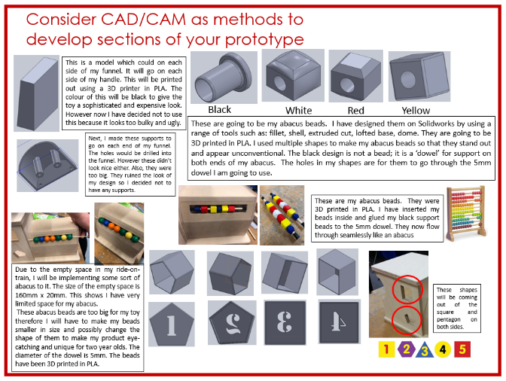
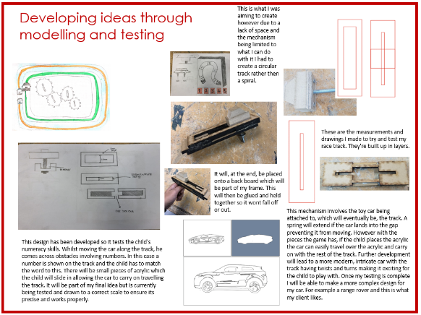
SECTION D: DEVELOPING DESIGN IDEAS (20 MARKS)
Remember to show your ongoing research
You need to show development of your ideas through using modelling strategies as well as CAD drawings. CAD drawings could be rendered to show colour possibilities.
You will need to conduct ongoing research into the materials you are considering using for your product. You need to show your understanding of their properties.
Any mechanisms/interlocking parts etc. that are a part of your design need testing. Evaluate your work as you go along.

Slide 23
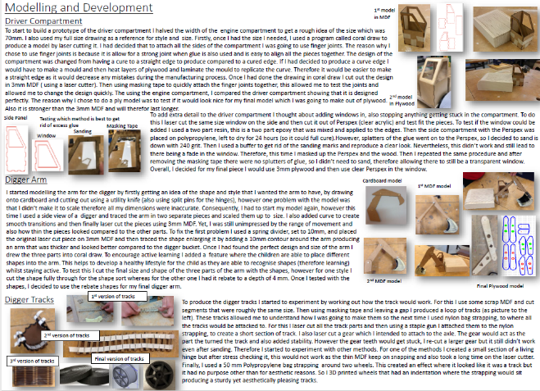

SECTION D: DEVELOPING DESIGN IDEAS (20 MARKS)
Evidence each stage of modelling and development
5 modelling stages just for this arm
Thomas Edison reportedly made hundreds, if not thousands of unsuccessful attempts at testing different substances as filaments in inventing the light bulb
Every wrong attempt discarded was regarded by Edison as a step forward; a new discovery of one more way that something cannot be done
What does this tell you about failure, perseverance and determination?
1,000 steps
ANNONATING YOUR IDEAS :
What is the function of the product?
What have you done, what developments/changes have you made?
How and why have you made them?
How have you modelled it?
How will it meet the needs of your client?
How is it ergonomically designed?
How successful was it?
What would it be made from if it was manufactured?
What further developments would you want to do?
How does it meet your specification?

Slide 24
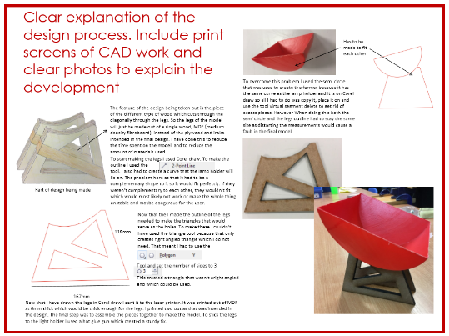
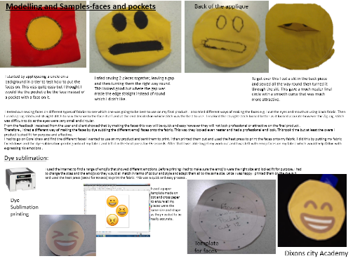

SECTION D: DEVELOPING DESIGN IDEAS (20 MARKS)
Modelling
Making a model can be the next step in the process
However simple, it enables a designer to translate their idea into reality
Everyday materials such as paper, card, tape, pipe cleaners, fabric and fasteners can all be utilised to great effect
Recording the steps (including the
use of photography and video) is
also a valuable process,
be it a success or failure
Why is it helpful to
record your failures?
Evidence any production aids, templates, stencils, patterns or jigs you used to make your prototype accurately
Developing prototypes
A prototype is a preliminary version of a product and should be made to the highest achievable quality
  To ensure the prototype is successful
  it should satisfy the client’s brief
  The design should also be innovative,
  functional, aesthetically pleasing
  and marketable

Slide 25
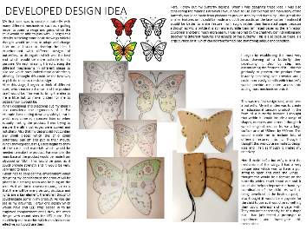

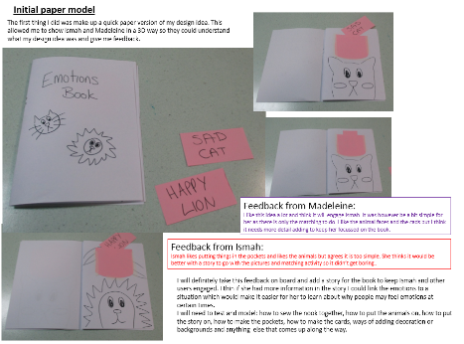
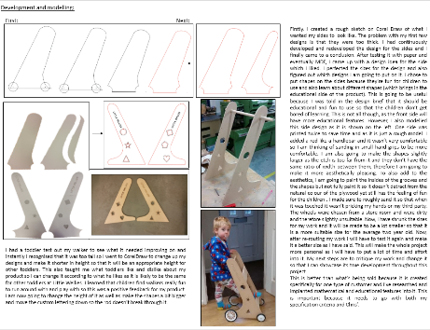
SECTION D: DEVELOPING DESIGN IDEAS (20 MARKS)
Testing
Testing could be as straightforward as checking
measurements or gathering opinions
There are three different
levels of testing:
  Non-destructive testing,
  Destructive testing and
  Market testing
Why would you perform
each type?
Testing and development models mixed with more drawing, with each stage taking the idea forwards
What did the user/client say?
What have you learnt from this and how will talking with your client this make your product better?
Feedback & testing from the user/client during development stages

Slide 26
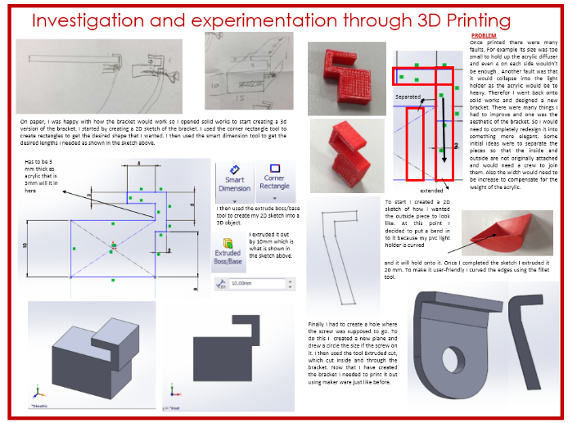
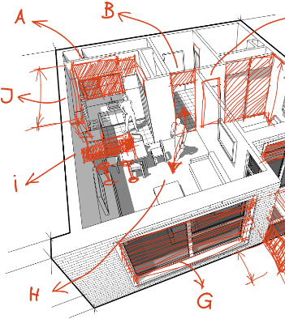
SECTION D: DEVELOPING DESIGN IDEAS (20 MARKS)
ANNOTATIONS
Annotations are notes
and labels which provide information about the design or process
  Annotated drawings show a work in progress
  They provide a way of communicating a
  designer’s plan
  What detail should be included in your annotations?
Annotations should clearly indicate information that the drawing may not convey
These may include:
  Materials
  Manufacturing processes
  Use of sustainable materials
For the client, they will also be looking to see if it meets their specification points

Slide 27
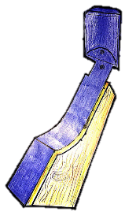


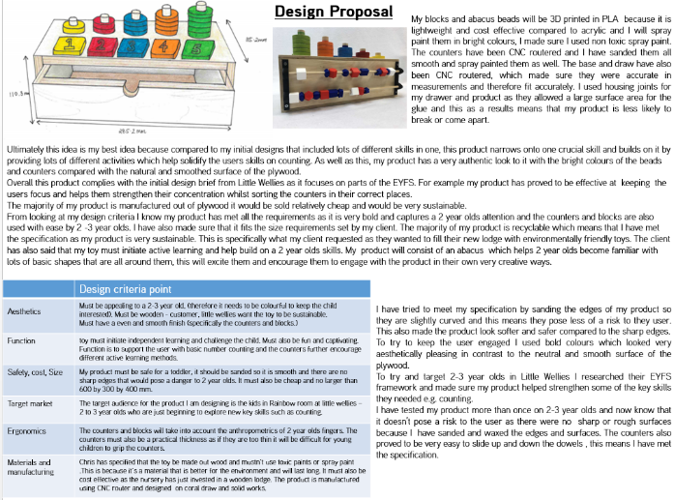
SECTION D: DEVELOPING DESIGN IDEAS (20 MARKS)
Design Proposal
Example of a 3D Drawing with main measurements
Produce either a model, CAD drawing or hand drawing of your final design. This MUST be high quality. You should have detailed drawings of the product and how it will be manufactured. Explain the materials you’ll use and how the product meets your specification. Why would this product satisfy your customers needs?
Why is this your best idea?
Why does it suit the target market/ client/user?
What will it be made from and why are these suitable materials?
How will it be made and why is this the best way to cut it out?
What other developments are you going to have to do to ensure that its commercially viable?
Evaluated against the specification

Slide 28
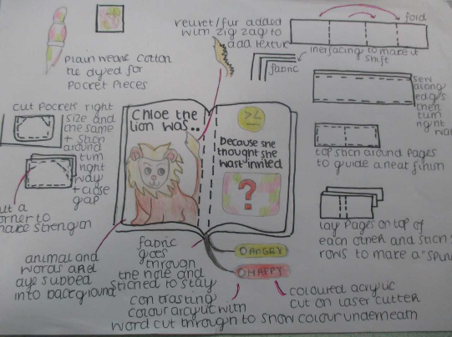
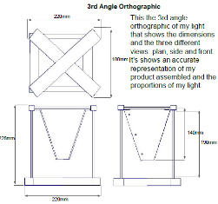
SECTION D: DEVELOPING DESIGN IDEAS (20 MARKS)
Design Proposal Drawing Possibilities
15cm
15cm
15cm
45cm
14cm
11cm
13cm
E
O
I
N
M
T
O
S
11cm
14cm
7cm
11cm
42cm
14cm
CAD Drawing
A combination of drawing styles
Clear sketches or 2D Orthographic drawings with measurements will be needed in most cases

Slide 29
MARK SCHEME
SECTION E: REALISING DESIGN IDEAS (20 MARKS)
Mark | Description
16 – 20 | The correct tools, materials and equipment (including CAM where appropriate) have been consistently used or operated safely with an exceptionally high level of skill.
 | A high level of quality control is evident to ensure the prototype is accurate by consistently applying very close tolerances.
 | Prototype shows an exceptionally high level of making/finishing skills that are fully consistent and appropriate to the desired outcome.
 | An exceptionally high quality prototype that has the potential to be commercially viable has been produced and fully meets the needs of the client/user.
11 – 15 | The correct tools, materials and equipment (including CAM where appropriate) have been used or operated safely with a good level, of skill.
 | Detailed quality control is evident to ensure the prototype is mostly accurate through partial application of tolerances.
 | Prototype shows a good level of making/finishing skills that are largely consistent and appropriate to the desired outcome.
 | A good quality prototype that may have potential to be commercially viable has been produced which mostly meets the needs of the client/user.
6 – 10 | The correct tools, materials and equipment (including CAM where appropriate) have been used or operated safely with an adequate level of skill.
 | Some quality control is evident through measurement and testing.
 | Prototype shows an adequate level of making/finishing skills that are mostly appropriate to the desired outcome.
 | A prototype of sufficient quality has been produced that may have potential to be commercially viable, although further developments would be required, and only partially meets the needs of the client/user.
1 – 5 | Tools, materials and equipment (including CAM where appropriate) have been used or operated safely at a basic level.
 | Basic quality control is evident through measurement only.
 | Prototype shows a basic level of making/finishing skills which may not be appropriate for the desired outcome.
 | A prototype of basic quality has been produced with little or no potential to be commercially viable and does not meet the needs of the client/user.
0 | Nothing worthy of credit.
You will work with a range of appropriate materials/components to produce prototypes that are accurate and within close tolerances. This will involve using specialist tools and equipment, which may include hand tools, machines or CAM/CNC. The prototypes will be constructed through a range of techniques, which may involve shaping, fabrication, construction and assembly. The prototypes will have suitable finishes with functional and aesthetic qualities, where appropriate. You will be awarded marks for the quality of your prototype(s) and how it addresses the design brief and design specification.

Slide 30
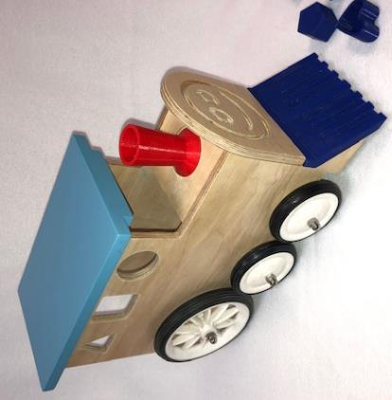
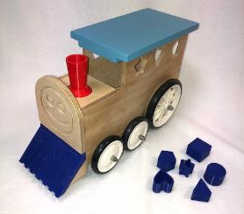
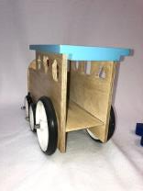
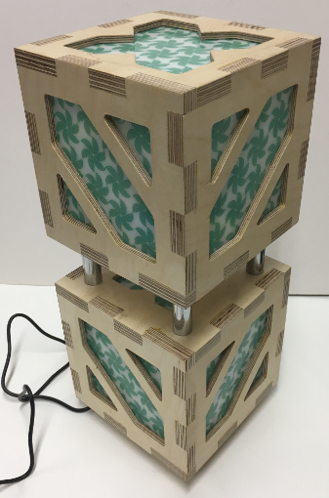
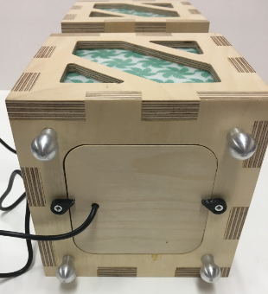
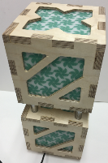
SECTION E: REALISING DESIGN IDEAS (20 MARKS)
Made to a commercial standard
Excellent standard of finish

Slide 31
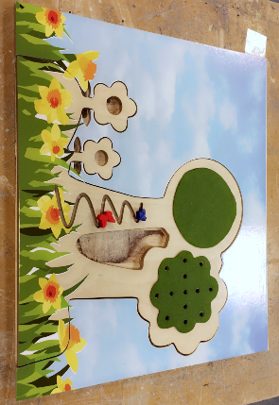
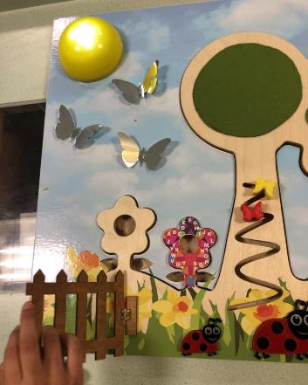
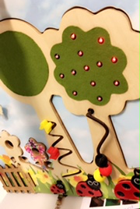
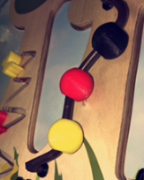
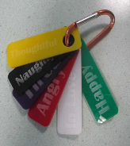
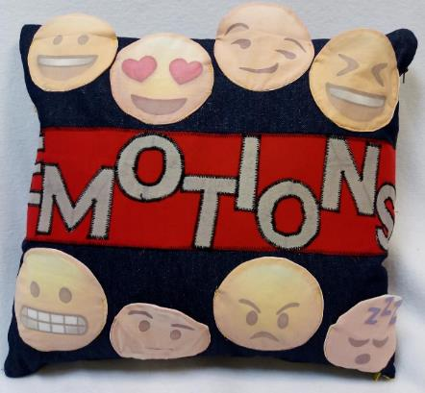
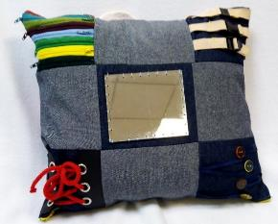
SECTION E: REALISING DESIGN IDEAS (20 MARKS)
Range of processes used in the final prototypes

Slide 32
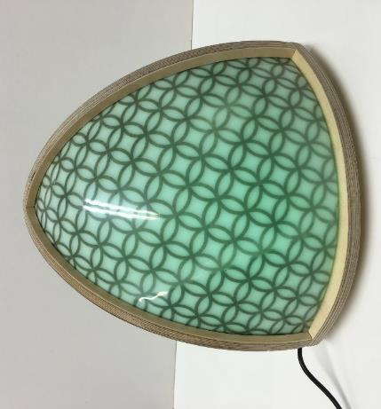







SECTION E: REALISING DESIGN IDEAS (20 MARKS)
High level of accuracy
Meets the clients needs

Slide 33


SECTION E: REALISING DESIGN IDEAS (20 MARKS)
SECTION D: DEVELOPING DESIGN IDEAS (20 MARKS)
You need to evidence all of your making. Evidence the tools, equipment and processes you’ve used. This can be done in several different ways.
Manufacturing Diary
Manufacturing Plan in a table
Manufacturing Plan in a flow chart
Make sure photos are CLEAR. Make sure you include CLEAR print screens of CAD work. Make sure you evidence quality control checks. this includes the use of jigs and formers to guarantee accuracy.
There must be evidence of ongoing evaluation. You should be continually getting feedback from your customer and show how this influences the development of your final outcome.
Link your making to your design brief and specification. Explain how you are meeting both.
Make sure every stage is clear and you have evidence of QA and QC
KEY:
  Start/Stop
  Process
  QA Check
  QC Check
START

Slide 34


SECTION E: REALISING DESIGN IDEAS (20 MARKS)
SECTION D: DEVELOPING DESIGN IDEAS (20 MARKS)
A manufacturing plan helps to identify the correct tools for each process involved in production
This also helps to ensure quality control will take place
The following relate to the first steps when soldering components onto a printed circuit board
Make sure every stage is clear and you have evidence of QA and QC
You MUST include quality control checks for each part as well.
Remember, if someone else was to read your manufacturing specification would they be able to follow it and make your product from your instructions?

Slide 35


SECTION E: REALISING DESIGN IDEAS (20 MARKS)
SECTION D: DEVELOPING DESIGN IDEAS (20 MARKS)
You need to evidence of a Manufacturing Specification, which shows all the parts /sizes of materials, templates, CAD files and processes.
In a table format you need to state all the different parts of your product. For each part you need to give dimensions and costings. You then need to write instructions, explaining how to make each part.

Slide 36
MARK SCHEME
SECTION F: ANALYSING & EVALUATING (20 MARKS)
Mark | Description
16 – 20 | Extensive evidence that various iterations are as a direct result of considerations linked to testing, analysis and evaluation of the prototype, including well considered feedback from third parties.
 | Comprehensive testing of all aspects of the final prototype against the design brief and specification. Fully detailed and justified reference is made to any modifications both proposed and undertaken.
 | Excellent ongoing analysis and evaluation evident throughout the project that clearly influences the design brief and the design and manufacturing specifications.
 | Good evidence that various iterations are as a result of considerations linked to testing, analysis and evaluation of the prototype, including some consideration of feedback from third parties.
11 – 15 | Good testing of most aspects of the final prototype against the design brief and specification. Detailed reference is made to any modifications either proposed or undertaken.
 | Good analysis and evaluation at most stages of the project that influences the design brief and the design and manufacturing specifications.
 | Some evidence that various iterations are as a result of considerations linked to testing, analysis and evaluation of the prototype, including basic consideration of feedback from third parties.
 | Adequate testing of some aspects of the final prototype against the design brief and specification. Some reference is made to modifications either proposed or undertaken.
6 – 10 | Adequate analysis and evaluation is present at some stages of the project but does not have sufficient influence on the design brief and the design and manufacturing specifications.
 | Limited evidence that various iterations are as a result of considerations linked to testing, analysis and evaluation of the prototype.
 | Basic testing of some aspects of the final prototype against the design brief and specification. Little reference is made to any modifications either proposed or undertaken.
 | Superficial analysis and evaluation. Little influence on the design brief and the design and manufacturing specifications.
1 – 5 | Nothing worthy of credit.
 | Extensive evidence that various iterations are as a direct result of considerations linked to testing, analysis and evaluation of the prototype, including well considered feedback from third parties.
 | Comprehensive testing of all aspects of the final prototype against the design brief and specification. Fully detailed and justified reference is made to any modifications both proposed and undertaken.
 | Excellent ongoing analysis and evaluation evident throughout the project that clearly influences the design brief and the design and manufacturing specifications.
0 | Good evidence that various iterations are as a result of considerations linked to testing, analysis and evaluation of the prototype, including some consideration of feedback from third parties.
Within an iterative design process you are expected to analyse and evaluate nonstop, this should be throughout the project and not just at the end. This should include defining requirements, analysing the design brief and specifications along with the testing and evaluating of ideas produced during the generation and development stages. Your final prototype(s) will need to undergo a range of tests on which the final evaluation will be formulated. This should include market testing and a detailed analysis of the prototype(s).

Slide 37





SECTION F: ANALYSING & EVALUATING (20 MARKS)
Testing with Client/User Feedback
You need to create a customer questionnaire and gain thorough feedback on your final product. You MUST include qualitative and quantitative feedback (statistics and opinions). You should evidence the feedback through various and relevant graphs and tables.
In detail you then need to analyse this information and give your own opinions of this. You should then explain how you would develop and improve your product from this feedback.
This was at the ideas stage
Final testing at the end of the project.

Slide 38


SECTION F: ANALYSING & EVALUATING (20 MARKS)
Evaluate each of your specification points. In detail explain if you met each point and how you achieved this. If you didn’t meet a point then again explain why not. It’s important to be critical of your own work in an honest way.
Testing against the Specification/Brief

Slide 39


SECTION F: ANALYSING & EVALUATING (20 MARKS)
Evaluation Summary / Improvements
In detail explain how you would modify and improve your product if you had the chance. Things to consider:
Weight of the product
Appearance – colour/shape/ form
Materials you’ve used.
Manufacturing methods you’ve used
Additional features that might improve the function
Size of the product
Ergonomics

Slide 40
GUIDENCE NOTES
Your PowerPoint needs to be a MAX of 20 slides.
This is a suggestion of what needs to be on your slides
Titles shouldn’t be bigger than size 32, main text should be no bigger than size 16 and no smaller than size 10.
EVERY DECISION YOU MAKE needs to be recorded in this project.
This can be a sketch, a model, a photograph, a CAD print screen or written. Your NEA
portfolio is telling a story of the journey you have been on. If you miss parts of the
story, you miss marks.
This guide is not a template this is just showing you how it might be done. These are not the only ways but you need to record everything in this document.
DO NOT bin any drawing, or any model just because you think you are done with it. You need to keep them all as evidence.
Make sure you record the development of the product as you go, do not leave it to the end. Your teacher will be checking on this.
Remember 20 slides is not a lot, its quality not quantity. Your annotation needs to be concise and don’t include repeated drawings, photographs or annotation.
Context Analysis, initial brief, task analysis
Identify client/user profile
Existing products – primary
Existing products – secondary
Design Brief & Specification
Design Ideas with design strategy
Design Ideas with design strategy
Development of ideas with testing and modelling
9 & 10 Development of final idea, and evaluation of idea against the specification
Development of final idea with testing and ongoing research,
Design Proposal (maybe added later on in the project)
Manufacturing Specification
Manufacturing Diary/ Plan
Manufacturing Diary/ Plan
Evaluation Testing
Evaluation – against design brief and context
Evaluation - Testing against the Specification/Brief
Evaluation - Testing with Client/User Feedback
Extra side for where needed

