Slide 1
Area and Volume Tuesday, 29 September 2020
Do Now:
1) In the equation for a straight line y = mx + c what does c represent?
2) If m is increased, what affect does that have on the line?
3) Write 380,000 in standard form
4) Write 0.000045 in standard form
5) In an osmosis practical, the mass of a potato chip increases from 12g to 19g. What percentage increase is that?

Slide 2
Do Now Answers:
1) In the equation for a straight line y = mx + c what does c represent? The y-intercept
2) If m is increased, what affect does that have on the line? Steeper line
3) Write 380,000 in standard form 3.8x10⁵
4) Write 0.000045 in standard form 4.5x10⁻⁵
5) In an osmosis practical, the mass of a potato chip increases from 12g to 19g. What percentage increase is that? 63%

Slide 3
Area and Volume
Learning Objectives
Calculate the circumferences, surface areas and volumes of regular shapes.

Slide 4


Rectangles
The perimeter of a rectangle with length l and width w can be written as:
l
Perimeter = 2l + 2w
w
or
Perimeter = 2(l + w)
The area of a rectangle is given as:
Area = lw

Slide 5
Squares
When the length and the width of a rectangle are equal we call it a square. A square is just a special type of rectangle.
The perimeter of a square with length l is given as:
l
Perimeter = 4l
The area of a square is given as:
Area = l²

Slide 6

Shapes made from rectangles
Notes:
Modify the compound shape on the board and discuss the various ways to find its area by splitting it into two rectangles or by subtracting a rectangle.
Turn off the square grid and hide the lengths of some of the sides by clicking on them. Discuss how the lengths of these missing sides can be found and use these lengths to find the perimeter and the area.

Slide 7
Shapes made from rectangles
How can we find the area of the shaded shape?
9 cm
We can think of this shape as being made up of one rectangle cut out of another rectangle.
A
4 cm
Label the rectangles A and B.
11 cm
B
6 cm
Area A = 9 × 11 = 99 cm²
Area B = 4 × 6 = 24 cm²
Total area = 99 – 24 = 75 cm²
Notes:
Discuss ways to find the shaded area before revealing the solution.

Slide 8
The area of a triangle
h
b
The area of a triangle with base b and perpendicular height h is given by:
1
Area of a triangle = bh
2

Slide 9
The area of a triangle
h
b
Any side of the triangle can be taken as the base, as long as the height is perpendicular to it:
b
b
h
h

Slide 10
The area of a triangle
Notes:
Modify the triangle to change its height and its width.
If required use the pen tool to draw a rectangle around the triangle to justify its formula.
The square grid can be turned off once the derivation of the formula has been established.
As an extension activity discuss how we could use Pythagoras’ Theorem to calculate the perimeter of the triangle.

Slide 11
The area of a triangle
Suppose that instead of the height of a triangle, we are given the base, one of the sides and the included angle.
We can use trigonometry to find the area of the triangle:
A
c
b
B
C
a
1
Area of triangle ABC = ab sin C
2
Notes:
Examples and the derivation of this result can be found in S3.4 Area of a triangle using ½ab sin C.

Slide 12
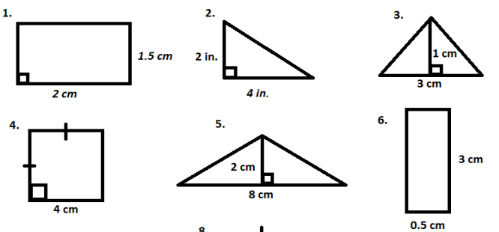
Mini whiteboards…
1.5cm²
4cm²
3cm²
1.5cm²
8cm²
16cm²

Slide 13
The area of a parallelogram
The area of any parallelogram can be found using the formula:
Area of a parallelogram = base × perpendicular height
perpendicular height
base
Or using letter symbols,
A = bh
Notes:
Ask pupils to learn this formula.

Slide 14
The area of a parallelogram
What is the area of this parallelogram?
We can ignore this length
4.9 cm
4.5 cm
7 cm
Area of a parallelogram = bh
= 7 × 4.5
= 31.5 cm²
Notes:
Tell pupils that to work out the area of the parallelogram they must start by writing the formula.
They can then substitute the correct values into the formula provided that they are in the same units.
Point out that the length of the diagonal can be ignored.
Stress that it is important to always write down the correct units at the end of the calculation.

Slide 15
The area of a parallelogram
Notes:
Modify the parallelogram to change its height and its width.
If required use the pen tool to show why the area of the parallelogram is equal to the area of a rectangle with the same base length and height.
The square grid can be turned off once the derivation of the formula has been established.
As an extension activity discuss how we could use Pythagoras’ Theorem to calculate the perimeter of the parallelogram. Investigate how the perimeter changes while the area remains constant.

Slide 16
The area of a trapezium
The area of any trapezium can be found using the formula:
1
Area of a trapezium = (sum of parallel sides) × height
2
a
perpendicular height
b
Or using letter symbols,
1
A = (a + b)h
2
Notes:
Explain that finding half the sum of the parallel sides is like finding the average length of these two sides.
Ask pupils to learn this formula.

Slide 17
The area of a trapezium
What is the area of this trapezium?
1
Area of a trapezium = (a + b)h
6 m
2
9 m
1
= (6 + 14) × 9
2
1
= × 20 × 9
2
14 m
= 90 m²
Notes:
Tell pupils that to work out the area of the trapezium they must start by writing the formula.
They can then substitute the correct values into the formula provided that they are in the same units.
Stress that it is important to always write down the correct units at the end of the calculation.

Slide 18
The area of a trapezium
What is the area of this trapezium?
1
Area of a trapezium = (a + b)h
2
1
= (9 + 4) × 12
9 m
2
4 m
1
= × 13 × 12
2
12 m
= 78 m²
Notes:
This example shows a right trapezium.

Slide 19
The area of a trapezium
Notes:
Modify the trapezium to change its height and the length of its parallel sides.
Use the pen tool to show how we could find the area of the trapezium by dissecting it into two triangles and a rectangle.
The square grid can be turned off once the derivation of the formula has been established.
As an extension activity discuss how we could use Pythagoras’ Theorem to calculate the perimeter of the trapezium.

Slide 20
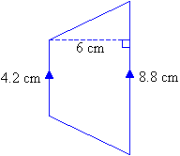
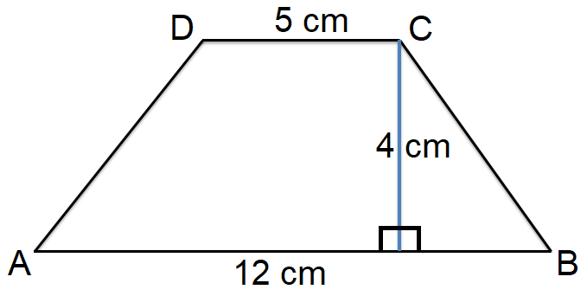
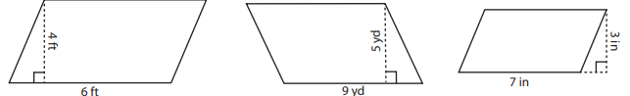
Mini whiteboards…
1
2
34cm²
39cm²
3
4
5
24ft²
45yd²
21in²

Slide 21
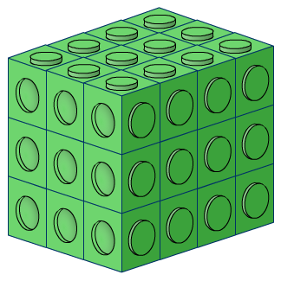
Volume of a cuboid
The following cuboid is made out of interlocking cubes.
How many cubes does it contain?

Slide 22
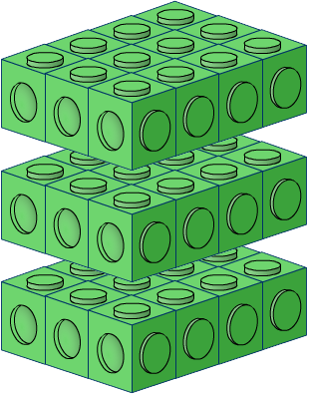
Volume of a cuboid
We can work this out by dividing the cuboid into layers.
The number of cubes in each layer can be found by multiplying the number of cubes along the length by the number of cubes along the width.
3 × 4 = 12 cubes in each layer
There are three layers altogether so the total number of cubes in the cuboid = 3 × 12 = 36 cubes

Slide 23
Volume of a cuboid
We can find the volume of a cuboid by multiplying the area of the base by the height.
The area of the base
= length × width
So,
height, h
Volume of a cuboid
= length × width × height
= lwh
length, l
width, w
Notes:
We can also think of the volume of a cuboid as a measure of the number of cm³ that will fit inside it.
Remind pupils that a cuboid is a special type of prism. Ask pupils if they can remember the formula for the volume of a prism and compare it to the formula on the board. This is covered in the next section of this presentation, but some pupils will remember it from earlier years.

Slide 24
Volume of a cube
How can we find the volume of a cube of length l?
The length, width and height of a cube are the same.
Therefore:
Volume of a cube
= (length of one edge)³
= l³
l

Slide 25
Volume of shapes made from cuboids
What is the volume of this 3-D shape?
3 cm
We can think of this shape as two cuboids joined together.
3 cm
4 cm
Volume of the green cuboid
= 6 × 3 × 3 = 54 cm³
6 cm
Volume of the blue cuboid
= 3 × 2 × 2 = 12 cm³
Total volume
5 cm
= 54 + 12 = 66 cm³
Notes:
This shape is an L-shaped prism, so we could also find the volume of this shape by multiplying the area of its cross-section by its length.

Slide 26
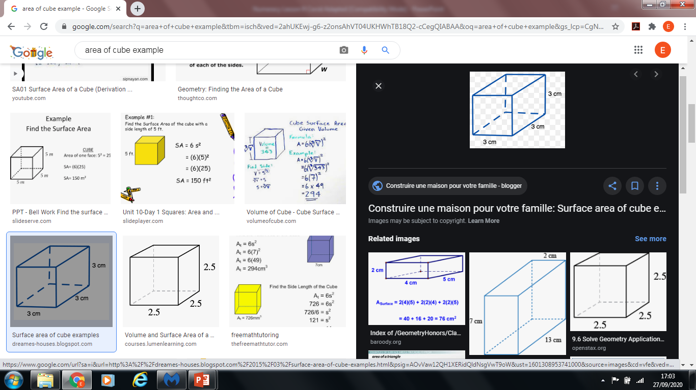
Mini whiteboards…
1
2
15.6cm³
27cm³
3
4
40cm³
182cm³

Slide 27

Volume of a cylinder
A cylinder is a special type of prism with a circular cross-section.
Remember, the volume of a prism can be found by multiplying the area of the cross-section by the height of the prism.
r
The volume of a cylinder is given by:
Volume = area of circular base × height
h
or
V = πr²h
Notes:
Recall that the area of a circle is equal to πr².

Slide 28
Surface area of a cylinder
To find the formula for the surface area of a cylinder we can draw its net.
How can we find the width of the curved face?
r
The width of the curved face is equal to the circumference of the circular base, 2πr.
?
h
2πr
Area of curved face = 2πrh
Area of 2 circular faces = 2 × πr²
Surface area of a cylinder = 2πrh + 2πr²
or
Surface area = 2πr(h + r)
Notes:
Discuss the factorization 2πrh + 2πr² = 2πr(h + r).
If pupils are familiar with dimensions, you could ask them to check that this formula is correct dimensionally.

Slide 29
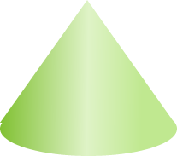
Volume of a cone
A cone is a special type of pyramid with a circular base.
Remember, the volume of a pyramid can be found by multiplying the area of the base by the height and dividing by 3.
The volume of a cone is given by:
1
Volume = × area of circular base × height
3
h
or
r
1
V = πr²h
3

Slide 30

Volume and surface area of a sphere
A sphere is a 3-D shape thats surface is always the same distance from the centre. This fixed distance is the radius of the sphere.
For a sphere of radius r:
4
Volume = πr³
r
3
and
Surface area = 4πr²
Notes:
A sphere can be described as the 3-D locus of the points that are a fixed distance from a point.
These formulae will usually be given in an examination and it is not necessary for pupils to learn or derive them.

Slide 31
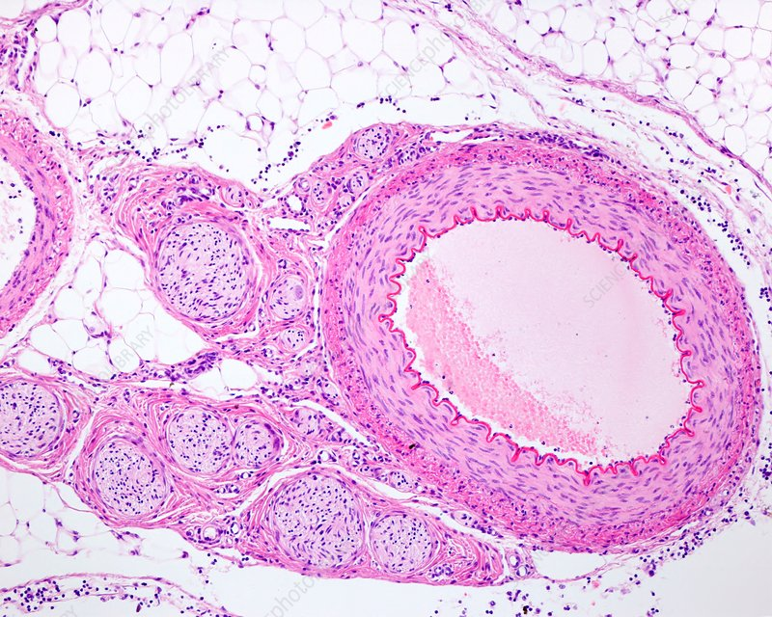
Mini whiteboards…
5mm
Calculate the surface area of the artery lumen
2) If the length of the artery is 80mm, what is it’s volume?

Slide 32
Answers
Calculate the surface area of the artery lumen
2πrh = 2 x π x 2.5 x 80mm = 1257mm²
2) If the length of the artery is 80mm, what is it’s volume?
πr²h = π x (2.5 x 2.5) x 80mm = 1571mm³

Slide 33
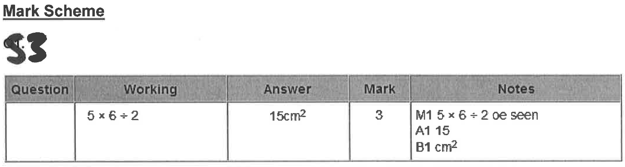
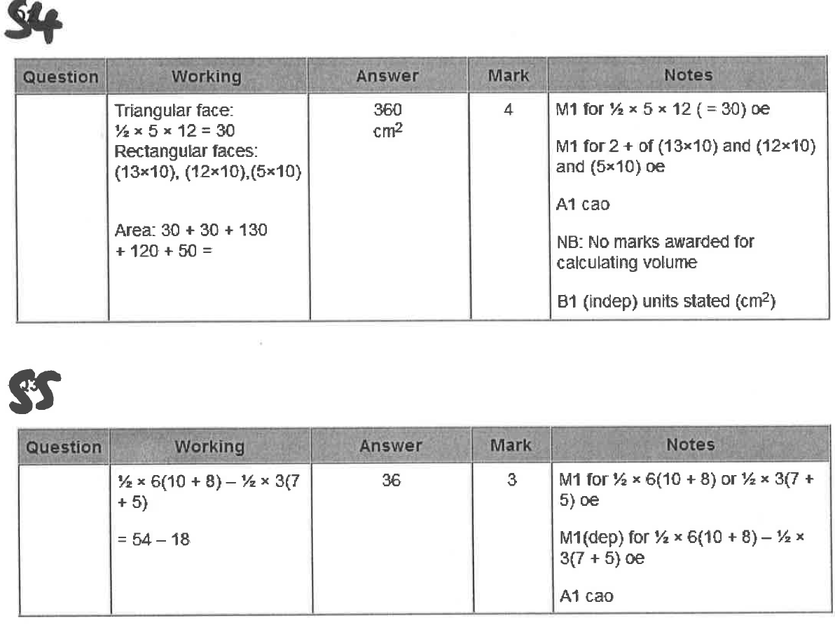
Numeracy booklet
Q53-55

Slide 34
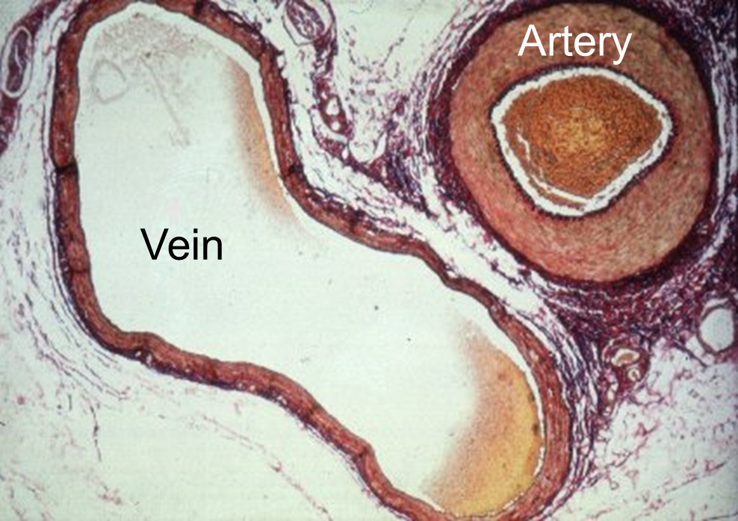
Exit ticket…
4mm
2mm
9mm
4mm
1) Calculate the lumen approximate surface area of:
-the vein
-the artery
2) If the length of the artery is 80mm, what is it’s volume?
8mm

Slide 35
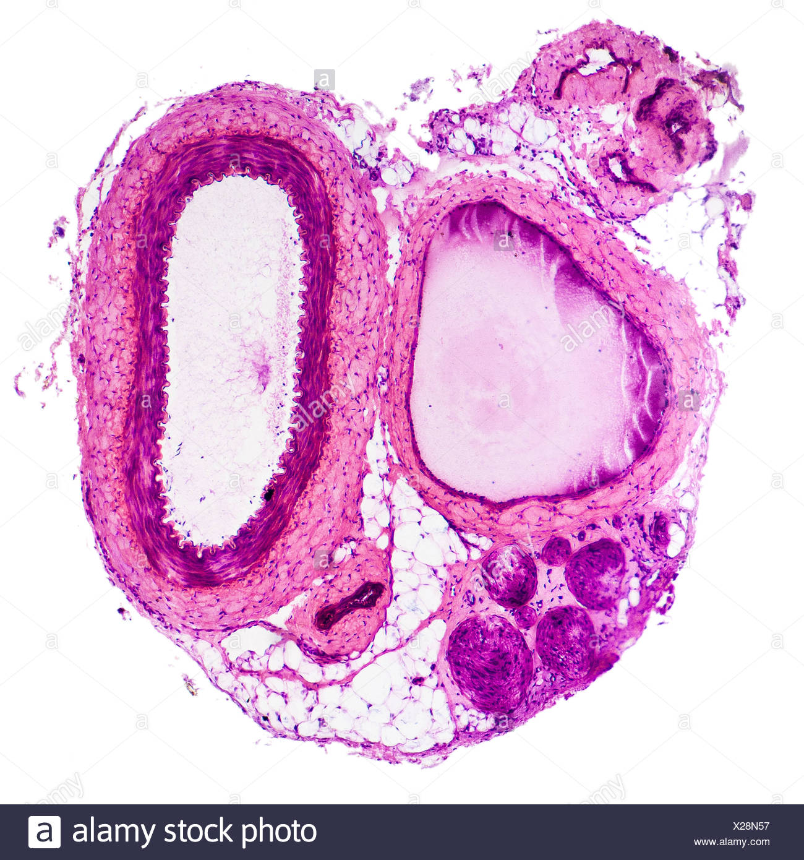
Additional micrographs

Slide 36
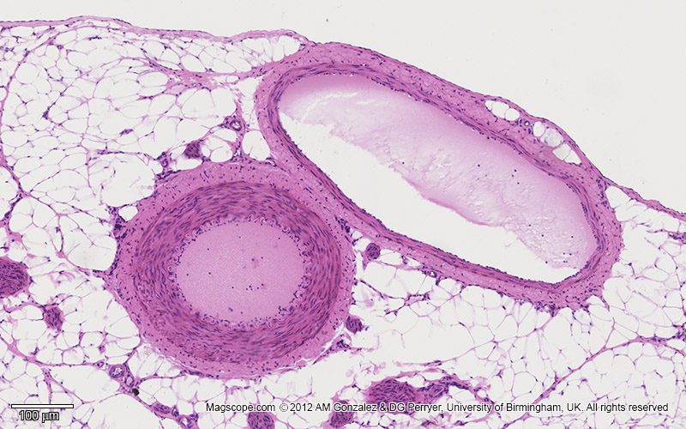
Additional micrographs

