Slide 1
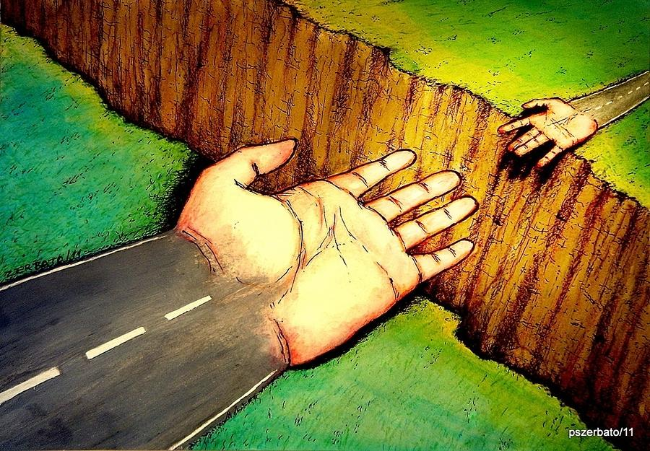
Philosophy & Ethics (Religious Studies)
Bridging Menu – Summer 2024
“Philosophy can’t build bridges, but can encourage people to cross them.”
Paulo Coelho
“No one can construct for you the bridge upon which precisely you must cross the stream of life, no one but you yourself alone.”
Friedrich Nietzsche

Slide 2






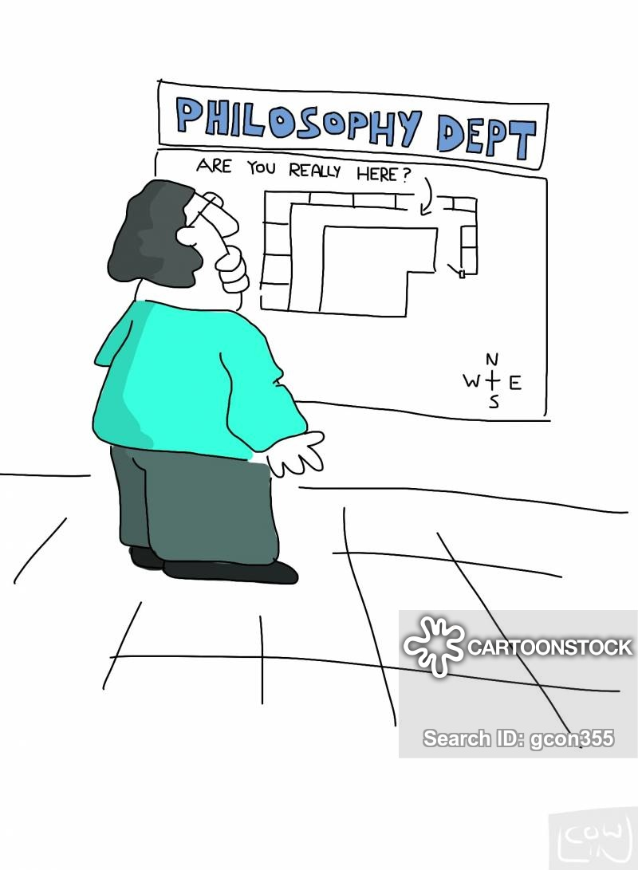


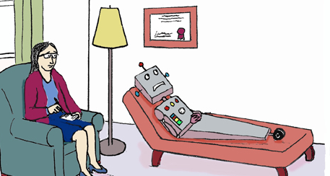
Philosophy & Ethics (Religious Studies) Bridging Menu (Green modules are core (compulsory) modules , indicates the most challenging modules )
 | Read | Watch | Listen | Do
 | “Practical Ethics” Peter Singer First published in 1979 and invaluable to generations of students, this book is an introduction to applied ethics by bioethical philosopher Peter Singer. (Low-cost paperback & download versions are available). The chapters on Embryo Experimentation and the Moral Status of Animals are particularly useful. (1) | Aquinas’ Cosmological Argument From the “Faith, Philosophy and Life” series, a study of Aquinas’ Cosmological Argument for the existence of God, and Hume and Kant's responses. (1) (The presenter is in a Church School, and begins with a prayer – which you are free to skip) | The Copleston/Russell debate. Listen to the audio of this famous BBC radio debate about the existence of God from 1948. Then fill in the task sheet. (2) | MOOCs: Search through the MOOCs on Unifrog using the subject filter for ‘Philosophy’ or ‘Religious Studies’. Choose an area of study or a specialism that particularly interests you. (3)
 | “Life Doesn't Begin at Conception” Philosophy lecturer Jean Kazez explores a range of views and questions linked to the debate about when life begins and when we really arrive on the scene. The article can be found on the Philosopher’s Magazine website. (1)
 |  |  |  | Choose a topic that interests you from the clips below 1) Science, Religion, and the Contest for Authority 2) Did Jesus Even Claim to be God Watch it and carry out further research on the topic. Collate your research and produce a final product to present your findings to others. (4) Include a range of scholarly viewpoints and a reasoned conclusion that answers the question in the title
 | “Do Animals Have Free Will?” In this article from the Philosopher’s Magazine, Professor Helen Steward argues that in thinking about free will, it is essential to consider the capacities of animals. What do you think? (1) | What is Philosophy? In this ‘Crash Course’ video, Hank Green attempts to answer this question by exploring the historical origins of philosophy in Ancient Greece. (1) | “In Our Time – Religion” A series of BBC Radio 4 podcasts on iplayer and BBC Sounds exploring aspects of religion & philosophy. Select a topic from those available. (1)
 | “Atheist In A Foxhole” Professor David Rönnegard asks how a committed atheist confronted with death might find consolation. (1)
 | “British public turn to prayer as one in four tune in to religious services.” This short article from The Guardian reflects on the spiritual impact of the 2020 Coronavirus outbreak.(1) | TED Talks (1) Science vs God Metaethics Crash Course Anselm and the Argument for God | Arguments for the Existence of God - This Oxford University podcast examines William Paley’s Design Argument. (1)
“Now I have got consciousness, I feel very self-conscious.”

Slide 3

Philosophy & Ethics (Religious Studies) Bridging Menu
You are about to start a fascinating journey into the world of Philosophy, Ethics & Religious Studies, good luck!
Choose what modules you do and when you do them, but work through them consistently. Different tasks will take you varying amounts of time. You should aim to do one or two per week
All green tasks are core modules, they are compulsory.
The chilli indicates that the task may be more challenging than the others.
All completed work should be handed into your teacher in your first lesson in September.
The numbers on the menu e.g. (1) give guidance on how to approach and evidence your work (see slides 4-7). Work can be typed or handwritten and should be stored in a document wallet, clear plastic sleeve or similar.

Slide 4
(1) - Book/Journal/Podcast/Video Review
Would you/would you not recommend it? Why?
Rating:
Review by: ___________________________________________
Title: _______________________________________________________
Author: ____________________________________________________
Review of (please circle)
Book Journal Podcast Video Other
What was it about?
What did you find particularly interesting/inspiring/shocking? Has this changed your opinion?
What would you like to learn more about?
How does it link to this subject and why is it important?

Slide 5
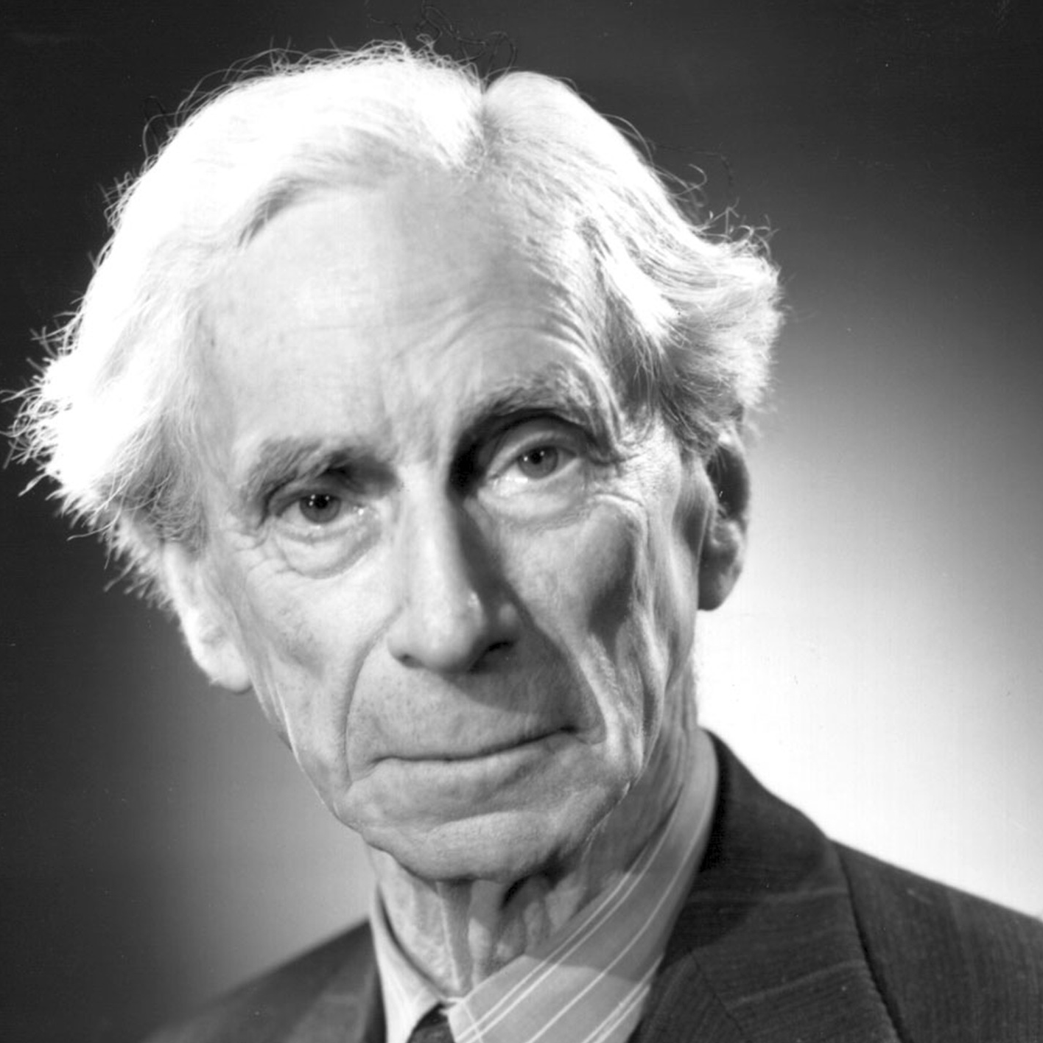
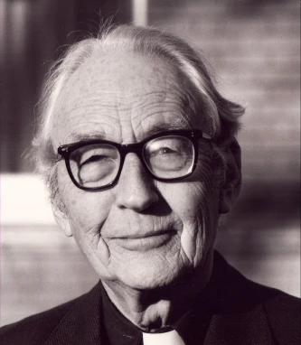
(2) The Russell/Copleston Debate
Listen carefully to the famous debate, broadcast by the BBC in 1948. Fill in the boxes below:
Write an introductory paragraph about the 2 philosophers in this debate?
What are the key points of Copleston’s argument?
How does Russell respond to this?
Who do you think “wins” this discussion. Give reasons to explain why. (Continue on the back if you need to)

Slide 6
(3) MOOCs
To evidence this you can:
Save and print out any notes you take
Take and save a screenshot of any completed modules, certificates and any other evidence that you have of a completed course

Slide 7

(4) Webinar/Research Task
Watch the webinar you have chosen. If watching live try to participate actively & ask questions
Carry out further independent research on your chosen topic – including a range of scholarly opinion & schools of thought.
Come to a reasoned conclusion – where possible try to critically answer the question in the webinar title e.g Does the Ontological argument work? (12th July 2022)
Collate your research and findings into a presentation that could take one of the following forms:
Podcast
Powerpoint Presentation
Mini film
Report
Newspaper article

