Slide 1
#Choosegeography
Demonstrating the value of Geography
"Geography — where you are born — is the single biggest driver of your lot in life".
Bill Gates 2019

Slide 2
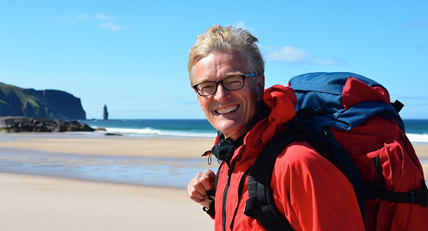
Why study geography?
“Geography helps us understand the world.
It gives us the science, the data, the insights to plan for the future.
(and) it’s an incredibly exciting subject.”
Nick Crane
Past President RGS-IBG, Presenter BBC Coasts

Slide 3
What is geography?
People
Places
Environments
Geography

Slide 4
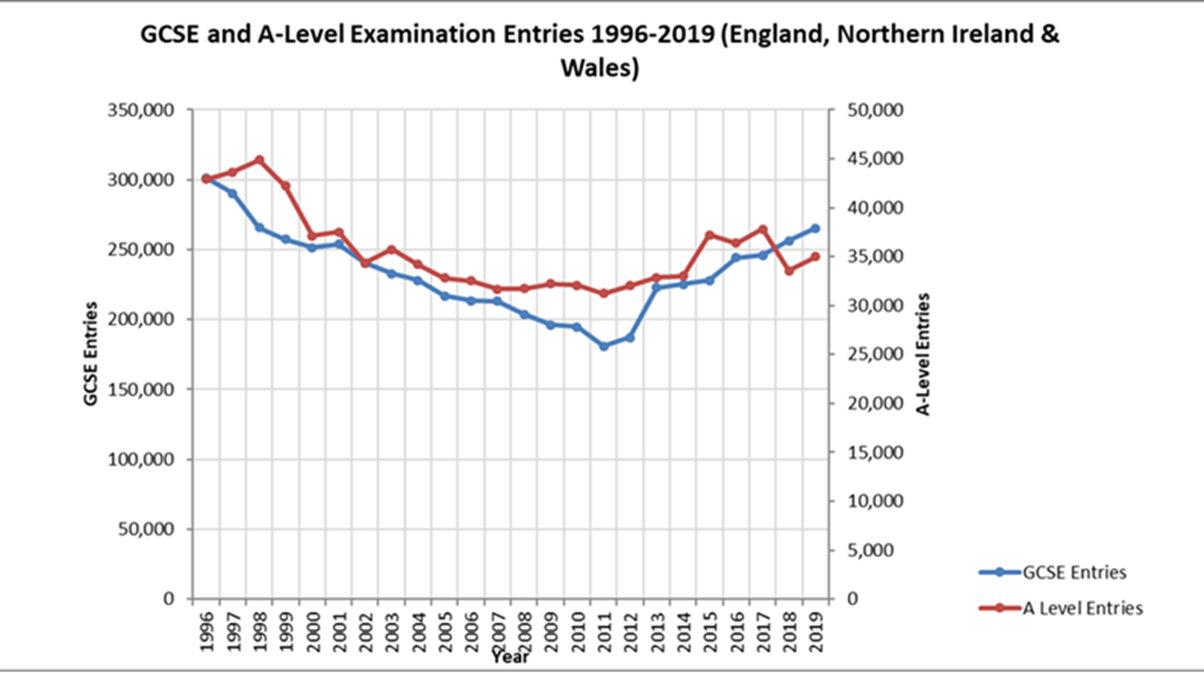
Geography at GCSE and A Level (England, Northern Ireland and Wales)

Slide 5
Trends: GCSE and A-level 2019
GCSE
265,000 students
Geography the 6th most popular subject at GCSE level
50% more entries than 2011
A Level
35,000 students in England, Wales and Northern Ireland sat an A Level
An increase on 2018
Across GCSE and A Level geography has an almost equal male/female balance in terms of numbers and the broad pattern of achievement

Slide 6
Supporting wider options
At GCSE geography is an academic GCSE which forms part of the EBacc humanities options
At A Level Geography has been identified as a ‘facilitating subject’. These are preferred subjects that the Russell Group of Universities have identified as opening up a wide range of options for university study.

Slide 7
The positive impact of studying geography:
Institute for Fiscal Studies
Study: Geog. students are more likely to complete their degree, have the 3rd lowest drop out rate of all subjects & have some of the highest National Student Satisfaction scores.
Employment: Five years after graduation, geography graduates have an above average likelihood of gaining employment. Geographer employment rates outperform other disciplines, including politics, physics and history.
Earnings: Geography graduate earnings outperform other subjects, including technology, biosciences and history. Men 2% more, women 10% more than average graduate salaries

Slide 8
Choose geography to understand climate change
YouGov poll commissioned by the RGS consulted 2029 adults in September 2019
Which GCSE subject helps teach about climate change?
Geography ranked first 74% - of all subjects by men and women, all age ranges, social classes and regions - 30% higher than second placed subject (Biology 44%)

Slide 9
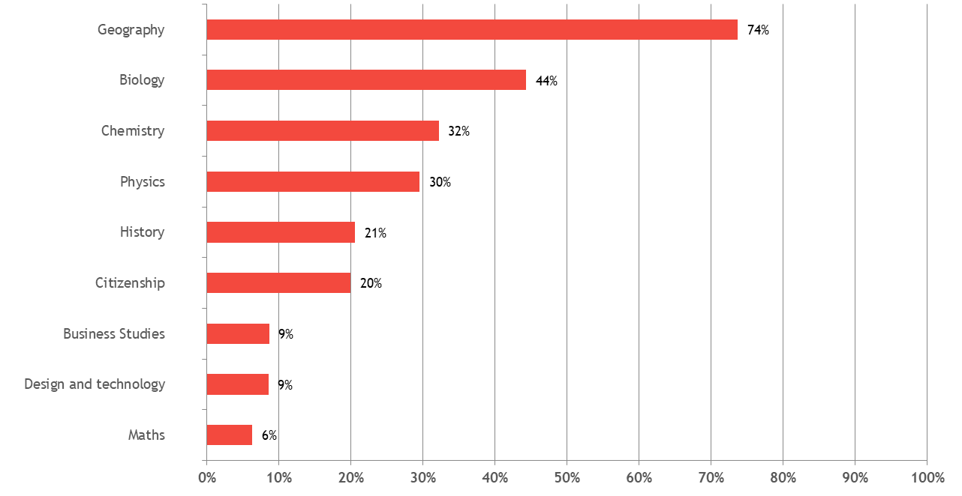
Which GCSE subject helps teach about climate change?
YouGov September 2019

Slide 10
Geography a data rich subject
Higher Education Research Council has recognised HE geography as part-STEM: as a result of its use of fieldwork, lab and data
The contribution of geography was the only non-maths subject referenced in Sir Adrian Smith’s review of post 16 maths
Geography is a data rich and gender balanced subject. Geography 48:52% M:F (maths ~60-40%, physics ~70-30%, computing ~90-10%).

Slide 11
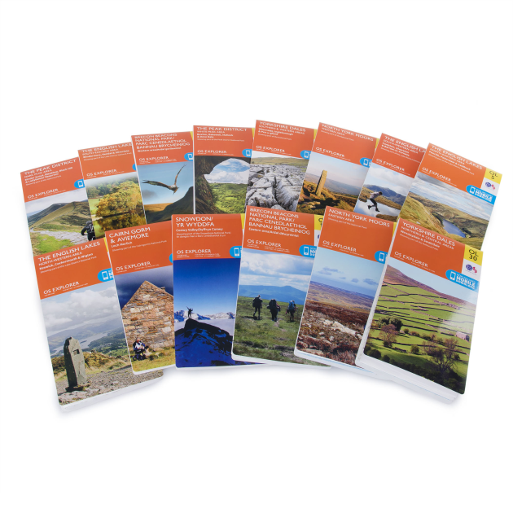

Why (geographical) data matters
OS makes 10,000 daily changes to Britain’s base map
Online maps are the 3rd most popular app to download
Geo-spatial commission. The UK can gain £11Billion from better use of geo-spatial data
Esri is a $1Billion global company

Slide 12

A selection of businesses, public sector and not-for-profit GIS users

Slide 13
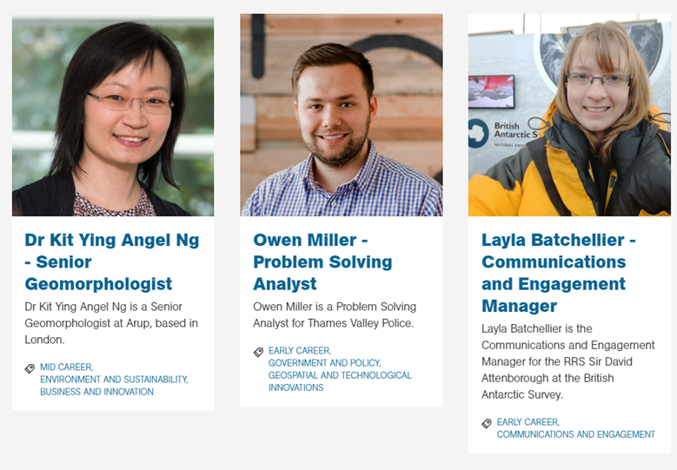
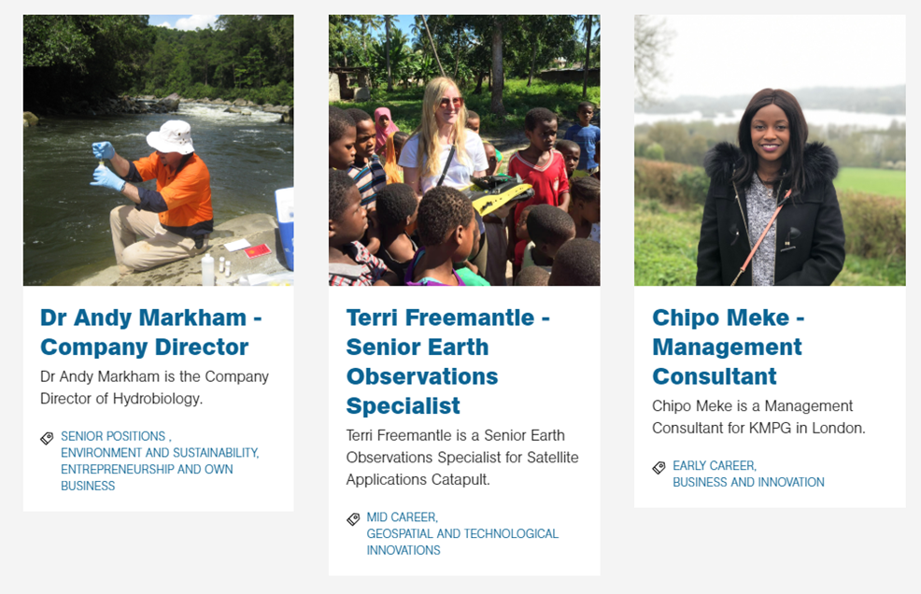
Iwww.rgs.org/Iamageographer

Slide 14

The case for geography
Geography illuminates the past, explains the present and prepares us for the future.
What could be more important than that?
Sir Michael Palin,
Past-President RGS-IBG
www.rgs.org

Slide 15
Useful resources:
Downloadable Going Places with Geography careers poster and booklet
https://www.rgs.org/schools/teaching-resources/going-places-with-geography-brochure/
Sir Michael Palin and Nick Cranes ‘Option Time’ letters
https://www.rgs.org/schools/teaching-resources/michael-palin%E2%80%99s-letter-promoting-gcse-and-a-level/
https://www.rgs.org/schools/teaching-resources/nick-crane-s-letter-promoting-further-stud y-and-ca/
Directory of undergraduate courses in the UK
https://www.rgs.org/geography/studying-geography-and-careers/geography-at-university/
Info on studying geography at GCSE, A Level and in HE
www.rgs.org/studygeography
For careers profiles of geographers in the professions
https://www.rgs.org/geography/studying-geography-and-careers/geography-professionals/
To book a Geography Ambassador presentation
www.rgs.org/geographyambassadors

