Slide 1
Probability and Algebra
Do Now:
On your whiteboards, write down the probability of the following events.
A coin being flipped and landing on heads.
A di being rolled and landing on an odd number.
A di being rolled and landing on a multiple of three.
A spade being drawn from a pack of cards.
A 6 being drawn from a pack of cards.
½
3/6 = ½
2/6 = 1/3
13/52 = ¼
4/52 = 1/13
Notes:
0-10 mins

Slide 2
Probability and Algebra
Learning Objectives
Be able to work out the probability of an event occurring.
Be able to work out the probability of an event not occurring.
Be able to rearrange algebraic equations.
Notes:
0-10 mins

Slide 3


The probability scale
We measure probability on a scale from 0 to 1.
If an event is impossible or has no chance of occurring, then it has a probability of 0.
If an event is certain it has a probability of 1.
This can be shown on the probability scale as:
0
1
1
2
impossible
even chance
certain
Probabilities are written as fractions, decimals and, less often, as percentages.
Notes:
Slides 2-6 – 10-20 mins

Slide 4
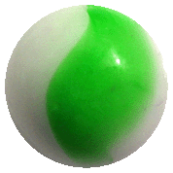
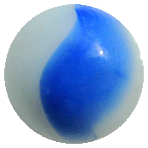
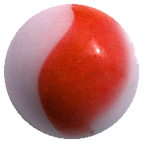
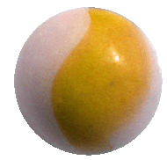
Calculating probability
If the outcomes of an event are equally likely then we can calculate the probability using the formula:
Probability of an event
Number of possible successful outcomes
=
Total number of possible outcomes
For example, a bag contains 1 yellow, 3 green, 4 blue and 2 red marbles.
What is the probability of pulling a green marble from the bag without looking?
3
P(green) =
or 0.3
or 30%
10
Notes:
Use mini whiteboards for these slides. Point out that calculated probabilities are usually given as fractions but that they can also be given as decimals and (less often) as percentages.
Ask pupils to give you the probabilities (as decimals, fractions and percentages) of getting
A blue marble
A red marble
A yellow marble
A purple marble
A blue or a green marble etc.

Slide 5
Calculating probability
This spinner has 8 equal divisions:
What is the probability of the spinner
landing on a blue sector?
landing on a red or green sector?
not landing on a green sector?
1
a) P(blue) =
8
6
3
b) P(red or green) =
=
8
4
4
1
c) P(not green) =
=
8
2
Notes:
You may need to explain the meaning of the P(x) notation.

Slide 6

Calculating probabilities
The probability of a spinner landing on yellow is 0.2.
What is the probability of not landing on yellow?
1 – 0.2 = 0.8
If the probability of an event occurring is p then the probability of it not occurring is 1 – p.
A spinner has green, red and blue sections. Landing on red is twice as likely as landing on green. Fill in the missing probabilities:
Green
Red
Blue
0.26
0.52
0.22

Slide 7
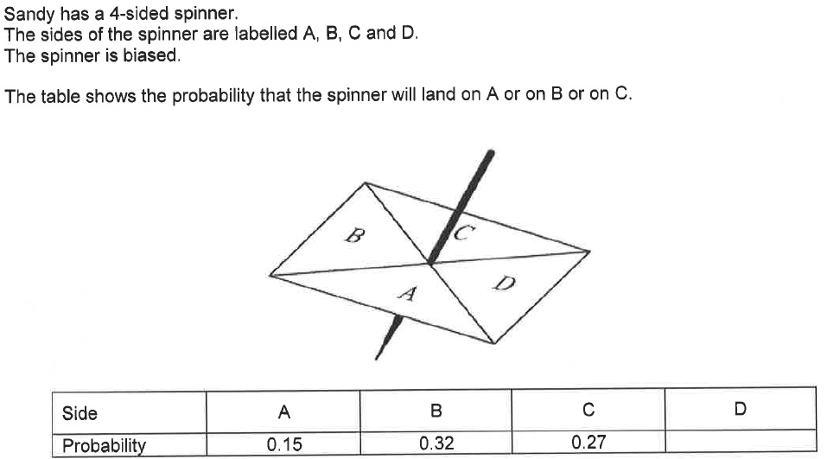
Work out the probability that the spinner will land on D. (2 marks)
Sandy spins the spinner 300 times. Work out an estimate for the number of times it will land on A. (2 marks)
Notes:
20-30 mins – exam q

Slide 8
Work out the probability that the spinner will land on D. (2 marks)
Sandy spins the spinner 300 times. Work out an estimate for the number of times it will land on A. (2 marks)
P = 1 – (0.15 + 0.32 + 0.27)
P = 1 – 0.74
P = 0.26
300 x 0.15
= 45

Slide 9
Probability and Algebra
Homework:
Complete questions 45-52 in the numeracy booklet.
Due: 29.9.20
Notes:
30-35 mins – quick reminder of algebra

Slide 10
Probability and Algebra
To do:
A = 20. B = 5. C = 4. Write down the value for D in each of the below.
D = ABC
D = (A+B)/C
D = (CA)/B
D = B(A+C)
1. D = 20 x 5 x 4
D = 400
2. D = (20+5) / 4
D = 25/4
D = 6.25
3. D = (4 x 20) / 5
D = 80 / 5
D = 16
4. D = 5 (20 + 4)
D = 5 x 24
D = 120
Notes:
30-35 mins – quick reminder of algebra

Slide 11
Probability and Algebra
To do:
For each equation, make C the subject.
D = ABC
D = (A+B)/C
D = (CA)/B
D = B(A+C)
C = D / (AB)
C = (A+B) / D
C = (DB) / A
C = (D/B) - A
Notes:
35-45 mins – practice rearranging. Talk through step by step with class.

Slide 12

Probability and Algebra
Complete the questions.
1. (3 marks)
2. (3 marks)
3. (3 marks)
Notes:
45-55 – practice questions

Slide 13
Probability and Algebra
9y-6y = 13-1
3y =12
y=4
x-2 = 7
x = 9
8x + 4y = 11 + 7y
8x = 11 + 3y
x = (11+3y) / 8
Notes:
45-55 – practice questions

Slide 14
Probability and Algebra
Exit Ticket
A tree grows over a pond. In autumn, the leaves fall over an area of 50m². 18m² of that is covered by the pond.
What percentage of the area that leaves fall is covered by pond?
What is the probability that a leaf will fall into the pond?
What is the probability that a leaf will fall into the pond in May?
36%
36 / 100 = 0.36 or 9/25
Based on this information, zero.
Notes:
55-60 - plenary

