Slide 1
Protein Review 15 March, 2022
Do Now
Name the part of an amino acid that is variable.
Name the reaction that causes a peptide bond to form between two amino acids.
Name the additional bond that causes the shapes of the alpha helix and beta pleated in the secondary structure.
Name one bond that is in the tertiary structure but not in the secondary structure.
How do enzymes lower the activation energy in anabolic reactions?
Describe the induced fit theory
How does substrate concentration affect the rate of reaction?

Slide 2
Answers
The R group.
Condensation reaction.
Hydrogen bonds.
Covalent bonds, disulphide bridges, ionic bonds or hydrophobic/hydrophilic interactions.
The enzyme holds the 2 substrate molecules close together, reducing any repulsion between the molecules so they bond more easily
This explains why enzymes are so specific and only bond to one particular substrate. Complementary substrate enters active site and causes active site to change shape so it fits more closely around substrate
The more substrate molecules there are in a solution, higher the frequency of collisions between substrates and enzymes so more active sites are used up. This increases the rate of reaction up to a point

Slide 3

Thumbs Up/Down. How much do you think you know about:
2.9 i) Know the basic structure of an amino acid (structures of specific amino acids are not required).
ii) Understand the formation of polypeptides and proteins (amino acid monomers linked by peptide bonds in condensation reactions).
iii) Understand the significance of a protein’s primary structure in determining its three-dimensional structure and properties (globular and fibrous proteins and the types of bonds involved in its three-dimensional structure).
iv) Know the molecular structure of a globular protein and a fibrous protein and understand how their structures relate to their functions (including haemoglobin and collagen).
2.10 i) Understand the mechanism of action and the specificity of enzymes in terms of their three-dimensional structure.
ii) Understand that enzymes are biological catalysts that reduce activation energy.
iii) Know that there are intracellular enzymes catalysing reactions inside cells and extracellular enzymes produced by cells catalysing reactions outside of cells.
CORE PRACTICAL 4:
Investigate the effect of enzyme and substrate concentrations on the initial rates of reactions.

Slide 4
Focus Area 1 from Do Now:
2.9
i) Know the basic structure of an amino acid (structures of specific amino acids are not required).
ii) Understand the formation of polypeptides and proteins (amino acid monomers linked by peptide bonds in condensation reactions).
iii) Understand the significance of a protein’s primary structure in determining its three-dimensional structure and properties (globular and fibrous proteins and the types of bonds involved in its three-dimensional structure).
iv) Know the molecular structure of a globular protein and a fibrous protein and understand how their structures relate to their functions (including haemoglobin and collagen).

Slide 5
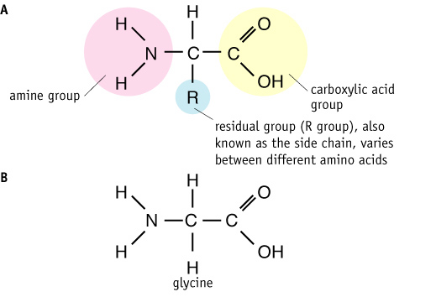
Protein Structure
Proteins are polymers of amino acids.

Slide 6
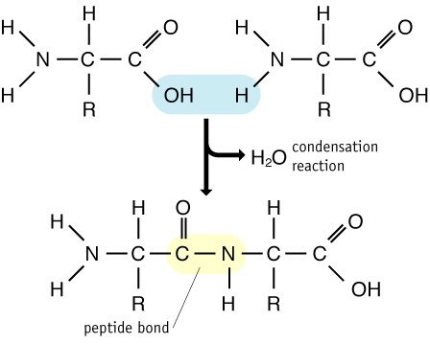
How amino acids are linked together
Amino acids are linked together by condensation reactions

Slide 7
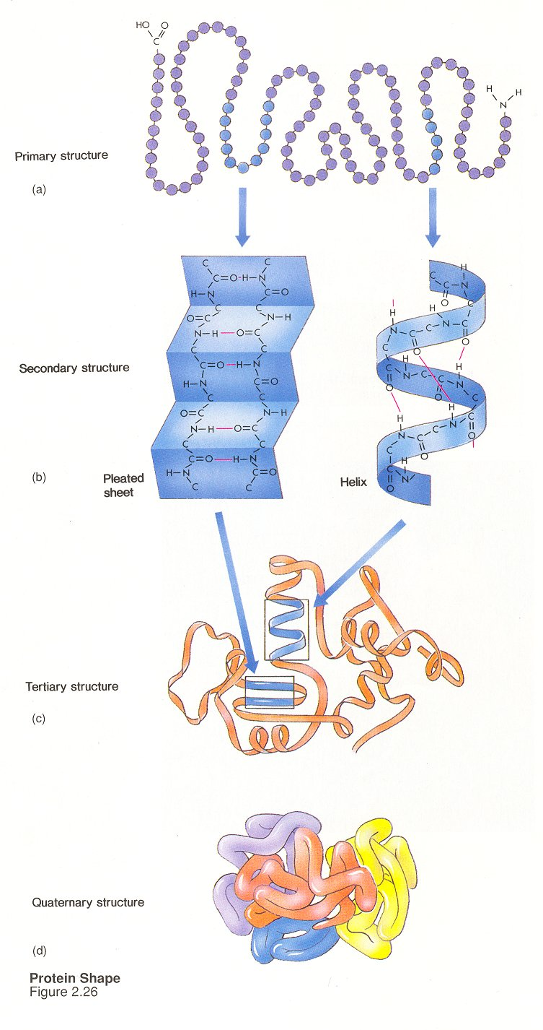
The primary structure of a protein is the number, type and sequence of amino acids held together by peptide bonds.

Slide 8
The secondary structure of a protein is brought about by the formation of hydrogen bonds between the CO and NH groups of the amino acids in the polypeptide chain. This leads to the coiling or folding of the polypeptide chain producing α helices and β-pleated sheets.

Slide 9
A tertiary structure creates a 3D shape due to the chemical bonds such as hydrogen, covalent and ionic bonds and hydrophobic interactions between the R groups of the amino acids in the polypeptide.

Slide 10
A protein that has a quaternary structure is composed of at least two polypeptide chains held together by hydrogen, covalent and ionic bonds.

Slide 11
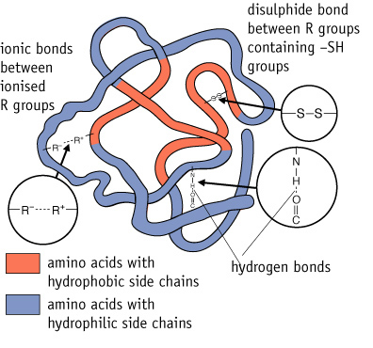

Slide 12
Primary, Secondary, Tertiary or Quaternary?
Has hydrogen bonds only
Secondary
Mini Whiteboards

Slide 13
Primary, Secondary, Tertiary or Quaternary?
Sequence of amino acids in a polypeptide
Primary

Slide 14
Primary, Secondary, Tertiary or Quaternary?
Alpha helix
Secondary

Slide 15
Primary, Secondary, Tertiary or Quaternary?
May involve two poylpeptides
Quaternary

Slide 16
Primary, Secondary, Tertiary or Quaternary?
Ionic bonds
Tertiary

Slide 17
Primary, Secondary, Tertiary or Quaternary?
Beta pleated
Secondary

Slide 18
Primary, Secondary, Tertiary or Quaternary?
Hydrophobic and Hydrophillic interactions of R groups are involved
Tertiary

Slide 19
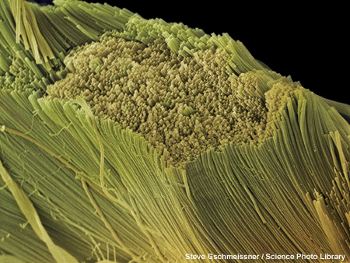
Fibrous Proteins
Fibrous proteins are formed from parallel polypeptide chains held together by cross-links. These form long, rope-like fibres, with high tensile strength and are generally insoluble in water.
collagen – the main component of connective tissue such as ligaments, tendons, cartilage.
keratin – the main component of hard structures such as hair, nails, claws and hooves.
silk – forms spiders’ webs and silkworms’ cocoons.
Notes:
Photo credit: Steve Gschmeissner / Science Photo Library
Scanning electron micrograph (SEM) of collagen bundles from the delicate connective tissue endoneurium. Endoneurium wraps around and between individual nerve fibres (axons), providing support and filling space between the nerve fibres. Endoneurium consists of collagen and elastin fibres and is found throughout the peripheral nervous system. Magnification not known.
Teacher notes
Collagen is the most abundant protein in the body, comprising about 25% of all protein.

Slide 20
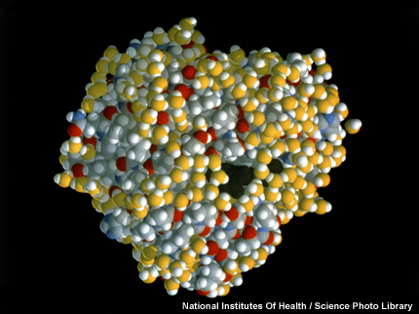
Globular Proteins
Globular proteins usually have a spherical shape caused by tightly folded polypeptide chains.
The chains are usually folded so that hydrophobic groups are on the inside, while the hydrophilic groups are on the outside. This makes many globular proteins soluble in water.
transport proteins – such as haemoglobin, myoglobin and those embedded in membranes.
enzymes – such as lipase and DNA polymerase.
hormones – such as oestrogen and insulin.
Notes:
Photo credit: National Institutes Of Health / Science Photo Library
Molecular graphic of the oxygen-carrying protein myoglobin. Myoglobin consists of a chain of amino acids folded into a globin molecule, which is similar to the four globin subunits in haemoglobin. Coloured spheres here represent atoms in the chain. The dark region in the centre is the haem group, which contains a single iron atom to which a molecule of oxygen can form a temporary bond. Myoglobin is found in muscle tissue, where it stores additional oxygen for use during strenuous exercise.

Slide 21
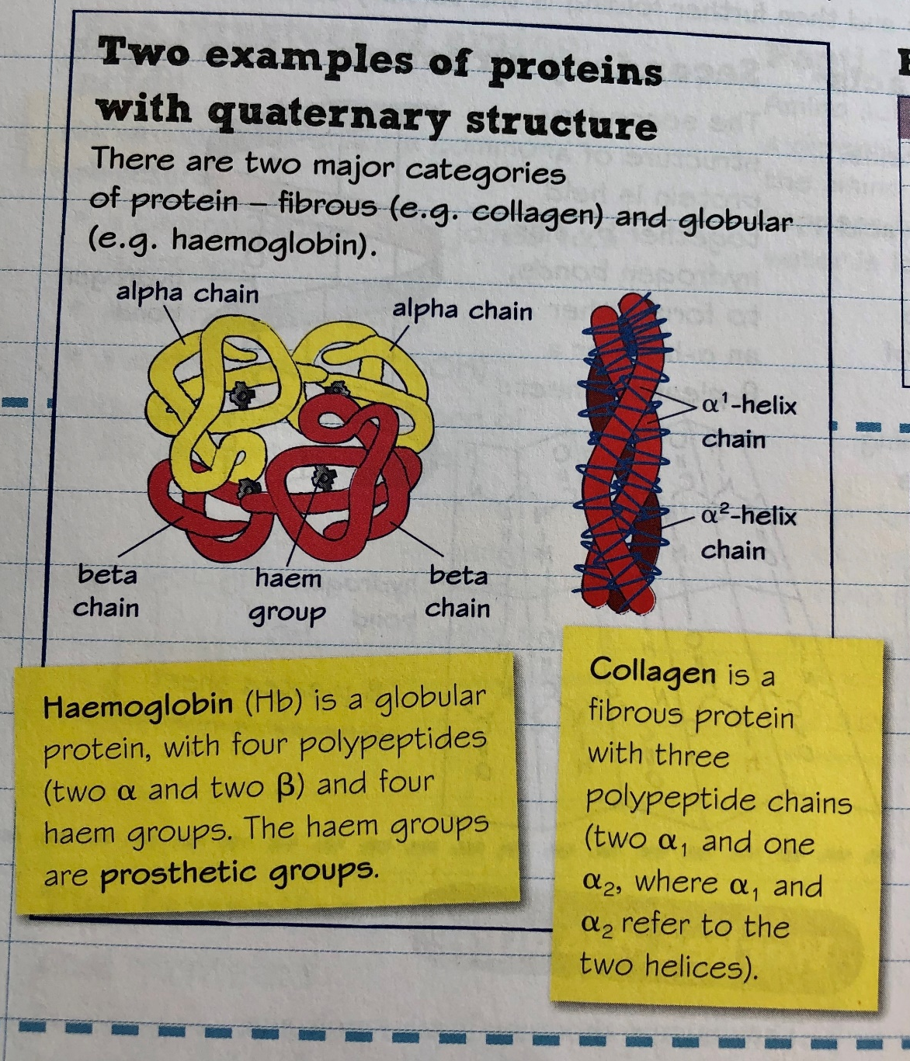

Slide 22
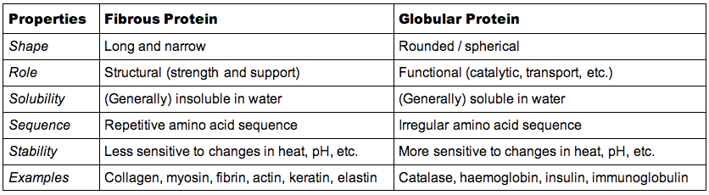
Partner Talk: discuss the properties of fibrous vs globular proteins
How: pairs
How long: 1 minute

Slide 23
Fibrous or Globular?
Fibrous
Structural role
Spherical
Soluble
Repetitive amino acids
Long and narrow
Functional, metabolic role
More sensitive to heat and unstable
Collagen
Insulin
Globular
Globular
Fibrous
Fibrous
Globular
Globular
Fibrous
Globular

Slide 24

Task: compare and contrast the structure and functions of globular and fibrous proteins.
The things that you should consider:
Their shape
Hydrophobic and Hydrophilic interactions
Their role
Their solubility

Slide 25
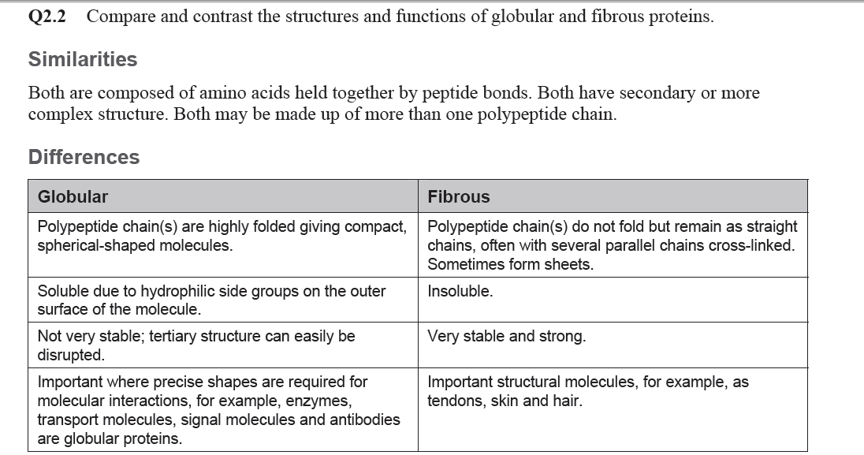
Answers

Slide 26
Focus Area 2 from Do Now:
2.10
i) Understand the mechanism of action and the specificity of enzymes in terms of their three-dimensional structure.
ii) Understand that enzymes are biological catalysts that reduce activation energy.
iii) Know that there are intracellular enzymes catalysing reactions inside cells and extracellular enzymes produced by cells catalysing reactions outside of cells.

Slide 27
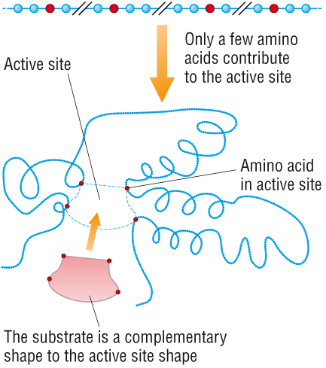

Slide 28
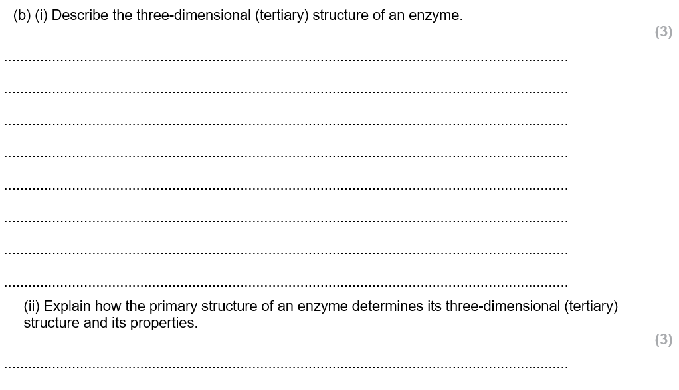
Exam practice

Slide 29
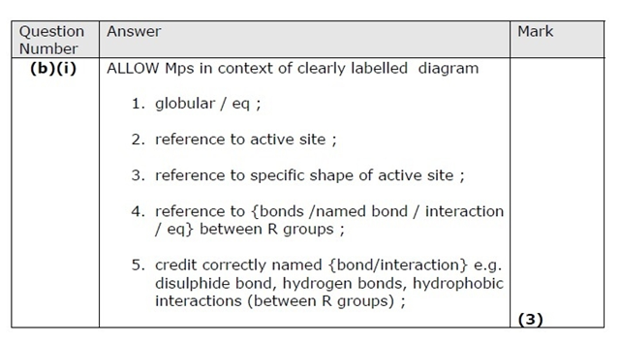
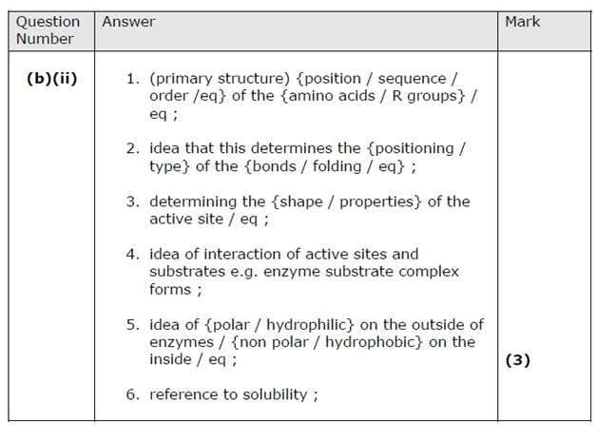

Slide 30
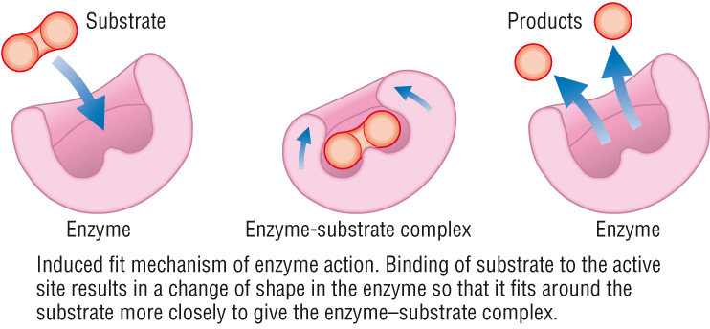
The ‘induced fit’ hypothesis model

Slide 31
The ‘induced fit’ hypothesis
Once the products have been formed, they leave the active site of the enzyme, which is left free to combine with another substrate molecule.
Enzymes are not used up in the reaction they catalyse so they can be used over and over again. The overall reaction between enzyme and substrate can be represented in the following equation:
Enzyme
Enzyme
Enzyme-Substrate complex
Substrate
Products

Slide 32

Enzymes
Enzyme
Enzyme
Enzyme-Substrate complex
Substrate
Products

Slide 33
Assessment for learning
Name the theory that explains how enzymes work fit together perfectly
Active site
Complementary
Lock and Key
Enzyme Substrate

Slide 34
Assessment for learning
2. Which one of the following conditions is least likely to denature an enzyme?
a high temperature
an extreme pH
heavy metal ions
a low temperature

Slide 35
Assessment for learning
3. Which of these best describes how the substrate fits with the enzyme.
it fits exactly into the active site
the "induced fit" hypothesis
the active site changes shape slightly to fit the substrate
the "lock and key" hypothesis

Slide 36
Assessment for learning
4. Enzymes are known as…
biological rabbitalysts
biological catalysts
biological hamsteralysts
Biological dogalysts

Slide 37
Assessment for learning
5. An enzyme will bind to a substrate to form ….
Reactants
Products
Substrate-enzyme complex
Enzyme-substrate complex

Slide 38
Assessment for learning
6. If an enzyme is denatured, the active site on the enzyme changes shape so that…
The products cannot bind.
The products can bind better.
The substrate cannot bind.
The substrate can bind better.

Slide 39
Assessment for learning
7. What effect does increasing temperature have on the rate of enzyme activity..
decrease to the optimum then increase
decrease indefinitely
increase indefinitely
increase to the optimum then decrease

Slide 40
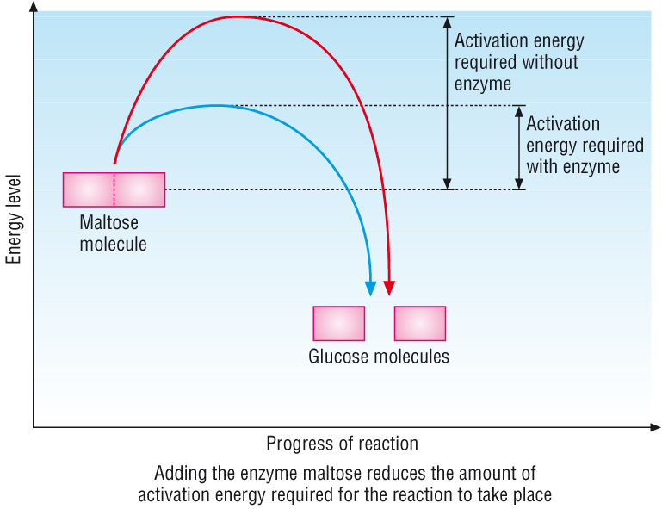
Reducing the activation energy

Slide 41
Exam practice
Describe the ‘lock and key’ model of enzyme action and explain how the ‘induced fit’ model is different (7 marks).

Slide 42
Review
The enzyme and the substrate have to fit together at the active site of the enzyme in the lock and key model (1 mark).
An enzyme substrate complex is formed (1 mark).
The active site then causes changes in the substrate (1 mark).
The change results in the substrate being broken down or joined together (1 mark).
The induced fit model has a similar mechanism as the lock and key model (1 mark).
The difference is that the substrate is thought to cause a change in the enzymes active site shape (1 mark), which enables a better fit (1 mark).

Slide 43
Focus Area 3 from Do Now:
CORE PRACTICAL 4:
Investigate the effect of enzyme and substrate concentrations on the initial rates of reactions.

Slide 44
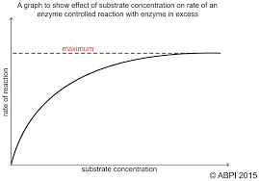
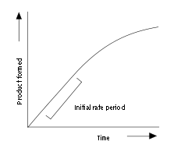
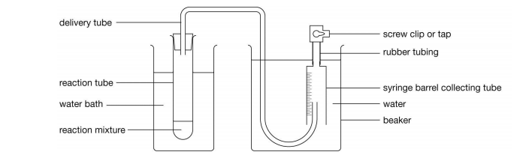
Task Whilst watching the video note the key variables (including examples of ranges) and equipment needed
https://www.youtube.com/watch?v=rABpkD42Ap4

Slide 45
Think Ink Pair Share For the core practical 4 note the:
independent variable (including its range and equipment required)
dependent variables (including how this is measured)
controlled variables (including how they are controlled)
how the investigations could be made repeatable

Slide 46
Answers
Independent variable = mass of potato using top pan balance e.g. 0.5g, 1.0g, 1.5g, 2.0g, 2.5g or concentration of the hydrogen peroxide e.g. 0m, 0.5m, 1m, 1.5m, 2m.
Dependent variable = the volume of oxygen produce over a time period, collected in a syringe or upside down measuring cylinder. This was then plotted onto a graph of time and volume of oxygen and a tangent was drawn to the curve at the steepest part within the first 60 seconds. This was used to calculate the initial rate (volume/time) and then plotted on a second graph with mass/concentration vs initial rate of reaction.
Controlled variables = mass of the potato/concentration of hydrogen peroxide, type and age of potato, temperature using waterbath, pH with pH buffer.
Repeatable = doing the experiment 3 times to calculate a repeatable average and check for outliers.

Slide 47
Exam Skill Focus:
Complete the exam questions in the booklet provided by your teacher.
The teacher will project some of the questions on the visualiser to help you to answer them.
Then mark using the mark scheme and model answers add in improvements in green pen.
Teacher note: At least 25 minutes of the lesson should be spent doing this

Slide 48
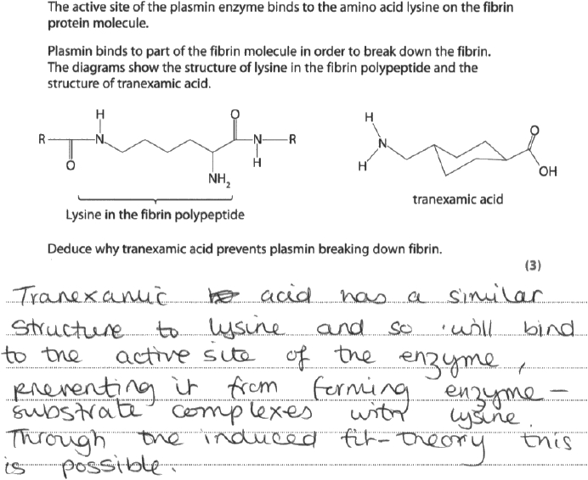
Model Answers
3

Slide 49
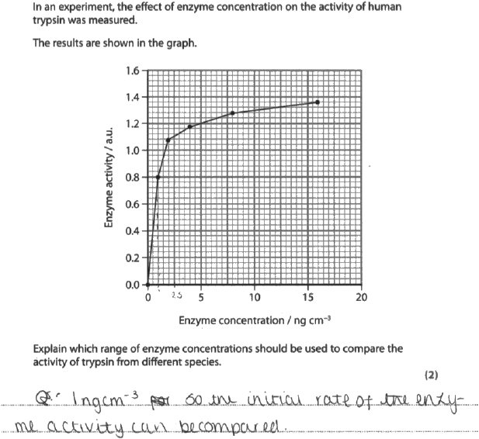
6

Slide 50
Exit Ticket
Traffic light your PLC for:
2.9 i) Know the basic structure of an amino acid (structures of specific amino acids are not required).
ii) Understand the formation of polypeptides and proteins (amino acid monomers linked by peptide bonds in condensation reactions).
iii) Understand the significance of a protein’s primary structure in determining its three-dimensional structure and properties (globular and fibrous proteins and the types of bonds involved in its three-dimensional structure).
iv) Know the molecular structure of a globular protein and a fibrous protein and understand how their structures relate to their functions (including haemoglobin and collagen).
2.10 i) Understand the mechanism of action and the specificity of enzymes in terms of their three-dimensional structure.
ii) Understand that enzymes are biological catalysts that reduce activation energy.
iii) Know that there are intracellular enzymes catalysing reactions inside cells and extracellular enzymes produced by cells catalysing reactions outside of cells.
CORE PRACTICAL 4:
Investigate the effect of enzyme and substrate concentrations on the initial rates of reactions.

