Slide 1
Revision on Predicted topics 15-May-25
DO NOW
Define STR.
How does the structure of sclerenchyma make them good for rope?
How does inbreeding lead to genetic defects?
How are mononucleotides joined?
How do diuretics reduce risk of CHD?

Slide 2
Answers
Short Tandem Repeats, sections of non-coding DNA from introns.
Thick lignin walls for strength and makes them waterproof, flexible so do not break easily, light because they are hollow.
There is a small gene pool which increases the chance of homozygous recessive genotypes for genetic defects.
Through condensation reactions between the phosphate of one mononucleotide and the sugar group of another.
Increase volume of fluid excreted by kidneys, decreasing blood plasma, reducing blood pressure.

Slide 3
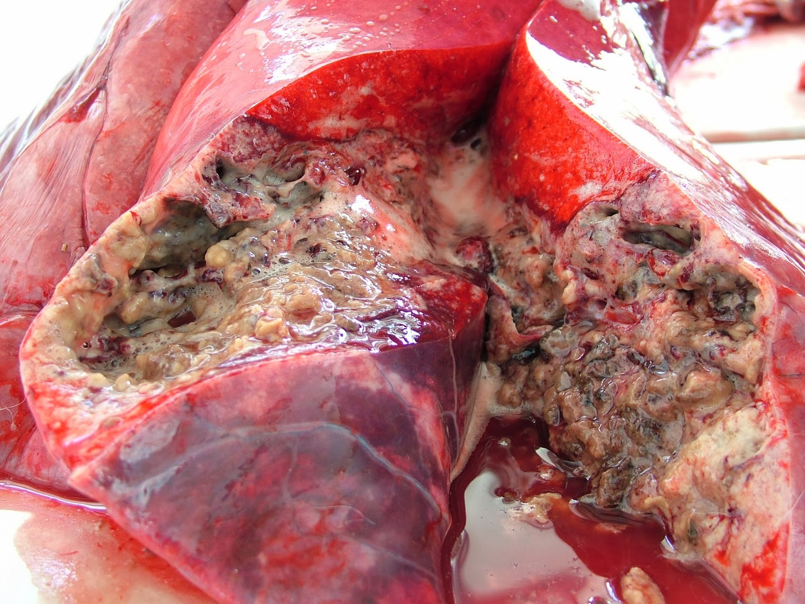
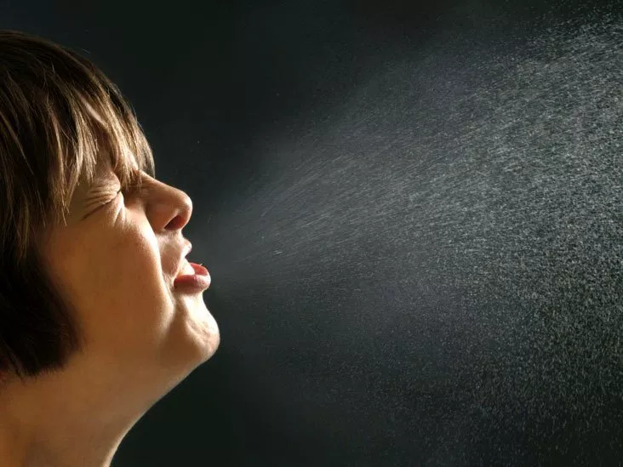
Tuberculosis – Background information
Which type of pathogen causes tuberculosis?
How is the pathogen transmitted?
Which white blood cell engulfs the bacterium?
Which type of tissue can form as a result of tuberculosis?
Why do the pathogen not survive in those tissues?
Bacteria
Droplets
Macrophagesc
Granuloma
Anaerobic condition

Slide 4
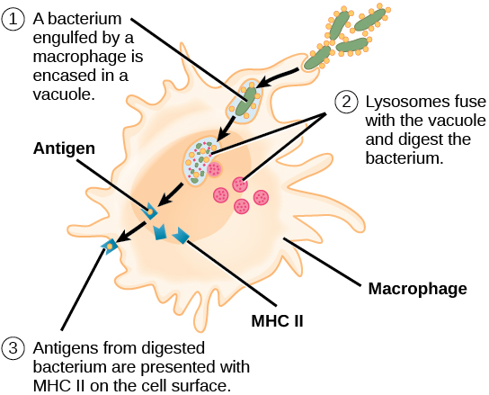
Think, pair, share
What: How does the Mycobacterium tuberculosis get destroyed
How: independently for 45 seconds, sharing in pairs for 1 min

Slide 5
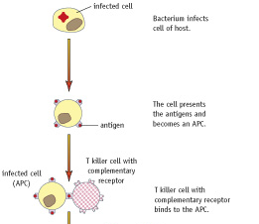
Does this always happen?
Notes:
Does this always happen?

Slide 6
Latent tuberculosis - Bacteria evade the immune system
Normally, macrophages engulf and destroy the bacteria.
However in some cases, Mycobacterium tuberculosis can survive inside macrophages.
They resist mechanisms which occur after being engulfed (due to their thick waxy cell walls making it difficult to break them down).
They can therefore remain alive but inactive inside the tubercles for years.
The infected person presents no symptoms of infection.
The live and inactive bacteria can remain within them.
The antigens remain hidden to the rest of the white blood cells in the body.
Notes:
But t killer cells can only kill the mycobacterium that could be digested

Slide 7
What type of infection is it when someone has inactive but living mycobacterium tuberculosis inside the tubercles?
Dormant infection
Latent infection
Active infection
Second phase infection

Slide 8
When are the latent bacteria able to make a comeback?
Old age
Weakened immune system e.g. AIDS
Malnutrition
All of the above

Slide 9
Exam questions

