Slide 1
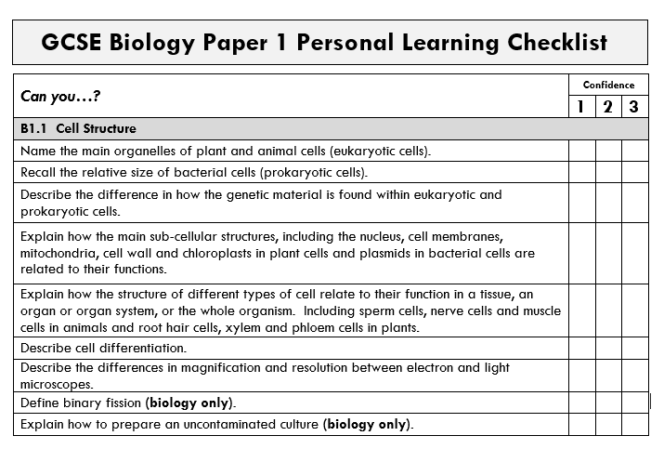
Revision – Top Tips
Number 1
Use your personal learning checklists (PLCs)
to inform your revision.
Colour-code each objective:
green = really confident
yellow/amber = not fully confident – need to do more revision
red = don’t know at all – revision priority

Slide 2
Number 2
Plan out where and when you are going to revise each subject so that you are not cramming the night before or giving one subject more time than the others.
Number 3
Make your revision interactive so that you are truly retrieving the information from memory and not just recognising your notes.

Slide 3

‘Look, Cover, Say, Write’ Revision Strategy
You have 1 minute to look at the cells below to try to memorise the labels.
Notes:
You could print the image and give to the class if you want.

Slide 4
‘Look, Cover, Say, Write’ Revision Strategy
The labels have been covered up. In pairs go through 1 -11 and say out loud what you think each label is.
Then in silence write down 1 to 11 and see how many you have remembered.
2
3
6
1
7
8
9
11
10
5
4

Slide 5
‘Look, Cover, Say, Write’ Revision Strategy
How many did you remember?
Notes:
You could print the image and give to the class if you want.

Slide 6
When can you use this revision strategy?
When revising from your revision guide.
When revising from flash cards.
When looking at videos or animations on revision websites.

Slide 7
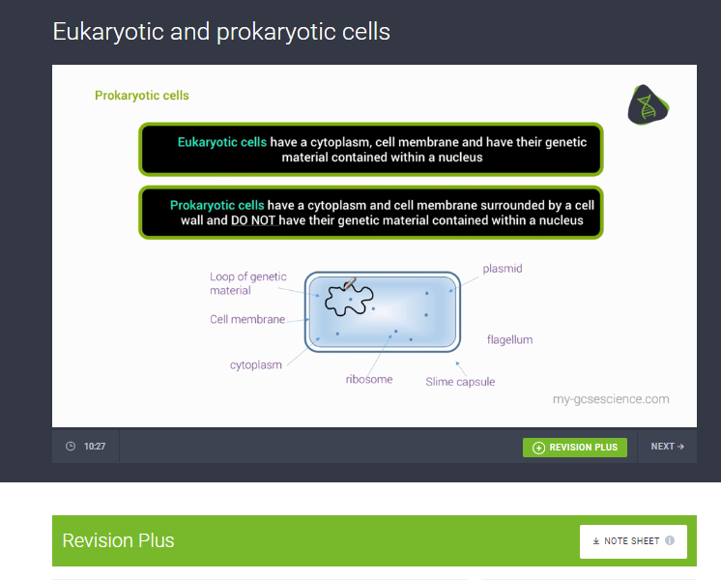
For example:
pause the video on mygcsescience.com
print the notes page
find the page in the Kerboodle online textbook
Then look at the notes and diagrams.
Cover them up with your hand.
Say out loud what you read.
Write down what you can remember.

Slide 8
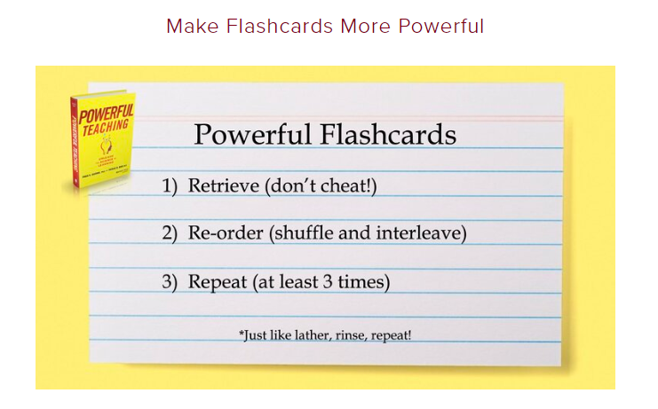

Slide 9

1. Retrieve
Write down the answer or say it out loud before flipping the card over.
This holds you accountable and ensures that you retrieve information, rather than falling for the illusion of confidence – thinking “of course I know it” and flipping the card over prematurely.

Slide 10

2. Re-order
Shuffle your deck each time you go through it to challenge yourselves, instead of going through your flashcard deck in the same order again and again.
This stops you from learning some topics well and others not so well and helps you to link topics together.

Slide 11
3. Repeat
As you go through the cards in your pack, discard those that you get correct as you go through them.
However, keep cards in your deck until you’ve correctly retrieved it three times.
Just because you have retrieved/remembered an item once doesn’t mean you “get it.”

Slide 12
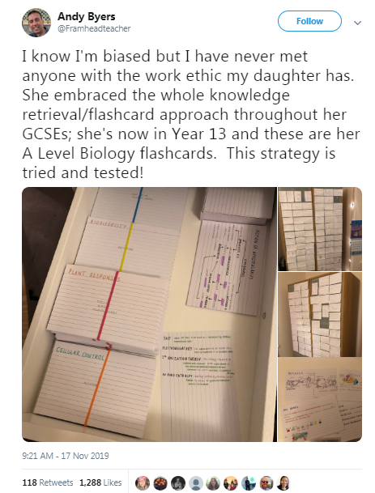
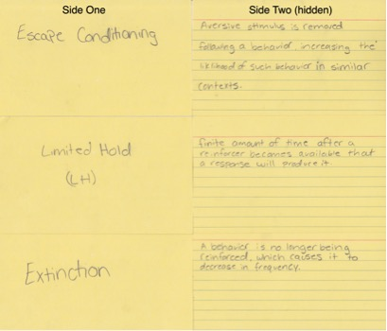

Slide 13
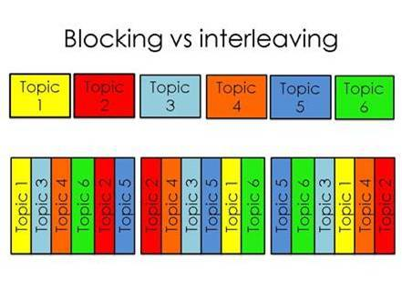
Number 4
Interleave your revision e.g. switch between different topics in your subject rather than revising all of one topic, then the next.
Research suggests that interleaving can help you see the links, similarities and differences between ideas more easily.

