Slide 1
Task: homework
What:
Fill in the revision sheets on the topics from the article.
How:
Use textbooks and revision guides to
How long:
2 hours

Slide 2
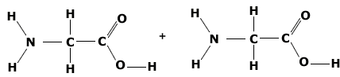
Topic 2 – Protein Structure
List some functions of proteins
Draw and label the basic structure of an amino acid
Draw the dipeptide formed in this reaction
What reaction joins amino acids together?
What bond holds two amino acids together?
What reaction breaks apart amino acids?
Compare the structures of:
Globular Proteins – give an example
Fibrous Proteins – give an example
Structures of a Protein
Primary
Secondary
Tertiary
Quaternary
How is the tertiary structure affected by an increase in temperature?
What determines a conjugated protein?

Slide 3
Topic 2 – Enzymes
Define these terms:
Catalyst
Enzyme
Activation Energy
Describe the lock and key theory. You could draw a diagram
How does temperature affect the rate of an enzyme controlled reaction? Draw a graph
How does pH affect the rate of an enzyme controlled reaction? Draw a graph
How does enzyme concentration affect the rate of an enzyme controlled reaction? Draw a graph
How does substrate concentration affect the rate of an enzyme controlled reaction? Draw a graph
Core Practical: Enzymes
Independent variable
Dependent variable
Control variables
Method
Expected results
How do enzymes reduce the activation energy?
What is the difference between intracellular and extracellular enzymes?
Give an example of each
Describe the induced fit theory. You could draw a diagram

Slide 4
Topic 3 – Eukaryotic and Prokaryotic Cells
Label the animal eukaryotic cell
Organelle | Structure | Function
Centrioles
Mitochondria
Nucleus
Nucleolus
Ribosomes
Rough Endoplasmic Reticulum
Smooth Endoplasmic Reticulum
Golgi Apparatus
Lysosomes
Cell Surface Membrane
Chloroplast
Vacuole
Cellulose Cell Wall
Label the prokaryotic cell

Slide 5
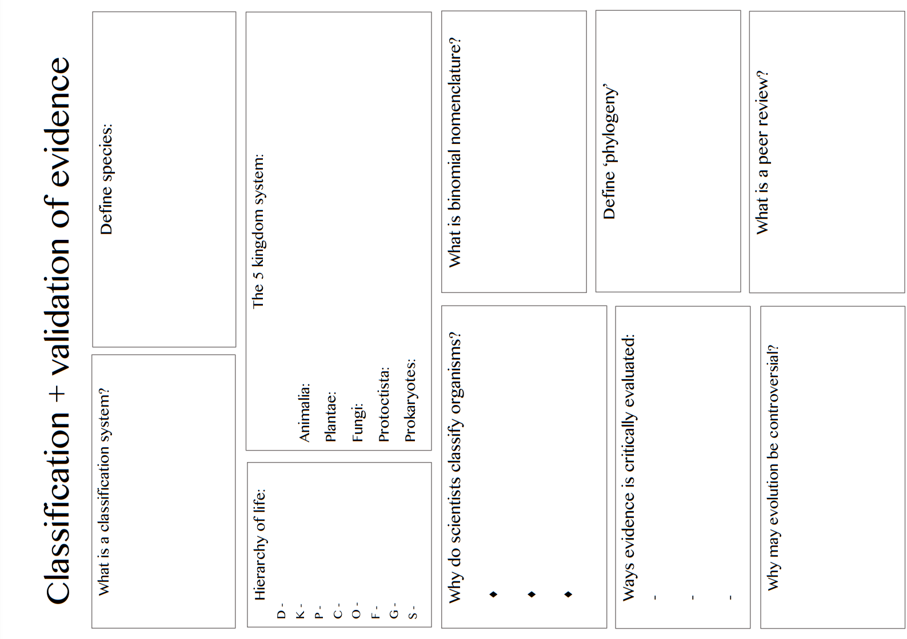

Slide 6
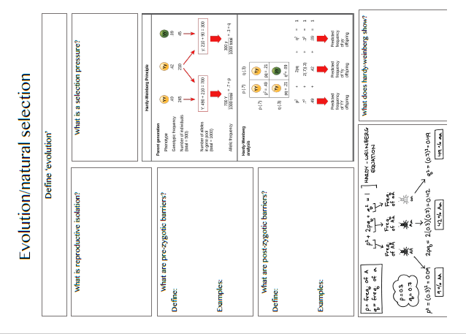

Slide 7
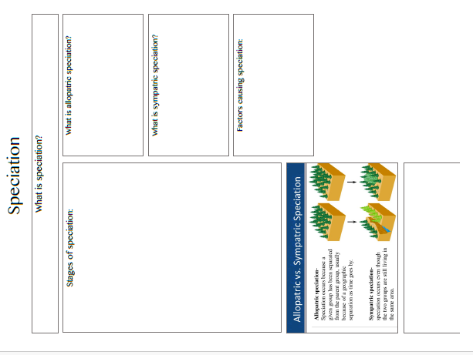

Slide 8
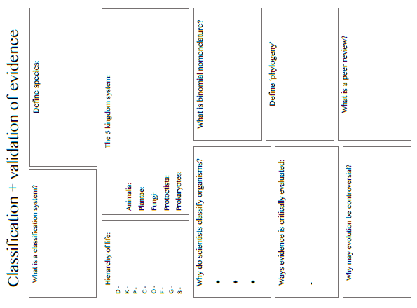

Slide 9
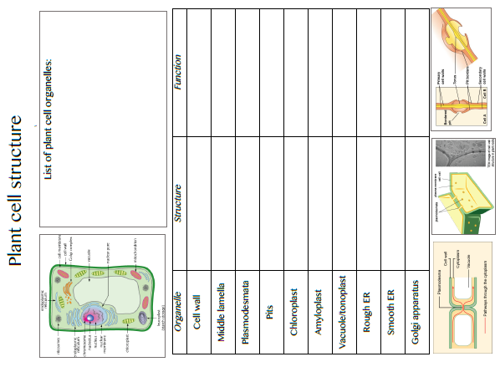

Slide 10
Topic 5 - Ecosystems
Define the terms:
Ecosystem
Community
Population
Habitat
What is meant by the term niche?
What are the three different types of niche?
1.
2.
3.
 | Biotic Factor | Abiotic Factor
Definition
Examples
Anthropogenic
Key principles of using a frame quadrat
Key principles of using a transect
Core Practical: Sampling within an Ecosystem
Variables:
Risk Assessment:
Method:
Conclusion:
Describe the process of ecological succession

Slide 11
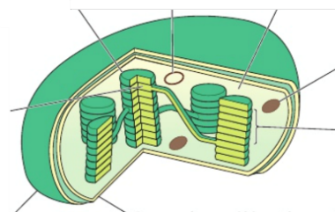
Topic 5 - Photosynthesis
Label the structure of a chloroplast
Light Dependent Reaction
Location:
Requirements:
Products:
Describe the main stages:
Light Independent Reaction
Location:
Requirements:
Products:
Describe the main stages:
Describe the products of photosynthesis and what they are used for
Polysaccharides
Lipids
Proteins
Nucleic acids
Core Practical: Hill Reaction
Variables:
Risk Assessment:
Method:
Conclusion:
Define the term limiting factor
What factors limit photosynthesis

Slide 12
Topic 5 – Evolution
Define the term species
How are organisms adapted to their environment?
Method of Isolation | Description
 | Species occupy different parts of the habitat
 | Species exist in the same area, but reproduce at different times
 | Species exist in the same area, but do not respond to each others’ courtship behaviour
 | Species have become isolated due to: mountain range, river, stretch of ocean
 | Species co-exist but there are physical reasons that prevent them from copulating
 | In some species, hybrids are produced, but they do not survive long enough to breed
 | Hybrids survive to reproductive age, but cannot reproduce
Describe the process of Natural Selection
Describe the process of speciation
Hardy-Weinberg Equation
In a population of 100 people: 87 have straight thumbs, 13 have curved thumbs (tt)
Use the H-W equation to calculate the frequency of alleles

Slide 13
Topic 5 – Energy and the Carbon Cycle
Define:
NPP
GPP
Write the equation that links NPP, GPP and Respiration
How is energy lost between each trophic level?
Draw a diagram of the carbon cycle
How do the following factors affect GPP?
Sunlight
Water
Temperature
What is the role of microorganisms in the carbon cycle?
What factors contribute to the amount of CO₂ in the atmosphere?
How is reforestation important in restoring the balanced of CO₂ in the atmosphere?
What are biofuels?
Why are biofuels important in restoring the balanced of CO₂ in the atmosphere?

Slide 14
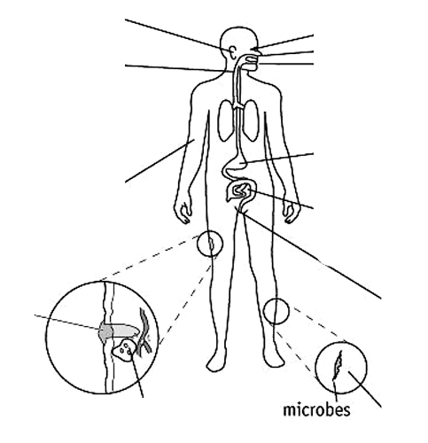
Topic 6 – Pathogens and Disease
How is the body adapted to minimise the entry of pathogens?
Draw and label a virus
How do viruses reproduce?
What is meant by term “latency”?

Slide 15
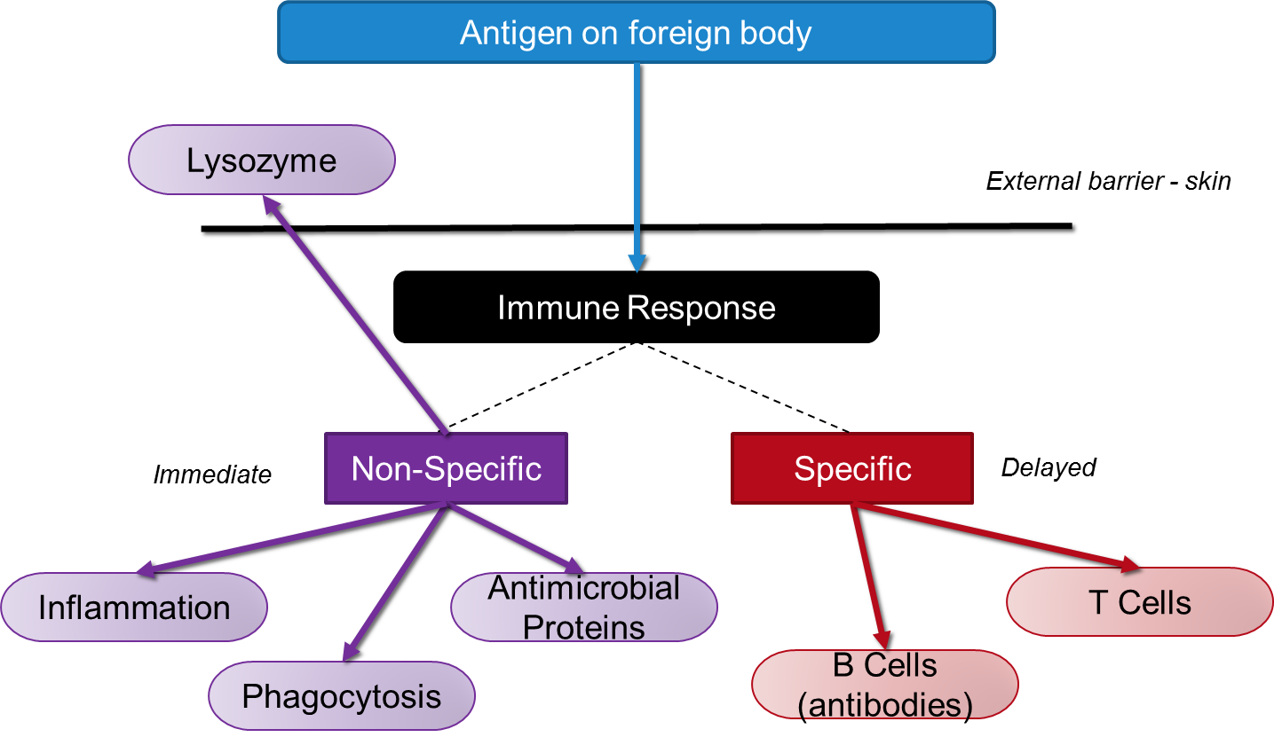
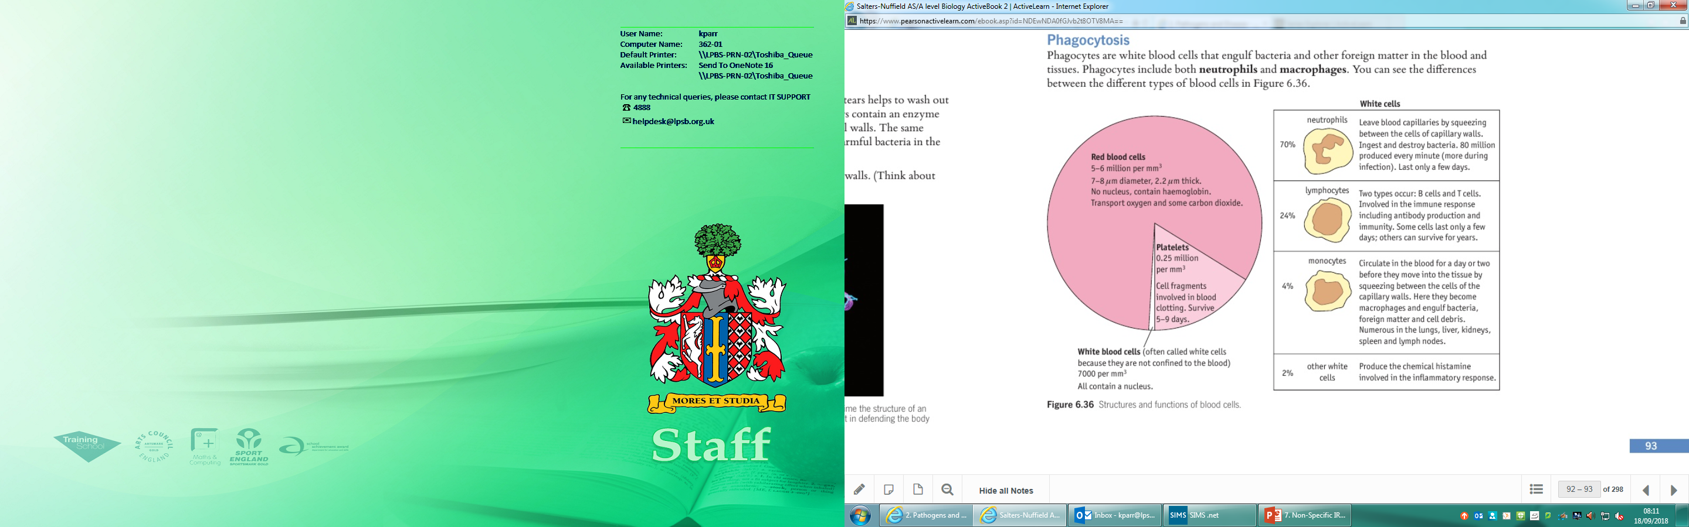
Topic 6 – Non-Specific Immune Response
What are lysozymes and where are they found?
What is their role in the non-specific immune response?
What are the roles of these types of white blood cell:
Neutrophils
Monocytes
Lymphocytes
Describe the inflammatory response
What are antimicrobial proteins?
What is their role in the non-specific immune response?
Describe how blood clots are formed
What role does the lymphatic system play in the immune response?

Slide 16
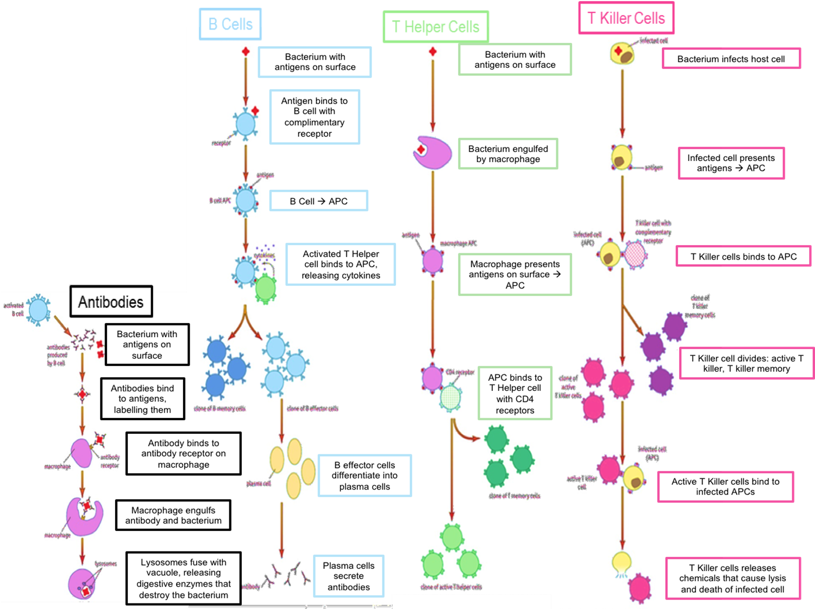
Topic 6 – Specific Immune Response
What is the role of B cells in the specific immune response?
What is the role of T Helper cells in the specific immune response?
What are antibodies?
Why is the structure of an antibody important for its function?
What is the role of cytokines?
Describe how the 3D structure of a protein is determined.
What is the role of T Killer cells in the specific immune response?

Slide 17
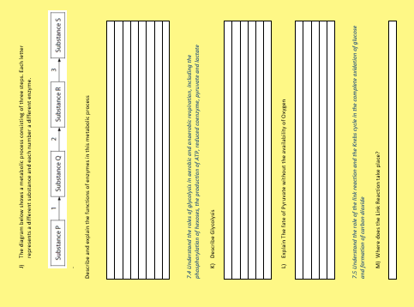

Slide 18
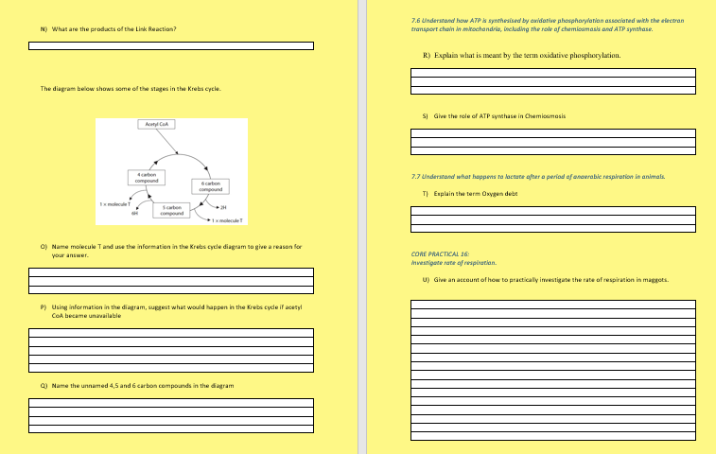

Slide 19
