Slide 1
Task: homework
What:
Fill in the revision sheets on the topics from the article.
How:
Use textbooks and revision guides to
How long:
2 hours

Slide 2
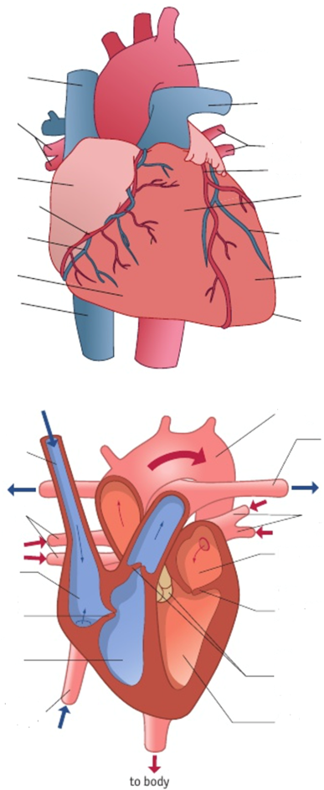
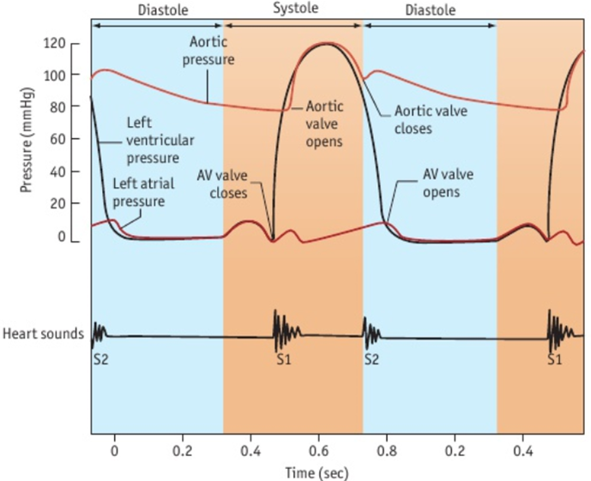
Topic 1 – Heart and Circulation
Draw and describe the structure of the blood vessels:
Artery: Vein: Capillaries:
Describe the 3 phases of the cardiac cycle.
Describe the changes in pressure during each cardiac cycle.

Slide 3
Topic 1 – Heart Disease
What is atherosclerosis?
Describe the course of events that leads to atherosclerosis.
Describe the process that causes the blood to clot
What is the difference between:
Correlation
Causation
How do the following affect the chances of having CVD?
Age
Smoking
Lack of Exercise
Diet
Genetics
What is blood pressure?
What is the range for ‘normal’ blood pressure?

Slide 4
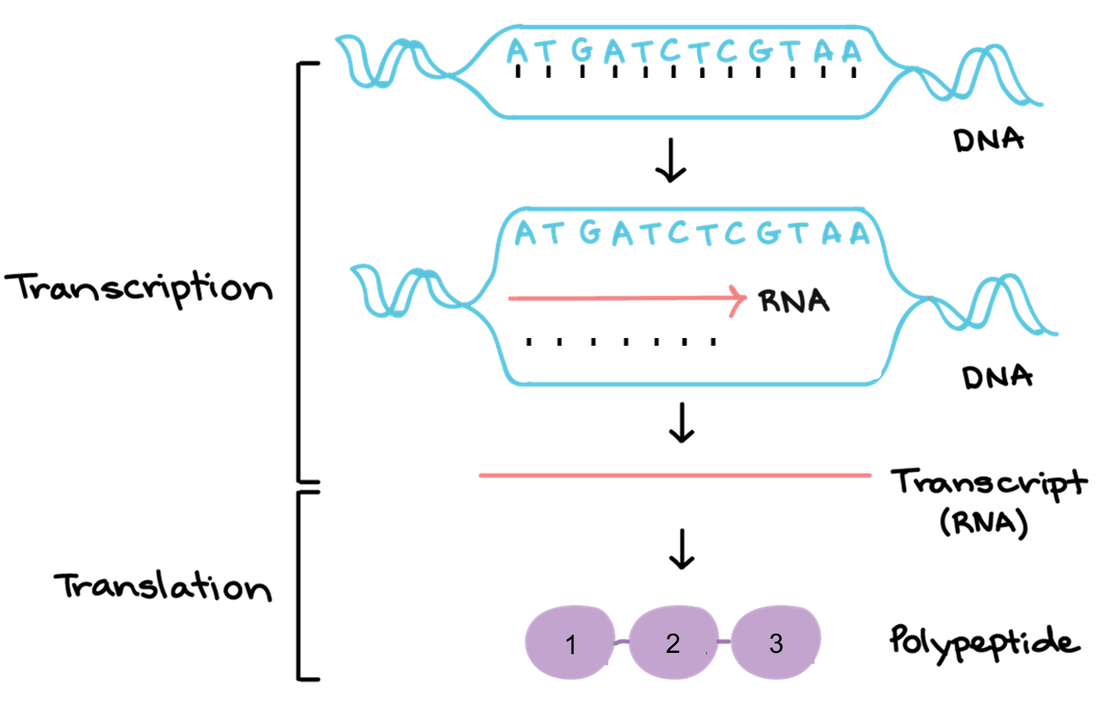
Topic 2 – Protein Synthesis
What is meant by these terms:
Genetic Code
Near-universal
Degenerate
Non-overlapping
 | Transcription | Translation
Location
Molecules Involved
5 Step Summary
Complete the diagram
Fill in the template strand of DNA
Write in the complimentary mRNA molecule
Draw in the correct anticodons on the tRNA molecule

Slide 5
Topic 3 – Eukaryotic and Prokaryotic Cells
Label the animal eukaryotic cell
Organelle | Structure | Function
Centrioles
Mitochondria
Nucleus
Nucleolus
Ribosomes
Rough Endoplasmic Reticulum
Smooth Endoplasmic Reticulum
Golgi Apparatus
Lysosomes
Cell Surface Membrane
Chloroplast
Vacuole
Cellulose Cell Wall
Label the prokaryotic cell

Slide 6
Topic 3 – Gene Expression
Describe how transcription is initiated
Describe what can prevent transcription
Define the term:
Tissue
Organ
Organ System
Describe how master genes control the expression of genes in the creation of the correct body organisation
Define the term “operon”
Lac Operon

Slide 7
Topic 3 – Polygenic Inheritance and the Epigenome
What is the difference between:
Continuous variation
Discontinuous variation
Height | Eye Colour | Hair and Skin Colour
Seasonal Colour Changes | Tyrosinase | Monoamine Oxidase
Define the term “epigenome”
How can the environment affect the epigenome?
What is apoptosis?
What is the Hayflick limit?
What is the role of:
Oncogenes
Tumour suppressor genes
What are the risk factors of some cancers?

Slide 8
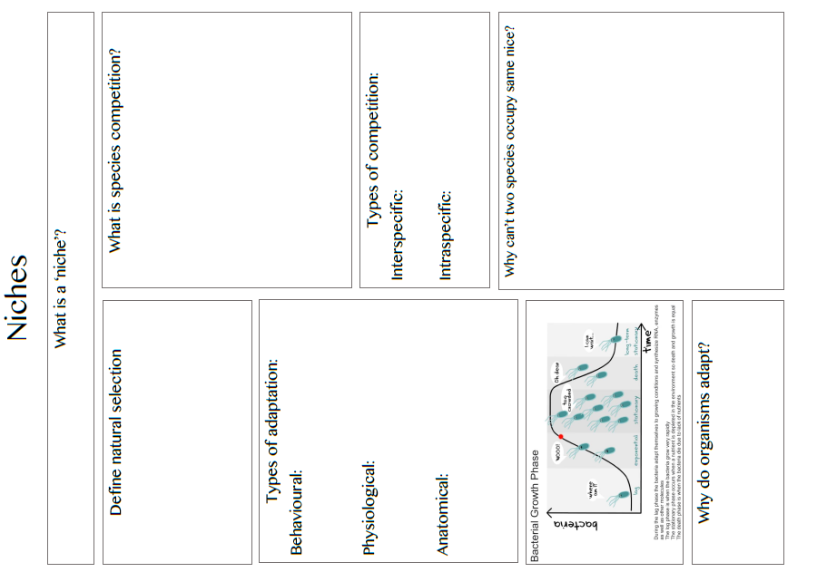

Slide 9
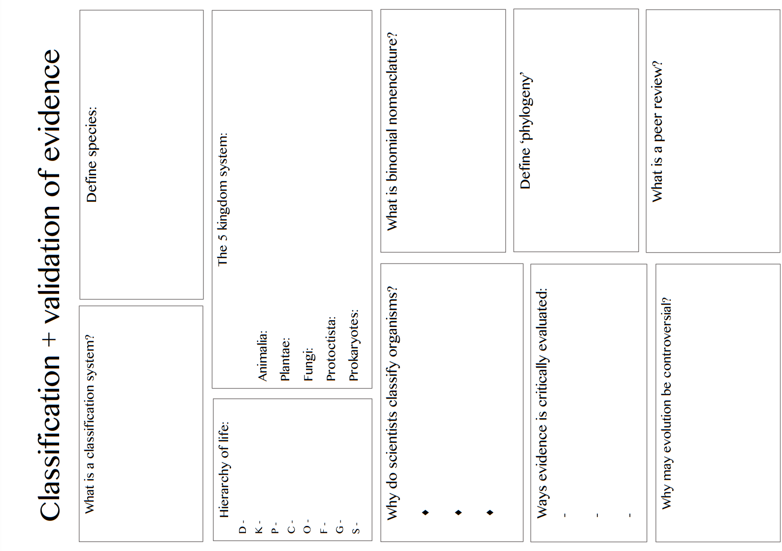

Slide 10
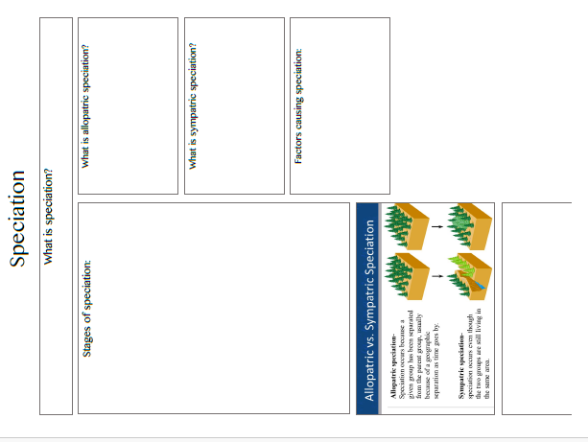

Slide 11
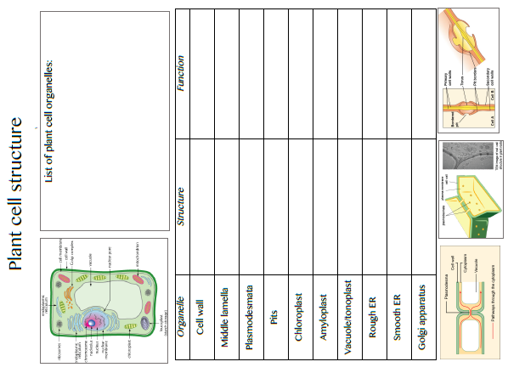

Slide 12
Topic 5 – Evolution
Define the term species
How are organisms adapted to their environment?
Method of Isolation | Description
 | Species occupy different parts of the habitat
 | Species exist in the same area, but reproduce at different times
 | Species exist in the same area, but do not respond to each others’ courtship behaviour
 | Species have become isolated due to: mountain range, river, stretch of ocean
 | Species co-exist but there are physical reasons that prevent them from copulating
 | In some species, hybrids are produced, but they do not survive long enough to breed
 | Hybrids survive to reproductive age, but cannot reproduce
Describe the process of Natural Selection
Describe the molecular evidence for evolution using proteomics and genomics
Hardy-Weinberg Equation
In a population of 100 people: 87 have straight thumbs, 13 have curved thumbs (tt)
Use the H-W equation to calculate the frequency of alleles

Slide 13
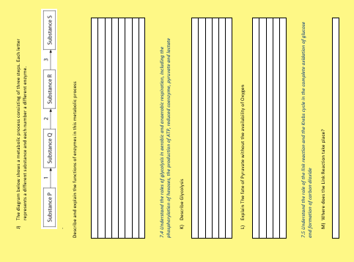

Slide 14
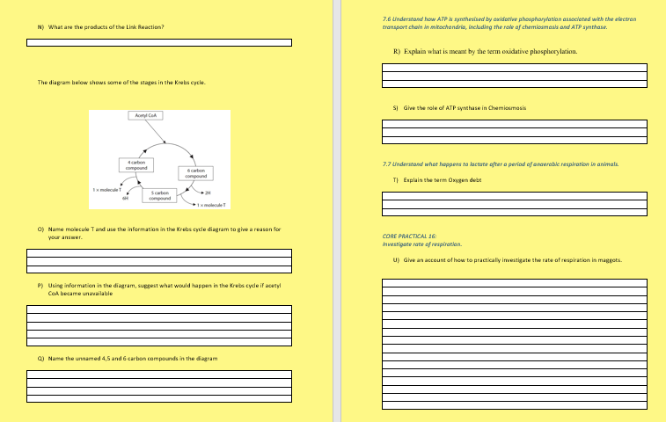

Slide 15
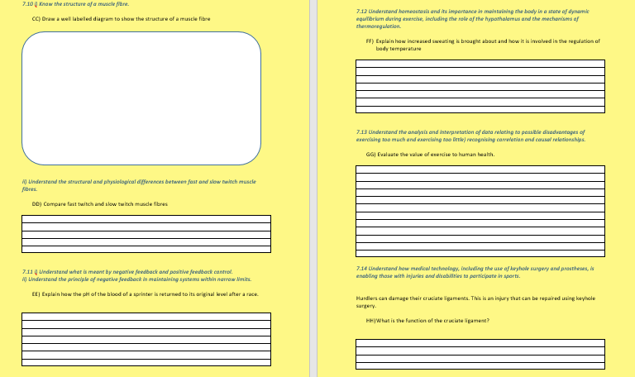

Slide 16
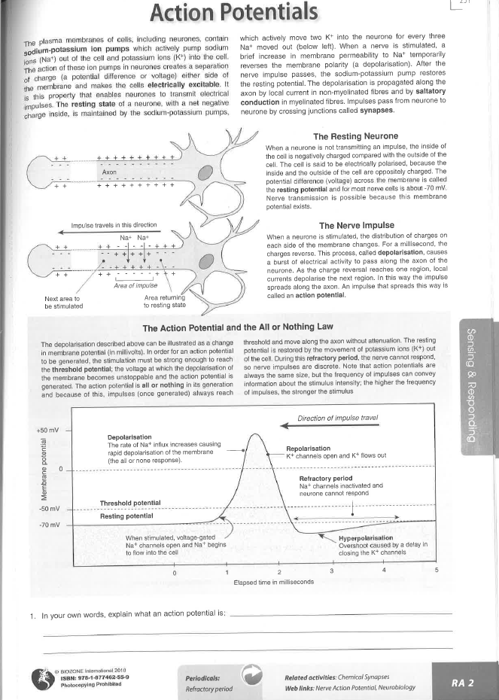
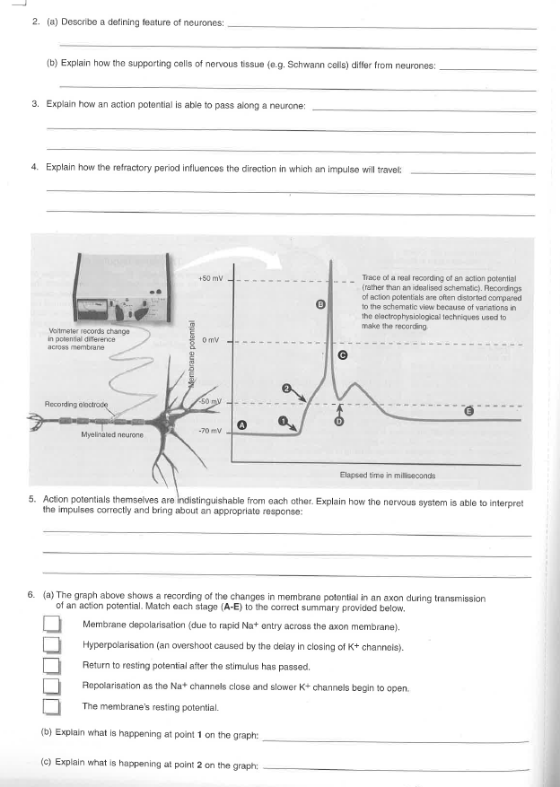

Slide 17
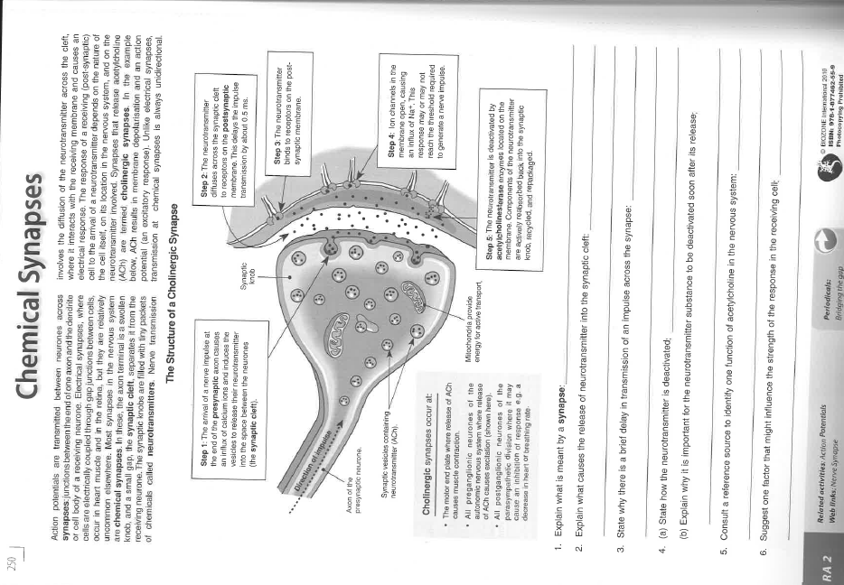

Slide 18
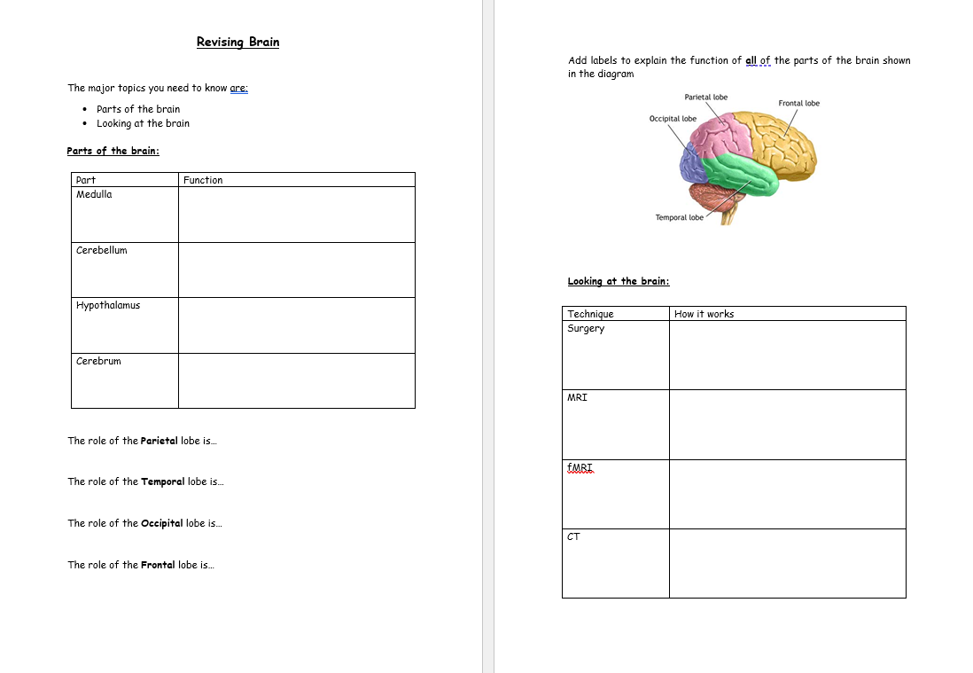

Slide 19
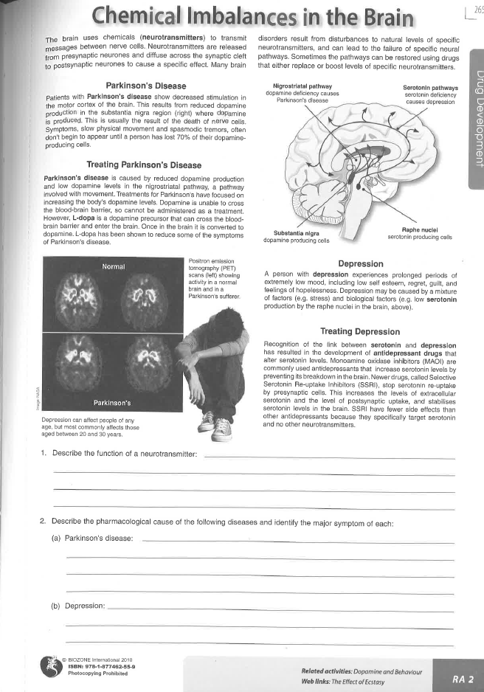
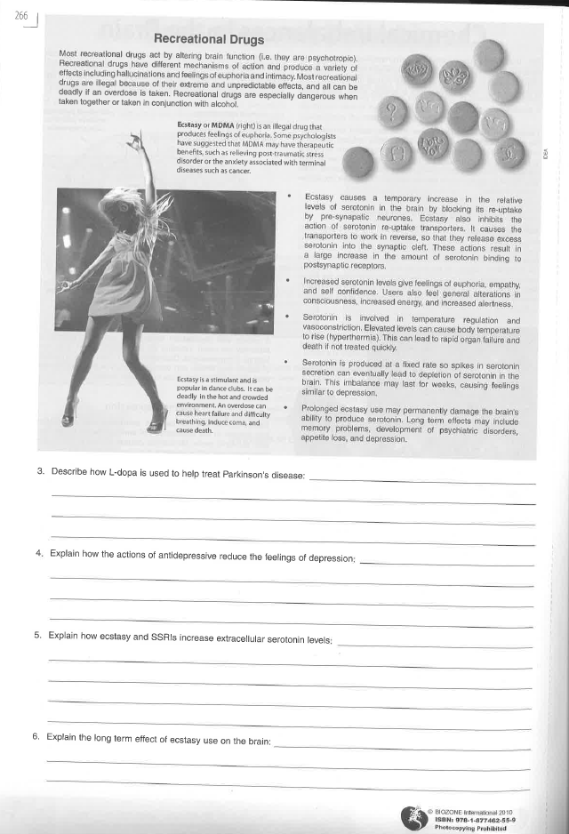

Slide 20
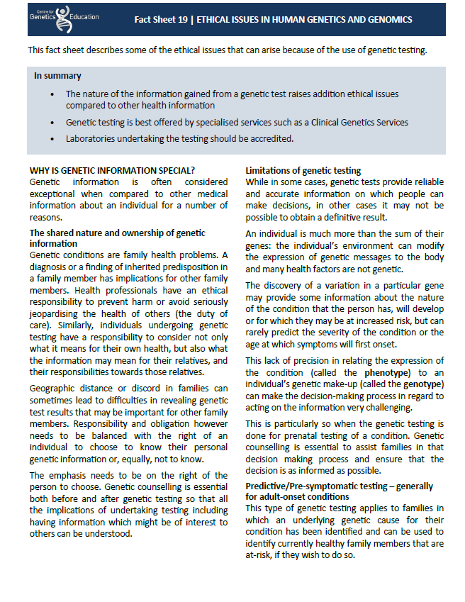
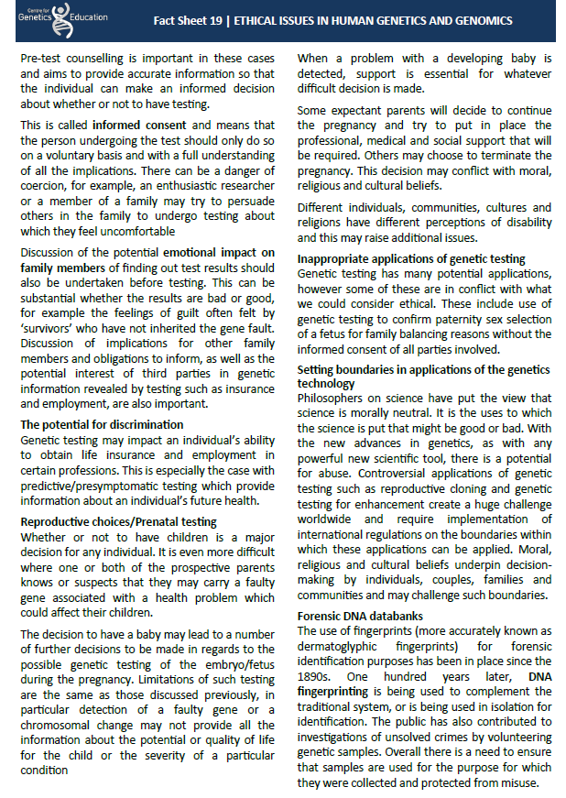

Slide 21
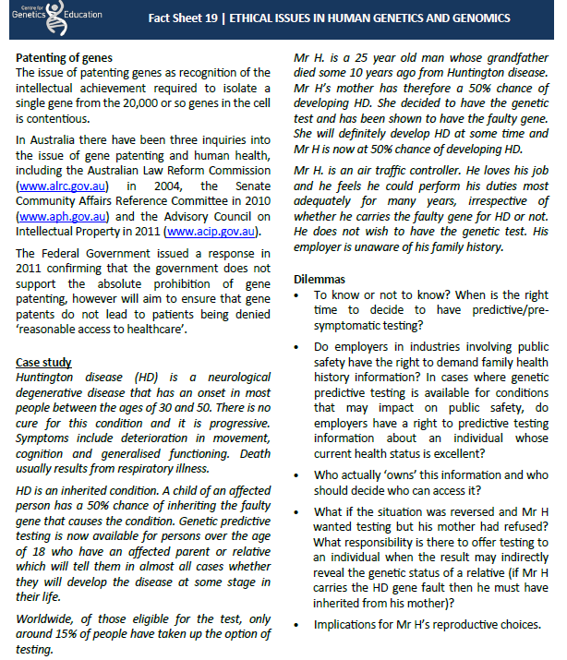

Slide 22
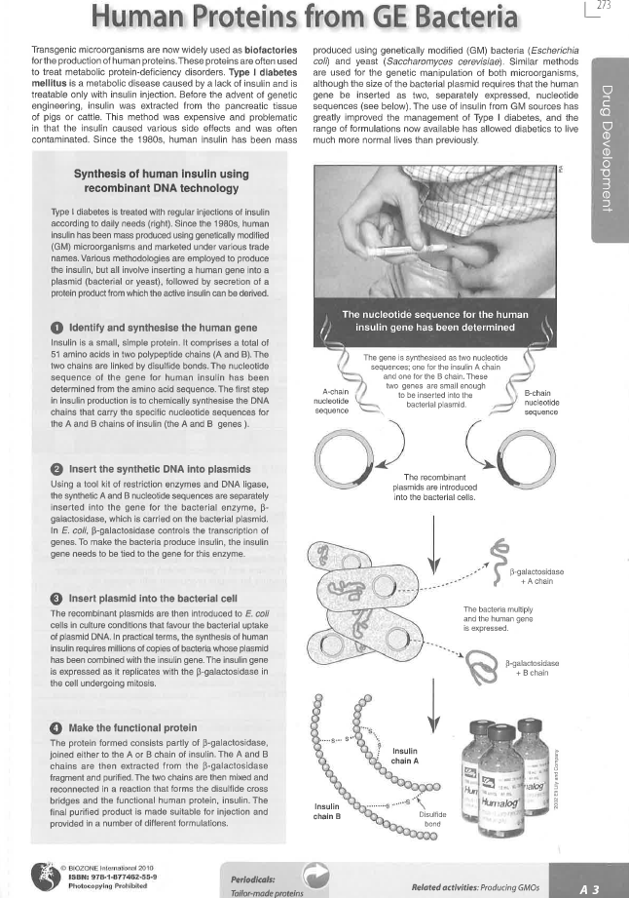
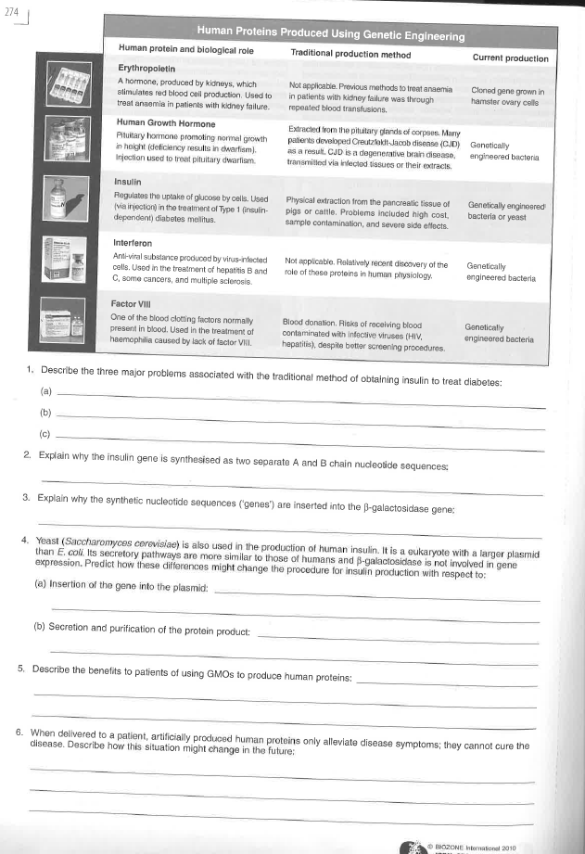

Slide 23
