Slide 1
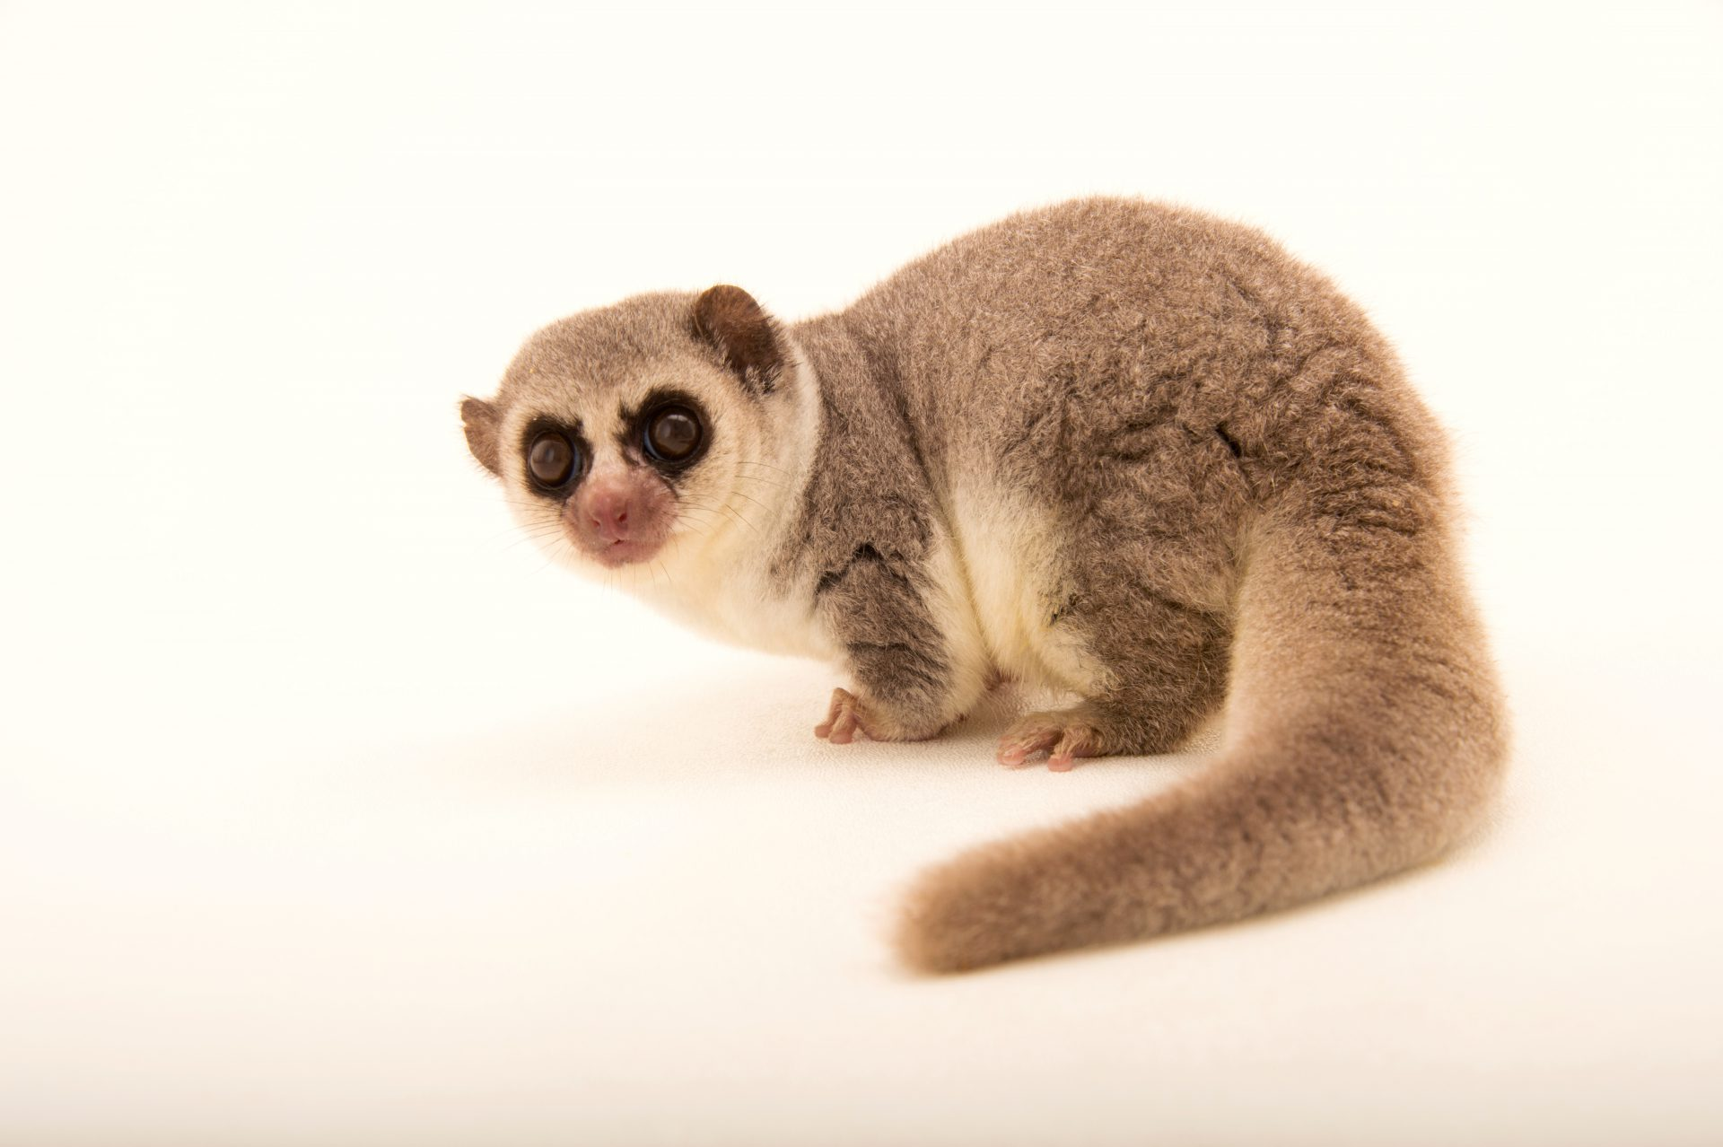
PAPER 3: General and Practical Applications in Biology
DO NOW: The fat tail lemur gorges on food before hibernation nd doubles it body weight by storing fat reserves in its tail. During hibernation it can metabolise and use lipids for energy.
What type of adaptation is the lemur's ability to conserve glycogen by using lipids? (1)
(ii) Triglycerides are a type of lipids used for energy storage. What bond needs to be hydrolysed to break down a triglyceride? (1)
(iii) Triglycerides are hydrolysed to form ________ and __________ (1)
(iv) This adaption first evolved in early ancestors of the lemur. With reference to natural selection, suggest how this adaptation could have evolved? (4)

Slide 2
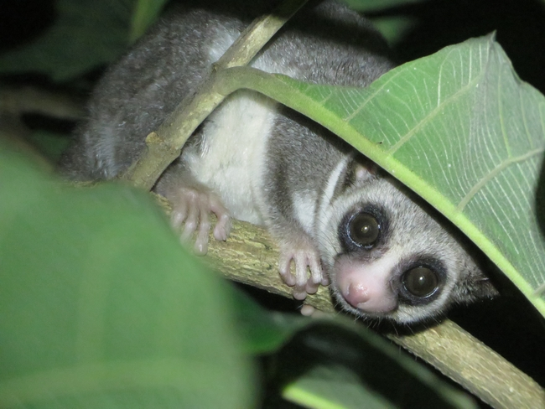
Self Assess: The fat tail lemur gorges on food before hibernation nd doubles it body weight by storing fat reserves in its tail. During hibernation it can metabolise and use lipids for energy.
What type of adaptation is the lemur's ability to conserve glycogen by using lipids? (1)
Physiological Adaptation
(ii) Triglycerides are a type of lipids used for energy storage. What bond needs to be hydrolysed to break down a triglyceride? (1) Ester
(iii) Triglycerides are hydrolysed to form Gylcerol and (3) Fatty (1)
With reference to natural selection, suggest how this adaptation could have evolved? (4)
Variation/Mutation → Selection pressure → Survival → allele frequency

Slide 3
Self Assess: The fat tail lemur gorges on food before hibernation nd doubles it body weight by storing fat reserves in its tail. During hibernation it can metabolise and use lipids for energy.
What type of adaptation is the lemur's ability to conserve glycogen by using lipids? (1)
Physiological Adaptation
(ii) Triglycerides are a type of lipids used for energy storage. What bond needs to be hydrolysed to break down a triglyceride? (1) Ester
(iii) Triglycerides are hydrolysed to form Gylcerol and (3) Fatty (1)
With reference to natural selection, suggest how this adaptation could have evolved? (4)
Variation/Mutation → Selection pressure → Survival → allele frequency

Slide 4
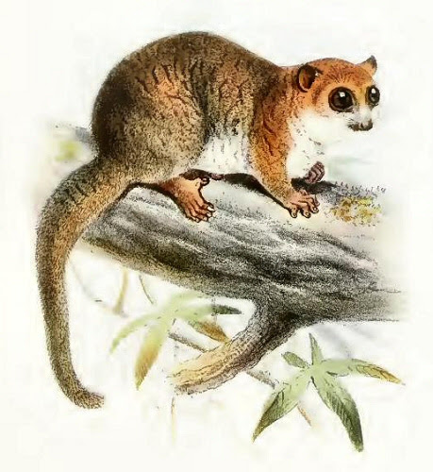
With reference to natural selection, suggest how this adaptation could have evolved? (4)
There was variation within a population of lemurs those with alleles for genes that allowed for more efficient metabolism of lipids could hibernate longer when food is scarce / require less food before / immediately after hibernation. These lemurs were more likely to survive and pass on these favourable alleles. Over many generations the allele frequency changed so that all members of the modern lemur population have acquired this adaptation
Additional Questions
How could the epigenome of the lemurs influence the genes that for lipid metabolism?
Suggest how similar changes might be useful to a marathon runner.

Slide 5
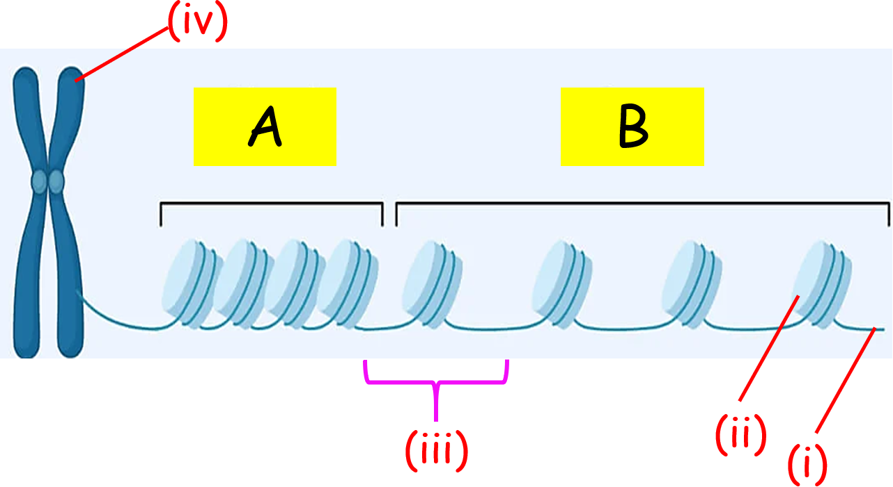
Identify labels (i), (ii), (iii) and (iv)
Differences between A and B are due to Mutations / Epigenetics
Genes located at A are switched ON / OFF
What might have caused this at A?
T____________ F__________ are more / less likely to ________ at promotor regions for genes located on B compared to A. R___ ____________ is more / less likely to transcribe the gene.
How could the epigenome of the lemurs influence the genes that for lipid metabolism?

Slide 6
Identify labels (i), (ii), (iii) and (iv)
(i) DNA (Double stranded DNA)
(ii) Histone
(iii) Chromatin
(iv) Chromatid (chromosome)
Differences between A and B are due to Epigenetics
Genes located at A are switched OFF
What might have caused this at A? Increased DNA Methylation and or decreased histone modification (acetylation)
Transcription Factors are more likely to Bind at promotor regions for genes located on B compared to A. RNA Polymerase is more likely to transcribe the gene.
How could the epigenome of the lemurs influence the genes that for lipid metabolism?

Slide 7
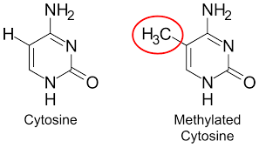
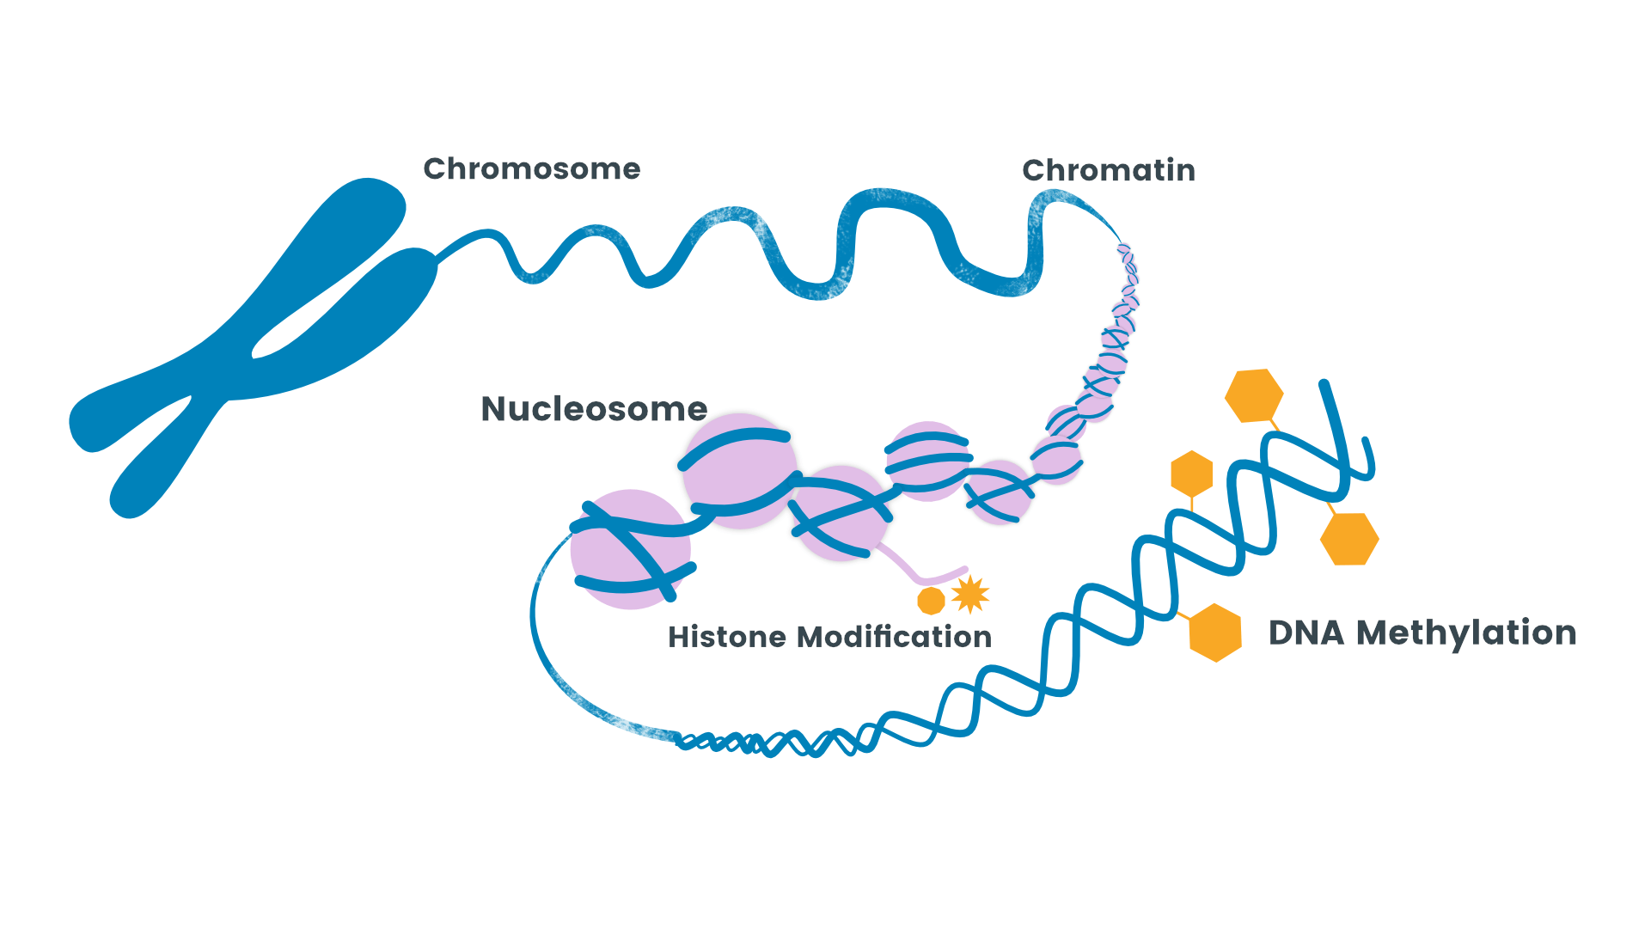
How could the epigenome of the lemurs influence the genes that for lipid metabolism?
Changes in the epigenome can result in changes in gene expression.
Addition of methyl groups to DNA (Methylation) will cause DNA to bind more tightly to histone. This switches the gene for lipid metabolism off by preventing transcription of the gene. (When the lemur is about to emerge from torpor / temperature of the environment increases)
Demethylation of DNA will cause genes for lipid metabolism to become activated. Transcprtion factors can bind to promotor regions for transcription of genes that result in the translation of proteins (hormones) that signal for more lipid metabolism (entering torpor / decrease in environmental temperature).
Increased histone modification such as acetylation will also cause these genes to be switched on.

Slide 8

Activation of genes for lipid metabolism would be useful to marathon runners as it would provide an additional substrate for respiration. Lipids can be used to create ATP for muscle contraction whilst conserving glycogen stores in muscles /liver.
Structure of glycogen enables rapid hydrolysis and release of glucose when higher intensity of running is required (faster pace at the end of the race)

Slide 9
https://www.youtube.com/watch?v=xptpXSTtgSY
Homeostasis & Thermoregulation (Topic 7) Torpor and metabolic rate suppression Thermoregulatory inversion (hibernators reverse typical heat production responses) Role of the hypothalamus in temperature regulation | Cardiovascular & Respiratory Adaptations (Topic 1 and 7) Reduced heart rate and circulation changes during hibernation – ECG and Parasympathetic Resistance to blood clotting, heart disease, and strokes – clotting factors Oxygen conservation mechanisms in torpor – Energy budgets and Respirometer
Epigenetics & Gene Regulation (Topic 3) DNA methylation and histone modification in hibernation genes – Switching on fat metabolism Comparative genomics and identifying genes linked to hibernation Gene expression changes during different seasons | Aging & Longevity Research (Topic 3) Effects of hibernation on aging and tissue repair – Mitosis Caloric restriction and lifespan extension – Environmental stimulus Autophagy (self-repair) in hibernating animals – Cancer and Stem cells
Metabolism & Energy Regulation (Topic 5 and Topic 7) ATP production and metabolic rate reduction in hibernators - Brown adipose tissue (BAT) and thermogenesis – Fat as an energy store Glucose and lipid metabolism during fasting periods – Structure of fats – use of GP to make fatty acids | Biotechnology & Medical Applications (Topic 6) Using transcriptomics to study gene expression in hibernators Potential for synthetic torpor in humans (e.g., space travel, medicine) Gene therapy and drug development for neurodegenerative diseases
Neuroscience & Brain Function (Topic 8) Adenosine pathways and their role in sleep and torpor Neural control of metabolism Effects of hibernation on cognitive function and brain health – devise investigation / evaluate | Evolutionary Biology (Topic 5) Did human ancestors hibernate? – Changing selection pressures Comparing hibernation strategies across species – Evidence for evolution Natural selection and genetic retention of hibernation traits - phylogenetic tree for mammals

