Slide 1

Attendance Hub
Module 4
28 November 2024
'NEC ASPERA TERRENT'
'hardships do not deter us'

Slide 2
Housekeeping and Expectations
Expectations for hub partner schools and lead school
The sessions will be recorded due to serval open evenings running this evening across our Hub
Questions posted into the chat. There will be a chance to answer at pause points
attendancehub@draytonmanorhighschool.co.uk
Resources can be found here: https://www.draytonmanorhighschool.co.uk/school-resources.php
Please ensure your webcams are on to allow for full participation but your microphones muted
Date of next meeting: Thursday 23 January
Notes:
A kind reminder of our expectations.
We already have our next meeting booked in for Thursday 28 November – we will email you reminders building up to that day.

Slide 3
DMHS Attendance Hub
A strong culture of attending school
1. Value of attendance
2. Partnerships
3. Structure
4. Data and Systems
5. Effective Interventions
6. Quality Assurance
Notes:
Just a reminder about our bespoke programme that we will be covering over the remaining 5 months. We have broken down each aspect of attendance into these modules where there will be some overlap between each but we hope this will support you in your setting in creating discussion and hopefully bettering school attendance
I would just like to take this moment to say that we are all facing a challenge around attendance – including us. The most important part of our work with attendance has been to not stand still on any of these areas but to rigorously review and implement changes to ensure that what we are doing when it comes to attendance is working and making a difference.

Slide 4
Do Now
What positives/ challenges have you faced with the new 2024 attendance guidance
What positives/ challenges have your school faced this term with attendance?
What data do you produce to analyse attendance?
What data do you find to be high impact in directing resources and interventions?

Slide 5

2024 Changes
10 sessions in 10 weeks fines
Early help
Notice to improve phone conversations
Notes:
Big changes for 2024 – statutory and has had implications for our ways of working
Early help is first and key. National media have picked up on fines but this is not the focus of the updates
Things to be aware of:
Important to update the policy
Inform parents of new notice to improve meetings/ conversations
Changes to the fines
Attendance data being shared
We are able to share our updated attendance policy with you which has included the updated guidance

Slide 6
Objectives of Module 4
Explain the ‘working tools’ of attendance
To discuss effective data methods and ways in which data influences interventions
To explore the new attendance toolkit

Slide 7
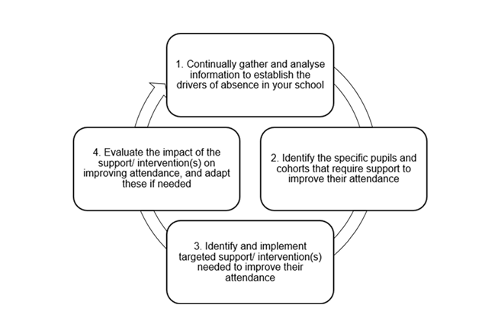
Data Flow Chart
https://attendancetoolkit.blob.core.windows.net/toolkit-doc/Attendance%20toolkit%20for%20schools.pdf

Slide 8
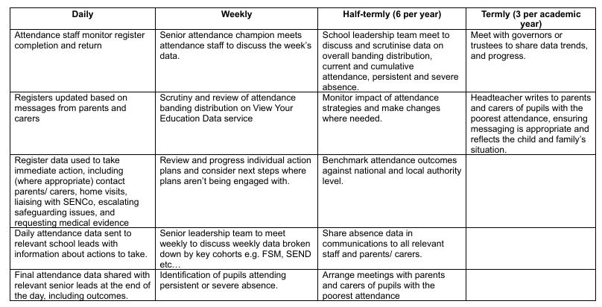
Data Monitoring Schedule
https://attendancetoolkit.blob.core.windows.net/toolkit-doc/Attendance%20toolkit%20for%20schools.pdf

Slide 9
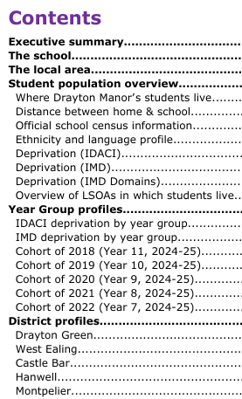

Knowing the context

Slide 10
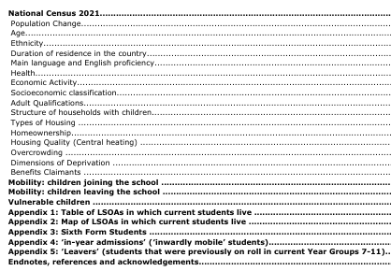
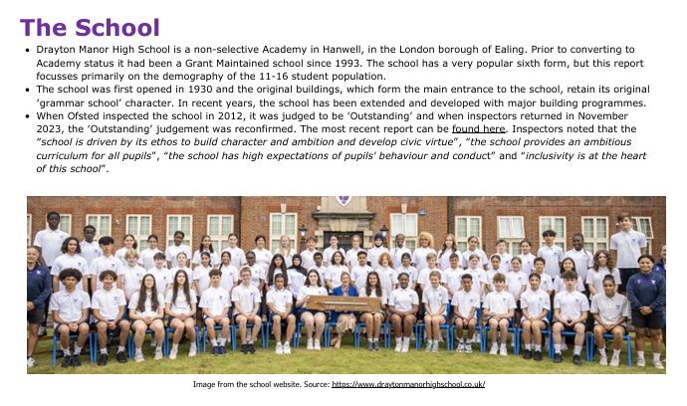
Knowing the context

Slide 11
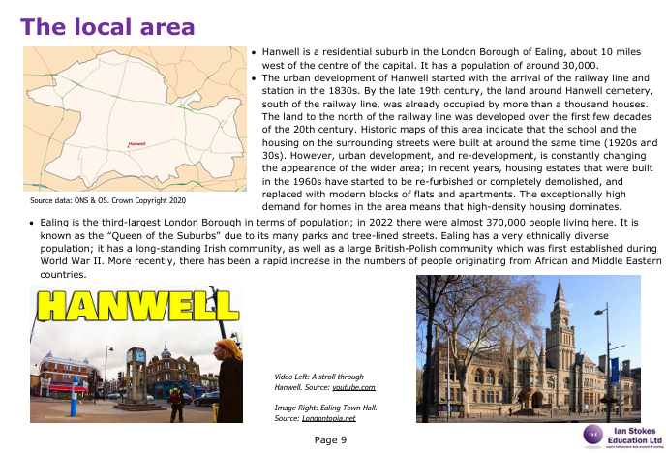
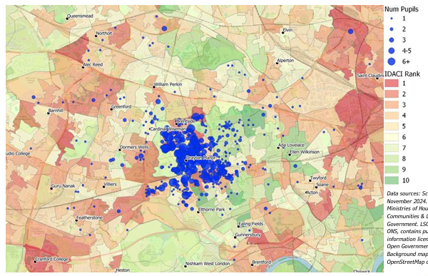
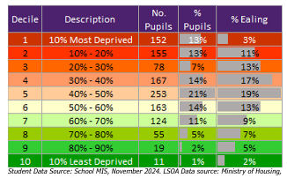
Knowing the context

Slide 12
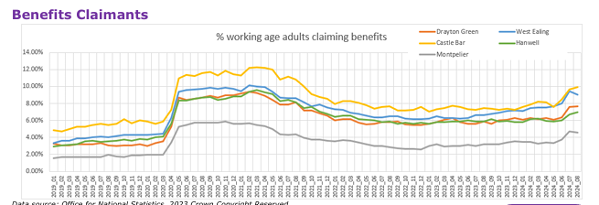
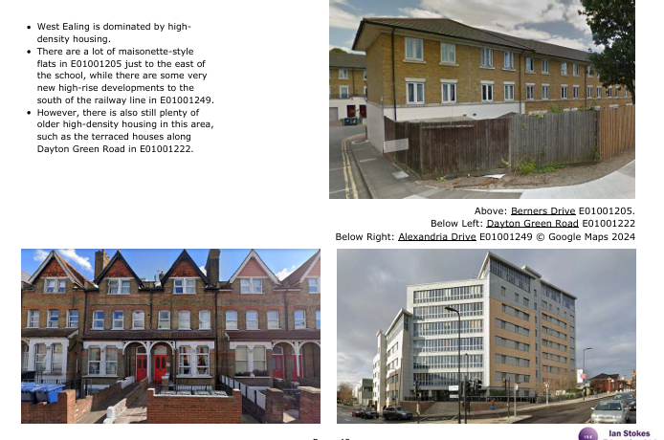
Knowing the context

Slide 13
“Inequality ate my Homework”
Knowing the context - Outcome

Slide 14
Quiet working space
Devices
Stable internet
Less parental support
Multi-generational household
Overcrowding
Insecure employment
“To give pupils the best chances in life, look at inequalities outside the school gates” Diane Reay, 2020
A total of 678 (58%) of students live in areas that have above-average levels of deprivation
A quarter of students live in areas that have very high levels of income deprivation
Only a handful of students live in areas that have very low levels of income deprivation
Notes:
Surveys in England suggest that pupils from disadvantaged backgrounds are less likely to have a quiet working space
less likely to have access to a device suitable for learning a stable internet connection
receive less parental support to complete homework
less developed effective learning habits.
50th most-deprived LSOA (out of a total of 32,846 LSOAs in England) on this measure, while E01001210 is the 17th most-deprived.

Slide 15
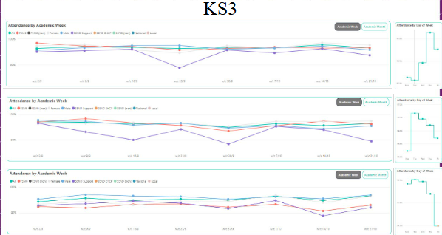
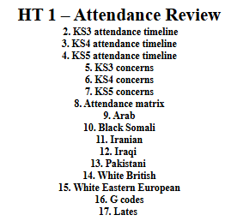
Termly Reports

Slide 16
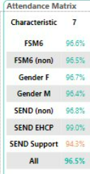
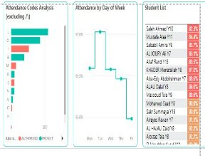
Termly Reports

Slide 17
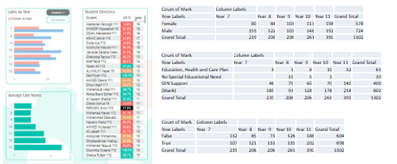
Termly Reports

Slide 18
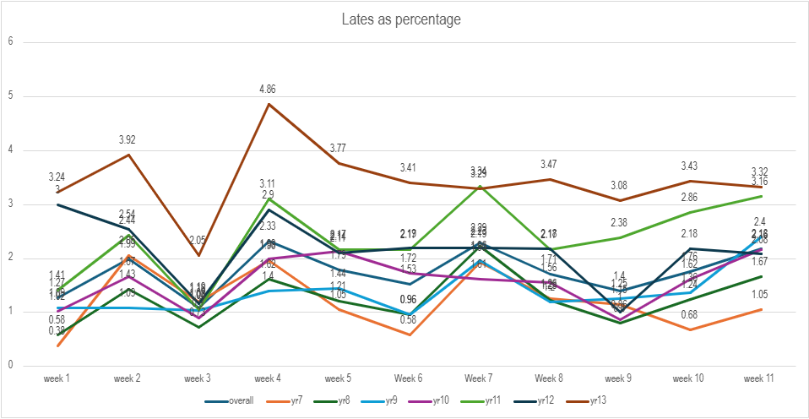
Importance of Visualisation

Slide 19
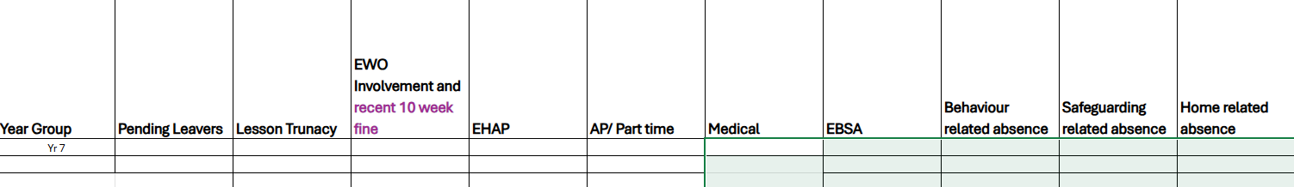
Weekly Data
Attendance Grid
Late to School – 3 sessions in 3 weeks
Late to Lesson – 3 sessions in 3 weeks
Lates Over Time
Attendance Over Time
Challenge 96

Slide 20
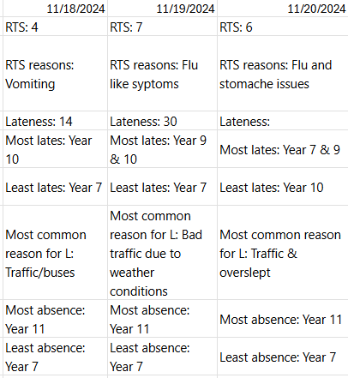
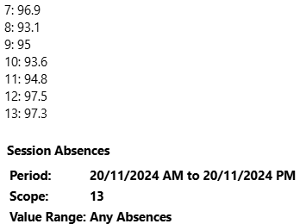
Daily Fingertip Data
10am
End of Day

Slide 21
How to share with Parents, Students, Staff
Comms strategy – what messages are sent, on what platform, on what days and how often?
Every letter/texts contains attendance figure – keeping attendance on the agenda

Slide 22
Follow Up Actions – What to do with all the Data?
Questions that we ask of ourselves:
  Who does receives the data reports?
  What are the follow up actions?
  In what forums are the data reports discussed and actions agreed?
  How can we stop data reports sitting in emails?

Slide 23
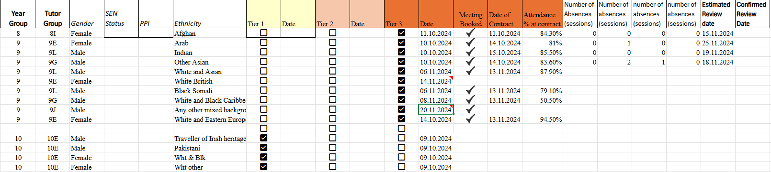
Keeping Track

Slide 24
Pause Point
Notes:
I am just going to pause for 2 minutes so that you can digest our second objective. If you have any questions relating to this objective please do post into chat and we can discuss in just a moment.

Slide 25
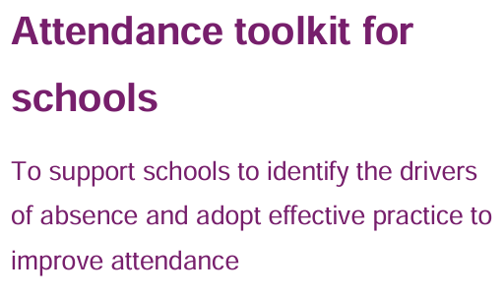
New Attendance Toolkit
This toolkit seeks to make it easier for schools to tackle the absence challenge. It describes approaches for leaders to consider and adopt where they feel these could be helpful in improving their approach to reducing absence, including practical resources to support schools.
Notes:
Attendance toolkit for schools.pdf

Slide 26
New Attendance Toolkit
Data and targeted support: how to gather, share and use attendance data to put in place action to improve attendance
Culture: how to embed a support-first culture to encourage high attendance and make school a place children want to attend
People: how to make attendance ‘everyone’s business’ and ensure individuals and teams work together to reduce absence
Processes and systems: how to develop and implement strong and rigorous processes to identify and respond quickly and effectively to absence
Relationships: how to build strong and positive relationships with pupils and families to understand, then prevent or remove barriers to attendance
Communications: how to develop and share strong and inclusive attendance communications that convey messages with impact
Notes:
Attendance toolkit for schools.pdf

Slide 27
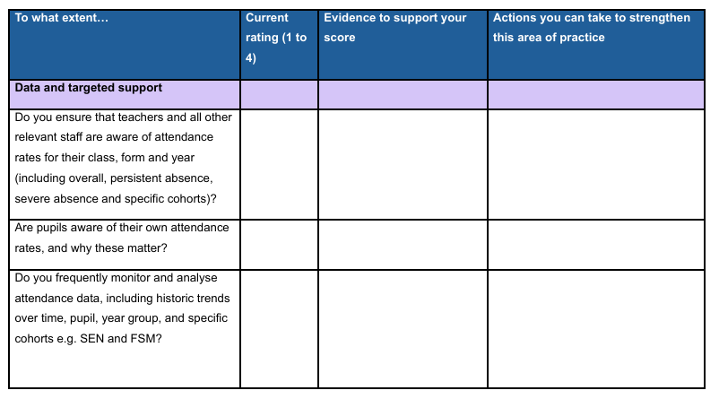
Self-Assessment

Slide 28
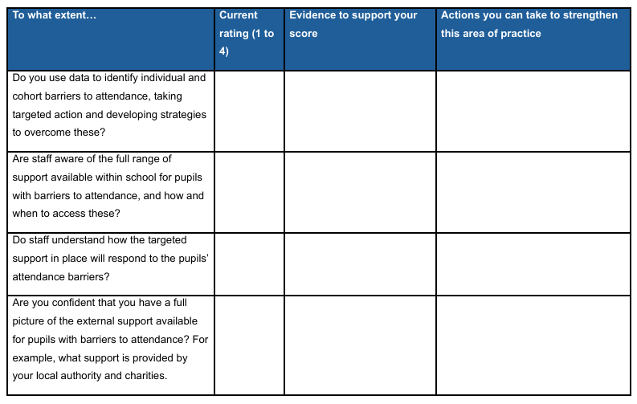
Self-Assessment

Slide 29
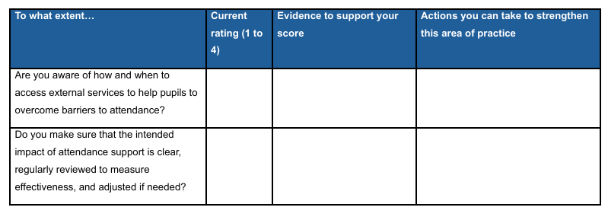
Self-Assessment

Slide 30
DMHS Attendance Hub
A strong culture of attending school
1. Value of attendance
2. Partnerships
3. Structure
4. Data and Systems
5. Effective Interventions
6. Quality Assurance
Module 5 is now open to access on the Hub resource webpage
We look forward to seeing you in November for module 5: Effective Interventions
Notes:
I hope you have enjoyed the session today. We will be emailing out further information about the next session in November. If there are any staffing changes and we need to update the contact details for the attendance lead, please do email us at attendancehub@draytonmanorhighschool.co.uk
Thank you again for joining us and I hope this busy term goes well! See you all soon.

