Slide 1
Attendance Hub Module 5 23 January 2025
'NEC ASPERA TERRENT'
'hardships do not deter us'

Slide 2
Housekeeping and Expectations
Expectations for hub partner schools and lead school
The sessions will be recorded due to serval open evenings running this evening across our Hub
Questions posted into the chat. There will be a chance to answer at pause points
attendancehub@draytonmanorhighschool.co.uk
Resources can be found here: https://www.draytonmanorhighschool.co.uk/school-resources.php
Please ensure your webcams are on to allow for full participation but your microphones muted
Date of next meeting: Thursday 20 March 4PM

Slide 3
DMHS Attendance Hub
A strong culture of attending school
1. Value of attendance
2. Partnerships
3. Structure
4. Data and Systems
5. Effective Interventions
6. Quality Assurance

Slide 4
Do Now
Think of a PA student, what strategies have you tried to improve attendance?
How have you involved staff, parents and the student to combat the attendance issues?
What cohort wide interventions have you tried for:
90-95
75-90
50-75
Severely absent

Slide 5
Objectives
How to implement systems for early intervention
How to intervene with persistently and severely absent students
How to create a culture of celebration of good attendance

Slide 6
The Scale of the challenge
DFE: View your education data

Slide 7
Celebrations for High Attendees
Regular and public celebration
Challenge 96 Tutor tracker
Attendance feeding into existing behaviour achievement systems: Ethic of Excellence/ Spirit of Endeavour
Attendance merits
4 week streaks/ perfect month attendance merits
Keeping attendance on the agenda – every text has the attendance percentage

Slide 8
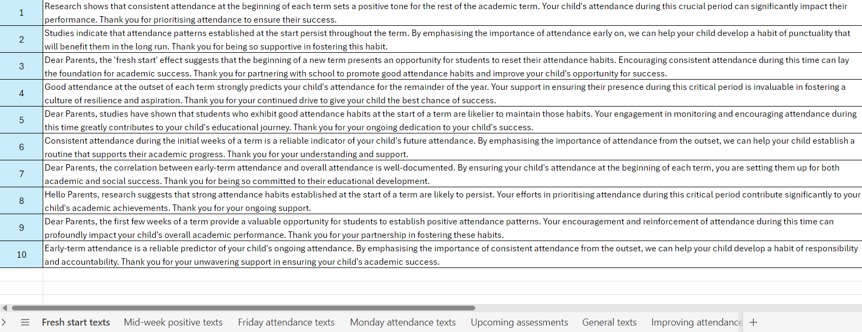
Nudge Texts
IRIS Parent Reach
Audit – have parents unsubscribed?
Keeping a bank of texts ready

Slide 9
Whole Cohort Interventions
Importance of Attendance letter at the beginning of each term including attendance figure (September: last years figure)
Immediate follow up with absence – reason requested and follow up phone call on day 1 of absence
Tiered letters

Slide 10
Reviewing the Impact
Our analysis showed that
Our year 7 cohort 2023 – 32 tier 1 letters sent
17 tier 2
8 on formal contracts
1 failure

Slide 11
Breaking Down the Issue
Weekly attendance bulletin to SLT and Heads of Year
Bulletin contains attendance grid
Breaking down the reasons for absence so all actions are informed
EWO involvement - Home
Medical - Safeguarding
EBSA - Behaviour Related

Slide 12
Phone Calls vs Letters
Daily absence calls and texts
Tutor calls for big push days
Formal warning letters
Notice to improve phone calls
Notice of Fixed Penalty Notice
Whole cohort letters
We have picked up in the data letters

Slide 13
Role of the Form Tutor – End of Desk Conversations
Expanding capacity from Heads of Year
Tutor phone calls for attendance
End of Desk conversations offering support and guidance
Tutor programme focusing in on attendance

Slide 14
Attendance Mentoring
PA/ SA students
Dynamic role – need for flexibility and adaptive approach
Formal mentoring
Dynamic mentoring – following up on poor excuses
Closing the cycle with follow up communication with parents
Asking for catch up work – GCSE students

Slide 15
Attendance Contracting
Formal contract meetings
Deputy/ Head of Year lead
Key stakeholders all invited to the meeting
EWO follow up if the contract fails
Closing the circle: celebration when the contract is passed

Slide 16
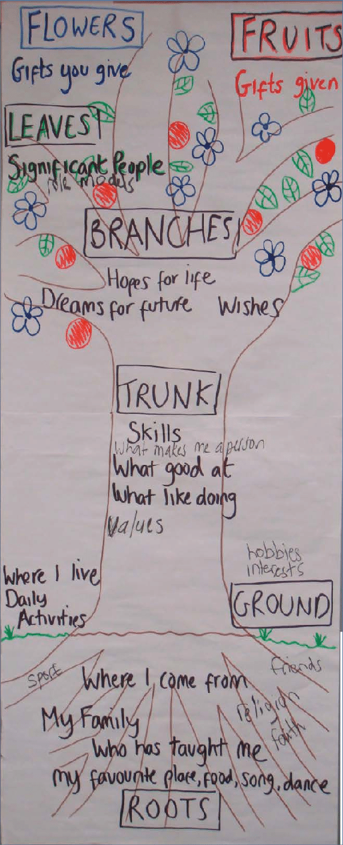
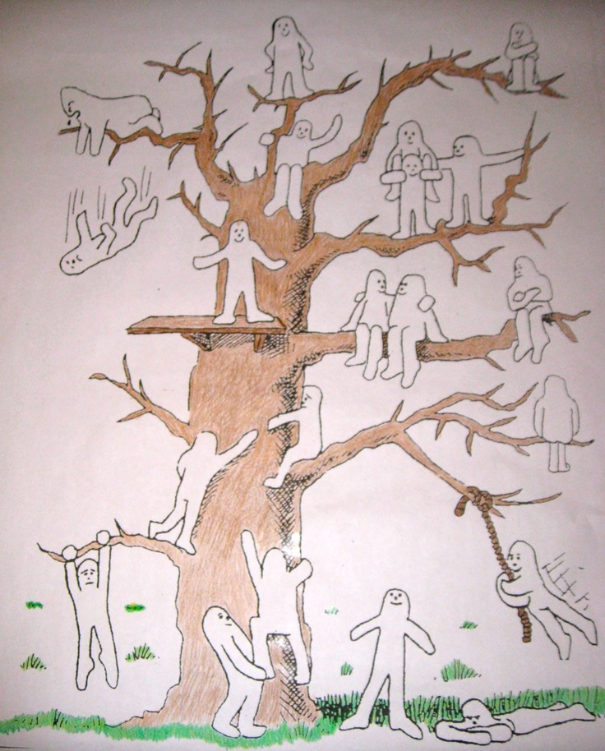
Getting to the root of the issue
Modified timetables
Part time timetables
Feelings tree
Tree of life
Return to school action plan

Slide 17
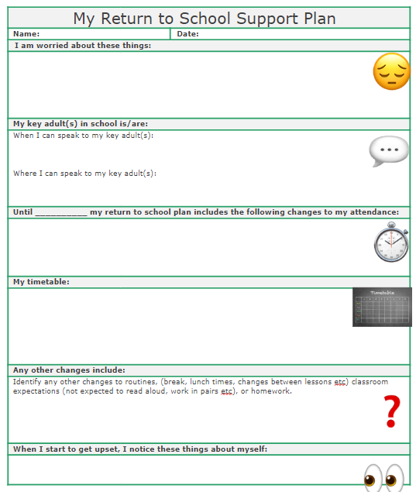
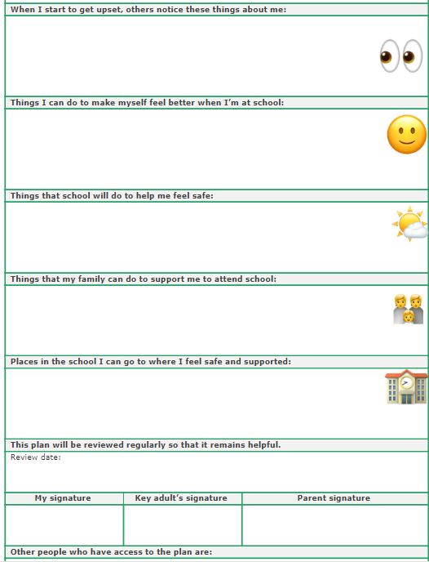

Slide 18
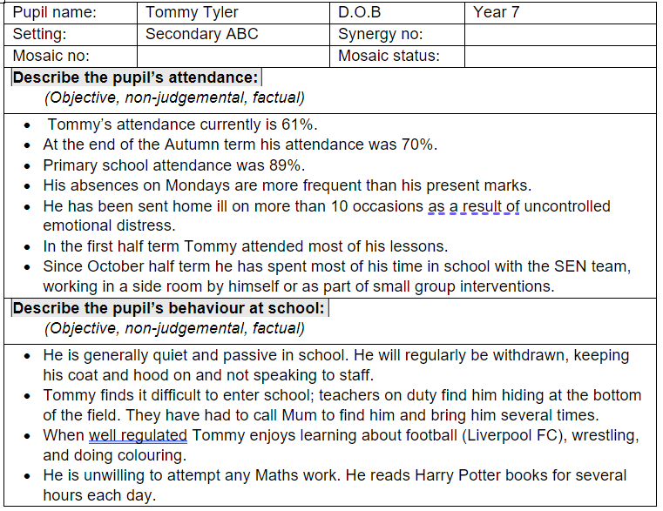
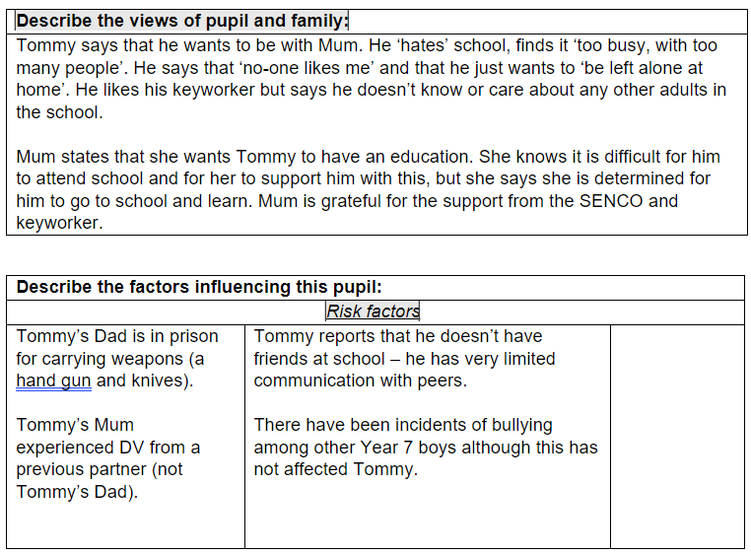
EBSA Assessment

Slide 19
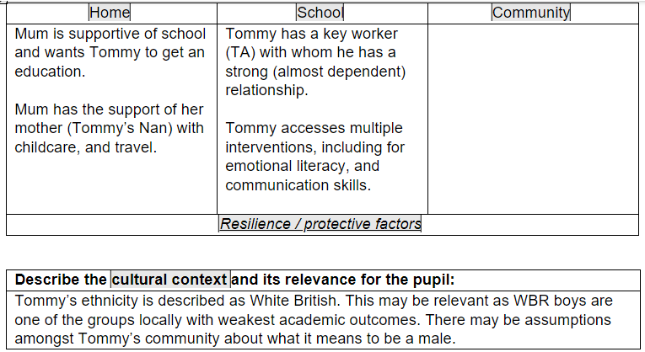
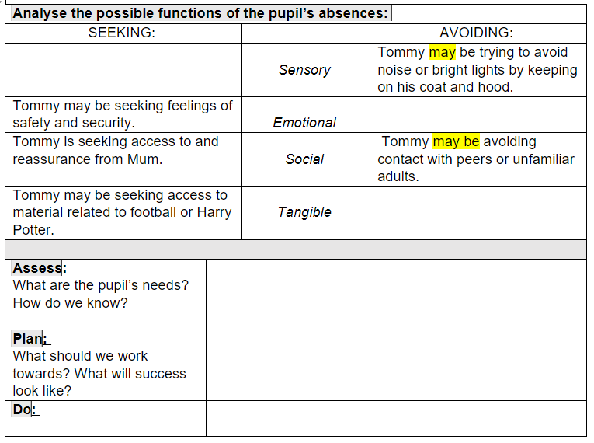
EBSA Assessment

Slide 20
Holiday Absence
5 continuous days of absence – Fixed Penalty Notice
We can see from the attendance data that…
Formal letter

Slide 21
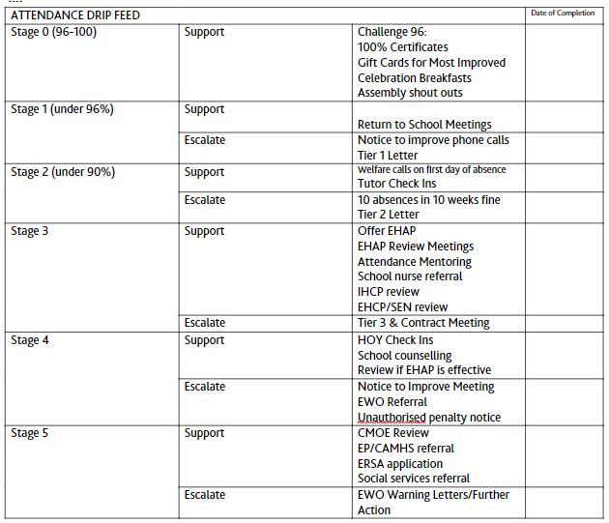

Slide 22
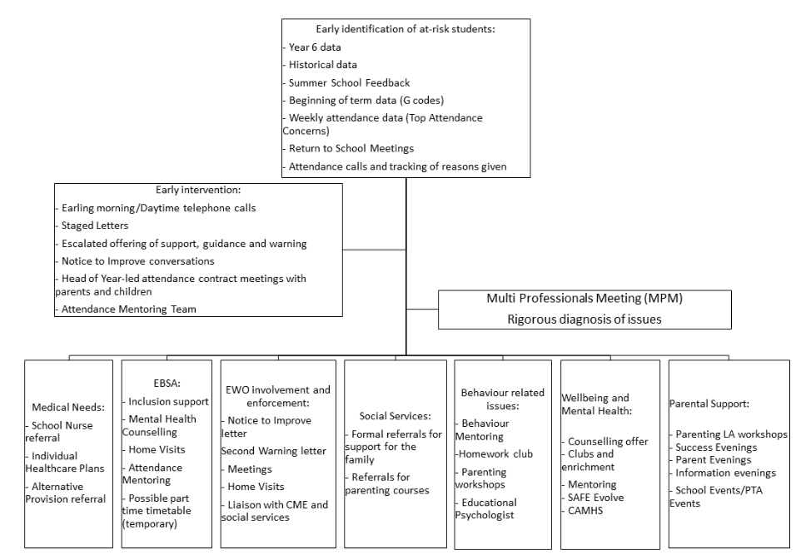

Slide 23
DMHS Attendance Hub
A strong culture of attending school
1. Value of attendance
2. Partnerships
3. Structure
4. Data and Systems
5. Effective Interventions
6. Quality Assurance
Module 6 is now open to access on the Hub resource webpage
We look forward to seeing you in March for module 6:
Quality Assurance

